Slide 1
E2 Preparer
How to register as a Preparer and create eDMRs

Slide 2
E2 Preparer Information:
Any external users could use a new E2 online account registration to register a Preparer account.
When creating a new preparer account, a valid email address will be required. (DO NOT use the same email as the Signatory.)
E2 will allow the user to complete the procedure online.
DEQ will not be involved in the process.
To create a new E2 account for a Preparer, follow this link:
  https://applications.deq.ok.gov/e2
Note: Prepares are NOT Signatories/Certifiers, so they cannot submit eDMRs.

Slide 3
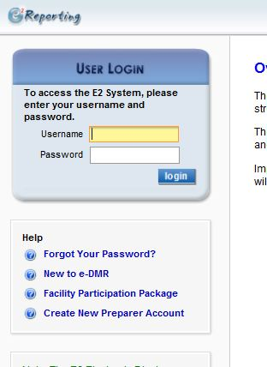
E2: Preparer - Login Page
Click Here
To Begin

Slide 4
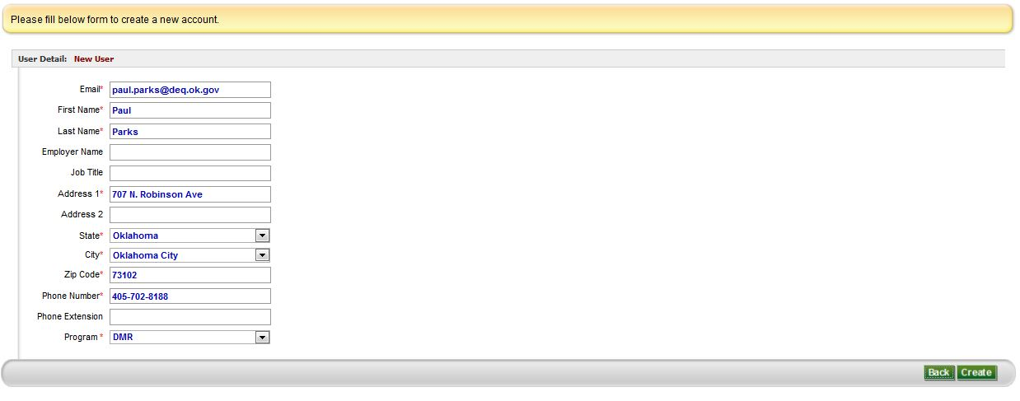
E2: Preparer Account Setup
Fill out the form. Starred fields are required.
Click Here when finished

Slide 5
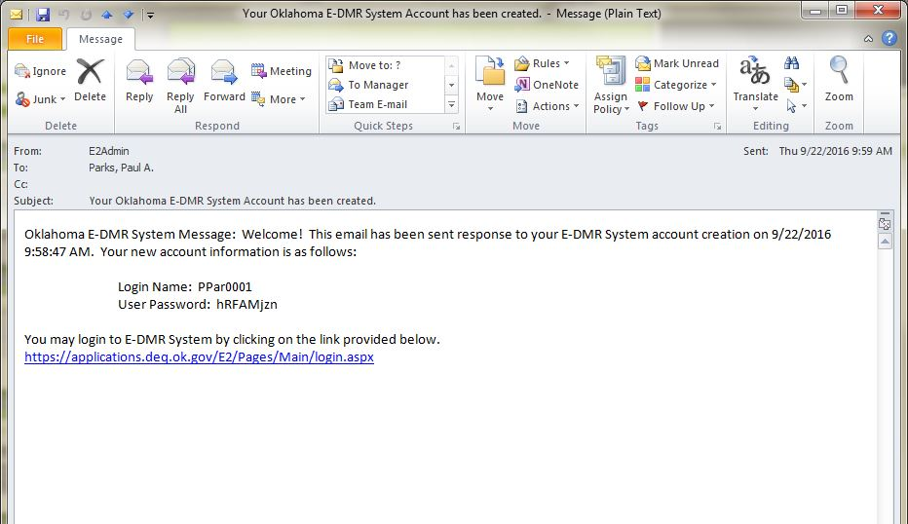
E2: Preparer Account Setup
After you hit “Create” you will receive this email. It gives you the Login Name and One-Time User Password for your account.
You will then go back to E2 and log in with those credentials.

Slide 6
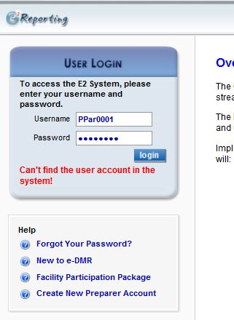
E2: Preparer Account Setup
Enter your log in information from the email.
Then Click “login”

Slide 7
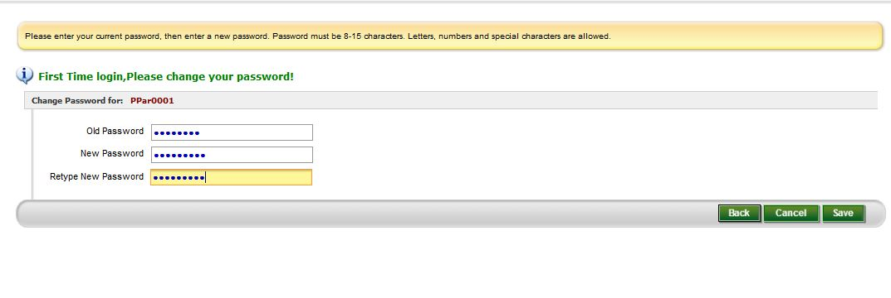
E2: Preparer Account Setup
You will now need to change your One-Time Password
Your new password must meet these requirements
Then Click “Save”

Slide 8
E2: Preparer Account Setup
After you have set up your Preparer Account and Changed the password you will need to follow the steps below to start creating an eDMR:
You will need to notify the Signatory that your account is ready to be added to a facility
Once the Signatory has added you, you will receive an email stating that you have been added, and to what facility you have been assigned.
The preparer can now log back into their E2 account and create a new eDMR for the facility/facilities he/she has been assigned to.

Slide 9
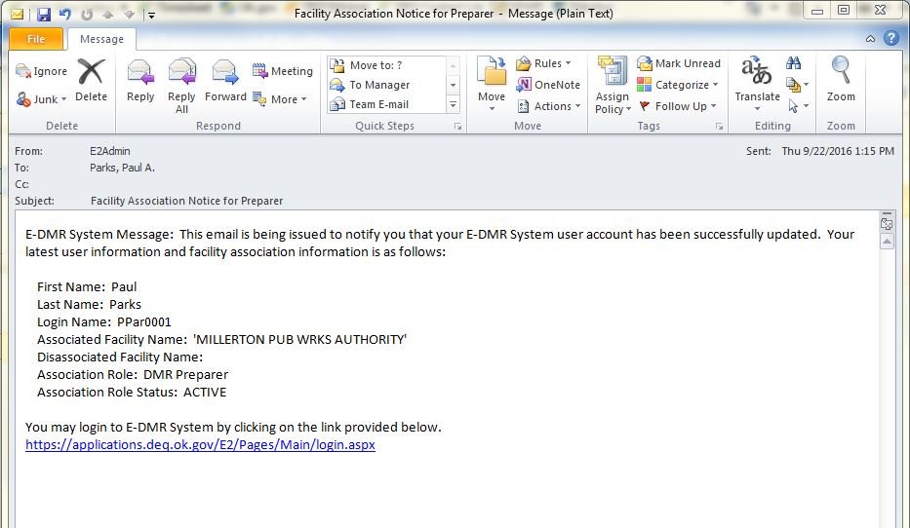
E2: Preparer Account Setup (Email Confirmation)
Make sure to review this information. If there is anything incorrect, you will need to notify your Signatory, so they can fix it.

Slide 10
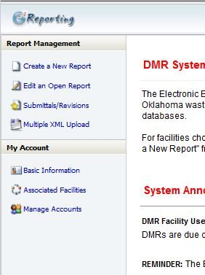
E2: Home Page after Login
Click here to begin the eDMR process

Slide 11
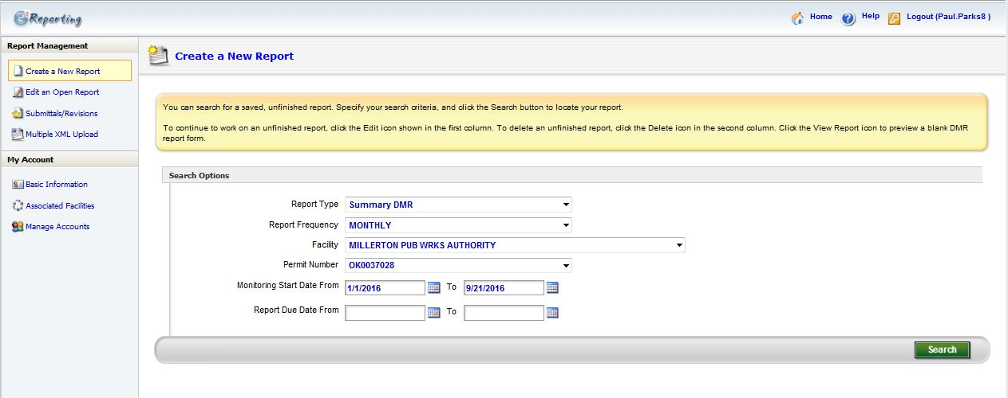
E2: Preparer Create eDMR
Enter Facility Information Here
Enter Monitoring Start and End dates here
Remove any information in these fields
Click here to Search by the given criteria

Slide 12
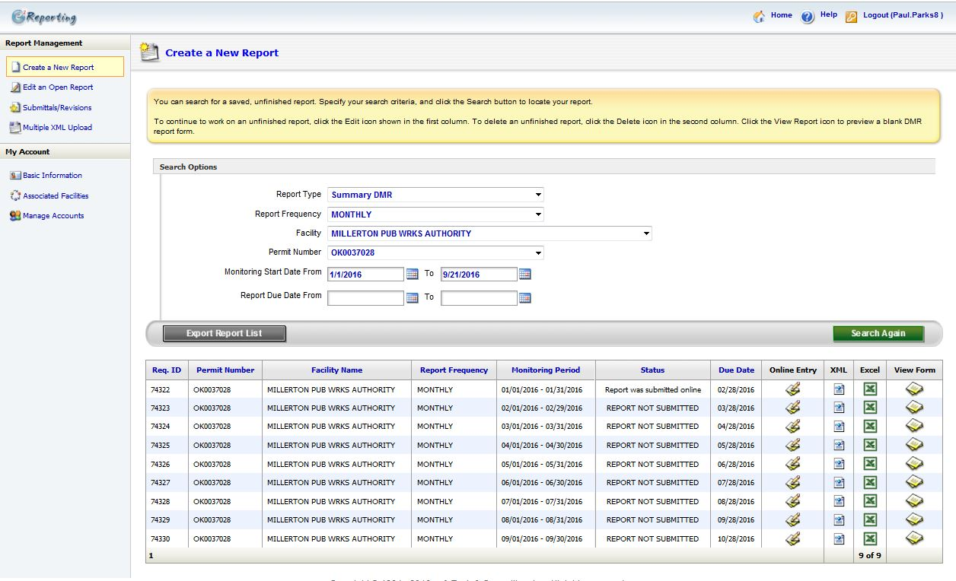
E2: Preparer Create eDMR
List of eDMRs found within your search criteria
Click one of these icons to open that particular eDMR that you would like to create

Slide 13
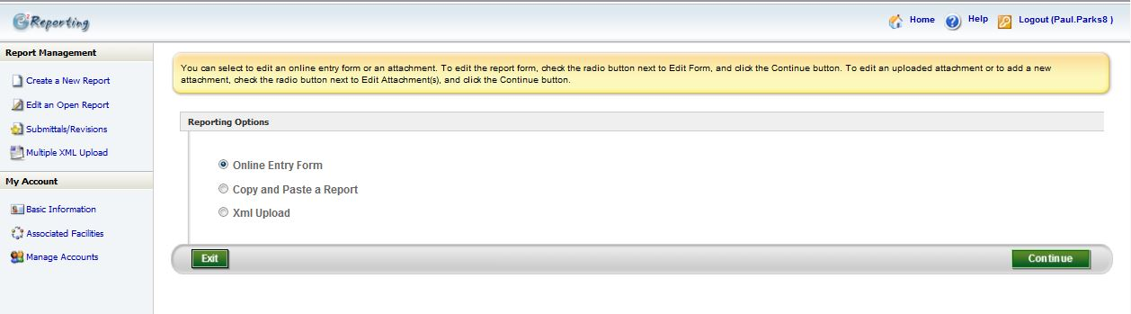
E2: Preparer Create eDMR
Select “Online Entry Form”
Click “Continue”

Slide 14
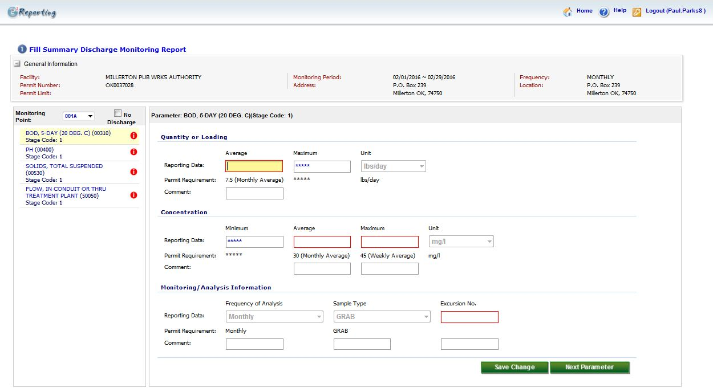
E2: Preparer Create eDMR
Click through each Parameter
Enter the values for each of the red boxes

Slide 15
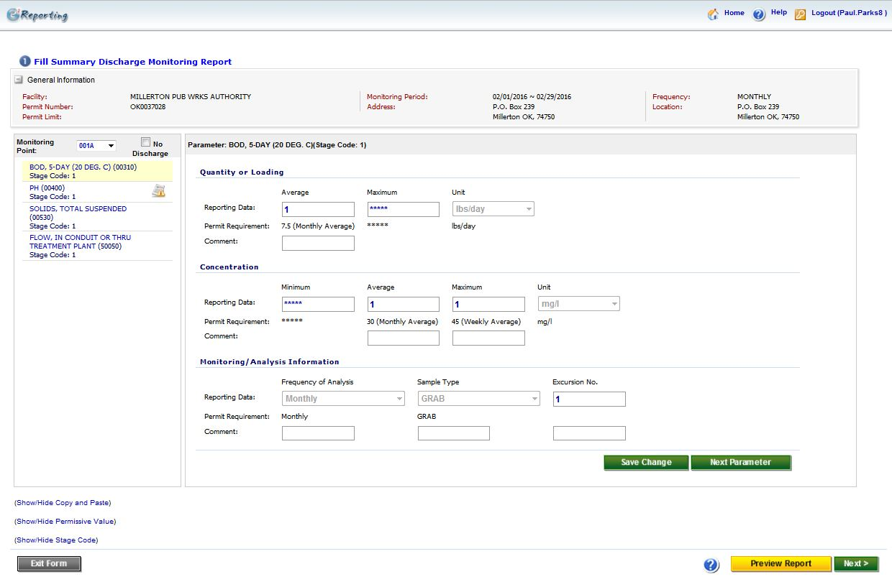
E2: Preparer Create eDMR
Notice that the red action symbols are gone. This means that all the values needed have been entered.
If everything looks correct, click Next
Click here to preview what the eDMR will look like

Slide 16
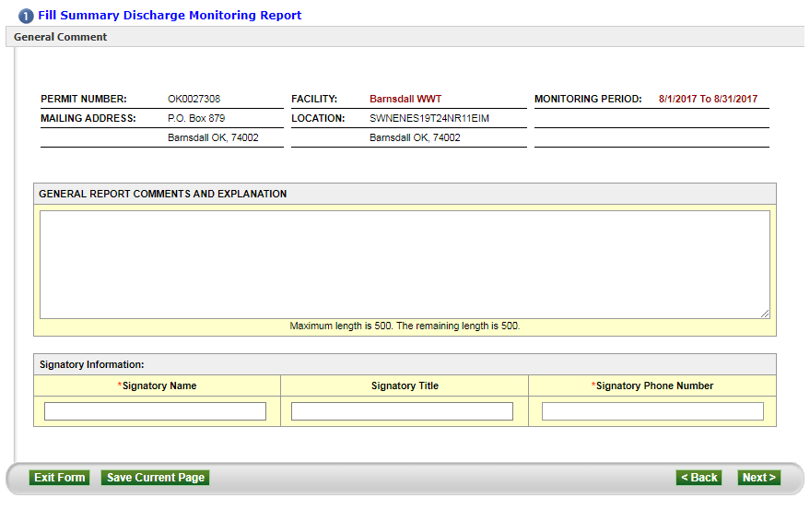
E2: Preparer Create eDMR
Use this field to add any comments you may want (Optional)
Enter the Signatory’s name
Click Next
Enter the Signatory’s phone number

Slide 17
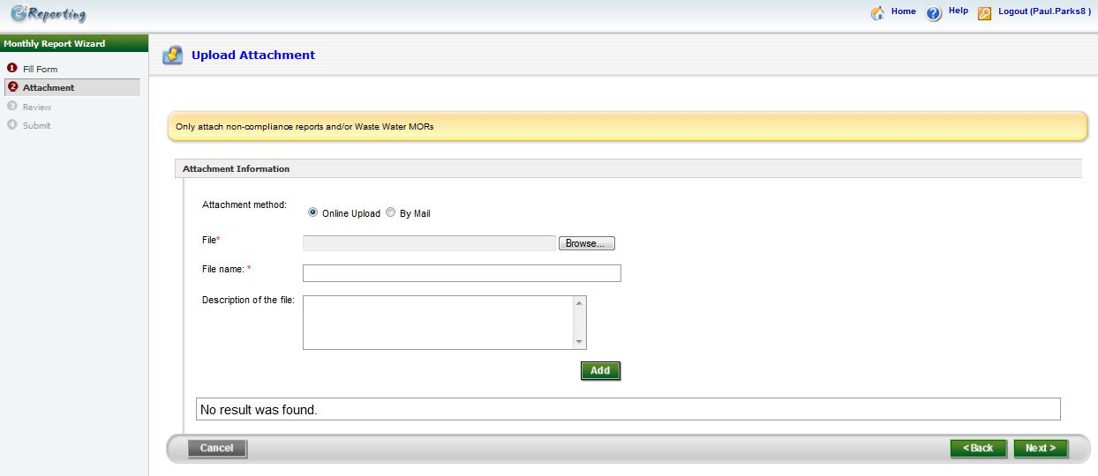
E2: Preparer Create eDMR
This page is optional. If you have a “Non-Compliance Report” and/or “Waste Water MORs” you can use this page to attach it to your eDMR submission
Click Next

Slide 18
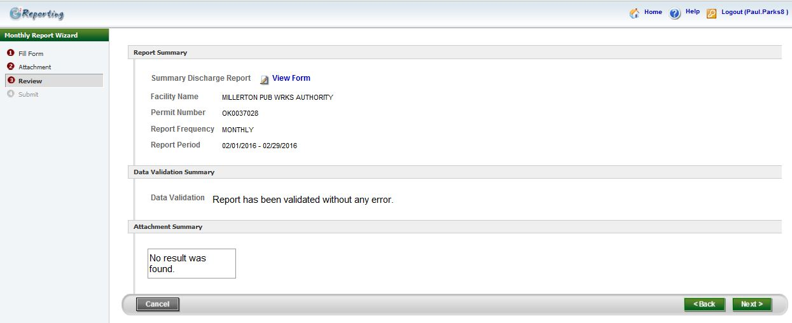
E2: Preparer Create eDMR
Click here to view a copy of the eDMR you will be submitting
Click Next

Slide 19
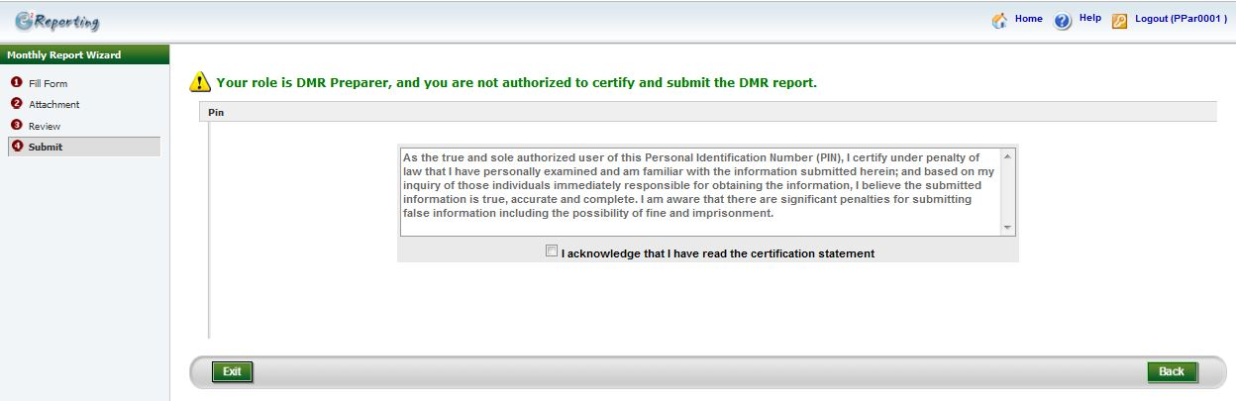
E2: Preparer Create eDMR
As Preparer you cannot submit the eDMR.
Clicking “Exit” will save the eDMR. Once you have done this, notify the Signatory that the eDMR is ready for review and submittal. Your part is done.

