Slide 1

Public Water Supply Operator Renewal Training
Fall 2025

Slide 2


Funding
Drinking Water State Revolving Fund Section
Water Quality Division​
Oklahoma Department of Environmental Quality​
Notes:
Introduce myself.

Slide 3

  What is DWSRF?
  Why DWSRF?
  Types of Funding
    BIL and Base
    Disadvantaged Communities
    LSL Inventory Assistance
    Emerging Contaminates
Presentation
Outline
  DWSRF Process

Slide 4


What is DWSRF?
Beginning...
Purpose...
Annually...
To Date...
Created in 1996 by Safe Drinking Water Act
Provide low interest loans and financial assistance for public water supply projects
The SRF program is allotted funds annually based on needs survey
Oklahoma DWSRF has funded over 2.3 Billion in water improvement projects
1
2
3
4
Co-administered by DEQ DWSRF and the Oklahoma Water Resources Board
Notes:
DWSRF is a loan program that has low-interest rate loans and is available for public water supply systems. It is open all year round, so there is no window for applications, and since its creation in 1996, we have provided over 2 Billion for water infrastructure improvement projects.
The DWSRF is co-administered which just means DEQ is responsible for getting systems on the list, going through the environmental and engineering approval process, bids and pay requests. The OWRB is responsible for the loan application process.

Slide 5




Why DWSRF?
  Subsidy or “free” monies potential
  Broad Eligibilities
  Upfront planning & design assistance
  Free technical assistance
  Refinancing and Restructuring
  Repayment may be tailored to the system’s needs
  May be blended with other funding sources
  Delay to repay
  Construction period
  No interest until funds reimbursed
  No interest if unused/funds may be de-obligated
  Interest rates 30% below market
  Ability to finance 100%
  Terms up to 30 years
Notes:
We know “WHAT” DWSRF is now why is DWSRF a good choice?
A lot of Free Things!
Potential for free money, or loan forgiveness, that many systems in OK qualify for; the free monies have broad potential.
We also have free planning and design assistance as well as free technical assistance.

Slide 6
Why DWSRF?
  Refinancing and Restructuring
  Repayment may be tailored to the system’s needs
  May be blended with other funding sources
  Subsidy or “free” monies potential
  Broad Eligibilities
  Upfront planning & design assistance
  Free technical assistance
  Delay to repay
  Construction period
  No interest until funds reimbursed
  No interest if unused/funds may be de-obligated
  Interest rates 30% below market
  Ability to finance 100%
  Terms up to 30 years
Notes:
Low-Interest and Long-Term Loan Options
Interest Rates are 30% below market rate, loans give the option to finance 100% and Terms can be up to 30 years long, depending on the life expectancy of the infrastructure.

Slide 7
Why DWSRF?
  Refinancing and Restructuring
  Repayment may be tailored to the system’s needs
  May be blended with other funding sources
  Subsidy or “free” monies potential
  Broad Eligibilities
  Upfront planning & design assistance
  Free technical assistance
  Delay to repay
  Construction period
  No interest until funds reimbursed
  No interest if unused/funds may be de-obligated
  Interest rates 30% below market
  Ability to finance 100%
  Terms up to 30 years
Notes:
Low-Interest and Long-Term Loan Options
Interest Rates are 30% below market rate, loans give the option to finance 100% and Terms can be up to 30 years long, depending on the life expectancy of the infrastructure.

Slide 8
Why DWSRF?
  Refinancing and Restructuring
  Repayment may be tailored to the system’s needs
  May be blended with other funding sources
  Subsidy or “free” monies potential
  Broad Eligibilities
  Upfront planning & design assistance
  Free technical assistance
  Delay to repay
  Construction period
  No interest until funds reimbursed
  No interest if unused/funds may be de-obligated
  Interest rates 30% below market
  Ability to finance 100%
  Terms up to 30 years
Notes:
Low Risk!
Your payment can be delayed, and During the construction period there is only the requirement to pay on the interest of the money you have spent, money that has been dispersed, not on the full amount of the loan. And no regular payments until the completion of the construction period.
Also there is no interest till funds are reimbursed, and
no interest if funds go unused or if funds are de-obligated. LOW RISK

Slide 9
Why DWSRF?
  Refinancing and Restructuring
  Repayment may be tailored to the system’s needs
  May be blended with other funding sources
  Subsidy or “free” monies potential
  Broad Eligibilities
  Upfront planning & design assistance
  Free technical assistance
  Delay to repay
  Construction period
  No interest until funds reimbursed
  No interest if unused/funds may be de-obligated
  Interest rates 30% below market
  Ability to finance 100%
  Terms up to 30 years
Notes:
Flexible!
Flexible with payment schedule. Say your system has a current payment of 500$ for the next twelve months, DWSRF can lower our required payment until that 500$ payment is gone, then bump our payments up to make up for the lower payments in the beginning.
This funding can be combined with other funding from RD, USARD, IHS, CBDG’s, Dept of Commerce, etc. very flexible.

Slide 10
Why DWSRF?
  Refinancing and Restructuring
  Repayment may be tailored to the system’s needs
  May be blended with other funding sources
  Subsidy or “free” monies potential
  Broad Eligibilities
  Upfront planning & design assistance
  Free technical assistance
  Delay to repay
  Construction period
  No interest until funds reimbursed
  No interest if unused/funds may be de-obligated
  Interest rates 30% below market
  Ability to finance 100%
  Terms up to 30 years
Notes:
DWSRF has a lot of free money to grant, low interest and long-term loan options, is low risk, and flexible to system needs.

Slide 11
Eligibility
Applicants must be non-for-profit Community Public Water Supplies
Eligible projects
Ineligible projects
Water wells
Water lines
Meters
Water Treatment Plant/Rehabilitation
Storage Tanks
Growth
Fire flow
Maintenance
Wastewater
Dredging Lakes
Dams*
*Special Requirements
Violations must be addressed prior to or as part of the project, if applicable
Notes:
Who Qualifies for DWSRF loans?
For-profit and non-community systems do not qualify, only non-for-profit and community water systems qualify.
Eligible projects are:
Ineligible projects are:
All projects are Focused on drinking water, not waste water. And all violations must be addressed before receiving funds.

Slide 12
Types of DWSRF Funding
Base
IIJA
General Supplemental
Lead Service Line Inventory & Replacement
Emerging Contaminants
General Supplemental
Disadvantaged Community
Notes:
We get our loan money two ways, through the states base grant and the federal BIL funding – Bipartisan Infrastructure Law;
The state money can be used for any thing on the eligible projects list, BIL funding can be used for eligible projects AND, LSL and EC
Now both of these funding sources have potential for free monies or loan forgiveness…

Slide 13
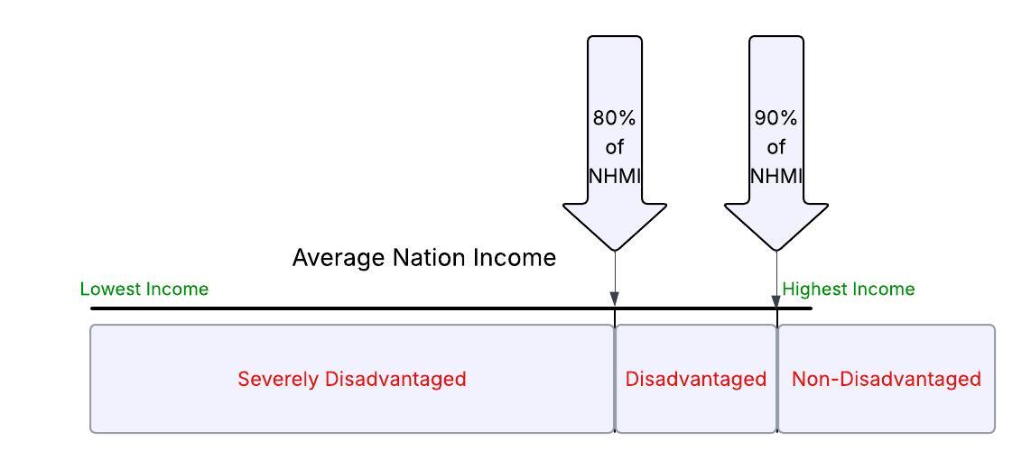
Funding Allocation
Severely Disadvantaged
Disadvantaged
BASE
  National Median Household Income
  Systems serving population with NMHI less than 80% of national average
  National Median Household Income
  Systems serving population with NMHI greater than 80%, but less than 90% of national average
AND
IIJA
Notes:
The “free monies” or loan forgiveness is determined by Disadvantaged Status.
How communities are classified as Disadvantaged and Severely Disadvantaged comes down to the average income of that community. The U.S. Census Bureau takes the average community income and compares it to the national average income.
If the community makes less than 90% but more than 80% it is dis.
If the community makes less than 80% of the Nation, it is severely dis.

Slide 14
Bipartisan Infrastructure Law (BIL)
$30.7 billion dedicated to DWSRF.​
    $11.7 billion for the General Supplemental.
    $15 billion for Lead Service Line Replacement.​
    $4 billion for Emerging Contaminants.​
IIJA
  Passed on November 6, 2021, by Congress.​
  Over $50 billion to EPA to improve drinking water, wastewater, and stormwater infrastructure.​

Slide 15



IIJA
General Supplemental
SFY 2025 Summary
Subsidy Disadvantaged
  Total SFY 26 = $36,188,000
  49% to be provided as loan forgiveness, or $17,732,120
  Serving 10,000 people or fewer, may receive 100% up to $800,000.
  Serving more than 10,000 people, may receive 25% of the loan amount or $1 million, whichever is less.​
Notes:
For Oklahomas DWSRF we have 33 million funding, and 16 million of that is reserved for loan forgiveness.
Two subsidies: one for disadvantaged and one for not disadvantaged communities.
The second column is for specific areas in a specific part of town.

Slide 16
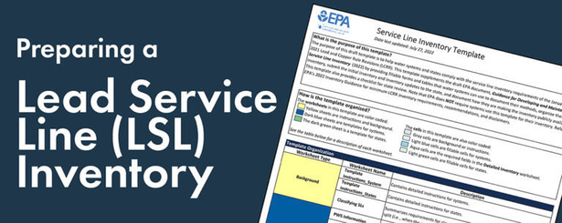
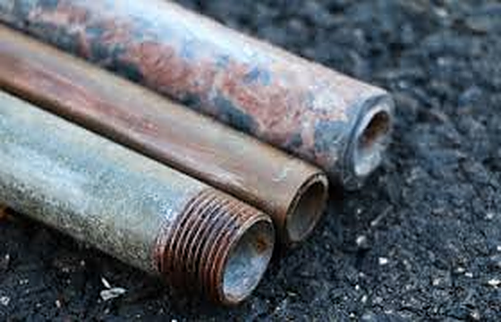
IIJA
LSL Inventory Assistance
  Deadline was October 2024
(This should be a “living” document as inventory process is expected to be ongoing.)
  Systems under 3,300 must complete inventory before eligible for funding to do investigation and/or replacement.
    -Technical Assistance provided by ORWA and OSU
    - No PPL letter required, no cost to the water system, no billing involved
  https://www.deq.ok.gov/lead-service-line-inventory/
Contact Connie Guinn for assistance
(405)702-8248
connie.guinn@deq.ok.gov

Slide 17
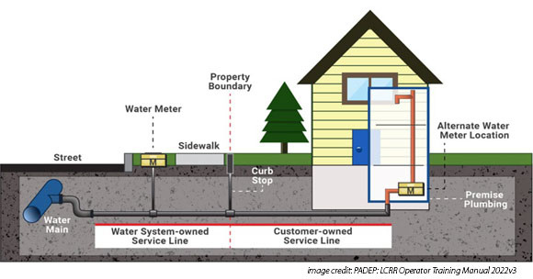
LSL Investigation & Replacement
IIJA
Subsidy: Disadvantaged
SFY 2026 Summary
  Serving 10,000 people or fewer, may receive up to 100% loan forgiveness for eligible projects.
  Serving more than 10,000 people, will qualify for 50% of the loan amount, or $3.5M.
  $42,392,344 Total
  51% Loan / 49% loan forgiveness
Serving 3,300 or less qualifies for free LSL Inventory Assistance

Slide 18
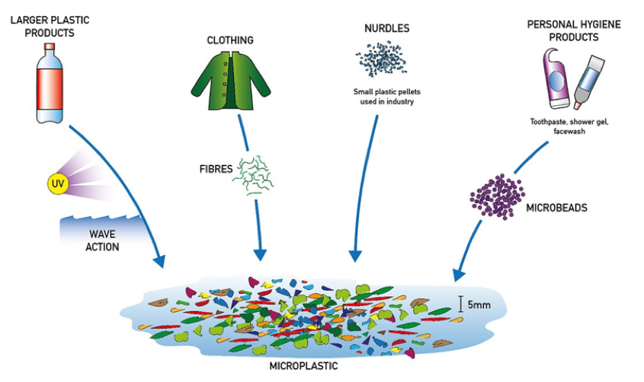
Emerging Contaminants
IIJA
  100% loan forgiveness
  Total available funds: $34,075,530
  Disadvantaged loan forgiveness is 25% ($2,776,000)
  Focus on per- and polyfluoroalkyl substances, known as PFAS.​
  Manganese is an option.
  Any chemical on EPA’s contaminant candidate list is eligible.
Notes:
If you want to use BIL for EC

Slide 19

Rural Infrastructure Grant
RIG
  3,300 or less
  Max $120,000
  Requires a 20% match
  The match can come from other funds, IHS, USDA, but not SRF.
  No Deadline – open year-round
  Planning and Design, Annual Audits, Emergency Repairs, Engineering Consulting Fees, storage projects, SCADA, Lab Upgrades, vehicles, and more
Notes:
120,000 grant maximum; includes the 20% match.
No deadline - grants may be applied for at any time. An existing grant must be closed and finalized before another application will be approved; however, systems may apply for multiple grants in any given time period.

Slide 20
DWSRF Application Process
CONTRACTS PHASE
  Pre-Bid Meeting
  Advertising and Accepting Bids
  OWRB Board/Binding Commitment
  Loan Closing, Interest Rate set
  Awarding Construction Contracts
  Oklahoma Competitive Bidding Act/DBE
PRE-CONSTRUCTION PHASE
  Pre-Construction Conference
  Project Signage
CONSTRUCTION
  Applicant Resident Inspection
  Monthly Meetings and Site Visits
  Pay Requests (Reimbursement)
  AIS/BABA/Davis Bacon
START-UP PHASE
  Contract with engineering firm
  Submission of “Project Priority List”
  DEQ Ranking of system by need
  Confirmation letter from DEQ that you are on the Project Priority List.
  PLANNING PHASE “Ready to Proceed”
  Environmental Review
  Capacity Development
  Engineering Planning and Design
  Financial Application
  Construction permit
**** Funds will not be obligated until all approvals are complete.****
Notes:
The items in bold are what the system is responsible for. Be sure to notates the environmental works

Slide 21
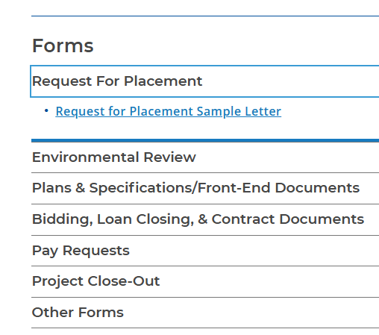
Submission of Project Priority List
  Projects must be listed on the DWSRF Project Priority List (PPL)
    How to get on that list:
      Secure an Engineer
      Go to DEQ webpage: deq.ok.gov → Divisions → Water Quality → Public Water Supply → Drinking Water State Revolving Fund
      “Request for Placement Letter (Example)”

Slide 22
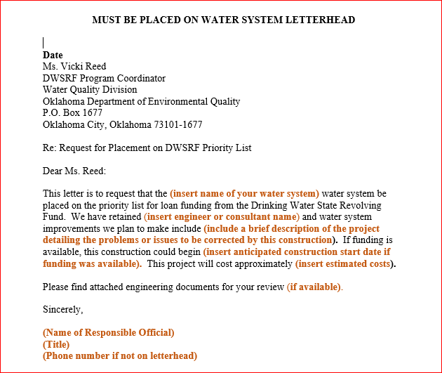
Notes:
Be sure to mention vicki reed.

Slide 23
Step-by-Step Application Process
CONTRACTS PHASE
  Pre-Bid Meeting
  Advertising and Accepting Bids
  OWRB Board/Binding Commitment
  Loan Closing, Interest Rate set
  Awarding Construction Contracts
  Oklahoma Competitive Bidding Act/DBE
PRE-CONSTRUCTION PHASE
  Pre-Construction Conference
CONSTRUCTION
  Applicant Resident Inspection
  Monthly Meetings and Site Visits
  Pay Requests (Reimbursement)
  AIS/BABA/Davis Bacon
START-UP PHASE
  Contract with engineering firm
  Submission of “Project Priority List”
  DEQ Ranking of system by need
  Confirmation letter from DEQ that you are on the Project Priority List.
PLANNING PHASE “Ready to Proceed”
  Environmental Review
  Capacity Development
  Engineering Planning and Design
  Financial Application
  Construction permit
**** Funds will not be obligated until all approvals are complete.****
Notes:
Now DEQ does the ranking for disadvantaged status and when complete DEQ will add you to the project priority list and will send a letter to your system informing you that is so.

Slide 24
Step-by-Step Application Process
CONTRACTS PHASE
  Pre-Bid Meeting
  Advertising and Accepting Bids
  OWRB Board/Binding Commitment
  Loan Closing, Interest Rate set
  Awarding Construction Contracts
  Oklahoma Competitive Bidding Act/DBE
PRE-CONSTRUCTION PHASE
  Pre-Construction Conference
CONSTRUCTION
  Applicant Resident Inspection
  Monthly Meetings and Site Visits
  Pay Requests (Reimbursement)
  AIS/BABA/Davis Bacon
START-UP PHASE
  Contract with engineering firm
  Submission of “Project Priority List”
  DEQ Ranking of system by need
PLANNING PHASE “Ready to Proceed”
  Environmental Review
  Capacity Development
  Engineering Planning and Design
  Financial Application
  Construction permit
**** Funds will not be obligated until all approvals are complete.****
Confirmation letter from DEQ that you are on the Project Priority List.
Notes:
The items in bold are what the system is responsible for. Be sure to notates the environmental works
The planning phase takes a while! Haha

Slide 25
Step-by-Step Application Process
CONTRACTS PHASE
  Pre-Bid Meeting
  Advertising and Accepting Bids
  OWRB Board/Binding Commitment
  Loan Closing, Interest Rate set
  Awarding Construction Contracts
  Oklahoma Competitive Bidding Act/DBE
PRE-CONSTRUCTION PHASE
  Pre-Construction Conference
CONSTRUCTION
  Applicant Resident Inspection
  Monthly Meetings and Site Visits
  Pay Requests (Reimbursement)
  AIS/BABA/Davis Bacon
START-UP PHASE
  Contract with engineering firm
  Submission of “Project Priority List”
  DEQ Ranking of system by need
PLANNING PHASE “Ready to Proceed”
  Engineering Planning and Design
  Environmental Review
  Capacity Development
  Financial Application
  Construction permit
**** Funds will not be dispersed until all approvals are complete.****
Confirmation letter from DEQ that you are on the Project Priority List.
Notes:
The items in bold are what the system is responsible for. Be sure to notates the environmental works
The planning phase takes a while! Haha

Slide 26
Step-by-Step Application Process
CONTRACTS PHASE
  Pre-Bid Meeting
  Advertising and Accepting Bids
  OWRB Board/Binding Commitment
  Interest rate set, Loan Closing
  Awarding Construction Contracts
    Oklahoma Competitive Bidding Act/DBE
PRE-CONSTRUCTION PHASE
  Pre-Construction Conference
CONSTRUCTION
  Applicant Resident Inspection
  Monthly Meetings and Site Visits
  Pay Requests (Reimbursement)
  AIS/BABA/Davis Bacon
START-UP PHASE
  Contract with engineering firm
  Submission of “Project Priority List”
  DEQ Ranking of system by need
PLANNING PHASE “Ready to Proceed”
  Engineering Planning and Design
  Capacity Development
  Environmental Review
  Financial Application
  Construction permit
**** Funds will not be obligated until all approvals are complete.****
Confirmation letter from DEQ that you are on the Project Priority List.

Slide 27
Step-by-Step Application Process
CONTRACTS PHASE
  Pre-Bid Meeting
  Advertising and Accepting Bids
  OWRB Board/Binding Commitment
  Loan Closing, Interest Rate set
  Awarding Construction Contracts
  Oklahoma Competitive Bidding Act/DBE
PRE-CONSTRUCTION PHASE
  Pre-Construction Conference
CONSTRUCTION
  Applicant Resident Inspection
  Monthly Meetings and Site Visits
  Pay Requests (Reimbursement)
  AIS/BABA/Davis Bacon
START-UP PHASE
  Contract with engineering firm
  Submission of “Project Priority List”
  DEQ Ranking of system by need
PLANNING PHASE “Ready to Proceed”
  Engineering Planning and Design
  Capacity Development
  Environmental Review
  Financial Application
  Construction permit
**** Funds will not be obligated until all approvals are complete.****
Confirmation letter from DEQ that you are on the Project Priority List.

Slide 28
Step-by-Step Application Process
CONTRACTS PHASE
  Pre-Bid Meeting
  Advertising and Accepting Bids
  OWRB Board/Binding Commitment
  Loan Closing, Interest Rate set
  Awarding Construction Contracts
  Oklahoma Competitive Bidding Act/DBE
PRE-CONSTRUCTION PHASE
  Pre-Construction Conference
CONSTRUCTION
  Applicant Resident Inspection
  Monthly Meetings and Site Visits
  Pay Requests (Reimbursement)
  AIS/BABA/Davis Bacon
START-UP PHASE
  Contract with engineering firm
  Submission of “Project Priority List”
  DEQ Ranking of system by need
PLANNING PHASE “Ready to Proceed”
  Engineering Planning and Design
  Capacity Development
  Environmental Review
  Financial Application
  Construction permit
**** Funds will not be obligated until all approvals are complete.****
Confirmation letter from DEQ that you are on the Project Priority List.
Notes:
When construction ends, this is when deobligations occur and construction has to end by a certain time fram – this may be more for more financial.

Slide 29
DWSRF Application Process
CONTRACTS PHASE
  Pre-Bid Meeting
  Advertising and Accepting Bids
  OWRB Board/Binding Commitment
  Loan Closing, Interest Rate set
  Awarding Construction Contracts
  Oklahoma Competitive Bidding Act/DBE
PRE-CONSTRUCTION PHASE
  Pre-Construction Conference
  Project Signage
CONSTRUCTION
  Applicant Resident Inspection
  Monthly Meetings and Site Visits
  Pay Requests (Reimbursement)
  AIS/BABA/Davis Bacon
START-UP PHASE
  Contract with engineering firm
  Submission of “Project Priority List”
  DEQ Ranking of system by need
  Confirmation letter from DEQ that you are on the Project Priority List.
PLANNING PHASE “Ready to Proceed”
  Environmental Review
  Capacity Development
  Engineering Planning and Design
  Financial Application
  Construction permit
**** Funds will not be obligated until all approvals are complete.****

Slide 30

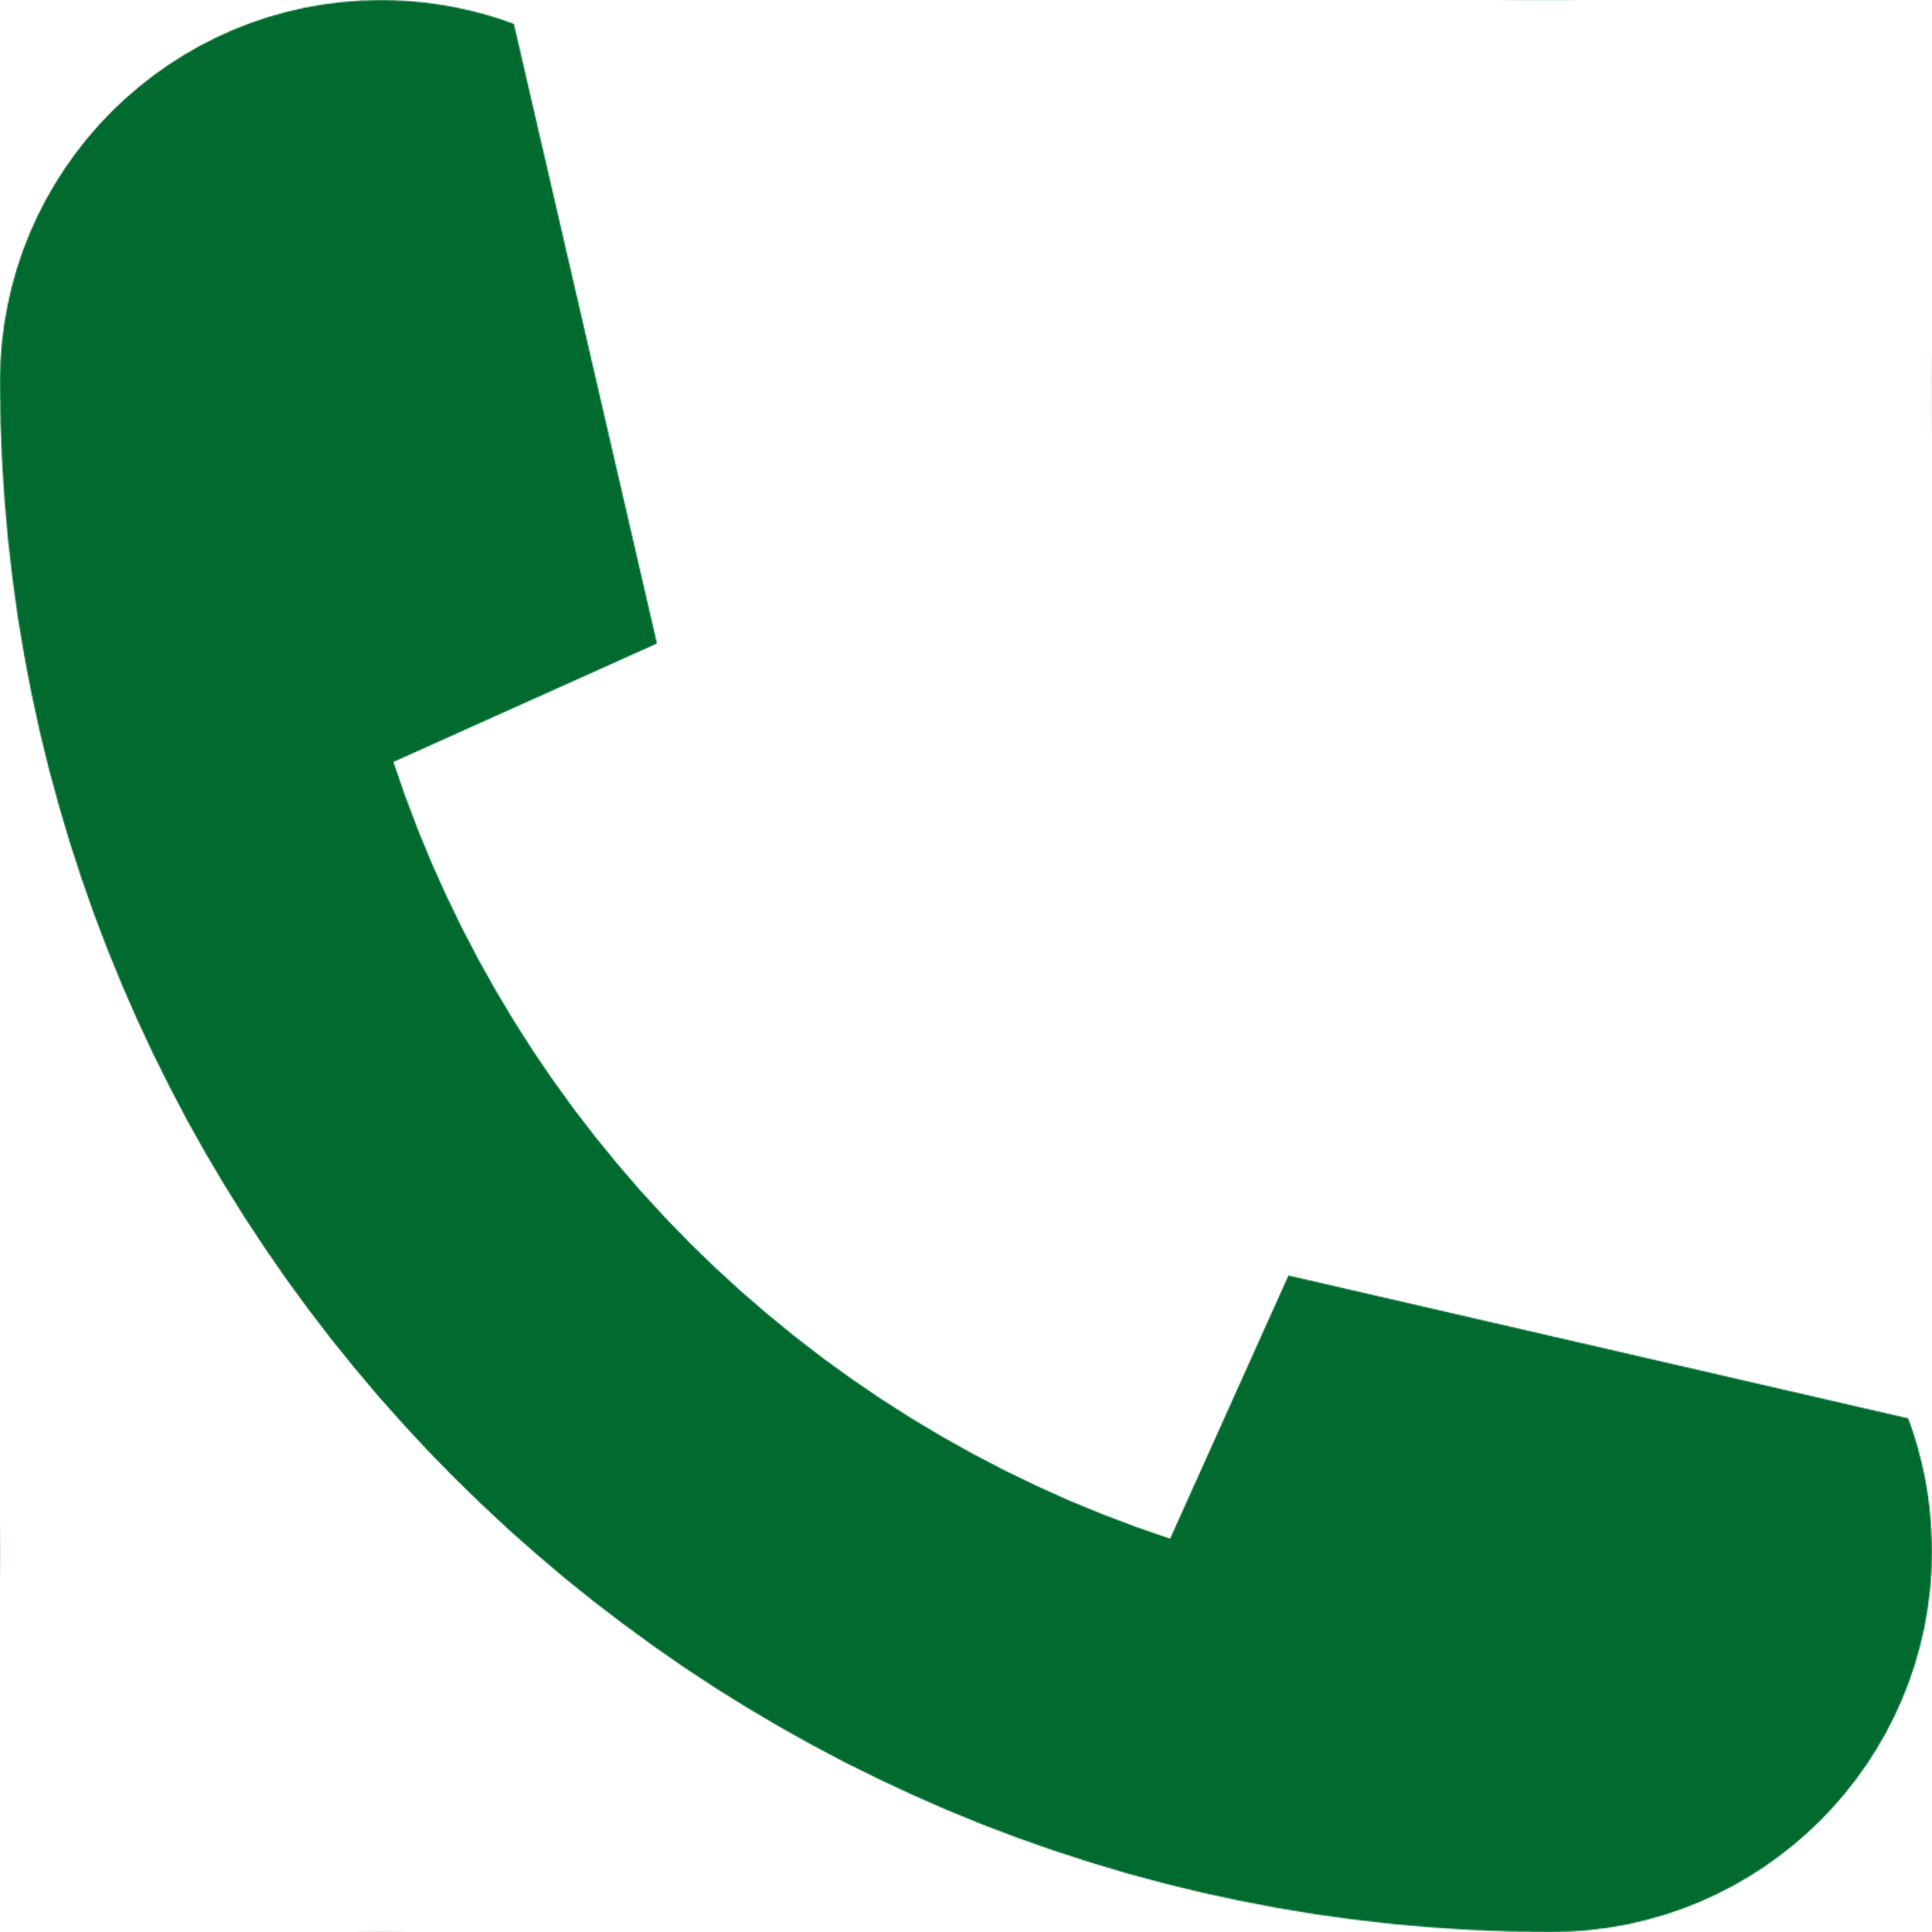


Questions? Thank You
405-702-8100
Amanda.Booze@deq.ok.gov
405.702.8233
Isaac.Cornelson@deq.ok.gov
Connie.Guinn@deq.ok.gov
405.702.8248
Oklahoma.gov/deq/divisions/water-quality/public-water-supply/dwsrf.html
Notes:
Ask Candy about our names on this slide.

