Slide 1


Capacity Development
Section
Overview
Notes:
Hi My name is ******. I am with the Capacity Development Section in the Water Quality Division of DEQ. Today I will be presenting on the technical assistance that my section provides.

Slide 2
What is Capacity Development?
Capacity Development is a fundamental component of the 1996 Amendments to the Safe Drinking Water Act (SDWA) that creates a framework for states to support the technical, managerial, and financial (TMF) aspects of public water supply operation.
Notes:
So, what is Capacity Development in relation to Public Water Supply systems?
Capacity Development was created in 1996 as an amendment to the Safe Drinking Water Act which created a framework for states to support the technical, managerial, and financial aspects of public water supply operation. To be viable and sustainable, it is critical that a water system be operated by a well-trained and capable staff, supported by effective management, and have sound financial policies.

Slide 3
What is the goal of Capacity Development?
Managerial
Financial
Technical
It is the goal of DEQ’s Capacity Development program to provide or locate resources and education to help Oklahoma’s water systems in these important TMF areas of operation.
Notes:
It is the goal of DEQ’s Capacity Development program to provide or locate resources and education to help Oklahoma’s water systems in these important Technical, Managerial, and Financial areas of operation.

Slide 4
Elements of Capacity Development - Technical
Technical
The physical and operational ability of a water system to meet Safe Drinking Water Act requirements, including the adequacy of physical infrastructure, technical knowledge and capability of personnel, and adequate source water.
Notes:
A water system's ability to meet the Safe Drinking Water Act (SDWA) requirements depends on several factors. Key among them is the adequacy of infrastructure like pipes and treatment facilities. Equally crucial is the technical expertise of the personnel managing the system. Additionally, a reliable water source ensures a consistent supply that meets quality standards. These elements collectively enable a system to provide safe drinking water, complying with SDWA standards.

Slide 5
Elements of Capacity Development - Managerial
Managerial
The ability of a water system to conduct its affairs in a manner enabling the system to achieve and maintain compliance with Safe Drinking Water Act requirements, including institutional and administrative capabilities such as ownership accountability, staffing and organization, and effective external linkages.
Notes:
A water system's effectiveness in managing its affairs is key to providing safe, reliable drinking water. This involves clear ownership accountability, adequate staffing, and efficient organization. Strong external partnerships with regulatory bodies and stakeholders offer crucial support in resources and guidance, ensuring compliance with the Safe Drinking Water Act. Overall, a system's compliance relies on managing its internal affairs and engaging with external partners.

Slide 6
Elements of Capacity Development - Financial
Financial
The ability of a water system to acquire and manage sufficient financial resources to allow the system to achieve and maintain compliance with Safe Drinking Water Act requirements, including revenue sufficiency, credit worthiness, and fiscal management and controls.
Notes:
The financial sustainability of a water system is crucial for ensuring ongoing compliance with the Safe Drinking Water Act (SDWA) requirements. This sustainability hinges on several key elements, including revenue sufficiency, creditworthiness, and effective fiscal management and controls. Revenue sufficiency ensures that the water system can generate enough income to cover operational and maintenance costs, as well as fund necessary upgrades and expansions. Creditworthiness is vital for securing loans and financing for large-scale projects, demonstrating the system's ability to manage debt responsibly and repay borrowed funds. Comprehensive fiscal management and controls involve meticulous budgeting, financial planning, and auditing processes to maintain transparency and accountability. Together, these financial pillars support a water system's capability to deliver safe and reliable drinking water while adapting to changing regulatory demands and infrastructural needs.

Slide 7

Step 1: Capacity Development Assessment
The purpose of the assessment is to help identify areas in water system operations that might impact the ability to sustainably produce water now and in the future.
Notes:
The first step is to complete a Capacity Development Assessment.
The purpose of the assessment is to help pinpoint areas in water system operations that might significantly impact the ability to sustainably produce water now and in the foreseeable future. For any weaknesses or deficiencies that are found, DEQ can provide or arrange for technical assistance to help the water system improve or correct the problem.

Slide 8
Capacity Development Assessment cont.
The assessment and technical assistance are provided at no cost to the water system, and help is provided strictly on a non-enforcement, voluntary basis.
All Oklahoma public water supplies are eligible to use the services provided through this program.
*A CDA is required to receive project funding support from the Drinking Water State Revolving Fund (DWSRF).
Notes:
All Capacity Development Assistance is provided at no cost to your water system, and all Public Water Supply systems are eligible.
Also, all Capacity Development Assistance is voluntary and completely non-enforceable. However, a Capacity Development Assessment is required if your water system is seeking funding from the Drinking Water State Revolving Fund for any project.

Slide 9
Capacity Development Assessment cont.
Check sheet Tab
Notes:
Shown on this slide is what the Capacity Development Assessment looks like.
The assessment has different answers that are chosen for each question. No, Not applicable, Yes – unverified, and Yes – verified. The difference between Yes-verified and Yes-unverified is that Yes-verified would be chosen if it is something that we have physically laid eyes upon. There are somethings we may not be able to physically put eyes on, but the answer is still yes, so that would be yes-unverified. Also noted is that some questions are bolded. The bolded questions indicate that they are required for systems seeking funding from DWSRF.
The assessment is broken down into sections based on the 3 elements of Capacity Development (Technical., Managerial, and Financial).
The first of which is the Technical element. In the technical section you will find questions such as:
Does your system have a written Operation and Maintenance Plan?
Do you have a written Training Plan?
Do you have accurate and up to date maps?
Do you have a written Emergency Response Plan?
Does your system track water loss using the AWWA water loss software?
And is all finished water metered and recorded?

Slide 10
Capacity Development Assessment cont.
Check sheet Tab
Notes:
The next section is Managerial. Here you have questions like:
Does your systems governing documents include things like elections and authorities of duties?
Are meetings conducted in accordance with the Oklahoma Open Meetings Act?
Does your system have written personnel policies and job descriptions?

Slide 11
Capacity Development Assessment cont.
Check sheet Tab
Notes:
Lastly, you have the financial section with questions like:
Does your system implement an asset management plan?
Are budgets conducted according to Generally Accepted Accounting Principals?
Does your system have written policies for accounts receivable and accounts payable?
And does your system have written budgetary control processes in place where financial duties are separated?
On the very right-hand side of the form, you will notice a black question mark on each question. The next slide will discuss what happens when you click that.

Slide 12
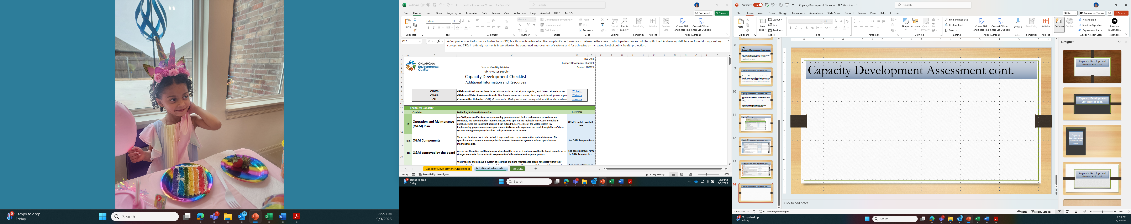
Capacity Development Assessment cont.
Additional Information Tab
Notes:
If you have clicked the black question mark, it directs you to the “Additional Information” Tab. This tab includes more information or clarification about the question asked. It also includes a reference feature which directs you to the applicable template if available or to other technical assistance providers such as ORWA.

Slide 13
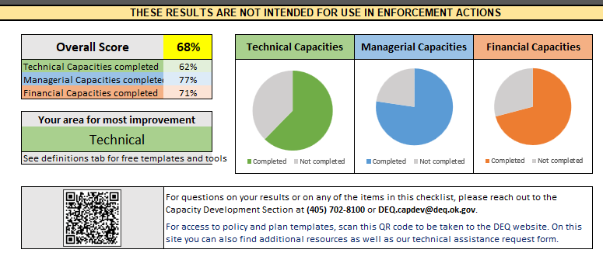
Capacity Development Assessment cont.
Results Tab
Notes:
The top of the results page tab breaks down the overall score in percentages. It shows which of the Technical, Managerial, and Financial areas that need improvement.

Slide 14

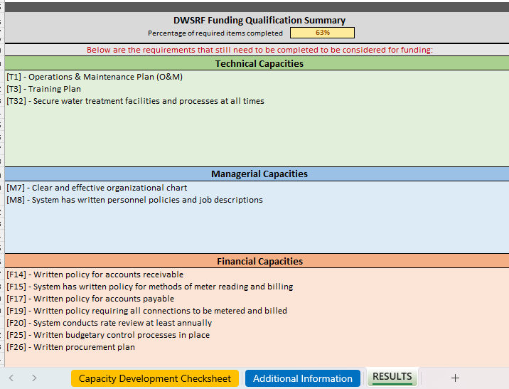
Capacity Development Assessment cont.
Notes:
Further down on the “Results” tab, it lists the questions that were marked “NO” that are required for DWSRF funding.
Again, all bolded questions in the assessment are required for funding.

Slide 15
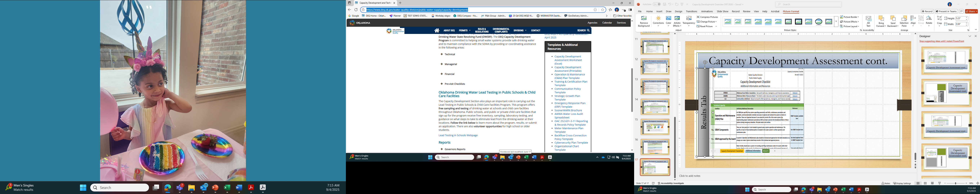
Capacity Development Assessment cont.
Templates and Assistance
Notes:
On the additional information tab, if you click on a template link in the reference column, you will be directed to the Capacity Development Section on the DEQ website. All of the templates that we have available are located here.

Slide 16
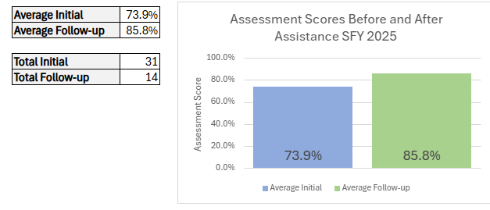
Capacity Development Assessment Success
Notes:
Our recent statistics show that overall capacity development assessment scores saw 16 percent increase from 73.9 percent to 85.8 percent from systems who received assistance.

Slide 17
Other Capacity Development Assistance
Water Loss Audit
Emergency Response Plan
Source Water Protection Plan
Asset Mgmt. Plan
Notes:
Along with the Capacity Development Assessment and templates, the Capacity Development Section specializes in other areas to help improve water systems.
Water Loss Audits, Emergency Response Plans, and Asset Management Plans will be discussed more in depth in the following slides.
The new revamped Source Water Protection Plan will be discussed in a later presentation today.

Slide 18
AWWA Water Loss Audit
Water Produced
Water Sold
Loss
Water Sold
Unaccounted for water
Notes:
Next up is the Water Loss Audit. DEQ utilizes the AWWA water loss audit software.
People generally think of water loss using the very simple equation of : water produced minus water sold. This approach is too simplistic to identify true water loss.

Slide 19
AWWA Water Loss Audit
Correct
Water Sold
Notes:
The AWWAs software calculates revenue water and non-revenue water. Revenue water is all water that is billed for. Non-revenue water encompasses all water that is not billed. The non-revenue water is further broken down to Apparent Loss and Real Loss.
Apparent Loss is also called “Paper” loss. It is water that reached the user but is not properly measured or paid for. Examples include things like customer meter inaccuracies, data handling errors and even water theft.
Real Loss is also called “Physical” loss. It is water that enters the distribution system but never reached the user. These are actual water line leaks.

Slide 20
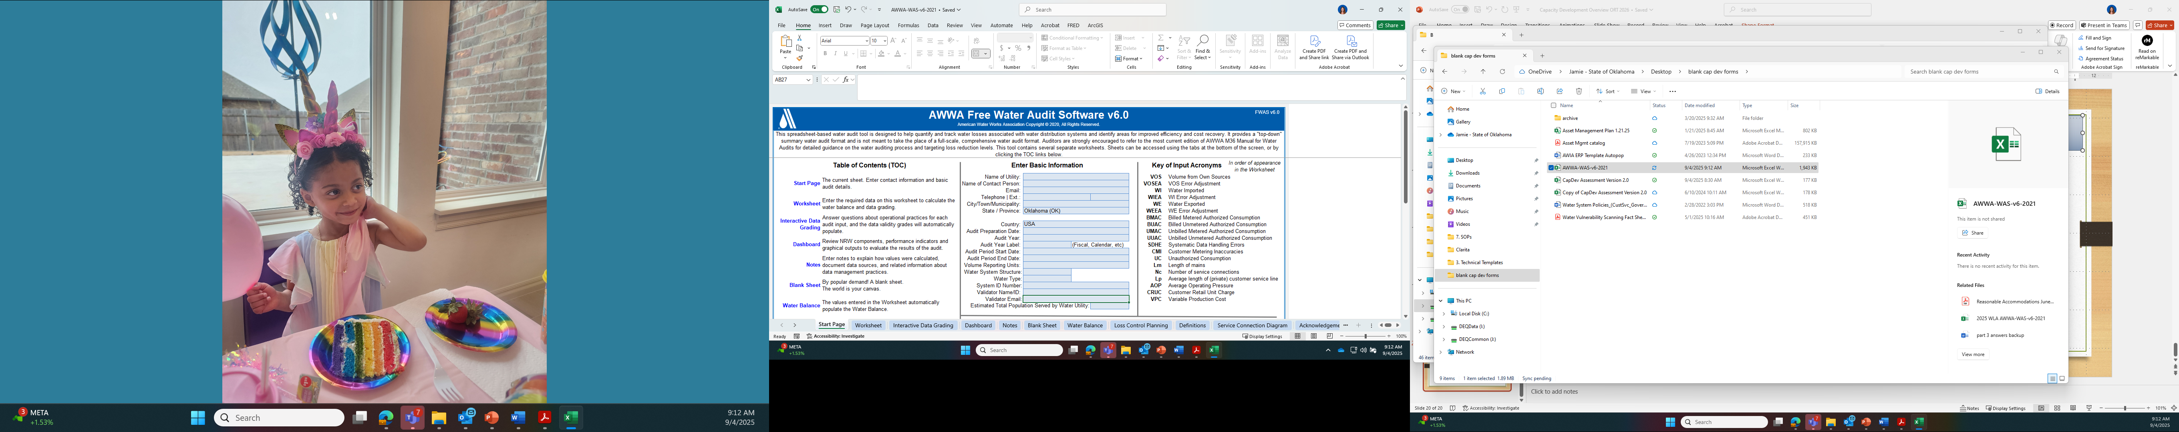
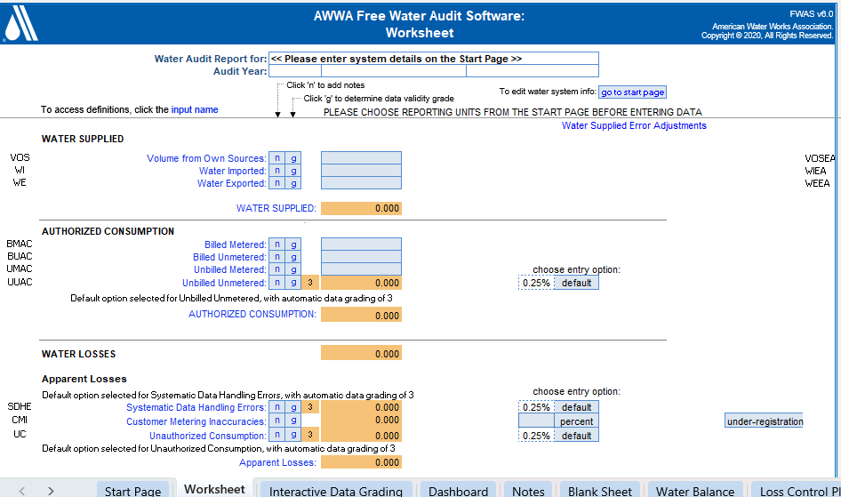
AWWA Water Loss Audit
12 consecutive months of data needed
Notes:
Shown is a small snapshot of what the software looks like. To complete a water loss audit, we use 12 consecutive months of data, accounting for water supplied, authorized consumption and many other metrics.

Slide 21
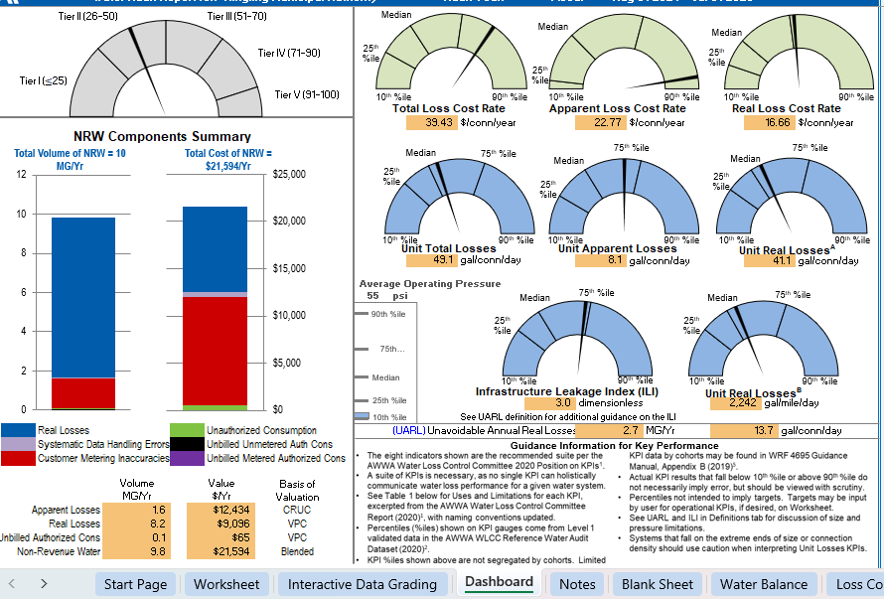
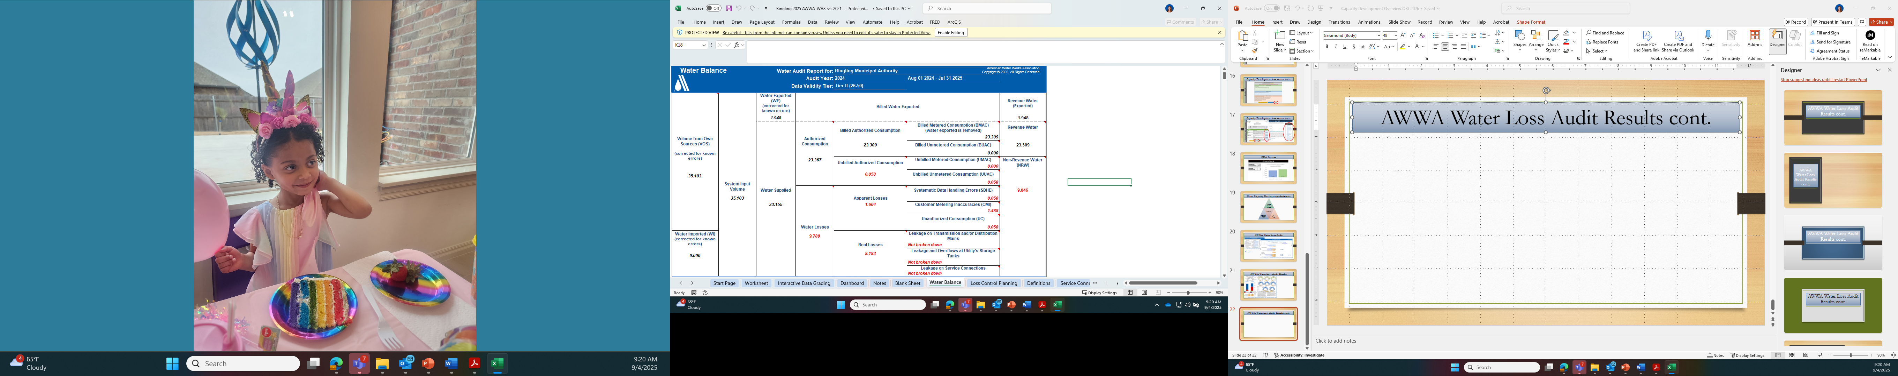
AWWA Water Loss Audit Results
Notes:
The dashboard page has operational efficiency indicators that show things like the real and apparent losses per service connection, and the cost to the system based on those losses.
The water balance table is a great visual breakdown to show where the water is going.
By doing a water loss audit, systems can better understand the problem and can apply better solutions, which saves, time and money.
For example, you wouldn’t want to focus on “physical” or real loss when the problem could be “paper” or apparent loss or vice versa.

Slide 22
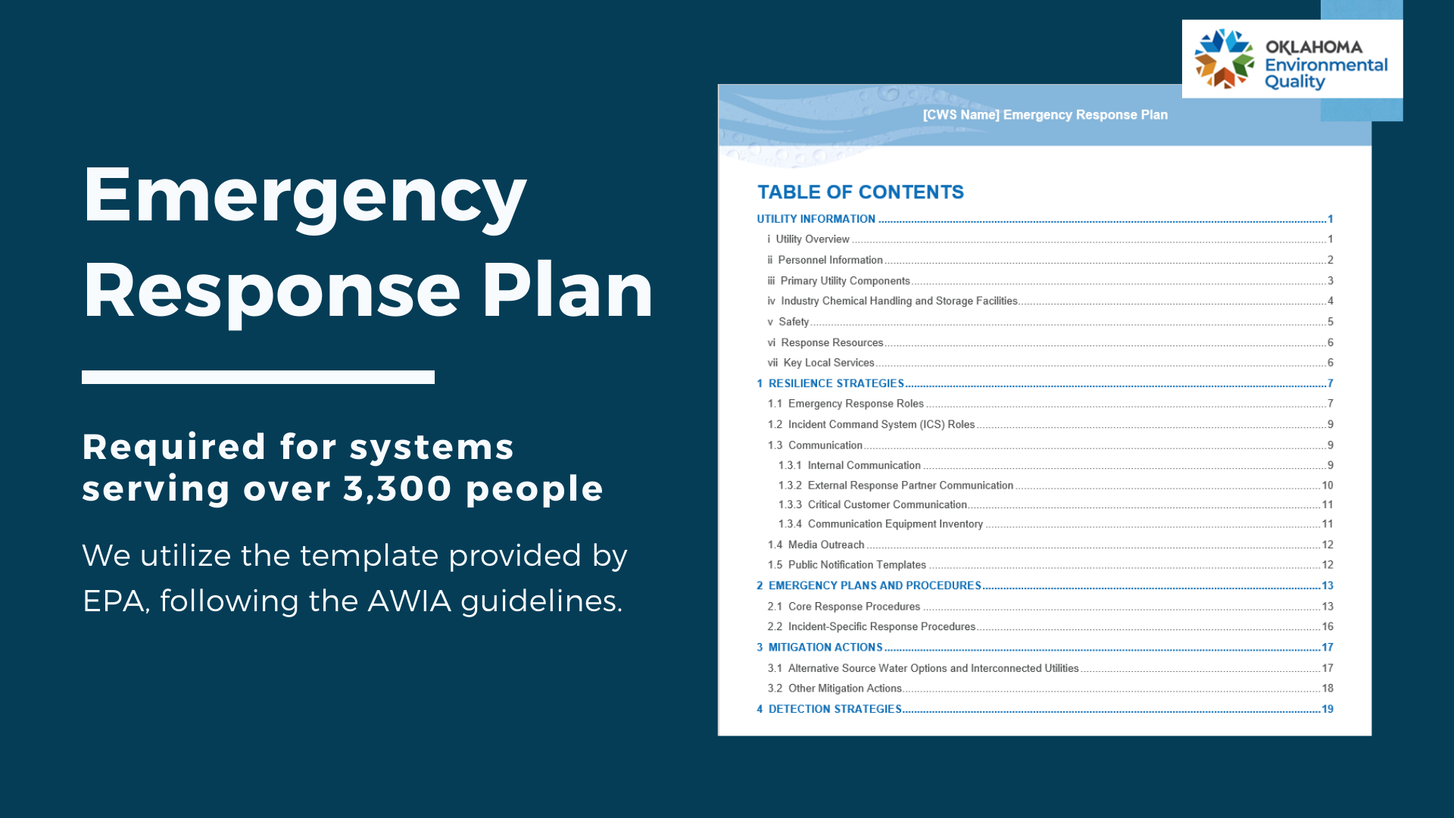
Emergency Response Plans
Required by EPA for systems serving over 3,300 people.
Required by DEQ for systems receiving DWSRF funding
We utilize the template provided by EPA, following the AWIA guidelines.
Notes:
Another technical assistance that we provide is help with creating emergency response plans.
The EPA requires systems that serve above a 3,300 population to have an Emergency Response Plan. If your water system is receiving DWSRF funding, an Emergency Response Plan is required no matter the population of your system.
The goal of an Emergency Response Plan is to have a plan to follow when emergency strikes.. This is a document that should be gone over when there is no emergency, so everyone knows what role they play and the responsibilities they have. The template can be tailored to your system’s needs.
When creating an ERP, ask yourself several questions. How can you detect threats early or get an early warning? What role will each person play? Who can you reach out to for help? And what steps can you take before, during, and after an emergency?

Slide 23
5 Core Components
Asset Management Plans
Current State of Assets
Level of Service
Criticality of Assets
Life Cycle Cost
Long-term Funding
Notes:
Asset management can be broken down to 5 core components.
The first of these components is current State– which is basically a detailed list of every asset or component needed to deliver safe drinking water to the consumers and the condition it is in.
Next, we have level of service. Level of service asks the questions like “What do your customers expect from you?” and “how do you plan to meet and obtain those customer needs?”
The third component is criticality. This looks at the probability and consequence of asset failure.
Next, we have life cycle cost. This looks at the total cost of an asset including purchase and replacement cost.
The final component is long term funding. This looks at how you plan to pay for the assets that are expected to fail in the future.

Slide 24
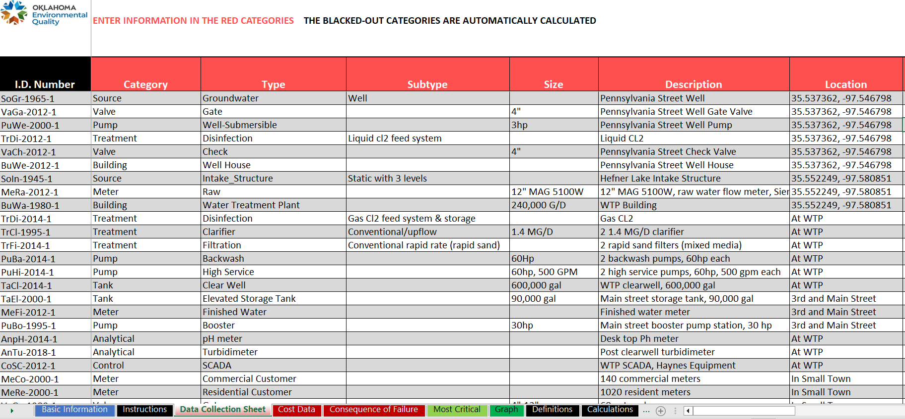
Asset Management Plan Tool
Notes:
Shown in this slide is DEQs very own Asset Management tool. It accounts for those 5 core components listed before by utilizing a series of tabs where you enter information about your assets.
The data collection sheet has information about the assets type, size, location, age, condition, and maintenance history.
The cost data tab has information about cost of the asset from when it was installed as well as predictive costs to replace the asset at the year of predicted failure.
The consequence of failure tab has a series of questions about the consequence of failure and the probability of failure of the asset to assign a criticality score.

Slide 25
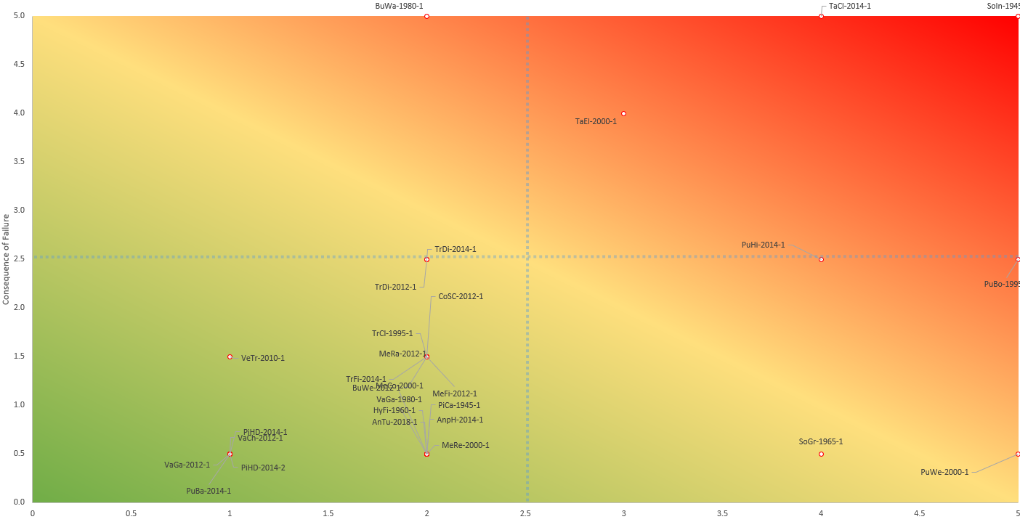
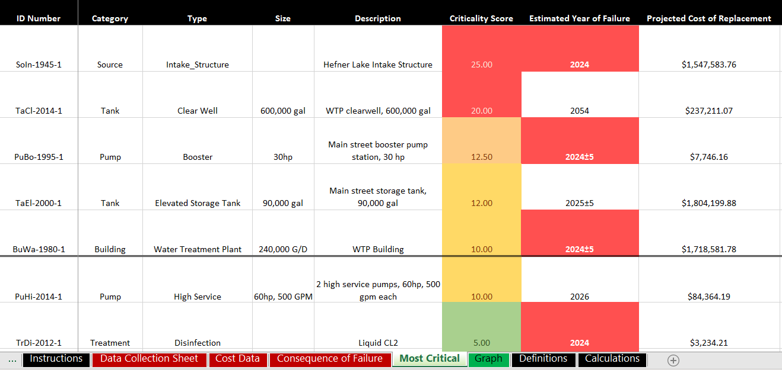
Asset Management Plan Results
Notes:
Shown on this slide are the two results pages, which list and visually show which of your assets you should be more aware of and help plan financially.

Slide 26

Other Capacity Development Programs
Lead Testing in Schools and Childcare Facilities
Notes:
Beginning in 2020, the Capacity Development Section began implementation of a program aimed at reducing or eliminating lead from drinking water in public schools and public or private childcare centers. Using funding appropriated by the EPA Water Infrastructure Improvements for the Nation Act- Section 2107, the Lead Testing in Schools and Child Care Facilities Drinking Water Grant Program (LWSC) offers free testing of drinking water for lead to any Oklahoma public school or childcare facility that requests to participate. In addition to free drinking water sampling, these facilities receive direction on how to address high lead levels based on EPA’s “3Ts” guidance, access to remediation funding, and follow up sampling if necessary.
It truly is a great and important program.

Slide 27

Other Capacity Development Programs
Relevant Seasonal Topics
News from EPA about new or updated regulations
Upcoming Trainings and Events
Funding sources
And more…
PWS Quarterly Newsletter
Notes:
The PWS Quarterly Newsletter started in January 2024. Four installations are sent out each year, one at the start of each quarter. Creation of the newsletter is headed by the Capacity Development Section with input from other sections within the PWS group. The newsletter is sent to all PWS systems who have signed up and consists of topics that keep systems up to date on new and updated rules and regulations.
It also provides links to resources that can assist systems with maintaining drinking water quality and highlights upcoming training and events conducted by various state and federal agencies within Oklahoma. Anyone can sign up for the newsletter by visiting the PWS website.

Slide 28

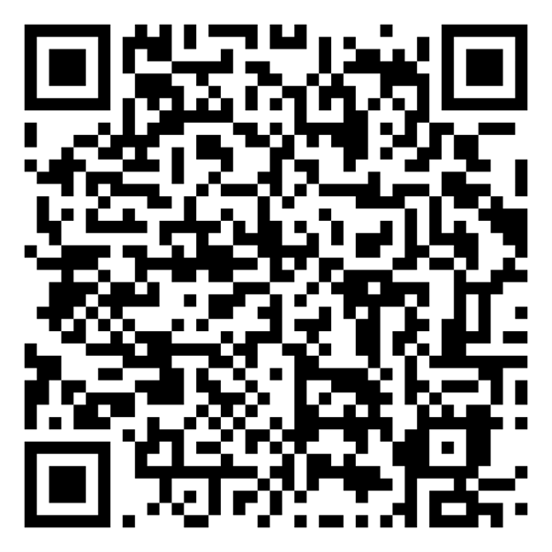
Request Free Technical Assistance
Water Wells
Distribution Hydraulics
Centrifugal Pumps
Altitude Control Valves
Pressure Control Valves
Water Treatment
Wastewater Treatment
Meter Testing
Lift Stations
Pump Stations
Water Audits
Leak Detection
Rate Studies
Inflow and Infiltration
Smoke Testing Sewers
Collection System Maint.
Risk Management
Asset Management
Confined Space Safety
Trench Safety
Chemical Feed Calibration
Financials
Billing
Bookkeeping
Notes:
A QR code is included in your booklet and will take you directly to the Capacity development website where you can request the technical assistance and obtain the templates that I have discussed today.
Also, I want to point out the great assistance that the Oklahoma Rural Water Association provides. For example, after completing a water loss audit and depending on the results, they can come out and do meter testing or leak detection. On their website, they have a form you can fill out to request.

Slide 29

Questions
Notes:
Thank you so much for listening about the technical assistance provided by the capacity development section. Please let me know if you have any questions.

