Slide 1


Area wide optimization
Program

Slide 2
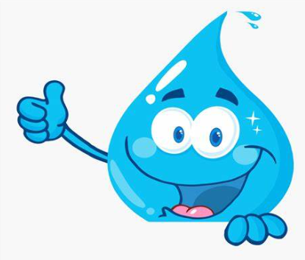
overview
What is AWOP?
Regions
Recent Workshop
CPEs
Awards
Contact Info

Slide 3
What is awop?
Began in 1989 – Oklahoma joined in 1999
Goal is to optimize water systems & maximize public health protection using existing staff and infrastructure
Topics Include:
  Turbidity
  DBPs
  Chlorine residual
  Corrosion control
  Ground water wells and treatment techniques
  Distribution systems and storage tank integrity
  Harmful Algae Blooms (HABs)
  Manganese control
  Nitrification
  Membrane Treatment Plants

Slide 4
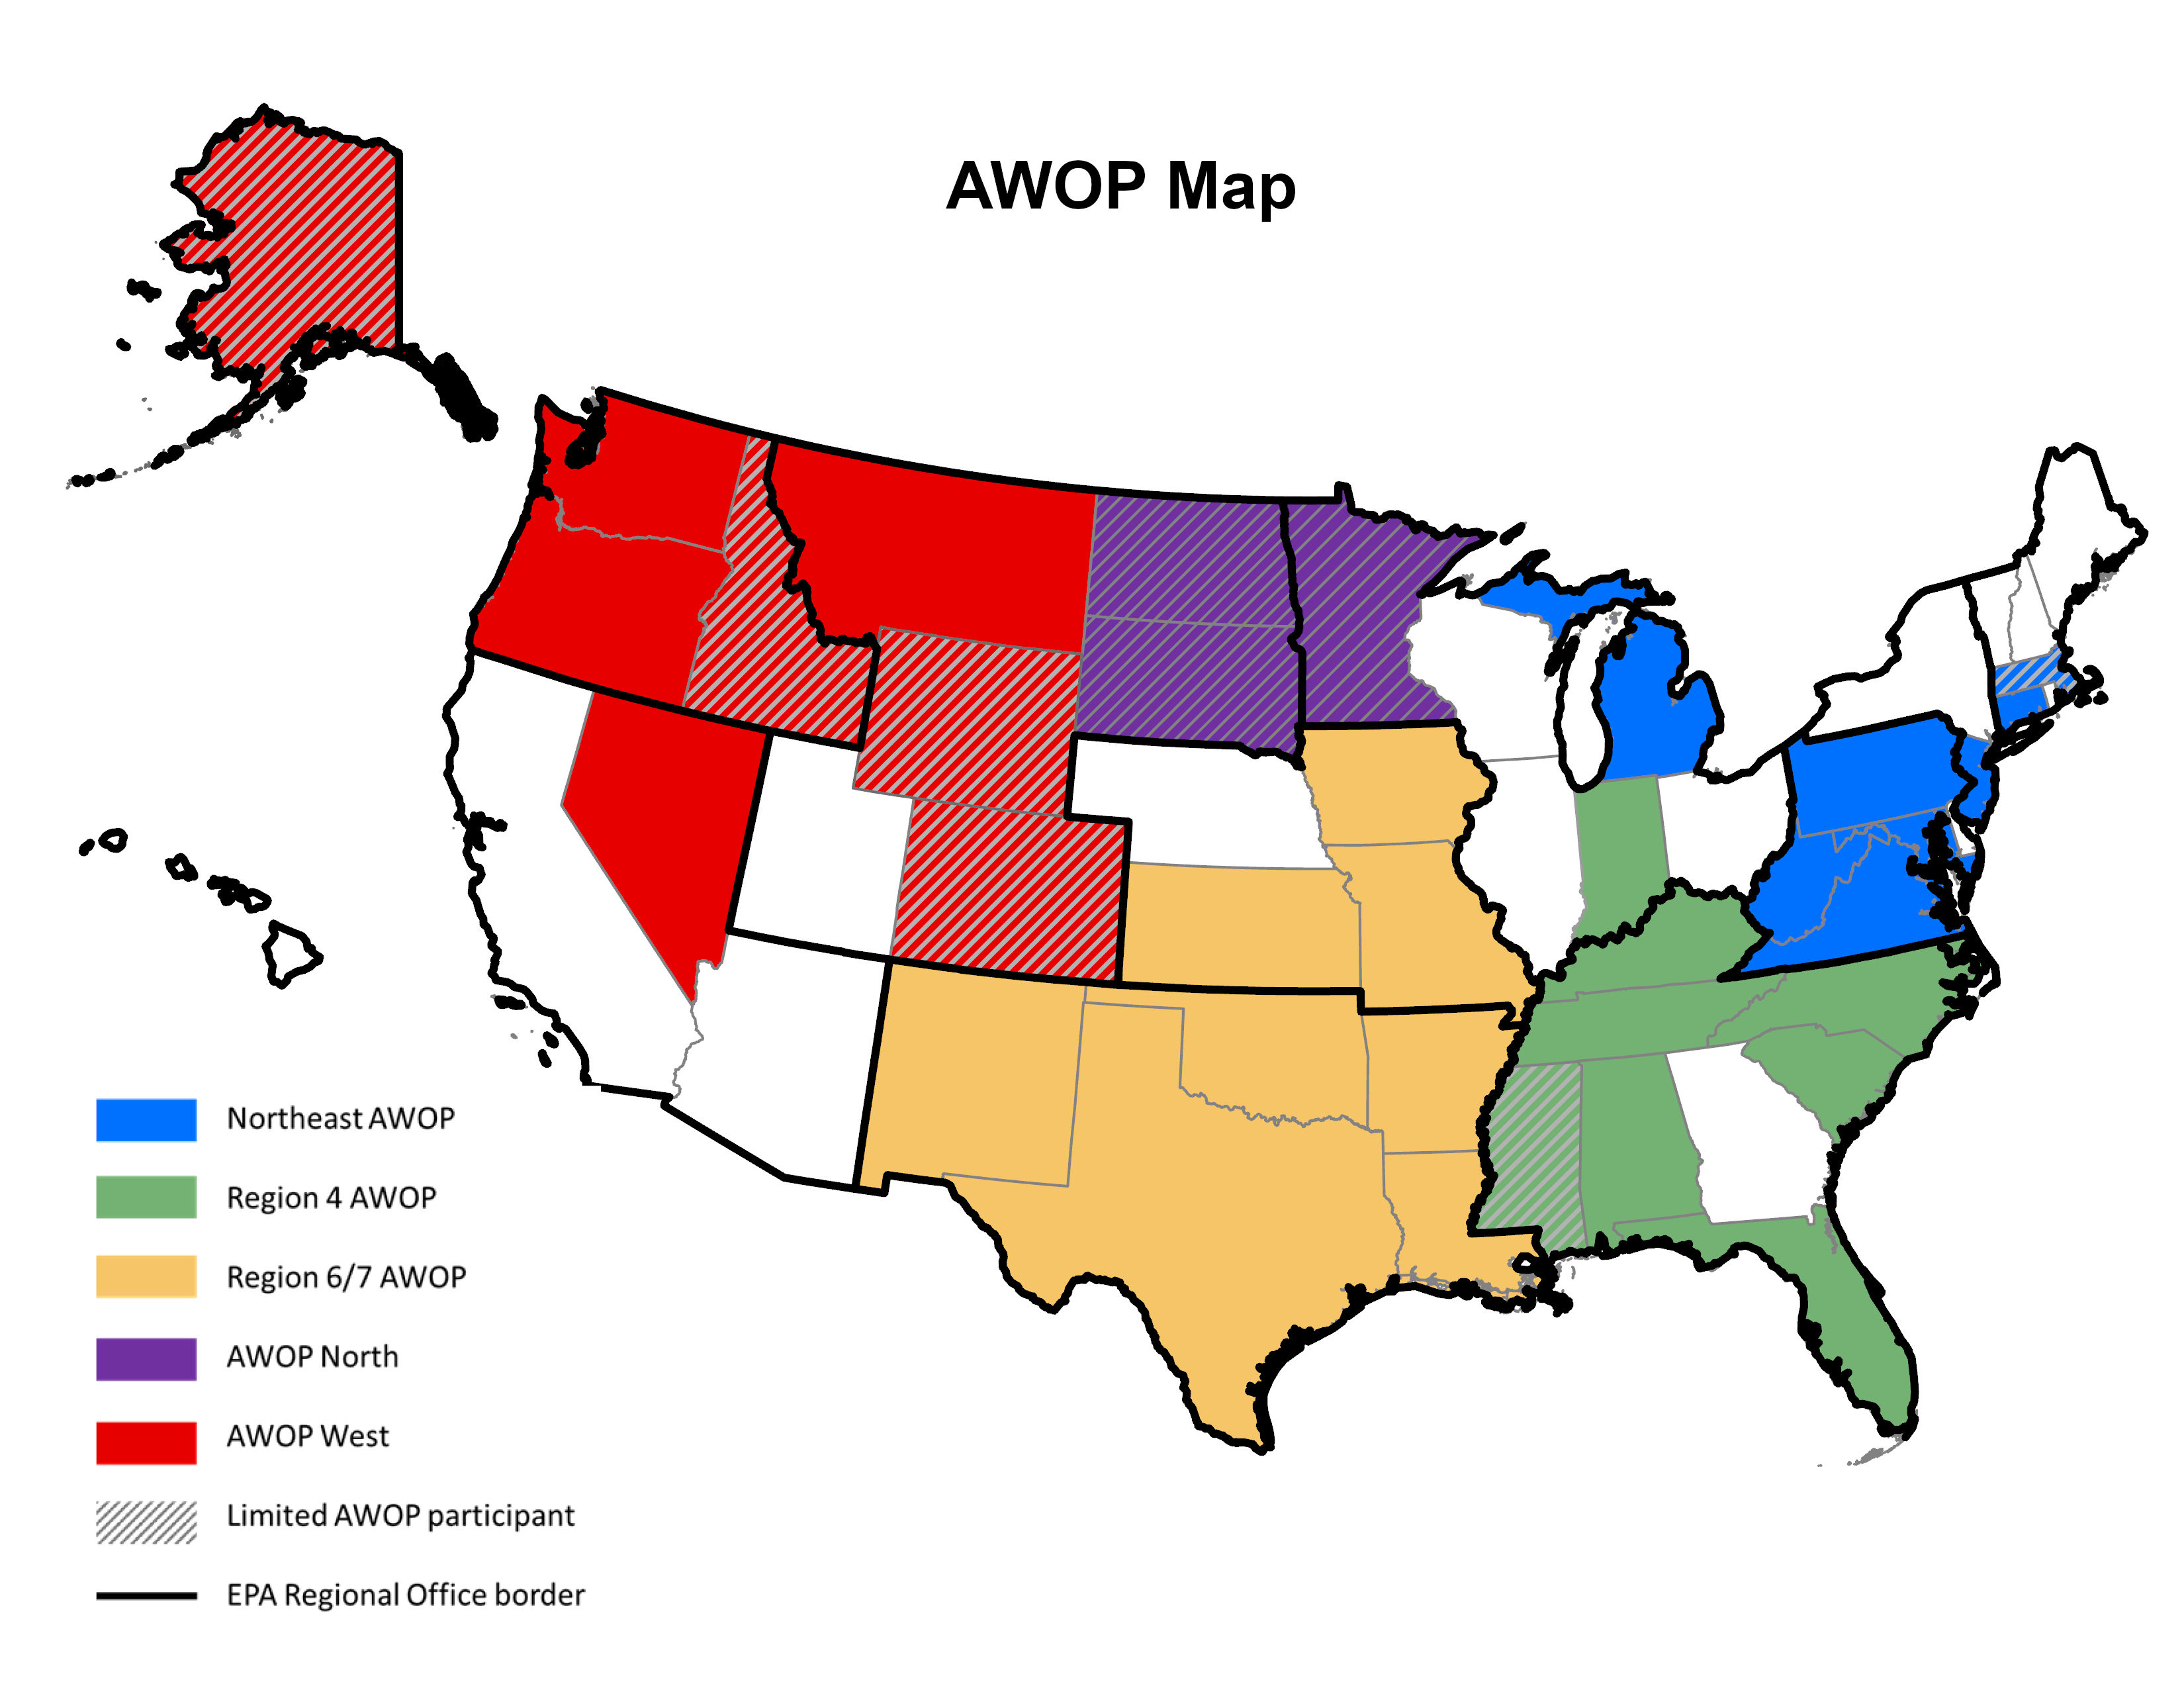
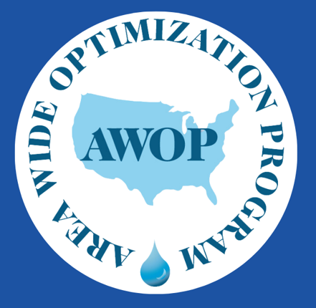
AWOP
Regions
We are in Region 6/7

Slide 5
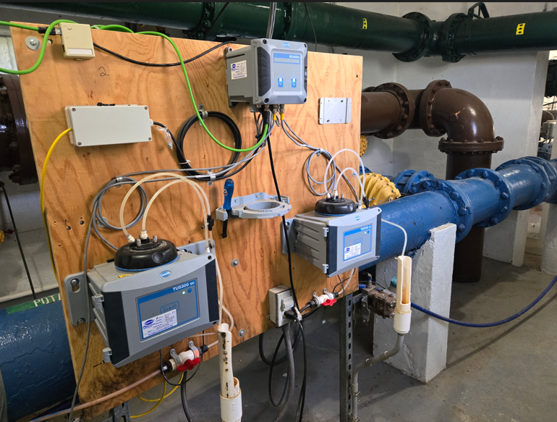
Turbidity workshop
Group 1
Reviewed sampling locations for raw, settled, IFE and CFE turbidity
Calculated detention times
Group 2
Maintenance frequency & SCADA
Group 3
Interpreting & Reporting Turbidity Data
Group 4
Benchtop vs. Continuous Turbidimeter Monitoring

Slide 6
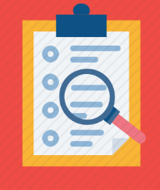
Findings
Two locations had longer than 1 minute detention times
Raw samples were more accurate from settled troughs instead of top of clarifier
WTP did not have access turbidimeter settings
Data capping was at 1 NTU
Backwash events were not omitted in SCADA system – causing spikes
Lab practices caused increased Turbidity sample results

Slide 7
Voluntary Comprehensive performance evaluation (CPE)
Evaluates based on ability to meet optimization goals
  Administration
  Operations
  Maintenance
  Design
3-4 day evaluation at WTP
Exit meeting for WTP and Administrative Staff
Written report of findings
Ranked list of performance limiting factors

Slide 8
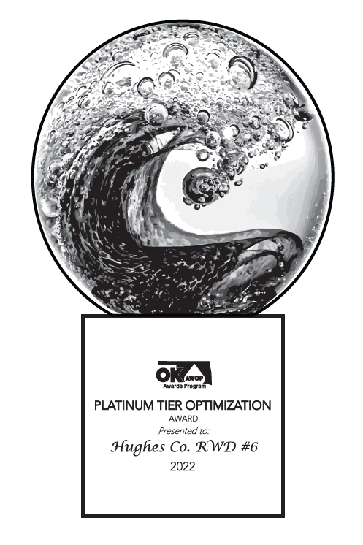
AWOP AWARDS
Must be a public water system to participate
Points determined annually by:
  Capacity Development assessment
  MCL and Monitoring Violations
  IFE, CFE, and Settled Turbidity
  Contact Time
  PoE and Distribution Chlorine Residual
  (As applicable for the type of water system)
Bonus points for Water Loss Audit, Workshops, CPEs, and more...
If interested, email awopawards@deq.ok.gov

Slide 9
Questions?
AWOP Coordinator
Tara Bussing
(405) 702-8189
tara.bussing@deq.ok.gov

