Slide 1

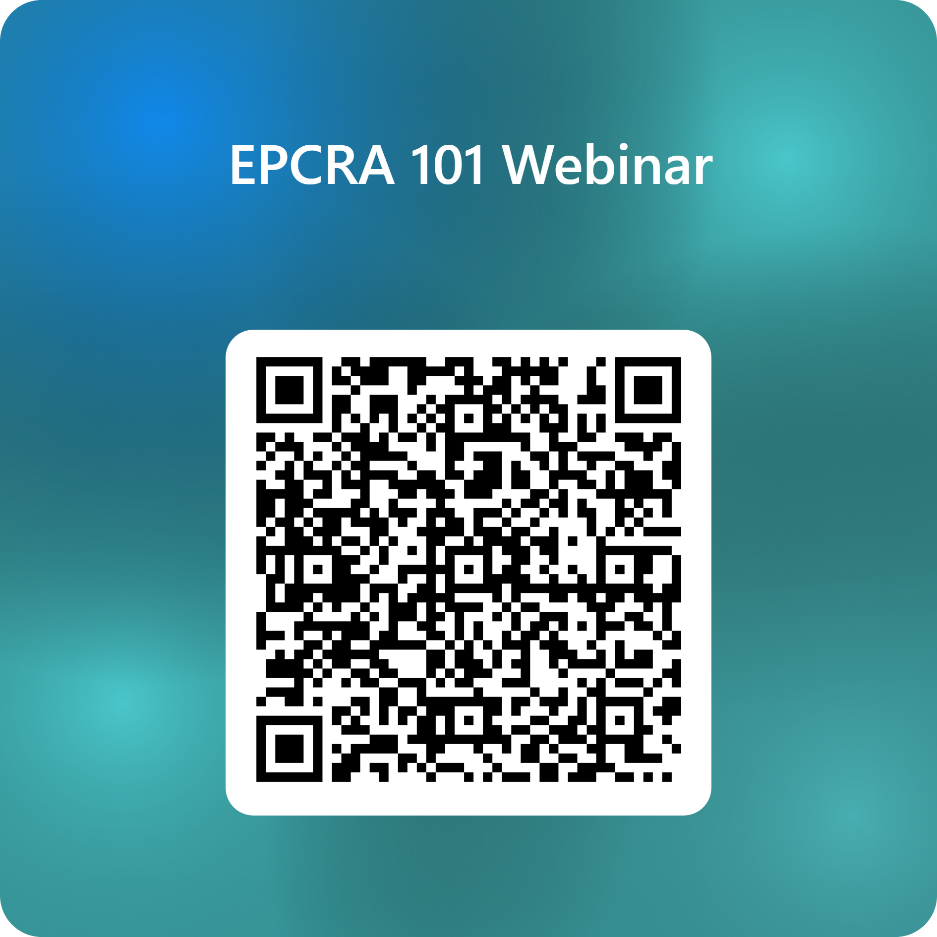
WELCOME!
Good Afternoon!
Make sure your Camera is off
Mic is Muted
This will be recorded and posted online
Please go to this link or scan the QR Code
  This is a webinar sign-in
  https://forms.cloud.microsoft/g/xmkGTLbtT5

Slide 2


EPCRA 101: From Chemical Storage to Community Preparedness
Matt Wormus
9/29/2026

Slide 3
Agenda for Today
01
History of Pre-EPCRA Emergency Planning
04
Exemptions
02
The Formation of EPCRA and LEPCs
05
Resources and Upcoming Webinars
03
EPCRA Reporting Sections (302 to 313, 324)
06
Takeaways and Questions

Slide 4
History
01
Chemical disasters that set the stage for EPCRA

Slide 5
Origins of EPCRA: Setting the Stage
1970
December
1971
April
1979
April
1984
December
U.S. Environmental Protection Agency (EPA) created
Occupational Safety and Health Administration (OSHA) begins operating
Federal Emergency Management Agency (FEMA) created
Union Carbide disaster in Bhopal, India

Slide 6
Chemical Incidents in the USA before 1980
1947 Texas City, Texas
The ship Grandcamp, loaded with ammonium nitrate, exploded in port. At least 581 people died, including all but one member of the city's volunteer fire department.
1971 Thiokol-Woodbine, Georgia
Fire and explosion at a flare plant killed 29 workers and injured 50. It occurred about five weeks after the OSH Act was signed on December 29, 1970.
1940s to 1970s Love Canal, New York
Chemical waste buried beneath a neighborhood contaminated homes and a school. The crisis helped lead to CERCLA (Superfund) in 1980.
1976 Argo Merchant, off Nantucket
The tanker ran aground on Nantucket Shoals and lost its entire cargo of 7.7 million gallons of No. 6 fuel oil.

Slide 7
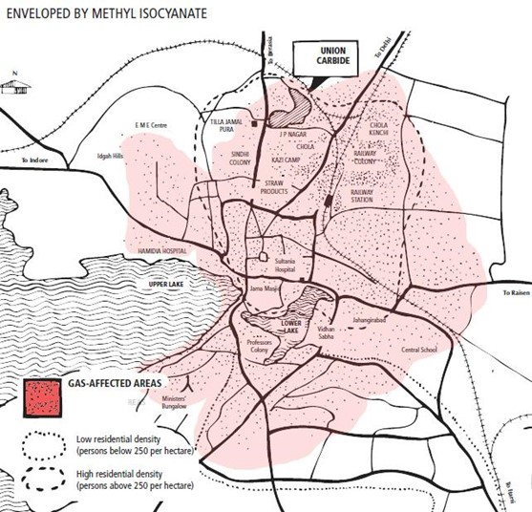
Union Carbide Disaster – Bhopal, India
December 2 to 3, 1984: methyl isocyanate (MIC) gas leaked from the Union Carbide India pesticide plant
About 558,000 injuries (2006 government affidavit). Official death count 3,787; other estimates exceed 16,000
The disaster drew the attention of U.S. lawmakers

Slide 8
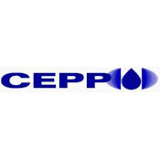
Origins of EPCRA – 1985
June 1985: EPA launched the Chemical Emergency Preparedness Program (CEPP), a voluntary program
Institute, WV: August 11, 1985
  Union Carbide
  Methylene Chloride
  Aldicarb Oxime
  6 workers injured; more than 100 residents sent to the hospital; no deaths
Notes:
CEPP goals: (1) increase community awareness of chemical hazards, and (2) develop state and local response plans for chemical accidents.
This program led to EPA's Chemical Emergency Preparedness and Prevention Office (CEPPO), which was later consolidated into the Office of Emergency Management (OEM).

Slide 9
EPCRA: Emergency Planning and Community Right-to-Know Act
Congress amended Comprehensive Environmental Response, Compensation, and Liability Act (CERCLA) in 1986 with the enactment of the Superfund Amendments and Reauthorization Act (SARA).
SARA Title III, also known as the Emergency Planning and Community Right-to-Know Act (EPCRA)
Signed October 17, 1986
Each LEPC's community emergency response plan must, at a minimum:
1) Identify the sources of potential emergencies;
2) Develop procedures for responding to emergencies; and
3) Designate who will coordinate the emergency response.
Notes:
Section 303(c) (42 U.S.C. 11003(c)) lists nine minimum plan elements, including facility and route identification, response procedures, coordinators, notification procedures, evacuation plans, training, and exercise schedules. Slide 18 covers Section 303 in more detail.

Slide 10
How Big Is EPCRA?
EPCRA is Title III of SARA
About 30 of SARA's 170 pages (100 Stat. 1729 to 1758).
SARA: Pub. L. 99-499, 100 Stat. 1613 to 1782
CERCLA: Pub. L. 96-510, 94 Stat. 2767 to 2811
Clean Air Amendments: Pub. L. 91-604, 84 Stat. 1676 to 1713
Page counts compare printed length only, not complexity or importance.
Notes:
Corrected from the earlier infographic, which listed SARA at about 1,144 pages. GovInfo lists Pub. L. 99-499 at 100 Stat. 1613-1782 (170 pages). CERCLA per GovInfo: 94 Stat. 2767-2811. Confirm the Clean Air Amendments end page (1713) before presenting.

Slide 11
EPCRA Formation and LEPCs
02
How Congress built the SERC and LEPC planning network

Slide 12
EPCRA’s First Steps
EPCRA 301: Establishes the SERCs, Planning Districts, and LEPCs
The Governor appoints the SERC, preferably members with emergency response expertise, or may designate existing state-sponsored organizations.
The SERC:
1. Establishes Emergency Planning Districts,
2. Appoints and Oversees LEPCs assigned to Emergency Planning Districts,
  a. Including reviewing local emergency response plans and LEPC membership.
3. Establishes public information request procedures for information under 312 and 324
  a. Including designation of an official to serve as coordinator for information.
4. May Revise Emergency Planning Districts and LEPCs, as deemed appropriate.
Notes:
If the Governor does not designate a SERC, the Governor serves as the SERC until a designation is made (42 U.S.C. 11001(a)).

Slide 13
EPCRA 301 in Oklahoma
SERC = OHMERC Oklahoma Hazardous Materials Emergency Response Commission
77
county-based emergency planning districts
Each district has its own Local Emergency Planning Committee (LEPC).
Secretary of Safety and Security
Commissioner of Public Safety
State Fire Marshal
DEQ Executive Director
Director, Oklahoma Emergency Management
Response community member
Regulated industry member
Seven members by statute. Agency heads may send a designee; the two orange-outlined seats serve 3-year terms [27A O.S. § 4-2-102(B)].
DEQ administers the reporting side (notification, SDS lists, Tier II, LEPCs). OEM administers the planning side and reviews LEPC plans [27A O.S. § 4-2-102(E)].
Notes:
Membership per 27A O.S. 4-2-102(B): Secretary of Safety and Security, Commissioner of Public Safety (Highway Patrol sits within DPS), State Fire Marshal, DEQ Executive Director, Director of the Department of Civil Emergency Management (now Oklahoma Emergency Management), one response-community member, and one regulated-industry member. LEPCs are not a statutory seat. Confirm the current LEPC count (77) before presenting.

Slide 14
LEPCs
Federal EPCRA requires LEPCs to appoint chairpersons and establish rules by which the committee shall function. Bylaws must include:
  Provisions for public notification of committee activities
  Public meetings to discuss the emergency plan, public comments, response to such comments by the committee, and distribution of the emergency plan.
August 17, 1987: latest statutory date for SERCs to appoint LEPC members (10 months after enactment, or 30 days after districts were designated, if sooner)

Slide 15
Make Up Of LEPCs
Government/Elected Officials
Responders/Planners
  Police, Fire, EMS, Emergency Management, Public Health
Regulated Industry
  Compliance Officers, ERTs, Chemical Facility Representatives
Community Groups
  Advocacy Groups, Print/Radio, Community Assets
  The Public
Health & Environment
  Hospitals, Public Works, DoT, OSHA, DEQ

Slide 16
LEPC Adaptations Over Time
LEPC Funding
  Unfunded Mandate
  State assistance with funding
    Tier II Fees
LEPC Focus
  Hazmat Focus to All-Hazards Planning
  More EOP/EAPs (Schools, Tribes, Camps, etc.)
  Community Outreach/Involvement

Slide 17
EPCRA 302: Substances, Facilities, and Thresholds
Section | What triggers it | Threshold
302 Emergency planning | An Extremely Hazardous Substance (EHS) on site | Above the EHS's Threshold Planning Quantity (TPQ); notify SERC and LEPC within 60 days
304 Release notification | Release of an EHS or a CERCLA hazardous substance | Release above the substance's Reportable Quantity (RQ)
311/312 SDS and Tier II | OSHA hazardous chemical present at any one time | EHS: 500 lb. or the TPQ, whichever is lower. Other chemicals: 10,000 lb.
313 TRI (Form R) | Listed toxic chemical manufactured, processed, or otherwise used | 25,000 lb. manufactured or processed; 10,000 lb. otherwise used; lower for PBTs
EPA List of Lists
Notes:
Retail gas stations have separate 311/312 thresholds (75,000 gal gasoline / 100,000 gal diesel), 40 CFR 370.10.

Slide 18
EPCRA 303 – Comprehensive Emergency Response Plans
LEPCs must develop comprehensive emergency response plans and review them at least once a year
Facilities must name a facility emergency coordinator and provide the information LEPCs need for planning
SERCs review LEPC plans (in Oklahoma, OEM reviews plans on behalf of OHMERC)
Each LEPC shall evaluate the need for resources necessary to develop, implement, and exercise the emergency plan, and shall make recommendations with respect to additional resources that may be required and the means for providing such additional resources.

Slide 19
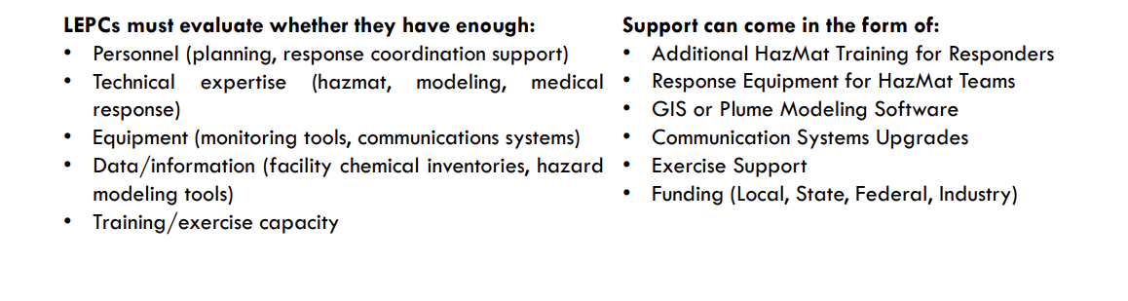
What The LEPC Should Evaluate?

Slide 20
Reporting sections
03
Sections 304 through 313, and public access under 324

Slide 21
EPCRA 304 – Spill Reporting/Notification
Facilities must immediately report accidental releases of EHSs defined under EPCRA Section 302 and HSs defined under CERCLA.
Any release of these substances in quantities greater than their corresponding RQs must be reported to the SERC and the LEPC.
These facilities must also provide a detailed follow-up written report as soon as practicable after the release. SERCs and LEPCs are required to make these reports available to the public.
For CERCLA releases, the National Response Center must also be notified by facilities.

Slide 22
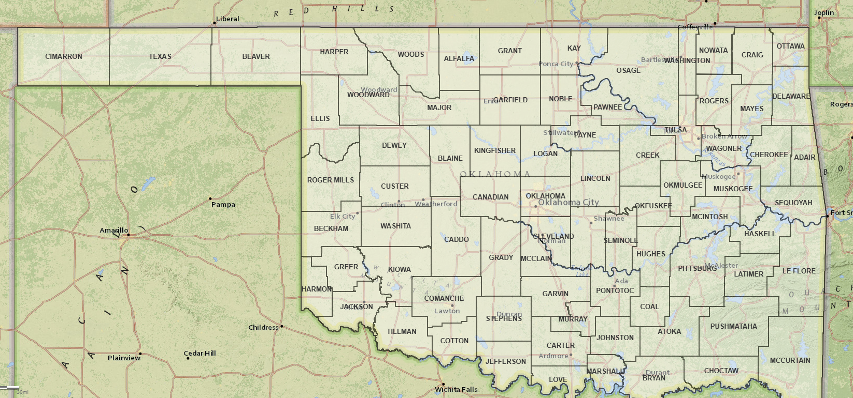
Spill Reporting Numbers
Oklahoma DEQ 24-Hour Hotline
1-800-522-0206
Spills, releases, and environmental emergencies
National Response Center (NRC)
1-800-424-8802
CERCLA hazardous substance releases above the RQ
Call both when a release meets federal thresholds. The DEQ hotline can help callers sort out which other notifications apply.

Slide 23
EPCRA 311/312: Community Right-to-Know
311
Section 311
SDS or chemical list
312
Section 312
Tier II inventory
• Safety Data Sheets (SDSs) or a list of hazardous chemicals
• Sent to the SERC, LEPC, and local fire department
• One-time submission, due within 3 months of becoming subject
• Updated within 3 months of significant new information
• Annual inventory of hazardous chemicals on site
• Due March 1, covering the prior calendar year
• In Oklahoma, filed electronically with DEQ only
• DEQ filing satisfies the LEPC and fire department submission [OAC 252:20-1-6]
Tier II is the Section 312 form. Section 311 is a separate SDS/list requirement.

Slide 24
Tier II Reporting
~45,000
Tier II facility reports filed for reporting year 2025
77
counties with Tier II facilities
Jan 1 to Mar 1
annual filing window
• DEQ keeps the statewide database of Oklahoma facilities that store hazardous chemicals above reporting thresholds.
• Filers range from oil and gas tank batteries to chemical plants to water treatment plants.
• Reports are submitted between January 1 and March 1 each year.
Notes:
RY2025 DEQ data contained 43,904 facility records (about 43,900 after removing one Texas facility and 19 duplicate submissions). Update the figure if RY2026 counts are available.

Slide 25
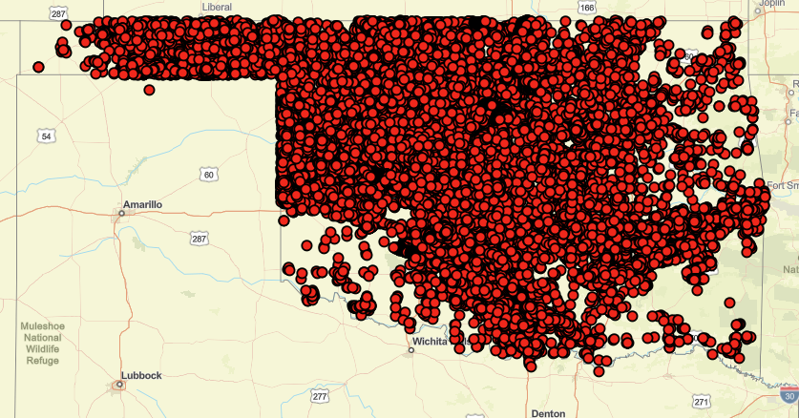
2026 Tier II Map

Slide 26
Tier II Data Workflow
1
2
3
4
Facility
Files Tier II electronically by March 1
DEQ
State repository; reviews and shares data
County LEPC
Uses data for emergency planning
Fire department and responders
Pre-plan incident response
Public access: Anyone may request a copy of a Tier II report by submitting a written request to DEQ for a specific facility. ***More on this later.***
Notes:
DEQ's Tier II page states that DEQ distributes reports to LEPCs and fire departments statewide.

Slide 27
Section 313: Toxics Release Inventory (TRI)
Inventory of routine toxic chemical emissions from certain facilities. This inventory is intended to inform the public about releases of toxic chemicals.
The data gathered is also intended to assist in research and development of regulations, guidelines, and standards.
The original data requirements for the TRI, specified in SARA Title III, have been greatly expanded by the Pollution Prevention Act of 1990.
The TRI must now also include information on source reduction, recycling and treatment.

Slide 28
Who Files a TRI Form R?
10+
full-time employees
Covered industry
SIC/NAICS code listed in 40 CFR 372.23
Over a threshold
for a listed toxic chemical
+
+
25,000 lb.
manufactured (including imported) per year
25,000 lb.
processed per year
10,000 lb.
otherwise used per year
Persistent, bioaccumulative, and toxic (PBT) chemicals have lower thresholds (40 CFR 372.28), from 0.1 gram for dioxin compounds to 100 lb. for lead.
Form R is due July 1 each year to EPA, covering the prior calendar year.
Notes:
Criteria from 40 CFR 372.22 (10 or more full-time employees; covered SIC/NAICS code; threshold exceeded). Statutory thresholds and July 1 due date: 42 U.S.C. 11023. Industry codes are now listed by NAICS as well as SIC.

Slide 29
EPCRA Section 324 – Public Availability
Documents must be made available to the public during normal working hours at a location designated by the SERC or the LEPC, subject to trade secret protections and a facility's right to withhold specific chemical locations:
  Emergency Response Plans and SDSs or chemical lists
  Tier II Hazardous Chemical Inventory Forms
  Toxic Chemical Release Forms (TRI/Form R)
  Written Follow-up Emergency Notices From Releases
Each LEPC must publish a notice once a year in local newspapers informing the community that emergency response plans, SDSs, and Tier II inventory forms have been submitted and are available for public review.
Notes:
Public Tier II requests must be in writing and name a specific facility. A statement of general need is required only for chemicals stored under 10,000 lb. that the SERC or LEPC does not already hold. The SERC or LEPC must respond within 45 days (42 U.S.C. 11022(e)(3)). In Oklahoma, DEQ also responds under the Open Records Act (27A O.S. 4-2-102(E)(1)(g)).

Slide 30
Exemptions
04
What is not reported, and why

Slide 31
EPCRA Exemptions
Consumer Products: Substances used for personal, family, or household purposes, or present in the same form and concentration as a product packaged for the public.
Foods, Drugs, and Cosmetics: Any food, food additive, color additive, drug, or cosmetic regulated by the FDA.
Research Laboratories and Medical Facilities: Substances used in a research lab, hospital, or other medical facility under the direct supervision of a technically qualified individual.
Agricultural and Fertilizer: Substances used in routine agricultural operations, and fertilizer held for sale by a retailer to the ultimate customer.
Transportation: Materials in transportation, including storage incident to transportation (Section 327). Release reporting under Section 304 still applies.
Solids in Manufactured Items: Substances present as a solid in a manufactured item, to the extent exposure does not occur under normal conditions of use.
Notes:
Exemptions 1 to 5 are the Section 311(e) exclusions from the definition of hazardous chemical (42 U.S.C. 11021(e)); they apply to Sections 311 and 312 only, not to Section 302 planning or Section 304 release reporting. The transportation exemption is Section 327 (42 U.S.C. 11047). Corrections: the FDA exemption covers FDA-regulated products, while employee personal use falls under the consumer exemption; the fertilizer exemption is not limited to solid fertilizer.

Slide 32
Hazmat Not Reported on Tier II
RCRA hazardous waste (no SDS required under OSHA)
Radioactive materials regulated by the Nuclear Regulatory Commission (ionizing radiation is outside OSHA HazCom)
Materials in transit: pipelines, highways, rail (DOT, PHMSA)
Lithium-ion batteries managed as RCRA hazardous or universal waste
Grow operations: routine agricultural use exemption (confirm scope for OMMA-licensed sites)
Chemical storage below reporting thresholds
State and local government facilities (Oklahoma has no OSHA-approved state plan)

Slide 33
Resources/Q&As
05
Tools, data, and training for EPCRA work

Slide 34
EPCRA Tools and Resources
EPA/DEQ Website
  EPA – TRI Data Downloads/Data Analysis
  FOIA Request for Data
  Training Dates/Program Updates
Geospatial Data/Maps
  Tier II Finders (Locational Only)
  TRI Finder
  LEPC Contact Aids

Slide 35
CAMEO Software Suite
Free Emergency Management Software used by Oklahoma DEQ Staff
  As well as Emergency Managers and Tier II Facilities
The MARPLOT mapping component allows overlaying Tier II sites with schools, hospitals, and other local points of interest
Training and Help Available

Slide 36
NASTTPO
National Association of SARA Title III Program Officials
  “Made up of members and staff of State Emergency Response Commissions (SERCs), Tribal Emergency Response Commissions (TERCs), Local Emergency Planning Committees (LEPCs), various federal agencies and private industry. Members include state, tribal or local government employees with Emergency Planning and Community Right to Know (EPCRA) program responsibilities, such as health, occupational safety, first response, environmental, and emergency management agencies.”
  2026 Mid-Year Workshop: October 26 to 28, 2026, Embassy Suites Northwest Arkansas, Rogers, Arkansas

Slide 37
Future Webinar Plan (Subject to Change)
1
2
3
4
Dec 2026
LEPC 101 and Best Practices
Spring 2027
Tier II Reporting 101
Summer 2027
Toxics Release Inventory (TRI) and Spill Reporting
2026 to 2027
CAMEO Data Manager: Live Demos and Exercises

Slide 38
Takeaways
06
Six points to take home

Slide 39
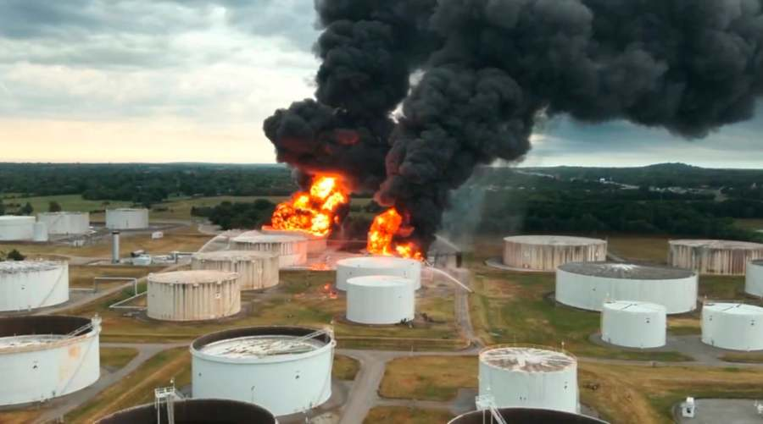
Takeaway 1 of 6
EPCRA is about community preparedness and the public’s right to know about hazardous chemicals in their communities.

Slide 40
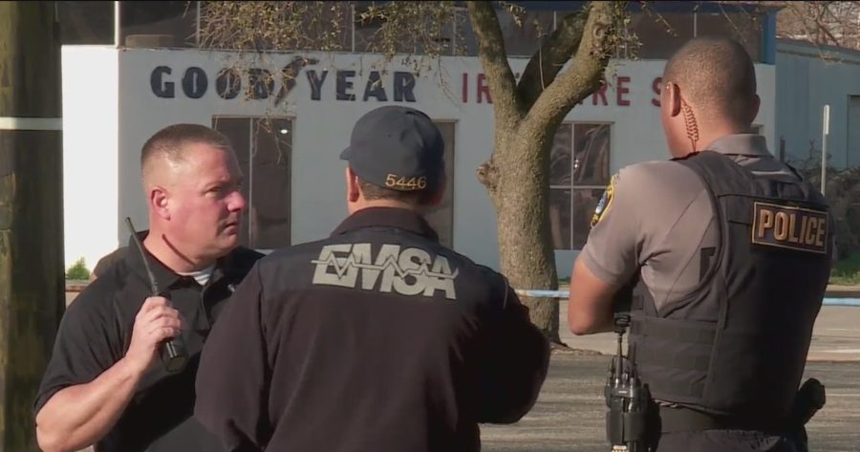
Takeaway 2 of 6
LEPCs are the local foundation of EPCRA and bring responders, government, industry, public health, and the community together.

Slide 41
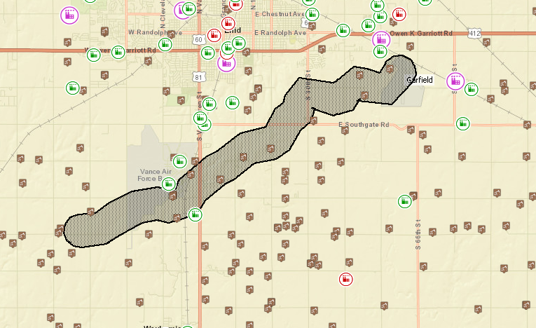
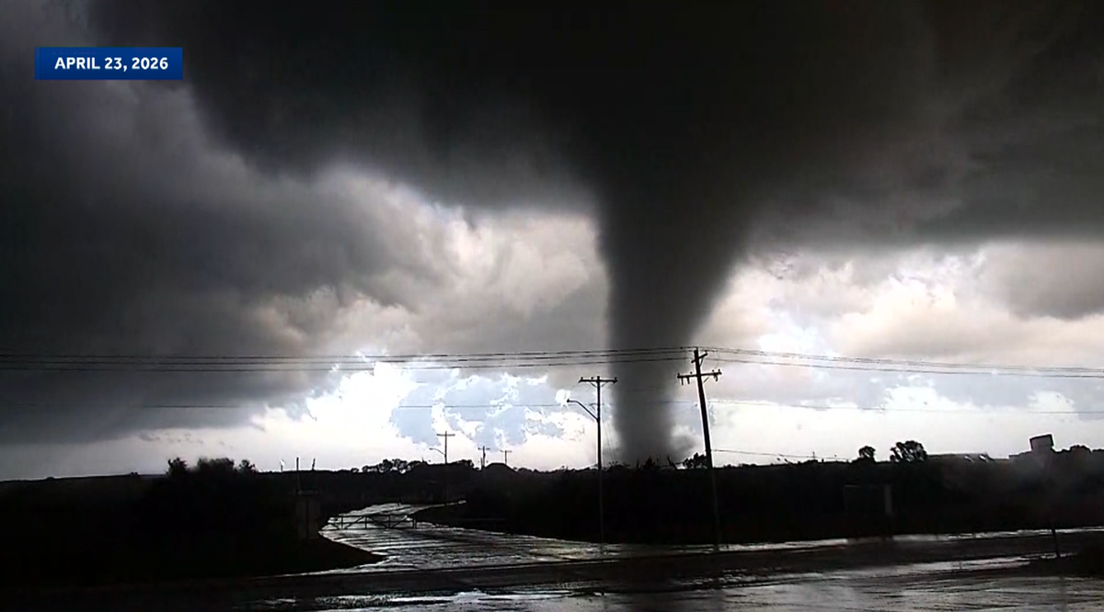
Takeaway 3 of 6
Tier II information connects chemical facilities to emergency responders by identifying where hazardous chemicals are stored and what is present.

Slide 42
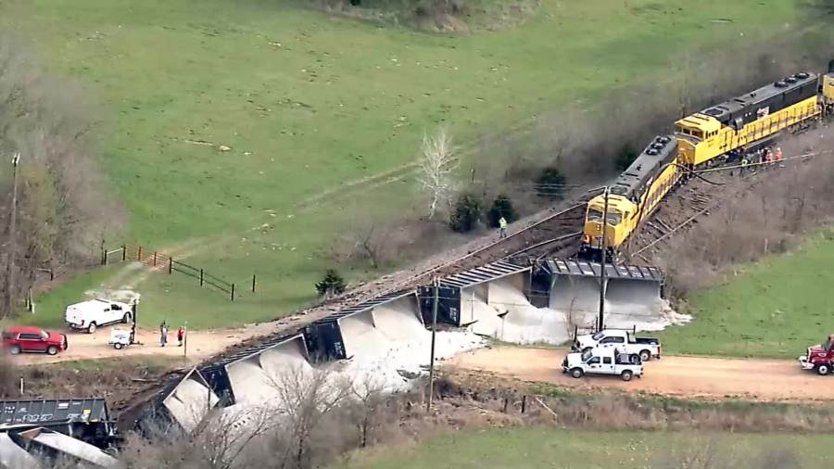
Takeaway 4 of 6
EPCRA reporting is a tool for preparedness—not just compliance. The information submitted by facilities supports local emergency planning and response.

Slide 43
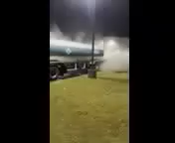
Takeaway 5 of 6
EPCRA information is intended to be accessible to the public, including emergency plans, Tier II inventories, TRI reports, and release notifications.

Slide 44
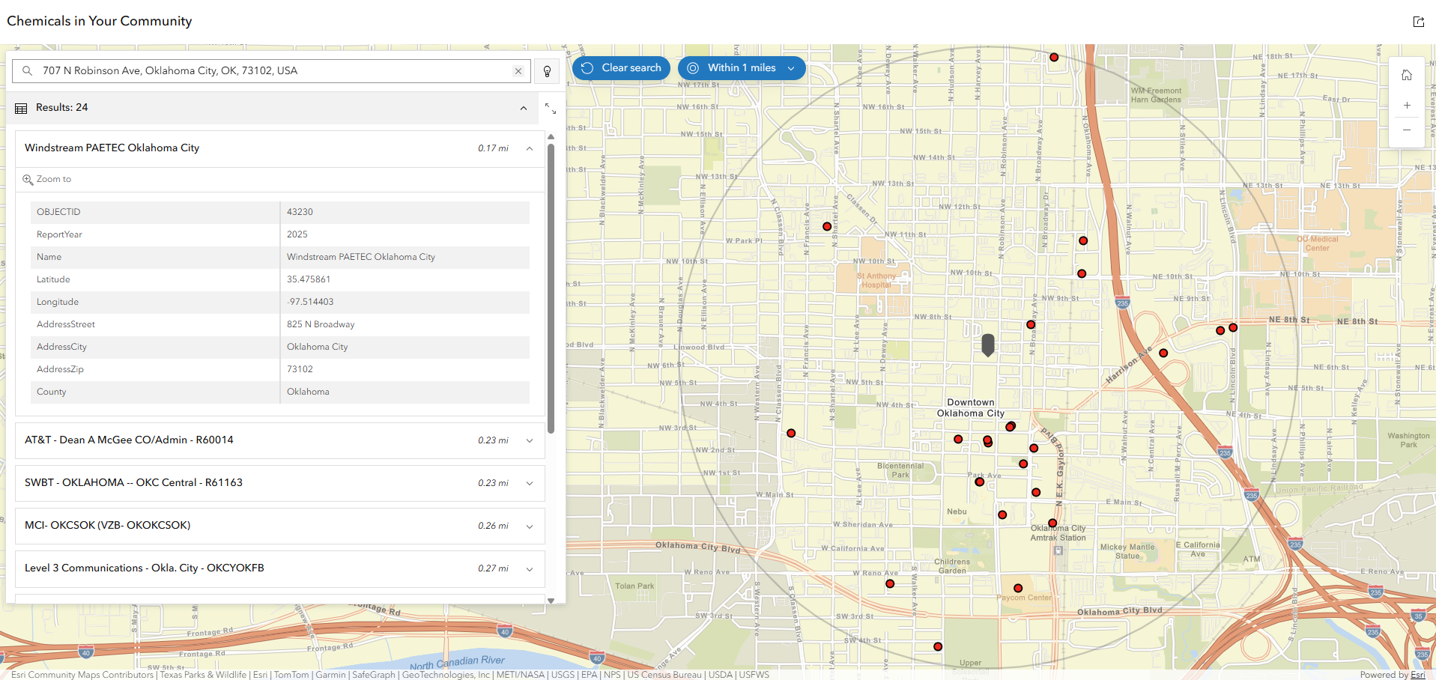
Takeaway 6 of 6
Use the available tools and data. DEQ/EPA resources, Tier II data, GIS, TRI, and CAMEO can help turn EPCRA information into practical emergency-planning resources.

Slide 45
Questions?
Matt Wormus
Oklahoma Hazardous Materials Emergency Response Commission
Land Protection Division
Chemical Reporting & Preparedness Section
Matthew.Wormus@deq.ok.gov
Office # - 405-702-5137
Work Cell # - 405-985-8815

