Slide 1
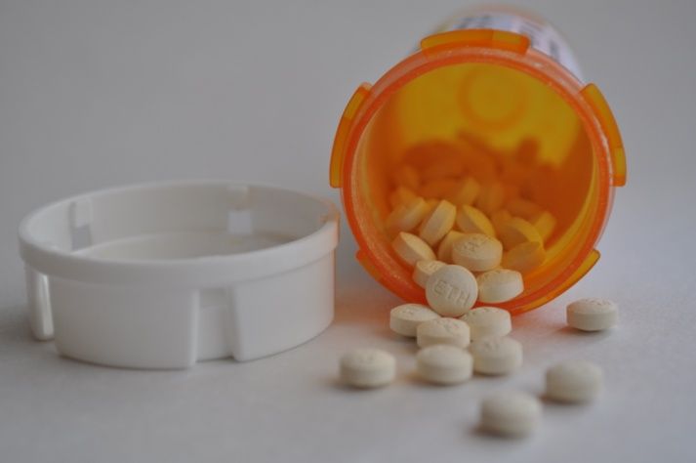
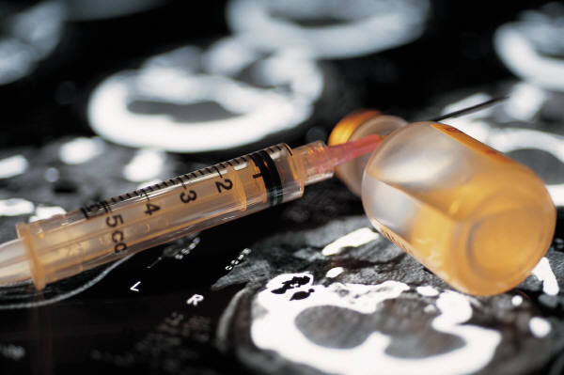
Hazardous Waste Pharmaceuticals
Proposed Rule
October 20, 2015
SBEAP Technical Subcommittee

Slide 2
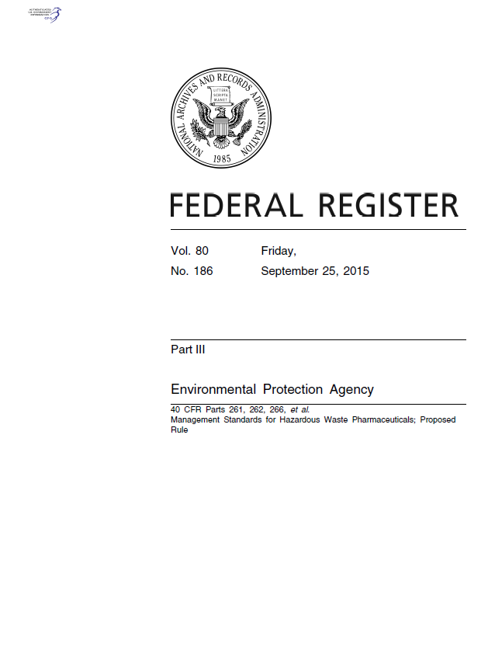
Outline of Today’s Briefing
Part I: Background
  Which Pharmaceuticals are Hazardous Waste?
  Flow of Pharmaceuticals & Problem Areas
Part II: Overview of Major Provisions of Proposal
  Defining Some Key Terms
  Standards for Healthcare Facilities
  Standards for Reverse Distributors
  State Adoption
Part III: What’s Ahead?

Slide 3
Part I: Which Pharmaceuticals are HW?
There is no (free) definitive list of all pharmaceuticals that are HW
A few sources to use:
  http://hwpharms.wikispaces.com/
  http://www.hercenter.org/hazmat/pharma.cfm
  http://www.hercenter.org/hazmat/tenstepblueprint.pdf
  https://www.colorado.gov/pacific/sites/default/files/HM_mw-examples-of-hw-pharmaceuticals.pdf
  http://www.dep.state.fl.us/waste/quick_topics/publications/shw/hazardous/WastePharmListLetter12_07.pdf

Slide 4
Examples of Listed HW Pharmaceuticals
P-Listed hazardous ACUTE wastes
  Warfarin (P001)
  Arsenic Trioxide (P012)
  Nicotine (P075)
  Physostigmine salicylate (P188)
  Physostigmine (P204)
U-listed hazardous wastes
  Mitomycin C (U010)
  Chloral hydrate (U034)
  Cyclophosphamide (U058)
  Lindane (U129)
  Selenium sulfide (U205)

Slide 5
Examples of Characteristic Pharmaceuticals
Ignitable (D001):
  Preparations with >24% alcohol
Toxicity (D004-D043): if present above certain concentrations in the leachate during TCLP test
  Chromium (multi-vitamins)
  m-Cresol (preservative in insulin)
  Mercury (preservative thimerosal)
  Selenium (multi-vitamins)
  Silver (burn creams)

Slide 6
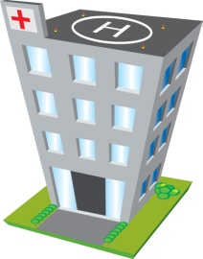
Part I: Flow of HW Pharmaceuticals
Potentially Creditable Pharmacy Drugs
1st Reverse
Distributor
Healthcare
Facility/
Pharmacy
HW TSDF
2nd Reverse
Distributor

Slide 7
Flow of HW Pharmaceuticals
Potentially Creditable Pharmacy Drugs
Non-creditable Floor Waste & Pharmacy Drugs
1st Reverse
Distributor
Healthcare
Facility/
Pharmacy
HW TSDF
2nd Reverse
Distributor

Slide 8
Flow of HW Pharmaceuticals
Potentially Creditable Pharmacy Drugs
Non-creditable Floor Waste & Pharmacy Drugs
1st Reverse
Distributor
Healthcare
Facility/
Pharmacy
HW TSDF
Non-Compliant
Disposal
Sewer
2nd Reverse
Distributor

Slide 9
3 Problem Areas to Address in Rule
Potentially Creditable Pharmacy Drugs
Non-creditable Floor Waste & Pharmacy Drugs
1st RD
Healthcare Facility/
Pharmacy
HW TSDF
Non-Compliant
Disposal
Sewer
2nd RD

Slide 10
Why a Pharmaceuticals Rulemaking?
We have issued clarifying guidance where possible and within the confines of the current regulations
Remaining issues require regulatory fixes via rulemaking

Slide 11
6 Main Remaining Issues for Rulemaking
Regulatory status of creditable pharmaceuticals
LQG status due to P-listed hazardous waste
  Warfarin & nicotine
Manufacturing-oriented framework of the generator regulations
Intersection of EPA & DEA regulations
Containers with P-listed pharmaceutical residues
Pharmaceuticals being flushed/sewered

Slide 12
Part II: Overview of Proposed Rule
Proposed to add hazardous waste pharmaceuticals to the Universal Waste program (2008)
  Commenters felt UW was inadequate for pharmaceuticals
  Could not address negative comments on proposal without re-proposing
New approach has been to build on the 2008 Universal Waste (UW) proposal by:
  Keeping the aspects of the UW proposal that commenters liked
  Addressing commenters’ concerns about the UW proposal
  Addressing new areas that the UW proposal did not
  Coordinating with other federal agencies (e.g., DEA)
  Promoting national consistency

Slide 13
TRUE or FALSE?
The proposed rule will establish an extended producer responsibility (EPR) program

Slide 14
Which Pharmaceuticals Will be Covered?
Only those pharmaceuticals that are already considered hazardous waste will be covered by the new rule
This rule does NOT propose to expand the number of pharmaceuticals that are considered hazardous waste
    This rule proposes to change HOW the hazardous waste pharmaceuticals must be managed
We encourage healthcare facilities to manage all waste pharmaceuticals under the new rule

Slide 15
Who Will be Covered by the Rule?
Healthcare facilities - except CESQGs
The proposed definition of Healthcare facility is: any person that
  (1) provides preventative, diagnostic, therapeutic, rehabilitative, maintenance or palliative care, and counseling, service, assessment or procedure with respect to the physical or mental condition, or functional status, of a human or animal or that affects the structure or function of the human or animal body; or
  (2) sells or dispenses over-the-counter or prescription pharmaceuticals.

Slide 16
Who Will be Covered by the Rule?
All pharmaceutical reverse distributors - regardless of current generator category
The proposed definition of Pharmaceutical Reverse Distributor is
  Any person that receives and accumulates potentially creditable hazardous waste pharmaceuticals for the purpose of facilitating or verifying manufacturer’s credit
  Any person, including forward distributors and pharmaceutical manufacturers, that processes pharmaceuticals for the facilitation or verification of manufacturer’s credit is considered a pharmaceutical reverse distributor
Some drug manufacturers may operate as pharmaceutical reverse distributors

Slide 17
Problem Area #1
Potentially Creditable Pharmacy Drugs (20%)
Non-creditable Floor Waste & Pharmacy Drugs (80%)
1st RD
HCF
HW TSDF
Non-Compliant
Disposal
Sewer
2nd RD
≈20%

Slide 18
6 Main Remaining Issues for Rulemaking
Regulatory status of creditable pharmaceuticals
Manufacturing-oriented framework of the generator regulations
LQG status due to P-listed hazardous waste
  Warfarin & nicotine
Intersection of EPA & DEA regulations
Containers with P-listed pharmaceutical residues
Pharmaceuticals being flushed/sewered

Slide 19
#6: Sewering Pharmaceuticals
Problem
Flushing of pharmaceuticals has become a commonly used disposal method by healthcare facilities which
  Contributes to pharmaceuticals in surface and drinking water,
  Has the potential to present risks to human health and the environment
  Are not being treated for by POTWs, except incidentally
Flushing is allowed by current regulation
“There’s not some sort of magic process that can remove everything we put down the drain”
David Sedlak, Director of the Institute for Environmental Science and Engineering at UC Berkeley

Slide 20
#6: Sewering Pharmaceuticals
Proposed Solution
Rule bans the sewering of HW pharmaceuticals
  Sewer ban applies to all healthcare facilities & RDs, including CESQGs
    Otherwise CESQG healthcare facilities are not subject to the proposal
  Prevents 6400 TONS of hazardous waste pharmaceuticals from contaminating the water per year
  Sewer ban reinforces and highlights EPA’s policy against flushing pharmaceuticals
    DEA no longer allows sewering as a means of destroying controlled substances
    Several federal agencies, including EPA, have been coordinating to educate consumers to stop flushing pharmaceuticals
  EPA would join other jurisdictions with sewer bans for pharmaceuticals, including IL, NJ, DC and CT (proposed)

Slide 21
Problem Area #2
Potentially Creditable Pharmacy Drugs (20%)
Non-creditable Floor Waste & Pharmacy Drugs (80%)
1st RD
HCF
HW TSDF
Non-Compliant
Disposal
Sewer
2nd RD
≈40-50%

Slide 22
6 Main Remaining Issues for Rulemaking
Regulatory status of creditable pharmaceuticals
LQG status due to P-listed hazardous waste
  Warfarin & nicotine
Manufacturing-oriented framework of the generator regulations
Intersection of EPA & DEA regulations
Containers with P-listed pharmaceutical residues
Pharmaceuticals being flushed/sewered

Slide 23
#5: Containers with Residues
Problem
If residues are acute/P-listed HW, then to be considered “RCRA empty,” containers must be:
  Triple-rinsed, or
  Cleaned by another method shown in the scientific literature or by tests by generator, to achieve equivalent removal
Current RCRA empty container rules apply to residues in very small containers used in healthcare setting, including:
  Vials
  Dixie cups
  Soufflé cups
  Blister packs, etc.

Slide 24
#5: Containers with Residues
Proposed Solution
Residues in unit-dose containers and dispensing bottles/vials would be exempt from RCRA
  Unit-dose containers (e.g., packets, cups, wrappers, blister packs and unit-dose delivery devices) and
  Dispensing bottles and vials up to 1 liter or 1000 pills
Dispensed syringes would be exempt from RCRA provided:
  The syringe has been used to administer the pharmaceutical to a patient, and
  The syringe is placed in a sharps containers that is managed appropriately
All other containers, including delivery devices, that once held listed or characteristic pharmaceuticals, must be managed as hazardous waste, including IV bags, aerosols, nebulizers, etc.

Slide 25
#4: Intersection of DEA & EPA Rules
Problem
There are a few RCRA hazardous wastes that are also DEA controlled substances
  Chloral hydrate (U034)
  Fentanyl sublingual spray (D001)
  Phenobarbital (D001)
  Testosterone gels (D001)
  Valium injectable (D001)
These are dually regulated by EPA and DEA – must comply with both sets of regulations

Slide 26
#4: Intersection of DEA & EPA Rules
Proposed Solution
Two Conditional Exemptions:
Hazardous waste pharmaceuticals that are also DEA controlled substances would be exempt from RCRA regulation
Conditions for exemption:
  Must be managed in accordance with all DEA regulations
  Must be combusted at a permitted/interim status:
    municipal solid waste combustor or
    hazardous waste combustor

Slide 27
#4: Intersection of DEA & EPA Rules
Proposed Solution
Two Conditional Exemptions (continued):
Authorized collectors of DEA controlled substances that co-mingle them with pharmaceuticals that are exempt household hazardous waste (HHW) would be exempt from RCRA regulation
Conditions for exemption:
  Must be managed in accordance with all DEA regulations
  Must be combusted at a permitted/interim status:
    municipal solid waste combustor or
    hazardous waste combustor

Slide 28
#3: Manufacturing Framework
Problem
Healthcare facilities that generate hazardous waste are currently regulated the same as any industrial facility that generates hazardous waste
Healthcare facilities differ from industry
  Healthcare workers and pharmacists have little expertise with RCRA yet are critical in getting the hazardous wastes directed to proper waste management
  Thousands of drugs in their formularies, which vary over time
  Lots of healthcare workers involved in generation of waste in lots of locations throughout facility
Hazardous waste pharmaceuticals are unique among hazardous wastes:
  Street value
  Potential for diversion/theft

Slide 29
#3: Manufacturing Framework
Proposed Solution
Part 262 generator regulations are replaced by sector-specific management standards for the management of hazardous waste pharmaceuticals at healthcare facilities and pharmaceutical reverse distributors
The Part 262 generator regulations do not apply to hazardous waste pharmaceuticals, including:
  SQG and LQG generator categories
  Satellite accumulation area (SAA) regulations
  Central accumulation area (CAA) regulations

Slide 30
#3: Manufacturing Framework
Proposed Solution
Accumulation on-site at healthcare facility:
  One-time notification as HCF (as opposed to as a generator)
  Performance-based training for healthcare workers
Potentially Creditable HW pharmaceuticals
  No specific labeling or accumulation time limits proposed
Non-creditable HW pharmaceuticals
  Similar to simplified Universal Waste standards
  One year accumulation before a permit is required
  Closed containers secured to prevent access to contents
  Wastes that can’t be incinerated must be accumulated separately (e.g., P012)
  HW codes are not required on accumulation containers
  Label as “Hazardous Waste Pharmaceuticals”

Slide 31
#3: Manufacturing Framework
Proposed Solution
Shipments off-site from a healthcare facility:
Potentially Creditable HW pharmaceuticals can go to a Pharmaceutical Reverse Distributor:
  Written, advance notice of shipments to RD
  Confirmation of receipt of shipment by RD
  Recordkeeping of shipments to RD
  Common carrier allowed
  HW codes not required during shipment
Non-creditable HW pharmaceuticals must go to a TSDF
  HW transporter required
  Manifesting required
  HW codes not required on manifest
  “Hazardous waste pharmaceuticals” in Box 14 of manifest

Slide 32
#2: LQG Status Due to Acute HW
Problem
LQG status for healthcare facilities & pharmacies due to exceeding 1 kg acute HW/month, which results in:
  Shorter accumulation time
  Biennial Reporting
  More training requirements and documentation
  Higher costs for generators
  Higher costs for states who must inspect LQGs more frequently

Slide 33
#2: LQG Status Due to Acute HW
Proposed Solution
HW pharmaceuticals do not have to be counted toward the healthcare facility’s generator status when they are managed under Part 266 Subpart P
  No SQG or LQG status for HW pharmaceuticals
  All HW pharmaceuticals are managed the same
  Don’t have to keep track of monthly generation for hazardous waste pharmaceuticals
  Don’t have to accumulate acutes and non-acutes separately
  Reduces incidences of episodic generation
  Removes regulatory disincentive for managing non-hazardous pharmaceuticals as hazardous pharmaceuticals

Slide 34
Problem Area #3
Potentially Creditable Pharmacy Drugs (20%)
Non-creditable Floor Waste & Pharmacy Drugs (80%)
1st RD
HCF
HW TSDF
Non-Compliant
Disposal
Sewer
2nd RD

Slide 35
6 Main Remaining Issues for Rulemaking
Regulatory status of creditable pharmaceuticals
LQG status due to P-listed hazardous waste
  Warfarin & nicotine
Manufacturing-oriented framework of the generator regulations
Intersection of EPA & DEA regulations
Containers with P-listed pharmaceutical residues
Pharmaceuticals being flushed/sewered

Slide 36
#1: Status of Creditable Pharmaceuticals
Problem
Current guidance allows point of generation of creditable pharmaceuticals to be at reverse distributor, based on the assumption that some pharmaceuticals will be redistributed
  Creditable pharmaceuticals are not regulated as wastes even though they are being discarded after manufacturer’s credit is processed by reverse distributor
  Current guidance creates concern about lack of tracking and the potential for diversion (theft)
Some states are questioning our interpretation
  Regulatory uncertainty exists for reverse distributors and the healthcare facilities that use them

Slide 37
TRUE or FALSE?
EPA will not allow the redistribution of pharmaceuticals

Slide 38
#1: Status of Creditable Pharmaceuticals
Proposed Solution
A Pharmaceutical Reverse Distributor would be considered a new type of hazardous waste management facility
  Can only accept “potentially creditable hazardous waste pharmaceuticals”
  No RCRA storage permit required
  All RDs are regulated the same for hazardous waste pharmaceuticals
    No CESQG, SQG or LQG categories for hazardous waste pharmaceuticals
  Standards similar to LQGs, with additions:
    One-time notification as RD (as opposed to as a generator or TSDF)
    Inventory of HW pharmaceuticals
    Facility security

Slide 39
State Adoption
On the whole, the proposed rule is considered more stringent than current policy and regulation
  States will be required to adopt the final rule
  Regulated entities will be required to use the final rule
The sewer ban is considered a HSWA provision
  It will be effective in all states upon the effective date for the rule, even before the state adopts it
Universal Waste is not considered protective enough for pharmaceuticals
  FL & MI will have to replace their UW programs with this one

Slide 40
Part III: What’s Ahead?
Publication of proposed rule in Federal Register
  Administrator signed the proposed rule August 31, 2015
  Published in FR: September 25, 2015; 80 FR 58014
60-day public comment period
  Public comment period ends Tuesday, November 24, 2015
  EPA has received multiple requests for extension
EPA reviews public comments & commences work on final rule
EPA decides whether to proceed on additional proposed or final rules related to:
  Expanding what pharmaceuticals are hazardous
  Nicotine

