Slide 1
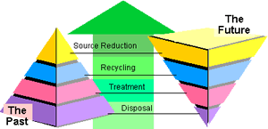
Pollution Prevention
Dawn of a New Age

Slide 2
Dawn of a New Age – History of Pollution Prevention
OK Statutory Directives
Recent Activities
  Autobody Outreach
  “Greening” Business
  Tourism
  Sustainability
  NE OKC Community
Recycling
Tax Credit
OKStar

Slide 3
“Pollution Prevention” (P2) means
Pollution Prevention Act of 1990
Any practice which reduces the use of any hazardous substance or amount of any pollutant or contaminant prior to recycling, treatment or disposal.
Reduction of the hazards to public health and the environment associated with the use or release or both of such substances, pollutants or contaminants.

Slide 4
27A O.S. § 2-3-105
  1994
  Defines pollution prevention
  Establishes the Pollution Prevention Program
  Provides program directives

Slide 5
1. Hazardous Substances
Encourage and assist facilities
Comprehensive pollution prevention planning
Developing measurable performance goals

Slide 6
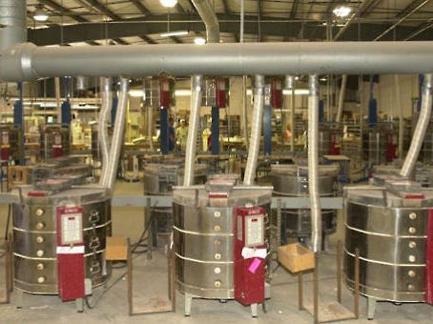
2. Offer and provide technical assistance
The Program shall not duplicate services readily available in the private sector.

Slide 7
3. Promote pollution prevention
The preferred means for achieving compliance
Encourage all agencies and political subdivisions of the state of Oklahoma

Slide 8
CONFIDENTIALITY, unless:
The user or generator agrees that such information may be available to the Department
The information is public record information
The information pertains to an imminent threat to public health or safety, or to the environment
Disclosure to the Department is required by law

Slide 9
Any technical assistance or information obtained shall not result in any regulatory inspections or other enforcement actions
Unless there is a reasonable cause to believe there exists a clear and imminent threat to the public health or safety or to the environment

Slide 10
Site Assistance Visits
By invitation
Low-key, unobtrusive & non-disruptive
May be limited to specific parts of the facility
CONFIDENTIAL
Compliance & Technical assistance

Slide 11
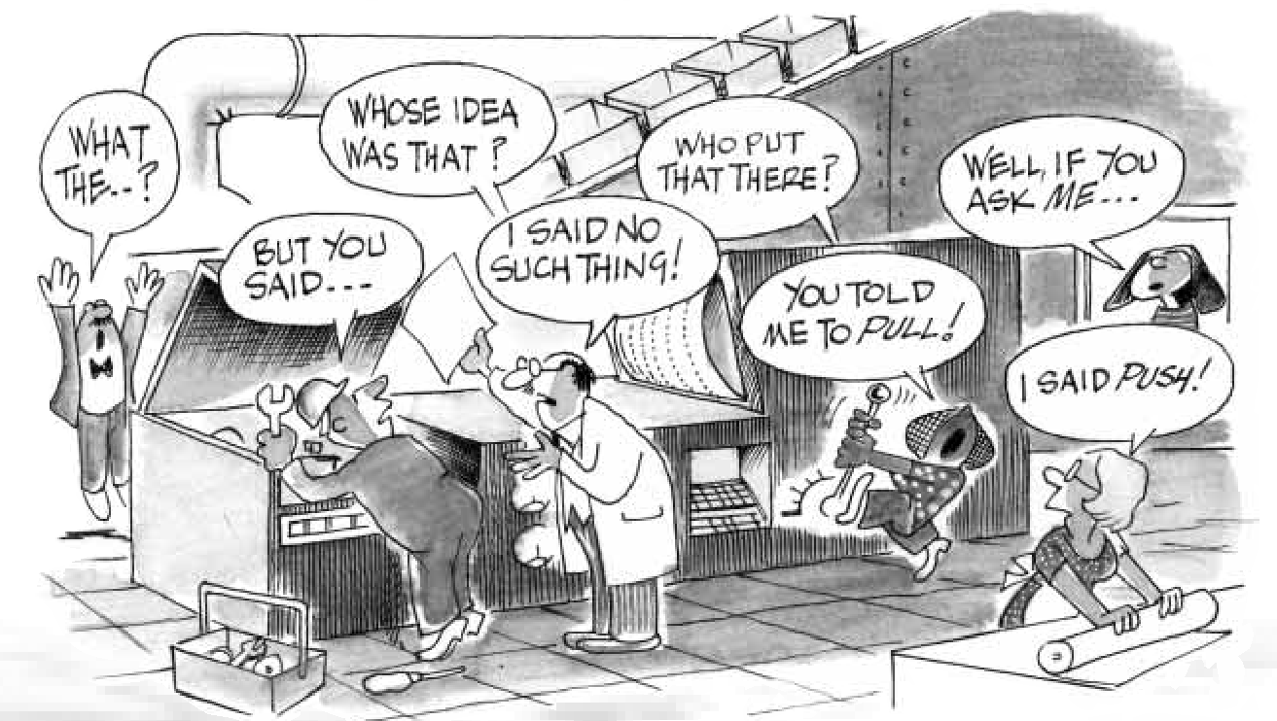
www.jdiamond.co.uk/Images/lean.h4.gif

Slide 12
What Is Waste?
… “anything other than the minimum amount of equipment, materials, parts, space, and worker’s time which are absolutely necessary to add value to the product.”
— Shoichiro Toyoda,
Toyota Motor Corporation
President 1982-1992
Chairman 1992-1999
Notes:
12
Lean has its roots in the Toyota Production System. Here is Toyota’s definition of waste, which expands the thinking. Toyota focus is broader to look at all the wastes. What would happen if we use this definition of waste instead of the typical definition?

Slide 13
Waste is anything that does not add value to product.
Notes:
13
13
Lean has its roots in the Toyota Production System. Here is Toyota’s definition of waste, which expands the thinking. Toyota focus is broader to look at all the wastes. What would happen if we use this definition of waste instead of the typical definition?

Slide 14

Notes:
Pollution prevention is multi-media and includes energy efficiency.

Slide 15
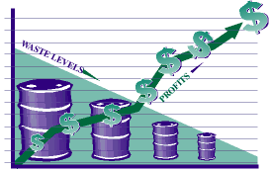
Why Waste Reduction?
Good business sense
Saves money
Reduced regulatory exposure

Slide 16
Cut Costs
Improve Operations
Foster Innovation
Engage Employees
Satisfy Customers
GREEN STRATEGIES
Notes:
What began as a seemingly altruistic endeavor, then shifted to a way to cut costs and improve reputation, has become a fundamental business competency, alongside accounting, finance, human resources, marketing, customer service, procurement, knowledge management and others. Indeed, in some firms, green thinking is becoming embedded in each of these other disciplines, increasingly woven into the corporate fabric. That has made green strategy and practices ever more valued, seen by top brass as a way to cut costs, improve operations, foster innovation, engage employees and satisfy customers — all critical during tough economic times.
The result was that for some companies, environmental improvements and innovations became a means of surviving lean times, and being more competitive once things rebound.
16

Slide 17
Seven “Deadly” Process Wastes
1. Production of defects
2. Overproduction ahead of demand
3. Unnecessary transport of materials
4. Waiting for the next process step
5. Inventories (excess material and information)
6. Unnecessary movement by employees
7. Over-processing
Notes:
Seven Types of Deadly Waste
Defects
These are products or services that do not conform to the specification or Customer’s expectation, thus causing Customer dissatisfaction.
Overproduction
Overproduction occurs when operations continue after they should have stopped. The results of overproduction are:- Products being produced in excess of what’s require; Products being made too early; Excess inventory carrying costs
Transport
This is unnecessary motion or movement of materials, such as work-in-process (WIP) being transported from one operation to another. Ideally transport should be minimized for two reasons:- 1) It adds time to the process during which no value-added activity is being performed. 2)Handling damage could be incurred
Waiting
Also known as queuing, waiting refers to the periods of inactivity in a downstream process that occur because an upstream activity does not deliver on time. Idle downstream resources are then often used in activities that either don’t add value or result in overproduction.
Inventory
This refers to inventory that is not directly required to fulfill current Customer orders. Inventory includes raw materials, work-in-process and finished goods. Inventory all requires additional handling and space
Motion
This term refers to the extra steps taken by employees and equipment to accommodate inefficient process layout, defects, reprocessing, overproduction or excess inventory. Motion takes time and adds no value to the product or service. “To move and add value is called work. To move and not add value is called motion. Motion means moving without working, moving and adding cost”.
Extra Processing
This term refers to extra operations, such as rework, reprocessing, handling or storage that occurs because of defects, overproduction or excess inventory.

Slide 18
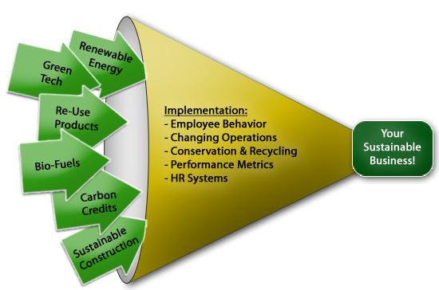
Notes:
The fact is that there are many tools available for use in building a sustainable business. Select the ones that are appropriate to the time /period of your business.
Implement by using waste reduction strategies. Establish performance metrics --- What gets measured gets managed.

Slide 19
P2: Value Added
Tool for an organization’s environmental performance!
Prevent Waste:
Involvement or
Commitment
Add Value:
Fulfillment
Expectations
Exceed Expectations
“Owner”
Employees
Suppliers & Contractors
Customer
“Delight”
Process
Customer Satisfaction is Worthless;
Customer Loyalty is Priceless!

Slide 20
P2 “Sustainable” Phases
OPERATIONS
EQUIPMENT/
SYSTEMS
PRODUCTION
PROCESS

Slide 21
Source Reduction Operation Phase
Start
Recognized Need
Assessment & Training
PHASE ONE
Good Housekeeping
Waste Separation
0-6 months, Big Return on Investment
Simple Recycling

Slide 22
The P2 Policy Drives Objectives & Targets
Conserve natural resources
P2 Policy
Objective
Reduce water usage
Reduce water consumption 25% (from 2013 baseline)
Target
Environmental performance = measurable results
based on the policy, objectives & targets!

Slide 23
Source Reduction Equipment Phase
Process Controls
Equipment Modifications
PHASE TWO
In-process Reuse & Recycling
6 months - 2 years
Some Return on Investment

Slide 24
Source Reduction Process Phase
Complex Recycling, Refining, Reuse
Process Changes
PHASE THREE
Raw Material and Catalyst Changes
2 years - 5 years
Little Return
on Investment
Product Reformulations

Slide 25


Slide 26
OKStar Process
Background compliance check
AQD, WQD, LPD, Municipal Wastewater
Complete application—self assessment
Site visit to review application
Review and determine level of recognition
Notification and suggestions for improvement

Slide 27
OKStar Appeals to Facilities of all Sizes
Altus Air Force Base
Drycleaning Station
Beam Industries
Bob Moore (Porsche-Audi, Mazda, Nissan)
Goodyear
Kimray

Slide 28
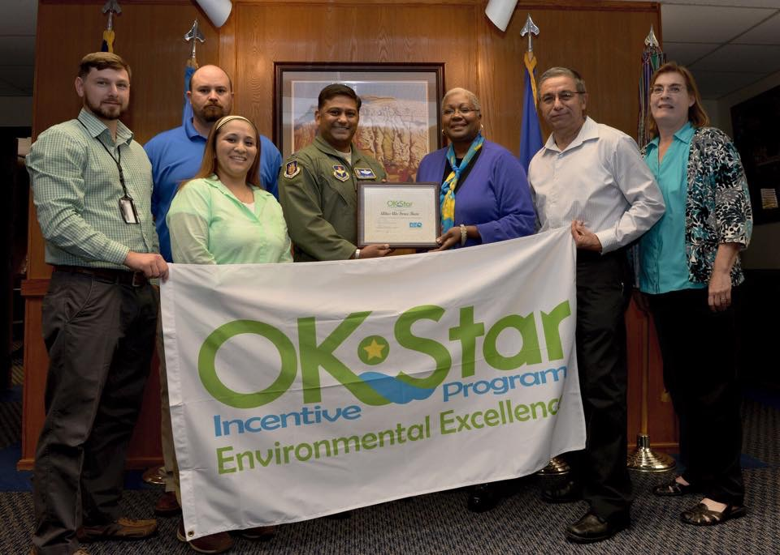
Recognition Levels
Silver
Gold
Platinum

Slide 29

General Mfg
Metal Finishers
Printers
Dry Cleaners
Food
Auto
Tourism (ECO)
Marinas
Govts

Slide 30
A vision without a plan is just a dream. A plan without a vision is just drudgery. But a vision with a plan can change the world.
– Proverb

Slide 31
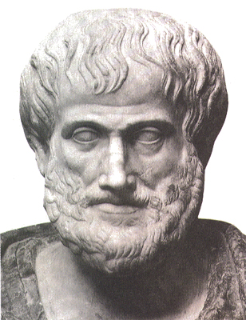
All human actions have one or more of these seven causes: chance, nature, compulsion, habit, reason, passion, and desire.”

Slide 32
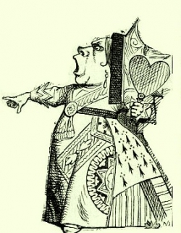
"Why, sometimes I've believed as many as six impossible things before breakfast."
— The Queen
Lewis Carroll, Alice in Wonderland

