Slide 1
Hazardous Waste Training
SQGs are required to perform training for all employees who are involved with hazardous waste.
Involvement includes:
Handling of the waste (from generation point to the container)
Management of the waste (managing the container)
Manifesting the waste (the person who signs the manifest and the person who maintains the manifest)
Emergency or Contingency Plan (all employees should know the Emergency Coordinator and what to do in emergency events)

Slide 2
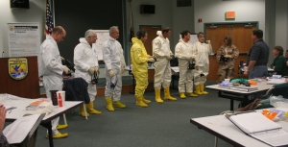
Hazardous Waste Training
WARNING:
  OSHA’s HAZWOPER
  TRAINING IS NOT
  ENOUGH!
HAZWOPER TRAINING:
Does not provide your employees a familiarity with your facility’s generated waste.
Does not provide training on container management.
Does not provide training on manifesting and other record keeping.
Does not provide training on your facility’s emergency response plan or Emergency Coordinator information.

Slide 3
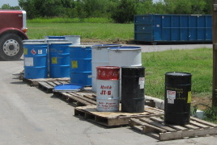
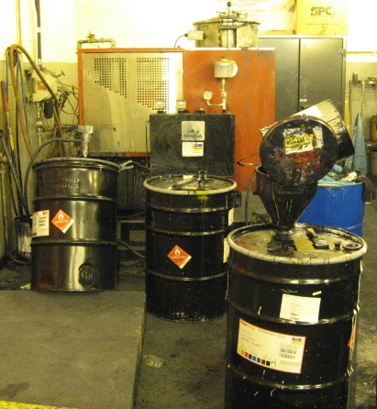
Hazardous Waste Training
Specific Subject Matter:
Container Management such as:
  Labeling
  Accumulation start date
  Definition of “closed”
  Weekly inspections/logs
  Manifesting, and record keeping (such as LDRs, BOL, inventories).

Slide 4
Hazardous Waste Training
A facility may claim training was completed.
Without documented training, how does an inspector to verify that? Training records. If not available, then:
  Conversations with employees about their waste management methods.
  Actual container management observed.
  Housekeeping issues observed.
  Documentation reviewed.

Slide 5
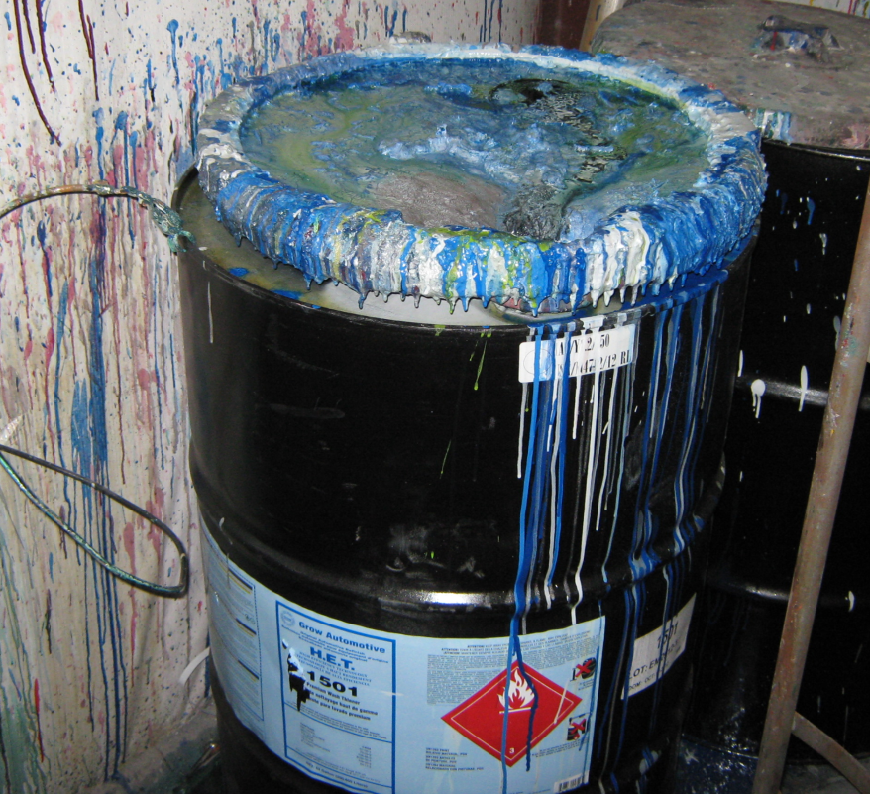
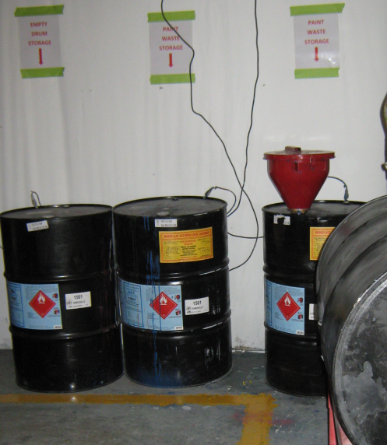
Hazardous Waste Training
Facility claimed employee training was completed. Which appears to support that?

Slide 6
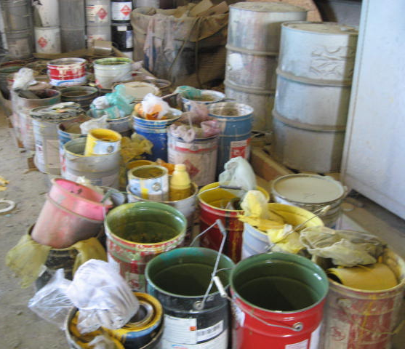
Hazardous Waste Training
Employee training was completed but not documented. Facility claimed they trained their employees on container management and an on-site distiller operation. HOWEVER:

Slide 7
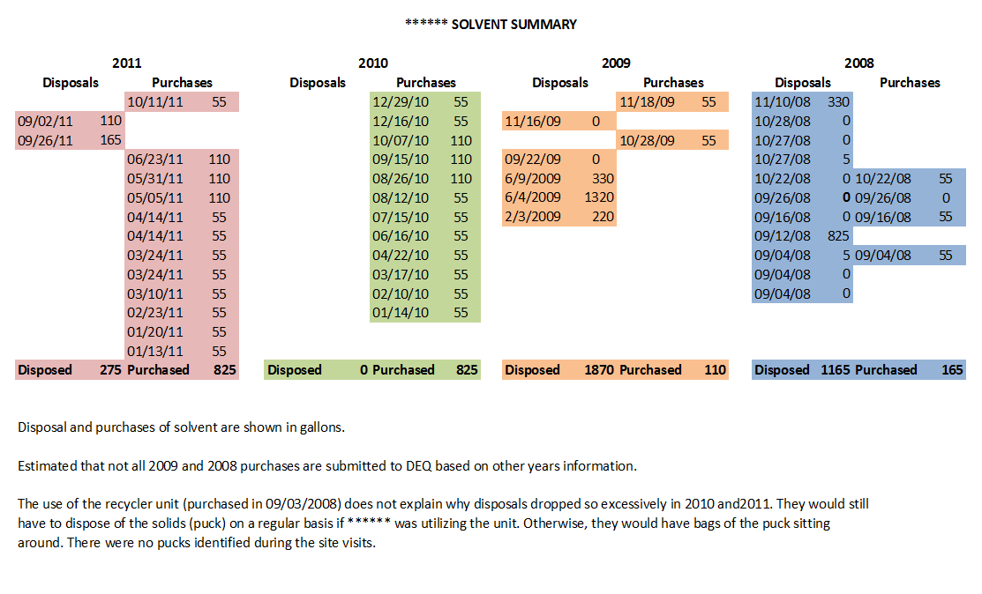
Hazardous Waste Training

Slide 8
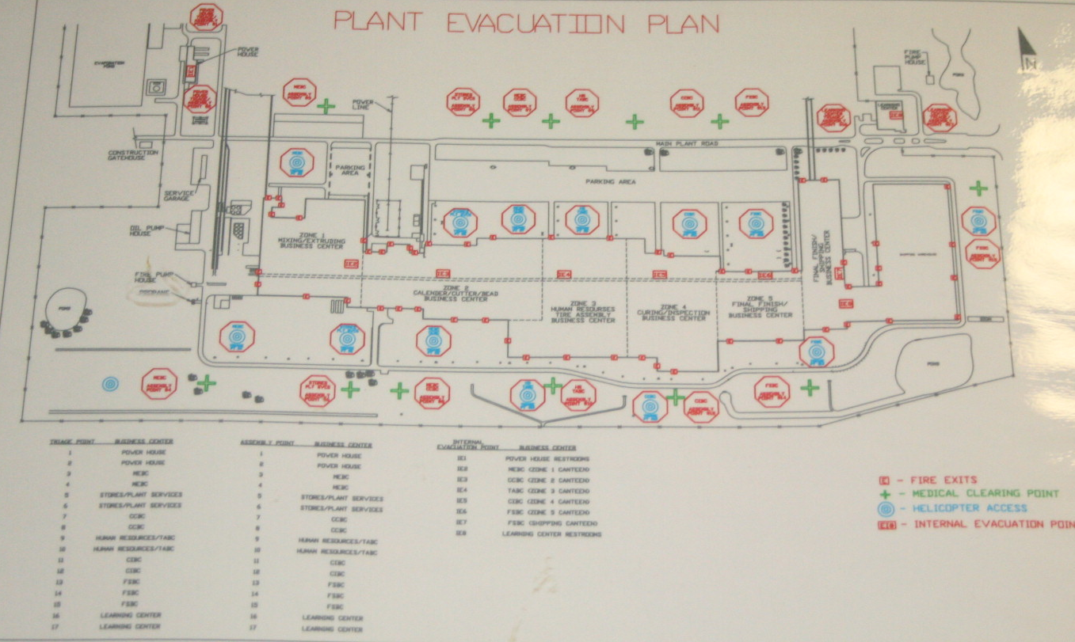
Hazardous Waste Training
Specific Subject Matter :
Emergency Coordinator information and location and access to emergency communication devices.

Slide 9
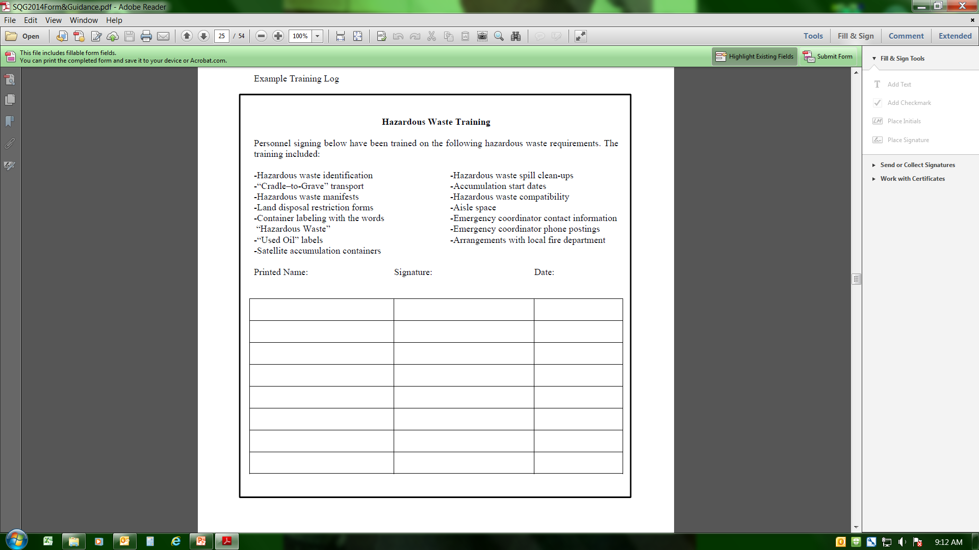
Hazardous Waste Training
DEQ recommends facilities document and maintain training records.
This is the easiest way to prove you provided the training in the event an issue arises.

