Slide 1
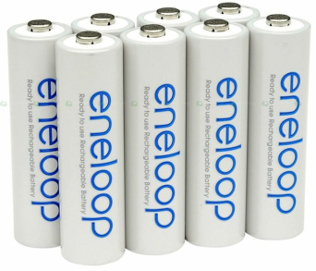
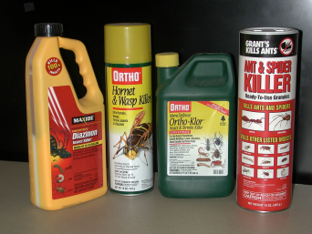
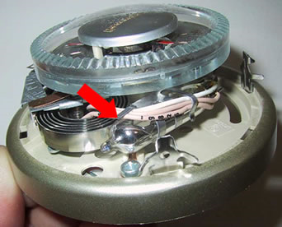

Universal Wastes
Batteries
Pesticides
Mercury-containing equipment (MCE)
Lamps

Slide 2
Universal Wastes
Small Quantity Handlers < 5000 kg
Large Quantity Handlers > 5000 kg
LQH requirements are greater
  Additional Training
  Additional Recordkeeping
  Notification of activity

Slide 3
Universal Wastes
One-year accumulation time
Closed container
Labeling
Training
Offsite shipments require records

Slide 4
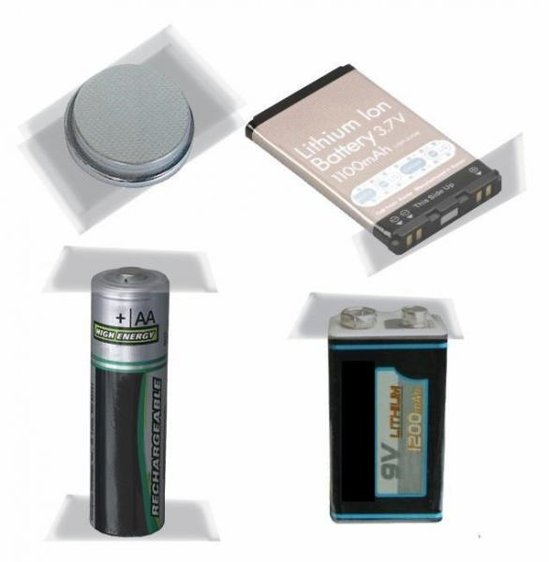
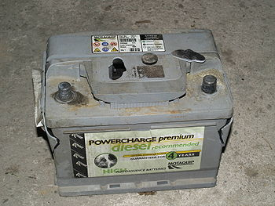
Universal Wastes - Batteries
Protected from shorting
No cell casing breaches
  Can remove electrolyte

Slide 5
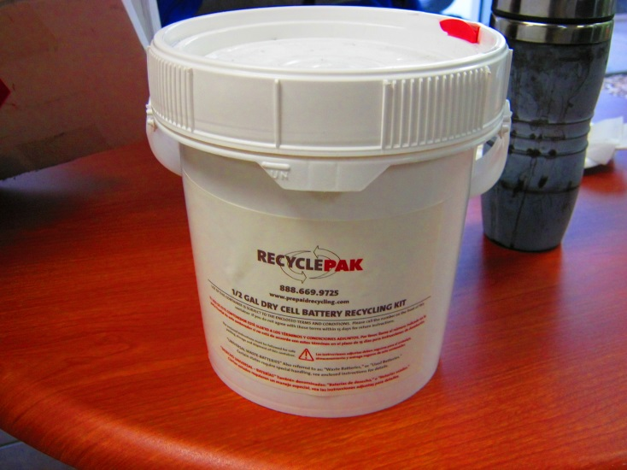
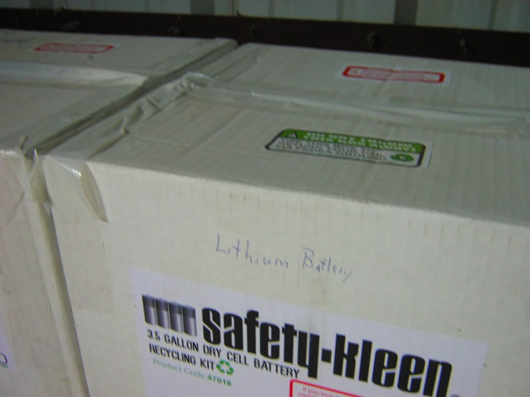
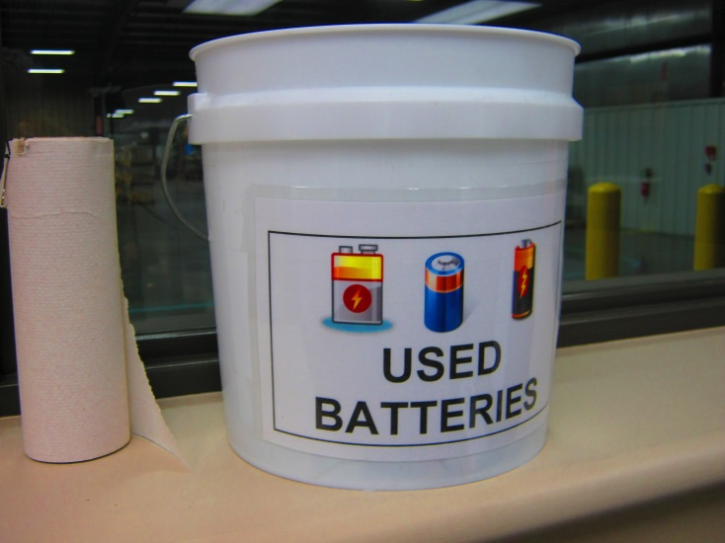
Universal Wastes - Batteries

Slide 6
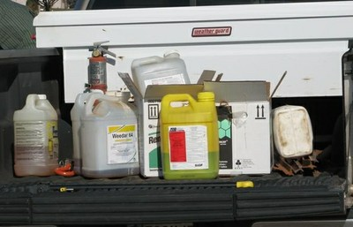
Universal Wastes - Pesticides
Two possibilities to qualify:
  If it is a recalled pesticide
      Infrequently encountered
  If it is part of a waste pesticide collection program

Slide 7
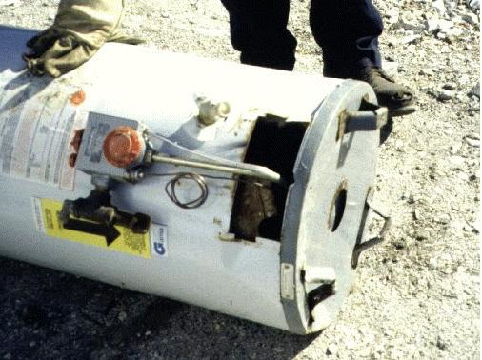
Universal Wastes - MCE
Includes a variety of items
Weight counting is dependent on the level of disassembly

Slide 8
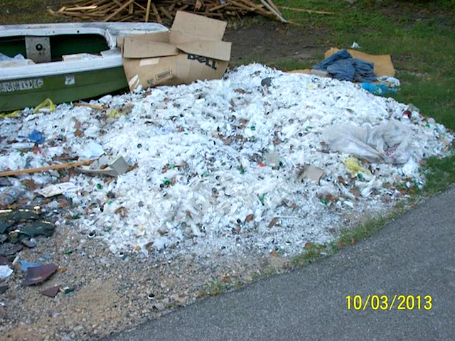
Universal Wastes - Lamps

Slide 9
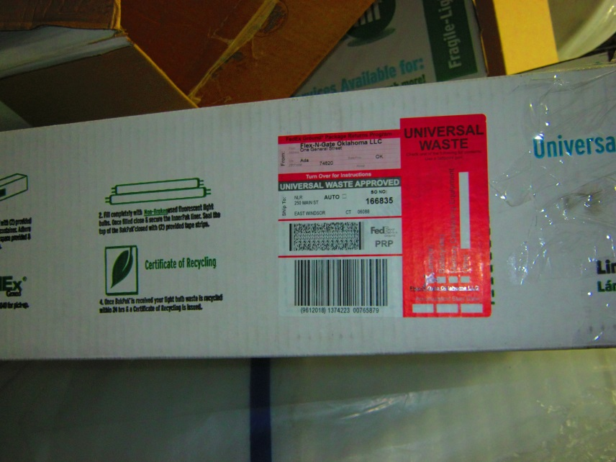
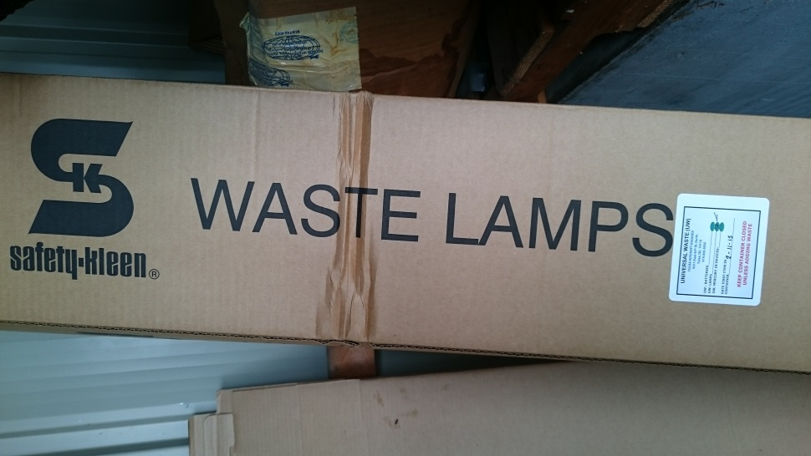
Universal Wastes - Lamps
Cannot be broken, except from operator error (~5% maximum as a general rule)
Cannot be overpacked
Crushed lamps are hazardous wastes

Slide 10
Used Oil
Labeling
  “Used Oil”, NOT “Waste Oil”, “Bad Oil”, etc
Spill Prevention & Secondary Containment
  Spill kit, bermed area…
Knowledge of Oil Composition
  If you add hazardous waste, the oil may become hazardous waste

Slide 11
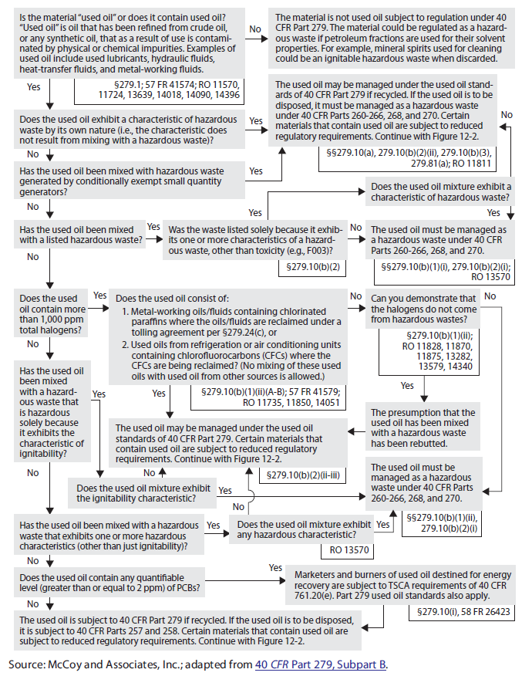
Used Oil – Management Applicability

Slide 12
Used Oil - Heaters
Can be burned onsite if:
  Heater <500,000 btu
  Gases vented to ambient air
  Owner-generated or from household DIY

Slide 13
Used Oil – Oily Substances
Oil Filters – exempt if:
  Not terne-plated
  Drained of oil
Oily Rags & Contaminated Scrap Metal – exempt if:
  No Free-flowing oil

Slide 14
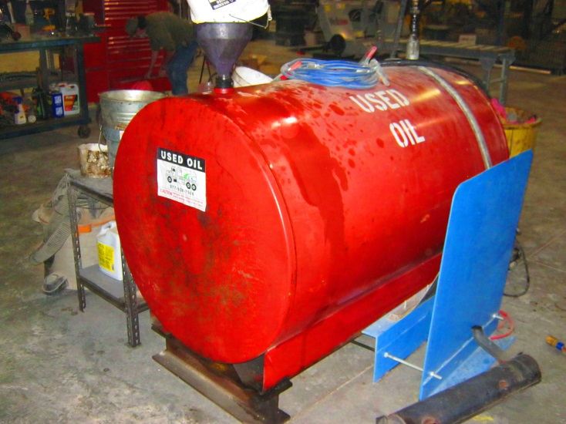
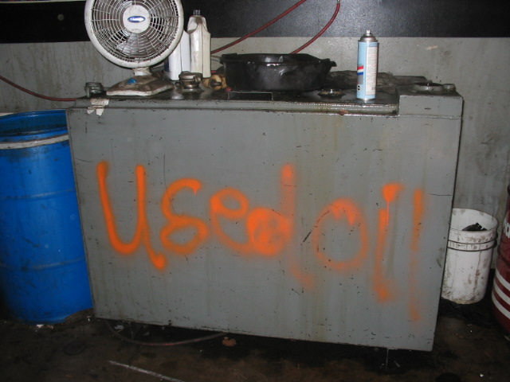
Used Oil

