Slide 1
Good Morning!
Please make sure you are Muted and Videos Are Turned Off.`

Slide 2
SCHEDULE
Introductions
Tier II 101 – PowerPoint
Introduction to Tier II Submit 2025
Working in Tier II Submit 2025 – Both Large and Small Number of Facilities
DEQ Website and Online Filing System

Slide 3
2025 TIER II Reporting at DEQ

Slide 4
What is Tier II Reporting
Database of facilities in Oklahoma that store over a reporting threshold of hazardous materials in the state.
Around 50,000 reports annually
Covers facilities from Tank Batteries to Chemical Facilities to Water Treatment Plants
Reports are submitted between January 1 and March 1 of every year. Electronic Files only. No Paper Copies

Slide 5
What is Tier II Reporting (pt2)
Reports are filed to the DEQ
DEQ then disperses Tier II Data to the County LEPC. County then disperses the data to the First Responder in that area
Public may request a copy of a Tier II Report by submitting a request for data to the DEQ

Slide 6
What Requires You to File a Tier II Report
ANY Chemical that is defined as Hazardous by OSHA Regulations
Over Threshold stored on site
  10,000lbs for non EHS (~34 barrels of Oil, ~2100 gallons propane)
  EHS chemicals are lower TPQ (found on the EPA List of Lists)
24 Hour Period

Slide 7
What Do You Need to File
Tier II Submit 2025 Software – Out Now
Login/Password
Last Years Report
Gallons to Pounds Converter (if needed)
Helpful Attachments (Optional)

Slide 8
What has changed for 2026 (software)
Updated state-specific fields and/or instructions in Connecticut, Hawaii, Maine, New Hampshire, Rhode Island, and Vermont.
Added a new Contact Type for Emergency Equipment Contact, which is required in five New England states.
Updated the information on Extremely Hazardous Substances (EHSs) to match the latest EPA List of Lists.
Added ability to reorder attachments on a Facilities record via drag-and-drop with the mouse (or an alternate keyboard-based option).

Slide 9
What has changed for 2026 (DEQ)
New DEQ Website
DEQ Online Portal Payment

Slide 10
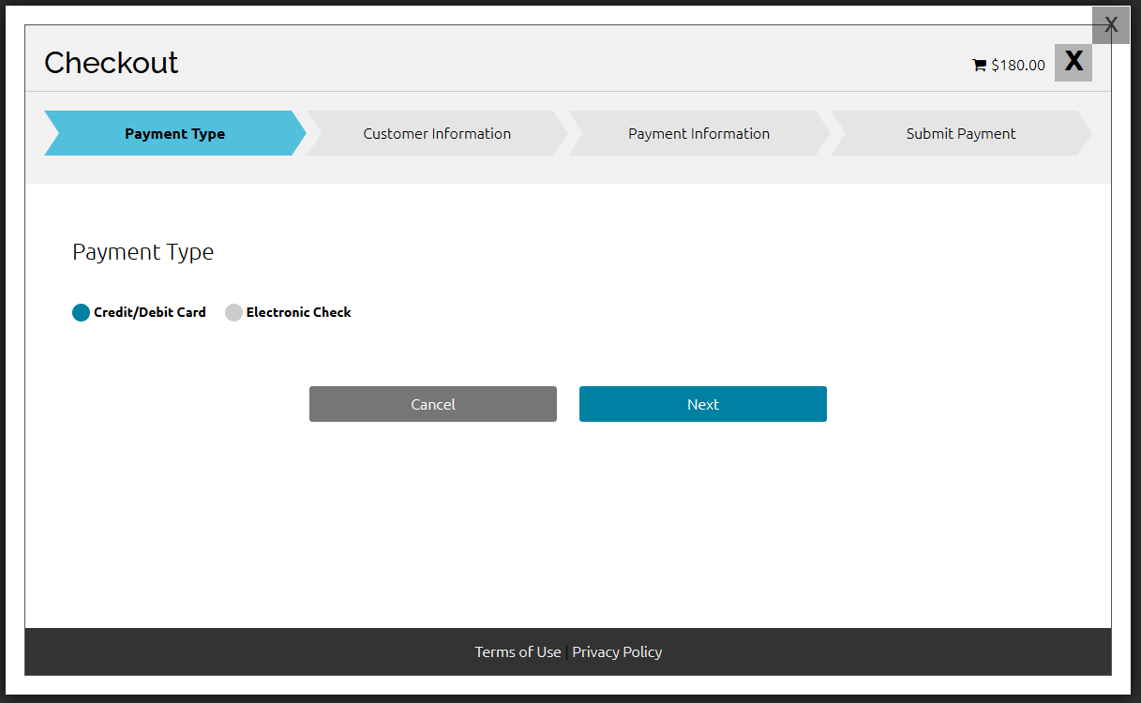
New DEQ Online Payment Portal

Slide 11
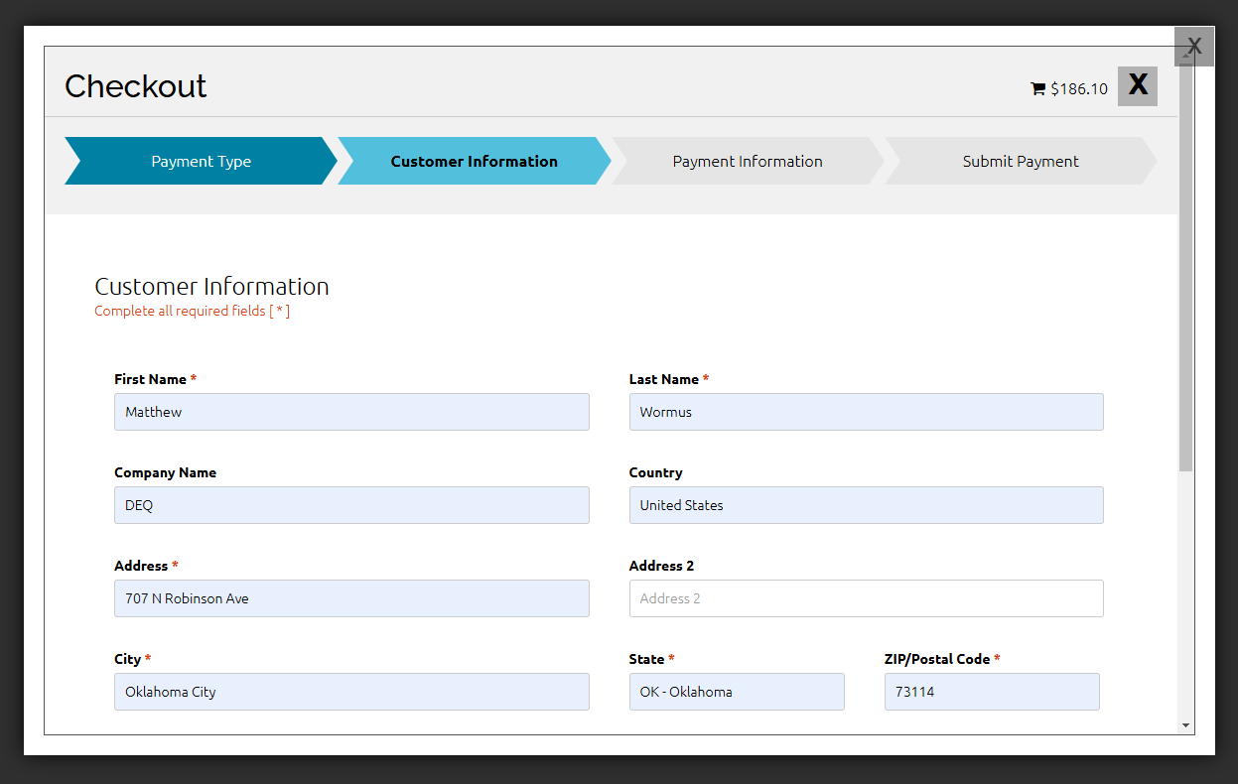
Payment via Credit Card

Slide 12
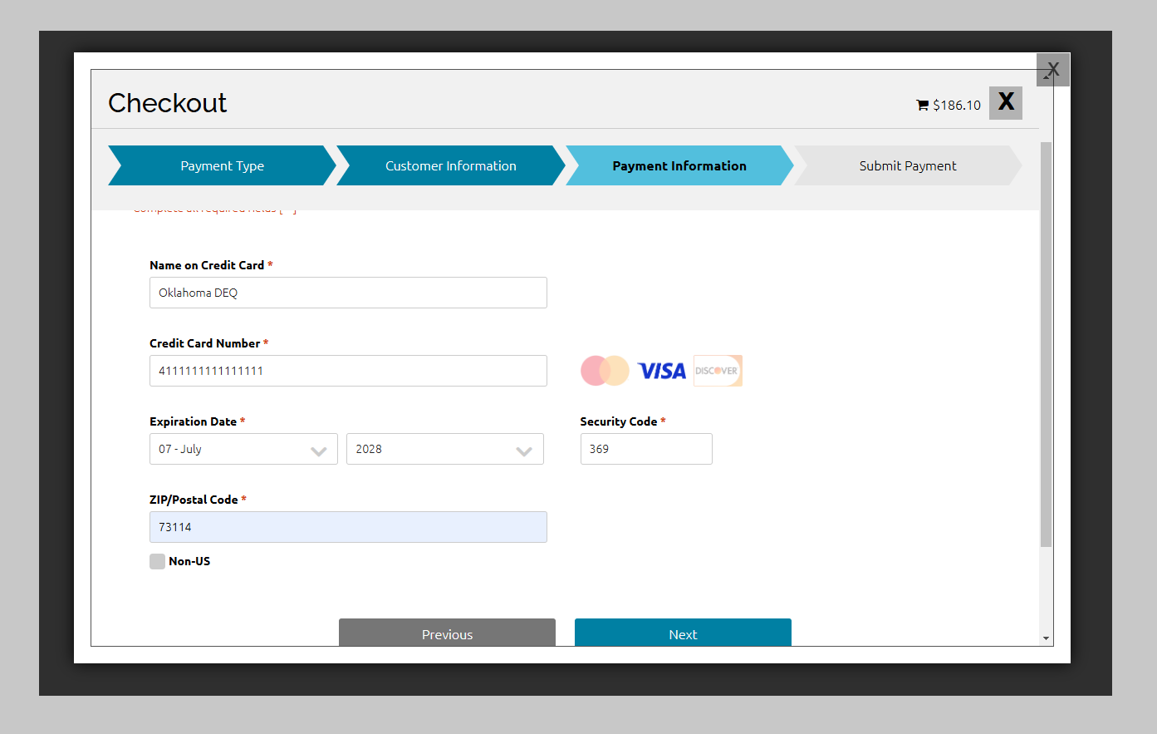
Payment via Credit Card

Slide 13
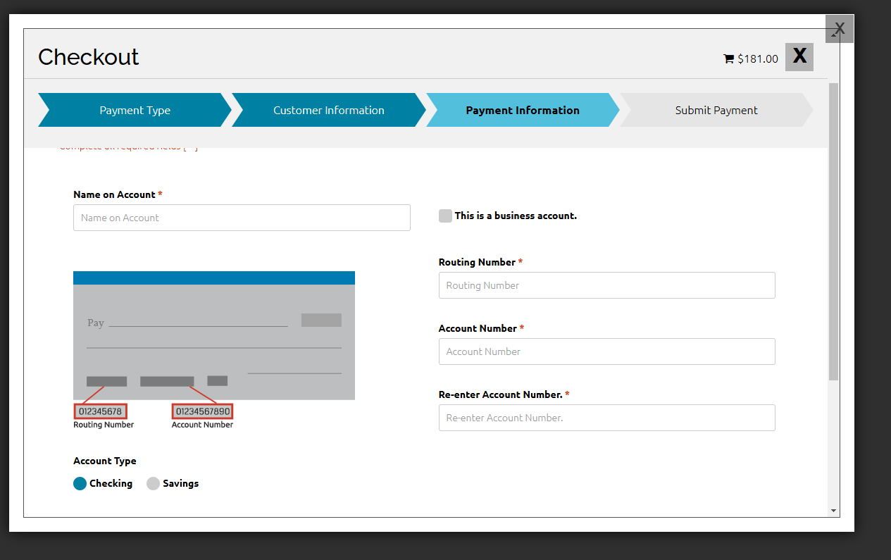
Payment Routing Number

Slide 14
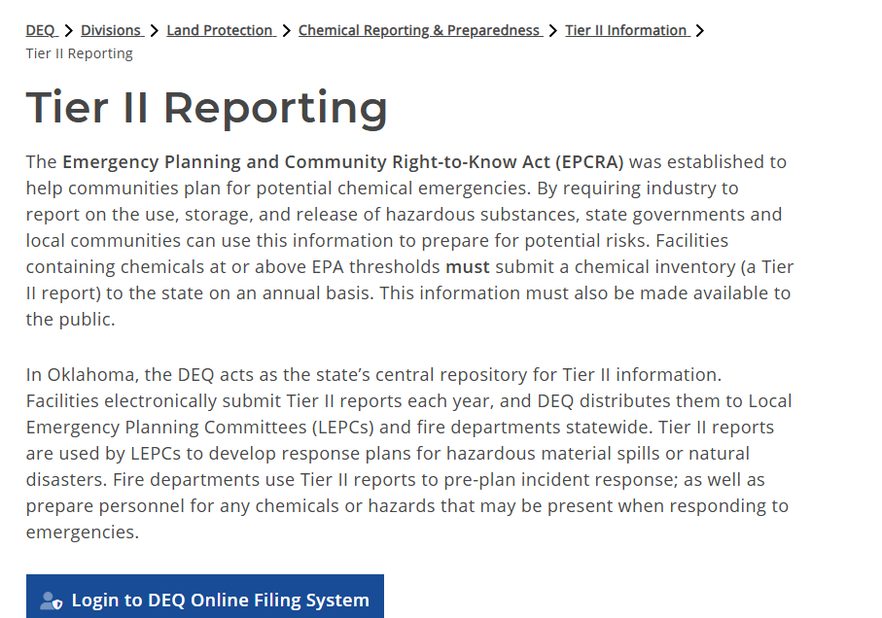
NEW DEQ Website

Slide 15
How to Get Tier II Assistance
Call/Email at anytime
  ask for Tier II Help
Online Tier II Training
  December 17th
IF in OKC Area, make appointment to meet at the DEQ Offices in OKC
  NOTE – Ongoing Construction limits parking
Tier II 101s
  Held during LEPC Meetings. Check website for updated schedule.

Slide 16
Billing Advice – From DEQ Finance
When requesting corrections to an order to place the order number in the Subject line of the email.
  ARHelpdesk@deq.ok.gov
  405-702-1130
One invoice PER account.
Do not email Credit Card info. Only call the number or mail it in

Slide 17
Report is filed, now what?
Pay your invoice by April 1st
Check Tier II GIS Map to see if report has been received
Be active in your LEPC
  Especially EHS sites
Keep report “living”
  Email or call with ANY changes to contacts, chemicals stored, etc. Within 30 days of changes

Slide 18
One Final Request
Please be patient when waiting for Tier II Assistance
  Weather
  Kids
  Illness
  Busy Season

Slide 19
Matt Wormus
  Matthew.wormus@deq.ok.gov
  405-702-5137
Tommy Holbrook
  Tommy.Holbrook@deq.ok.gov
  405-702-5156

