Slide 1
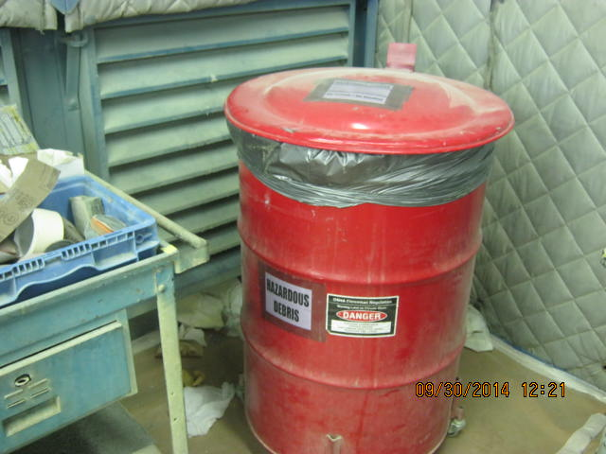
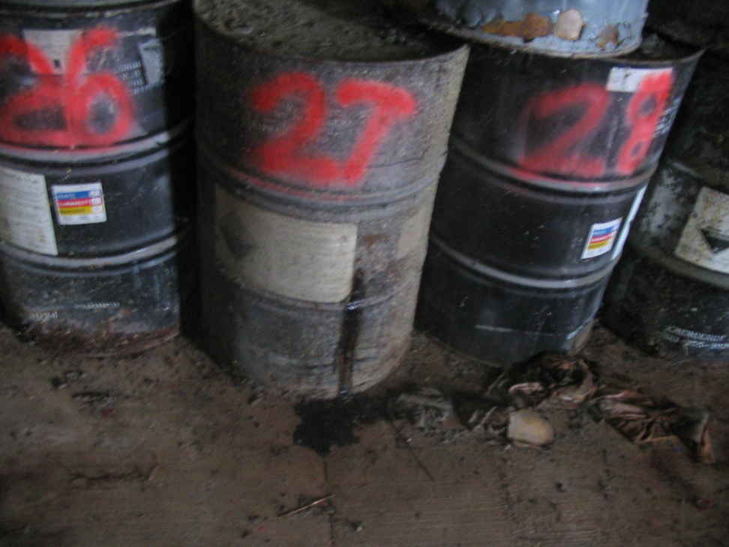
Hazardous Waste Container Management

Slide 2
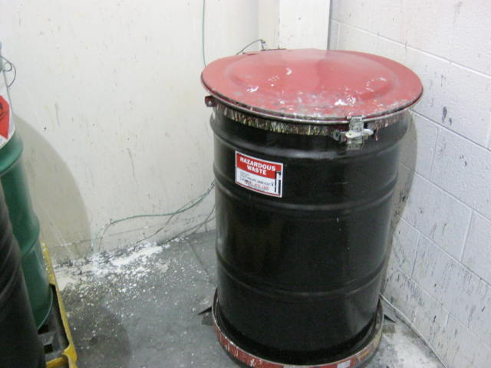
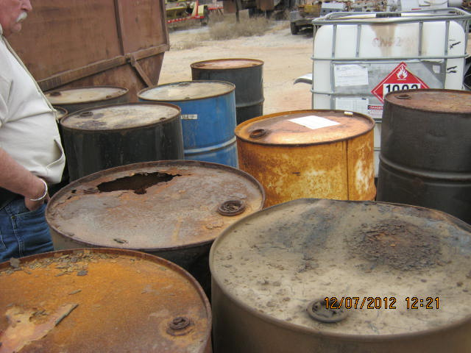
Are Containers in Good Condition?
Some issues here
Appropriate

Slide 3
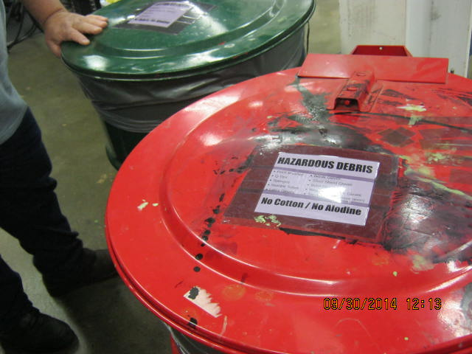
Labels SA Container
Closed unless adding waste
Satellite accumulation is stored at or near point of hw generation.
Under control of operator
Marked as HW or identification of contents
Don’t date until container is full or ready for storage. Your 180 day clock begins
Moved to 180 day storage within three days of being filled

Slide 4
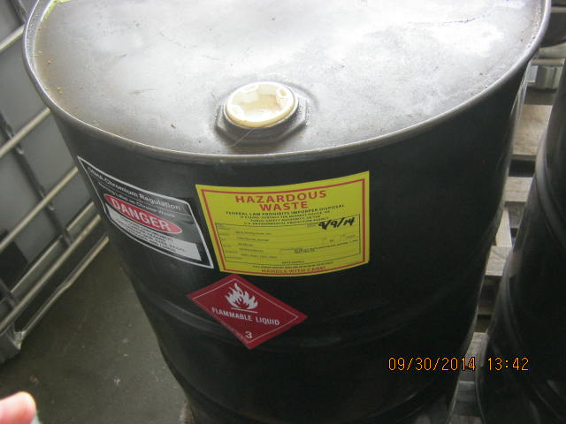
Storage Labeled “Hazardous Waste”
Closed
Container is labeled as “hazardous waste”
Has generator name and contact information
Has EPA ID number
Has the date that the drum was full or put in storage.

Slide 5
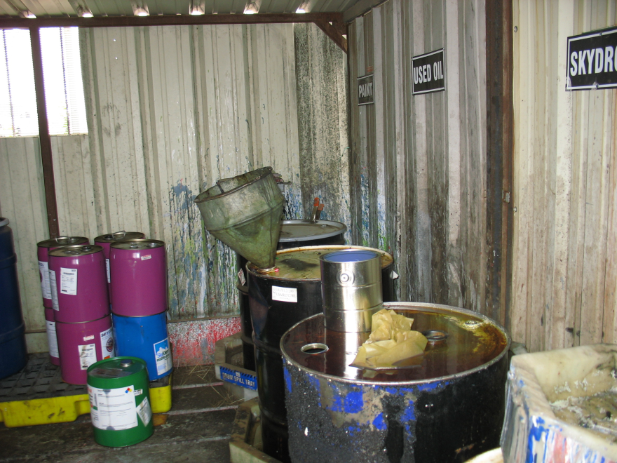
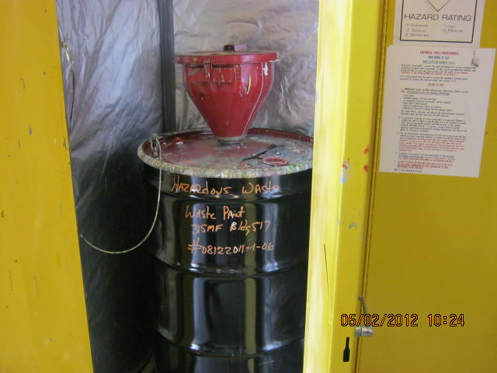
Closed: Except When Adding Waste
No, not spill proof or vapor tight.
Yes, use of flip-top lids with clamp for quick access is Okay.

Slide 6
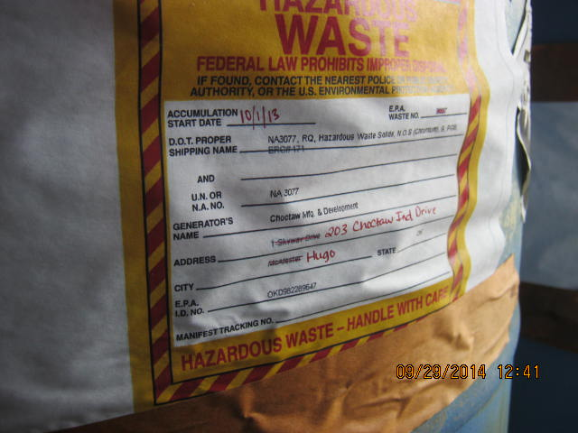
Accumulation Start Date
Accumulation start date is on practically every label and can be misleading
Regulations require storage date
Containers being filled could be a satellite container and not require date
Containers could be a storage container and require a date the minute one drop goes into the drum
Understand how you wish to manage containers at your facility. Satellite, or storage?
What’s Wrong Here?

Slide 7
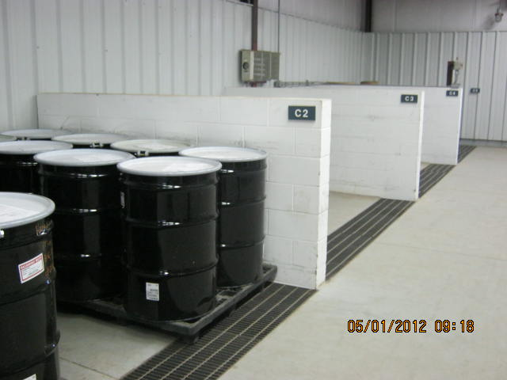
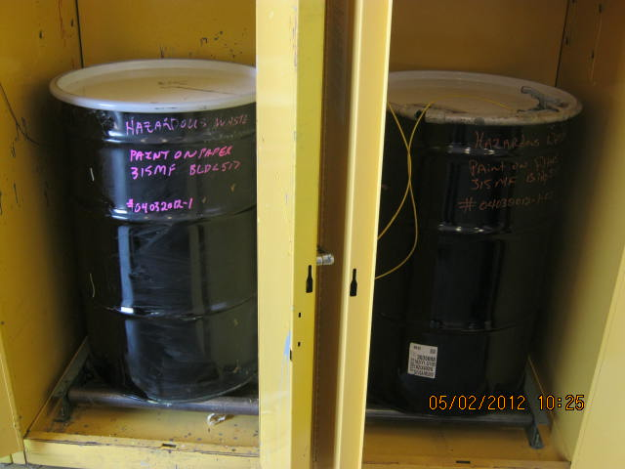
Separation of Incompatible Wastes
Satellite: Great example
Storage: Incompatible waste separated by wall.

Slide 8
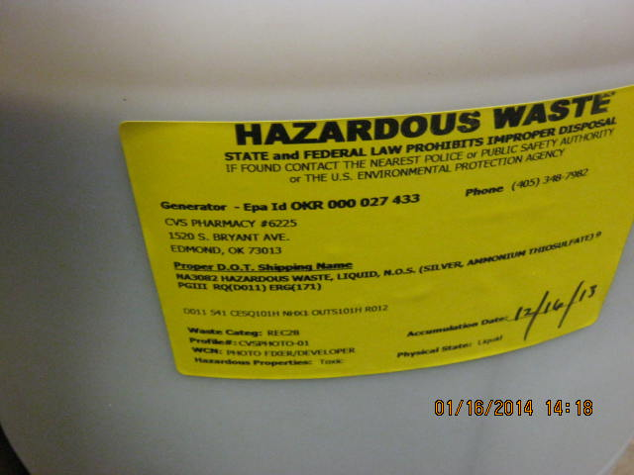
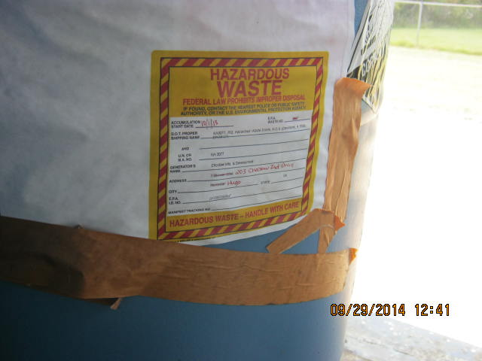
Store waste less than 180 days. 270 days if you ship over 200 miles
  Not acceptable. Stored for almost 1 year
Acceptable

Slide 9
Storage Limits
Store less than 6,000 kg (13,227 lbs.) at one time
How many drums is this?
  Depends on density of waste. To estimate, the weight of 50 gallons of water is 417 lbs.(1 gallon=8.34 lbs.)
Approximately 32 drums stored at one time.
Most solvents are less dense than water. So they float on top of water (oil, gasoline).
Some wastes are more dense. Lead contaminated soils, for example.
Accumulating over 13,227 lbs. makes you a LQG.

Slide 10
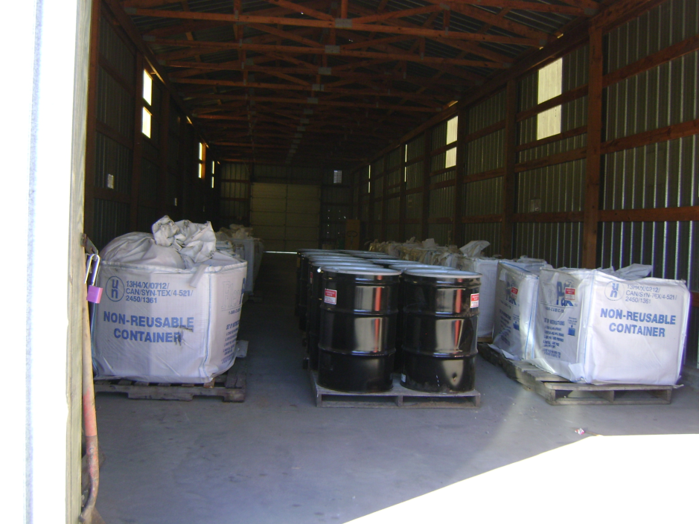
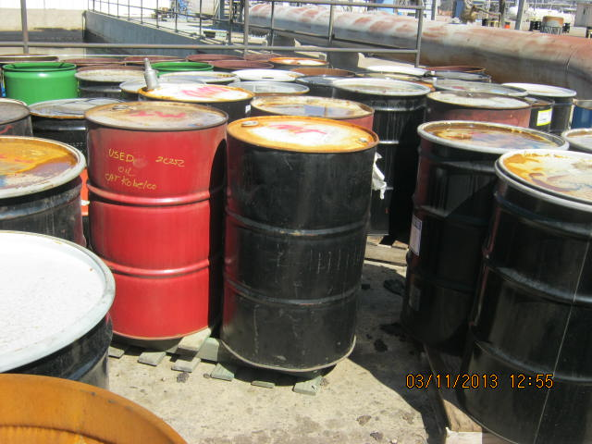
Sufficient Aisle Space
Inappropriate, no aisle space. No way to inspect containers.
Appropriate

Slide 11
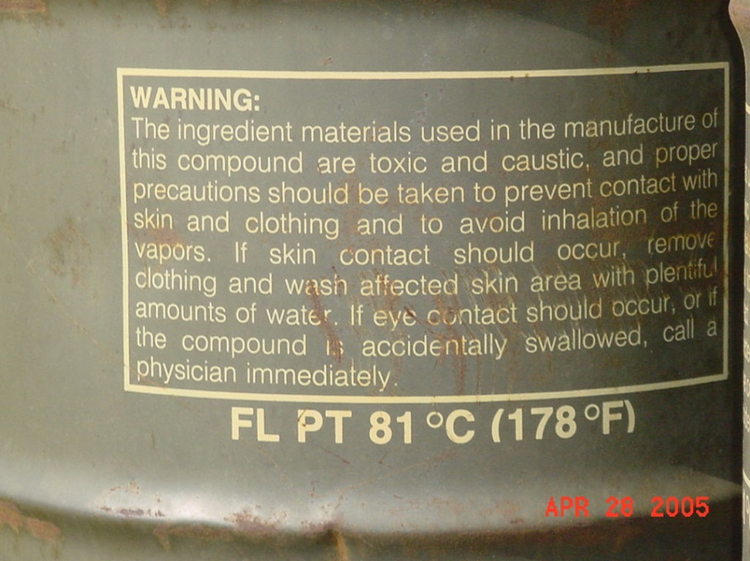
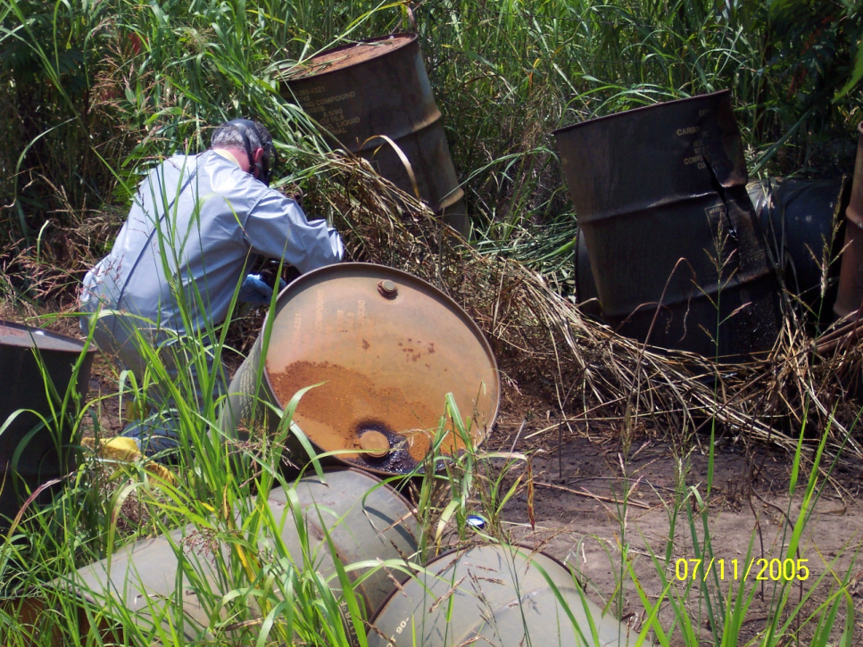
No Releases to Land, Air or Water
Don’t dump.
Orthodichlorobenzene waste thrown out back.

Slide 12
Weekly Storage Container Inspection
Requirement | Satellite Accumulation | 180-Day Container
Must be in good condition | Yes | Yes
Must be compatible with waste | Yes | Yes
Must be closed except when adding or removing waste | Yes | Yes
Inspection requirement | None | Weekly
Labeling requirement | “Hazardous Waste” or other description | “Hazardous Waste”
Dating requirement | When 55 gallons (or 1 quart for acute waste) is exceeded | When waste first goes into container or full satellite container is moved to storage area
Length of storage | Unlimited | 180 days (or 270 days if TSD facility is > 200 miles away) (30-day extension)
Volume in storage | 55 gallons or 1 quart for acute waste | 13,227 lbs (6,000 kilograms)
Containers in poor condition?
Leaking?
Accumulation start date?
Labeling?
Closed?
Inventoried?
Compatibility?
Should have comments for corrections to problems.

