Slide 1
COVID-19 Vaccine Provider Call July 2022 Please place your name, and provider in the chat.
Notes:
Good afternoon, welcome everyone. If you have not yet, please be sure to place yours and your provider name in the chat. Let’s go ahead and get started. My name is Christa Copeland and I am the communications manager for the immunization program here at OSDH. Thank you for joining us today, especially on a Friday before a holiday weekend ☺ We will try to be good stewards of your time today.

Slide 2
Agenda
State Data / COVID Administration Guidance
COVID-19 Vaccine Ordering Update
Vaccine Ordering & Distribution
OSIIS Updates
Monthly Spotlight feat. Dr. Eve Switzer
Tips for Addressing Vaccine Hesitancy
Notes:
Today we are going to go over state data and administration guides and give you updates on vaccine ordering, distribution, and OSIIS. Then later in the call we’re going to hear from Dr. Eve Switzer with tips for addressing vaccine hesitancy. So, with that let’s jump. I’ll hand it off to Anna.

Slide 3
COVID-19 Vaccine State Data & Administration Guidance
Anna Anthony, RN, BSN
Immunization Service, Public Health Nurse

Slide 4
Statewide COVID-19 Vaccine Administration (as of 6/21/2022)
2,236,538
people have received at least 1 dose* of the COVID-19 vaccine
805,120
people have received a 3rd dose^ or booster dose^^ of the COVID-19 vaccine
107,956
people have received a 4th dose or 2nd booster dose of the
COVID-19 vaccine
1,898,796
people are fully vaccinated** with the COVID-19 vaccine
Across Oklahoma, a total of 4,919,422
COVID-19 vaccine doses have been administered
since 12/14/2020
*Refers to eligible individuals (ages 5 years+) receiving Pfizer and Moderna COVID-19 vaccines and/or receiving single shot of J&J/Janssen Vaccine; **Refers to eligible individuals (ages 5 years+) fully vaccinated after receiving either Pfizer and/or Moderna COVID-19 vaccines (both doses) and/or receiving single shot of J&J/Janssen Vaccine; ^3rd dose (Pfizer or Moderna) for individuals moderately to severely immunocompromised to be received at least 28 days after a second dose; ^^Booster dose for individuals 65+ or certain other adults at high risk of severe COVID-19 to be received at least six months after completion of the primary mRNA vaccine series or two months after receiving single dose of J&J/Janssen vaccine.
Note: Total vaccines administered does not include doses administered by federal entities (Bureau of Prisons, Veterans Heath, Indian Health Service, or Department of Defense).
Not for public distribution, data intended for internal planning purposes.
Data Source: COVID-19 Vaccination Reporting Specification (CVRS) Dataset - Oklahoma State Immunization Information System (OSIIS); Data reflect information entered as of 11:59PM 6/21/2022

Slide 5
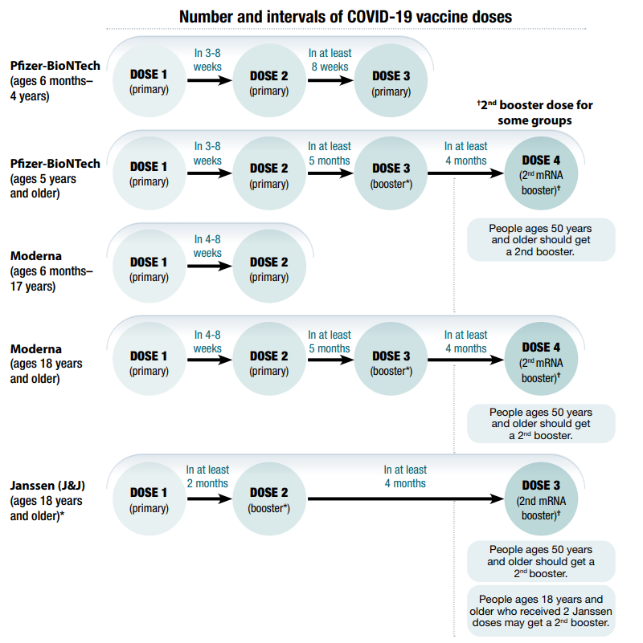
Covid-19 Vaccination Schedule (Non-Immunocompromised)
Clinical Guidance for COVID-19 Vaccination | CDC

Slide 6
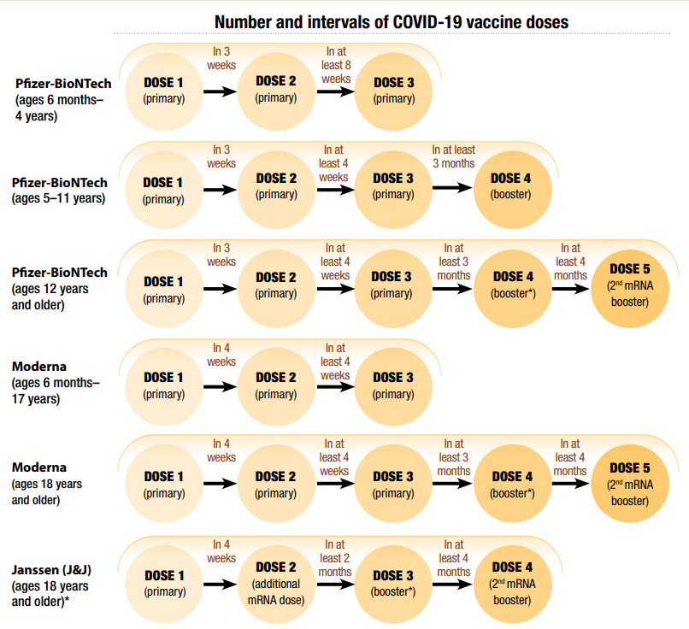
Covid-19 Vaccination Schedule (Immunocompromised)
Clinical Guidance for COVID-19 Vaccination | CDC

Slide 7
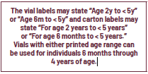
Pfizer Vaccine Formulation/Presentation Guide
Co-Administration
For more complete information and guidance, visit: Home (cvdvaccine-us.com)
ShowLabeling.aspx (pfizer.com)
Notes:
On June 17, 2022, the Emergency Use Authorization of Moderna COVID-19 Vaccine was expanded to include use as a primary series in individuals 6 months through 17 years of age. At the time of this letter, vaccine vials specifically labeled for the age group 6 years through 11 years of age are not available.
The purpose of this letter is to inform vaccination providers that the Moderna COVID-19 Vaccine vial labeled “BOOSTER DOSES ONLY” is also authorized to provide primary series doses (0.5 mL each) for individuals 6 through 11 years of age.1 This presentation of the Moderna COVID-19 Vaccine is supplied as multiple-dose vials with dark blue caps and labels with a purple border [NDC 80777-275-05].

Slide 8
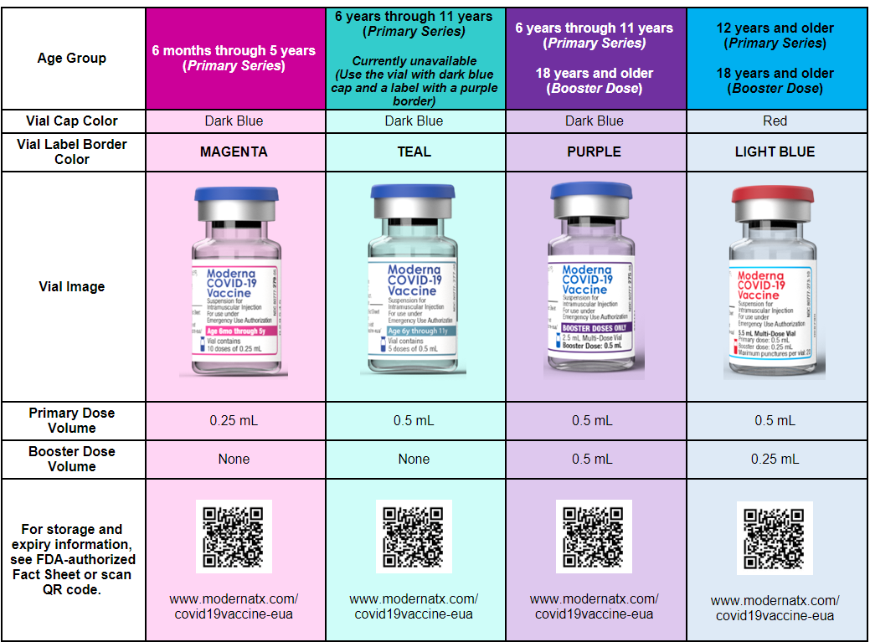
Moderna Formulation/Presentation Guide
Co-Administration
Notes:
On June 17, 2022, the Emergency Use Authorization of Moderna COVID-19 Vaccine was expanded to include use as a primary series in individuals 6 months through 17 years of age. At the time of this letter, vaccine vials specifically labeled for the age group 6 years through 11 years of age are not available.
The purpose of this letter is to inform vaccination providers that the Moderna COVID-19 Vaccine vial labeled “BOOSTER DOSES ONLY” is also authorized to provide primary series doses (0.5 mL each) for individuals 6 through 11 years of age.1 This presentation of the Moderna COVID-19 Vaccine is supplied as multiple-dose vials with dark blue caps and labels with a purple border [NDC 80777-275-05].

Slide 9
Johnson & Johnson/Janssen
Co-Administration
Primary Series
One dose (0.5 mL each).
Booster Doses
Recommend that people receive an mRNA booster at 2 months after initial dose.
A second booster dose may be administered to those 50yrs and older OR immunocompromised individuals 18yrs+ at least 4 months after their booster.
Changes to the J&J/Janssen EUA (as of May 5, 2022)
Janssen COVID-19 Vaccine EUA Fact Sheet for Healthcare Providers (fda.gov)
Pages 4-5, 13: Immune Thrombocytopenia
Federal Allocation has resumed for a limited time. Any order placed for the minimum amount (100) will be direct shipped. Orders requesting less than the minimum amount will be fulfilled by local County Health Departments.
Providers need to remain aware of expiry date of vaccines in their inventory.
The expiration date can be obtained by entering the lot number from the carton or vial using the website www.vaxcheck.jnj
Notes:
For speaker (ANNA ☺): As of yesterday, May 5th, the FDA announced a limitation on the authorized use of Janssen to individuals 18 years of age and older.
-After conducting an updated analysis, evaluation, and investigation of reported cases the FDA has determined that the Janssen Vaccine can cause thrombosis with thrombocytopenia syndrome (TTS) which may be life-threatening.
-Among reported cases of TTS following administration of the Janssen Vaccine, symptoms began approximately one to two weeks after vaccination.
-Do not administer the Janssen COVID-19 Vaccine to individuals with a history of thrombosis with thrombocytopenia following the Janssen COVID-19 vaccine.

Slide 10
Mixing and Matching Boosters
Co-Administration
 | COVID Vaccine Received:
 | PFIZER | MODERNA | JANSSEN
Who Should Get a Booster | * Everyone 5+ | * Everyone 18+ | * Everyone 18+
When to Get a Booster | * At least 5 months after completing your primary COVID 19 Vaccination Series | * At least 5 months after completing your primary COVID 19 Vaccination Series | * At least 2 months after completing your primary COVID 19 Vaccination Series
Which Booster can you get | *18+: any mRNA COVID vaccine* | *18+: any mRNA COVID vaccine* | *18+: any mRNA COVID vaccine*
 | 5-17: PFIZER COVID Vaccine Only
 | *non-mRNA can be used to booster in special circumstances, please consult Primary Care Physician

Slide 11
Co-Administration
Administer vaccinations that may be more likely to cause a local reaction in different limbs, if possible.
When deciding whether to co-administer other vaccine(s) with COVID-19 vaccine, consider:
Whether the patient is behind or at risk of becoming behind on recommended vaccines.
The patient's risk of vaccine-preventable disease.
The reactogenicity profile of the vaccines.
The likelihood of avoiding a missed opportunity to vaccinate.

Slide 12
COVID- 19 Vaccine Ordering Updates
Margaret Archer, MPH, and Muhammad Khalil, BSM
Covid-19 Vaccine Ordering Team

Slide 13
Updated COVID-19 Vaccine for Children Ordering in OSIIS
Pfizer and Moderna pediatric vaccines are available to order in OSIIS for children ages 6 months to 5 years.
Moderna pediatric vaccine is also available to order in OSIIS for children ages 6 to 11 years.
Please note the Moderna 6-11 vaccine is labeled as ‘Adult/Booster Only.’
When placing an order for Moderna 6-11 for children, the provider must select PEDIATRIC under “Intent”
You can find this helpful wall chart on the FDA's website.
Ordering for these doses will follow the regular OSDH COVID-19 vaccine ordering schedule: Tuesday through Monday with a cut-off Monday at 5 pm.
As a reminder, these vaccines are approved under an Emergency Use Authorization (EUA). Please pay special attention when providing parents educational information and in obtaining informed parental consent.
Notes:
-The Pfizer-BioNTech vaccine for children aged 6m–4 years ships at -80°C, like all current Pfizer COVID-19 vaccines, and has a similar product configuration to the 5–11-year-old vaccine, but with a different color cap (maroon), different concentration (3 micrograms/0.2mL), different amount of diluent added (2.2mL), and a new national drug code (NDC). Please see accompanying CDC document “Pfizer-BioNTech COVID-19 Vaccine Products” for more details. The new NDC will require additional coding and information technology accommodations, which are underway.
-The Moderna vaccine for children aged 6m–5 years ships at –20 °C, like all current Moderna COVID-19 vaccines, and has a different product configuration to the adult vaccine. It has a different concentration (25 micrograms/0.25mL) and a new NDC; it does not require diluent. The new NDC will require additional coding and information technology accommodations, which are underway. A document detailing characteristics of the Moderna vaccine for children aged 6m–5 years is being developed.
VRBPAC: Vaccines and Related Biological Products Advisory Committee

Slide 14
Vaccine Storage and Handling
Sonja Claborn and Tina Shatto,
Immunization Field Consultants

Slide 15
Best Practice for Inventory Management
To reduce waste, providers should be aware of vaccine in their inventory that are nearing expiration dates and prioritize their administration.
Providers should enroll in the CDC Code Management Service to access the most up to date Expiration Information for all Vaccines.
Vaccine Lot Number and Expiration Date Webpage
Click the "Register" button in the upper right-hand corner to complete the registration form to request access.
Moderna and J&J Vaccine Expiration Lookup & Reference Information:
Moderna Vial Expiration Data Look Up Tool
J&J Expiration Date Look Up Tool
Notes:
Inventory Management – rotate stock and check expiration dates weekly.
PLEASE NOTE and say out loud: THERE IS NO PFIZER LOOKUP TOOL SITE. The Pfizer expiration dates and lot numbers can only be found using the CDC code management service.

Slide 16
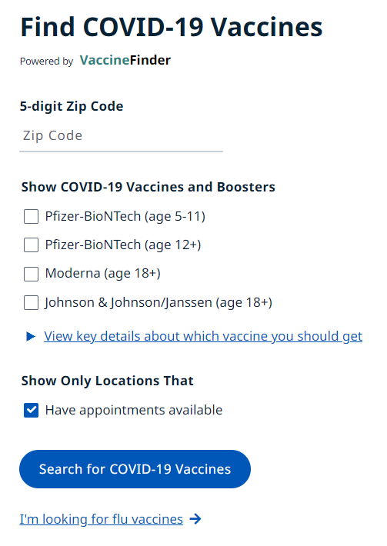
Inventory Update Required Vaccine Finder, OSIIS
Failure to maintain an updated inventory may impact vaccine orders.
Per the CDC, starting May 1st providers are required to update inventory in Vaccine Finder on a weekly basis.
Inventory will be listed by vaccine name and age designation, not cap color.
Training Videos and Guides:
https://www.vaccines.gov/covid-provider-resources/
Step By Step Instructions:
https://www.vaccines.gov/resources/QSG.for.Add.Vaccine.Flow_Clean_06_04_21_FINAL.pdf
For assistance in updating Vaccine Finder or OSIIS please call Immunization Services at (405) 426-8580.
Notes:
Kaitlin: say this per Dr. Khan: As a pandemic provider you are required to update inventory in Vaccine Finder and OSIS every week.

Slide 17
Wastage
Do not return unused, open, spoiled, or expired COVID19
vaccines to manufacturers, distributors, OSDH, or CHD.
Discard all expired, wasted, and opened vials in the sharps container at the end of each day. Do not put open vials back into the fridge: adjust in OSIIS and discard at the end of the day.
COVID-19 vaccine program requirements include reporting wastage (unused, open, spoiled, or expired) into OSIIS. Please follow the Wastage tip sheet to report COVID-19 vaccine wastage.
After recording, the vaccine must be disposed in accordance with Oklahoma regulations and processes to dispose of regulated medical waste.
Notes:
Many providers have expired covid-19 vaccines, and we would like to remind you about the wastage process for expired and spoiled vaccines.
COVID-19 vaccines cannot be returned back to CHDs, manufacturers, or the State Health Dep.
These vaccines must be taken out of the inventory in OSIIS using VTrckS-Other reason for expired vaccines and all others (marked with green check marks) for spoiled. Never select Private reason for covid-19 vaccines!
Vaccines must be labeled and discarded of at the end of the day if possible.

Slide 18
Updated Pfizer Data Logger: Controlant SAGA Logger
Pfizer vaccine shippers are transitioning to an updated data logger from Controlant called "SAGA Logger."
The SAGA Logger will provide improved performance for monitoring and reporting during shipment.
The interactive LCD tracker display shows current temperatures and the minimum and maximum temperatures of the shipper contents during transit.
The new SAGA Logger is slightly larger in size, and, as with the previous logger, requires return shipping in the packaging materials provided with your order.
Key improvements to this device include:
Enhanced location accuracy with Wi-Fi.
Utilization of the 4G cellular network.
Interactive LCD display with an improved user interface.
150 days of backup storage when no cloud is available.
Longer battery life.
Improved data transmission capability.
Notes:
Saga Logger User Manual - November 2021 - Customer Space - Confluence (atlassian.net)

Slide 19
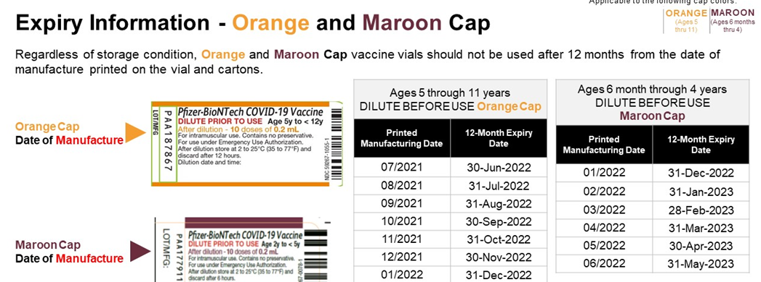
Pfizer Expiry Information

Slide 21
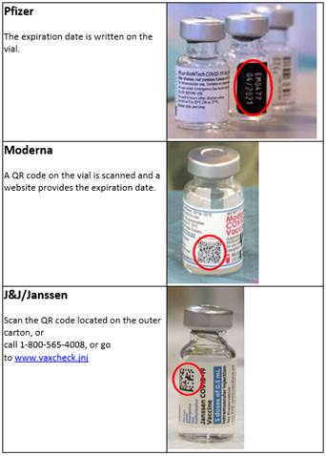
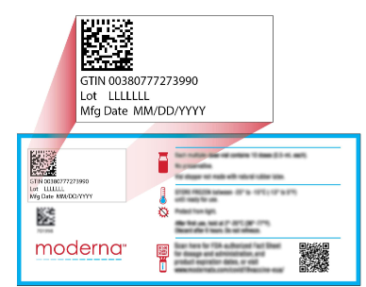
Moderna and Janssen Expiration
Important for all vaccines:
Check the expiration dates upon receiving vaccines.
Due to increased studies about stability data, check the expiration date again later (before administering vaccines and during weekly reconciliation).
Please note that Moderna expiration extensions only apply to vaccines that have not been thawed or refrigerated.
Reminder: Janssen should never be stored in the freezer or ultracold.
How to check expiration dates?
Scan QR code and it will take you to the website showing the expiration date.
Locate lot number on the package and type
into the website.
Janssen website
Moderna website
Notes:
Always check the expiration date upon receipt and prior to use.
Pfizer: Purple Cap follow Extension guidelines
Orange and Gray Cap follow Expiration Calculation 12 months from date manufactured if stored in UTL
Moderna extension on exp. Date
The extension is based on ongoing stability data and applies only to vials that were maintained at frozen storage temperatures between minus 50 degrees Celsius to minus 15 degrees Celsius (minus 58 degrees Fahrenheit to 5 degrees Fahrenheit). The extension does NOT apply to thawed vials that were refrigerated or thawed at any time.
Janssen Vaccine: On April 7, 2022, the FDA approved an extension of the shelf life for the Janssen COVID-19 Vaccine from 9 months (270 days) to 11 months (330 days). Please note that the shelf-life extension applies to all batches that have been released to the US market.

Slide 22
Johnson & Johnson Shelf Life Extension
Co-Administration
The Food & Drug Administration announced the approval of a shelf-life extension for the Johnson & Johnson’s Janssen COVID-19 vaccine for an additional 5 months.
The shelf-life of this vaccine has been updated from 6 months to 11 months.
This shelf-life extension applies to all inventory dated to expire on March 7, 2022 or later.
Vaccine dated prior to March 7, 2022, should be disposed of according to state and local regulation and reported as waste based on your COVID-19 provider agreement.
Vaccine providers should visit the Janssen COVID-19 Vaccine Expiry Checker webpage to confirm expiration dates. This shelf-life extension applies to refrigerated vials of J&J/Janssen COVID-19 vaccine that have been held in accordance with the manufacturer’s storage conditions.
Notes:
This decision is based on data from ongoing stability assessment studies that demonstrate that the vaccine is stable at 9 months when refrigerated at temperatures of 36° to 46° F (2° to 8° C).

Slide 23
Vaccine Ordering and Distribution
Margaret Archer, MPH
Data Analyst, Epidemiologist
Notes:
Next topic is vaccine ordering and distribution.

Slide 24
Reconciliation
Reconciliation – weekly
Providers are required to reconcile and order covid vaccines during the ordering time frame: Tuesday through Monday.
If a clinic doesn't reconcile COVID inventory for 14 days, they will not be able to create VFC & 317 vaccine orders.
An informational video on COVID 19 vaccine reconciliation and ordering can be accessed at https://vimeo.com/528424790
Inventory Reconciliation
Notes:
We want to remind you that inventory reconciliation is a requirement for all providers that order covid-19 vaccines, including County Health Departments. Covid-19 inventory must be reconciled weekly. Some providers have two inventory locations – one for normal vaccines, another for covid. Providers need to make sure they reconcile not only the default inventory location, but also the covid location.

Slide 25
Reconciliation and Vaccine Ordering
Reconciliation – Weekly Requirement
Providers are required to complete inventory reconciliation before ordering Covid Vaccines during the established COVID Ordering time frame: Tuesday through Monday with a cut-off at Monday 5 pm.
If a clinic does not reconcile COVID inventory for 7 days, they will not be able to create a vaccine order.
Providers can order as much as they need. If less than the minimum quantity is needed, providers will need to place an order for the minimum quantity and add a comment in the Clinic Comments text area indicating the number of doses needed.
Notes:
We want to remind you that inventory reconciliation is a requirement for all providers that order covid-19 vaccines, including County Health Departments. Covid-19 inventory must be reconciled weekly. Some providers have two inventory locations – one for normal vaccines, another for covid. Providers need to make sure they reconcile not only the default inventory location, but also the covid location.

Slide 26
Ordering Process: starting Aug 17 Minor change in delivery of orders with min quantities
Providers can create orders in OSIIS during the ordering timeframe which is Tuesday through Monday.
If an order is placed in OSIIS sometime between Tuesday May 3rd – Monday, May 9th, it will be processed and sent for fulfillment on Tuesday, May 10th.
Providers can order as much as they need. If less than the minimum quantity is required, you still need to order the minimum quantity and add a comment in the Clinic Comments text area indicating the number of doses needed.
For example, if you place an order for Pfizer 5-11 and Pfizer 12+ in the same order, and you wish to receive the minimum order quantity for Pfizer 12+ (300 doses) but only need 4 vials of Pfizer 5-11, please be sure to specify this information in the Clinic Comments.
Providers now have the option to opt-out from receiving Adult vaccine ancillary kits with their vaccine order.
If you wish to opt-out, please specify this information in the Clinic Comments.
Please note: opt-out is ONLY available for adult vaccine formulations.
Please do not refuse any vaccine shipments.
Notes:
Starting Aug 17, we'll have a minor change in delivery of covid-19 vaccines. Everything else stays the same.
Providers should always create their orders in OSIIS during the ordering timeframe. Providers can order as much or as little as they want. The min order quantities in OSIIS: Pfizer – 100, Moderna – 100. If you need less than min quantity, you will still select the min quantity and put the comment with the actual amount needed into the comment – how it is shown on the screenshot. Pfizer is available for adults and kids. If you are ordering only for ped population – select this option.
Please note: The opt-out option is not currently available for pediatric
COVID-19 vaccine as Pfizer pediatric ancillary kits contain the diluent
necessary to administer the vaccine.

Slide 27
Ordering Process
The cut-off to create orders in OSIIS – Monday, 5pm.
To make any changes or cancellations to orders after the deadline, providers must reach out ASAP.
To request a change, a provider should email to OSDH VaccineHelp <VaccineHelp@health.ok.gov>
If provider doesn’t receive a confirmation of changes/cancellation within 24h, provider must call the OSDH Immunization Service 405.426.8580 to ensure that the order has been cancelled.
Orders with at least min quantity, will be approved in OSIIS and directly shipped to providers – subjected to CHANGE depending on the available weekly threshold amounts.
Orders with less than min quantity will be rejected in OSIIS with a note that County Health Department (CHD) will fulfill the order and get in touch with the provider via email or phone.
Example of the message: "Your order will be fulfilled by your County Health Department. Watch for e-mail communication about the process and phone calls to arrange vaccine transfer."
CHDs will deliver vaccines to providers on the same or the following week. Delivered by CHD employees, national guard, or courier service.
Notes:
orders with at least min quantities or less than minimum quantities will be approved in OSIIS and will be fulfilled and delivered by CHDs depending on the available weekly threshold amounts.

Slide 28
Ordering Process
Upon delivery of vaccine by CHD, the provider should complete 4 steps:
Sign a Bill of Lading and keep a copy.
Check that delivered vaccines are viable.
Immediately place vaccines into storage according to the guidelines and label appropriately indicating expiration and/or Beyond-use dates (BUDs).
Accept transfer in OSIIS.
Questions about orders:
OSIIS: OSIISHELP@health.ok.gov
Vaccine ordering process: VaccineHelp@health.ok.gov
Order fulfillment/delivery: Contact CHDs (contacts will be shared in the follow-up email).
Notes:
I want to highlight the importance of the 4 steps each provider needs to do when receiving vaccines from CHDs. Please don't forget about the 4th step. If you don't accept the transfer in OSIIS, CHD will not be able to reconcile their inventory and order any vaccines.
If you have any questions about orders related to OSIIS: please reach out to the OSIIS help desk at “”
For questions about the vaccine ordering process: please contact VaccineHelp@health.ok.gov
For questions about order fulfilment/deliver, please reach out to the County Health Department’s contacts. This contact information will be shared in the follow-up email.

Slide 29
OSIIS Updates
Martin Lansdale, MPH
OSIIS Data Quality Coordinator

Slide 30
Moderna Booster in OSIIS
Notes:
Last week we received a request from CDC asking Oklahoma providers to regularly update information in VF. This must be done every day or at leaset every 72 hours. After this call, please check if your inventroy has been updated in VF.

Slide 31
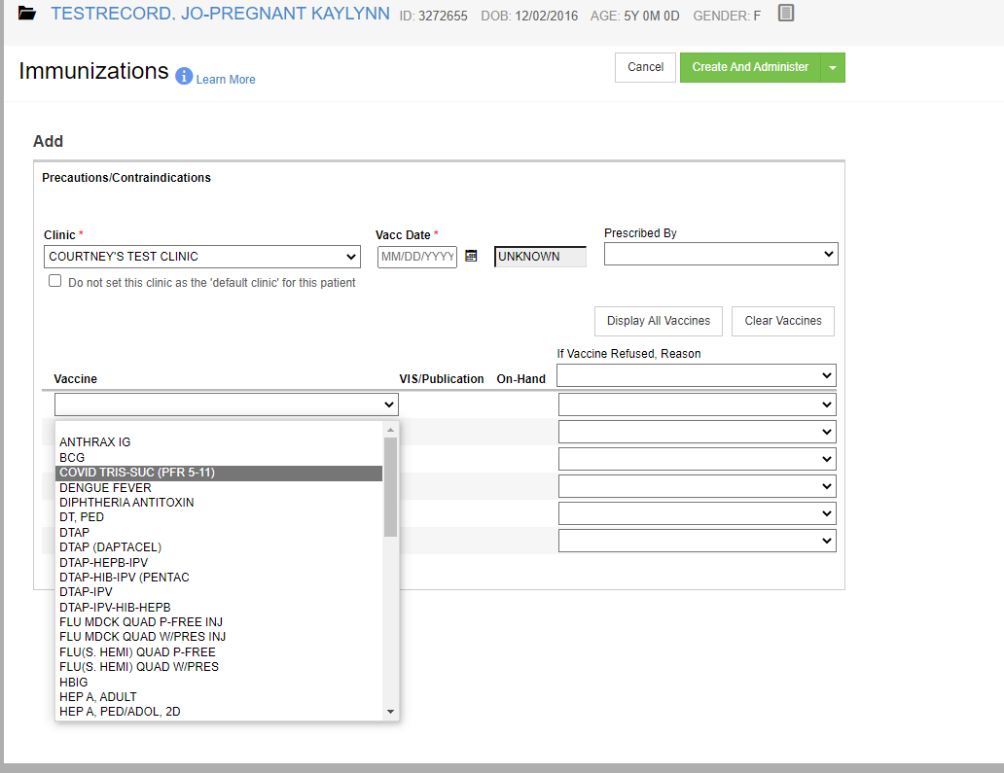
Pediatric Pfizer
Notes:
Last week we received a request from CDC asking Oklahoma providers to regularly update information in VF. This must be done every day or at leaset every 72 hours. After this call, please check if your inventroy has been updated in VF.

Slide 32
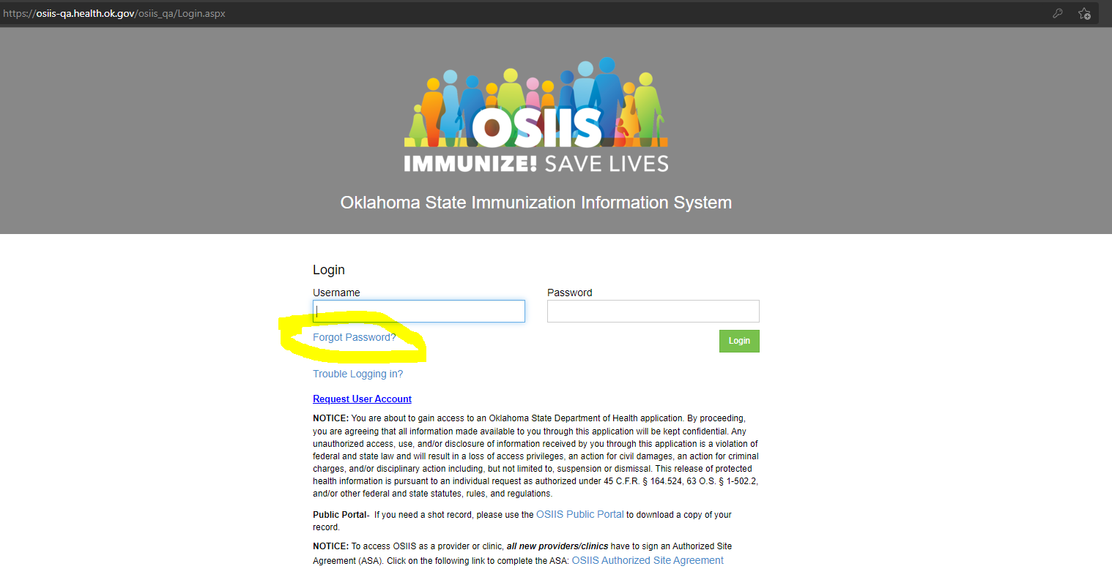
Updating Passwords in OSIIS
Notes:
Last week we received a request from CDC asking Oklahoma providers to regularly update information in VF. This must be done every day or at leaset every 72 hours. After this call, please check if your inventroy has been updated in VF.

Slide 33
Shot Records: Public Portal
OSIIS has a public portal that can be found at the below link:
https://osiis.health.ok.gov/osiis_public/Application/PublicPortal
DISCLAIMER: Not all shots are recorded in OSIIS as reporting private vaccine is not required.
Patients can search and download a copy of their shot record for just covid shots or their complete immunization history through the portal.
The public portal uses patient name, date-of-birth, email, and phone number for verification purposes (all have to be on the shot record in OSIIS or patients cannot pull their shot record).
Currently OSIIS has a high amount of missing emails/phone numbers.
Providers need to make sure to document email and phone number for the patient and add/send it to OSIIS with the shot record in order to increase the likelihood of a records match in the portal.
Notes:
Last week we received a request from CDC asking Oklahoma providers to regularly update information in VF. This must be done every day or at leaset every 72 hours. After this call, please check if your inventroy has been updated in VF.

Slide 34
How To Guides
"How To" Guides
Moderna Booster OSIIS Guide
How to Turn On User Default Order Notifications
Inventory Reconciliation
How to Place a Covid-19 Vaccine Order
Immunizing a Patient for COVID
How to add an extra dose
Wastage
Notes:
If you need help with any of the processes, please use our detailed "How to" guides.

Slide 35
Tips for Addressing Vaccine Hesitancy
Dr. Eve Switzer MD, FAAP
Notes:
Dr Switzer is a general pediatrician who has been in private practice at Northwest Pediatrics in Enid
for over 25 years. She received her medical degree from the University of New Mexico School of
Medicine and completed her pediatric residency at the University of Texas in San Antonio. She is
board certified in pediatrics and is a fellow of the American Academy of Pediatrics.
Dr Switzer is the current president of the Oklahoma Chapter of the American Academy of Pediatrics
and recently served as Co-Chair of the AAP’s National Nominating Committee. She is an adjunct
professor at the Oklahoma State University Center for Health Sciences. In 2014, Dr Switzer was
appointed to the Federal Advisory Committee on Training in Primary Care Medicine and Dentistry by
the U.S. Secretary of Health and Human Services. She also currently serves on the Board of
Advocates for the Oklahoma Children's Hospital Foundation.

Slide 36
Questions/Suggestions

Slide 37
Resources
Testing:
Nasopharyngeal, throat, saliva
Testing@health.ok.gov
Monoclonal Antibodies: (Amanda Cavner)
Antivirals@health.ok.gov
https://oklahoma.gov/covid19/what-you-should-know/monoclonal-antibody-therapies.html
Vaccine:
COVID-19 Vaccines | FDA
PREP Act Guidance
Interim Clinical Considerations for Use of COVID-19 Vaccines | CDC
COVID-19 Vaccination for Children | CDC
Pfizer: Home (cvdvaccine-us.com)
Moderna: What is Moderna COVID-19 Vaccine (EUA)? | How Does It Work? (modernatx.com)
J&J: Resources for COVID-19 Vaccine Education | Johnson & Johnson (jnj.com)
Notes:
Facilities can order PPE using the Big Commerce online ordering system.
If a facility needs assistance with setting up an account, please use the link, https://okppe.mybigcommerce.com/. Proceed to the "Need an Account?" page and complete the Contact Us for an account. Usually, an account is created within 24 hours.
For testing supplies and guidance, you can contact testing@health.ok.gov
There are limited quantities of NP, Throat, Saliva available
For questions regarding Monoclonal Antibody Theraputics: contact antivirals@health.ok.gov with questions about guidance or administration
There are currently 102 providers in Oklahoma, this website will take you to a map that tells you the location of the nearest provider of monoclonal antibodies is

Slide 38
Resources/Tools
OSIIS Training: https://osiis.health.ok.gov/osiis/Application/ApplicationHelp/Index
Notes:
Facilities can order PPE using the Big Commerce online ordering system.
If a facility needs assistance with setting up an account, please use the link, https://okppe.mybigcommerce.com/. Proceed to the "Need an Account?" page and complete the Contact Us for an account. Usually, an account is created within 24 hours.
For testing supplies and guidance, you can contact testing@health.ok.gov
There are limited quantities of NP, Throat, Saliva available
For questions regarding Monoclonal Antibody Therapeutics: contact antivirals@health.ok.gov with questions about guidance or administration
There are currently 102 providers in Oklahoma, this website will take you to a map that tells you the location of the nearest provider of monoclonal antibodies is

Slide 39
Vaccine Inventory Adjustment: On-Hand Expired Vaccines
When reconciling inventory, check that your facility has no expired inventory on hand.
Navigate to the Vaccine Inventory On-Hand screen by selecting:
Inventory > Vaccines > On-Hand from the left-hand menu.
Change the Status from On-Hand to Depleted/Expired
Locate the Filter tab
Locate the vaccine inventory item requiring an inventory adjustment.
Click the corresponding Action button and select Adjustment.
Complete the following required fields:
Date (enter the actual date on which the inventory was wasted)
Reason (select Vtrcks Other)
Modification (if a value does not default, select Add or Subtract to make the corresponding adjustment)
Doses Adjusted (enter the number of doses wasted for the selected reason)
Comments (Expired)
Click the Create button.
Click the On-Hand menu item to return to the Vaccine Inventory On-Hand screen where you can verify the inventory was adjusted correctly.
See attached video on Resources/Tools
Notes:
OSIIS (ok.gov)

Slide 40
QAs From Live Call
Notes:
Facilities can order PPE using the Big Commerce online ordering system.
If a facility needs assistance with setting up an account, please use the link, https://okppe.mybigcommerce.com/. Proceed to the "Need an Account?" page and complete the Contact Us for an account. Usually, an account is created within 24 hours.
For testing supplies and guidance, you can contact testing@health.ok.gov
There are limited quantities of NP, Throat, Saliva available
For questions regarding Monoclonal Antibody Theraputics: contact antivirals@health.ok.gov with questions about guidance or administration
There are currently 102 providers in Oklahoma, this website will take you to a map that tells you the location of the nearest provider of monoclonal antibodies is

