Slide 1


istance
Education

Slide 2
What do the following
Post-Secondary Institutions have in common?
Harvard University
Ohio State University
University of California
South Caroline Technical College System
Massachusetts Institute of Technology

Slide 3

ANSWER
3
Each of these
Post-Secondary Institutions have in common…
Each has had to resolve a civil rights complaint about the inaccessibility of its information technology, including technology used in online courses.
These complaints are usually brought through the Office of Civil Rights of the U.S. Department of Education or the Civil Rights Division of the Department of Justice.

Slide 4
Designing a
DE Course
4
Design is powerful in its ability to include some and exclude others.
Design that does not take into consideration the variety of ways students access online content differentially impacts certain students.

Slide 5
Accessible
Definition used by the Office of Civil Rights and U.S. Department of Education regarding inaccessible IT.
Means a person with a disability is afforded the opportunity to acquire the same information, engage in the same interactions, and enjoy the same services as a person without a disability in an equally effective and equally integrated manner, with substantially equivalent ease of use.
The person with a disability must be able to obtain the information as fully, equally, and independently as a person without a disability.

Slide 6
Accommodation
An adaptation that is made for a specific individual when a product or service is not accessible.

Slide 7

Helpful Hints to Building a Dyslexia Friendly
DE Course
      Readable Fonts
      Heading and Structure
      Color
      Layout
      Writing Style

Slide 8
The two biggest things to focus on when building your DE lessons:
8
&
1. What is the best font to use for ease of reading and those individuals with dyslexia?
2. Color schemes, layouts and contrast color blind individuals

Slide 9
What is the best typeface to use for individuals with dyslexia and why?
Serif
A serif font features strokes at the end of the letterforms.
These strokes are referred to as “serifs” and they help guide the eye when reading text.
Sans-Serif
A sans-serif font does not have strokes at the end of its letterforms.
Sans-serif fonts have a more modern appearance and are often used in digital media.
OR

Slide 10
What Is Sans Serif And Why Use It?
10
Sans-Serif (Dyslexia friendly)
A, E, I, R, M, N
        Arial
        Comic Sans
        Verdana
E

Slide 11
What Is Serif And Why Use It?
Serif
  A, E, I, R, M, N
    Georgia
    Times New Roman
    Aldhabi
E

Slide 12
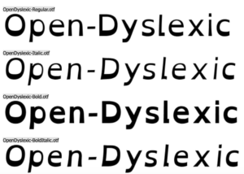
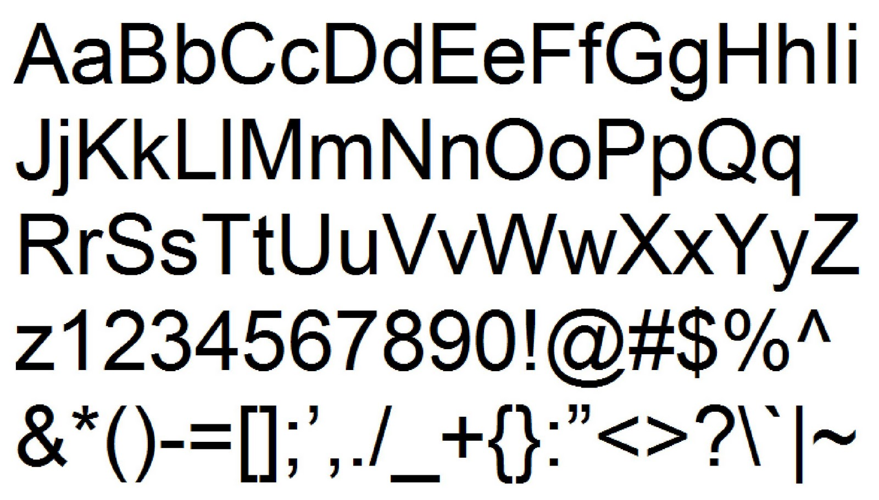
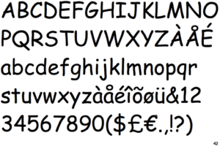
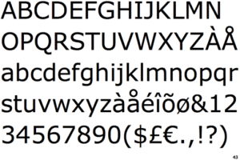
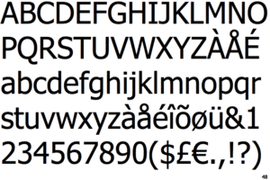
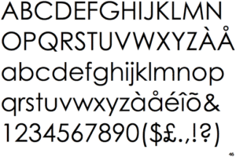
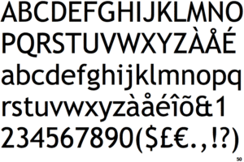
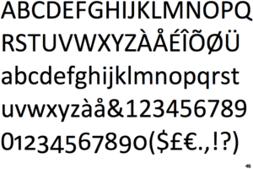
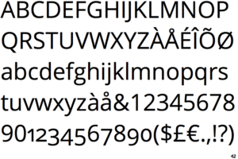
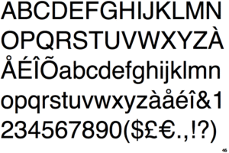
What is the Top 10 typeface to use for individuals with dyslexia and why?
1. Open-Dyslexic
2. Arial
3. Comic Sans
4. Verdana
San Serif
5. Tahoma
6. Century Gothic
7. Trebbuchet
8. Calibri
9. Open Sans
10. Helvetica
Dyslexia Friendly Fonts: The Top 10 Fonts for Dyslexia (exceptionalindividuals.com)

Slide 13
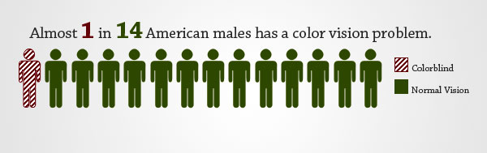
Indistinguishable Colors In Color Blindness

Slide 14
Color Blindness is the BIGGEST Issue and Receives the MOST Complaints.
Red-Green Colorblindness
Deuteranomaly | Can see more green shades than red
Protanomaly | Can see more red shades than green
Protanopia | Both colors are hard to tell the difference between red and green
Blue-Yellow Colorblindness
Tritanomaly | Hard to differentiate blue/yellow along with red and yellow
Tritanopia | Makes it difficult to tell the difference be certain color combos, blue/green, purple/red and pink/yellow.
Colors, all around will look less bright.

Slide 15
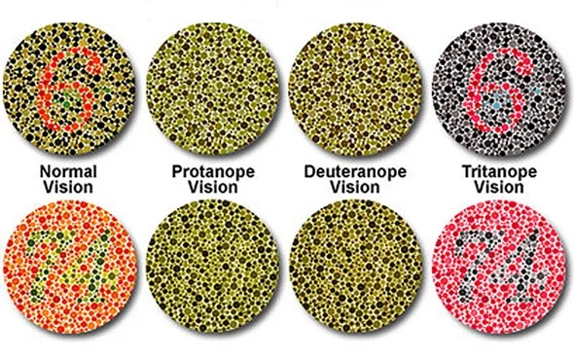
Ishihara Color Blindness Test
15
Normal
Vision
Protanope
Vision
Deuteranope
Vision
Tritanope
Vision

Slide 16

Protanomaly
Protanomaly
(red-green color blindness), affects the red cone cells. People with this type struggle to differentiate between red and green colors.

Slide 17
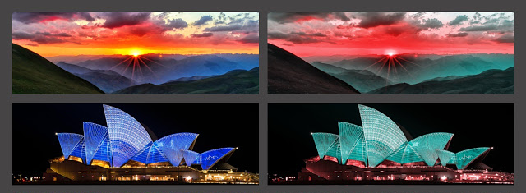
Tritanomaly
Tritanomaly
(blue-yellow color blindness) which is caused by the malfunction of blue cone cells. This affects the ability to perceive blue and yellow colors

Slide 18
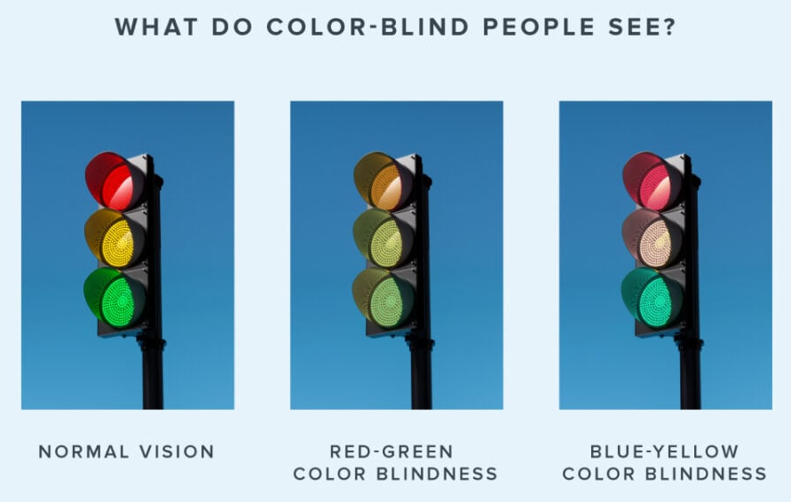
Indistinguishable Colors In Color Blindness

Slide 19
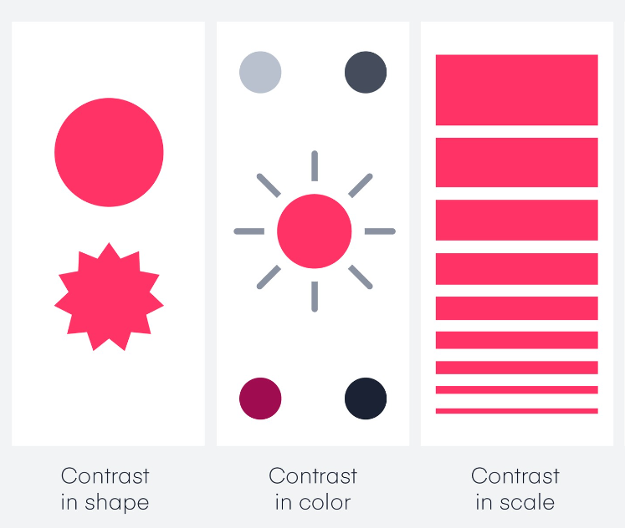
Helpful Hints to Building a Color-Blind Friendly DE Course
Avoid color combinations
    especially problematic colors
Make it monochrome
Use high contrast
Use thicker lines
Use both colors and symbols
Modify brightness, saturation, hue
Easy to spot links
wearecolorblind.com

Slide 20
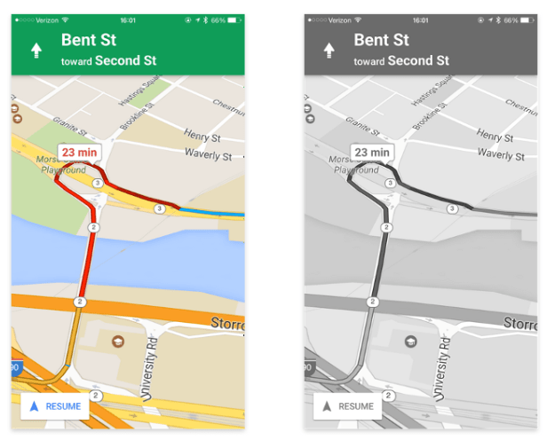
Indistinguishable Colors In Color Blindness

Slide 21
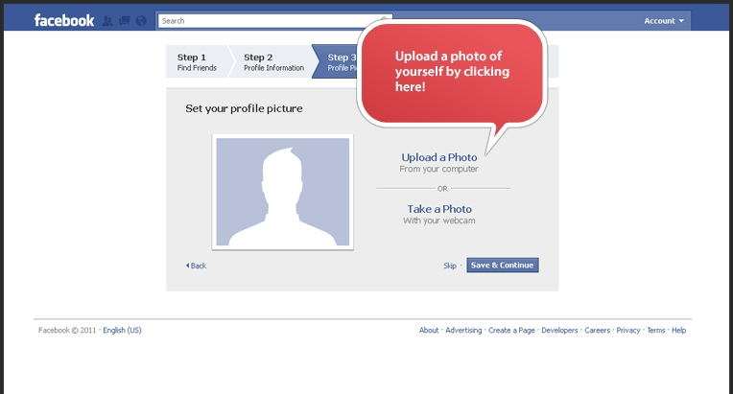
Indistinguishable Colors In Color Blindness

Slide 22
Main Objective When Designing Your DE Classes
A well-designed course is more usable for all students. The design also takes into consideration that not all students navigate or access the online environment in the same way. This toolkit focuses on three key principles:
Intuitive: The layout of the course is simple, consistent and predictable.
Perceivable: The content is designed so that it can be perceived by a wide range of users, regardless of disability.
Navigable: Course navigation does not assume that the student is using a specific device, such as a mouse. A user can navigate the course using the keyboard alone or with the use of assistive technology in ways that are equally effective.

Slide 23
Where to start?
World Wide Web Consortium (W3C)
https://www.w3.org/WAI/standards-guidelines/wcag/
Web Content Accessibility Guidelines (WCAG) – 2.0/2.1
https://www.w3.org/TR/WCAG21/
https://webaim.org/standards/wcag/checklist

Slide 24

The W3C is an international community where members organizations, a full-time staff and the public work together to develop strategies, standards, resources to make the web accessible to people with disabilities.
Mission: Is to lead the world wide web to it’s full potential by developing protocols and guidelines that ensure the long-term growth of the Web.
Vision: Involves participation, sharing knowledge, and thereby building trust on a global scale.
24

Slide 25

WCAG 2.1
Provides common definition for accessible content, a benchmark. Web “content” is the information in a web page, or web application, including natural information such as text, images, and sounds. Code or markup that defines structure, presentation, etc.
25

Slide 26
26
WCAG 2.1 Title IV Section 508 §E207.2
The relationship between Section 508 and WCAG standards. In the revised 508 standards (began January 18, 2018), there was a change that basically says that 508 aligns with WCAG levels A and AA.
E207.2 WCAG Conformance: User interface components, as well as the content of platforms and applications, shall conform to Level A and Level AA Success Criteria and Conformance Requirements in WCAG 2.0 (2.1 has since been released).

Slide 27
WCAG 2.1
27
The WCAG checklist is broken up into 4 principles:
1. Perceivable
2. Operable
3. Understandable
3. Robust

Slide 28
28
WCAG 2.1
Perceivable:
1.1 Text Alternatives
1.2 Time-base Media
1.3 Adaptable
1.4 Distinguishable

Slide 29
WCAG 2.1
29
Operable:
2.1 Keyboard Accessible
2.2 Enough Time
2.3 Seizures
2.4 Navigable
2.5 Input Modalities

Slide 30
30
WCAG 2.1
Understandable:
3.1 Readable
3.2 Predictable
3.3 Input Assistance
4.1 Robust

Slide 31
WCAG 2.1
31
The guidelines are categorized into three different conformance levels (Level A, Level AA and Level AAA) based on the impact they have on design or visual presentation of the pages in order to meet the needs of different individuals and different situations. Conformance levels must be met in full and conformance to higher levels indicates conformance at lower levels

Slide 32
WCAG 2.1
32
Level A – Sets the minimum level of accessibility and does not achieve broad accessibility for many situations.
Level AA – The most common level of conformance to obtain. This is the recommended conformance for all web-based information.
Level AAA – It is not recommended to strive for a full AAA compliance as it is not possible to satisfy all Level AAA Success Criteria for some content.

Slide 33
Tips to keep in mind when designing DE classes
33
Use clear, consistent layouts and organization schemes to present content.
Use descriptive wording for hyperlink text (e.g., “DO-IT Knowledge Base” rather than “click here”)
Images – minimize the use of PDF’s, provide concise alternative-text descriptions of content presented with images.
Make sure all content and navigation is accessible using the keyboard alone.
Caption or transcribe video and audio content.

Slide 34

Oklahoma ABLE Tech
The link below takes you to the ABLE Tech – Resources: Information Technology Accessibility page:
34
Home - Oklahoma ABLE Tech (okabletech.org)
Document Accessibility
Audio & Video Accessibility
Test Alternative, Writing Content and Color
Procurement, Purchasing and Use Decision Making
Web Accessibility
Email & Marketing Tools Accessibility
Social Media Accessibility

Slide 35
Once Your DE Class Is Built…
What’s Next?
35
1. Accessibility Forum (AF). What is an AF and why use it?
Microsoft has a really good AF program(s). There are also other AF programs out there that are just as good.
If your school/tech center decides to purchase an AF program, you need to make sure have the required language in the agreement to ensure that you are getting exactly what you want and an AF that will meet all the ADA regulations. I have a standard, “language for purchasing agree for an AF” if you would like a copy.

Slide 36

Any questions?

Slide 37
Thank you
Alan Nahs
Civil Rights and Title IX Coordinator
Alan.nahs@careertech.ok.gov
405-743-5578 office
405-880-9457 Cell

