Slide 1
TC Info Submissions

Slide 2
CTIMS Support Contact Information
Email: CTIMSSupport@careertech.ok.gov
Phone: 405-743-5134

Slide 3
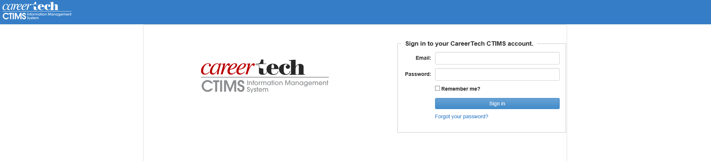
Go to https://ctims.okcareertech.org/CTBDSWeb
Sign into CTIMS using your school email address and password.

Slide 4
Create New Certified PID

Slide 5
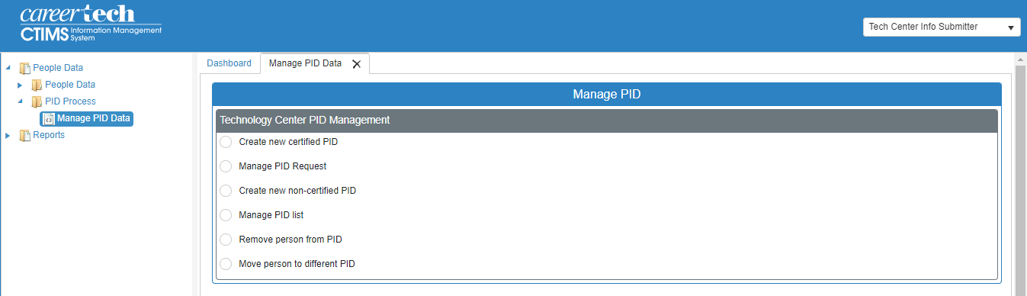
On the left navigation menu:
Click the arrow next to People Data. Then click the arrow next to PID Process.
Select Manage PID Data.
Click on Create new certified PID.
NOTE: There is an approval process for certified PIDs.

Slide 6
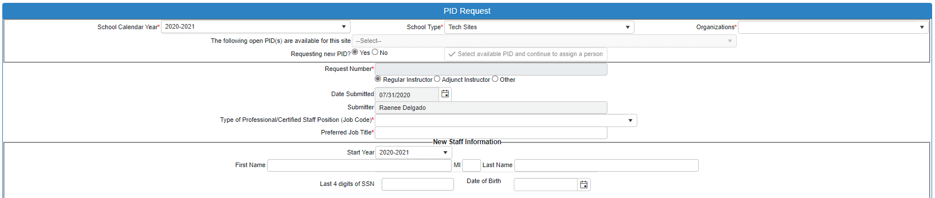

Type the first 3 letters of the organization next to Organizations*.
Select Yes next to Requesting new PID?
Fill in the following: Type of Professional/Certified Staff Position (Job Code)* (the only option here is 066-Instructor)
Fill in the following: Preferred Job Title* (Once you select 066 for the job code a new section will populate under the new staff information section.)
If you have the new staff member’s information, fill out the New Staff Information section.
1.
2.
1.
2.
3.
4.
3.
5.
4.

Slide 7
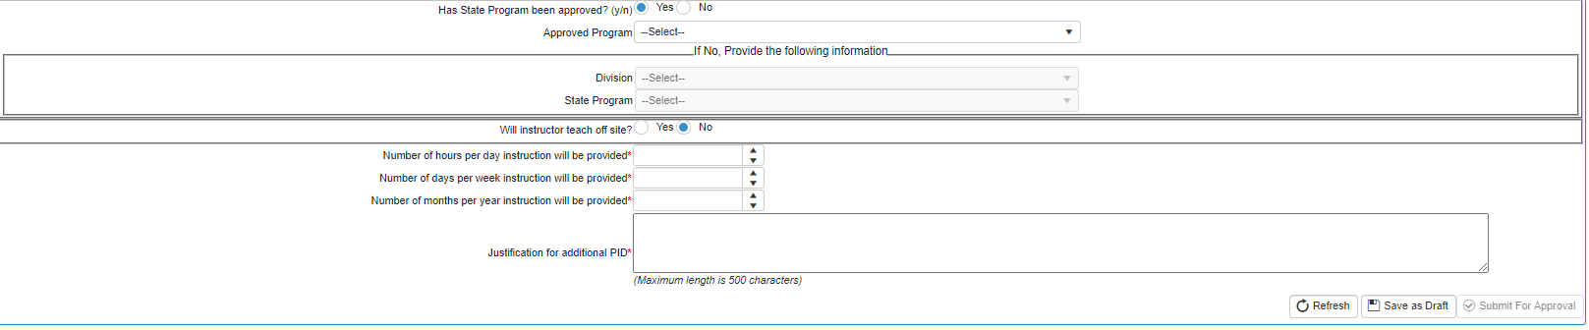
Select if state program has been approved or not.
If yes, select the approved program from the drop down.
If no, select the division and state program under the If No, Provide the following information section.
Select if the instructor will be teaching off site or not.
If no, enter the number of hours per day, per week and per year instruction will be provided. These 3 fields are required. Justification for new PID is required.
Click Save as Draft.
1.
2.
3.

Slide 8
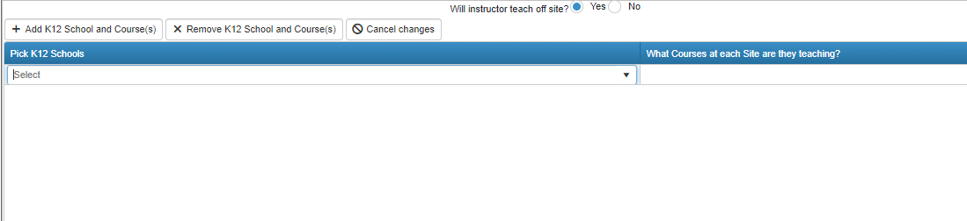
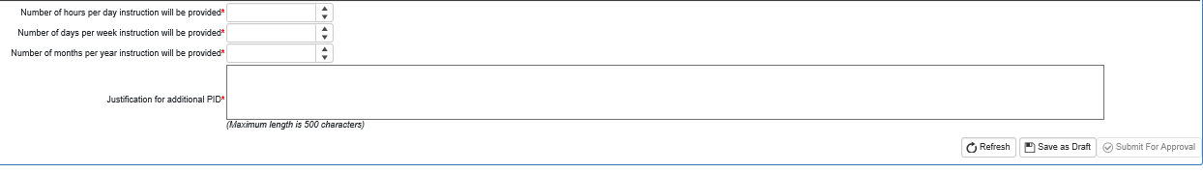
If you select yes the instructor will be teaching offsite, click + Add K12 School and Courses button to add the comprehensive school and the courses at each site they will be teaching.
Enter the number of hours per day, per week and per year instruction will be provided. These 3 fields are required. You must enter a justification as to why you are needing this new PID.
Click Save as Draft.
1.
2.
3.

Slide 9
Adding existing person (in CTIMS) to an available certified PID:
Type the first 3 letters of the organization next to Organizations*.
Keep No selected next to Requesting new PID?.
Click Select available PID and continue to assign a person.
Click drop-down arrow next to The following open PIDs are available for this site to see available PIDs.
1.
4.
2.
3.

Slide 10
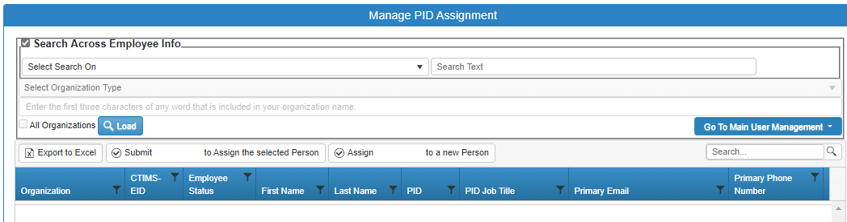
Click the box to the left of Search Across Employee Info.
Click the drop down and choose how you want to search for the person you just assigned to PID.
Type the text to search in the search text box.
Click Load.
Select the person to go into the PID from the results.
Click Submit (PID-) to assign the selected person.
1.
2.
3.
4.
6.
5.

Slide 11
Adding a new person to an available certified PID:
Type the first 3 letters of the organization next to Organizations*.
Keep No selected next to Requesting new PID?.
Click Select available PID and continue to assign a person.
Click drop-down arrow next to The following open PIDs are available for this site to see available PIDs.
1.
4.
2.
3.

Slide 12
Click the box to the left of Search Across Employee Info.
Click the drop-down menu to choose what search criteria you want to use to find the person that was assigned to the PID.
Type the text to search in the search text box.
Click Load.
Select the person to go into the PID from the results.
Click Assign (PID-) to a new person.
1.
2.
3.
4.
6.
5.

Slide 13
Manage PID Request
Check where the PID request is in the approval process

Slide 14
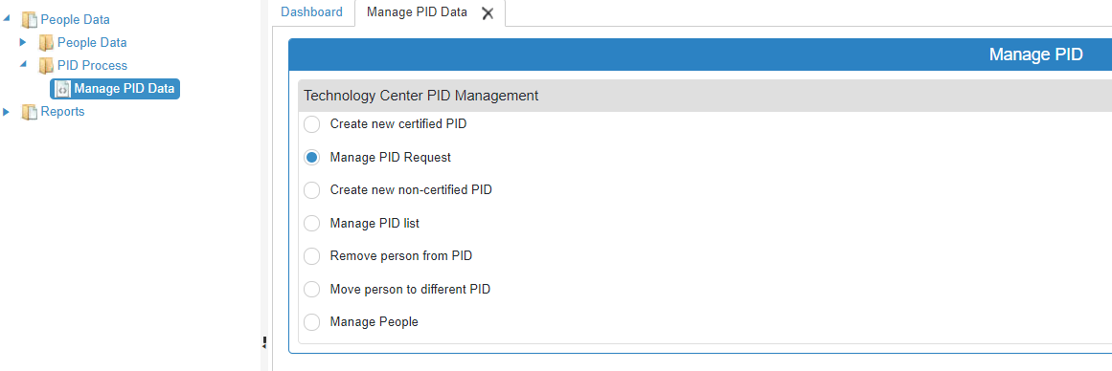
On the left navigation menu:
Click the arrow next to People Data. Then click the arrow next to PID Process.
Select Manage PID Data.
Click on Manage PID Request.

Slide 15
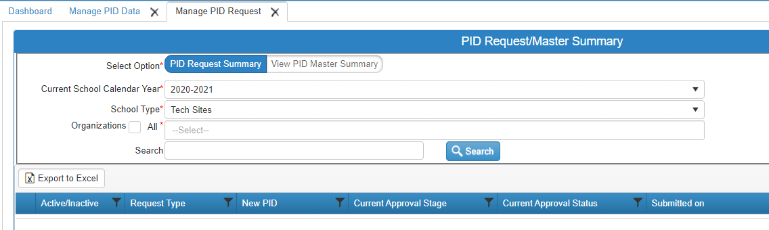
Type your organization next to Organizations All* or click the check box next to All* to pull all campuses.
Click Search.
1.
2.

Slide 16
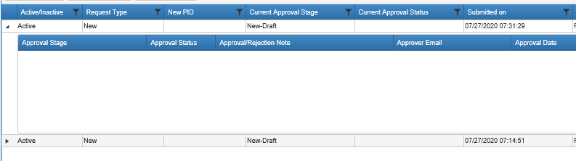
Click the arrow to the left of the PID request to check where the request is in the process.
1.
Clicking the arrow will open the window to see approval stage, status, approval/rejection notes, etc.

Slide 17
Create New Non-Certified PID

Slide 18
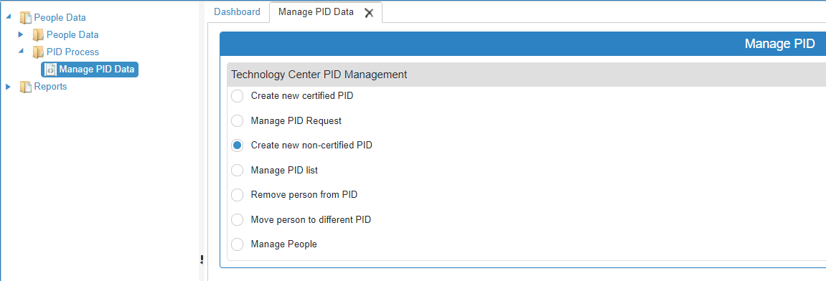
On the left navigation menu:
Click the arrow next to People Data. Then click the arrow next to PID Process.
Select Manage PID Data.
Click on Create new non-certified PID.

Slide 19
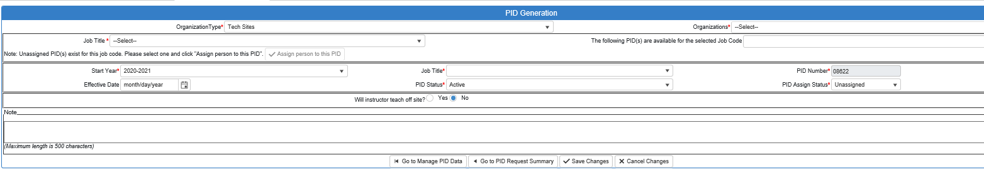
Type the first 3 letters of your organization next to Organizations and select it.
Click the drop-down next to Job Title and start typing the job title you are looking for and select it.
You can click the drop-down next to The following PID(s) are available for the selected Job Code to see if there is already an available PID at that campus for that job title.
If yes, click Assign person to this PID.
If no, click Save Changes.
1.
2.
3.
4.
5.

Slide 20
Manage PID List
To update contract length, state programs and percent funding

Slide 21
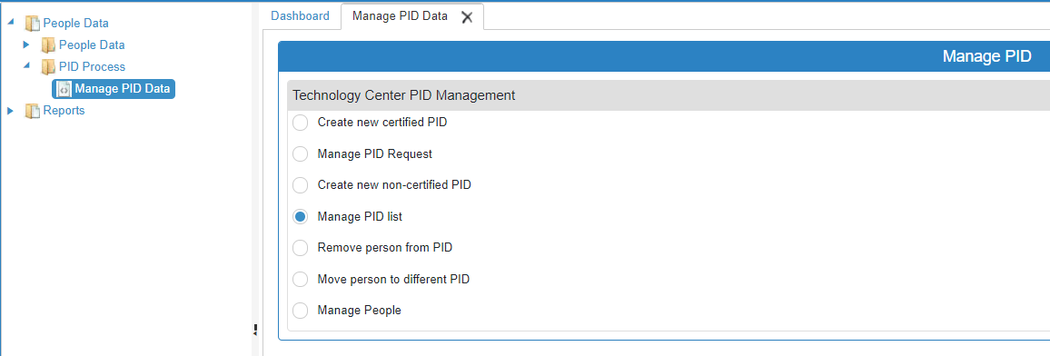
On the left navigation menu:
Click the arrow next to People Data. Then click the arrow next to PID Process.
Select Manage PID Data.
Click on Manage PID list.

Slide 22
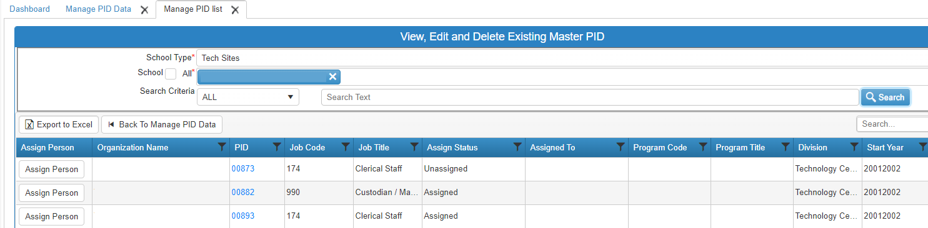
Type the first 3 letters of your school next to All.
Click Search.
To update funding or contract information, click blue the PID hyperlink.
1.
2.
3.
NOTE: You can assign a person to a PID from this screen, as well. Click the Assign Person button next to the line with the correct PID.

Slide 23
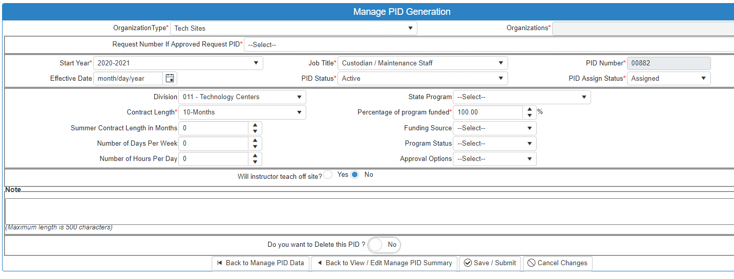
Update any information needed. Then click Save / Submit.

Slide 24
To assign someone to an existing PID:
Click the Assign Person button next to the correct PID. (You can filter the PID column to find the PID you are looking for).
1.

Slide 25
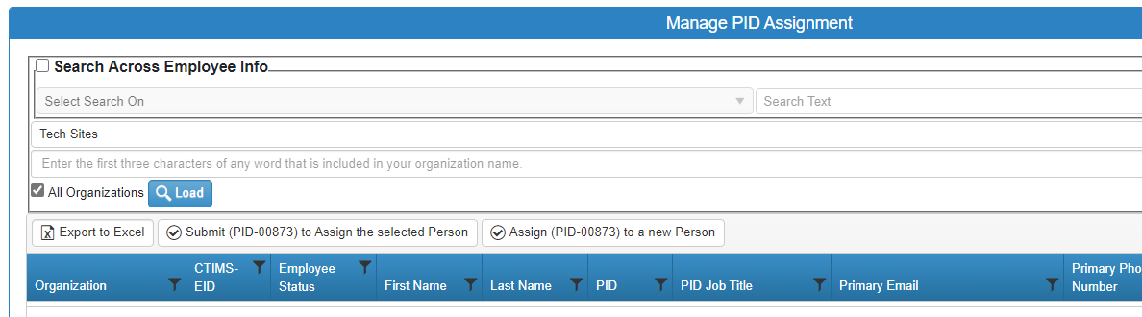
Click the drop-down for Select Organization Type and choose Tech Sites.
Enter the first 3 characters of any word that is included in your organization’s name.
Uncheck the box next to All Organizations.
Click Load.
In the results, select the person to go into the PID by clicking anywhere on the row to highlight it. (You can filter each column to narrow your search.)
Click Submit (PID-) to Assign the selected Person.
1.
2.
3.
4.
6.
5.

Slide 26
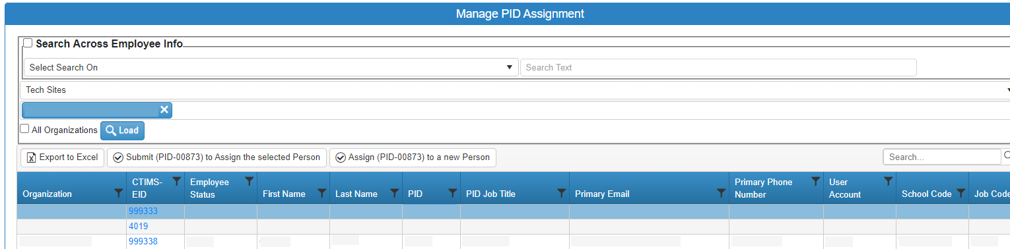
From the Manage PID Assignment screen you can click on the CTIMS-EID number link to see/update someone’s personal information.

Slide 27
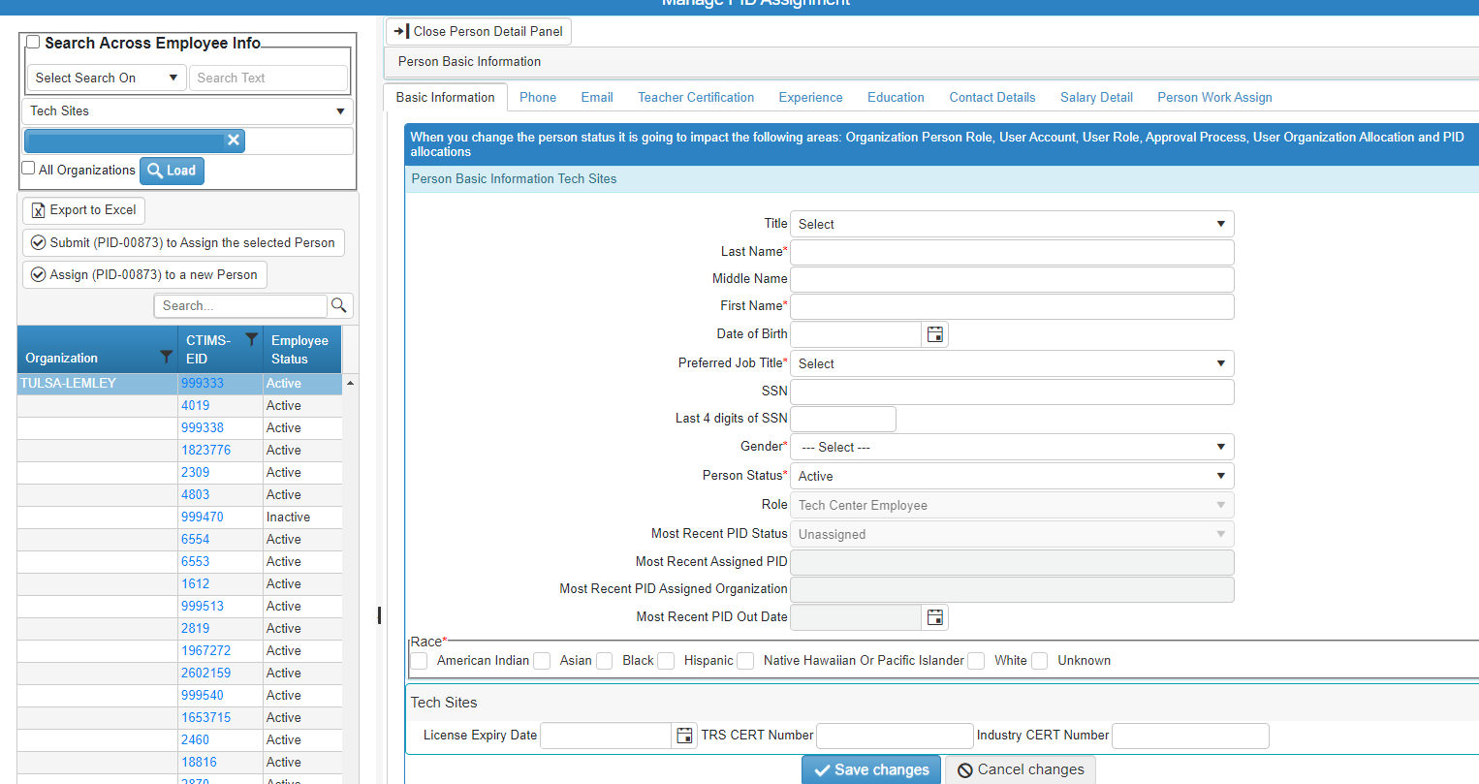
The screen will split. You can update or add information to any screen.
When updated, click Save Changes at the bottom.
There are multiple tabs. Click on a tab to go to a new information screen.

Slide 28
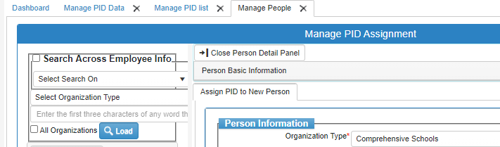
After you save changes, click ok.
Then click Close Person Detail Panel.

Slide 29
Remove Person from PID
.

Slide 30

On the left navigation menu:
Click the arrow next to People Data. Then click the arrow next to PID Process.
Select Manage PID Data.
Click on Remove person from PID.

Slide 31
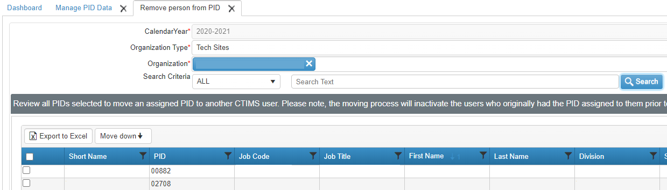
Type the first 3 letters of the Organization.
Click Search.
Click the check box to the left of the person you are needing.
Click Move down.
1.
2.
4.
3.

Slide 32
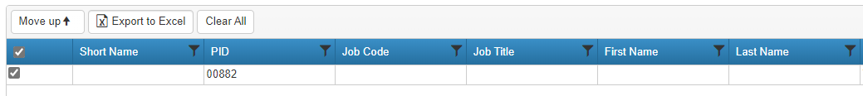
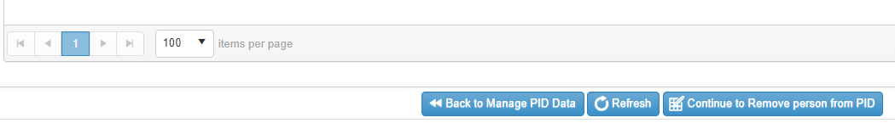
Scroll down to the bottom of the page and click Continue to Remove person from PID.
Click ok.

Slide 33
Move Person to Different PID
.

Slide 34
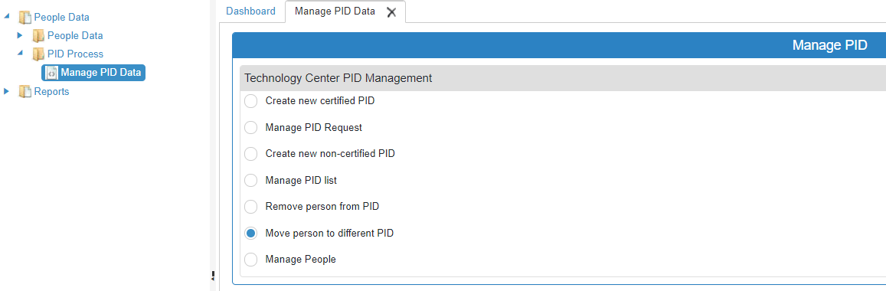
On the left navigation menu:
Click the arrow next to People Data. Then click the arrow next to PID Process.
Select Manage PID Data.
Click on Move person to different PID.

Slide 35
Type the first 3 letters of the Organization.
Click Search.
Click the check box to the left of the person to be moved.
Click Move down.
1.
2.
4.
3.

Slide 36
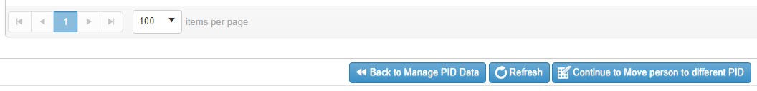
Scroll down to the bottom of the page and click Continue to move person to different PID.
Click ok.

Slide 37
Manage People
To update individual information

Slide 38
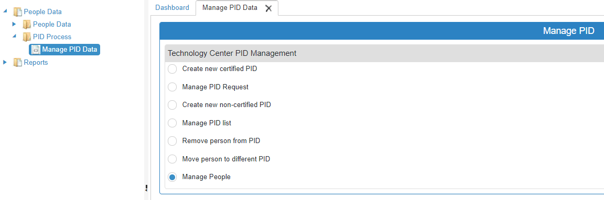
On the left navigation menu:
Click the arrow next to People Data. Then click the arrow next to PID Process.
Select Manage PID Data.
Click on Manage People.

Slide 39
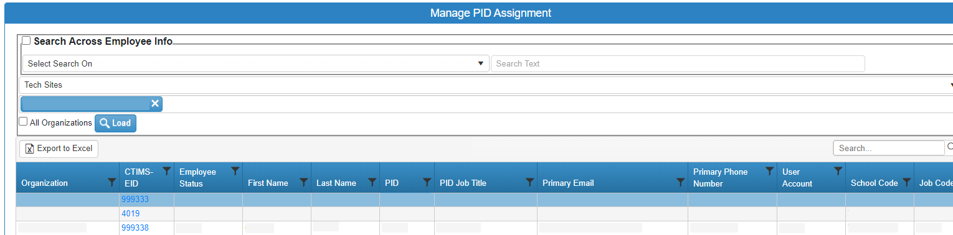
Click Load to load all organizations assigned to you.
Or uncheck All organizations and enter the first characters of any word that is included in your organization name under Tech Sites.
Or you can click the box in the left of Search Across Employee Info at the top of the page to search by employee.

Slide 40
The screen will split. You can update or add information to any screen.
When updated, click Save Changes at the bottom.
There are multiple tabs. Click on a tab to go to a new information screen.

Slide 41
After you save changes, click ok.
Then click Close Person Detail Panel.

