Slide 1
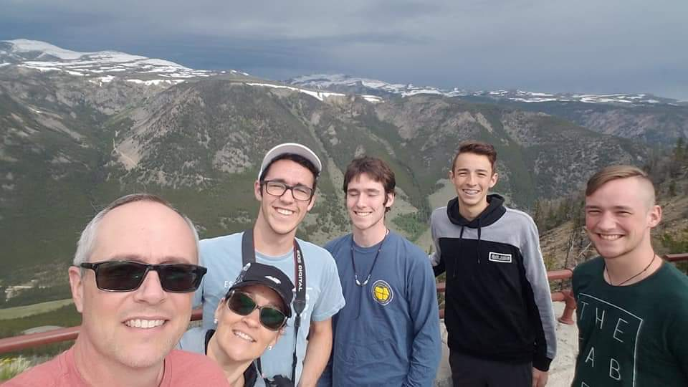
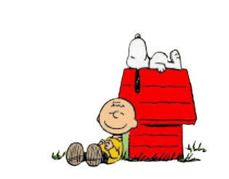
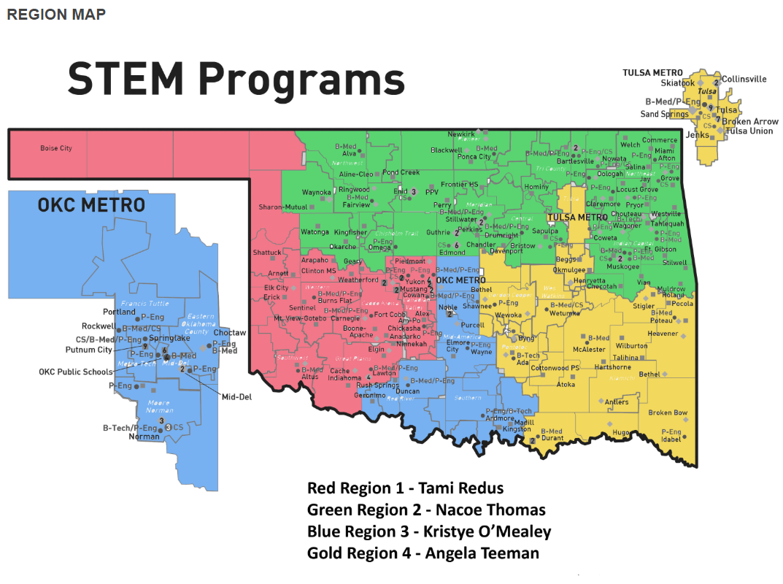
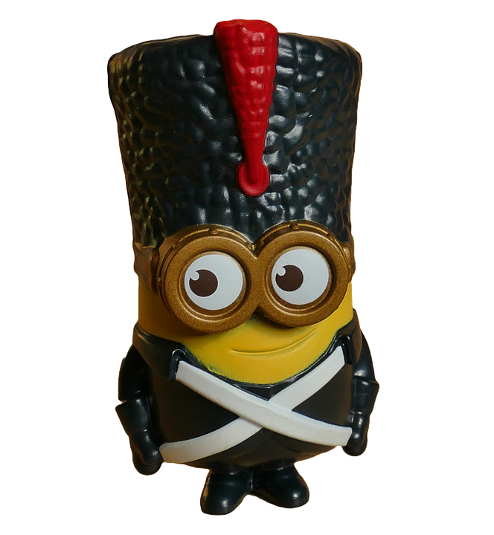
B I B L E
Program Evaluations
N
Notes:
Click the audio icon in the thought bubble to get started.

Slide 2
Here is how this presentation works:
As you progress through each slide, you will learn about the evaluation process.
Anything that is underlined in future slides will be a link to a video or document. Any ‘PLAY’ icons will be voice instructions, so click on those.
All of the details will be covered here and throughout the presentation, you will see links to the contact information you need for any questions that you may have as you prepare.

Slide 3
Table of Contents
Documentation
Standard 1
Standard 4
www.ctyou.org
Standard 2
Standard 5
FAQs
Standard 3
Standard 6

Slide 4
Documentation
Why are we asking for it?
CareerTech programs are funded by a line item in the Federal budget. So, as a state agency, that money funnels through us; therefore, we are required to make sure that our programs are meeting the appropriate standards.
How do I know what I need to gather/prepare?
The document our staff uses to assess each program is labeled K12 Program Evaluation Document.
It is located on ctyou here. You can download the document and know exactly what you need to prepare. We will walk through it during the FAQs.

Slide 5
Documentation
When do I have to have all of these things together?
We ask you to have all of the documentation loaded into ctyou 2 weeks before your on-site visit.
We look through it beforehand so that when we come, we can talk about anything we may need further explanation on.
Do I have to account for the last 5 years? What if I’m new?
Yes, these evaluations happen every 5 years so you need to gather what you can from the last 5 years.
If you are new - relax! If the previous teacher did not leave anything helpful, start from scratch and we will help where we can.

Slide 6
www.ctyou.org
What is ctyou?
Ctyou is our LMS. This is where we store ALL of the resources we provide for you. It is also where you will store ALL of your documentation.
Click here to watch a 13 minute video of how to locate your school folder and how to add documentation to it.
If you are ever asked for an enrollment key, use ‘STEM40’.
What if I have never used ctyou before?
No problem! You will just create an account. This takes about 3 minutes and was mentioned in the video you just watched.
Like anything new, the more you use it, the easier it gets! Don’t hesitate to contact your specialist if you need help!!!

Slide 7
Frequently Asked Questions
What if something happens and I need to reschedule my on-site visit?
This is no big deal! If something comes up on your school calendar, if you have a sick kid, if you wake up sick yourself and etc… Just give us a call as soon as you know and we will reschedule our visit date.
What if this is the first year our school has had this CareerTech program?
Then of course we won’t expect you to gather any information for the past 5 years because there is none.
We will still make a visit to your school and just help you to make sure that you are documenting things for the next time around.

Slide 8
Frequently Asked Questions
What if I can’t find some of the items you need?
Most of the documents that you may not be able to find, we are likely the ones that find those anyway. On the evaluation document, when you see the phrase ‘STEM Specialist will document’, that means that we will grab that information from our own records.
Let’s talk about this document, shall we.
Click here.

Slide 9
Standard 1
Standard 1 is verifying a few administrative things :
That your school has signed the right paperwork…your specialist will document this.
That your courses have the correct OCAS codes for the state.
The only documentation that YOU need to provide for this standard is a screenshot of your OCAS codes.
Click here for a document covering how to check your OCAS codes with screenshots to guide you through the easy
5-step process.

Slide 10
Standard 2
Standard 2 is where most of the action is happening.
This standard encompasses “teacher items”
AND
TSA requirements
The short list for teacher items :
Strategic Plan
Syllabus
Lesson Plans
Class Schedule
Differentiation exs
Use of Technology
The short list for TSA :
Affiliation
FLC/SLC
Program of Work
Meeting minutes
Community Service

Slide 11
Standard 2
Things the specialist can document for you on this standard are :
Class Schedule
Affiliation
FLC/SLC
Program of Work, IF you have been sending it in annually
The Strategic Plan seems to be the item teachers struggle with. Don’t stress.
We are looking at how you are planning to grow and sustain your program for the next 3 - 5 year. It is a living document that you can just edit annually as you make progress.
There are templates on ctyou (in the ‘Standards & Resources’ box) or you can make your own document just the way you want.

Slide 12
TSA
A few things to remember:
This is a ‘student - led’ organization
Elected officers should be doing most of the work
FLC is where they learn how to create the Program of Work and usually have time to do it there
President and VP should do agendas
Secretary should take minutes
Treasurer should help account for fundraisers
Reporter should handle social media
Sergeant-at-Arms should work on community service
As the teacher, you guide and oversee but the students run the show. You are training them to be responsible leaders, which is why the organization is so valuable!

Slide 13
Standard 3
Standard 3 is verifying :
Enrollment - can’t exceed 24
Program of Study - that your school has a list of STEM courses from 6th - 12th grade, including options from the Tech Center you feed in to, so that the students can know where to go next if they want to continue
Career Development
The specialist will verify enrollment from past reports.
The Program of Study is a document that you need only create one time. Check with your counselor and local Tech Center to see if they have already created one before you start.
We want to know what career development opportunities you are providing in your course.

Slide 14
Standard 4
Standard 4 is about verifying data.
If you are in a K12 school, your specialist can verify ALL the reports, IF, you have been sending in your 412 reports annually. Otherwise, you may have to contact your financial district personnel.
The only information a teacher would have to document for this standard is HIGH SCHOOL COURSE SCORES.
The only scores we document are AP and PLTW EOIs.

Slide 15
Standard 5
Standard 5 is basically where you brag on yourself!
We are looking at teaching credentials, awards, PD and etc…
Your specialist will verify your annual CareerTech PD - like Summit, teacher academies and etc…
YOU SHOULD DROP PICTURES OF ::
Your teaching certificate
Any PD certificates that you have earned - STEM only
Awards you have received

Slide 16
Standard 6
Standard 6 is verifying things having to do with program operations.
The following are observed during the ON-SITE visit :
Facilities
Equipment/Suppllies
Inventory
Safety
You will provide documentation for :
Advisory Committee
Industry Involvement
For Advisory Committee, provide :
Meeting minutes
Sign-in sheet with the names and titles of the individuals present
Suggestions that were made to your program strategic plan and how you will address those
For Industry Involvement, provide:
Pictures of guest speakers, tours, projects, community service, etc...

Slide 17
If you have ANY questions at all, please reach out to your region specialist. Our contact information can be found here.
We are here to assist you in this process in any way that we can. We are happy to answer any questions or walk you through any procedures - either on the phone or via Zoom,
We want to make this process as smooth and as painless as possible. We know that our teachers are doing amazing things! We love building relationships with you and seeing your classrooms in action.
The goal of our division is to help you have strong, growing programs. Our desire is for continuous improvement in our office as we serve you and in your programs as they continue on.

