Slide 1

Time Management Skills
Developed by Resource Center for CareerTech Advancement, a division of Oklahoma CareerTech

Slide 2
Mastering Techniques for Learning
Learning never ends. Whether at work or in class, all people are constantly learning. If you develop efficient and effective techniques for learning, you will acquire more knowledge than those who have not learned how to learn. As a result, you will reach your goals more easily and quickly. Specific skills and techniques can be learned to help increase the ease, rate, and accuracy of acquiring knowledge.

Slide 3
Mastering Techniques for Learning
Techniques for Learning in a Classroom
Develop a positive, “can-do” attitude.
Attend all classes.
Be on time.
Sit where you can see and hear and can be seen and heard.
Read and complete assignments.
Preview the day’s assignment before class.
Come to class prepared to discuss and ask questions.
Take careful, readable notes.

Slide 4
Mastering Techniques for Learning
Techniques for Learning in a Classroom - continued
Listen with your full attention.
Ask questions when you don’t understand.
Review information as soon as possible after class.
Get to know some other serious students.

Slide 5

Mastering Techniques for Learning
Techniques for Remembering
Associate – connect new information to something you already know.
Count – learn the number of items involved.
Sound out – make an image with sound.
Shorten – take parts of the information and arrange them into your pattern or mnemonic.
Visualize – make a mental picture.

Slide 6

Mastering Techniques for Learning
Techniques for Taking Notes
Be ready with paper and pen before class begins.
Use looseleaf paper and write on one side.
Write down only the key ideas.
Listen and watch for behaviors that signal key ideas:
  Body language
  Change in the tone of voice
  Pauses
  “Warning words” that come before important information

Slide 7

Mastering Techniques for Learning
Techniques for Taking Notes - continued
Pay close attention to opening and closing remarks.
Write down any idea that is repeated.
Copy diagrams, charts, and graphs.
Develop a shorthand form of writing.
Organize your notes in a pattern.
  Use an outline form.
  According to the history of the subject
  Spatial or geographic form (by location)
  Alphabetical order
  In series
  In categories

Slide 8

Mastering Techniques for Learning
Steps for Using a Reading System
Survey the whole chapter or unit.
Read quickly until you are full of information; then stop.
Write down the key ideas immediately.
Say the key ideas of key words out loud.
Record the information in your mind.
Review later; on a regular schedule.
Discuss material with others.

Slide 9
Mastering Techniques for Learning
Techniques for Developing Successful Study Habits
Set aside a regular, uninterrupted time for studying.
Work in a quiet, well-lighted, well ventilated area.
Have on hand everything you need to work efficiently.

Slide 10

Mastering Techniques for Learning
Techniques for Developing Successful Study Habits - continued
Focus your attention on your work.
  Leave personal problems outside your study area.
  Work in silence.
  Close your mind and ears to outside noises/distractions.
  Snack either before you begin to study or on a planned break.
Stop studying when you get tired or begin making mistakes.

Slide 11

Mastering Techniques for Learning
Techniques for Developing Successful Study Habits - continued
Study for short periods and take breaks.
Get or make a course outline and always look for the overall view of the material.

Slide 12

Mastering Techniques for Learning
Guidelines for Reading
Survey the material:
  Begin by looking through the material from front to back.
  Read the Preface to see what the author wants to accomplish in the book.
  Look through the Table of Contents to see what you will be studying.
  Look at the pictures.
  Notice the type of format used.
  Survey one chapter to see how material is organized.

Slide 13

Mastering Techniques for Learning
Guidelines for Reading - continued
  Do not read to be reading; read to understand the information.
  Read for the main ideas and important details.
  Concentrate on the subject matter.
  Read everything, including charts, tables, footnotes, and graphs.
  Coordinate what you read with what you learn in the classroom; develop a system of taking notes in class and use with other notes taken.

Slide 14
Mastering Techniques for Learning
Guidelines for Reading - continued
  Remember that information given is one point of view.
  Ask your instructor for help if material is difficult for you to read.
  Remember that the reason you are reading is to gain knowledge.

Slide 15

Mastering Techniques for Learning
Techniques for Preparing for a Test
  Take good notes on what you read and what you hear in class.
  Listen and watch for clues from your instructor about the material to be covered.
  Watch for gestures and changes in posture or voice that signal important information.
  Underline in your notes and book anything your instructor repeats.

Slide 16

Mastering Techniques for Learning
Techniques for Preparing for a Test – continued
  Include supplemental information in your notes.
  Find out what material will be covered on the test.
  Find out what types of questions will be on the test.
  Set up and use a study schedule starting three to six days before the test.

Slide 17

Mastering Techniques for Learning
Techniques for Preparing for a Test – continued
  Increase your study sessions by three-hour blocks.
  Avoid cramming.
  Review and pre-test yourself with your notes.
  Get a good night’s sleep.
  Get your body ready:
    With exercise.
    With the right food.
    Without drugs.

Slide 18
Mastering Techniques for Learning
Techniques for Preparing for a Test – continued
  Scan your notes lightly before the test.
  Prepare yourself to succeed:
    Get rid of tension by taking deep breaths, exercise or whatever works best for you.

Slide 19
Mastering Techniques for Learning
Techniques for Taking a Test
  Arrive early or on time with everything you need.
  Listen carefully to all the instructions and comments from your instructor.
  Scan the entire test.
  Schedule your time – spend more time in questions that are worth more points; consider length of test, how many parts it has, easy vs. harder questions.

Slide 20
Mastering Techniques for Learning
Techniques for Taking a Test - continued
  Read all instructions and questions carefully and several times.
  Watch for clue words – underline them and other key ideas before answering.
  Answer easy questions first.
  Mark questions you cannot answer and come back to them later.

Slide 21
Mastering Techniques for Learning
Techniques for Taking a Test - continued
  Make a guess only when no penalty is given for wrong answers:
    When the test is scored by the number of correct answers, it is usually safe to guess.
    If the test is scored by subtracting the number of wrong answers from right ones, leave the answer blank.
    Review entire test and check your answers.
    Use all the time allowed.

Slide 22
Mastering Techniques for Learning
Techniques for Taking a Test - continued
  Apply techniques for taking an essay test:
    Study to get an overview of the material.
    Read the directions carefully and underline clue words:
      Compare – discuss similarities and differences.
      Contrast – discuss the differences.
      Criticize – discuss strengths and weaknesses.
      Define – state major characteristics/qualities using the correct terms for subject area.
      Discuss – select your point of view; present main ideas and connect together.

Slide 23
Mastering Techniques for Learning
Techniques for Taking a Test - continued
      Evaluate – present the pros and cons.
      Explain – state the procedures; show how main points combine to make the whole idea.
      Interpret – discuss your ideas about the subject and support them with reasoning and examples.
      Justify – back up the idea or statement with reasoning, facts, and examples.
      Prove – show that a statement or idea is true and its opposite is false; support with facts, examples, and reasoning.
      Summarize – state all the major points.

Slide 24

Mastering Techniques for Learning
Techniques for Taking a Test – continued
Apply techniques for taking an essay test - continued
  Budget your time.
  Outline your answers, including examples, on a separate piece of paper.
  Write a clear opening statement of your main idea.
  Provide enough supporting information.
  Connect the ideas to make a point.
  Present only one main point in a paragraph.

Slide 25

Mastering Techniques for Learning
Techniques for Taking a Test – continued
Apply techniques for taking an essay test - continued
  Use your time to show what you know.
  Use key phrases, words, and statement from lecture’s.
  Read over your answer.
  Go over the graded test; use it to plan a strategy for your next test.

Slide 26
Managing Time
Managing time is a wonderful concept, but for most of us it’s easier said than done. If you’re like most people, you start the day with good intentions, then feel frustrated at the day’s end because you didn’t accomplish everything you wanted or needed to do. Managing time is a skill that can be learned, and when you have mastered it, you’ll be surprised at how much less frustrated you feel at the end of each day.

Slide 27

Managing Time
Benefits of Time Management
  Conserves your valuable personal resources – skills, energy, and money.
  Organizes your day to accomplish your goals, the thing that need to be done.
  Allows you the extra time you need to do special things you want to do
  Can you think of other benefits?

Slide 28
Managing Time
Influences on the Use of Time
  Goals, values, and standards
  Responsibilities in life
  Ability to plan, organize, and perform a task
  Ability to manage time
    Establish goals
    Determine priorities
    Avoid time traps
      Procrastination
      Fear
      Make the work expand to fit the time available
      Disorganization
      Inertia

Slide 29

Managing Time
Guidelines for Managing Time Effectively
  Make a realistic plan.
    Make a daily “to-do” list.
    Set realistic deadlines.
    Use small amounts of time.
    Distribute work and recreational activities throughout the week.
    Alternate heavy and light tasks.
    Include rest periods.
    Be decisive.
    Eliminate unnecessary jobs.
    Delegate responsibility.

Slide 30
Managing Time
Guidelines for Managing Time Effectively - continued
  Dovetail tasks.
  Work faster.
  Offer yourself an incentive.
  Eliminate procrastination.
  Develop habits to save time.

Slide 31
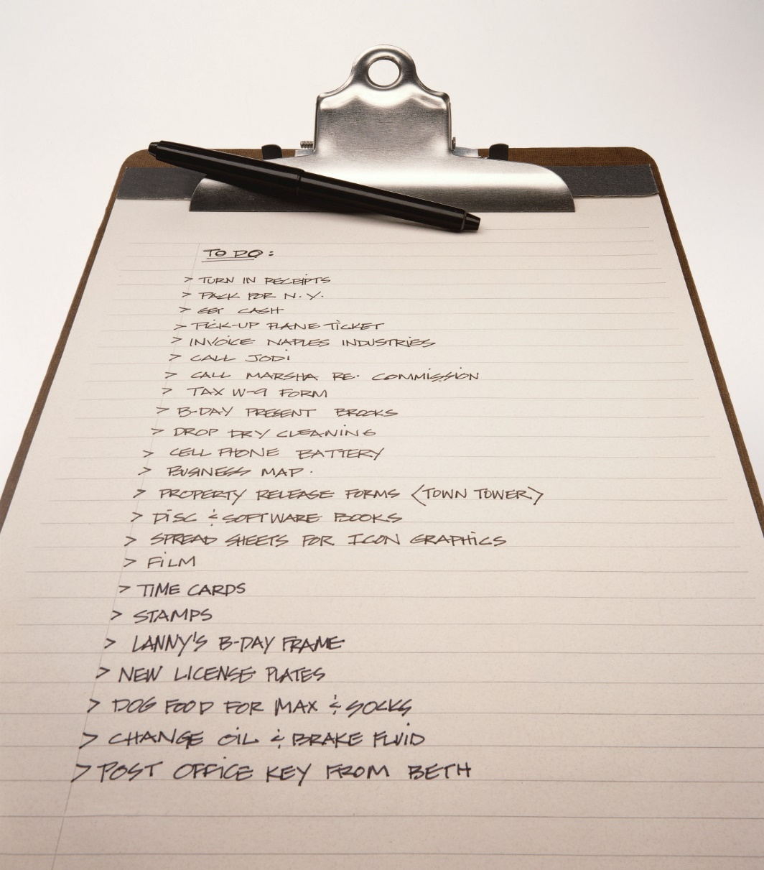
Managing Time
Importance of Making Lists
  Lists help you keep track of everything that must be done.
  Lists help you prioritize tasks in order of appearance.
  Lists help you focus on one task at a time, which reduces the amount of time it takes to accomplish a task.
  Lists let you plan important tasks to complete at the time of least fatigue.

Slide 32

Managing Time
Advantages of Using a Time Plan
  Shows relationships between activities.
  Encourages the thinking through of each step.
  Serves as a guide while time and activities move along.
  Provides the basis for judging the accomplishment of goals and for future planning.

Slide 33

Managing Time
Guidelines for Making a Written Time Plan
  Keep it simple – avoid developing fancy details that use too much time in the planning stage.
  Make your plans complete – if you leave out important items, they will have to be squeezed in later.
  Keep you plans flexible – allow time for the unexpected.

Slide 34

Managing Time
Guidelines for Making a Written Time Plan - continued
  Make your plans workable – be realistic; learn what you can and cannot expect of yourself.
  Prioritize your activities – do the most important things first; do the least important last.

Slide 35
Balancing Family and Career
    Balancing a career and a family can be a real challenge. With the ever-changing structure of the family and the demands of the workforce today, careers are playing a bigger role in many families’ lives. Families must learn new skills to meet these additional challenges. Knowing and following certain guidelines can help with the “balancing act.” The choice of types of income-producing jobs are expanding. Today, there are more options and flexibility than ever before in finding a family and career arrangement that works for you.

Slide 36
Balancing Family and Career
    Impact of Careers on Families
    Both parents (or other family members) may work:
    Both parents may be career oriented and may want to work.
    For many, satisfaction and identity are derived from a career – they want to work even if they don’t “have” to work.
    A dual-career family may be necessary financially to relieve financial pressure, improve standard of living or save for a goal.

Slide 37
Balancing Family and Career
    Impact of Careers on Families - continued
    Many family incomes are low enough to require both partners to work just to meet daily needs.
    A family owned and operated business may require both parents and other family members of the family to work in the business.
    Careers change role expectations for family members.
      More women are in the workforce today; either by choice or necessity, women’s roles have changed to reflect this. Women have more influence on family decisions now.

Slide 38
Balancing Family and Career
    Impact of Careers on Families - continued.
    Careers change role expectations for family members - continued
      Children with two working parents and those in single-parent households have taken on greater responsibilities; many children go to after-school programs or go home to an empty home; they may be responsible for taking care of younger siblings or performing household tasks.
      Relocation for a current job or new career can require family members’ adjustments.

Slide 39
Balancing Family and Career
    Impact of Careers on Families - continued.
    Career or job satisfaction has a strong impact on families.
    Careers may require improved skills in time management to handle schedules that must be juggled.
    Retraining may be needed to develop new skills in a current job or to transition to a new career.
    Health and other benefits have become increasingly important, impacting career planning.

Slide 40
Balancing Family and Career
    Challenges Facing Single-Parent and Dual-Career Families
    Single-Parent Family Challenges
      Single parent may find balance difficult.
      Children may become more independent and self-sufficient at an earlier age.
      Child care services usually needed for younger children.
      Single parents usually need a full-time job to support the family; it is usually lower than with two-parent families.
      Single parents may rely on extended family members and friends to help with children.

Slide 41
Balancing Family and Career
    Challenges Facing Single-Parent and Dual-Career Families - continued
    Dual-Career Family Challenges
      Inflexible work schedules can cause parents to miss family functions.
      Parents can become fatigued due to demanding schedules.
      Role expectations can change for each family member.
      Less time may be available for family to spend together and for parents to spend alone.
      The family may have to rely more on service providers.

Slide 42
Balancing Family and Career
    Guidelines for Balancing Family and Career
      Set goals.
      Be flexible.
      Keep a sense of humor.
      Learn to budget your time, money, and resources.
      Have a mutual understanding with partner and be supportive.
      Understand the expressions of your boss, co-workers, and family.

Slide 43

Balancing Family and Career
    Guidelines for Balancing Family and Career - continued
      Communicate your expectations to your boss, co-workers, and family.
      Set priorities.
      Develop a good support system.
      Work at keeping your family a cohesive unit.

Slide 44
All rights reserved; copyright
© 2019 Resource Center for CareerTech Advancement
For more information, email us at resourcecenter@careertech.ok.gov
Visit our website at https://www.okcareertech.org/educators/resource-center

