Slide 1
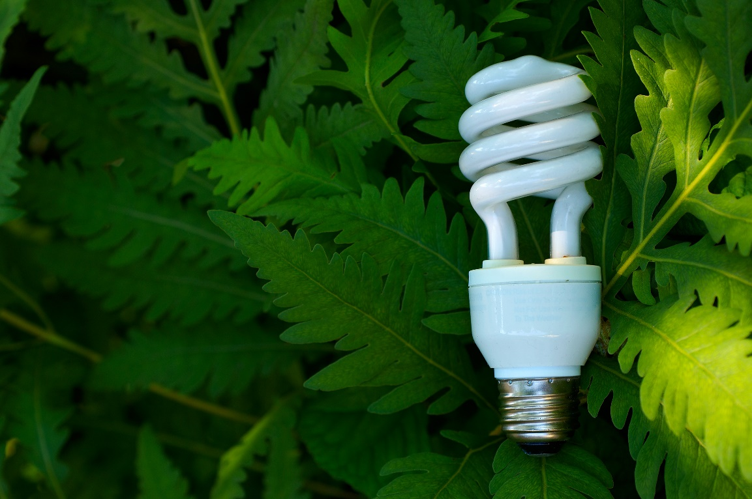
Green Living Skills – Part 3
Making Green Choices
Developed by Resource Center for CareerTech Advancement,
a division of Oklahoma CareerTech

Slide 2
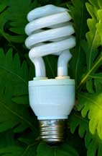
Making Green Choices
Green choices confront us every day.
We can use water more wisely, buy better foods, shop for alternative and eco-friendly products, or choose not to buy new products at all.
We can save energy and money every day at home and at work, and can even change our lifestyles to a greener one.

Slide 3
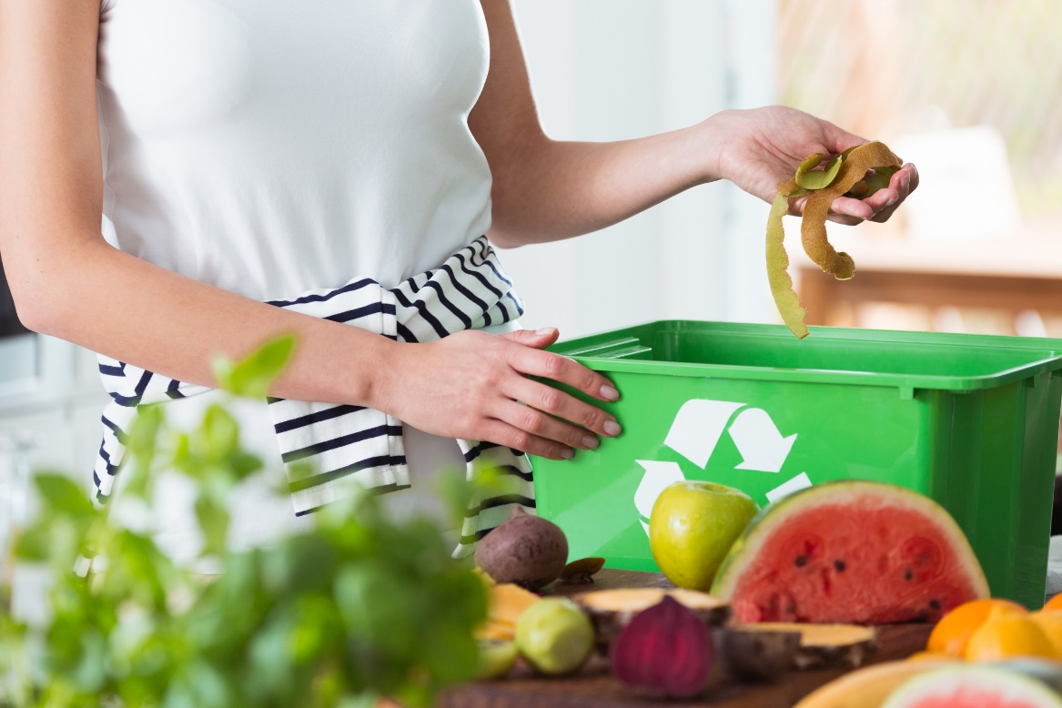
Making Green Choices
Topics covered:
Water Supply and Use
Green Food Choices
Eco-Friendly Fabrics and Clothing
Going Green Shopping
Sustainable Alternatives to Wood Products
Degradable, Biodegradable and Compostable Items
CFL and LED Lighting
How to Buy Green Electricity
Benefits of Green Housing
“Going Green” with Housing
Reducing Waste at Home
“Leaning Green” at Work

Slide 4
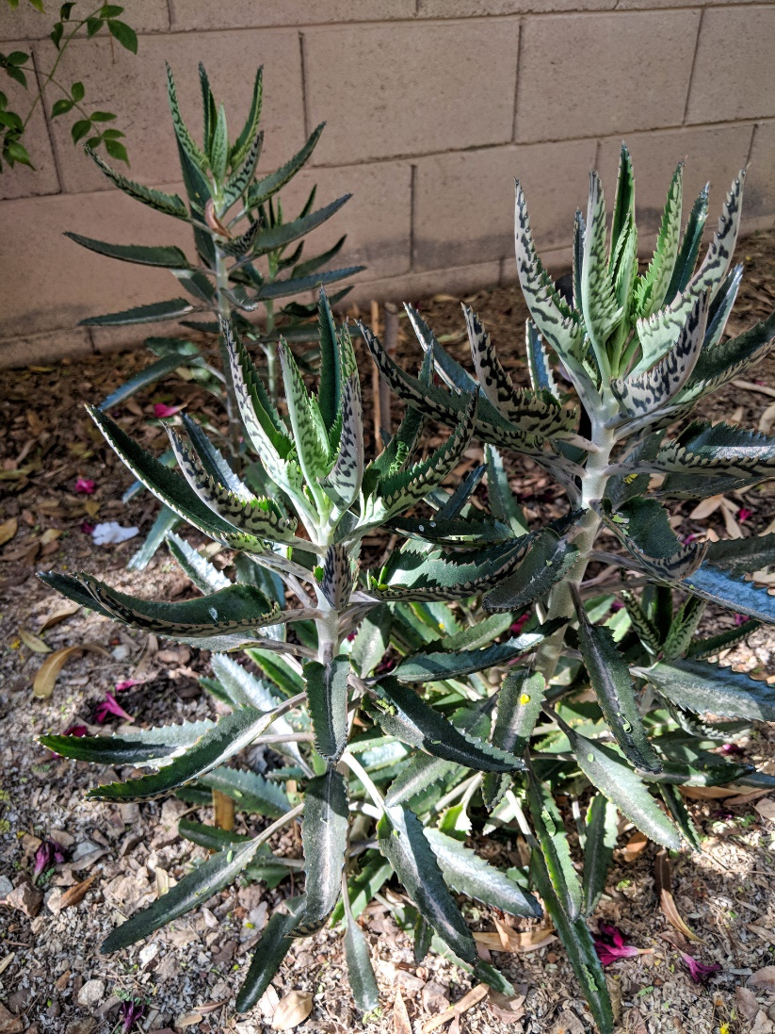
Water Supply and Use
xeriscaping - converting landscape plants to those that are adapted to the particular region and climate
About three-quarters of the Earth’s surface is covered with water. Water is almost everywhere, yet only one percent of it is fresh water that people can use.
The human body is made up of more than 60 percent water. A person can survive a month or more without food, but only about a week without drinking water.

Slide 5
Water Supply and Use
We use lots of water for drinking, cooking, cleaning, washing, and flushing.
Not only do we use water in our day-to-day living, but we also use water “virtually”:
Water is a part of products we use, including food, paper, fabric, and many other items.
Unfortunately, water is becoming scarce.
Human demand, pollution, drought, and climate change are putting pressure on the supply of water.
Our lakes, rivers, and aquifers are showing significant reductions in water levels.

Slide 6
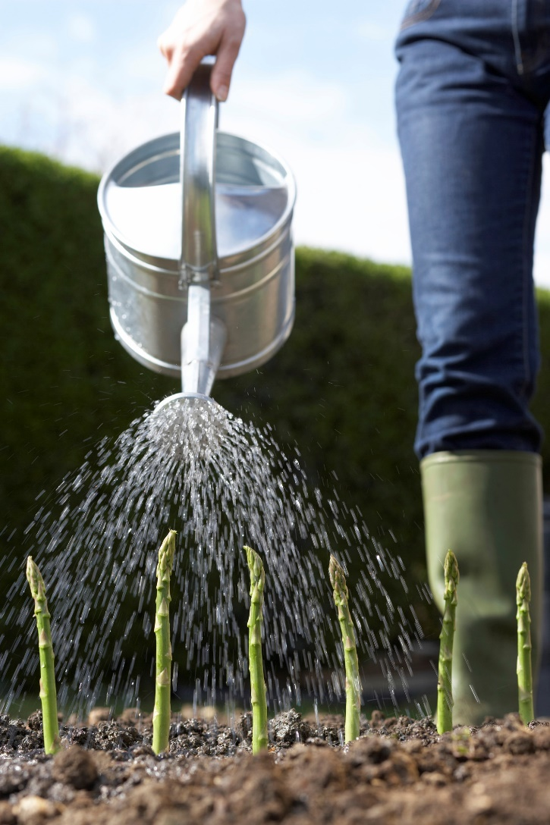
Water Supply and Use
Most of the water used in the United States is used for agricultural production, energy and power generation, and manufacturing.
A smaller percentage goes for household uses.
When looking at ways to conserve water, it is important to consider the big picture.
The water footprint is a way of measuring water use. It is defined as the amount of fresh water needed to produce or manufacture goods and services.
Using less energy, purchasing fewer items, and making changes in your daily habits are all ways to reduce the amount of water you use.

Slide 7
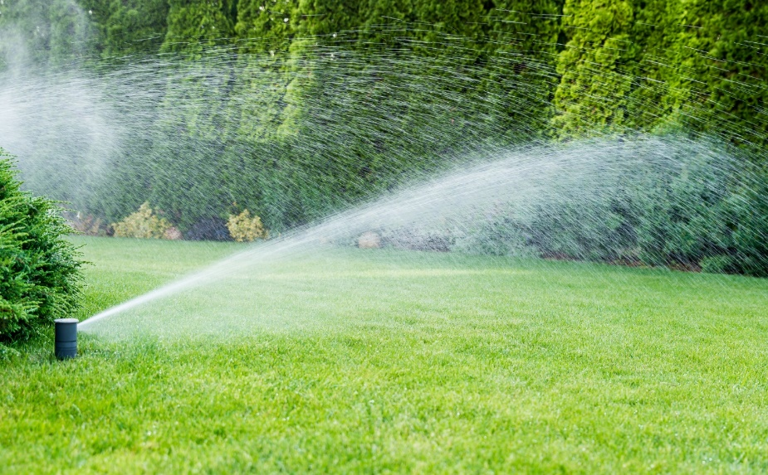
Water Supply and Use
According to the EPA:
The typical single-family home uses almost 70 gallons per person per day.
Toilet use accounts for 25 to 30 percent of household water use.
50-70 percent of home water is used for watering lawns and gardens.
Nearly 14 percent of the water a typical homeowner pays for is never even used — it leaks down the drain.
If your faucet is dripping at the rate of one drop per second, you can expect to waste 2,700 gallons per year.
A running tap can use about 2 gallons of water per minute.
Leaky toilets can waste as much as 200 gallons each day.

Slide 8
Water Supply and Use
Reducing the amount of water you consume may be the most important — and easiest — way to make a difference. Even breaking a few bad habits and making small changes will help.
You can take these steps to conserve water:
Don’t let the water run while shaving or brushing teeth.
Take short showers instead of tub baths.
Install a low-flow shower head with a maximum flow rate of 2.5 gallons per minute or less.
Keep drinking water in the refrigerator instead of letting the faucet run until the water is cool.
Scrape, rather than rinse, dishes before loading into the dishwasher; wash only full loads.
Wash only full loads of laundry or use the appropriate water level or load size selection on the washing machine.

Slide 9
Water Supply and Use
Buy high-efficiency plumbing fixtures and appliances.
Repair all leaks.
Water the lawn or garden during the coolest part of the day (early morning is best).
Water plants differently according to what they need. Check with your local extension service or nurseries for advice.
Set sprinklers to water the lawn or garden only — not the street or sidewalk.
Use soaker hoses or trickle irrigation systems for trees and shrubs.
Keep your yard healthy — dethatch, use mulch, etc.
Sweep outdoors instead of using a hose.
Landscape using “rain garden” techniques to save water and reduce stormwater runoff.
Consider xeriscaping.

Slide 10
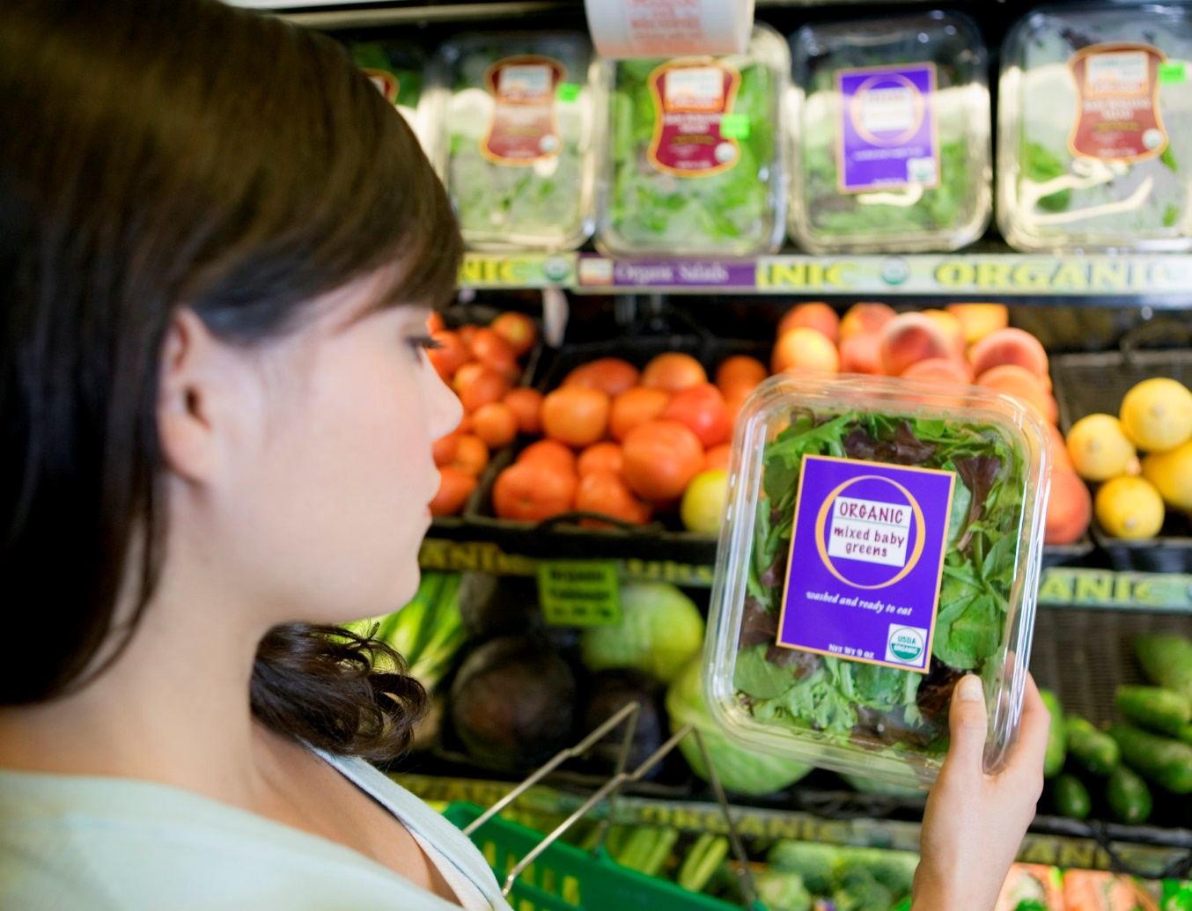
Green Food Choices
Organic food production involves techniques and philosophies that encourage environmental stewardship and biodiversity to grow more healthful and tastier foods.
Organic production promotes sustainability and helps reduce dependence on nonrenewable resources.

Slide 11
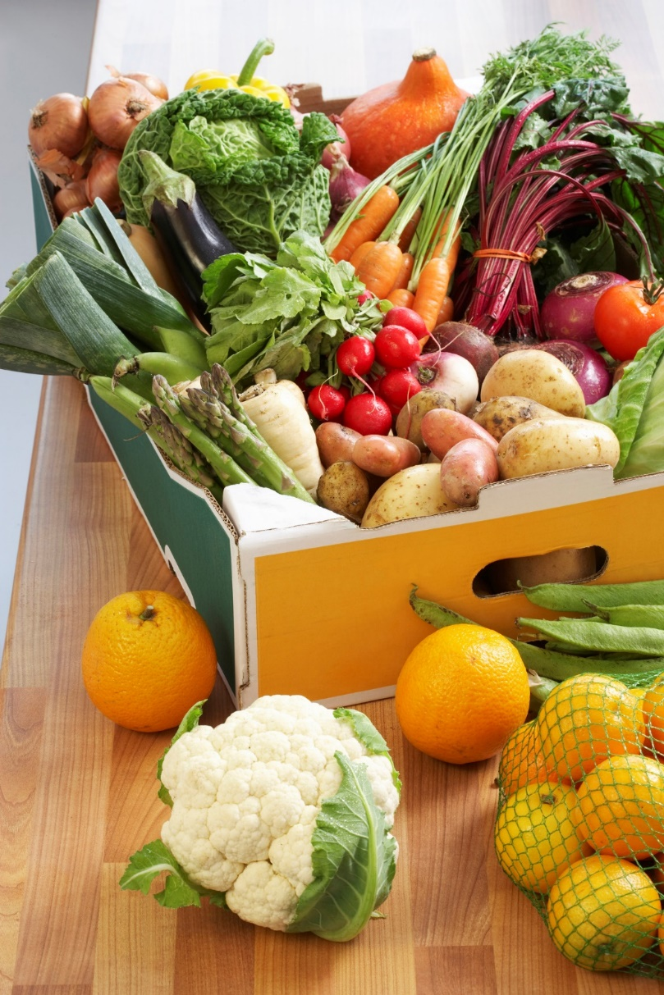
Green Food Choices
The term “organic” is not the same as “natural.”
Food items that have undergone minimal processing and that are free of preservatives are called natural.
Not all natural foods are organic. In order for a product to be considered organic, producers must follow standards and guidelines set by the U.S. government.

Slide 12
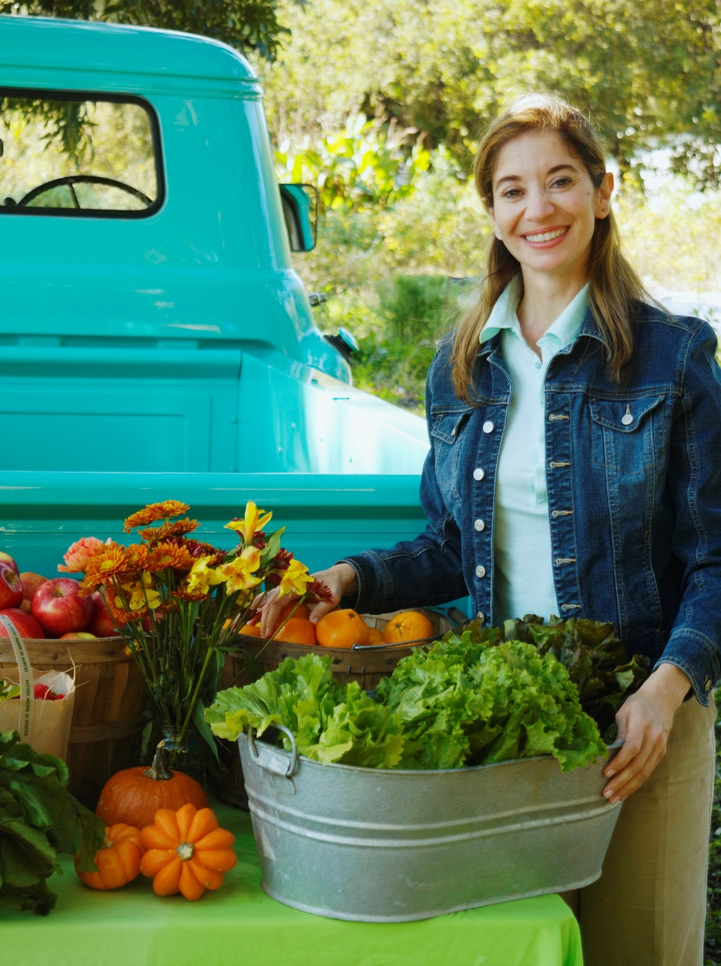
Green Food Choices
Organic farmers grow their produce by natural means, without the use of chemical insecticides and herbicides or irradiation (although certain chemical fertilizers are allowed).
Organic products are not genetically modified.
A genetically modified organism (GMO) is a plant or animal that has been changed by genetic engineering (GE) — the altering of genetic codes in a laboratory.

Slide 13
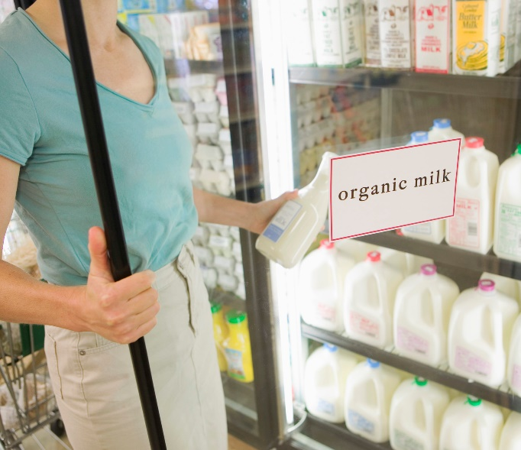
Green Food Choices
Organically grown fruits, vegetables, and other produce can display the USDA Organic sticker.
The word “organic” may also appear on milk, cheese, and egg cartons.
The phrase “100 percent organic” appears on processed foods made only with organic ingredients.
“Organic” appears on the packaging of processed foods that are made of at least 95 percent organic ingredients by weight.
Products that are “made with organic ingredients” are made of at least 70 percent organic ingredients.
Organic items may cost a little more because more time and labor may be required in the production process, and because the production facilities are often smaller.

Slide 14
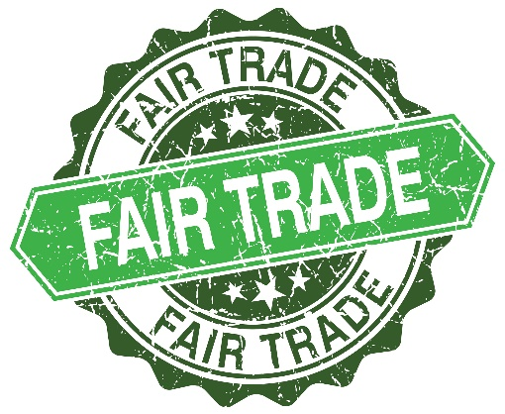
Green Food Choices
Fair trade is a system that promotes economic and social equality while respecting cultural identity.
The term fair trade is often used when labeling items produced in developing countries, such as clothing, coffee, bananas, pineapples, furniture, toys, personal accessories, and many other products.
The fair trade label assures the consumer that the farmers and workers are paid and treated fairly, the rights of women and children are protected, and that the working conditions are safe.
Fair trade produce is grown using the practices of sustainable agriculture, water conservation, and environmental stewardship, and it is often organic.

Slide 15
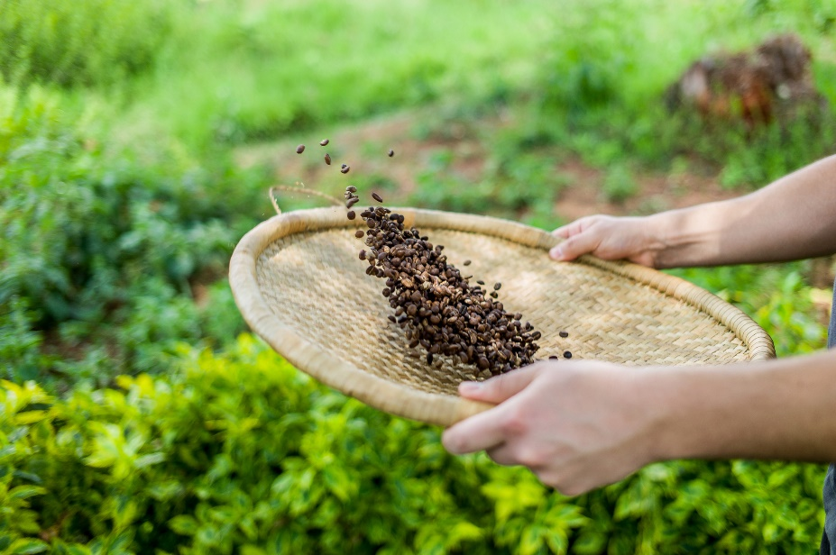
Green Food Choices
Fair trade organizations work to develop partner-ships with their suppliers and also contribute to the development of communities.
By promoting a fair system of exchange, local producers can create sustainable, positive change and improve their living conditions and overall quality of life.
Working directly with farmers, artisans, and craftworkers, fair trade organizations keep prices affordable for consumers while returning a higher amount to the producers.

Slide 16
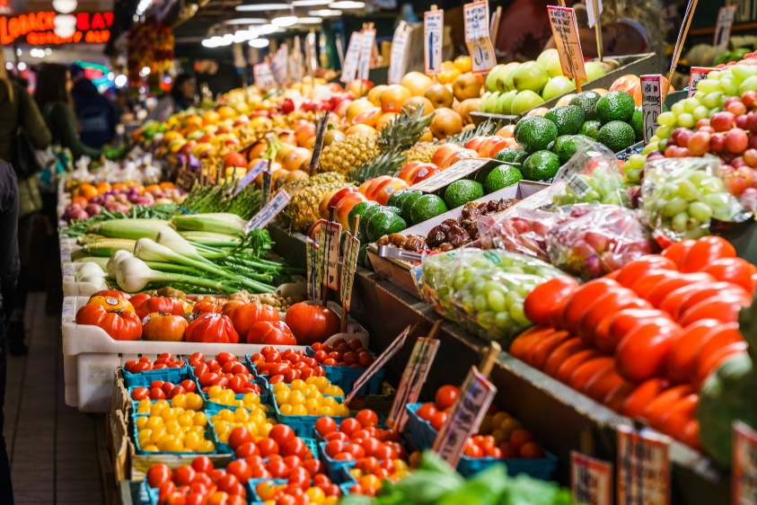
Green Food Choices
Produce grown in the U.S. travels an average of 1500 miles before it reaches the consumer. American food prices have remained relatively low because energy prices have stayed low. As energy prices increase, food prices will likely increase as well.
Buying local does not necessarily mean that products are organic or sustainable. However, buying local often brings the consumer face-to-face with the producer. This allows consumers to ask how the products they buy are grown and produced. Consumers also get the chance to meet the producers.

Slide 17
Green Food Choices
An easy way to buy local is to start with fruits and vegetables. By eating local produce when it is in season, your family enjoys the benefits of eating fresh, good tasting, unprocessed foods. You also help eliminate the waste of food that is damaged during shipping.

Slide 18
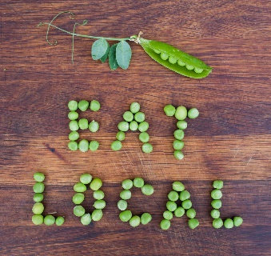
Green Food Choices
Buying local is also eco-friendly because it reduces transportation. Consumers who are worried about fuel consumption and global warming believe they can do their part by supporting growers and producers who operate closer to home. Local food production also reduces food processing and packaging requirements. Much less paper and cardboard is needed to package food to keep it fresh because it is not transported over long distances and kept in containers for long periods of time. Buying local can increase a sense of community, as well as increase purchasing options in the marketplace — community vendors can carry products that often aren’t available in national chain stores.

Slide 19
Green Food Choices
Green Choices for Preparing and Serving Food
Cook at home, instead of going to a restaurant. This will save fuel and product packaging, and can be better for your health.
Use the smallest appliance that will do the job.
Example: Instead of heating a small item in the oven, use a toaster oven.
Make sure the pan fits the size of the heating element or burner.

Slide 20
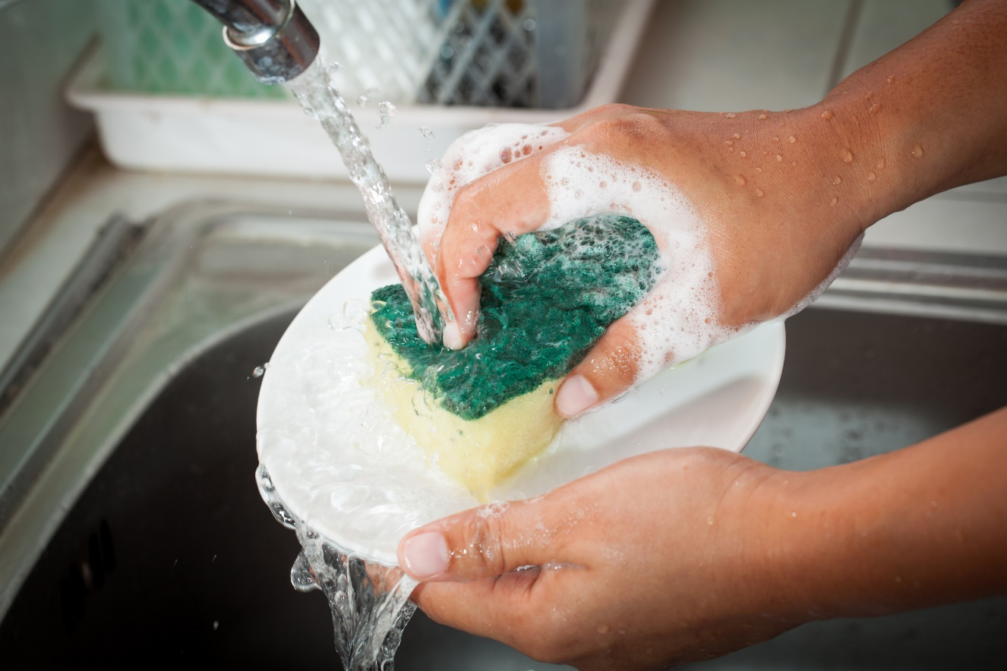
Green Food Choices
Use cloth napkins and towels and washable plates, rather than single-use paper products.
While waiting for hot water from the faucet, use the cold running water to fill a coffee or tea pot, a pet’s water bowl, a water pitcher or refillable water bottle, etc.
Wash dishes by hand if the dishwasher will not be full. Use a sink full of water, rather than running water. (Rinse clean dishes under running water.)

Slide 21
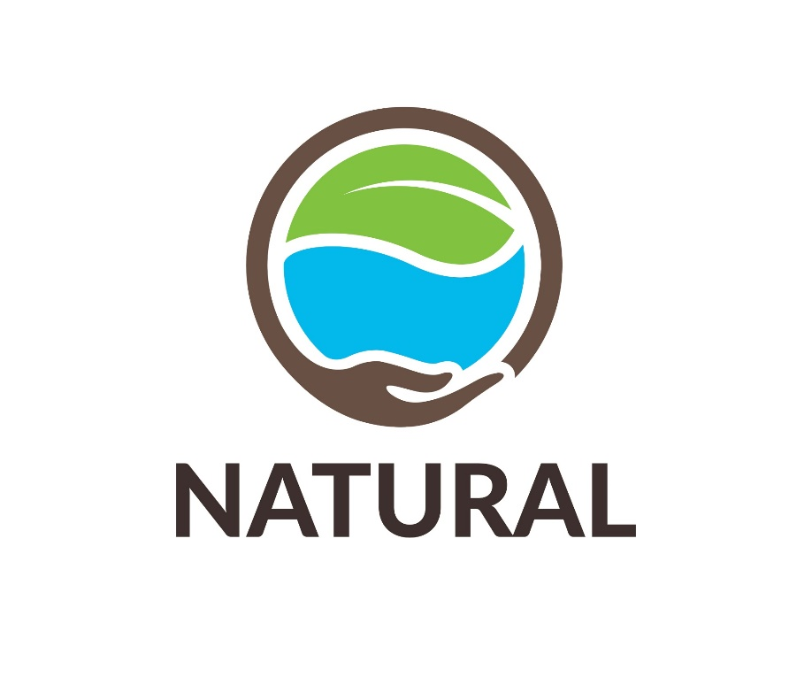
Eco-Friendly Fabrics and Clothing
Green clothing or eco-clothing is made from fibers, fabrics, and substances produced in an environmentally friendly way. It is also a means for creating safe clothing materials that are healthy for the people who manufacture them and the people who wear them. The use of organic substances and sustainability are key characteristics.

Slide 22
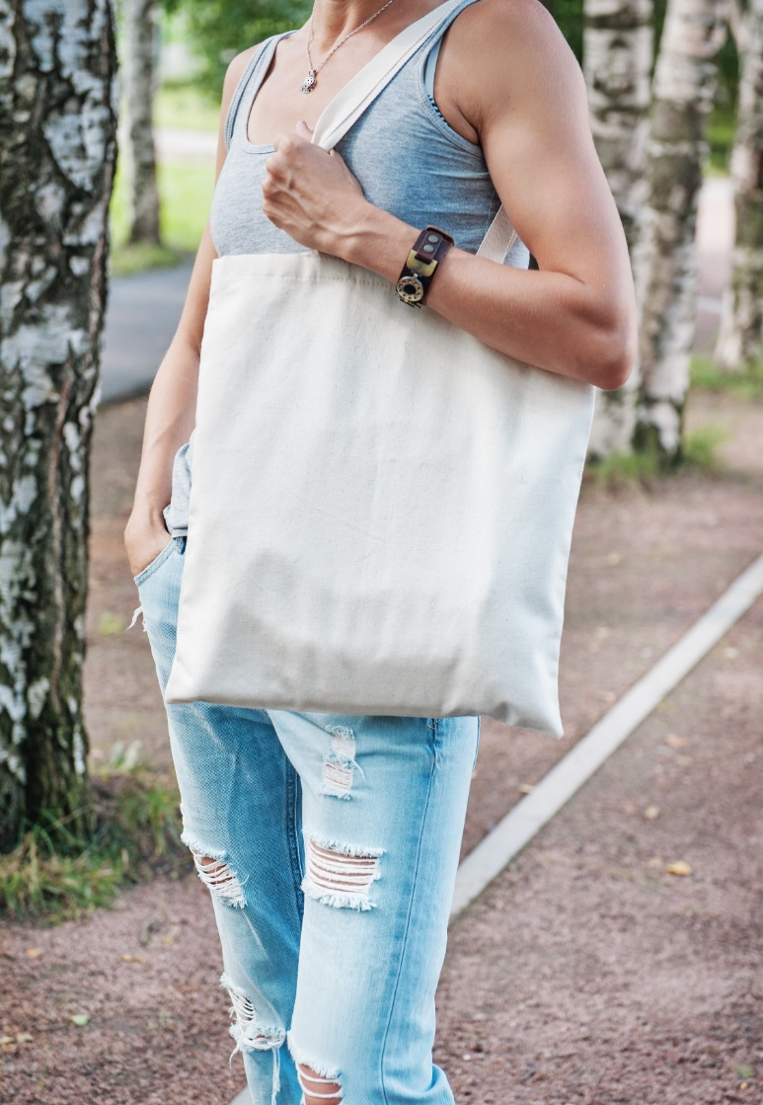
Eco-Friendly Fabrics and Clothing
The term organic clothing usually refers to the way the raw fabrics were produced. Organic raw materials are raised using environmentally sound farming practices, with water and soil conservation in mind, and without chemicals. Organic cotton farming, for example, uses methods that replenish the soil’s nutrients. Low-impact dyes are used, such as mineral shades that don’t harm the environment. Only certified organic production facilities are allowed to manufacture and label organic clothing.

Slide 23
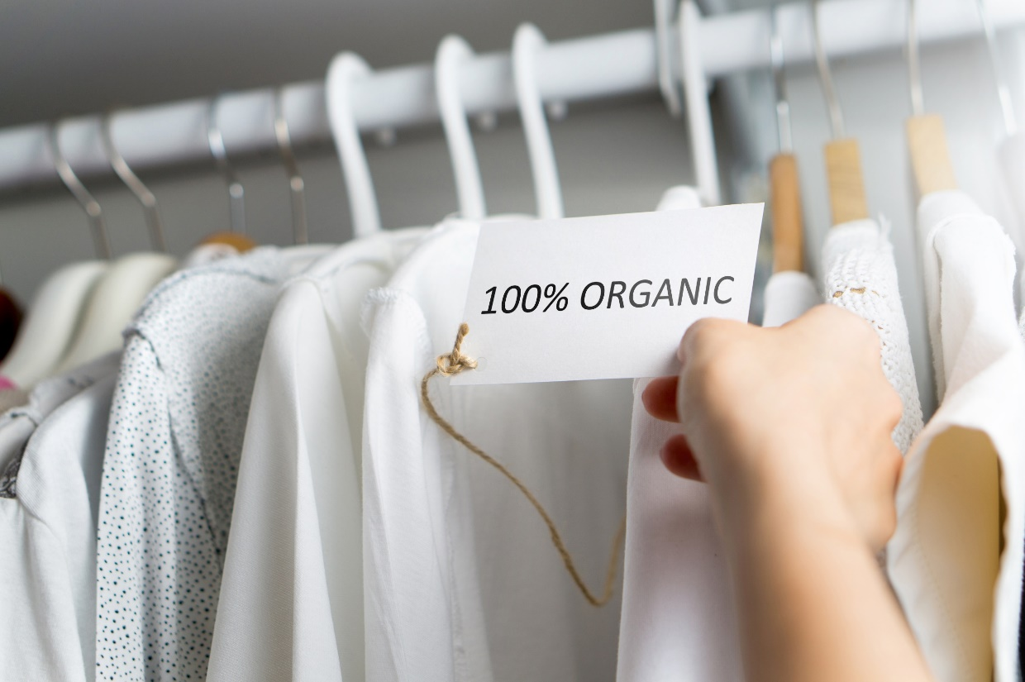
Eco-Friendly Fabrics and Clothing
Sustainable clothing emphasizes the use of sustainable farming practices in the production of renewable raw materials, along with the efficient use of energy and water. Sustainable clothing also emphasizes the recycling of everyday products.
Some eco-friendly materials include the following:

Slide 24
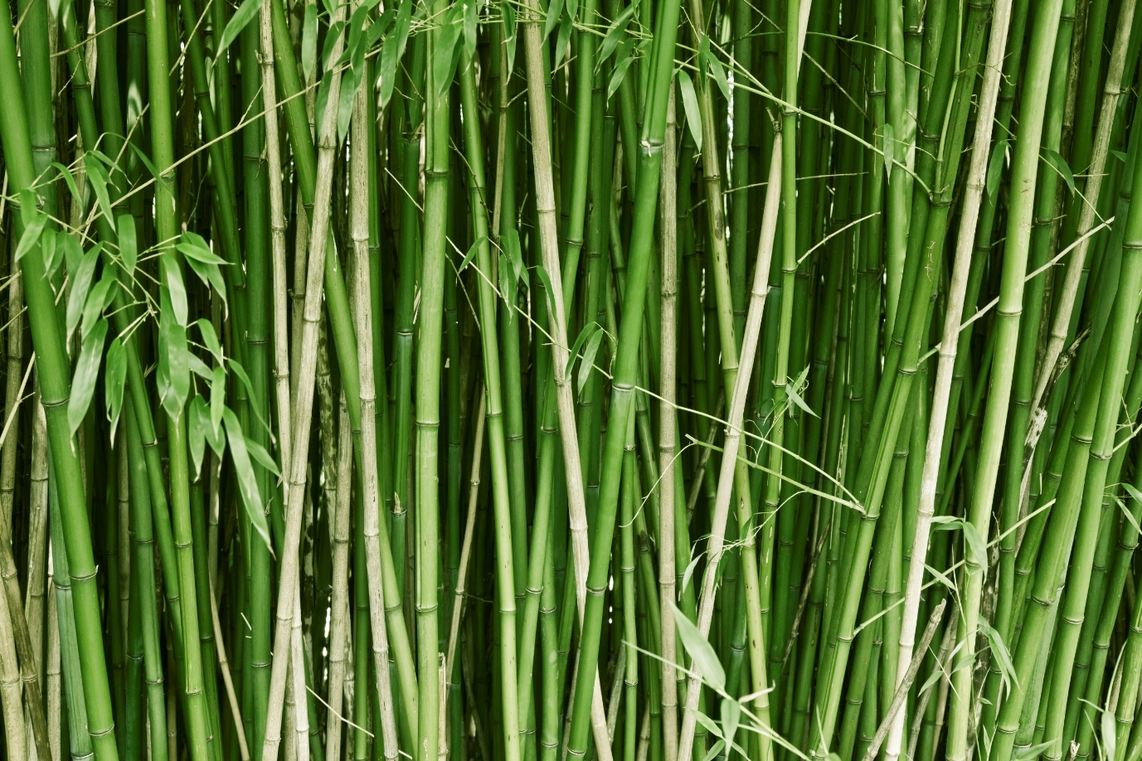
Eco-Friendly Fabrics and Clothing
Bamboo grows quickly and thrives without fertilizers and pesticides. When harvested, it is cut rather than uprooted, which helps protect the soil. Bamboo produces a yield almost 10 times that of cotton. Bamboo works well for fabrics to be worn in warmer temperatures. It produces a breathable, odor-free fabric that dries quickly. Bamboo fabrics also have natural anti-bacterial qualities.

Slide 25
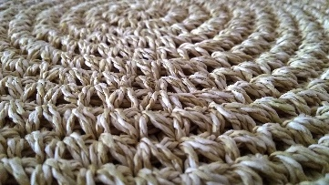
Eco-Friendly Fabrics and Clothing
Sisal is a plant with long, sword-shaped leaves. Sisal farming is considered to be environmentally friendly, unless native forests have been cleared to make room for its cultivation. Otherwise, sisal can be grown without fertilizers (although herbicides are sometimes used) and can be used to make fabric, rugs, carpeting, wall coverings, and ropes and twine.

Slide 26
Eco-Friendly Fabrics and Clothing
Hemp is a fiber that is weather resistant, long-lasting, absorbent, and very strong. Hemp is cost effective and can be grown with little water, cultivation, and care and does not need pesticides and fertilizers. Products made from hemp are usually imported, since it is generally illegal to grow hemp in the U.S.
Lyocell is made from wood cellulose and other plant cells. It is used to make Tencel fabric for clothing. Tencel is wrinkle-resistant and has the look and feel of silk, but it is very easy to care for. Lyocell is often used as batting or stuffing for comforters and pillows. It is also used for household and surgical disinfectant wipes, tea bags, protective covers for CDs, and many other products. Lyocell production is environmentally friendly because the wood is replenishable. Lyocell is also 100 percent biodegradable and can be extracted from the plant material without artificial chemicals.

Slide 27
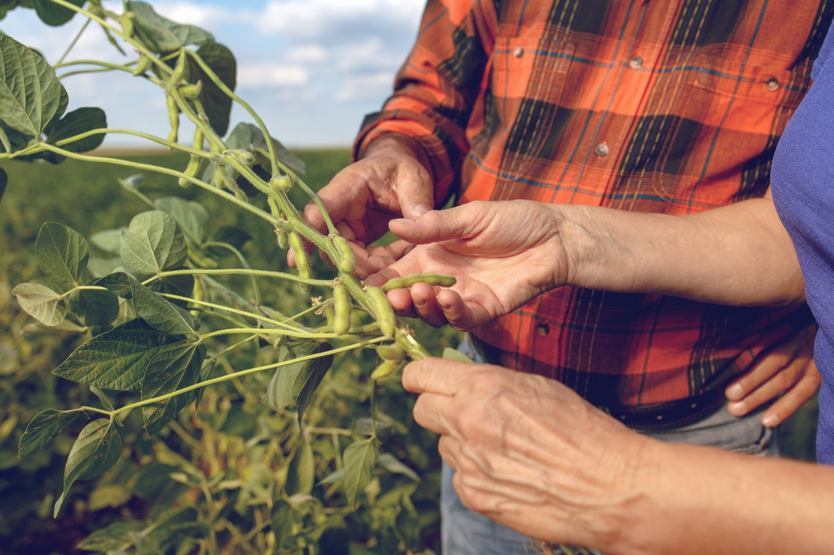
Eco-Friendly Fabrics and Clothing
Soy fibers are usually made from the recycled waste from what remains after the manufacture of products such as soybean oil and soymilk. Soy blended or pure soy fiber clothing has a luster that is similar to silk, but absorbs moisture like cotton and is highly breathable.

Slide 28
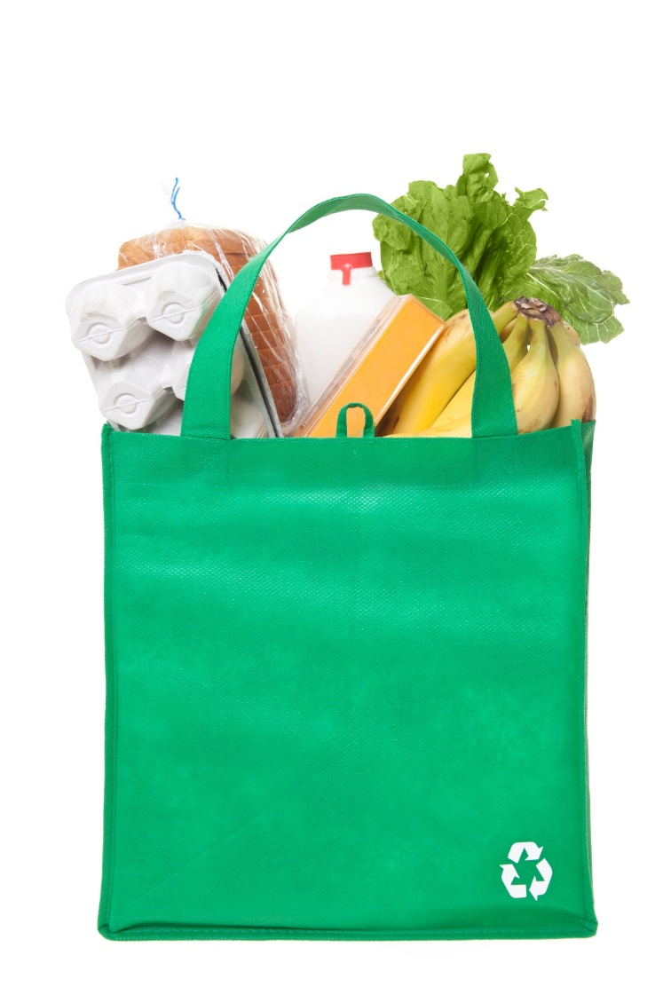
Going Green Shopping
Buy smart — decide whether you really need something before buying it.
Re-use grocery shopping bags.
Use alternatives to buying.
Buy durable products — things that will last a long time.
Examples: rechargeable batteries, reuseable cups
Avoid excess packaging — buy products that have less packaging, or buy in bulk.

Slide 29
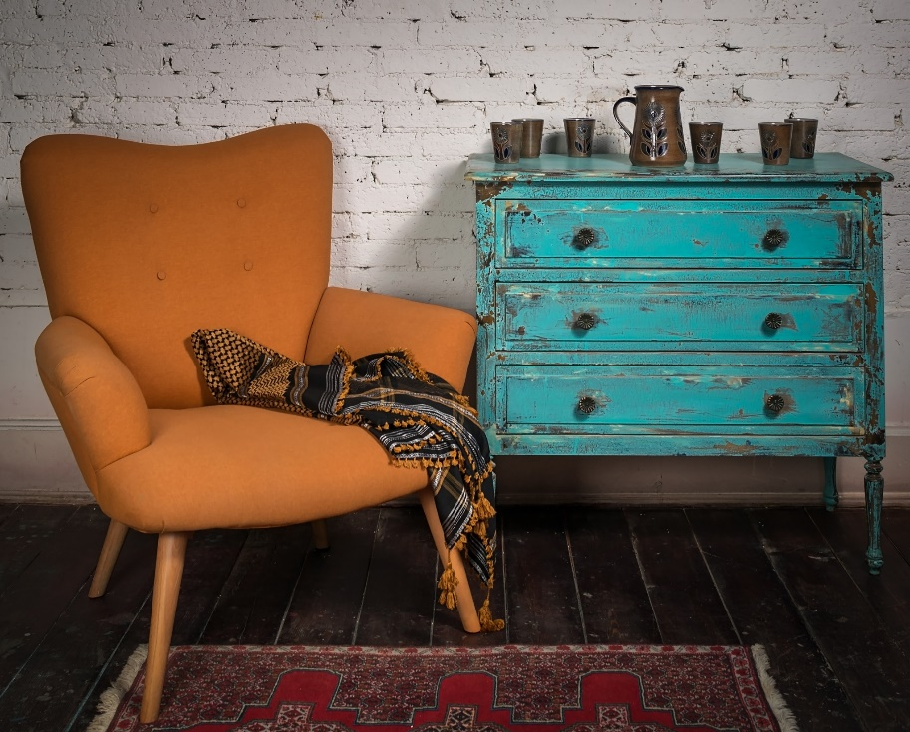
Going Green Shopping
Save resources and energy by looking for used items rather than new ones.
Examples: clothing, sports equipment, books, furniture
Share things with friends and family members.
Examples: computer games, books
Buy items that have recycled content.
Note: Products that include recycled materials use fewer natural resources.

Slide 30
Sustainable Alternatives to Wood Products
Old-growth forests are often hundreds of years old. They have never been logged and are mostly undisturbed by humans.
These mature forests are ecologically important because they are usually the home to unique plant and animal life — including many threatened and endangered species.
Mature forests also benefit the world’s climate because they absorb carbon dioxide.
Only about 10 percent of the forests worldwide are considered to be old growth; most have been cut for lumber, paper, or other uses. This is a major reason to use paper and wood products made from alternative resources.

Slide 31
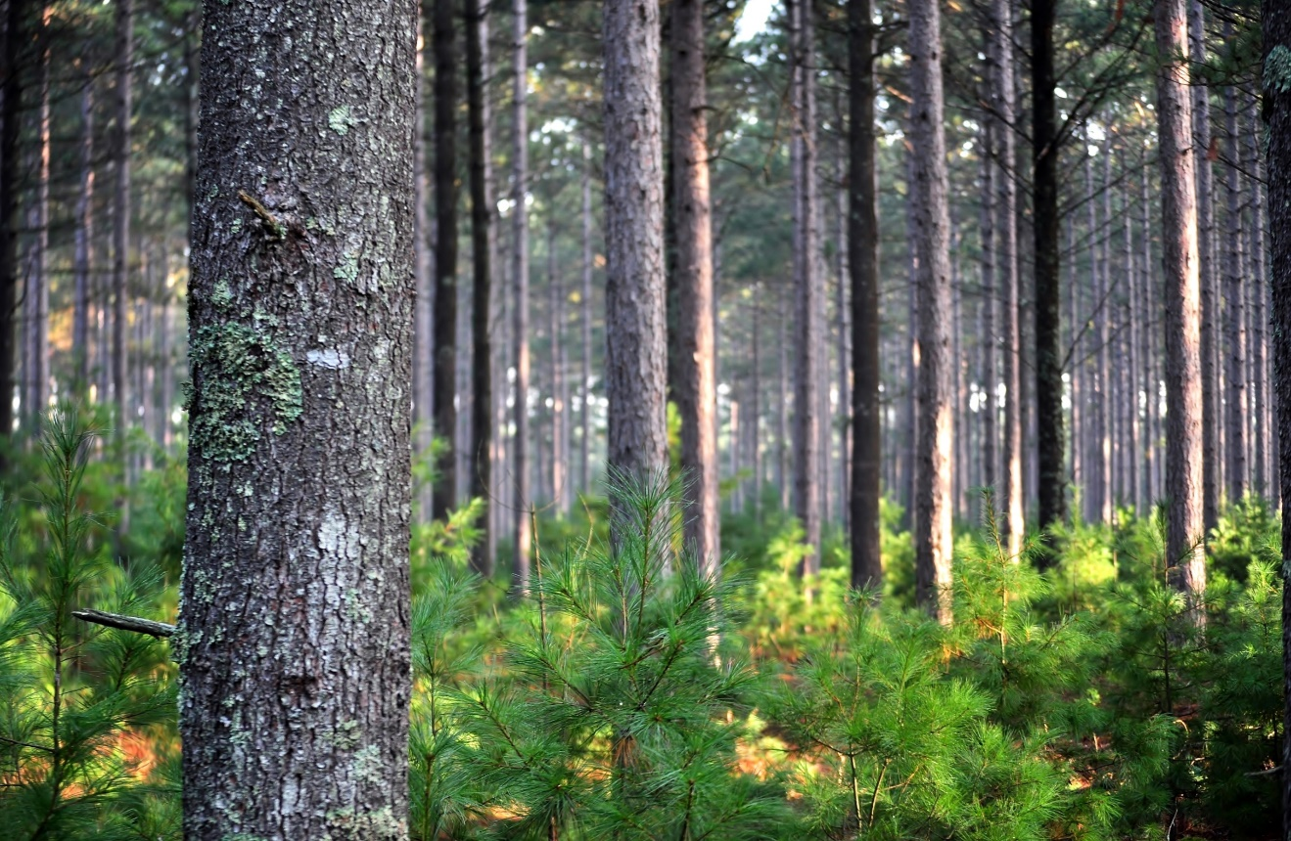
Sustainable Alternatives to Wood Products
Fortunately, many alternatives to wood exist. These plants are fast growing and yield a higher output than natural forests. They can also be grown and harvested with less impact on the environment. Below is a short list of resources that you should keep in mind when shopping for sustainable wood and paper products.

Slide 32
Sustainable Alternatives to Wood Products
Bamboo — Most people think of Asia when bamboo is mentioned, but there are more than 1,000 species of bamboo, and several are native to North America.
Under the right conditions, bamboo can grow a foot a day. It is also prolific and resilient.
Bamboo is used in the making of baskets, paper, toothpicks, furniture, particle board, flooring materials, scaffolding, and many other products. More and more, it is being used to replace plastics and wood.
Bamboo is readily available, sustainable, and renewable.

Slide 33
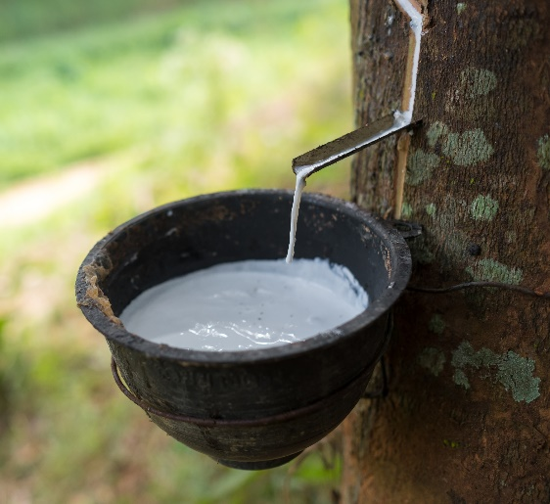
Sustainable Alternatives to Wood Products
Rubberwood — This wood comes from the rubber tree. These trees are tapped for their latex each year.
When the trees mature to about 30 years of age, they no longer produce enough latex for the tree to be commercially viable.
In the past, these trees were chopped down and used as firewood. Now this wood is used to make furniture, flooring, construction materials, and other timber products.
Rubber trees grow tall and straight. The wood is of high quality, has a beautiful grain, and it is eco-friendly and sustainable.

Slide 34
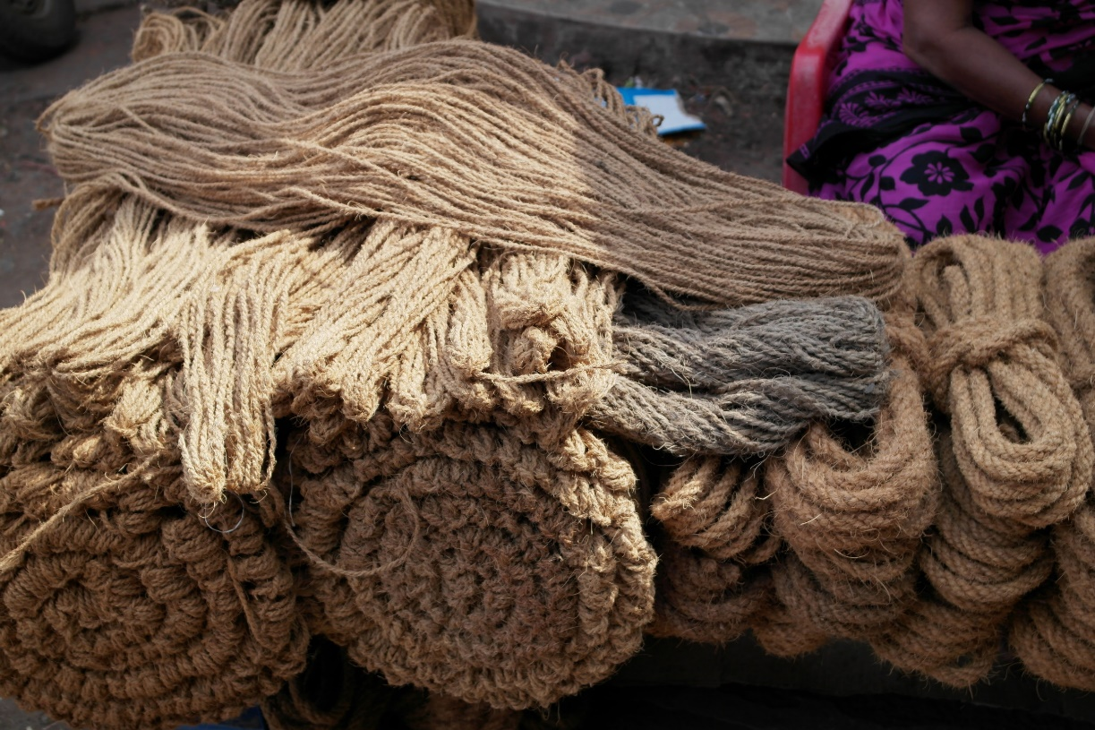
Sustainable Alternatives to Wood Products
Hemp — Industrial hemp is a robust and sometimes invasive plant. It has a thick root system that helps prevent soil erosion.
Its production is environmentally friendly because it does not require fertilizers or herbicides, and requires little water.
The stalks are used for making such products as rope, paper, fiberboard, and insulation material.

Slide 35
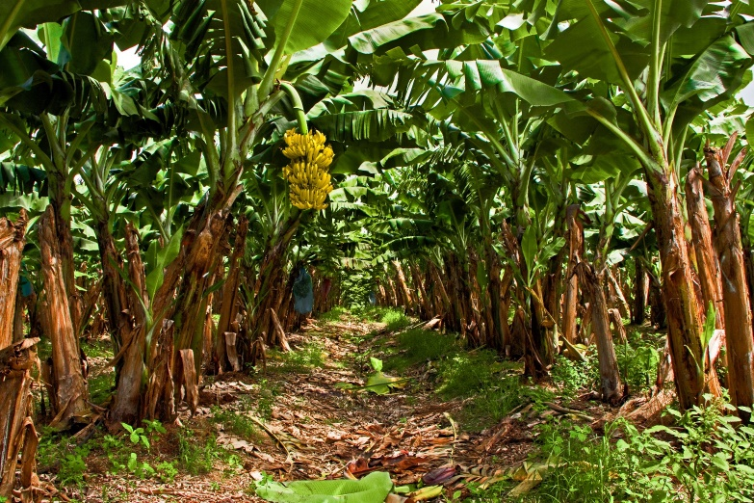
Sustainable Alternatives to Wood Products
Kenaf — A native of Africa, kenaf is a hibiscus plant.
It is hardy, thrives in poor soils, grows fast, and does not require much fertilizer or pesticides.
Kenaf produces a tremendous amount of high-quality fiber for use in treeless paper products. It produces more paper fiber than hemp.
Banana — Paper products can be made from the waste bark of banana trees.
The bark is cut after the bananas have ripened.

Slide 36
Sustainable Alternatives to Wood Products
Cotton waste — Paper can be made from old cotton clothing, rags, and other cotton waste.

Slide 37
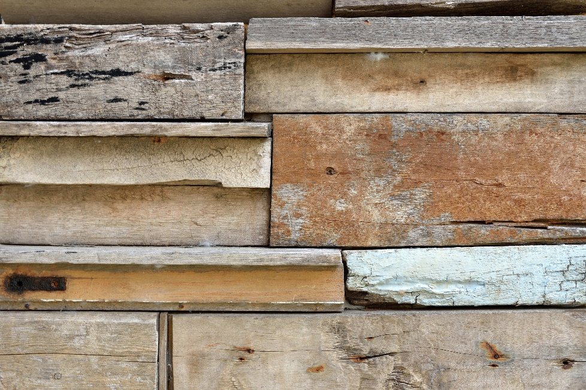
Sustainable Alternatives to Wood Products
Recycled lumber — Building materials can be reclaimed from structures about to be remodeled or demolished.
Before bringing in a wrecking crew, workers take apart the building layer by layer and remove items that are in good condition and can be reused.
Such items could include siding, flooring, cabinets, doors, windows, moldings and trim, railings, support beams, and even the lumber used in framing.

Slide 38
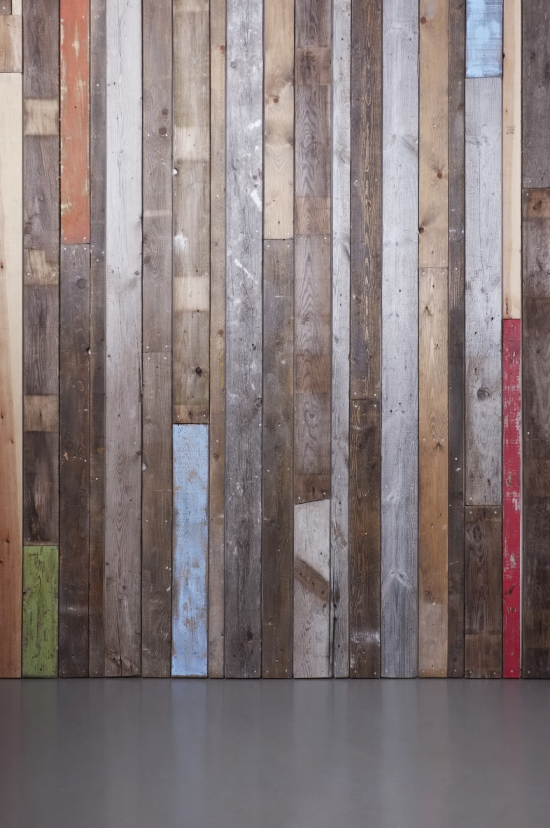
Sustainable Alternatives to Wood Products
When choosing building or remodeling materials, base your selection on durability.
Items that need to be replaced frequently are not very environmentally friendly.
Also, look for materials that are manufactured or refurbished close to home. Buying regionally saves transportation energy.

Slide 39
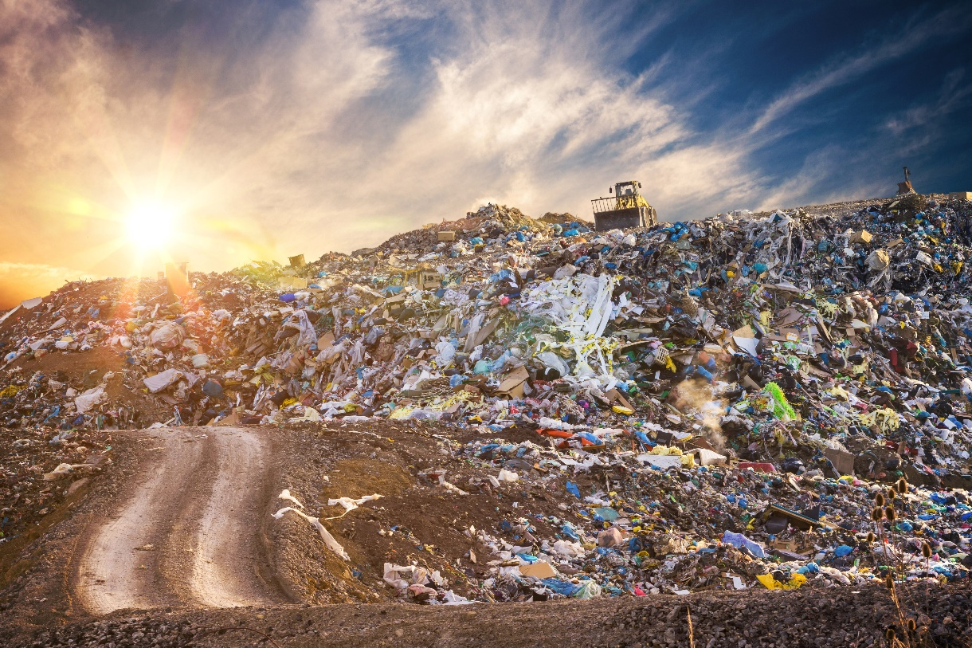
Degradable, Biodegradable and Compostable Items
The words degradable, biodegradable, and compostable are common environmental buzzwords. But what do these words mean?
Actually, these terms are difficult to explain because organizations don’t always define them the same way. As a result, the words are sometimes misused or used incorrectly to describe certain products.

Slide 40
Degradable, Biodegradable and Compostable Items
Words to Know
Biodegradable - a substance that can be broken down by a naturally occurring organism into more basic components
Degradable - a substance that breaks down through a naturally occurring chemical reaction
Landfill - organized waste disposal site

Slide 41
Degradable, Biodegradable and Compostable Items
A degradable product is one that breaks down through a naturally occurring chemical reaction.
A biodegradable product is usually defined as one that can be broken down by a naturally occurring organism — perhaps by fungi or bacteria — into more basic components. However, according to these definitions, most substances could be considered to be degradable or biodegradable, even though the process could take decades.
Therefore, the speed at which a product breaks down becomes important.

Slide 42
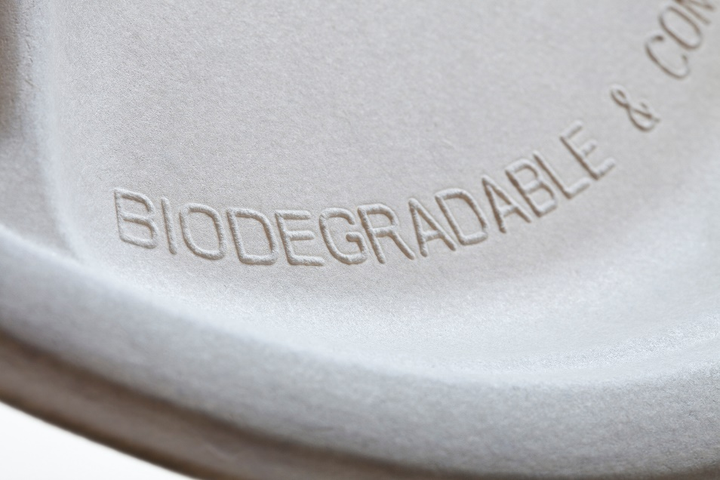
Degradable, Biodegradable and Compostable Items
City governments that regulate household trash sometimes have standards for biodegradable waste. They often define “green waste” in terms of the products being discarded, such as vegetable food matter, garden and lawn refuse, and paper and paperboard.
Products that are made from 100 percent organic materials are generally considered to be the best biodegradable products. An ideal biodegradable product is one that is carbon based and that would eventually wind up as a complex of carbon dioxide and water.

Slide 43
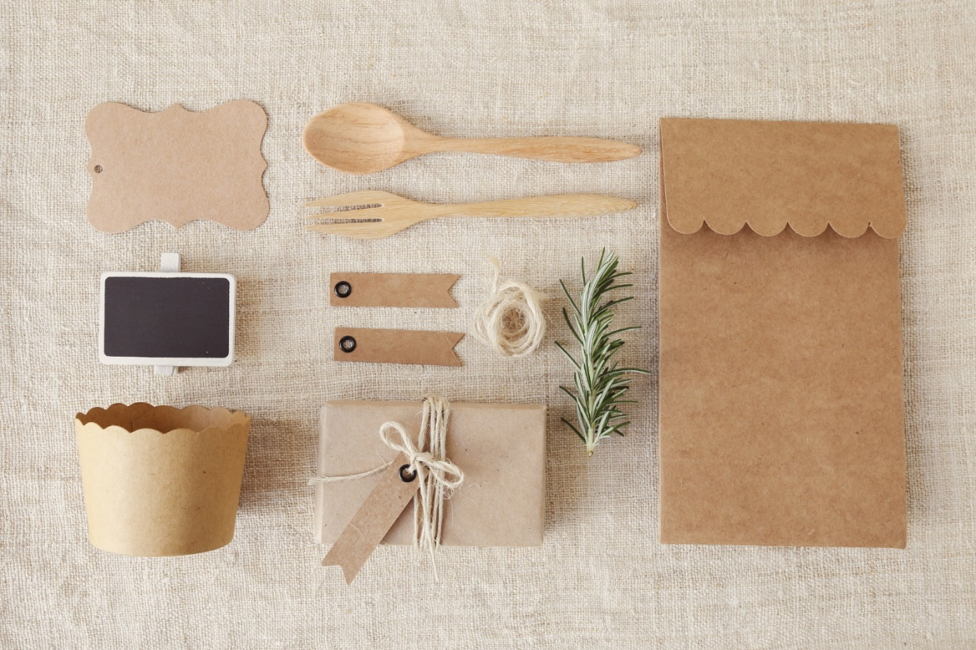
Degradable, Biodegradable and Compostable Items
Products that are made from 100 percent organic materials are generally considered to be the best biodegradable products. An ideal biodegradable product is one that is carbon based and that would eventually wind up as a complex of carbon dioxide and water.

Slide 44
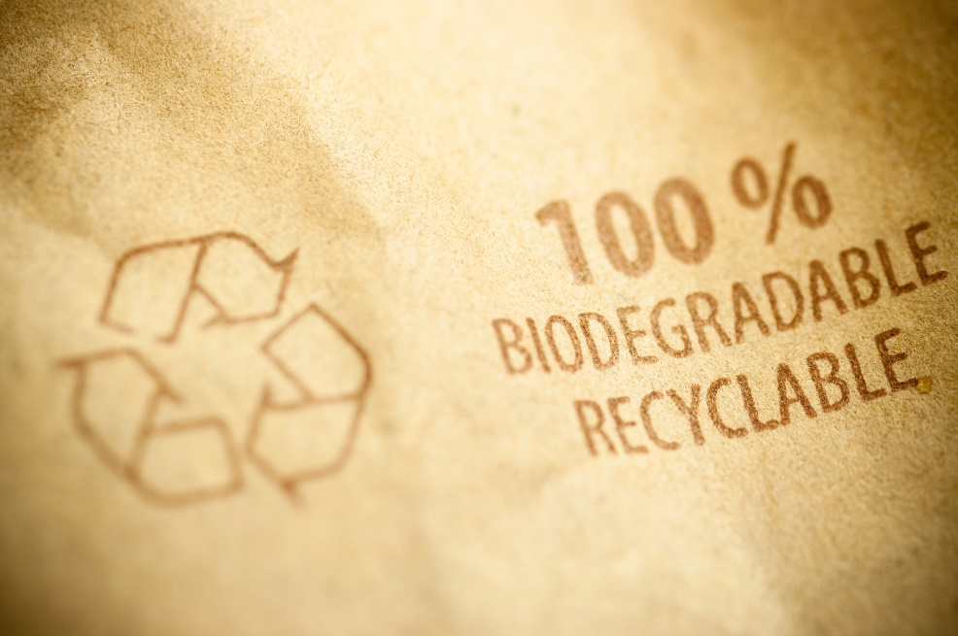
Degradable, Biodegradable and Compostable Items
There are some disadvantages to biodegradable waste.
When dumped in landfills, it’s often buried below the point where the “good” bacteria can survive.
It then breaks down under anaerobic conditions (without oxygen), which creates methane, a greenhouse gas that adds to global warming.
Newer plastic products that are designed to photo-degrade (break down due to sunlight) can’t do so, because they aren’t exposed to sunlight.

Slide 45
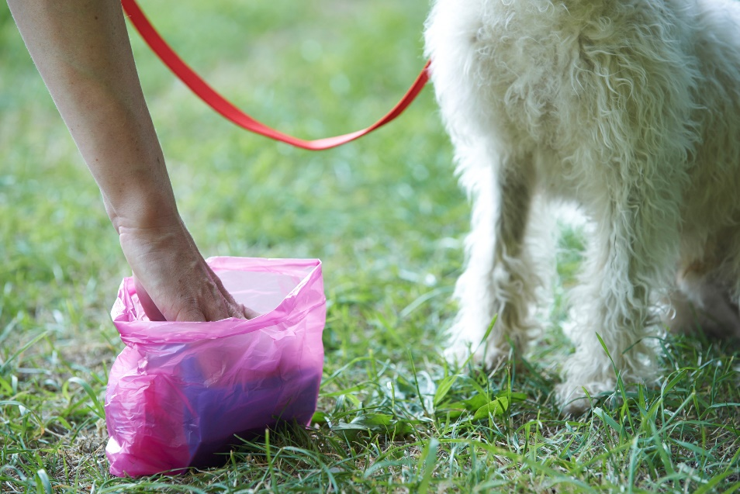
Degradable, Biodegradable and Compostable Items
Another concern is that even if a product is biodegradable, it does not automatically mean that the product is eco-friendly.
For example, animal waste, which is considered biodegradable, may contain traces of drugs, including antibiotics and hormones.
Biodegradable waste can contain toxic substances such as heavy metals and pesticides that can seep into groundwater.
Also, some biodegradable substances break down into something that is much more harmful to the environment than the original material, and sometimes more energy resources are needed in the production of biodegradable products.

Slide 46
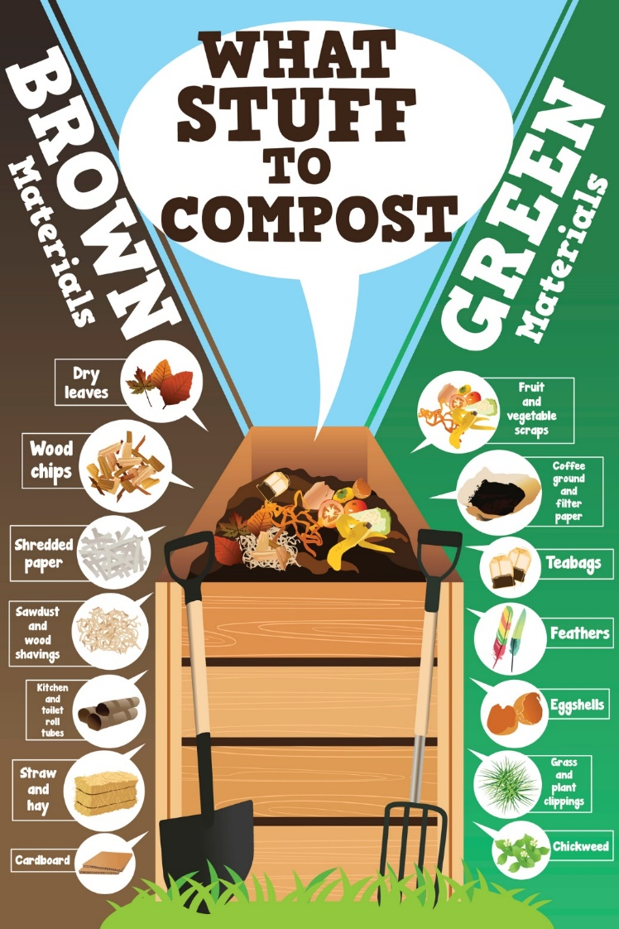
Degradable, Biodegradable and Compostable Items
Compostable products are green from start to finish. Compostable items are made from plant materials such as corn, potatoes, plant cellulose, soybeans, and sugar.
Composting is nature’s way of recycling. Microorganisms and other creatures use the organic materials as food, creating a soil-like substance in the process.
Compost is rich in nutrients. It can be mixed back into the soil to be used again by trees, grass, and other plants.
Usually, meat products cannot be composted in the open because doing so can spread diseases.

Slide 47
Degradable, Biodegradable and Compostable Items
When shopping for products, a green consumer should read product labels carefully.
Try to purchase products that are made from substances that can be recycled. Products that are made from natural ingredients are usually safer and degrade easier.
When possible, buy items from companies that fully disclose the ingredients in their products.
By consuming fewer products, you can reduce the amount of waste you produce.

Slide 48
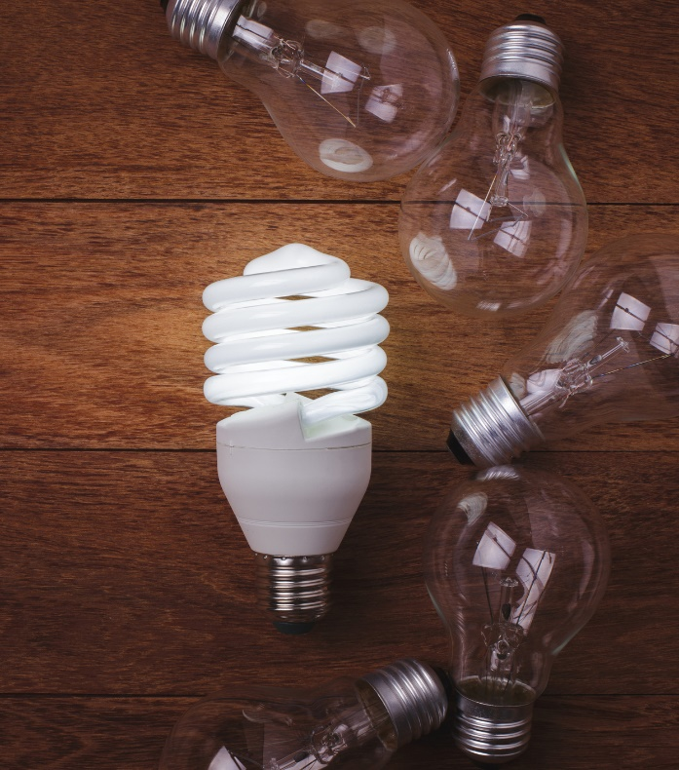
CFL and LED Lighting
Compact fluorescent lamps or compact fluorescent light bulbs (CFLs) are energy-saving bulbs that can replace traditional (incandescent) and other lights. CFLs are initially more expensive than incandescent bulbs, but they require up to 80 percent less energy and have a much longer life — lasting between 6 and 15 times longer than incandescent bulbs. CFLs can save as much as 2000 times their weight in greenhouse gas emissions. In fact, CFLs are so much more energy efficient than traditional bulbs, many countries are phasing out the sale of incandescent bulbs completely.

Slide 49
CFL and LED Lighting
Since CFLs contain a small amount of mercury, they must be handled more carefully than incandescent bulbs. Mercury can be dangerous to humans and the environment, so CFLs should be disposed of properly. The small amount of mercury in a CFL bulb does not pose a major health threat, but the build-up of mercury in the environment over time is something to avoid. (Mercury is used in CFL bulbs because it gives them a longer life.)

Slide 50
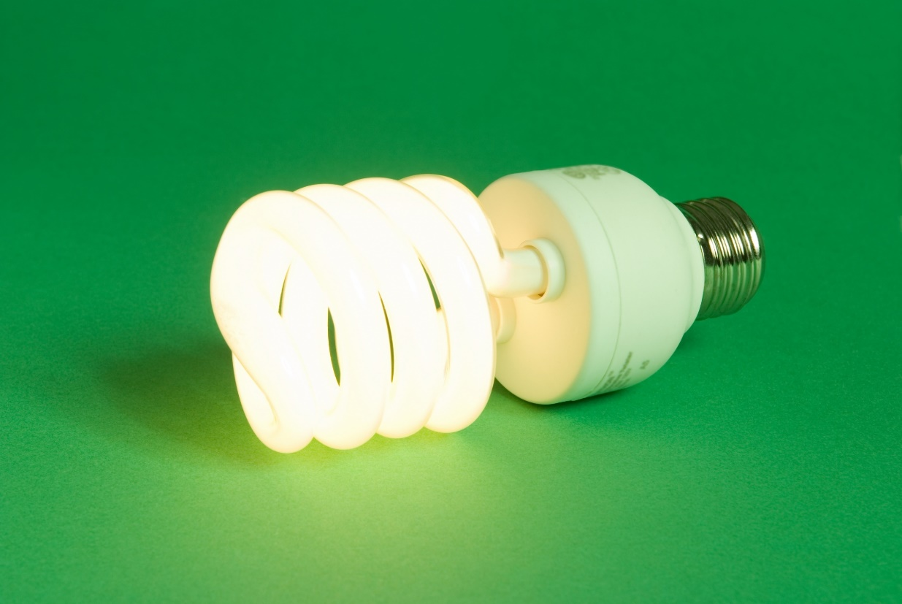
CFL and LED Lighting
Most CFLs have a warranty. Once a CFL bulb burns out, recycle it or discard it according to local ordinances. Seal the CFL in a plastic bag. If your city has a household hazardous waste drop-off site, take your discarded CFLs there. Some cities recommend that CFLs simply be double-bagged in plastic bags and then thrown away in the regular trash.

Slide 51
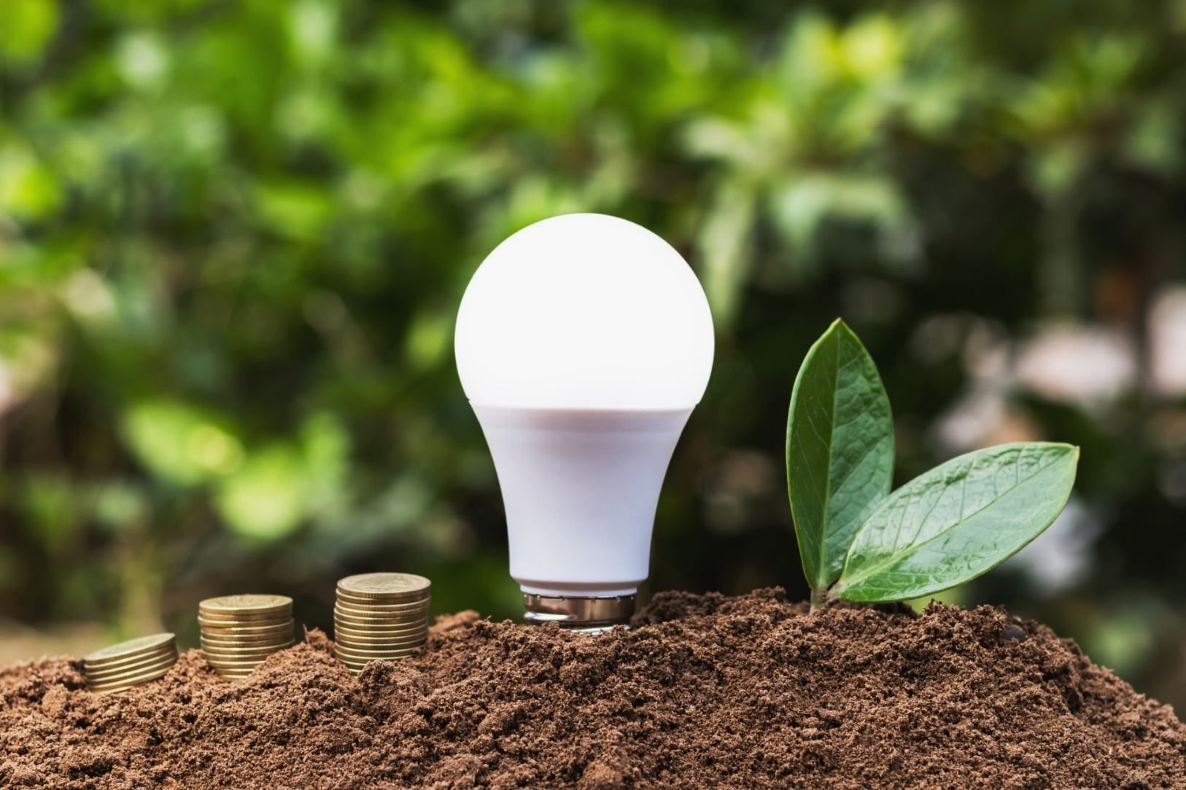
CFL and LED Lighting
LED (light emitting diode) lighting is also an energy miser. LEDs are safe, they do not contain mercury, and they can last even longer than CFLs. LEDs are not as widely used as CFLs because they are more expensive.

Slide 52
CFL and LED Lighting
Unlike traditional (incandescent) bulbs, LEDs produce very little heat. They also do not have a filament. Instead, they light up by the movement of electrons in a semiconductor material. This enables them to last about 10 times longer than CFLs. LEDs also use only about half as much electricity as CFLs. LEDs are small, so many LEDs are used in one lighting fixture. A common use for LEDs is in traffic lights.

Slide 53
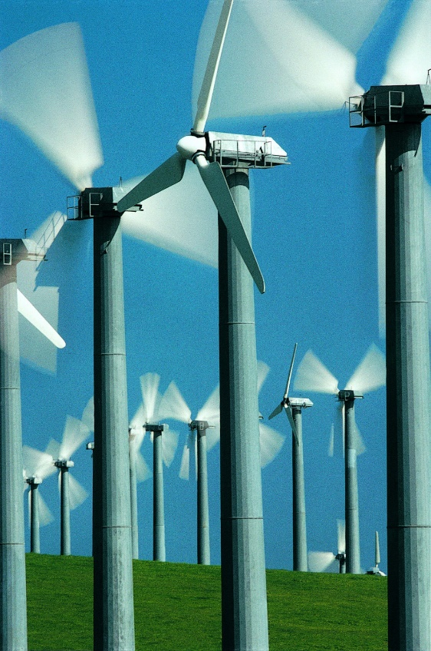
How to Buy Green Electricity
Green electrical energy comes from renewable sources, such as the wind, the sun, and the Earth’s own energy.
Most of the electrical power produced in the United States comes from coal-powered generators.
However, it is possible for consumers in many parts of the country to “green-up” their electrical power usage by buying renewable energy credits.
Consumers don’t purchase electricity directly from a green-power plant. Instead, a local electric provider purchases a certain amount of renewable energy for all of its customers, and this power is transmitted from across the power grid.

Slide 54
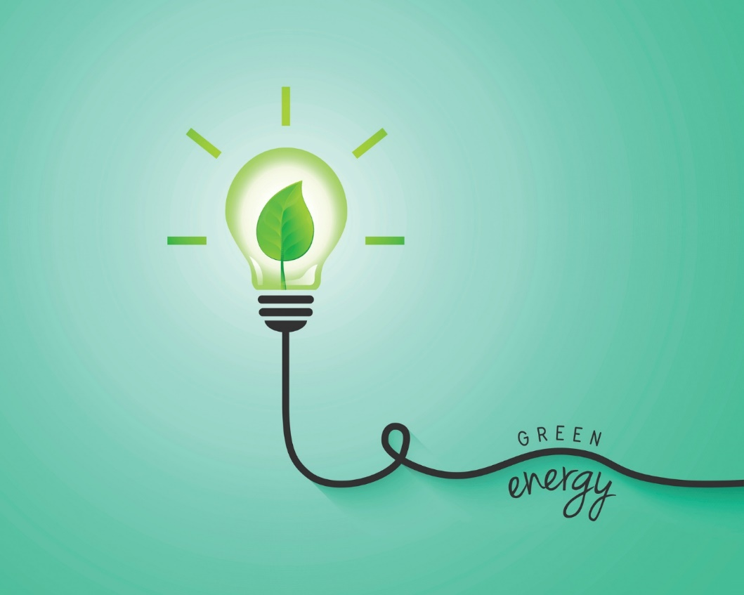
How to Buy Green Electricity
If you’re interested in switching to renewable power, the first step is to call your electric company to see what types of green power options are available.
If you decide to purchase renewable energy credits, be prepared to pay a little extra. If cost is a concern, most electric companies allow consumers to buy a portion of their electricity from renewable sources.
However, some companies require a minimum purchase and an annual contract.

Slide 55
How to Buy Green Electricity
It is also important to be sure you’re getting what you pay for.
Organizations such as Green-e and the Environmental Resources Trust can verify the type and amount of green power your local electric company supplies.
Of course, the easiest way to green-up your power usage is to conserve electricity!

Slide 56
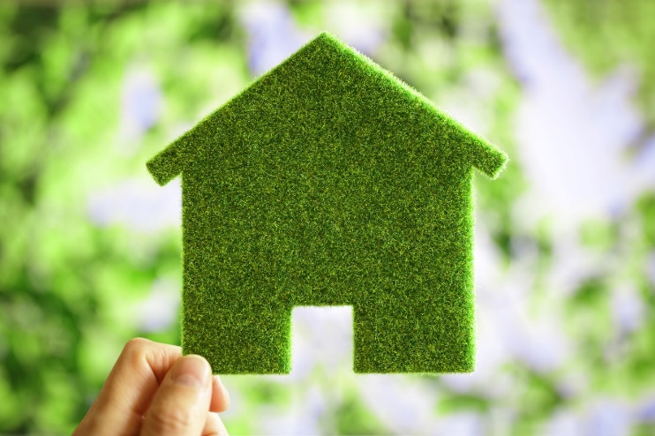
Benefits of Green Housing
Words to Know
CDC - the Centers for Disease Control and Prevention
HUD - the U.S. Department of Housing and Urban Development
Green living also applies to housing choices.
A green home is one that is smartly designed to use construction methods and maintenance features to make it healthier to live in while having less of an impact on the environment.
This can be accomplished by meeting or exceeding energy efficiency requirements, reducing the amount of water and other resources used, and improving indoor air quality.

Slide 57
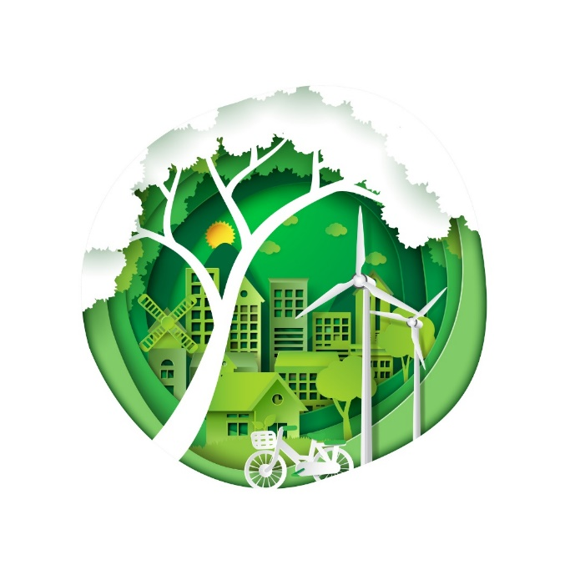
Benefits of Green Housing
Green building means using improved home designs, construction practices, and landscaping methods so that homes will last longer and cost less to live in.
Overall, the green housing approach is better for the consumer and for the community.
Studies show that air within some homes and buildings is actually more polluted than outdoor air.
For the consumer, the benefits of green housing mean a healthier indoor environment.
Green housing is also more comfortable and durable.
Since it is more energy efficient, green housing is more environmentally responsible.

Slide 58
Benefits of Green Housing
Green construction has an even greater impact on low-income consumers. Nationally, more than 25 million households — owners and renters — are occupied by individuals and families earning $25,000 or less. These citizens pay a higher percentage of their incomes for home energy, typically live in less efficient homes, and feel the consequences of climate change more acutely than people in higher-income households.

Slide 59
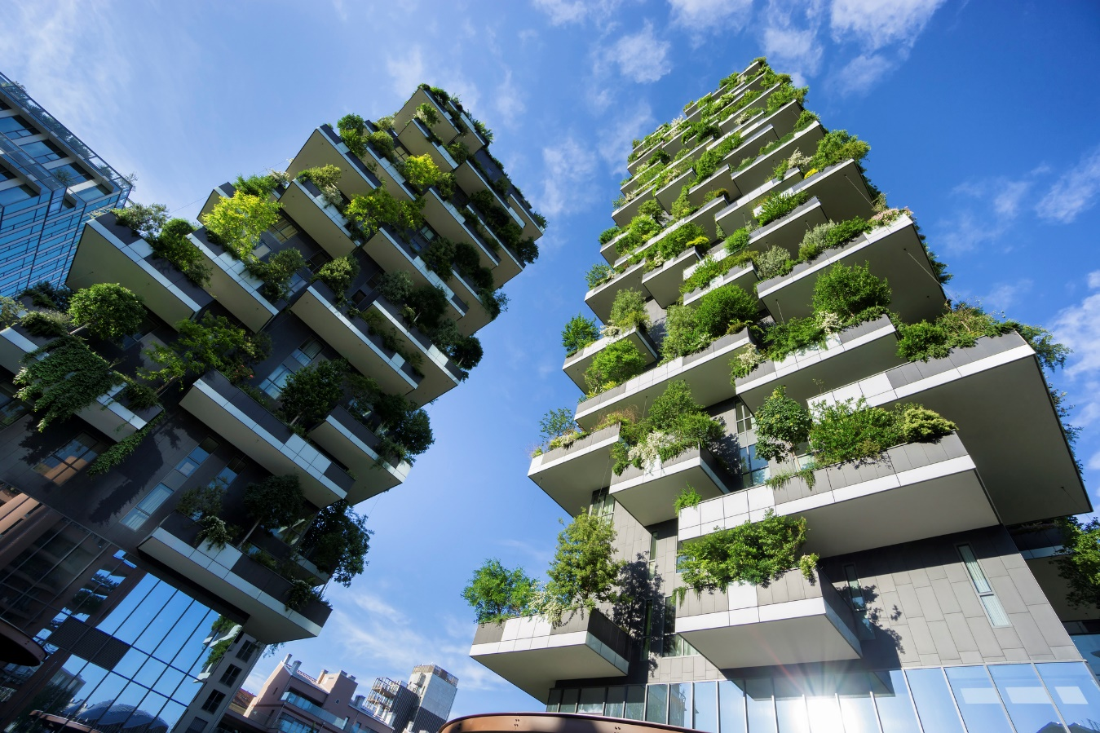
Benefits of Green Housing
Green housing also benefits the community and the economy. In addition to significantly reducing energy use and carbon dioxide (CO2) emissions, green construction creates conventional as well as “green” job opportunities. This in turn helps stabilize struggling communities and increases property values.

Slide 60
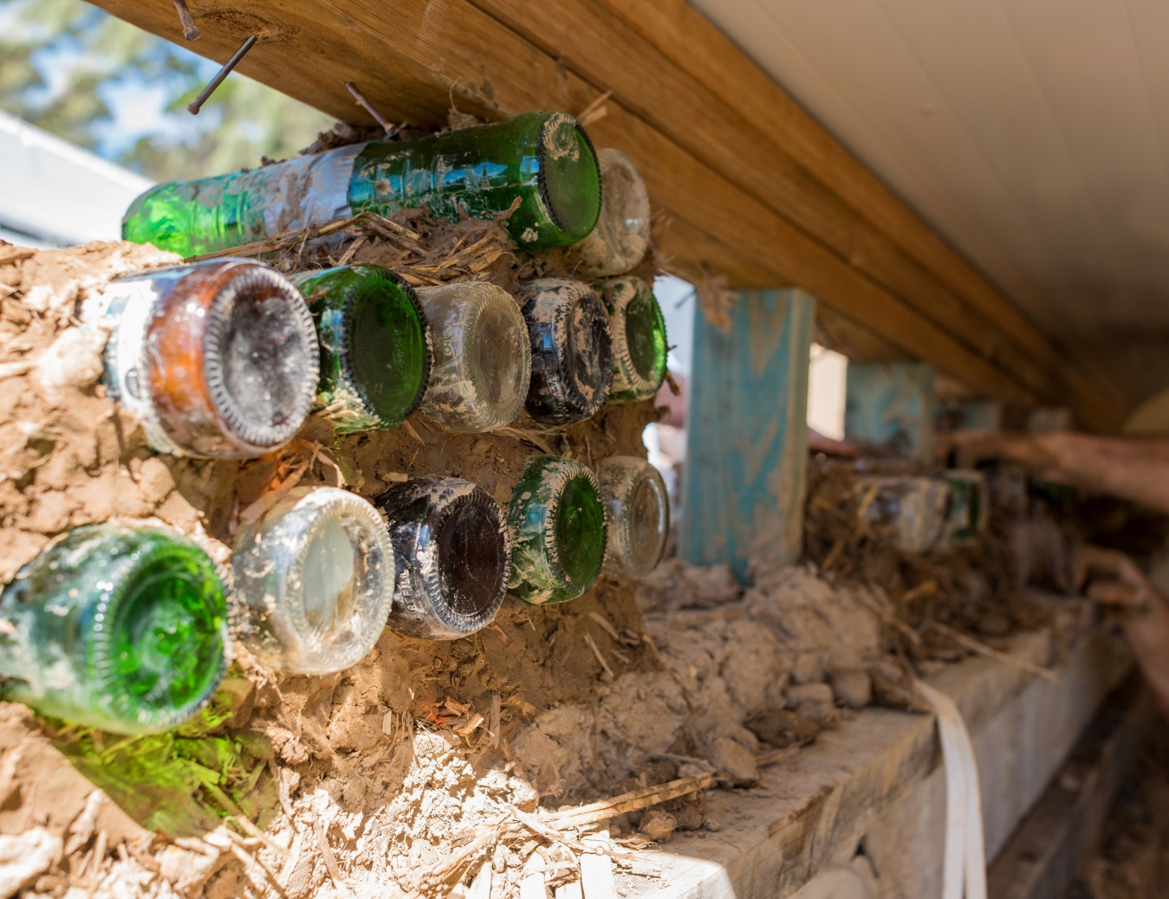
Benefits of Green Housing
Three approaches to “going green” with housing are:
Buying or building a green home — looking for green home features in an existing home, or in a home to be built
Remodeling an existing home — from painting one room to rebuilding from the framing up
“Leaning green” — everyday steps that anyone can take

Slide 61
“Going Green” with Housing
Buying or building a green home
Location
Not built on sites that are environmentally sensitive
Best on “in-fill” properties — former parking lots, factory sites, etc.
Size — the smaller the better to reduce resource usage
Design
Oriented to benefit from natural daylight
Uses strategies to bring daylight into the interior — windows, skylights, etc.
Uses “shading devices” on southern and western sides — especially trees
Uses dual-glaze windows and heat-reflecting Energy Star roofing (or landscaped roof)

Slide 62
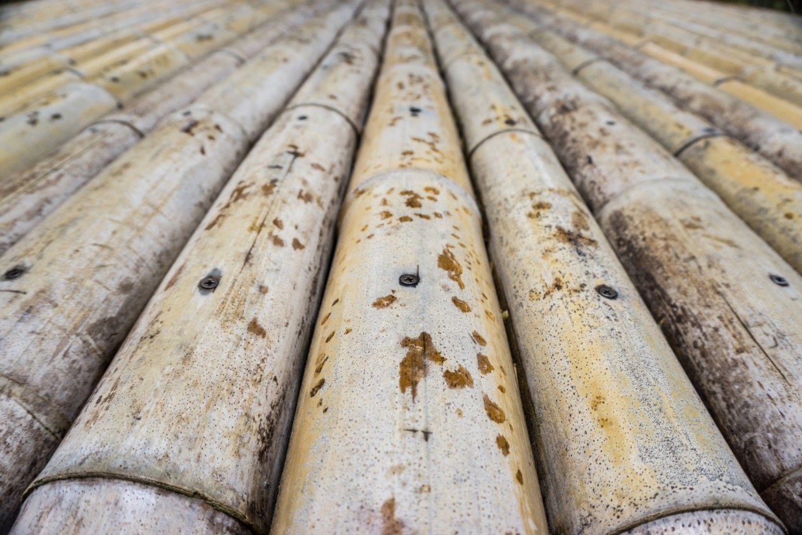
“Going Green” with Housing
Green building materials
Uses non-toxic materials and furnishings
Uses rapidly-renewable alternatives to wood, such as bamboo, or tropical hardwoods certified by the Forest Stewardship Council
Uses salvaged materials such as kitchen tiles
Uses materials with high recycled content

Slide 63
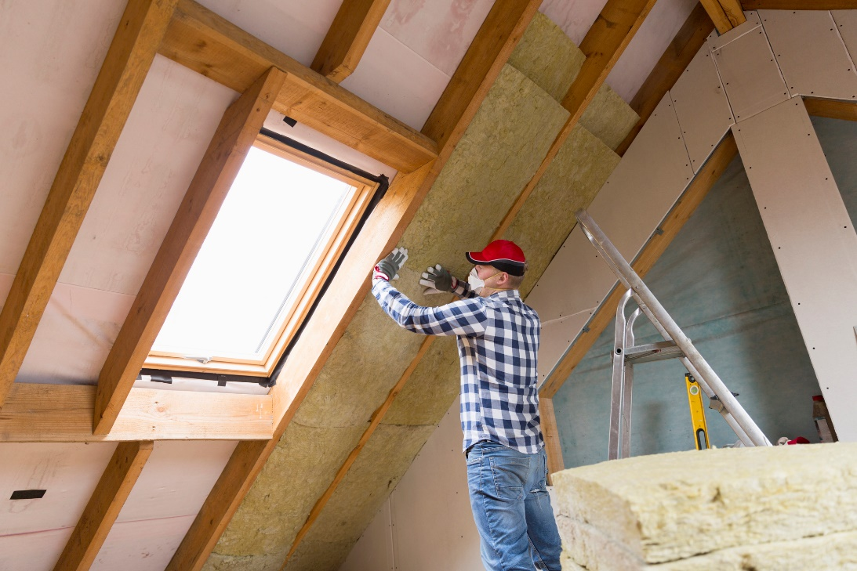
“Going Green” with Housing
Words to Know
Energy Star - a standard for energy-efficient consumer products
Insulation in walls and roof — Non-toxic with high R-factor (for heat resistance)
Windows and doors (exterior)
Have Energy Star ratings
Should tightly seal openings
Energy efficiency
Uses energy-efficient lighting, heating, cooling and water-heating systems
Has Energy Star-rated appliances

Slide 64
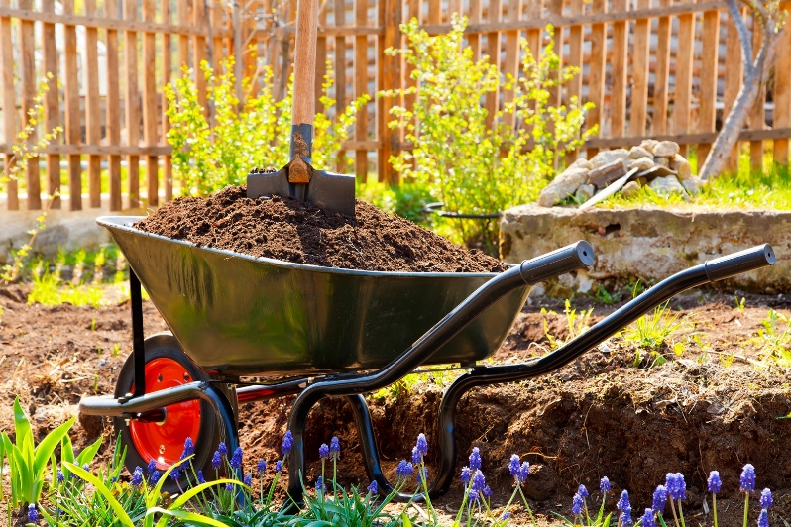
“Going Green” with Housing
Energy-generating — Uses technology to create energy, such as solar panels that convert sunlight into electricity
Water-efficient
Has water-efficient fixtures
Uses water-conserving irrigation
Indoor environmental quality
Brings natural daylight to at least 75% of interior
Takes advantage of natural ventilation
Has heating, ventilation, and air conditioning (HVAC) systems that filter incoming air and vent stale air
Landscaping
Minimizes “heat islands” (exterior walls, driveways, patios, other “hardscape” areas)
Features drought-tolerant plants

Slide 65
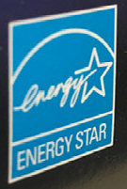
“Going Green” with Housing
The Energy Star program (of the U.S. Environmental Protection Agency) includes guidelines for builders to build energy-efficient homes that earn the Energy Star label.
Requirements for builders include: effective insulation systems; tight construction and ducts; efficient heating and cooling equipment; high performance windows; efficient products (lighting fixtures, appliances, ventilation fans, etc.); and third-party testing.

Slide 66
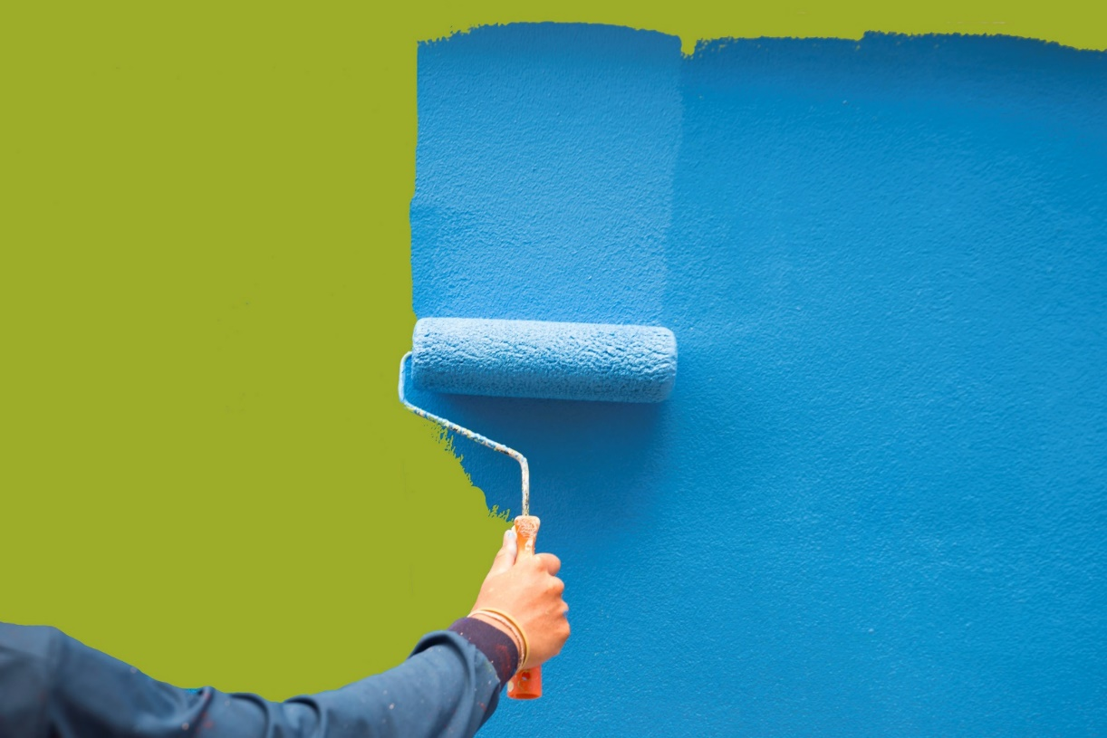
“Going Green” with Housing
Remodeling an existing home
Remodeling can range from painting a room to rebuilding from the framing up.
Going green during remodeling involves a consideration of existing conditions, from room layouts to hazards (mold, lead, asbestos).
It also involves integrating the old (existing) with the new.

Slide 67
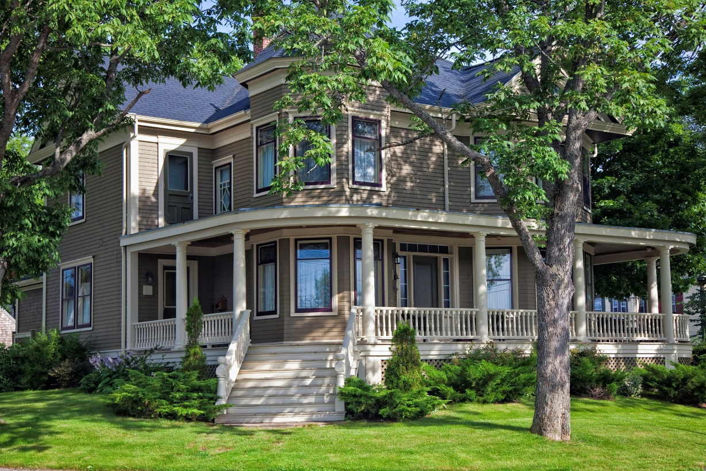
“Going Green” with Housing
Site
“Deconstruct instead of demolish” — minimize disruption to soil, plants
Recycle waste
Foundation — Control moisture
Landscaping
Resource-efficient
Plants grouped by water needs
Shade trees
Compost for healthy topsoil
Collect and retain rainwater for irrigation

Slide 68
“Going Green” with Housing
Frame (“Building Envelope”)
Engineered lumber, wood certified by the Forest Stewardship Council
Reduce pollution from garage
High-performance windows (replace single-pane) or storm windows (retrofit)
Insulation
Recycled content
Caulking and weatherstripping
Plumbing
High-efficiency toilets, water heater
Water-efficient faucets and showerheads

Slide 69
“Going Green” with Housing
HVAC
High-efficiency heating and AC system
High-efficiency HVAC filters
Effective ductwork (seal joints and seams, insulate, etc.)
No fireplace, or retrofit wood-burning fireplace with insert
Exhaust systems for bathrooms, kitchen
Carbon monoxide alarms
Finishes
Reduce tracked-in contaminants in entryways
Low-VOC paint, finishes, adhesives
Certified woods; reclaimed, recycled, refinished interior materials
Rapidly-renewable materials
Reduce formaldehyde indoors

Slide 70
“Going Green” with Housing
Renewable energy — solar systems
Appliances and lighting
Water- and energy-efficient
Lighting controls
The American Society of Interior Designers (ASID) and the U.S. Green Building Council have collaborated to produce guidelines for residential remodeling along green principles.

Slide 71
“Going Green” with Housing
“Leaning green” today
Clean the dryer’s lint trap. This improves air circulation (which will dry the laundry faster) and helps prevent a fire hazard from lint build-up in the dryer vent.
Use human-powered appliances and equipment. This reduces your carbon footprint.
Wash and rinse full loads of clothes in cold water. This saves water-heating costs and water.
Relocate the refrigerator to a cooler spot — away from a heating vent, oven, or window. This keeps the appliance from having to work harder to chill foods.

Slide 72
“Going Green” with Housing
Use fewer hazardous household products and chemicals:
Prevent or reduce pest problems — to avoid the need for chemicals to kill them. Wash dishes and counters daily, clean up spilled food immediately, store food in covered containers, fill gaps or holes around pipes, and keep trash areas clean.
Use a tool or method instead of a chemical to solve a problem, such as a plunger to unclog a drain, baking soda to scrub something clean, or vinegar to cut grease.

Slide 73
“Going Green” with Housing
Put computers into sleep mode when you’re not using them. This reduces energy costs.
Use compact fluorescent lighting (CFL), or install dimmer switches with traditional (incandescent) bulbs. Dimming can help a traditional bulb to last longer and lowers its energy use.

Slide 74
“Going Green” with Housing
Use programmable thermostats properly:
Install the thermostat on an interior wall and away from heating or cooling sources — appliances, registers, windows, doorways and lights.
Keep the thermostat set at energy-saving temperatures for long periods of time, such as during the day when no one is home, while away for the weekend or on vacation, and through the night.
Resist the urge to override the pre-programmed settings. When you override the settings, you use more energy and pay more.
Use low-VOC paints. This can improve indoor air quality.

Slide 75
“Going Green” with Housing
Vent kitchens and bathrooms to the outdoors. This limits the opportunity for mold to grow, and improves indoor air quality.
Seal any gaps between the garage and the house (if attached). This maintains indoor air quality by preventing fumes and exhaust from entering through wall cracks or door seals.
Recycle and replace refrigerators or freezers. Older appliances (more than 10 years old) are less energy-efficient.
Repurpose water for irrigation. Collecting rainwater helps to value water as the “new oil.”

Slide 76
“Going Green” with Housing
Build and maintain healthy soil:
Use a soil test kit to determine what your soil needs.
Feed your soil with compost.
Make compost at home, or buy it in bulk.
Reroof using cool roof products. They reflect more of the sun’s heat, lowering the roof’s temperature by up to 100 degrees (F). Options include ceramic or concrete tiles, metal, and synthetic membranes.
Use salvaged, secondhand, or antique furnishings and fixtures. This is a better use of natural resources than buying new products.
Use appliances with the Energy Star label. They use less energy and water, and save you money.

Slide 77
“Going Green” with Housing
Never burn hazardous wastes in a barrel or stove.
Note: Burning can release toxic gases, and produce hazardous ash and smoke. It is also illegal in many states.
Grow a “green roof.” A green roof is a vegetative layer grown on a rooftop. The vegetation on a green roof shades surfaces and removes heat from the air. The surface of this rooftop can be cooler than the surrounding air; conventional rooftop surfaces can be up to 90 degrees (F) warmer.

Slide 78
“Going Green” with Housing
Plant deciduous trees (trees that lose their leaves each year) along west- or south-facing windows and walls. This limits the amount of sunlight striking these surfaces in the summertime, reducing your air conditioning costs.
Note: Shading reduces the surface temperatures below the plants. These cooler surfaces, in turn, reduce the heat transmitted into buildings or re-emitted into the atmosphere.

Slide 79
Reducing Waste At Home
Words to Know
Grasscycling - recycling yard waste by mowing the grass so that it is never more than 2-3 inches tall, allowing the grass clippings to decompose and return nutrients to the yard
Americans produce millions of tons of trash each year. Much of this trash is from paper products.
Other sources include yard trimmings, glass, plastics, food scraps, and metal.
According to the EPA, between 1960 and 2007 the amount of waste each person creates has almost doubled from 2.7 to 4.6 pounds per day.

Slide 80
Reducing Waste At Home
The most effective way to stop this trend is by preventing waste in the first place.
Waste prevention, also known as source reduction, is the practice of designing, manufacturing, purchasing, or using materials (such as products and packaging) in ways that reduce the amount or toxicity of trash created.
Reusing items is another way to stop waste at the source because it delays or avoids that item’s entry in the waste collection and disposal system.
In other words, source reduction is waste prevention.

Slide 81
Reducing Waste At Home
You can take these steps today to prevent waste:
Buy only what you need.
Reduce the amount of unnecessary packaging:
Choose products that use the least packaging.
Buy grocery and hardware products that have no packaging, such as screws or vegetables in loose bins, instead of in prepackaged containers.
Use products you already have as alternatives to additional products. (For example, use 1 tablespoon of vinegar or lemon juice in 1 quart of water as an alternative to buying glass cleaner.)
Buy products in bulk if you use them frequently, such as laundry soap, pet food, shampoo, etc.
Use products in concentrated forms, such as laundry detergent.

Slide 82
Reducing Waste At Home
Use reusable products whenever possible.
Examples: cloth napkins, sponges, sturdy plastic
utensils, refillable bottles
Take only what you need of single-use items.
Examples: one paper napkin, one ketchup
packet
Reduce unwanted mail.
Maintain durable clothing and appliances to extend their use.

Slide 83
Reducing Waste At Home
Reuse anything that can have more than one use.
Examples: paper and plastic bags, note paper (use both sides), packaging “peanuts” and bubble wrap, brown paper bags as wrapping paper, jugs and coffee cans for storage containers
Borrow, rent or share items you use infrequently.
Examples: party supplies and decorations, tools, garden equipment, rug cleaners
Sell or donate usable items instead of throwing them away.
Examples: thrift stores, resale and consignment shops, garage sales, hand-me-down items to family members, organized clothing swaps

Slide 84
Reducing Waste At Home
Buy products that are recyclable or come in recyclable containers — and recycle them.
Buy products that are made from recycled materials.
Use “greenscaping” practices:
Use grasscycling or xeriscaping techniques.
Use manual garden tools, instead of power tools.
Borrow or rent lawn and garden equipment, if needed.
Use rain barrels to collect rain water from the roof, for watering plants and gardens.
Use pesticides as little as possible and in the smallest areas possible. Pull weeds by hand.

Slide 85
Reducing Waste At Home
Compost yard waste and some food scraps.

Slide 86
“Leaning Green” At Work
Turn office equipment off at night — including your computer and monitor.
If your computer has power management software installed, activate it.
Use less paper and re-use paper, when possible.
Note: Print out copies only when you absolutely need them.
Print double-sided per page.
Note: Much more energy is used to manufacture and distribute a sheet of paper than to print the sheet at your office!
Review and edit documents on screen.

Slide 87
“Leaning Green” At Work
Share documents and ideas using e-mail and cloud storage services.
Use recycled paper with “post-consumer content” of at least 30 percent.
Use unbleached paper.
Note: Paper manufacturers use chlorine to bleach paper white. This chlorine can get into the environment, where it creates dioxins that cause cancer, birth defects, and other health problems. Unbleached paper is available for many paper products.
Join a carpool and/or ride a bike to work.

Slide 88
“Leaning Green” At Work
Choose a flexible work schedule, if your employer offers them, to shorten your workweek — and your need to drive to work.
Re-use binders, binder clips, folders and other office products.

Slide 89
All rights reserved; copyright © 2018 Resource Center for CareerTech Advancement
For more information, email us at
resourcecenter@careertech.ok.gov
Visit our website at https://www.okcareertech.org/educators/resource-center

