Slide 1

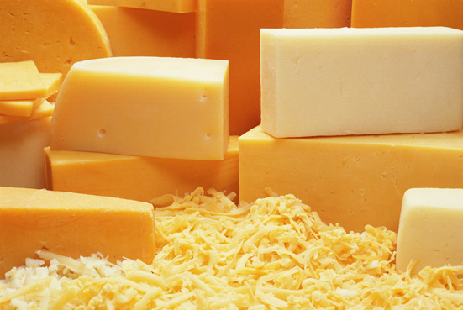
Did You Know?
In the manufacture of cheddar cheese, the curd is sliced, turned regularly, and stacked and restacked to induce matting of the curd and expel most of the whey. This turning and stacking is known as “cheddaring.”
Notes:
Source: Bureau of Labor Statistics, Monthly Labor Review, April 1993
Photo: © PhotoDisc, Inc., People and Lifestyles

Slide 2

Did You Know?
The eggshell and membranes under it provide a barrier that limits the ability of organisms to enter the egg. The shell surface has from 7,000-17,000 tiny pores that permit moisture and carbon dioxide to move out and air to move in.
Notes:
Source: USDA, Agricultural Research, June 2004
Photo: © PhotoDisc, Inc., Market Fresh

Slide 3
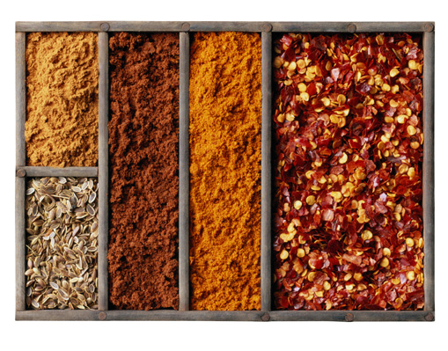
Did You Know?
Saffron is the world’s most expensive spice. It comes from the stigmas of a crocus and no other part of the plant is used. An acre planted with saffron will yield only 8-12 pounds of dried spice per year.
Notes:
Source: USDA, The Spice Market in the United States: Recent Developments and Prospects (Agriculture Information Bulletin Number 709)
Photo: © PhotoDisc, Inc., Market Fresh

Slide 4
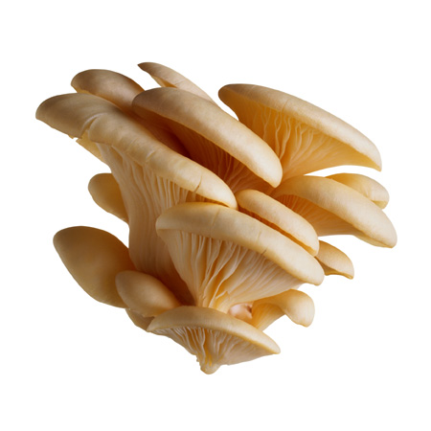
Did You Know?
A fungus is actually a primitive vegetable. Fungi can be found in air, in soil, on plants, and in water. Thousands, perhaps millions, of different types of fungi exist on Earth. The most familiar ones are mushrooms, yeast, mold, and mildew. Some live in the human body, usually without causing illness.
Notes:
Source: U.S. Department of Health and Human Services, National Institutes of Health, Microbes in Sickness and in Health
Photo: © PhotoDisc, Inc., Market Fresh

Slide 5
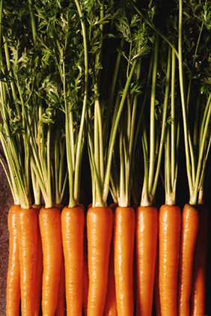
Did You Know?
Originally, carrots did not have the familiar orange hue of today. Centuries ago, carrots were various shades of white, purple, and yellow, with today’s orange carrot an apparent aberration reportedly developed in the 16th century by the Dutch.
Notes:
Source: USDA/ERS, Agricultural Outlook, November 1997
Photo: © PhotoDisc, Inc., Agriculture

Slide 6
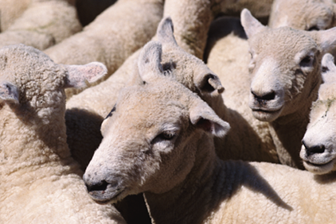
Did You Know?
In the United States, wool is mainly a byproduct from breeds of sheep raised for meat and ranges in quality from fine to coarse.
Notes:
Source: USDA/ARS, Agricultural Research, May 2005
Photo: © PhotoDisc, Inc., Agriculture

Slide 7
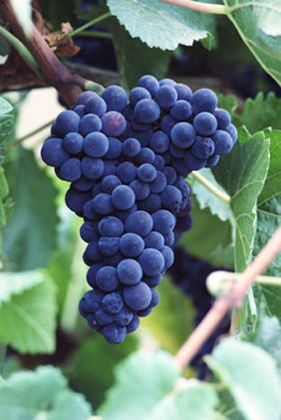
Did You Know?
Technically, a grape becomes a raisin when, during the drying process, its sugar content drops below 16 percent.
Notes:
Source: USDA/ERS, Fruit and Tree Nuts Outlook (FTS-303), March 2003
Photo: © PhotoDisc, Inc., Agriculture

Slide 8
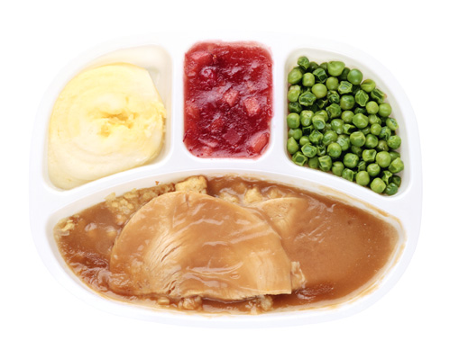
Did You Know?
In 1951, the first frozen pot pies appeared, followed in 1954 by the type of meal that became a symbol of the 1950s—the TV dinner.
Notes:
Source: USDA/ERS, Food and Rural Economics Division, Agriculture Information Bulletin No. 750, “Cooking Trends Echo Changing Roles of Women”
Photo: © PhotoDisc, Inc., Backgrounds and Objects

Slide 9
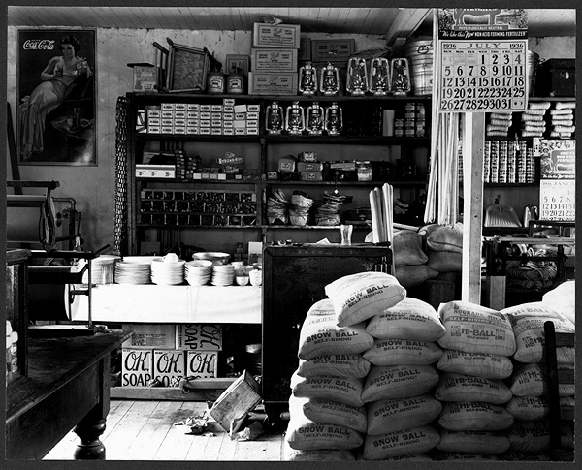
Did You Know?
Shopping carts have provided clues to the changing character of grocery stores since the Great Depression. Back then, small one-person operations were the norm and customers shopped with small baskets or store operators filled their shopping lists.
Notes:
Source: Bureau of Labor Statistics, Monthly Labor Review, September 1992
Photo: Walker Evans, general store interior, Moundville, Alabama [1936?], Library of Congress

Slide 10

Did You Know?
The taste cells that line the buds respond to only five known qualities: sweet, sour, salty, bitter, and glutamate. The experience of taste is a complex mixture of smell, temperature, taste, and texture.
Notes:
Source: U.S. Department of Health and Human Services, Oral Health in America: A Report of the Surgeon General, 2000
Photo: © PhotoDisc, Inc., Health and Medicine

Slide 11
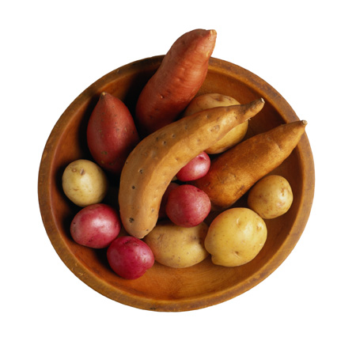
Did You Know?
Potatoes are America’s most popular vegetable. The typical American consumes more than 140 pounds of them every year—50 pounds more than the per capita consumption of tomatoes, the potato’s closest competitor.
Notes:
Source: USDA, Agricultural Research, March 2003
Photo: © PhotoDisc, Inc., Market Fresh

Slide 12
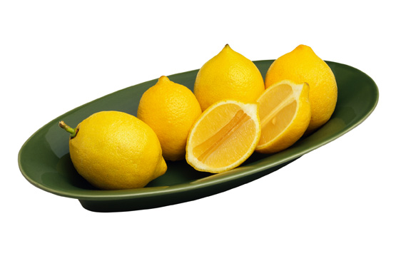
Did You Know?
Lemons belong to the citrus fruit family. Unlike oranges and grapefruit, lemons are rarely consumed alone. The high acid content in lemons makes them unpalatable for most people to consume like oranges or grapefruit.
Notes:
Source: USDA/ERS, Fruit and Tree Nuts Outlook (FTS-310), May 2004
Photo: © PhotoDisc, Inc., Market Fresh

Slide 13
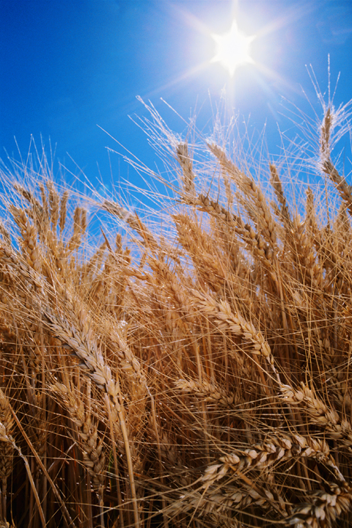
Did You Know?
Soft wheats are used to make pastries, cookies, crackers, and flat or hearth breads, such as pita bread. Hard wheats are used to make the everyday loaves of bread Americans are so familiar with.
Notes:
Source: USDA, Agricultural Research, March 2002
Photo: © Corbis Corporation, Business & Agriculture

Slide 14

Did You Know?
The surface of a woolen fiber is covered with microscopic scales, somewhat like scales on a fish or shingles on a roof. Wool shrinks during machine-washing because the heat and pressure lock the scales in place.
Notes:
Source: USDA/ERS, Agricultural Research, May 2005
Photo: © PhotoDisc, Inc., Shopping List

Slide 15
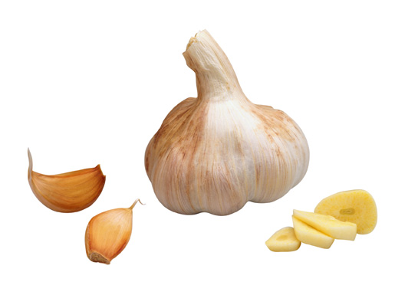
Did You Know?
For centuries garlic was valued as a medicinal herb by such cultures as the Chinese and the Egyptians.
Notes:
Source: USDA/ERS, Agricultural Outlook, June-July 2000
Photo: © PhotoDisc, Inc., Market Fresh

Slide 16
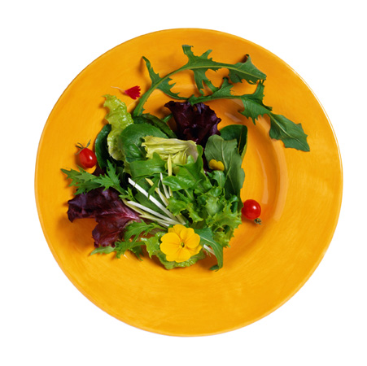
Did You Know?
Saturated fat boosts your blood cholesterol level more than anything else in your diet. Eating less saturated fat is the best way to lower your blood cholesterol level.
Notes:
Source: National Institutes of Health, National Heart, Lung, and Blood Institute, Healthy Heart Handbook for Women, July 1997 (revised)
Photo: © PhotoDisc, Inc., Market Fresh

Slide 17
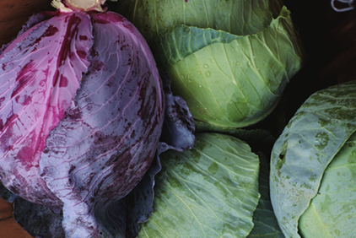
Did You Know?
Although a type of wine-pickled sauerkraut was reportedly made in China over 2,000 years ago, the Germans are credited with being the first to ferment cabbage using salt near the end of the 16th century.
Notes:
Source: USDA/ERS, Agricultural Outlook, September 2002
Photo: © PhotoDisc, Inc., Agriculture

Slide 18
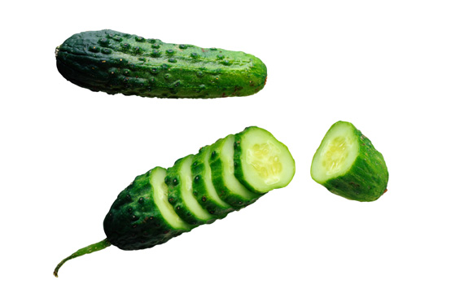
Did You Know?
Along with drying and dehydrating, pickling is one of the oldest forms of food preservation.
Notes:
Source: USDA/ERS, Agricultural Outlook, December 2000
Photo: © PhotoDisc, Inc., Market Fresh

Slide 19
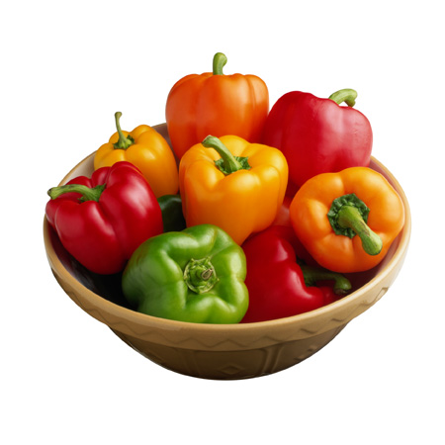
Did You Know?
Brighter colored peppers tend to be sweeter than green peppers because the sugar content increases as the pepper matures.
Notes:
Source: USDA/ERS, Agricultural Outlook, December 2001
Photo: © PhotoDisc, Inc., Market Fresh

Slide 20

Did You Know?
In the early 1930s, the economic constraints of the Depression influenced dietary guidance. In 1933, Hazel Stiebeling, a USDA food economist, developed food plans at four cost levels to help people shop for food. The plans were outlined in terms of 12 major food groups to buy and use in a week to meet nutritional needs.
Notes:
Source: USDA/ERS, Food and Rural Economics Division, Agriculture Information Bulletin No. 750, “America’s Eating Habits: Changes and Consequences”

Slide 21
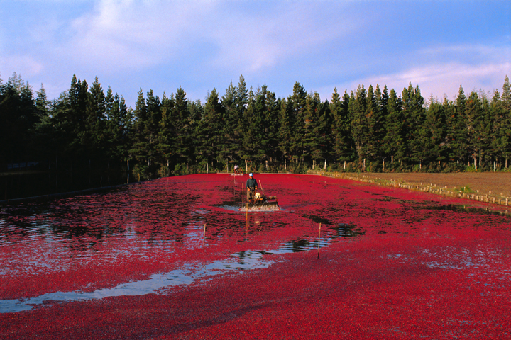
Did You Know?
The American cranberry is one of only three North American native fruits commercially grown in the U.S. They were used by Native Americans as a food, fabric dye, and medicine.
Notes:
Source: USDA/ERS, Fruit and Tree Nuts Outlook (FTS-295), November 2001
Photo: © Corbis Corporation, Business & Agriculture

Slide 22
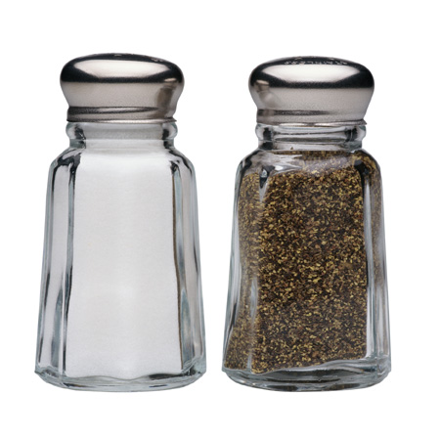
Did You Know?
Prehistoric human beings obtained their salt primarily from the meat of the animals they hunted. With the beginning of an agricultural society, humankind found the need to supplement vegetable and cereal diets with extra quantities of salt.
Notes:
Source: U.S. Department of the Interior, Bureau of Mines, The Material Flow of Salt (Information Circular), 1993
Photo: © PhotoDisc, Inc., Market Fresh

Slide 23
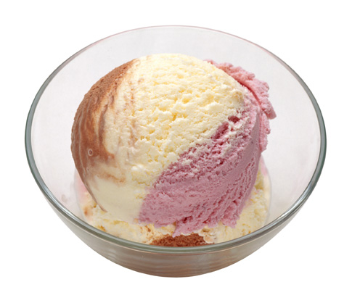
Did You Know?
Ice cream was primarily a soda fountain product until the 1930s when home refrigeration and installations of refrigerated cabinets in grocery stores became common.
Notes:
Source: USDA/ERS, The Structure of Dairy Markets: Past, Present, Future (Agricultural Economic Report No. 757), September 1997
Photo: © PhotoDisc, Inc., Backgrounds and Objects

Slide 24
Did You Know?
During the 40 years preceding 1950, poultry consumption varied between 15 and 25 pounds per person—about one-third that of either beef or pork. The highest consumption occurred during World War II because, due to its secondary status in the American diet, poultry was not covered by rationing.
Notes:
Source: USDA/ERS, Structural Change in U.S. Chicken and Turkey Slaughter (Agricultural Economic Report No. 787), 2000

Slide 25
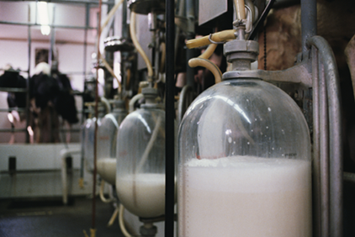
Did You Know?
In one day, a cow consumes 35 gallons of water, 20 pounds of grain, and 35 pounds of hay and silage.
In one day, a cow produces 5.4 gallons of milk or 2.0 pounds of butter or 4.6 pounds of cheese.
Notes:
Source: USDA-NRCS, For the Good of the People: Fun Facts about Farmers and Ranchers, October 2003
Photo: © PhotoDisc, Inc., Agriculture

Slide 26
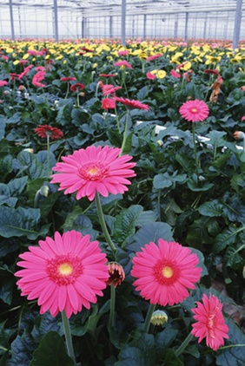
Did You Know?
The first application of modern scientific methods to plant reproduction is credited to Gregor Mendel in the mid-19th century. Mendel’s research focused on the identification of particular traits in garden peas, and the ways in which such traits were inherited by successive generations.
Notes:
Source: USDA/ERS, The Seed Industry in U.S. Agriculture (Agriculture Information Bulletin No. 786)
Photo: © PhotoDisc, Inc., Agriculture

Slide 27
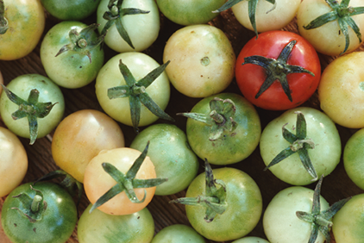
Did You Know?
Though botanically a fruit, in 1893 the U.S. Supreme Court ruled the tomato was a vegetable. The import tax on vegetables (not on fruits) protected U.S. tomato growers from foreign markets.
Notes:
Source: USDA, Beltsville Agricultural Research Center
Photo: © PhotoDisc, Inc., Agriculture

Slide 28

Did You Know?
Native to Mexico and South America, poinsettias were named after the U.S. ambassador to Mexico—Joel Poinsett—who introduced the plant in the U.S. in 1825.
Notes:
Source: USDA/ERS, Agricultural Outlook, December 2002
Photo: © PhotoDisc, Inc., Agriculture

Slide 29

Did You Know?
“Uncle Sam” is modeled after Sam Wilson, a meatpacker from Troy, New York. During the War of 1812, the meat he shipped to the government was stamped “U.S. Beef.” Soldiers began to call it Uncle Sam’s beef.
Notes:
Source: USDA/ERS, Agricultural Outlook, December 2002
Photo: © PhotoDisc, Inc., Government and Social Issues

Slide 30
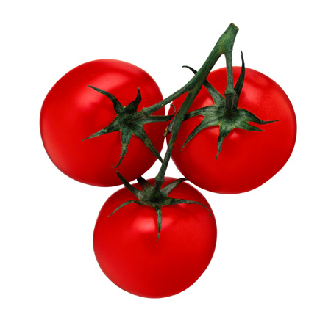
Did You Know?
Spanish explorers introduced the tomato to Europe in the 1600s. Northern Europeans suspected the “wolf peach” was poisonous and only grew it for decoration.
Notes:
Source: USDA, Beltsville Agricultural Research Center
Photo: © PhotoDisc, Inc., Market Fresh

