Slide 1
Career Success Skills
Developed by Resource Center for CareerTech Advancement,
a division of Oklahoma CareerTech

Slide 2



Planning a Career – Strong Employment Areas
Service sector
  Healthcare
  Social Assistance
  Leisure and Hospitality
  Educational Services
  Information Services
  Computer Systems Design and Related Services
  Employment Services
  Construction Industry
Notes:
Words the students should know for the first 11 slides:
Entrepreneur – assuming the risk as an individual of owning and operating a business to earn money and make a profit.
Private sector – working in a company or organization the focuses on making a profit.
Public Sector – working in a local, state, or national governmental organization.

Slide 3

Planning a Career – Declining Areas
Goods-Producing Areas
  Agriculture
  Mining
  Manufacturing though computer, automobile and aerospace products manufacturing will increase output.
Notes:
Discuss that trends can change – what was a declining area may turn around. Visit the U.S. Department of Labor Statistics for recent information on trends and supplement this area as needed. www.bls.gov
Select students to record things on the board. Develop three lists: “Yesterday’s Jobs,” “Today’s Jobs,” and “Tomorrow’s Jobs.” Start a discussion by listing a job under each category. Get the students to start thinking about how jobs have been eliminated, changed, and created. Ask the students to add jobs to each list.
Ask students to define “job security” in terms of past, present, and future jobs.

Slide 4

Identify Possible Careers
Define your future needs and wants.
Identify possible careers that suit you.
Gather career information about each possible career.
Evaluate your choices.
Choose a career path.
Design a plan to reach your goal.
Be flexible.
Continue to evaluate your career.
Notes:
Divide the class into small groups. Give each group a sample career to discuss. Ask each group to discuss the possible impact of the career on a person’s life, including social status, standard of living, working conditions, wellness, leisure time, ability to attain life goals, etc. Ask each group to select a spokesperson to summarize the group’s discussion for the class.

Slide 5

Sources for Career Information
Career consultants
Counselors
Educational institutions
Employers
Internet networks and resources
Personal contacts
  Parents
  Other family
  Friends and acquaintances
  Neighbors

Slide 6

Sources for Career Information - continued
Professional societies and journals
Public libraries, career centers, and guidance offices
Trade associations and magazines
OK Career Guide – www.okcareerguide.org
Notes:
Have the students sign-up for an account on OK Career Guide, www.okcareerguide.org, and search for information on careers.

Slide 7
Career Clusters
Agriculture, Food, and Natural Resources
Architecture and Construction
Arts, A/V Technology, and Communications
Business Management and Administration
Education and Training
Finance
Government and Public Administration
Health Science
Hospitality and Tourism
Notes:
Compare the list of career clusters that appear in the Occupational Outlook Handbook to the ones listed here.

Slide 8
Career Clusters - continued
Human Services
Information Technology
Law, Public Safety, Corrections, and Security
Manufacturing
Marketing
Science, Technology, Engineering, and Mathematics
Transportation, Distribution, and Logistics

Slide 9

Characteristics and Skills for Entrepreneurship
Personal Characteristics
  Adaptable/committed
  Competitive
  Creative
  Drive/sense of urgency/achievement-oriented
  Farsighted/aware
  Honest
  Leadership ability
  Realistic
  Responsible
  Self-confident
  Self-control/emotional stability
  Others? _________________________________________________
Notes:
Discuss with the students why the items listed are important for success as an entrepreneur. Discuss others not listed and ask the students to write them in the blank lines provided.

Slide 10
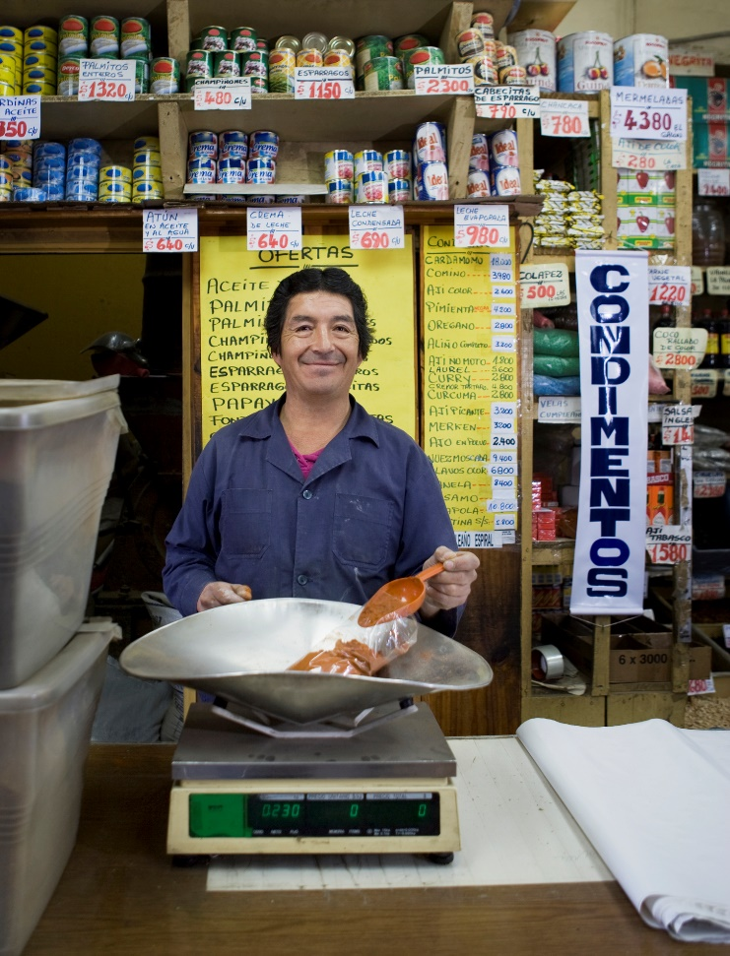
Characteristics and Skills for Entrepreneurship
Skills and Experience
  Basic skills related to your product or service
  Business education/skills or experience
  Communication skills
  Decision-making skills
  Hiring skills
  Interpersonal/social skills
  Management/supervisory skills or experience
  Organizational skills
  Planning skills
  Related work experience
  Others? _________________________________________________

Slide 11
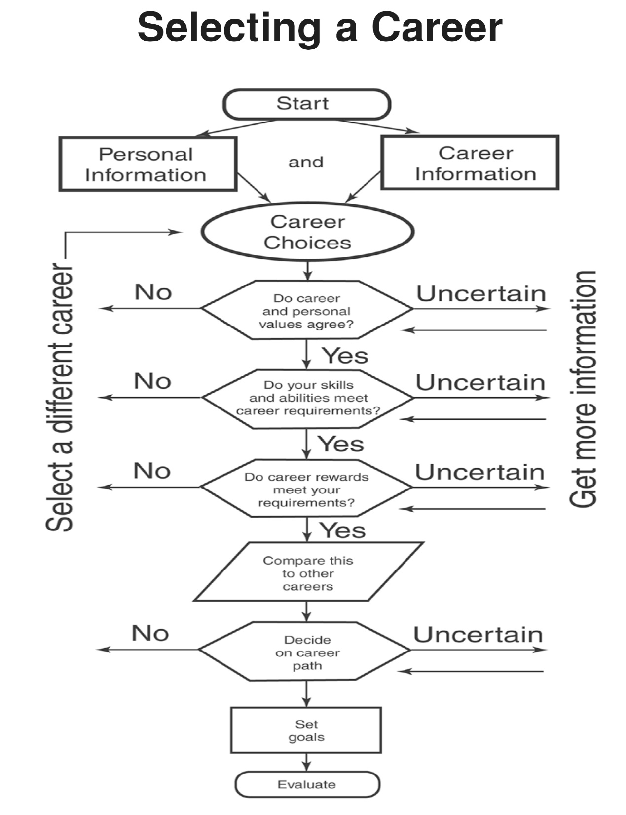
Selecting a Career
Flowchart
Notes:
Additional Resources:
Bureau of Labor Statistics
www.bls.gov/
• Careerbuilder
www.careerbuilder.com
• The College Board
www.collegeboard.com
Occupational Outlook Handbook
https://www.bls.gov/ooh/
• Oklahoma Employment Security Commission
https://www.ok.gov/oesc_web/
usa.gov – small business information
https://www.usa.gov/business?source=busa

Slide 12
Think About These Things
What are your personal job interests?
What job characteristics are important to you?
Research careers that interest you to learn what is required.
Research career opportunities in your community. What is available?
Build a personal career goals resource file.
  Three career goals
  Personal characteristics/skills/hobbies
  Working conditions
  Careers of interest to you
  Skills you will need and how to get them

Slide 13

Applying for a Job
Sources for job openings
  Public and private employment agencies
  Employment offices of private business firms
  School counselors/placement services
  Classified ads online/Internet resources
  Government offices
  Window signs
  Direct calls
  Networking
  Internships
Notes:
• Discuss with the students the questions:
■ Which source would they use to begin a job search?
■ Which sources have helped them or their acquaintances in the past?
■ Have they encountered problems in using any of the sources?
Ask if any of the students has participated in an internship. Ask for volunteers to describe their experiences.
• Invite a representative from an employment agency to explain how employment agencies can help people find jobs.

Slide 14
Strategies for Networking
Know your short-term and long-term goals.
Practice your social skills.
Develop your personal self-introduction. Create interest in you.
Look for networking opportunities.
Reintroduce yourself to people; remind them when/where you met.
Focus on people when you meet them.
Be courteous with everyone you meet.
Keep contact information up to date; including titles of those you meet.
Keep in touch to keep your network active.
Follow up promptly.

Slide 15

Documents You Need to Apply for a Job
Social Security card
Driver’s license or birth certificate
Work permit (if needed)
Copies of your resume
Letters of recommendation
Samples of your work/online portfolio
Reference list
Notes:
• Ask students to locate these documents before they apply for a job.
• Go to the website of the Social Security Administration at <www.ssa.gov/> and show students how to apply for a social security number online if they do not have one.

Slide 16

Information in a Resume
Personal data
Career objectives
Work experience
Educational background
Personal skills and qualities (optional)
Honors and activities (optional)
References – on a separate sheet of paper; always get approval from people you list.
Check for typos and spelling errors.
Notes:
Discuss the parts of a resume and how to construct one.
• Invite a business owner or personnel manager to talk to the class about how he or she evaluates a resume.

Slide 17
Letter of Application
Should be brief – no more than three or four paragraphs
First paragraph – introduce yourself and identify job sought
Next paragraph – educational experience and qualifications/abilities related to the position sought
Final paragraph – request an interview at employer’s convenience; provide information on how and when to contact you.
Letter should be typed.
Check your spelling!
Never send a resume without a cover letter.
Notes:
Discuss what should be included in a letter of application.

Slide 18

Application Form Guidelines
Read the entire application before beginning to fill it out.
Follow all directions and instructions.
Be neat.
Answer all questions, even if they don’t apply to you; use NA (not applicable) or draw a short line through blanks.
Know the position for which you are applying.
Double check the form to make sure all questions are answered.
Notes:
• Obtain samples of application forms from area businesses or find sample online.
• Discuss the importance of each of the listed guidelines.

Slide 19

Types of Employment Tests
Performance tests
Aptitude tests
Personality tests
Civil service tests
Psychological tests
Drug tests
Notes:
• Obtain information about employment tests from area businesses and from state employment services. Discuss that information with the class.
• Ask volunteers to share with the class their experiences with employment tests.

Slide 20

Personal Characteristics Employers Look For
Enthusiasm and interest
Dedication and dependability
Alertness, quickness of mind
Honesty and integrity
Desire to work
Desire to help others
Desire to improve oneself
Knowledge of tasks required in the position
Eye contact
Notes:
• Discuss with the students the kind of person they would like to hire if they were the employer. Compare the students’ responses to the items listed in the objective.

Slide 21

Guidelines for Dressing for an Interview
Dress to fit the job for which you are applying.
Select clothing that looks good on you.
Dress conservatively (dark blue or grey are good suit colors).
Be modest and well-groomed.
Wear minimal jewelry.
Have neatly trimmed hairstyle.
Polish shoes.
Empty pockets.
No cigarettes, gum, candy, sunglasses, perfume/cologne
Notes:
• Discuss the boxed item, “Dress for Interview Success.” Ask if any of the students has participated in an interview. Ask for volunteers to describe their experiences.
• Look for examples in magazines of appropriate and inappropriate dress for an interview.
• Have the students design a bulletin board about interview dress.
Go to https://www.cnn.com/2011/09/16/living/workplace-professional-dress-cb/index.html for information on professional dress.
Go to http://www.executivestyle.com.au/20-tips-to-dress-appropriately-for-work-2xvcy for 20 tips for dressing professionally.

Slide 22
Before and During the Interview
Before the interview:
  Learn about the company – products/services, how long in business, has company expanded or changed?
  Know the name, position, and title of the interviewer and how to pronounce.
  Know the typical salary for this type job.
During the interview:
  Know the working conditions (hours, pay periods, dress codes, etc.).
  Know safety and security precautions.
  Public/community relations
  Salary
  Benefits
  Opportunities for advancement

Slide 23

Preparing for an Interview
Obtain application forms.
Prepare your resume and letter of application.
Complete application forms.
Send resume, letter of application, and completed form to employer.
Respond immediately and courteously to requests for interview.
Prepare questions about the job and employer – do your research!
Notes:
• Identify sources for obtaining information about jobs and employers.
• Remind the students that preparation will help them to be more calm and make the interview go more smoothly.

Slide 24

Making an Appointment by Phone
Plan what you will say before calling.
State your name and reason for the call.
Ask when would be the best time to come in for an interview.
Record date, time, and place of the interview.
Ask for the name of the person doing the interview.
Thank the receptionist for assisting you. Keep the receptionist “on your side” as he/she can be part of the interviewing process.
Don’t ask how much the job pays.
Always be polite and courteous.
Ask if you should pick up and application or if it will be sent to you.
Notes:
Discuss phone etiquette and courtesy.

Slide 25

Recommended Interviewing Practices
Take necessary documents with you to the interview.
Take a pen and small notebook/notepad.
Arrive early for the interview.
Go alone unless you are told otherwise.
Introduce yourself to the receptionist and state why you are there.
Shake hands with the interviewer.
Sit down when and where the interviewer indicates you should.
Sit quietly until the interviewer begins.
Try not to appear nervous.
Notes:
Discuss ways to calm nerves before an interview such as deep breathing, visualization, etc.

Slide 26
Recommended Interviewing Practices - continued
Maintain good posture.
Maintain eye contact with the interviewer.
Listen very carefully.
Do not smoke or chew gum.
Show real interest in the job.
Use good manners.
Be brief, positive, and honest when answering questions.
Avoid using slang or offensive language.
Be ready to talk about you work experience and special skills.

Slide 27

Recommended Interviewing Practices - continued
Discuss positive aspects about yourself, not negative aspects of others or previous employers.
Wait until the end of the interview (or when you are asked) to ask questions you have about the job and company.
  Do NOT ask about salary first.
Politely than the interviewer for his or her time and consideration.
Offer to provide any additional information.
Be ready to take any tests.
Develop and use a pleasant speaking voice.
Follow-up with a thank-you letter or note.
Notes:
Discuss the importance of a follow-up thank you.

Slide 28

Following Up
Follow-Up Letter
  Typed or neatly written.
  Clean, neat, attractively arranged.
  Free of errors – spelling, punctuation, grammar.
  Sent within a day or two after the interview.
  Include the following:
    Expression of appreciation for the interviewer’s time and interest.
    Summary of your qualifications and continued interest in the position.
    Reinforcement of key points you made.
    Your name, address, phone number, and email.

Slide 29
Following Up - continued
  Make this your last bid for the job.
  Address a legal-sized envelope (same address as is inside).
  Fold the letter properly – fold bottom 1/3 up; second fold from new bottom up; insert into envelop so the top edge is at top of envelope.
  Stamp and mail.
Follow-Up Phone Call
  Include your name, date of interview, position for which you were interviewed.
  Ask whether a decision has been made in a polite manner.
  If someone else has been hired, thank the interviewer for considering you and express continued interest in working for the company.
Notes:
Resources for this section:
• Social Security Administration
www.ssa.gov/
• College Grad Job Hunter
www.collegegrad.com
• Occupational Outlook Quarterly Online Index (PDF publications, etc.)
https://stats.bls.gov/careeroutlook/home.htm

Slide 30

Succeeding on the Job
Characteristics of a good employee:
  Cooperation
  Initiative
  Honesty
  Willingness to learn
  Ability to follow directions
  Neat appearance; good grooming
  Pleasantness
  Professional communication
  Politeness
  Patience
  Punctuality
  Good Attendance
  Accepting criticism well
  Loyalty
  Sense of humor
  Positive attitude
  Lack of jealousy
  Tactfulness
  Interest in the job
Notes:
Invite a local employer to speak to the class about what he or she looks for in a new employee. (If you can invite several employers, they could have a panel discussion about successful employees.)
Make sure students know the meaning of ethics:
ethics — relating to what is good or bad; having to do with moral duty and obligation

Slide 31

Personal Appearance Guidelines
Avoid the following:
  Too much makeup
  Cheap, gaudy jewelry or excessive jewelry
  Run-down heels
  Bad breath
  Body odor
  Unkempt hair and nails
  Extreme and unsuitable styles
  Exaggerated hair styles

Slide 32
Personal Appearance Guidelines - continued
Buy the best clothes you can afford.
Keep your clothes clean and neatly pressed.
Dress stylishly, but avoid extremes.
Avoid bad color combinations.
Observe the taste and style of well-dressed people.
Seek advice on colors and styles of clothes.
Study the serviceability and suitability of clothes.
Dress according to your age, position in life, personality, figure, complexion, and occasion.
Keep hair trimmed and shave often.

Slide 33

Personal Appearance Guidelines - continued
Keep pockets from bulging.
Mend rips promptly and re-sew dangling buttons.
Hang clothes straight on hangers when not in use.
Bathe frequently.
Brush your teeth at least twice a day.
Your appearance will represent the employer.
You feel more self-confident when you look your best.
Making a favorable impression make the listener more ready to hear you.
Employers generally think a sloppy person is a sloppy worker.

Slide 34

First Day on the Job
Arrive 10 – 15 minutes early.
List to all instructions carefully – ask questions if needed.
Be friendly to co-workers but don’t waste time visiting.
Try not to be nervous.
Learn about the organization.
Report mistakes to your supervisor.
Think for yourself.
Take a real interest in your job.
Notes:
• Ask for students with jobs to volunteer to talk about their first-day experiences. What did they learn?

Slide 35

First Day on the Job - continued
Keep your work area neat.
Avoid watching the clock.
Learn company rules and regulations; ask for a company handbook.

Slide 36
Common Items in an Employee Handbook
Company information including history, welcome, policies, expectations, training opportunities.
Basic workday information such as working hours, shifts, breaks, tools, phone calls, parking, ID cards.
Wage information like policies, pay periods, pay distribution, overtime policies and hours, payroll deductions, time clocks/cards.
Benefits information including insurance, holidays, savings plans, unemployment options, vacations, worker’s compensation.
Safety and health information such as policies, first aid, housekeeping, PPE, safety rules.
Notes:
• Obtain copies of employee handbooks from local employers, if possible. Use the samples to illustrate the purposes of employee handbooks.
• Compare formal sources of information, such as employee handbooks or personnel policies, with informal sources, such as listening to co-workers or observing how others work. Ask the students to discuss the possible advantages and disadvantages of both sources

Slide 37

Common Items in an Employee Handbook - continued
Communications information like policies, options for communication.
Company rules – there may be certain actions that lead to disciplinary actions or firing.

Slide 38
Getting Along with a Supervisor
Accept the authority of the supervisor.
Ask the supervisor for more responsibilities when assigned duties are completed.
Do not give the appearance of flirting with anyone on the job.
Handle merchandise and supplies respectfully.
Do not pretend to know all about the organization.
Learn from all supervisors, both good ones and the less skilled.
Be considerate and polite at all times
Notes:
• Discuss the importance of each of the listed guidelines.

Slide 39

Getting Along with Co-Workers
Introduce yourself.
Be pleasant, cheerful, and friendly to everyone.
Learn the names and interests of other employees.
Greet or smile at other employees when arriving for work.
Listen, ask questions, and thank those who try to be helpful.
Say good-bye or make gestures to say good-bye when leaving for the day.
Do not force yourself on others.
Notes:
• Discuss the importance of each of the listed guidelines.

Slide 40
Getting Along with Co-Workers - continued
If invited, join employer-sponsored social groups/teams.
Realize that new employees may have fewer privileges.
Do not talk about your salary.
Cooperate with co-workers and help them when possible.
Maintain a positive attitude toward co-workers.
Show your enthusiasm.
Show a sense of humor; be able to laugh, but don’t try to be the company clown.

Slide 41

Reasons People Lose Jobs
Poor human relations and attitude.
Lack of technical knowledge.
Low dedication to work ethic.
Notes:
• Invite a personnel manager from a local business or organization to talk to the class about the reasons people lose jobs

Slide 42

Communicating a Positive Work Ethic
Being punctual
  Arrive 10 – 15 minutes early,
  Dress and gather tools on your own time.
  Return from breaks on time
  Run personal errands on your own time.
  Don’t watch the clock.
  Be willing to work longer if needed.
  Never rush or walk away from a customer for a break or to leave work.
Appearing neat and appropriately dressed
  Keep hands and nails clean.
  Avoid dangling jewelry.
Notes:
• Have the students design a bulletin board about a positive work ethic.

Slide 43
Communicating a Positive Work Ethic - continued
Appear neat and appropriately dressed - continued
  Avoid clothing fads, jeans, and t-shirts unless part of the dress code.
  Guard against body and breath odor.
  Keep hair clean and styled.
  Use as little make-up as possible.
  Put on a smile.
  Visiting on the job
    Limit personal phone calls and email.
    Make sure family and friends know they shouldn’t call or have long visits during work hours.

Slide 44

Communicating a Positive Work Ethic - continued
Missing work
  Have good attendance and maintain good references.
  Try not to miss when you know there are many tasks to be completed.
  Call your employer as early as possible when you must miss work for illness.
  Always ask, not tell, your supervisor when you need time off.
  Ask for time off as early as possible, and also remind your supervisor again several days before taking off.
  Thank your supervisor for letting you off.
  Be willing to trade hours with co-workers.
  Be willing to go into work on short notice when possible.

Slide 45

Communicating a Positive Work Ethic - continued
Keeping busy
  Look for extra work to do when regular work is finished.
    Things always need to be cleaned, straightened, stacked, marked, or displayed.
    Use slack periods to learn more about your job.
  Do not wait to be told to do things.
  Work even when the supervisor isn’t around.
  Stay with a task until it is finished.
  Do not become upset if you must repeat a job.
Staying poised
  Stay calm.
  Work quickly and steadily without getting flustered when things go wrong.

Slide 46

Communicating a Positive Work Ethic - continued
Stay poised – continued
  Speak in a clear, distinct voice; avoid using slang, cursing, or improper English.
  Avoid giggling, a loud voice, or distracting nervous gestures or habits.
Being professional
  Have a positive attitude.
  Be enthusiastic.
  Keep an open mind.
  Try to learn something new each day.
  Read about your profession.
  Join and be active in your professional organizations.
  Volunteer to attend workshops and in-service programs offered.
  Continue education in your chosen field.

Slide 47

Communicating a Positive Work Ethic - continued
Communicating effectively
  Listen carefully and ask questions if you don’t understand.
  Repeat the message or instructions to the sender for verification.
  Do not misuse language by name-calling or using emotionally loaded words.
  Do not overstate by using words such as “always,” “ever,” and “never which suggest absolute certainty.

Slide 48

Personal, Social, and Business Ethics
Personal Ethics
  As varied as the individual.
  Judgements formulated by religious beliefs, family or cultural background, or personal experience.
  Values that influence the way a person deals with others.
  Judgements determine how a person views and resolves ethical situations.
Social Ethics
  Rules of conduct that are accepted as essential for our welfare and survival
  Standards of behavior that are agreed upon by a society
Notes:
• Ask the students to give examples of each type of ethics. Discuss the possible consequences of unethical behavior in personal life, in society, and at work.
• Discuss the impact of culture on business/work ethics.

Slide 49

Personal, Social, and Business Ethics - continued
Business Ethics
  Standards of conduct and moral judgement in policies and practices on the job
  Having to do with a person’s ethical behavior on the job
  Behavior and moral character demonstrated from the entry level to top management

Slide 50

Characteristics of a Leader
Creative
Enthusiastic
Flexible
Inspirational
Optimistic
Organized
Self-Confident
Skillful at communicating
Understanding of others
Well-informed
Notes:
• Ask individual students to identify a leader and explain why that person is a leader.
• Invite representatives from various organizations and city government to visit the class and serve on a panel discussion about the leadership skills necessary in their organizations.

Slide 51

Steps in Becoming a Leader
Become a follower first.
Develop a healthy self-concept.
Learn by doing.
Make a good first impression.
Receive education and training.
Seek advice and support.

Slide 52

Ways to Demonstrate Leadership
Follow the rules.
Carry out assigned responsibilities.
Cooperate with other group members.
Display common courtesies.
Respect other people and their property.
Volunteer to serve on projects.
Others? _________________________________________________
Notes:
• Ask the students to identify additional ways to demonstrate leadership.

Slide 53

Asking for a Raise
Know your boss and your employer.
Time your request.
Know if you are justified in asking for a promotion or raise by making a good case for yourself in writing.
Be honest with yourself about your attitudes and work habits.
Make an appointment.
Take your notes with you.
Explain your progress in your work.
Notes:
• Ask two students to role-play a situation in which an employee asks a supervisor for a raise. Allow class members to make suggestions about the employee’s approach.

Slide 54

Asking for a Raise - continued
Thank your employer for the time spent.
Leave – go back to work and be patient.
Ask your employer if any decision has been made after two weeks.

Slide 55

How to Treat a Customer
Greet customers quickly and courteously.
Let customers know they will be helped as soon as possible.
Show interest by listening to and looking at customers.
Ask questions to learn customer’s needs.
Provide knowledgeable answers to questions by knowing about products and/or services.
Treat customers with respect.
Be friendly and enthusiastic.
Keep calm and don’t get defensive when handling complaints.
Notes:
• Discuss with the students the question, “How is customer service important to the success of a business or other organization?”

Slide 56

How to Treat a Customer - continued
Don’t socialize with co-workers or friends when customers are waiting for help.
Don’t let personal problems interfere with serving customers.
Treat each customer as an individual; do not let a bad experience with one customer affect they way other customers are treated.
Give good service so customers will want to return.

Slide 57
A Few Tips for Using E-mail
Follow your employer’s policy about using e-mail on the job.
Check your e-mail regularly.
Always reply promptly, even if a brief acknowledgment is all you can send.
For a sensitive subject, avoid using email.
Be careful how you express yourself (especially if you are upset).
Don’t use text from someone else’s message without that person’s approval in advance.
Don’t change someone else’s message and pass it along without clearly identifying the changes you made.
Notes:
• Explain why each guideline is important.
• Lead a group discussion. Discuss questions such as:
■ Should the employer monitor employee electronic communications?
■ What should be considered proper uses of the employer’s computing resources?
■ Who should own work produced with company resources?

Slide 58

A Few Tips for Using E-mail - continued
Avoid reproducing an e-mail message in full when responding to it (especially if you are sending it to a group of people).
Keep messages concise and to the point.
Avoid unnecessary punctuation (such as multiple
exclamation points).
Make the subject line of your e-mail is
meaningful to the receiver.
Do not send frivolous, abusive, or
defamatory messages.
Be tolerant of other’s mistakes.

Slide 59

A Few Tips for Using E-mail - continued
Plan to handle your e-mail when you are away.
Encourage people to communicate with you by e-mail. Give them your correct e-mail address and include it on your business card.
Read over every e-mail message before you send it.

Slide 60
All rights reserved; copyright © 2018 Resource Center for CareerTech Advancement
For more information, email us at
resourcecenter@careertech.ok.gov
Visit our website at
https://www.okcareertech.org/educators/resource-center

