Slide 1
Lightcast Reports:
Free Labor Market Information
And Economic Data Reports
Tracy Boyington
Resource Center for CareerTech Advancement
Oklahoma Department of CareerTech

Slide 2
What is Labor Market Information (LMI)?
Wages/benefits
Job opportunities
Unemployment rate
Skill requirements
Projections
Demographics
Industry trends
Demand and growth
Notes:
Labor Market Information can include any of the following

Slide 3
What are Lightcast Economic Data Reports?
Free service provided by the Resource Center
Data is gathered by Lightcast from various sources, including:
U.S. Department of Labor
U.S. Department of Commerce
U.S. Census Bureau
U.S. Department of Education
Tens of thousands of online job postings
Notes:
The Resource Center has a subscription to Lightcast, which allows us to pull these reports.
Lightcast gathers their information from a wide variety of sources. Many are official government sources such as the ones listed here. They also “scrape” data from online sources such as job postings.

Slide 4
What type of reports are available?
Education and Training
Occupations
Industries
Economy and Demographics

Slide 5
What type of reports are available?
Education and Training
Education Pipeline – An overview of the programs that train for an occupation, as well as the schools that provide training
Program Snapshot – An overview of the demand for a program with data related to competitive landscape, job postings, skills, target occupations, and more
Program Table – A table of the academic programs in a region with data related to completions, openings, earnings, jobs, and more
Notes:
Data on education/training programs is available by CIP code (nces.ed.gov/ipeds/cipcode)
Note that these reports only include programs that are reported to the U.S. Department of Education National Center for Education Statistics (i.e., IPEDS). This will include most postsecondary full-time programs, but most of our CareerTech short-term programs are not reported.
Note also that we cannot get data on what is happening inside a specific school, other than the number of completers. If you need data on what is happening inside a tech center, you can go through CTIMS or look at the interactive data on our website. But if you want to know how many cosmetology programs there are in a region, or how many people completed a specific full-time program statewide, we can get that for you.

Slide 6
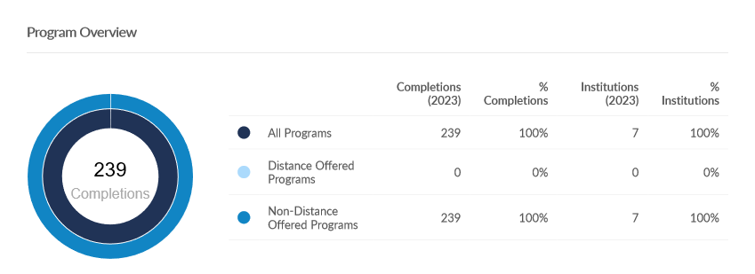
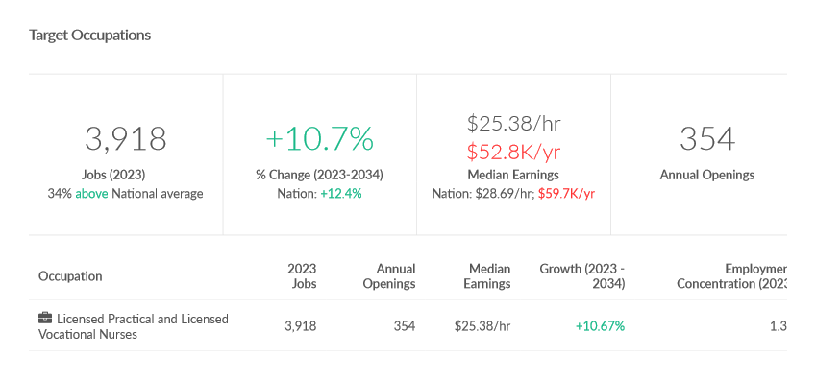
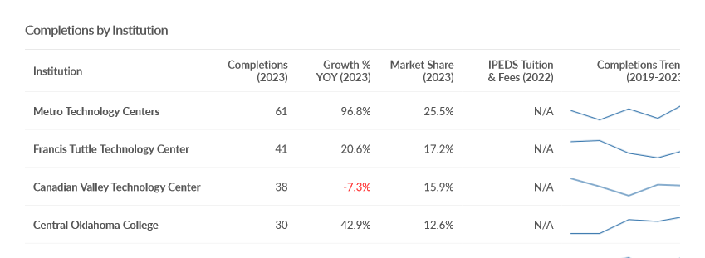
Notes:
These are some snapshots from the Program Snapshot for Practical Nursing programs. In these examples, you can see the number of completions in this particular region (OKC MSA), the institutions providing the training, and the target occupations for those who complete those programs.

Slide 7
What type of reports are available?
Occupation
Occupation Snapshot – An overview of one occupation, with data related to jobs, earnings, programs, demographics, and more
Occupation Table – A more customizable table displaying one or more occupations with data related to jobs, growth, earnings, completions, demographics, and more
Notes:
The Occupation Snapshot is a detailed overview of one occupation. This one is a PDF with charts you can use in your own reports, if desired. It looks at the job market, compensation, top requested skills, top employers, demographics of the employees, average earnings, and other data.
The Occupation Table is an Excel file that lists one or more occupations. This allows for more customization. For example, we can look up to 10 years in the future, and we can get more granular detail about pay (i.e., 10th percentile, 90th percentile) and demographics.

Slide 8
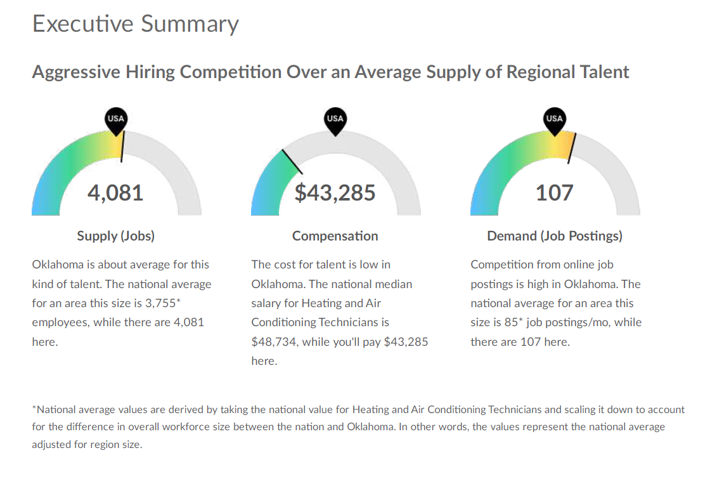
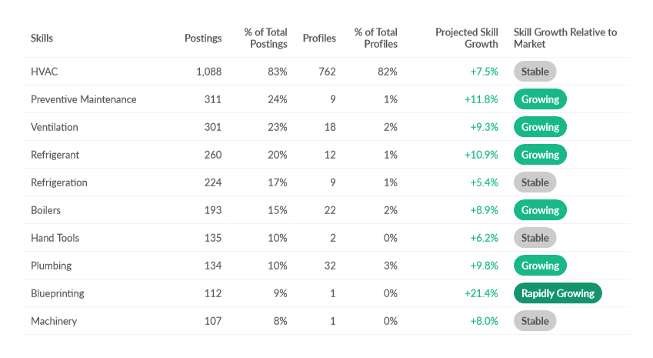
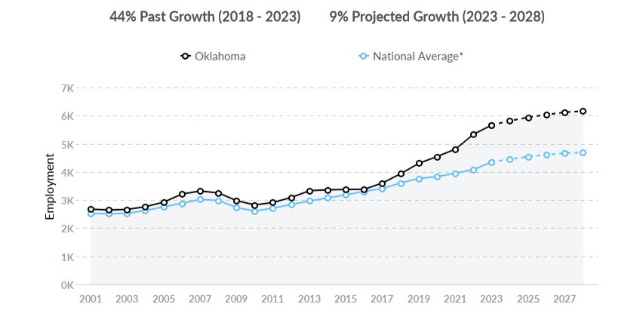
Notes:
Screen shots from Occupation Snapshot Report. This is just some of the data included in the report – these examples show an executive summary of jobs and compensation, history and predictions for the future, and desired skills.

Slide 9
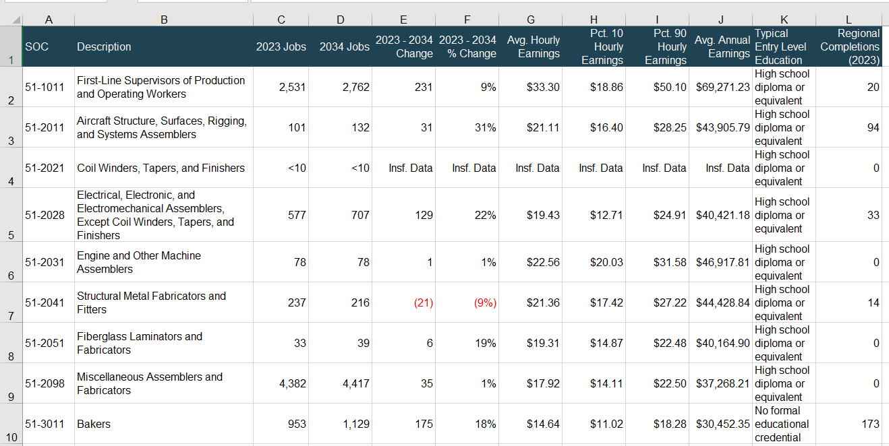
Notes:
Screen shot from Occupation Table. This is a table of production occupations, with a sample of some of the data that can be included.

Slide 10
What type of reports are available?
Occupation
Highest Ranked Occupations – An overview of top occupations in a region according to employment, earnings, job growth or decline, and more
Job Posting Analytics – An overview of job posting activity over time with data related to occupations, job titles, and skills/certifications required
Notes:
The Highest Ranked Occupations report lists the top 10 to 50 occupations, rated in different categories, such as number of jobs, job growth, and pay. This can be limited to jobs that don’t require a degree, or jobs that do require a degree, or can include all jobs.
Job Posting Analytics - The other reports on Occupations are only available for those occupations that are part of the Bureau of Labor Statistics’ Standard Occupational Classification System, which is the “official” list of 867 occupations. But there are newer and/or more specific occupations that aren’t well represented by this list. For those jobs, we can look at Job Posting Analytics. For example, social media manager is not in the BLS list, but we can search for job postings with that job title, or with social media as a required skill. This is a good way to look at the demand for specific skills, such as a certain programming language, the ability to use a particular type of equipment, or a specific certification.

Slide 11
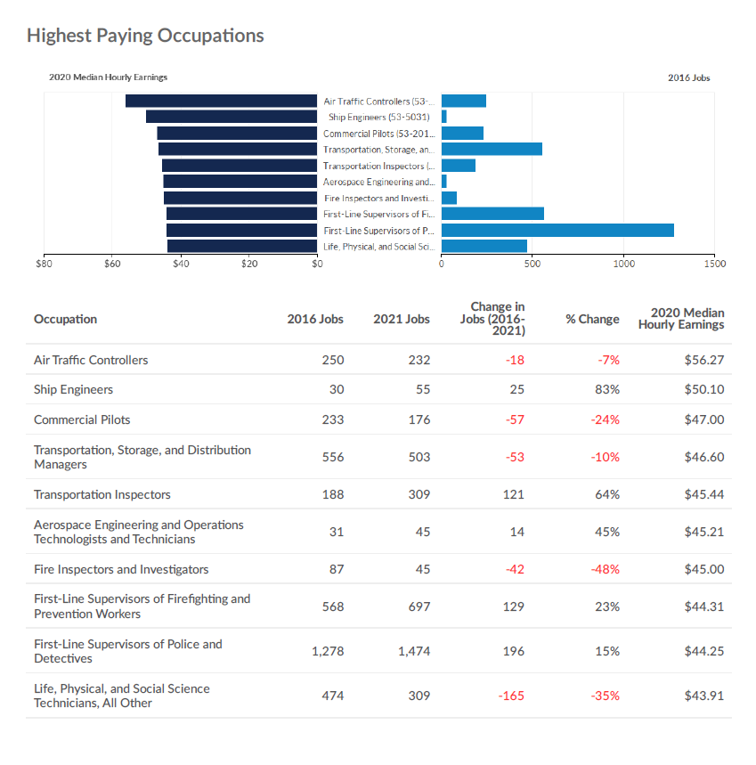
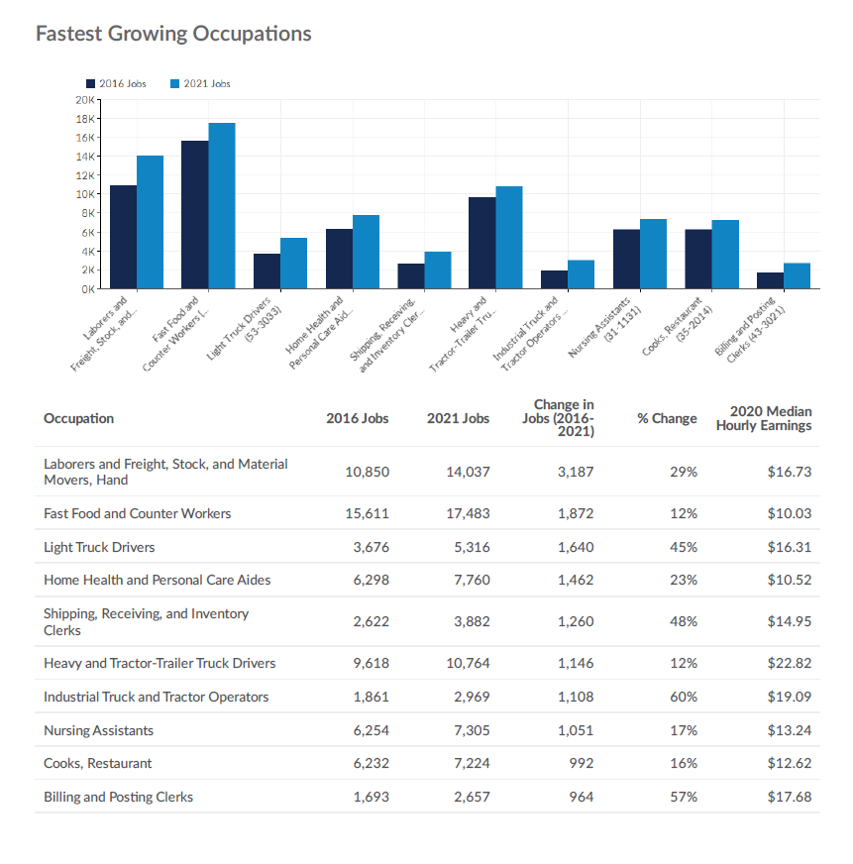
Notes:
Screen shots from Highest Ranked Occupations – this is one of the samples I’ve given you today. Yours is for the entire state of Oklahoma, but it can be customized for your district. This example is limited to occupations that do not require a degree, but we can also look for jobs at any education level. We can look at all jobs, or limit it to jobs in a particular category in the Bureau of Labor Statistics classification system, such as Healthcare Support Occupations or Production Occupations. Occupations are ranked according to several factors – number of jobs, number of advertised openings, pay, growth, and performance. We also have the Lowest Ranked Occupations if you’re interested.

Slide 12
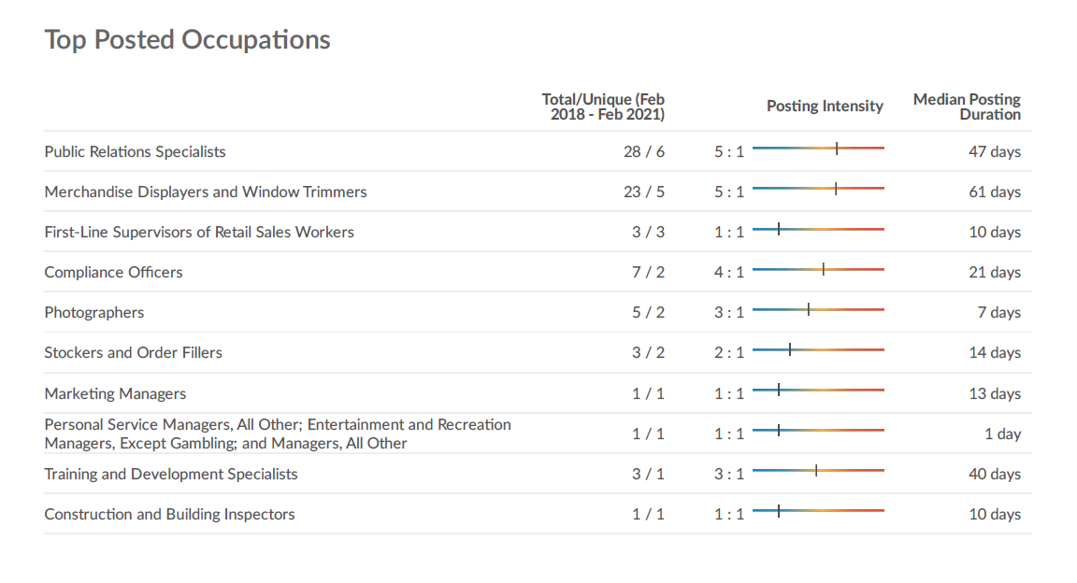

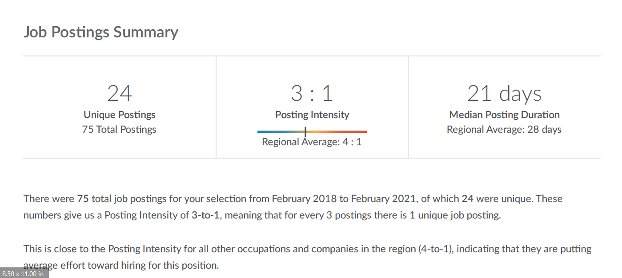
Notes:
Screen shots from Job Posting Analysis – In this case, a school wanted information about jobs calling for specific skills: digital photography and photo editing. Neither of those is an official occupation, so I was able to look at job postings calling for those skills and find out what the job market is like for them.

Slide 13
What type of reports are available?
Industry
Industry Snapshot – An overview of one industry with data related to jobs, growth, earnings, demographics, and more
Industry Table – A more customizable table displaying one or more industries with data related to jobs, growth, earnings, completions, demographics, and more
Businesses Table – A list of the businesses in a region, with factors including business size, sales, women/minority ownership, and more
Notes:
Like the Occupation Reports, the Industry reports give you either a detailed report on one industry with graphics, or an Excel report on multiple industries with the ability to customize the data reported.
The Businesses Table is a list of the businesses in a region. This can include all businesses or can be limited by industry. It provides information on the business size, years in business, whether it is a small business, woman- or minority-owned, and other factors, and includes contact information.

Slide 14
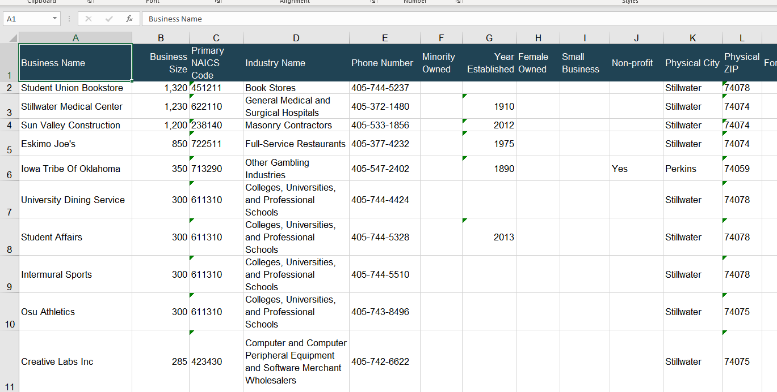
Notes:
Screenshot from the Businesses Table. This is sorted by business size, note that it indicates the year established, the location, and whether a business is female- or minority-owned.

Slide 15
What type of reports are available?
Economy and Demographics
Economy Overview – An overview of a regional economy with data related to jobs, demographics, and social metrics
Population Demographics Report – An overview of demographics and population in a region with data related to age cohort, gender, and race/ethnicity
Population Demographics Table – A table of demographic and population data including age cohort, gender, and race/ethnicity
Notes:
The Economy Overview is a snazzy looking report with data about a region’s economy. You have a sample of this one today for your district. Since some of this information is not available on a ZIP code level, I generally run these by whole counties. That means there will be some overlap between you and your neighbors. Example: Francis Tuttle and Eastern Oklahoma County both include all of Oklahoma County.
The Demographics Report and Demographics Table provide different depths of information about the demographics of the population in a region. These are available on a ZIP code level, so they can be more accurately limited to your district boundaries.

Slide 16
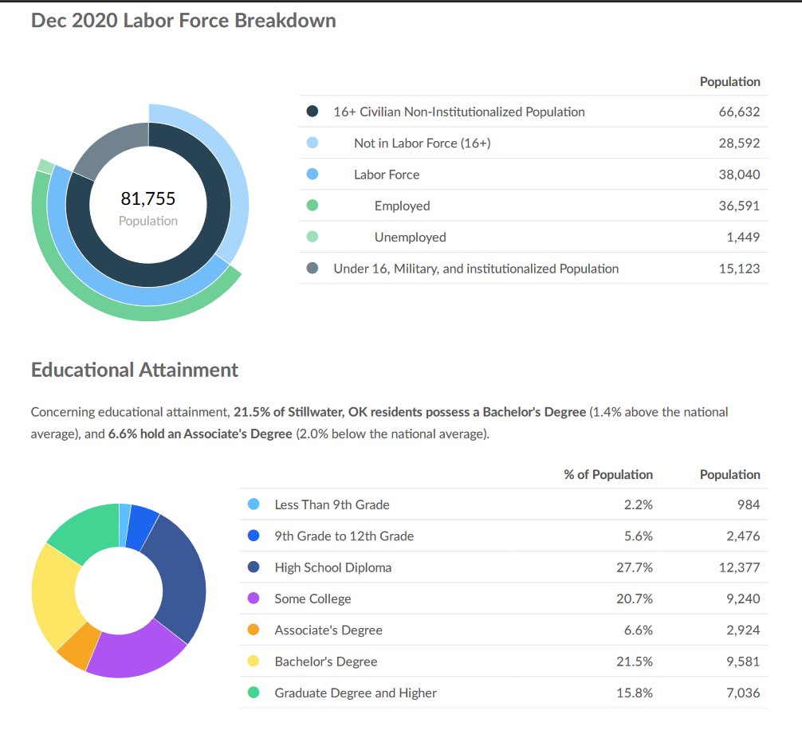
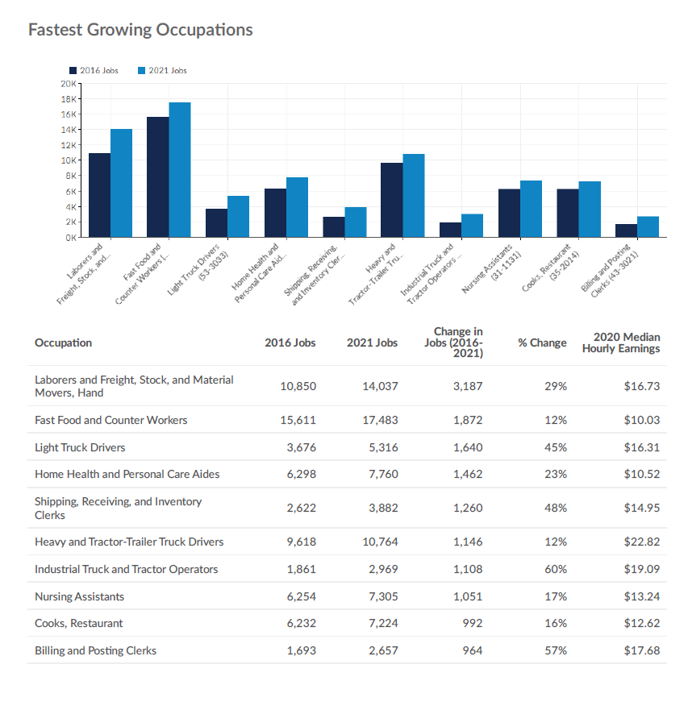
Notes:
Details from the Economy Overview, including some demographic information

Slide 17
Notes:
This shows the variety of community indicators available, including family size, disabled population, foreign-born population, veterans, poverty level, income, house value, remote workers, and more.

Slide 18
What is a region?
Any of these reports will be run for a particular region
A region can be a county, a group of counties, a group of ZIP codes, a Metropolitan Statistical Area, or a distance from a certain point on a map (such as 100 miles from a school, or a one-hour drive from a business)
Notes:
I’ve talked about regions a lot. We have to pick a region before we can run any report.
A region can basically be anything you want it to be. You can limit it to your district, or you can look outside your district. For example, if you’re looking at the potential job market, your completers will probably be willing to travel outside the district for a job, so you might want to look at a one-hour drive time from your school. If you’re recruiting a business, you can look at a larger surrounding area for potential employees.
I will usually create regions using whole counties because some data is not gathered on a ZIP code level, it’s only available by whole county. But if you want very strict boundaries for your data, ZIP codes are always an option.
And yes, for those of you near a state border, we can include other states in our region as well.

Slide 19
What can I do with this information?
Needs assessment
Perkins V
Marketing
Career counseling
Recruitment
Accreditation application
Grant applications
Notes:
How can you use this information?
Needs assessment - A lot of technology centers use the data for determining whether to add a program. Does this job pay well? Will there be jobs for our graduates?
Perkins V calls for data-driven decision making and a comprehensive local needs assessment. This is that data.
Marketing – maybe you have a program or a class and you want to call attention to the pay and the demand for that job, or maybe you want a list of the businesses in your area that you can sort by industry, or number of employees.
Career counseling – what are the top jobs in my area? What are some good jobs that don’t require a degree? What jobs will be available to me if I take this particular program?
Recruitment – a potential business wants to know how many people are trained for a particular job, and what the typical pay rate is, or they want to know how far people are willing to commute to work
Accreditation application – We can provide data about demographics and socioeconomic status and your school’s competitive environment
Grant applications – again, data about demographics, socioeconomic status, job availability and pay

Slide 20

Tracy Boyington 405.743.5516 tracy.boyington@careertech.ok.gov
Notes:
How do you get a report? Contact me.
You can visit our website to see and download samples of reports, or you can just tell me what information you’re looking for and I’ll figure out which report works best for you.
Timeline? Often done the next day, a large group of reports takes longer.

