Slide 1

Overview of
Competency-Based Curriculum Essentials
Copyright © 2019 Resource Center for CareerTech Advancement

Slide 2

Competency-Based Curriculum Essentials
Clearly-stated learning objectives
Instruction aligned with learning objectives
Evaluation aligned to learning objectives and curriculum
Cognitive and affective skills practice
Psychomotor (“hands-on”) skill practice
Skill mastery documentation

Slide 3
Competency-Based Curriculum Essentials
What is a learning objective?
  A specific, measurable task
  Learners perform a skill or demonstrate knowledge
    List in order the steps to…
    Fill out a form…
    Describe what the security guard should do when…
  Often from national, state, or industry standards

Slide 4
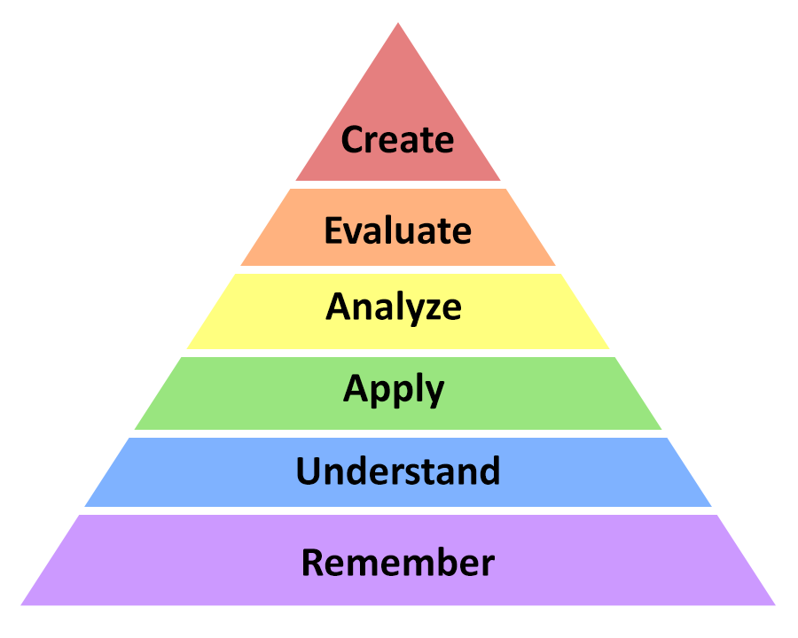
Competency-Based Curriculum Essentials
How does instruction align with learning objectives?
  Objectives indicate which level of learning is appropriate

Slide 5
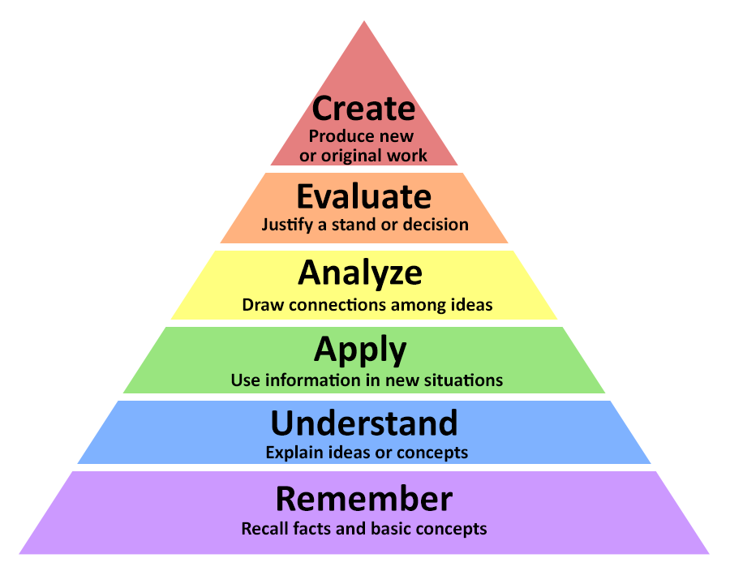

Slide 6
Competency-Based Curriculum Essentials
How is evaluation aligned to learning objectives and curriculum?
  Objectives indicate how learning will be evaluated
  Recall, arrange, differentiate, design, etc. (knowledge or psychomotor skills)
  Formative assessment: done as you teach, to see if re-teaching is needed
  Summative assessment: at the end of learning

Slide 7
Competency-Based Curriculum Essentials
How is evaluation aligned to learning objectives and curriculum?
  Performance tests
  Written/cognitive tests
  Quizzes
  Self-checks
  Rubrics (project/activity)
  Portfolios

Slide 8
Competency-Based Curriculum Essentials
Cognitive, affective, and psychomotor skills practice
  Teach, evaluate, reteach as necessary
  End-of-unit review
  Step-by-step checklists for psychomotor skills
  Pencil-and-paper activities (Assignment Sheets) with rubrics for cognitive and affective skills

Slide 9
Competency-Based Curriculum Essentials
Skill mastery documentation
  Profile of Training Mastery (Competency Profile)
    Checklist of all learning objectives
    Instructor can mark each objective off as it is mastered by the learner

Slide 10
For More Information:
Craig Maile, Manager
  craig.maile@careertech.ok.gov
  405.743.5448
Tracy Boyington, Instructional Development Specialist
  tracy.boyington@careertech.ok.gov
  405.743.5516

Slide 11

All rights reserved; copyright © 2019 Resource Center for
CareerTech Advancement
For more information, email us at resourcecenter@careertech.ok.gov or visit our website at https://www.okcareertech.org/educators/resource-center

