Slide 1
Writing the FY -21 Carl Perkins Basic Grant Application
Federal Legislation Division

Slide 2
Introductions
Janet Cooper – Western Region Carl Perkins Coordinator
Steve Robison – Western Region Carl Perkins Coordinator
Josh Miller – Southeast Region Carl Perkins Coordinator
Debbie Hamble – Northeast Region Carl Perkins Coordinator
Stephanie Hodges – Financial Analyst
Letha Bauter – Federal Programs Manager

Slide 3
New Four-Year Application
Year One
CLNA
Full Application
Year Two
Update Budget
Update Any Changes to Application
Year Three
Update CLNA
Update Budget
Update Any Changes to Application
Year Four
Update Budget
Update Any Changes to Application

Slide 4
Major changes in Carl Perkins V
Requires Data-Driven Decision-Making
Includes Comprehensive Local Needs Assessment
Increases Stakeholder Involvement
Work-Based Learning Emphasis
Revises Accountability Indicators
New definition of Concentrator, combining Non-Traditional measures
Enhances Efforts to Serve Special Populations
Encourages Innovation
Maintains Commitment to Programs of Study

Slide 5
Resources for Grant Writing
Application document in Word format
PowerPoint presentation
Technical Assistance document
Comprehensive Local Needs Assessment template
Program of Study template
Allowable and Unallowable list
Grant Application Training flyer
Use of Funds document
Application Scoring Rubric
Links to all documents will be provided on the Carl Perkins V website: https://www.okcareertech.org/about/state-agency/divisions/federal-legislation-assistance/carl-perkins/perkins-v

Slide 6
How to Use the Technical Assistance Document
The “Clarification” column provides a breakdown or rephrasing of the application question, descriptions, definitions and other explanations. These should assist you in your interpretation of the application question and provide insight into what the reviewers are looking for when scoring your application.
The “Assistance – Examples” column provides additional assistance and some sample responses to the application questions.

Slide 7
Grant Emphasized Use of Funds
Enhancing career guidance and counseling where state funds are limited.
Providing innovative, high-tech equipment in CareerTech programs in high schools, technology centers and community colleges that lead to high-wage, high-demand employment in new and emerging technologies.
Building relationships with business and industry to provide opportunities for program development, internships and mentoring for students and instructors.
Professional development for instructors on new technology and teaching methods using technology.
Providing support to develop technology center to community college curriculum alignment to allow high school students to earn college credit in technical programs while in high school through prior learning assessments.
Providing career information and planning for secondary and postsecondary students.

Slide 8
Use of Funds – Application
All expenditures must meet grant guidelines and be “allowable.”
Grant funds may only be expended in areas of “needs” or “opportunities” identified as a priority by your CLNA (Section 2).
Expenditures must be assigned to one of the program codes identified in the “Use of Funds Guidebook” and OCAS Coding manual. (Section 4).
Example:
CLNA Student Performance area includes:
Academic Integration (330)
Evaluation (337)
Secondary/Post-Secondary Link (340)

Slide 9
Grant Worksheet Application
Section 1 – FFATA Information (Federal Financial Information Collection Requirements
Section 2 – Comprehensive Local Needs Assessment
Section 3 – Programs of Study
Section 4 – Budget Narrative
Section 5 – Organization Overview
Section 6 – Itemized Budget Guidelines

Slide 10
Section 1 – Federal Financial Information Collection Requirements
Applicant must provide the schools’ DUNS number, SAM’s registration, Zip+4 and Congressional District number.
All applicants must respond to questions 1.1 – 1.5.
Whether you answer questions 1.6 and/or 1.7 will depend on your answer to the previous question.

Slide 11
Section 2 – Comprehensive Local Needs Assessment
All Comprehensive Local Needs Assessments (CLNA) must be submitted on the approved template.
A copy of the CLNA template is located on our Carl Perkins V website, along with the FAQ document, The Answers, and the CLNA Training PowerPoint: https://www.okcareertech.org/about/state-agency/divisions/federal-legislation-assistance/carl-perkins/perkins-v
A link to the template is also provided in the application at the beginning of Section 2

Slide 12
Your CLNA is not “scored.”
You will use your CLNA results to answer the questions in Section 2 and to drive your budget expenditures.
The next four slides are from the CLNA template:
Perkins V Process – Page 5
Needs Assessment and Application Purpose – Page 6
Six Steps to Completing CLNA – Page 9
Conclusions and Action Items – Page 24
Failure to attach a completed CLNA will result in an Automatic Rejection of your application.

Slide 13
Perkins V Process
Comprehensive Local Needs Assessment (CLNA)—Complete Fall 2019
Foundation for Local Application
Student Opportunities
Data Driven Decisions
Directs Budget Decisions
Local Application—Complete Spring 2020
Attach CLNA
CLNA Aligns With Application Questions

Slide 14
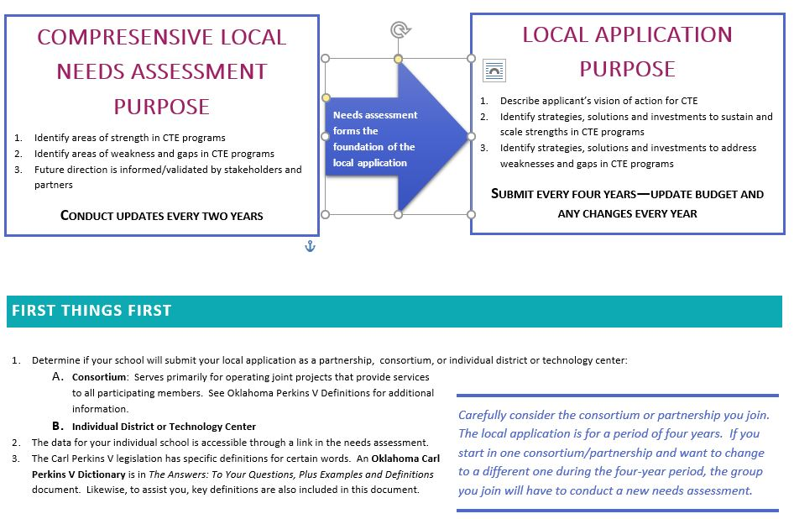

Slide 15
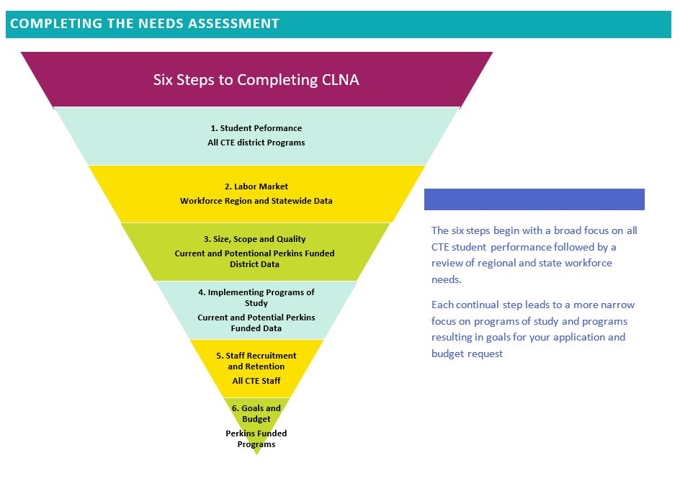

Slide 17
Section 2.1 - Priorities
List the top 3-5 priorities your school has identified using the results of your CLNA.
Priorities must address an identified “Gap/Need” or a specific “Opportunity for Improvement.”
Address each of these issues for all priorities:
Identify the opportunity or gap to be addressed
Describe how CLNA results were used to determine there was a gap/opportunity area at your school
Name the program(s) this priority addresses (Ag, BITE, FACS, etc.)
List budget requirements needed, if any, to implement/complete the priority

Slide 18
Section 2.2 - Action Items
Action items will be listed for two Fiscal Years separately:
Fiscal Year 2020-2021
Fiscal Year 2021-2022
List any action items your school plans to take in these five CLNA areas:
Student Performance Data
Labor Market Alignment
Size, Scope, Quality
Implementing Programs of Study
Recruitment, Retention and Staff Training

Slide 19
Section 2.3 – New CTE Programs
Indicate whether or not your school/consortium plans to implement a new CTE program within the next two years.
If you are implementing a new CTE program, provide the following:
The programmatic area of the new program (Ag, BITE, FACS, Marketing, T&I, Health, or STEM)
The priority this program will address
Actions your school will take to establish this program
All actions requiring the use of Perkins funds

Slide 20
Section 2.4 – CTE Information
Provide details on how you share information about your CTE programs and Programs of Study with students.
Provide information on additional methods used to share this information with Special Population students. This information should be targeted/specific to Special Populations and not simply same methods as are used with the general student body.

Slide 21
Roundtable Discussion – Section 2
Take 5 minutes to discuss the Section 2 questions with your group.
Does your group have any concerns or need clarification on any of these questions?
Would any of your group be willing to share examples of priorities they have identified, actions they will be taking or methods they use to tell students about CTE?

Slide 22
Section 3 - Programs of Study
You must use the approved Programs of Study template for submissions with your grant application. A link to the template is provided in the application and it can also be found on our Carl Perkins Website.
You will need to attach a Program of Study for each programmatic area where you plan to expend funds in the next two fiscal years.
If you are funding only Guidance/Advisement based salary and benefits, you must attach at least one Program of Study from an approved CTE program at your school.

Slide 23
You are required to keep complete, accurate Programs of Study from ALL CTE instructional areas offered by your organization on file at your location.
Failure to attach ALL required Programs of Study will result in an Automatic Rejection of your Application Worksheet.

Slide 24
Section 3.1 – Programmatic Areas Offered
Put a check mark in front of every approved CTE program offered by your school or any of your consortium members.
If even one consortium member offers an approved CTE program in a program area, that should be indicated in this area.
Include CTE approved but unfunded programs here.
Include CTE approved programs at Middle Schools here.

Slide 25
Section 3.2 – Post-Secondary Certification, Licensure or Degree
List the exact post-secondary certification, licensure or degree shown on every Program of Study listed in Section 3.1.
Provide the specific certification, licensure or degree. Do not provide program names (Welding) or general certifications (Microsoft).
All certifications, licensures or degrees should be industry or institutionally recognized and approved.

Slide 26
Additional Program of Study Information
Programs of Study will be attached after you have completed Section 5 and before you move on to the Budget Spreadsheet.
A Program of Study must include a complete listing of specific courses at the high school, both CTE and academic, that are associated with the career pathway chosen.
Programs of Study should include a complete listing of specific courses at the technology center and/or community college level that lead a student to an industry license, certification, or degree. You should contact your local technology center, college or university to discuss how students can continue their career pathway and attain a degree, licensure, or certification.

Slide 27
Programs of Study should demonstrate that there is no duplication of course work between Secondary and Post-Secondary course outlines and that there is a seamless path to certification, licensure or degree.
A Program of Study cannot lead directly into to a 4-year degree program without first achieving an Associate Degree or certification/licensure at a post-secondary level.
Programs of Study should have multiple termination points, all awarding either a post-secondary certification, an industry-recognized certification or an AAS degree.

Slide 28
Roundtable Discussion – Section 3
Take 5 minutes to discuss the Section 3 questions with your group.
Does your group have any concerns or need clarification on any of these questions?
Would any of your group be willing to share any new, innovative Programs you wish to fund in the next two years?

Slide 29
Section 4 – Budget Narrative
In this section you will discuss the priorities you plan to expend Perkins funding on for the upcoming year (Fiscal year 2020-2021) only.
Only answer in the areas below where your CLNA identified Gaps/Opportunities AND which your school set as a priority for the upcoming year.
You do not need to answer in every area – only in those where you will be spending Perkins funds this year.

Slide 30
Every item in your Budget Spreadsheet must be listed and discussed in this budget narrative.
Items may be grouped if they are part of a related project or non-stand alone accessories to a major purchase, but each item must be listed. The description/rationale for purchasing each item in the group must be the same.
Example: STEM Supplies: VEX robotic kits, Controllors, Field Perimeter Kit, Field Tile Kit
Example: Digital Camera, zoom lenses, cases, batteries, filters

Slide 31
The following format should be used for budget expenditure narratives:
Consortium Member Name (if applicable)
CTE Program (BITE, Ag, Health, STEM, T&I, FACS, Marketing)
Item name and description
A description of how this item/expenditure will improve your organizations CTE programs and how it relates to a specific Program of Study.
The “Use of Funds” document provides definitions for all allowable expenditure areas (by program code).
Failure to complete each step of the Budget Narrative will result in an automatic rejection of your application Worksheet.

Slide 32
Section 4.0 – Four Year Budget Overview
Provide an overview of how your organization plans to expend their Perkins funding over the next four years.
Based on your CLNA results, describe the areas where funding will be focused.
Describe the long-term goals your organization plans to accomplish utilizing Perkins funding.

Slide 33
Section 4.1 – Consortium Allocations
Consortium lead fiscal agents cannot budget back to their consortium members the exact amount those members were allocated by ODCTE.
Budgeting back the exact amount of the allocation is cause for an automatic rejection of your application Worksheet.
List both the amount ODCTE allocated to each consortium member and the amount the consortium will allocate to each consortium member.

Slide 34
Section 4.2 – Student Performance
For priorities identified in your CLNA area #1 – Student Performance, identify all expenditures your organization will be making this fiscal year (2020-2021).
Provide narrative for all expenditures in the approved format (school name, program name, expenditure description, how it improves your CTE programs).
Approved Use of Funds categories for this area would include:
Academic Integration (330)
Evaluation (337)
Secondary/Post-Secondary Link (340)

Slide 35
Section 4.3 – Labor Market Alignment
For priorities identified in your CLNA area #2 – Labor Market Alignment, identify all expenditures your organization will be making this fiscal year (2020-2021).
Provide narrative for all expenditures in the approved format (school name, program name, expenditure description, how it improves your CTE programs).
Approved Use of Funds categories for this area would include:
Workforce Partnerships (338)
Services & Activities: High Skill, High Wage, In-Demand (339)

Slide 36
Section 4.4 – Size, Scope and Quality
For priorities identified in your CLNA area #3 – Size, Scope and Quality, identify all expenditures your organization will be making this fiscal year (2020-2021).
Provide narrative for all expenditures in the approved format (school name, program name, expenditure description, how it improves your CTE programs).
Approved Use of Funds categories for this area would include:
Use of Technology (332)
Work-Based Learning (331)

Slide 37
Section 4.5 – Implementing Programs of Study
For priorities identified in your CLNA area #4 – Implementing Programs of Study, identify all expenditures your organization will be making this fiscal year (2020-2021).
Provide narrative for all expenditures in the approved format (school name, program name, expenditure description, how it improves your CTE programs).
Approved Use of Funds categories for this area would include:
Guidance and Counseling (334)
Career Awareness (335)

Slide 38
Section 4.6 – Staff Recruitment, Retention and Training
This section deals with recruitment, retention and training of staff, not students.
For priorities identified in your CLNA area #5 – Recruitment, Retention and Staff Training, identify all expenditures your organization will be making this fiscal year (2020-2021).
Provide narrative for all expenditures in the approved format (school name, program name, expenditure description, how it improves your CTE programs).
Approved Use of Funds categories for this area would include:
Professional Development (333)
Recruitment and Retention (336)

Slide 39
Section 4.7 – Consortium Purchasing
Consortium Lead Fiscal Agents must specify if:
They will purchase all items and ship them to their member schools. Consortium lead will then claim reimbursement directly from ODCTE.
Each member district will make their approved purchases then submit reports and invoices to the Lead Fiscal Agent for reimbursement.

Slide 40
Roundtable Discussion – Section 4
Take 5 minutes to discuss the Section 4 questions with your group.
Does your group have any concerns or need clarification on any of these questions?
Would any of your group be willing to share tips they have learned for writing complete and accurate budget narratives or ways they have learned to streamline the process?

Slide 41
Section 5 – Organization Overview
In this section you will discuss:
Your collaboration with local workforce boards
How you provide challenging Academic and Technical Content
How your school(s) deal with Special Population students
Work-Based Learning Opportunities you offer
Post-Secondary Credit Opportunities
Staff Recruitment, Retention & Training
Performance Data Gaps

Slide 42
Section 5.1 – Career Exploration and Development
List the partners you work with to provide career exploration and development activities/courses/services to your students (page 8 of the CLNA).
Give specific examples of courses, activities, tools or services you use to provide career exploration and development to your students.
Describe how your partners worked with you or provided input into these activities.

Slide 43
Section 5.2 – High Skill, High Wage, In-Demand Information
Describe how you share information on High Skill, High Wage, In-Demand jobs with your students.
Discuss how input from your workforce partners (stakeholders) affected how you deliver this information to your students.

Slide 44
Section 5.3 – Career and Academic Counseling
Describe specific career and academic counseling you provide to your students before they enter CTE programs.
Describe specific career and academic counseling you provide to your students after they enter CTE programs.
Discuss how input from your workforce partners (stakeholders) influenced the counseling provided in these areas.

Slide 45
Section 5.4 – Challenging Academic and Technical Content
Describe how your CTE programs are structured so that CTE students receive the same challenging academic and technical content as non-CTE students.
Describe how you ensure your CTE content is coherent and rigorous (graduation requirements, math and literacy requirements, enriched curriculum).
Include specific activities or methods that provide students with a “well-rounded education.”

Slide 46
Section 5.5 – Special Populations and High Skill, High Wage, In-Demand Jobs
The definitions of all Special Population groups are provided in the Technical Assistance document.
“Special Populations” does not mean “Special Education.”
Describe specific activities your organization provides to share High Skill, High Wage, In-Demand career information with Special Population students.
These activities cannot be exactly the same as are provided for all other students – they must be additional activities designed to meet the needs/requirements of the Special Population groups.

Slide 47
Section 5.6 – Non-Traditional Students
Describe how your organization will prepare all CTE students for non-traditional fields.
Preparing Special Population students for non-traditional fields must be specifically addressed.
You should cover how students are recruited for non-traditional fields and accommodations made when teaching them.

Slide 48
Section 5.7 – Equal Access
Describe – in detail – how your organization ensures that all Special Population students have equal access to every CTE course, program and Program of Study.
Be specific about accommodations and adaptations made in your CTE programs for Special Populations.

Slide 49
Section 5.8 – Non-Discrimination
Describe how your organization ensures that no student is discriminated against based on their status as a Special Population.
State the specific federal, state, district policies on discrimination that are followed.
List training you provide to your staff to help them address special populations, their education and discrimination.

Slide 50
Section 5.9 – Work-Based Learning Opportunities
Name specific examples of work-based learning provided by your organization.
Work-Based Learning means:
Sustained interactions with industry or community professionals in real workplace settings (to the extent practicable) or in simulated environments and
Work-Based Learning occurs at an educational institution that foster in-depth, first-hand engagement with the tasks required of a given career field and
Work-Based Learning is aligned to curriculum and instruction.

Slide 51
Section 5.10 – Collaboration with Workforce Partners
List the stakeholders/partners your organization has worked with to develop or expand work-based learning opportunities for your students.
Give specific examples of work-based learning opportunities that have been developed utilizing this collaboration.

Slide 52
Section 5.11 – Post-Secondary Credit
Describe the types of post-secondary credit your high school CTE students are eligible to participate in:
Concurrent Enrollment
Dual Enrollment
Advanced Placement Exams
Equivalency/Proficiency Exams
Describe how your organization works to strengthen the ties between secondary and post-secondary institutions, especially those who partner on your Programs of Study.

Slide 53
Section 5.12 – Staff Recruitment, Retention and Training
This section deals with the recruitment, retention and training of organization staff members, not students.
You must address Recruitment AND Retention AND Training for all staff members listed:
Teachers/Faculty
Administrators
Support Personnel/Paraprofessionals
Groups Underrepresented in the Teaching Profession
Do not provide the same answer for all types of staff members.

Slide 54
Section 5.13 – Performance Data Gaps
Describe how your school will address any gaps between your Local Actual Performance Levels and the State Goals over the 4 years of this application.
Four-Year Graduation Rate
Academic Proficiency: Reading/Language Arts
Academic Proficiency: Mathematics
Academic Proficiency: Science
Post-Secondary Placement
Non-Traditional Program Enrollment
Program Quality: Work-Based Learning Participation
If no meaningful progress is achieved by the end of the third year, describe additional actions your organization will take to eliminate these gaps.

Slide 55
Roundtable Discussion – Section 5
Take 5 minutes to discuss the Section 5 questions with your group.
Does your group have any concerns or need clarification on any of these questions?
Would any of your group be willing to share successes (best practices) or concerns in dealing with Special Populations, Work-Based Learning, Staff Recruitment/Retention/Training, Stakeholder Collaboration? What has worked or not worked for you?

Slide 56
Narrative Completion
You have now completed the narrative portion of your Carl Perkins Local Application for funding.
Upload and attach all required documentation:
Completed Comprehensive Local Needs Assessment
All required Programs of Study
Read the information in Section 6 carefully then press the “Save & Next” button on the bottom right of the screen.

Slide 57
Section 6 – Itemized Budget Guidelines
You must budget the entire allocation for your school or consortium at this time.
You are only completing the itemized budget for the upcoming fiscal year (2020-2021).
Every item listed in your itemized budget must have been listed and discussed in the budget narrative (Section 4).
All item descriptions must include:
The school name (if you are a consortium)
The program name (Ag, BITE, FACS, Marketing, Health, T&I, STEM)
A brief description of the expenditure

Slide 58
Item descriptions should be brief, but provide sufficient information to match the item to invoice documentation submitted in the reimbursement phase.
Failure to correctly complete the Itemized Budget Spreadsheet will result in an automatic rejection of the Application Worksheet.

Slide 59
Automatic Rejections
Your Local Application may be “automatically rejected” for these reasons:
Failure to attach a completed Comprehensive Local Needs Assessment
Failure to attach all required Programs of Study. All Programs of Study must be complete and accurate
Failure to correctly complete the Itemized Budget Spreadsheet.
Budgeting back the exact ODCTE allocation to consortium member schools.
Organizations will be given the opportunity to correct all applications that are “automatically rejected” and those that score below 65%.

Slide 60
Important Dates
March 23, 2020 Notices of Allocation sent out April 20, 2020 Notices of Allocation due back to ODCTE
May 8, 2020: Applications close
March – May Technical Assistance Labs. See flyer for
specific dates
July 1, 2020: Application approval/rejection notifications
emailed out. Please plan on checking your
email for additional actions/due dates if
you are off-campus at this time.

Slide 61
New Four-Year Application
Year One
CLNA
Full Application
Year Two
Update Budget
Update Any Changes to Application
Year Three
Update CLNA
Update Budget
Update Any Changes to Application
Year Four
Update Budget
Update Any Changes to Application

Slide 62
Scoring Rubric
A score of 65% or higher is required for grant approval.
“Automatic rejections” result in grant denial, regardless of total score, until all required corrections are made.
The rubric ratings for each Section on the Local Application generally fall into four categories:
Exemplary Responses 9-10 points
Meets Expectation Responses 7-8 points
Needs Technical Assistance Responses 4-6 points
Criteria Not Met Responses 0-3 points

Slide 63
Exceptions to the general ratings include:
Section 1 scores 7 points if all required FFATA information is provided, or 0 if required information is missing.
4.1 will be scored at 10 points for all non-consortium fiscal agents.
4.7 no points will be awarded, however 10 points will be deducted for consortium fiscal agents that do not respond.
Section 6, the Budget Worksheet, scores a maximum of 20 points.
You should review the scoring criteria to evaluate your responses prior to grant submission.
Final application scores will no longer be released. Schools will be notified by July 1, 2020 whether their grant application has been approved or rejected for corrections.

Slide 64
Helpful Hints
Save the Local Application Word document to your computer and work in it. When you have finished, copy/paste your responses into CTIMS. This will prevent CTIMS from timing out on you. You cannot upload the application Word document into CTIMS.
You must be signed into CTIMS with the Local Initiative Coordinator role in order to complete the application Worksheet.
Use only Internet Explorer version 11 or higher to access CTIMS.
Save your work frequently.

Slide 65
Save the CLNA and required Programs of Study to your computer. Double-check that all these required attachments have been successfully uploaded in CTIMS before submitting your application.
Click on the “Worksheet Summary” button to review your grant application before you submit it.
The Application/Worksheet must be approved by all three local roles before it will be fully submitted: Local Initiative Coordinator, Local Finance Coordinator and Local Superintendent/President.
If your Application Worksheet is rejected, or if you initiate a Change Request, it must be re-approved by all three local roles.

Slide 66
Contact Information
We encourage you to email us – it’s a great way to ensure we all have appropriate documentation.
Western Region Carl Perkins Coordinators:
Janet Cooper janet.cooper@careertech.ok.gov
Steve Robison steve.robison@careertech.ok.gov
Southeast Region Carl Perkins Coordinator:
Josh Miller josh.miller@careertech.ok.gov
Northeast Region Carl Perkins Coordinator:
Debbie Hamble debbie.hamble@careertech.ok.gov
Financial Analyst:
Stephanie Hodges stephanie.hodges@careertech.ok.gov
Federal Programs Manager:
Letha Bauter letha.bauter@careertech.ok.gov
Oklahoma Carl Perkins Webpage (see either Perkins V or Resources) :
https://www.okcareertech.org/about/state-agency/divisions/federal-legislation-assistance/carl-perkins/

