Slide 1

Instructional Coach PLC: Interactive reading: Including student talk for deeper understanding.
November 19, 2025
12:00 PM
stephanie.coca@careertech.ok.gov

Slide 2

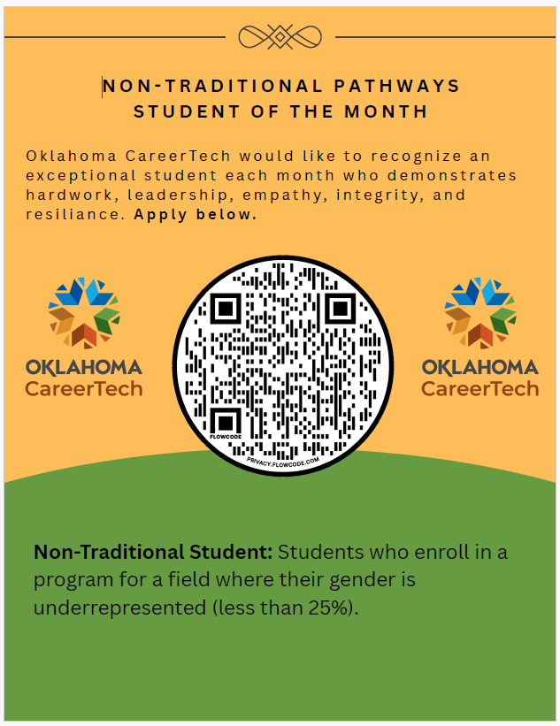

Slide 3
2025-2026 Instructional Coach PLC Dates
August 20th, 2025, 12:00 -1:00 pm https://us02web.zoom.us/j/88112880870 | Preparing for your Students-Supporting your teachers. (IEPs, 504s, ELAPs…)
September 10th, 2025, 12:00 -1:00 pm https://us02web.zoom.us/j/83873772596 | Backward planning: Looking at the end to provide more explicit instruction.
October 15th, 2025, 12:00 -1:00 pm https://us02web.zoom.us/j/83273589498 | Integrating language into content and supporting guided student talk.
November 19th, 2025, 12:00 -1:00 pm https://us02web.zoom.us/j/83253924404 | Interactive reading, including student talk for deeper understanding.
December 10th, 2025, 12:00 -1:00 pm https://us02web.zoom.us/j/84409259166 | Assessment best practices that inform instruction and refine practice.
January 21st, 2026, 12:00 -1:00 pm https://us02web.zoom.us/j/86796322814 | Interactive reading and academic writing: supporting student understanding and their expression of understanding.
February 11th, 2026, 12:00 -1:00 pm https://us02web.zoom.us/j/89682871239 | Engagement Model for Collaborative Mentorship and Implementation of Explicit Language Teaching Skills
March 11th, 2026, 12:00 -1:00 pm https://us02web.zoom.us/j/81270390668 | Family Engagement- supporting students and family involvement to improve student performance.
April 15th, 2026, 12:00 -1:00 pm https://us02web.zoom.us/j/86338481888 | Instructional Coach Choice
May 13th, 2026, 12:00 pm https://us02web.zoom.us/j/84328916721 | Brainstorming for Next Year- 1st Year Teacher Training?

Slide 4
Learning Outcomes
Review lesson plan best practices including inclusion of scaffolding strategies to support all students (sheltered content instruction).
Review what is a student learning goal and how to focus on language expected for students to be successful in school and beyond.
Explore productive student talk structures in the classroom and their benefits to supporting student understanding of what they are reading and hearing.
Ensure student engagement with “I Do- We Do- You Do- Close”.

Slide 5
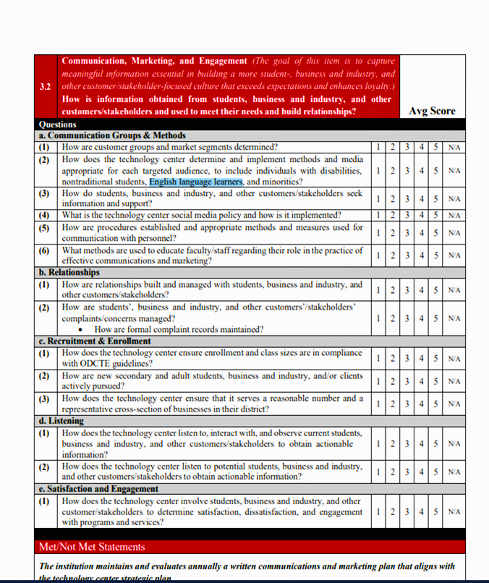


Technology Center Significance
How does the technology center determine and implement methods and media appropriate for each targeted audience to include individuals with disabilities, nontraditional students, English language learners, and minorities?

Slide 6
Cross-agency & Intra-agency Coordination
Have a plan for getting support to multilingual students.
Cross -agency Coordination
Have a plan for communication.
Schedule a meeting with sending school counselor.
Request ELAPs.
Share
Intra-agency Coordination
Have a site-wide plan for communication.
Set up a support request form.
Have a site-wide plan for teacher professional
development.
Provide teachers with tools to be successful when working with multilingual students.
Counselors have an understanding of programs that may
limit multilingual learners with lower proficiency or without
documented status.

Slide 7
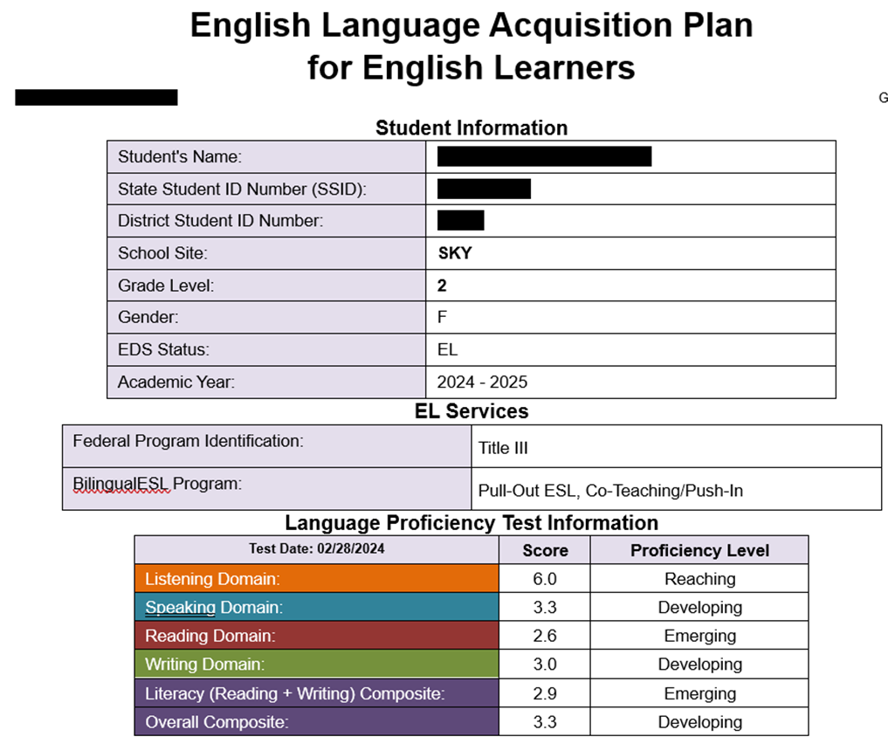
English Language Academic Plan (ELAP)

Slide 8


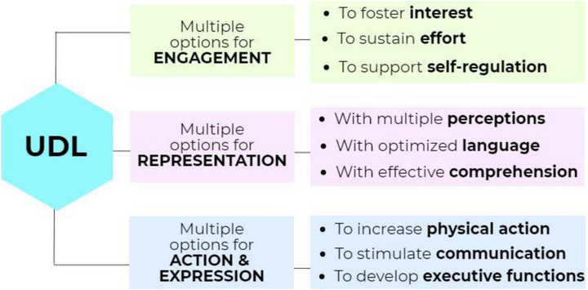


Instruction & Application
Open
Make it meaningful.
I Do
Model the content and language.
We Do
Practice together in groups or pairs.
You Do
Students apply learning independently.
Close
Summarize and reflect with students.

Slide 9
High Quality Instructional Framework
Sheltered Content Instruction
Research-based approach that integrates academic content learning, English language development, and scaffolded support so that teachers can deliver rigorous, grade-level instruction to support ELL’s comprehension, participation, and language growth.

Slide 10
What does Sheltered Content Instruction look like?
Sheltered Content Instruction
“Language Aware” lesson design.
Example: Science lesson on ecosystems (content), compare and contrast discussions or descriptions (language)
Incorporate Scaffolding Strategies that supports meaningful ELL engagement and internalization of academic language.
visuals, graphic organizers, modeling, sentence frames, modeling, etc.
Meaningful Vocabulary Instruction to enhance understanding.
Focus on Tier 2 and Tier 3 words (e.g. analyze, photosynthesis)
Focus on the use of Comprehensible Input techniques.
Adjust teacher talk: slower speech, clear enunciation, paraphrasing, using visuals
Check for understanding often and in varied ways
Teach with Cultural Responsiveness
Build on students’ background knowledge and home cultures.
Validate their linguistic and cultural diversity.

Slide 11
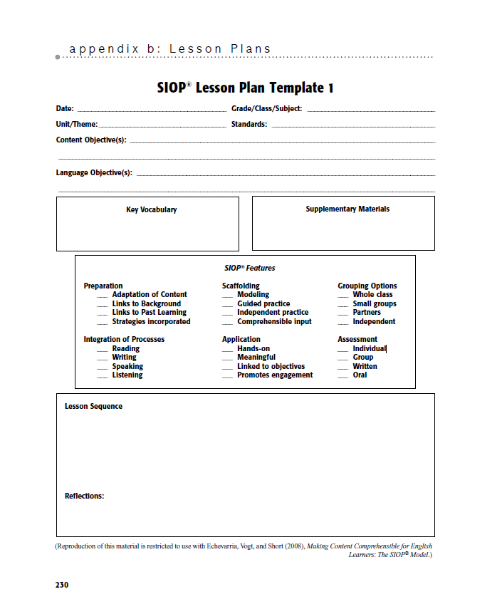
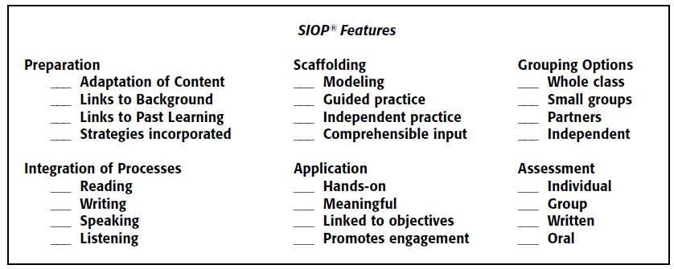

Scaffolding

Slide 12

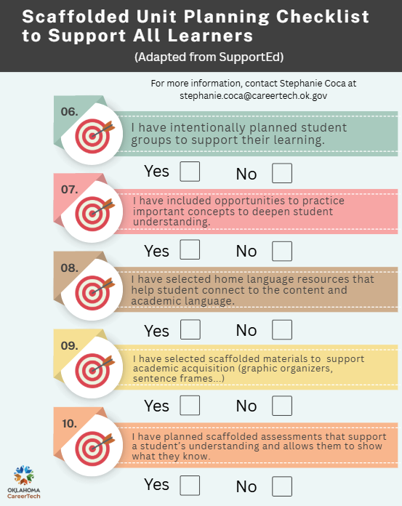
Teacher Checklist to Support ALL Students

Slide 13
Formative and Summative Assessment
With a clear end goal:
More individual, explicit feedback can be provided.
Instructional experiences are more intentional.
Students are better prepared for the challenge they are involved in.
Instructors are happier with student products.

Slide 14

Reminder: Steps to Integrating language into content and supporting guided student talk.
Step 1: Choose the final product you would like your students to do to show their understanding of the
concepts. Working from the End to the Beginning.
Step 2: Do the end product yourself. Create a sample student response.
Step 3: Create a list of the academic/content language students will have to know to be successful for
project completion.
Step 4: Choose which language function is most important to completing this project.
Cause and Effect?
Compare and Contrast?
Explain and Describe?
Proposition and Support?
Sequence?
Step 5: Create a template for students to follow if they need it that includes a list of important language
and language frames.
Providing language frames that are portable and flexible promotes metalinguistic awareness and deeper content understanding.

Slide 15
Structured Talk Routines: Builds understanding, fluency, and self-efficacy

Slide 16



Student Learning Goals
Students will understand________________________ and will be able to
__________________________ in/by _____________________________.
Students will understand how to complete a fillet weld in the flat position that meets the visual inspection criteria of the AWS D1.1 Structural Welding Code and will be able to use explain and describe and sequence language by teaching the concept using a live or recorded demonstration.

Slide 17

Backward Design: Creating a student product.
Students will understand how to complete a fillet weld in the flat position that meets the visual inspection criteria of the AWS D1.1 Structural Welding Code and will be able to use sequence language by teaching the concept using a live or recorded demonstration.
Important Vocabulary
Important Phrases
A fillet weld
triangular cross-section
interior angle
right angle (90°)
joint
T-joints, lap joints
corner joints
overlapping surfaces
intersecting surfaces
flat
convex
concave profile
leg
root
face
toe
throat
thick
thin
________ is used to ________
_______by fusing __________
This is ___________________
The key point ____________
The weld fills up _________
The position is____________
Lay________________________
_________is tacked_________

Slide 18

Content Object= Cognitive Task
Explain how to complete a fillet weld in the flat position that meets the visual inspection criteria of the AWS D1.1 Structural Welding Code in a live or recorded demonstration.
What is the functional language the student will need to use?
Cause and Effect?
Compare and Contrast?
Explain and Describe?
Proposition and Support?
Sequence?
What does this language look like and how do I familiarize students with this language?
Language Function Frames Examples Here

Slide 19

Use Language Frames that are portable and flexible.
First, a roughly triangular cross-section is used to join two pieces of metal that meet at an interior angle.
The weld creates a strong joint in structures by fusing the overlapping or intersecting surfaces.
During the weld, notice that it produces violent movement.
First,________ is used to ________
___creates______by __________
During _______, notice that it produces __________
PProviding language frames that are portable and flexible promotes metalinguistic awareness and deeper content understanding.

Slide 20
Cognitive Task= Language Function
Explain how to complete a fillet weld in the flat position that meets the visual inspection criteria of the AWS D1.1 Structural Welding Code in a live or recorded demonstration.
What is the functional language the student will need to use?
Explain and Describe Sequence
________ is used to ________
_______by __________
This ____ produces __________
The key point ____________
The _________ fills up _________
The position is____________
Lay________________________
_________is tacked_________
Let it ___________
Don’t _________________
________indicates___________
To begin with _______________________.
We are going to start by_____________.
Next, we are going to ____________by __________
During _____________________
Prior to ________________________
______________________simultaneously.
Finally, ________________________________

Slide 21
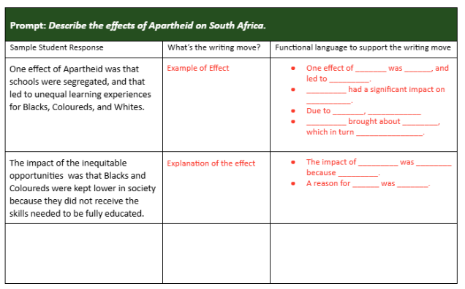
Teacher Product Example:
Providing language frames that are portable and flexible promotes metalinguistic awareness and deeper content understanding.

Slide 22
Student Drafting Template for Speaking or Writing.
Example 1
A fillet weld leg
triangular cross-section root
interior angle face
right angle (90°) toe
joint throat
T-joints, lap joints thick
corner joints thin
overlapping surfaces
intersecting surfaces
flat
convex
concave profile
First,___________ is used to______________________.
__________creates ________________ by _______________.
During the _______, notice that it produces __________.
The key point ____________________________.
________________ is ________________.
Let’s ______________.
Don’t _____________________.
_______________ indicates ______________.
Finally, remember to____________________.
Providing language frames that are portable and flexible promotes metalinguistic awareness and deeper content understanding.

Slide 23
Student Drafting Template for Speaking or Writing.
Example 2
Explain/describe:
The ______ is when_____________. (for all parts)
Sequence:
The _____ begins with_____ and it is set during_________.(exposition)
In the ______, Rachel struggles with_______________ and ______________. (Rising action)
Eventually, __________. (climax)
So, _________. (falling action)
In the end,_____________. (resolution)
Plot diagram, exposition, conflict, rising action, climax, falling action, resolution, characters, setting (time and
place), plot
All academic/content words will need to be taught before moving on to the story.
Providing language frames that are portable and flexible promotes metalinguistic awareness and deeper content understanding.

Slide 24
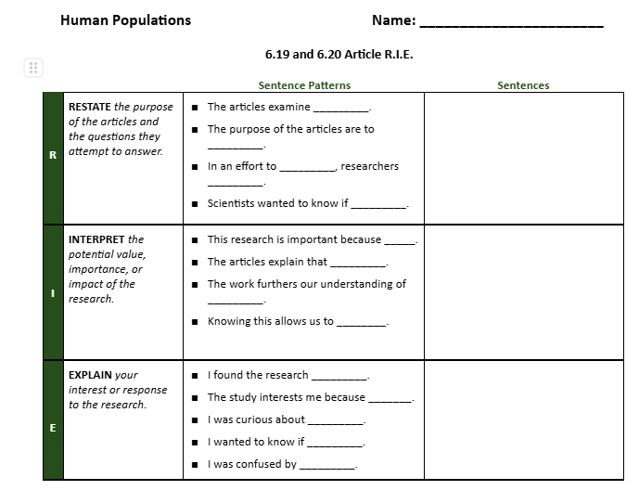
Student Drafting Template for Speaking or Writing.
Example 3
Vocabulary/Important Terms:
Population Growth Rate -
Immigration -
Emigration -
Migration -
Exponential Growth -
Logistic Growth -
Carrying Capacity -
Density Independent Factors -
Density Dependent Factors -
Providing language frames that are portable and flexible promotes metalinguistic awareness and deeper content understanding.

Slide 25
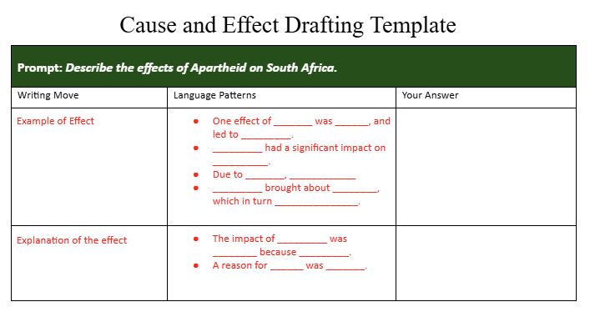
Student Drafting Template for Speaking or Writing.
Example 4
Vocabulary/Important Terms:
apartheid
segregated
unequal
coloureds
blacks
whites
inequitable
Providing language frames that are portable and flexible promotes metalinguistic awareness and deeper content understanding.

Slide 26
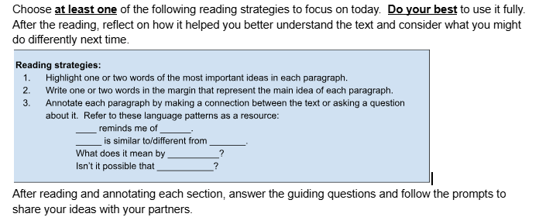
Incorporating Productive Student Talk
Reading Comprehension Reinforced through Talk
Providing language frames that are portable and flexible promotes metalinguistic awareness and deeper content understanding.

Slide 27
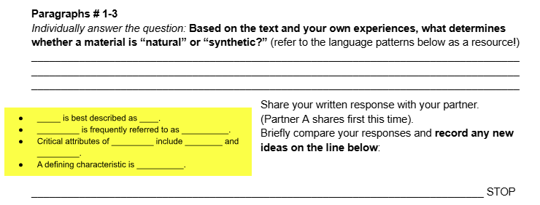
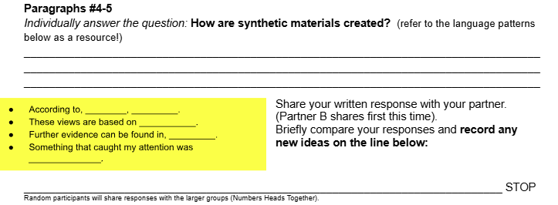
Incorporating Productive Student Talk
Numbered Heads Together

Slide 28
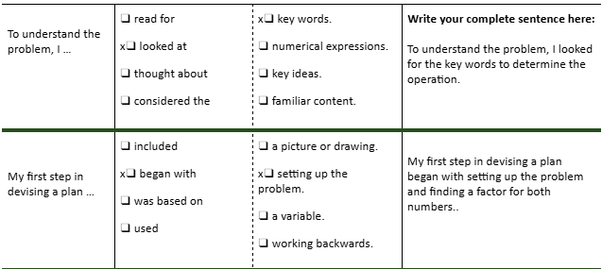
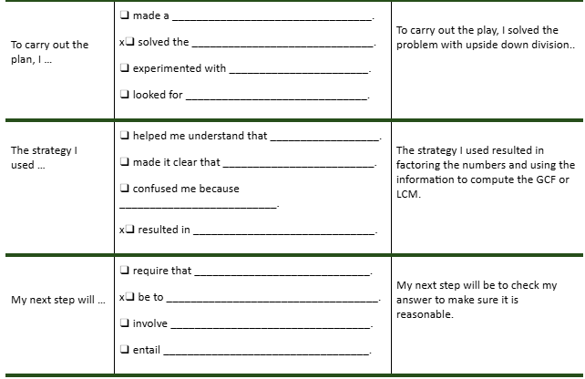
Incorporating Productive Student Talk
Problem Solving Summary
Talking Chips https://youtu.be/BmQRHuR0fsI?si=bzhfmTYVNKZ83L8U

Slide 29
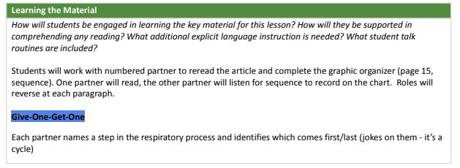
Incorporating Productive Student Talk
Reading Comprehension Reinforced through Talk
GoGoMo

Slide 30
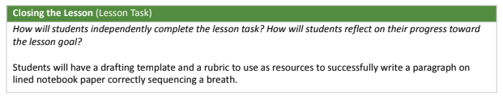
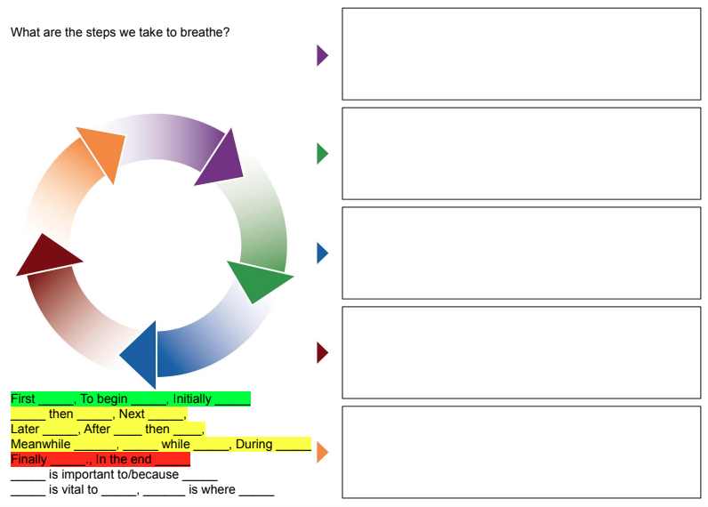
Incorporating Productive Student Talk
Reading Comprehension Reinforced through Talk and Again through Writing!

Slide 31
Reminder: Steps to Integrating language into content and supporting deeper understanding.
Step 4: Choose which language function is most important to completing this project.
Cause and Effect?
Compare and Contrast?
Explain and Describe?
Proposition and Support?
Sequence?
Step 5: Create a template for students to follow if they need it that includes a list of important language
and language frames.
Step 6: Choose a structured talk routine (Numbered heads together, Talking Chips, GoGoMo.... ) to allow students to practices speaking academically and confidently to expand their understanding or check their misunderstanding. Don’t forget to provide students with language frames to help them get started!
Step 7: Create a notemaker or a writing activity so that they write what their understanding through reading and speaking. Don’t forget the language patterns!
Providing language frames that are portable and flexible promotes metalinguistic awareness and deeper content understanding.

Slide 32
DISCUSSION
What questions do you have?

Slide 33
THANK YOU

