Slide 1
Graduation Requirements Reform
HB 3278/HB 2672

Slide 2
Goal
Every student finding their pathway to career success!
What does that mean??
Flexible attainment of educational requirements in secondary education.
Integrating career focused courses and programs into secondary educational careers.
A focus on educational training and work-based learning experience to highlight postsecondary opportunities.

Slide 3
Timeline
Optional this year for schools or students (HB2672/conference bill)- passed on 5/30/2024, signed by Governor 6/14/2024
"Beginning with the 2024-2025 school year, students whose parent or legal guardian approve modification of the existing graduation track as outlined in subsections B and C of this section, subject to school approval, may complete a minimum of twenty-three (23) curriculum units or sets of competencies at the secondary level."
Mandatory in 2025-2026 school year for students enrolled in the 8th grade (HB3278)- passed on 5/13/2024, signed by Governor 5/15/2024
"Beginning with students entering the eighth grade in the 2025-2026 school year, in order to graduate from a public high school accredited by the State Board of Education with a standard diploma, students shall complete a minimum of the following twenty-three (23) curriculum units or sets of competencies at the secondary level."

Slide 4
HB 2672 Language
Beginning with the 2024-2025 school year, students whose parent or legal guardian approve modification of the existing graduation track as outlined in subsections B and C of this section, subject to school approval, may complete a minimum of twenty-three (23) curriculum units or sets of competencies at the secondary level as listed below; and students entering the eighth grade in the 2025- 2026 school year, in order to graduate from a public high school accredited by the State Board of Education with a standard diploma, students shall complete a minimum of the following twenty-three (23) curriculum units or sets of competencies at the secondary level.

Slide 5
HB 2672 Language Continued
A school district shall determine the specific description of the locally approved math and science-based application courses allowed pursuant to paragraphs 2 and 3 of subsection D of this section. Formal notification with the specific course description shall be provided to the State Department of Education prior to July 1 of each school year. The notification shall include what courses will be coded as locally approved math and science-based application courses for the ensuing school year.

Slide 6
23 Units or Sets of Competencies are Required to meet State Graduation Requirements:
(4) English
(4) Mathematics
(3) Laboratory Science
(3) History & Citizenship
(6) Pathway Courses
(3) Approved by Local School Board

Slide 7
English (no change)
Four units or sets of competencies of English to include:
  Grammar
  Composition
  Literature
  or any English course approved for college admission requirements

Slide 8
Mathematics (can begin in 8th grade)
Four units or sets of competencies of mathematics, two of which shall be:
  Algebra I
  and either Algebra II or Geometry.
The other two units may include:
            Computer Science
            College courses approved for dual credit
            Approved full-time postsecondary career and technology program
            Locally approved math-based application course
            or any mathematics course with content and/or rigor above Algebra I
            Algebra II
            Geometry
            Trigonometry
            Math Analysis
            Calculus
            Statistics
            Math of Finance

Slide 9
Students taking Algebra 1, Geometry or Algebra 2 before 8th grade:
The units or sets of competencies in mathematics required in subsection B, C, or D of this section may be completed at any time during the eighth through twelfth grades. If a student completes any required courses or sets of competencies in mathematics prior to eighth grade, the student may take any other mathematics courses or sets of competencies to fulfill the requirement to complete the units or sets of competencies in grades eight through twelve after the student has satisfied the requirements of subsection B, C, or D of this section.

Slide 10
Laboratory Science (same language as the CORE path)
Three units or sets of competencies of laboratory science approved for college admission requirements including one unit or set of competencies of life science meeting the standards for Biology I; one unit or set of competencies of physical science meeting the standards for Physical Science, Chemistry, or Physics
and one unit or set of competencies from the domains of:
            physical science
            life science
            or earth and space science
            or approved fulltime postsecondary career and technology program or locally approved science-based application course
            or any science course with content and/or rigor above Biology I or Physical Science

Slide 11
Anything not specifically listed in the bill or not having content and/or rigor above Algebra I, for math, must be approved by the local school board.
Anything not specifically listed in the bill or not having content and/or rigor above Physical Science or Biology I, for science, must be approved by the local school board.
Formal notification with the specific course description shall be provided to the State Department of Education prior to July 1 of each school year. The notification shall include what courses will be coded as locally approved math and science based application courses for the ensuing school year.

Slide 12
History and Citizenship (no change)
Three units or sets of competencies of history and citizenship skills including:
    One unit of American History
    1/2 unit of Oklahoma History
    1/2 unit of United States Government
    and one unit from the subjects of:
History
Government
Geography
Economics
Civics
or non-western culture and approved for college admission requirements

Slide 13
Pathway Units
Six pathway units or sets of competencies approved at the discretion of the school district board of education which align with each student's Individual Career and Academic Plan (ICAP) and may include, but are not limited to,
any additional units or sets of competencies as provided in paragraphs 1 through 4 of this subsection (slide 6-9)
World or non-English language
Computer technology
Junior Reserve Officers' Training Corps (JROTC)
Internship or apprenticeship programs
Career and technology education courses
Concurrently enrolled courses
Advanced placement courses
International Baccalaureate courses approved for college admission requirements,
Music, art, drama, speech, dance, media arts, or other approved courses

Slide 14
Approved by Local School Board
Three units or sets of competencies of elective courses approved by the school district board of education
Example from an Oklahoma School:
A district is asking their teachers to submit a course syllabi and an outline addressing why their course could be used as either a math or science application course.

Slide 15
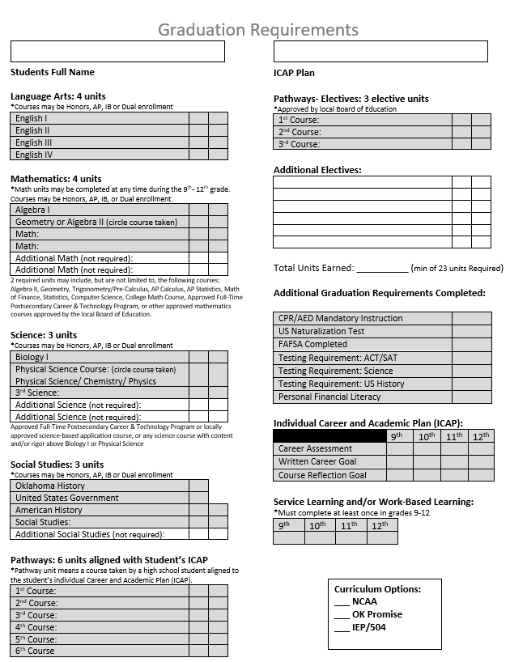
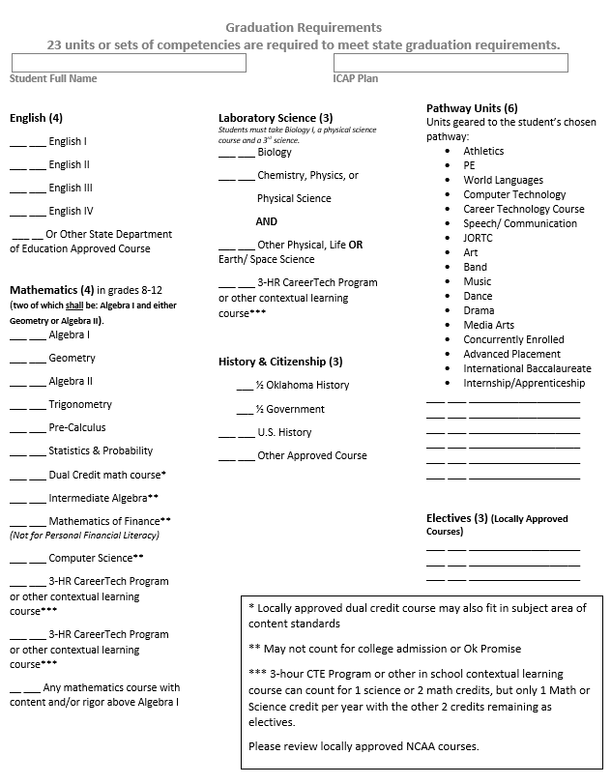
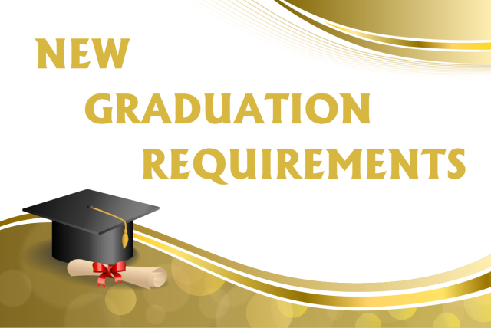
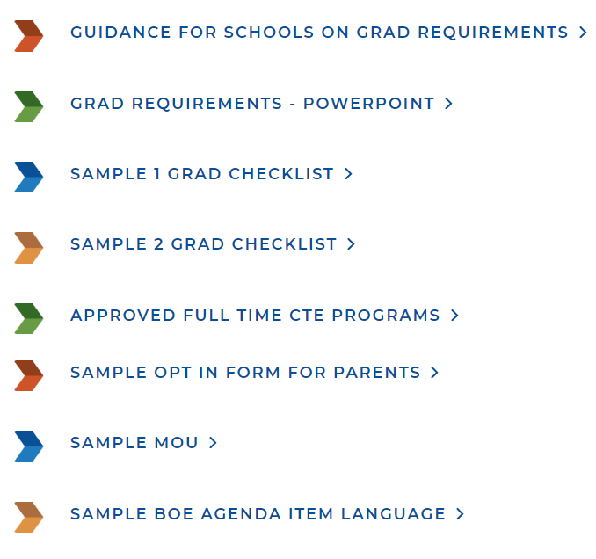
Resources
Okcareer.tech/ccd

Slide 16
Definitions
Contextual methodology - academic content and skills taught by utilizing real-world problems and projects in a way that helps students understand the application of that knowledge
Locally approved - approved by the local school district board of education
Math based application course - a course that teaches math content within a real-world application
Pathway unit - a course taken by a high school student that is aligned with the student's current Individualized Career and Academic Plan (ICAP)

Slide 17
Scenarios
Student is in a full-time welding program at a Technology Center, can I use that as a 3rd and 4th math?
I have a student athlete, what courses will count for NCAA based on the new graduation requirements?
Is a student still required to take (2) World/Non-English Language or Computer Technology?

Slide 18
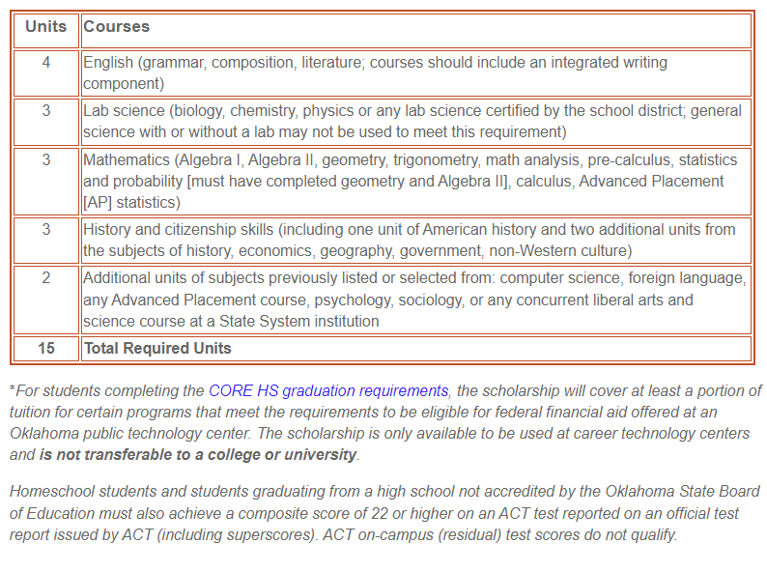
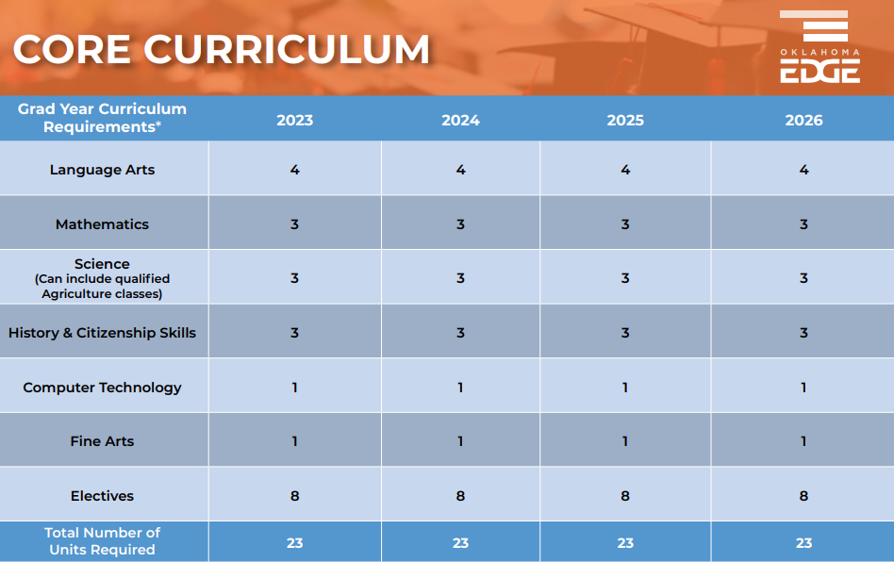
Oklahoma Promise: 2 new bills for 24/25
SB 1302- Amends OK Promise Requirements
SB 1328- Allows students on a Core Graduation Pathway to be eligible to use OK Promise for
Have completed the core curriculum and be seeking admission to a technology center school overseen by the State Board of Career and Technology Education. Students shall also have attained a 2.5 grade point average in the core curriculum courses.

Slide 19
Important CTE Transcripting Information
Transcripting a full time program that is satisfying a 3rd/4th Math or 3rd Science:
  How to show on transcript: If a student has chosen a career pathway and is taking a three-hour career and technology program in place of a third or fourth math credit, the subject code for the course they are taking is recorded on the transcript. Then, a comment should be added to the transcript stating that the third or fourth math requirement for graduation has been satisfied by [course or program name/code].

Slide 20

The OKCareerGuide team has created multiple opportunities to provide you with the training you need, both face-to-face and online. You’ll find regularly scheduled webinars, links to our latest material on YouTube, basic training guides and more here.

Slide 21
Help Is Available
Oklahoma Department of CareerTech: okcareer.tech/ccd
Shawna Nord, Manager Counseling and Career Development
  405-743-5524, shawna.nord@careertech.ok.gov
Julie Childers, Academic Coordinator
  405-743-5110, julie.childers@careertech.ok.gov
Oklahoma State Department of Education
Christi Sturgeon, Program Manager- Comprehensive School Counseling
  405-522-3263, christi.sturgeon@sde.ok.gov

Slide 22

Thank You!

