Slide 1
Navigating Key Elements in Concurrent Enrollment
Ms. Angel Icenhour
2026

Slide 2
Important note
All information shared applies to public colleges and universities in Oklahoma.

Slide 3
Agenda
01 | What is Concurrent Enrollment?
02 | Eligibility and Requirements
03 | High School Application of Credits
04 | Counselor + Student Support Tools
05 | Programs & Partnerships
06 | Data & Trends
07 | Professional Network & Events

Slide 4
What is concurrent enrollment?

Slide 5

Concurrent Enrollment
Concurrent enrollment is a program that allows qualified high school students—typically 11th‑ and 12th‑graders—to take credit‑bearing college courses while still enrolled in high school. These courses appear on both the high school and college transcript and become part of the student’s permanent academic record.
It’s an opportunity for students to experience real college coursework, explore academic interests, and get a head start on their degree before graduating high school. Many classes count toward high school graduation requirements in addition to college credit, as outlined in Oklahoma statute 70 O.S. § 628.13.

Slide 6
Eligibility and requirements

Slide 7
General Provisions
Must be a high school junior or senior.
Seniors 18 hours tuition waived
Juniors 9 hours tuition waived (contingent upon seniors being fully funded)
Must meet the general admission and course placement criteria.
Must have permission from parent or guardian.
Must have signature from principal or counselor.
Student is on track to graduate by the spring of their senior year.

Slide 8
Admission criteria
Community Colleges
Regional Universities
Research Universities
National ACT | 19
Pre-ACT (10th grade) | 19
Residual ACT* | 19
SAT | 990
PSAT 10 or PSAT/NMSQT | 990
GPA | Unweighted HS GPA 3.0
National ACT | 20
Pre-ACT (10th grade) | 20
Residual ACT* | 20
SAT | 1030
PSAT 10 or PSAT/NMSQT | 1030
GPA + Class Rank | Unweighted HS GPA 3.0 + Class Rank top 50%
National ACT | 24
Pre-ACT (10th grade) | 24
Residual ACT* | 24
SAT | 1160
PSAT 10 or PSAT/NMSQT | 1160
GPA + Class Rank | Unweighted HS GPA 3.0 + Class Rank top 33.3%
*Only one On-Campus ACT per year (from November 1 to October 31) is valid for admission and course placement.

Slide 9
Course placement
Students must demonstrate college readiness in the subject area corresponding to their college course (English, math, science, or reading for any other course).
ACT subject test score
SAT subject test score
Secondary assessment

Slide 10
Workload calculation
Students may not exceed a 19-semester-hour college workload.
Students may enroll in a maximum of 9 college credits during a summer semester.
½ high school unit = 3 hours college coursework
Non-academic units are excluded
Aria
Class | Credit
English Comp I | 3
AP Chemistry | 3
Functions and Modeling | 3
World History | 3
Office Aid | 0
Spanish II | 3
Accounting I | 3
Total | 18

Slide 11
Retention standards
Students must maintain a 2.0 cumulative college GPA to continue in concurrent enrollment.
Any student falling below this will not be allowed to enroll in another college course during high school.
Students are still admitted using freshman admission standards, though they may be placed on Academic Notice their first semester.

Slide 12
Ce & college admission
OSRHE Policy Definition:
“First-Time-Entering Student” is a student with six or fewer attempted credit hours, excluding developmental education or pre-college work and excluding credit hours accumulated by concurrently enrolled high school students.
No matter how many hours a high school student earns through CE (even if they earn an associate’s degree!), they will still be treated as a first-time entering student at State System institutions for admission/scholarship purposes.
For private and/or out-of-state institutions, this may vary.

Slide 13
High school application of credits

Slide 14
Counting concurrent courses toward hs graduation requirements
Districts make the decision about how college credit is applied to high school graduation requirements.
OSRHE highly recommends districts adopt a board policy on how college courses fulfill graduation credits.
The college course must appear on the high school transcript. College grades should NOT be “weighted” on the high school transcript by bumping them up one letter. This affects college admission and scholarships, especially Oklahoma’s Promise. Please don’t do it. (e.g., If a student earns a B in a college course, it should be accurately recorded as a B on their high school transcript, not as an A.)

Slide 15
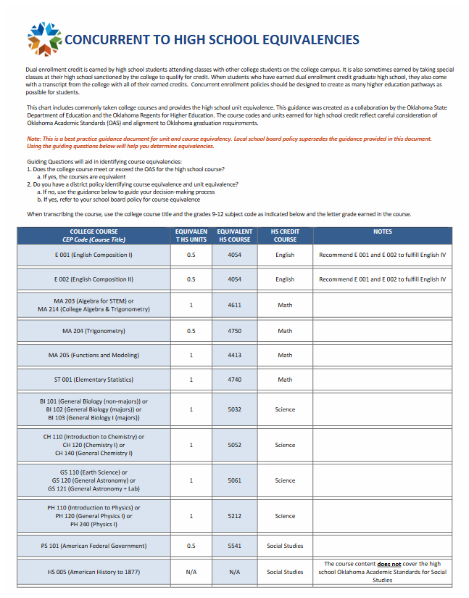
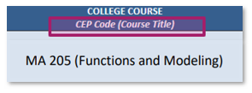
Concurrent to hs equivalencies
OSDE Concurrent to High School Equivalencies
Recommendations for common concurrent courses
https://sde.ok.gov/sites/default/files/College%20Course%20-%20Equivalencies.pdf

Slide 16
Counselor + student support tools

Slide 17
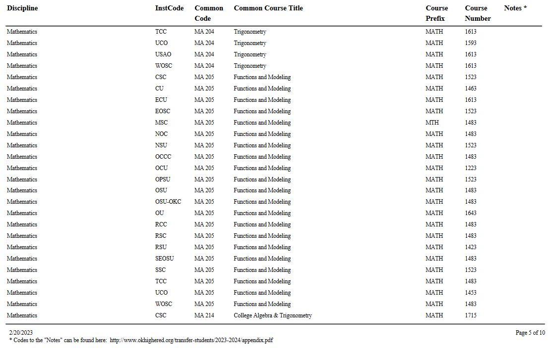

Course equivalency project
Course equivalencies are tables of courses that are transferable among Oklahoma public colleges and institutions (as well as some private institutions). Each table displays equivalent courses at each college and university and is organized by academic discipline, such as biology or history.

Slide 18
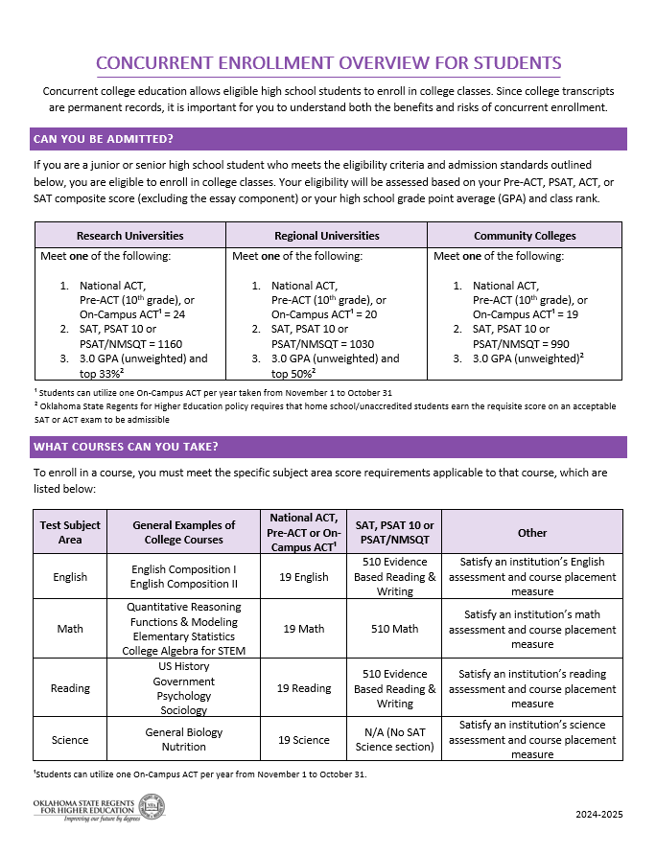
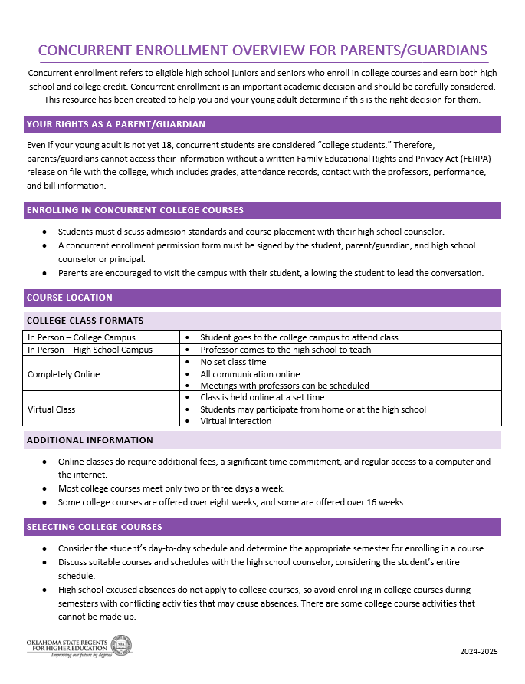
toolkits
Concurrent Enrollment Overview for Students and Counselors
Concurrent Enrollment Overview for Parents/Guardians
https://www.okcollegestart.org/College_Planning/Prepare_for_College/concurrent_enrollment.aspx

Slide 19
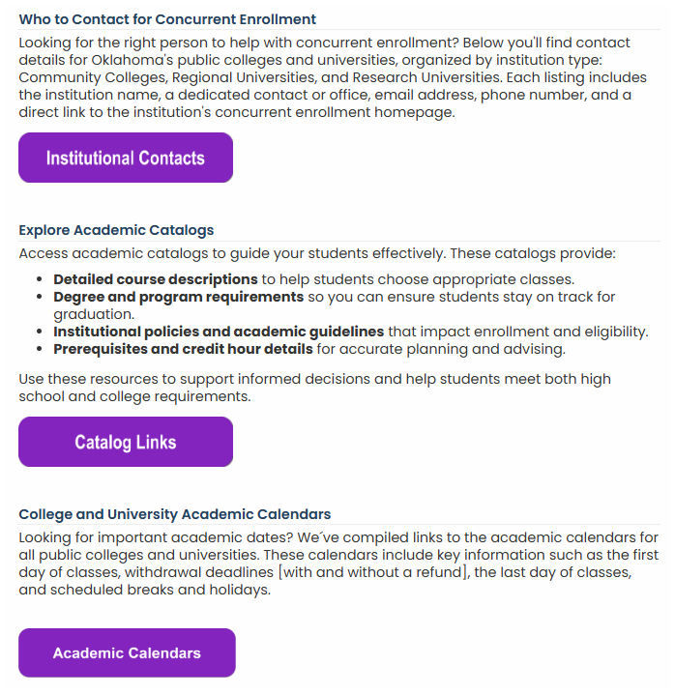
Website updates
All items were added in direct response to counselor feedback.
Academic Calendar links were added in the 2024-2025 academic year.
Catalog Links and Institutional Contacts were added in 2025-2026.

Slide 20
Programs & partnerships

Slide 21


Memorandum of understanding
If an institution assigns a faculty member to teach a course at a high school, a formal memorandum of understanding (MOU) must be in place between the institution and the high school outlining the responsibilities, expectations, and terms of the partnership.

Slide 22
Early college high school programs
ECHS programs are partnerships between high schools and colleges/universities for students to earn a meaningful college credential while completing their high school curriculum.
They are designed to serve underserved student populations by providing free or significantly reduced‑cost access to college coursework.
Program structures vary widely between different programs.

Slide 23
Echs pARTNERSHIPS
Connors State College
Muskogee Public Schools
Murray State College
Ardmore Public Schools
Dickson Public Schools
Durant Public Schools
Fox Public Schools
Kingston Public Schools
Madill Public Schools
Plainview Public Schools
Sulphur Public Schools
Tishomingo Public Schools
Wilson Public Schools
Oklahoma City Community College
Crooked Oak Public Schools
Oklahoma City Public Schools
Capitol Hill High School
Classen SAS
Douglass High School
John Marshall High School
Northwest Classen High School
Southeast High School
U.S. Grant High School
Santa Fe South Pathways Middle College (Charter)
Southwestern Oklahoma State University
Yukon Public Schools
Seminole State College
Seminole Public Schools
Shawnee Public Schools
The Academy of Seminole
Tulsa Community College
Broken Arrow Public Schools Charles Page High School (in Sand Springs) KIPP Tulsa University Prep High School McLain High School (TPS) Memorial High School (TPS) Union Public Schools
University of Central Oklahoma
Edmond Public Schools

Slide 24
Data & trends

Slide 25
Ten-year concurrent enrollment student headcount

Slide 26
Ten-year concurrent enrollment credit hour production

Slide 27
2024-25 institutional headcount

Slide 28
2024-25 institutional tier enrollment
Current enrollment trends show that 72% of students are enrolled at community colleges, 22% at regional universities, and only 6% at research institutions.
This breakdown underscores the pivotal role community colleges play in serving the majority of our student population, offering accessible and affordable pathways.

Slide 29
Professional network and events

Slide 30


Want to join a network of concurrent enrollment professionals? Considering signing up for The Oklahoma Alliance of Dual Credit Partnerships (OADCP) an affiliated chapter with the National Alliance of Concurrent Enrollment Partnerships (NACEP).
What is NACEP?
The sole accrediting body for concurrent enrollment partnerships, ensures programs meet high standards for smooth student transitions to college and continuous professional development. To support their national network of members and advance the field, they actively share the latest knowledge on best practices, research, and advocacy.
OADCP is committed to fostering excellence in dual credit programs, ensuring
they meet the diverse needs of high school students.

Slide 31
2026 webinar schedule – become a member to receive registration links!
February 18th at 2:15 pm
Title: Insights from LA: Key Takeaways from the National Alliance for Concurrent Enrollment Programs Conference
Description: Join us for an engaging session where presenters share highlights from the sessions; they attended at the NACEP National Conference in Los Angeles, CA. Discover emerging trends, innovative practices, and actionable strategies, shaping concurrent enrollment programs nationwide. Whether you’re looking to enhance partnerships, improve student outcomes, or stay ahead of policy changes, this recap will provide valuable insights and practical ideas to bring back to your institution.
April 8th at 2:15 pm
Title: Real Talk from Oklahoma Counselors: Navigating Concurrent Enrollment
Description: Hear directly from Oklahoma high school counselors about what it’s really like to guide students through concurrent enrollment. They’ll share their experiences with advising and registration—what works, what’s confusing, and how they keep students on track despite challenges like unclear program rules and limited training. You’ll get practical ideas straight from the people doing the work every day, including tips for better training and stronger partnerships between schools and colleges. If you’re involved in concurrent enrollment in any way, this session will give you real-world insights and strategies to help counselors—and students—succeed.
September 23rd at 2:15 pm
Title: Spotlight on Success: Innovative Concurrent Enrollment Programs Across Oklahoma
Description: Join us for an inspiring showcase of concurrent enrollment success stories from across Oklahoma. This webinar will highlight innovative programs, creative partnerships, and impactful student outcomes that are shaping the future of dual credit. Hear directly from educators, administrators, and students who are leading the way with scalable models, community collaboration, and bold ideas. Whether you're looking to strengthen your existing program or launch new initiatives, this session will offer practical insights and proven strategies to elevate your work.
November 4th at 2:15 pm
Title: From Cleveland to Oklahoma: Practical Takeaways from the NACEP Conference
Description: Join us for an informational session to learn from presenters who attended the NACEP National Conference in Cleveland, Ohio. They’ll share what they heard, learned, and brought back from the conference, highlighting key ideas and takeaways related to concurrent enrollment. This session offers an opportunity to gather practical insights and ideas you can apply at your own institution or district.

Slide 32
Course review process

Slide 33
70 O.S. § 11-103.6, Math and Science Locally Approved Courses
 | Locally Approved and Regents Approved | Locally Approved
Purpose | Important for college‑bound students to ensure college admission readiness and continued eligibility for Oklahoma’s Promise. | For students who do not plan to attend college.
Requirement | Laboratory Science courses must exceed the rigor or Biology I or Physical Science Mathematics courses must exceed the rigor of Algebra I | Determine the specific course description and formally notify SDE prior to July 1 of each school year.
Deadline | 2nd Friday in February | July 1 notification
Laboratory Science | 5075 | 5072
Mathematics | 4645 | 4642

Slide 34

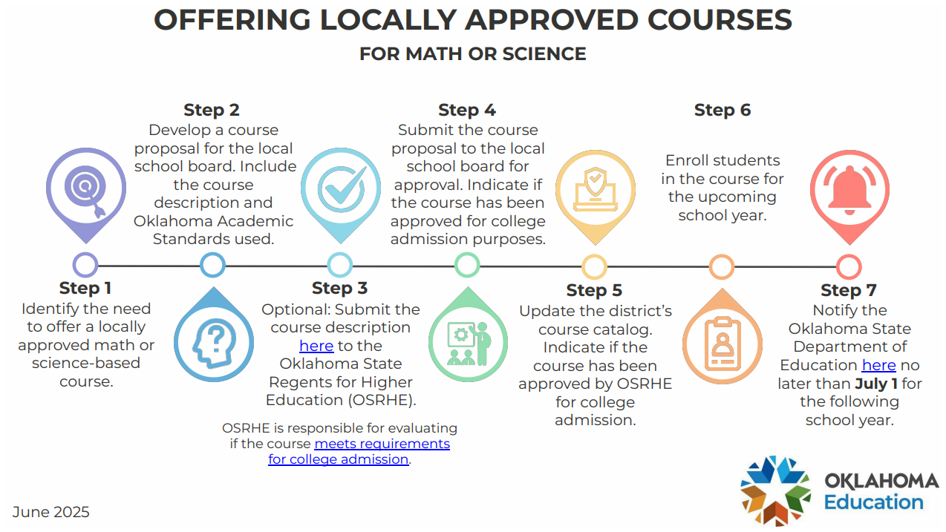

Slide 35
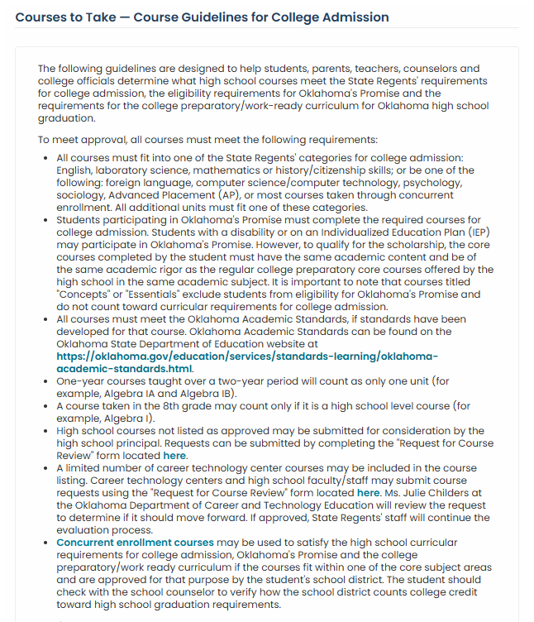

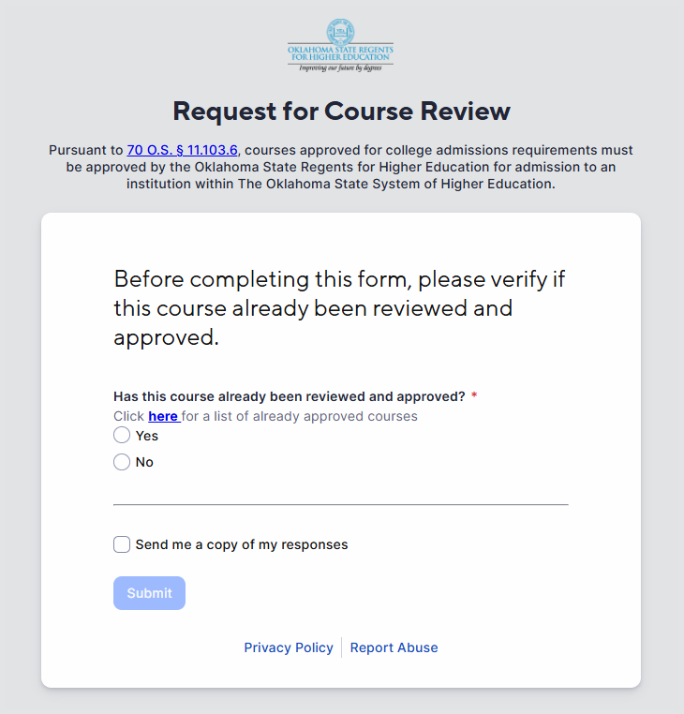

Slide 36
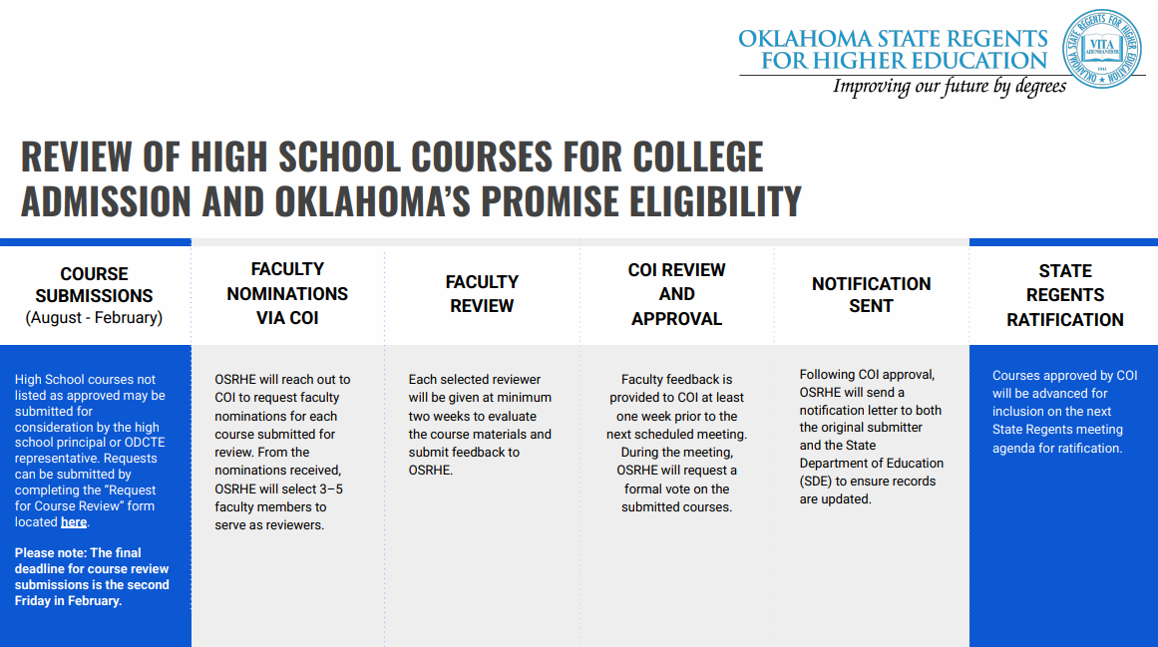

Slide 37

Questions?
aicenhour@osrhe.edu

