Slide 1
Not all Gifted Students Look the Same.

Slide 2
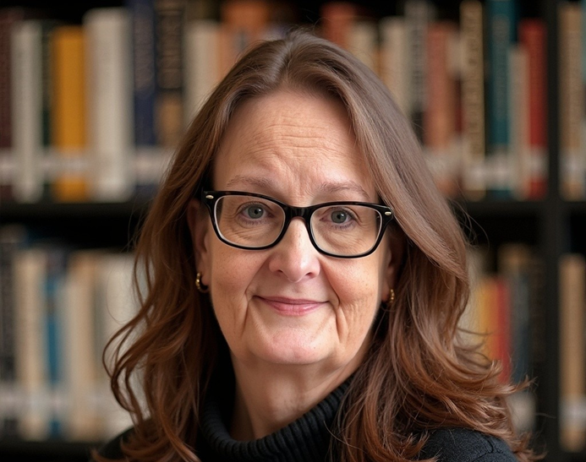
Welcome & Introduction
Dr. Regina Hein
Project Manager for Gifted & Talented and Advanced Placement
Regina.Hein@sde.ok.gov
(405) 522-3188

Slide 3

Agenda
Myths/Facts about GT
What does it mean to be Gifted in Oklahoma?
The six types of gifted students and how to meet their needs
The sorting hat
Closing

Slide 4
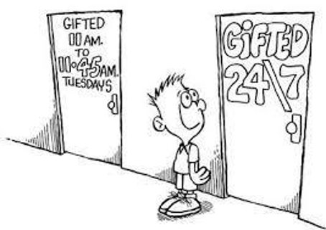
Myths about gifted students

Slide 5


1
Gifted students do not need help; they will do fine on their own.​

Slide 6

2
Teachers challenge all the students, so gifted kids will be fine in the regular classroom.​

Slide 7
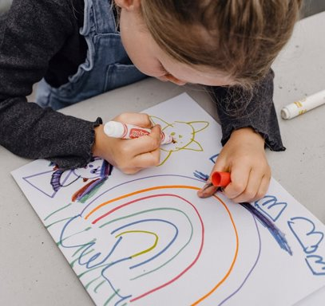
3
All children are gifted.

Slide 8
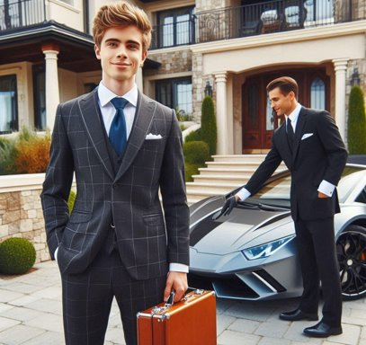
4
Gifted programs are elitist.

Slide 9
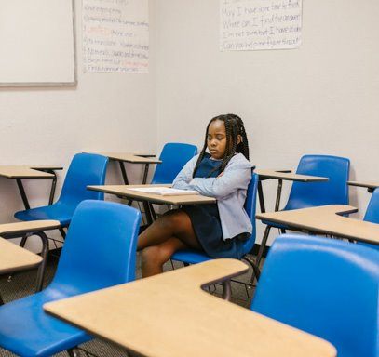
5
That student cannot be gifted. They have low grades, is a behavior problem, has a disability, etc.…​

Slide 10

What is Gifted?

Slide 11
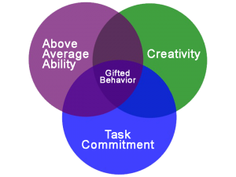
What Does it mean to be “Gifted”?
Generally viewed as a social construct
Emerged in early 20th century
Brain research
Can be really complicated

Slide 12
Oklahoma Statute​ Title § 70 O.S. 1210.301
Gifted and talented children are those who are identified as having demonstrated potential abilities of high-performance capability (top 3% on an intellectual capability test) or excel in one or more of the following ability areas:
Creative thinking
Leadership
Visual or performing arts
Specific academic subjects
And need differentiated or accelerated education or services
Notes:
Requires identification and serve under the gifted and talented children act 1981
Education of Gifted and Talented Children Act

Slide 13

Oklahoma Statute​
Gifted and talented children are those who are identified as having demonstrated potential abilities of high-performance capability (top 3% on an intellectual capability test)

Slide 14
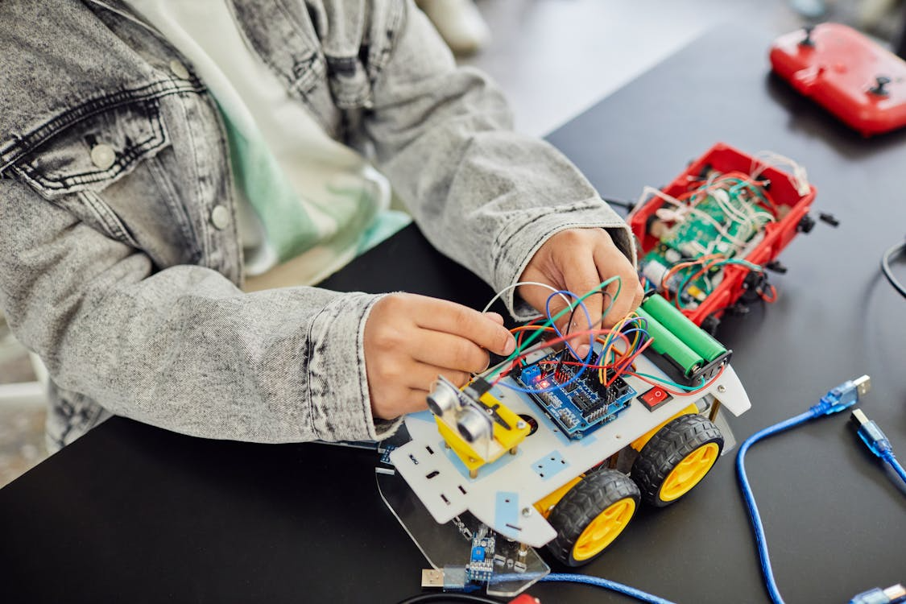
Title § 70 O.S. 1210.301
or excel in one or more of the following ability areas:
Creative thinking
Leadership
Visual or performing arts
Specific academic subjects

Slide 15

Oklahoma Statute​
And need differentiated or accelerated education or services

Slide 16
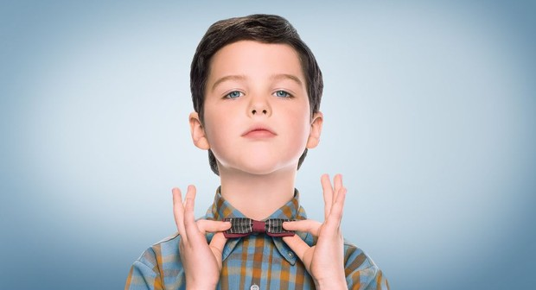
All Gifted Students do not look like this….

Slide 17
6 Types of Gifted People – Which One Are You?

Slide 18

Break Time!

Slide 19
Archetypes: A starting point, Not a Stereotype
The six profiles offer insight, not limitation.
Each gifted learner is unique – no one fits perfectly into a single box.
Use these archetypes as a guide, not a label.
Flexibility and responsiveness are key in meeting wide-ranging needs.
Notes:
Before we dive into the six types of giftedness, I want to offer a quick reminder: these categories are not boxes—they're tools. It's easy to slip into rigid thinking when we use labels, but that’s not the goal here.
These archetypes are flexible, not fixed. A child may reflect more than one type—and may shift types over time, depending on their environment, support, and development. They give us language to recognize patterns and needs, not to define limits.
Think of these types as guides to help us better understand, support, and celebrate the complex and evolving nature of gifted individuals.

Slide 20
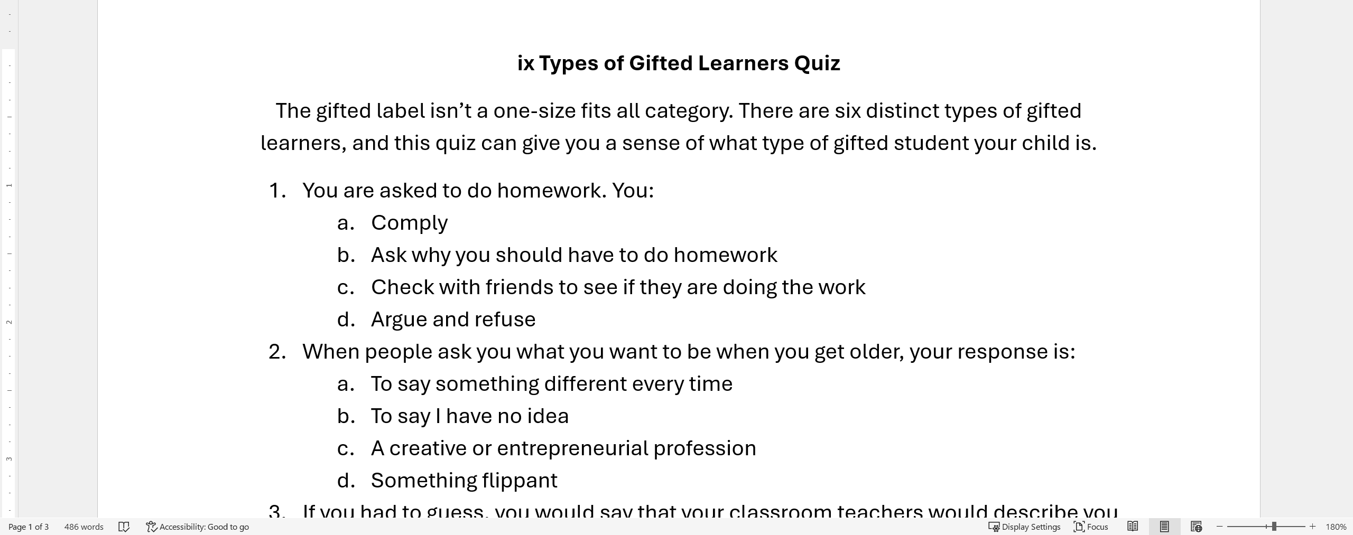
Six types of Gifted Learners Quiz
Notes:
I adapted this quiz to support today’s presentation. It’s not a norm-referenced or scientifically validated assessment—so it’s not meant to diagnose or label. Instead, it’s a light, informal tool to spark self-reflection and discussion.
The quiz is based on a research-backed framework that has recently regained attention, especially in efforts to address the misidentification and under-identification of gifted students—particularly those from underrepresented or non-English-speaking communities.
As you take the quiz, I encourage you to answer from the perspective of your younger self—think about how you might have responded as a child or teen. While this isn’t a diagnostic tool, it can provide meaningful insights into different expressions of giftedness and help us better understand the diverse needs of gifted learners.

Slide 21
What type are you?
Type 1 – The Traditional
Type 2 – The Challenging
Type 3 – The Underground
Type 4 – At Risk
Type 5 – Double Labeled 2E
Type 6 – The Autonomous Learner
Circle your answer for each question on the answer grid.
Total the number of circles for each type.
Focus on your highest and lowest areas.

Slide 22
6 Gifted Profiles “Profiles of Gifted” 1988 George Belts & Maureen Neiheart
Excel in structured environments
Seek validation
Challenging
Imaginative, Innovative
Clash with traditional norms
Underground
Hides their talents to fit in
Traditional

Slide 23
6 Gifted Profiles “Profiles of Gifted” 1988 George Belts & Maureen Neiheart
At-Risk
Disengaged
Behavioral Challenges
2 E
Additional Challenges
Autonomous
Self-directed
Could be learning disabled
Independent

Slide 24
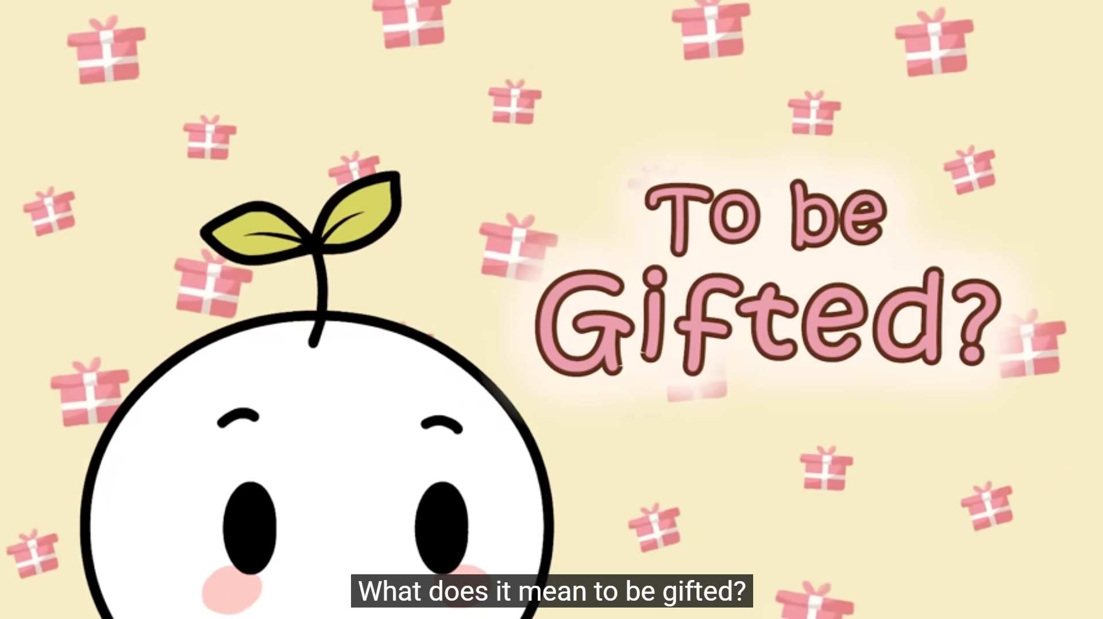
Betts & Neihart’s Six Types of Gifted Students
The Traditional
The Challenging
The Underground
The At-Risk
2E
The Autonomous
Notes:
When we think of a gifted student, we often picture a high-achiever—always prepared, top of the class. But giftedness doesn’t always look like that.
Some gifted students underachieve, some rebel, some have disabilities, and others are so independent they go unnoticed.
To help us better understand this diversity, Drs. George Betts and Maureen Neihart created the Six Profiles of Gifted Students in 1988. Their model reminds us that gifted learners:
Are not a one-size-fits-all group
Have varied emotional, academic, and behavioral needs
Require different types of support to thrive
The six types—Successful, Challenging, Underground, At Risk, Twice-Exceptional, and Autonomous—give us a framework to go beyond labels and test scores, and instead ask: What does this gifted student need to grow?

Slide 25

Traditional Gifted
Feelings & Attitudes
Does well in school
Perfectionist
Eager to please
Behavior
Seeks teacher approval
Avoids risks – chooses safe activities
Accepts & Conforms
Gets good grades
Notes:
These are the high-achieving, compliant students most often associated with being gifted. They follow rules, earn good grades, and seek to please adults. While they make teachers' jobs easier, they may avoid risk, develop perfectionism, and become overly reliant on external validation—limiting their creativity and personal growth.

Slide 26
Traditional
Needs
To take risks
Creativity development
Higher-level study skills
Adult/Peer Perceptions
Loved by teachers
Will succeed on their own
Abilities are over-estimated by parents

Slide 27
Traditional Supports
Home Support
Freedom to make choices
Risk-taking experiences
Affirm the child
Ability to cope with challenges
School Support
Needs more than AP, IB, & Honors
Activities that push out of comfort zone
Development of independent learning skills
Time with intellectual peers
Notes:
Focus on effort
Encourage risk taking and creativity
Encourage them to advocate for themselves
Hard to stand up to peers

Slide 28
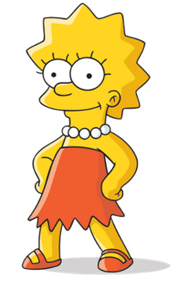
Traditional Examples
Examples:
Emma Watson
Princess Leia
Lisa Simpson
Marie Curie
Barack Obama
Taylor Swift
Notes:
Emma Watson – excelled academically at Brown University, while acting, thrived in a structured environment
Marie Curie – Excelled in academia, met and exceeded scientific expectations with great discipline
Barack Obama – academically accomplished , diplomatic, and goal orientated
Taylor Swift – high achieving, polished performer, excels in structured goal focused industries

Slide 29

The Challenging
Feelings & Attitudes
Highly creative
Board & frustrated
Impatient & Defensive
Will not work for the grade
Behaviors
Challenges the teacher/authority
Questions rules, policies
Honest & direct
Stands up for Convictions
Notes:
These students are highly intelligent but often resist structure. They’re original thinkers, question authority, and may be perceived as rebellious or difficult. They might underachieve because they are board or frustrated with rigid school systems. Their creativity and intensity can be mistaken for defiance.

Slide 30
The Challenging
Needs
To learn tact, flexibility, self-awareness, and control
To relate to others
Interpersonal skills
Adult & Peer perceptions
Irritating
Rebellious
Power struggle
Discipline problems
Peers see them as entertaining
Notes:
Collaboration
Relationships
Easily distracted by other interest
Opportunity to show their learning in a creative way
Let them make things better, improve design

Slide 31
The Challenging
Home support
Allow them to pursue interests
Model appropriate behavior
Affirm their strengths
School Support
Dual enrollment
Placement with appropriate teachers
Direct and clear communication

Slide 32

The Challenging
Examples
Kevin Mc Calaster
Han Solo
Steve Jobs
Elon Musk
Tony Stark (Iron Man)
Notes:
Steve Jobs – unconventional, intense, creative, resistance to authority, innovative
Elon Musk – visionary thinker, challenges norms, pushes boundaries

Slide 33

The Underground
Feelings & Attitudes
Desire to belong socially
Conflicted, guilty, insecure
Diminished sense of self
Ambivalent about achievements
Behaviors
Denies talent
Drops out of GT & Advanced classes
Resists challenges
Seems unsure of direction
Notes:
These students hide their abilities, often due to social pressure. This is especially common during adolescence and among girls or students from underrepresented groups. They may downplay their intelligence to fit in with peers or to avoid being labeled. As a result. They often become quiet, compliant, and seem average in performance

Slide 34
The Underground
Needs
Support for abilities
Involvement with gifted peers
An audience to listen to what they have to say
Adult & Peer perceptions
Seen as average & successful
Seen as quiet/shy
Perceived to be compliant
Unwilling to risk
Notes:
Middle school girl
Middle school non white boys
Imposter syndrome
Coast through classwork

Slide 35
The Underground
Home Support
College & career planning
Model lifelong learning
Don’t compare with siblings
Normalize the experience
School Support
Instruction on social skills
Open discussions
Provide role models
Address their goals

Slide 36
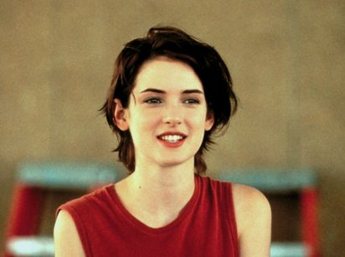
The Underground
Examples
Finn – Star Wars
Charlie Brown
Katniss Everdeen (Hunger Games)
Lady Gaga
Winona Ryder
Marilyn Monroe
David Bowie
Notes:
Lady Gaga – gifted student who felt like an outsider, struggled with peer acceptance, later embrased her individuality
Winona – struggled with identity and fitting in
Marilyn – often underestimated intellectually, well read, hid her intellectual side to preserve public image
David – masked parts of his identity to fit in, reinvented himself

Slide 37

At-Risk
Feelings & Attitudes
Resentful, angry
Explosive
Defensive
Resistant to authority
Does not work for grades
Behaviors
Will work for the relationship
Doesn’t complete tasks
Criticizes self and others
Produces inconsistent work
Notes:
These students have often disengaged entirely from school. They may have started as successful or creative gifted students but over time a mismatch between their needs and they system has led to frustration and apathy. Some may act out or withdraw. They may feel alienated, undervalued or misunderstood.

Slide 38
At-Risk
Needs
Counseling
Direction and short-term goals
An alternative or individualized program
Adult & peer Perceptions
Adults may be angry with him/her
Seen as loners
Seen as dangerous
May be afraid of them
May be afraid for them
Notes:
Angry
Depressed
Defensive
Risky behaviors
Frustrated
Create support/relationships
Supervise

Slide 39
At-Risk
Home Support
Keep dialogue open
Counseling
Hold accountable
Avoid power struggles
Preserve the relationship
School support
Don’t lower expectations
Academic coaching
Promote resilience
Discuss secondary options

Slide 40
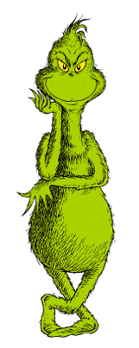
At-Risk
Examples
Anakin Skywalker (before he became Darth Vader)
Grinch
Albert Einstein
Walt Disney
Thomas Edison
Whoopi Goldberg
Will Hunting (Good Will Hunting)
Notes:
Einstein – struggled in school, dropped out at age 15,
Walt Disney – dropped out at 16
Thomas Edison – left school early labeled difficult by teachers
Whoopi – dyslexia, drop out,

Slide 41

2 E (Twice Exceptional)
Feelings & Attitudes
Learned helplessness
Intense frustration
Feeling of inferiority
Poor academic self-concept
Don’t view themselves as successful
Don’t know where to belong
Behaviors
Are good problem solvers
Thinks conceptually
Enjoys novelty & complexity
Disorganized
Notes:
Also known as double labeled. These learners are gifted but also have a disability such as ADHD, autism, dyslexia, or emotional challenges, their abilities may mask their disabilities or vice versa, leading to misdiagnosis or no diagnosis at all. They may be seen as lazy, inconsistent, or problem students.

Slide 42
2 E (Twice Exceptional)
Needs
Emphasis on strength
Skill development
Learn to persist
Monitor for additional disorders: ADHD, Autism, etc.
Adult & Peer Perceptions
Seen as weird
Viewed as helpless
Avoided by peers and teachers
Perceived as needing a lot of supervision
Seen only for disabilities
Notes:
Anxiety
Not easy to identify
If identified they are older, middle school
Please don’t just focus on their disabilities, nurture strengths
Short concise directions
Wait time
Help with organization
Graphic organizers

Slide 43

2 E (Twice Exceptional)
Home support
Recognize and affirm gifted abilities
Challenge in strength area
Nurture self-control
Assume college is a possibility
School Support
Focus on talent development & not on only remediating deficits
Placement in gifted programs
Teach self-advocacy
Time to be with GT peers

Slide 44
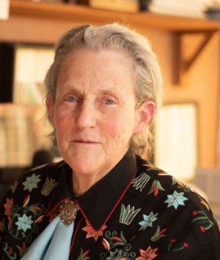
2 E (Twice Exceptional)
Examples
Rudolph
Percy Jackson (series)
Temple Grandin
Stephen Hawking
Anderson Cooper
Greta Thunberg
Notes:
Anderson Cooper – dyslexia
Greta – autistic
Temple – autistic

Slide 45

Autonomous Learner
Feelings & Attitudes
Self-confident
Self-accepting
Possess desire to know & learn
Willing to fail
Intrinsic motivation
Behaviors
Works independently
Does not seek external approval
Follows strong areas of passion
Thinks creatively
Stands up for convictions
Notes:
“These are the gifted students who have figured it out. They are independent, self motivated, and passionate about learning. They take initiative, set goals, and pursue their interests with little direction. They thrive in and out of school and can navigate challenges with resilience and confidence.

Slide 46
Autonomous Learner
Needs
Facilitation of continuing growth
Support for risk-taking
On-going factitive relationships
Adult & Peer Perceptions
Admired for abilities
Seen as capable & responsible
Psychologically healthy
Will be extremely successful
Notes:
Do things their own way
Get out of their way so they can learn
Can advocate for themselves
Independent
Class may move too slow
Respect authority but will question rules
Self paced learner
Can learn online easily
Will own their learning

Slide 47
Autonomous Learner
Home Support
Allow friends of all ages
Include in family decision-making
Listen
Advocate for child at school & in the community
School Support
Allow development of a long-term, integrated plan of study

Slide 48
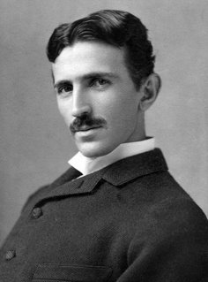
Autonomous Learner
Examples
Hermey the Elf
Rey
Leonardo da Vinci
Maya Angelou
Nikola Tesla
Mark Zuckerberg
Notes:
Leonardo – studied independently
Maya – self-educated
Tesla – explored ideas independently
Zuckerberg – dropped out of Harvard to start Facebook

Slide 49
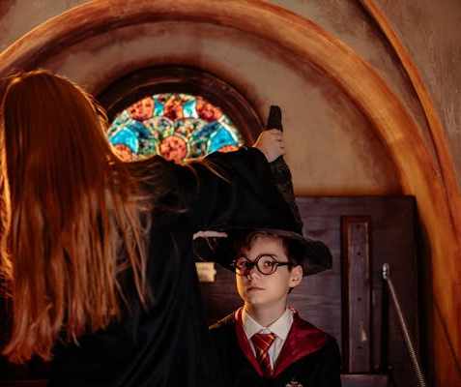
Congratulations!!
You have been hired as the Gifted & Talented teacher at Hogwarts.
Your first assignment is to group your students into the 6 types of gifted.

Slide 50

Your Students …….
Draco Malfoy
Fred & George Weasley
Ginny Weasley
Harry Potter
Hermione Granger
Luna Lovegood
Neville Longbottom
Ron Weasley

Slide 51

Activity
With your group, discuss the character’s traits, behaviors, and possible needs.
Decide which of the six types of gifted learners best represents this character.
Tape the picture of the character onto the correct chart paper labeled with the six types.
Be prepared to share your group’s reasoning.

Slide 52

Classifying Students
Gallery Walk

Slide 53

Resources to Support Gifted
National Association for Gifted Children (NAGC)
Oklahoma Association for Gifted, Creative, and Talented (OAGCT)
Oklahoma State Department

Slide 54
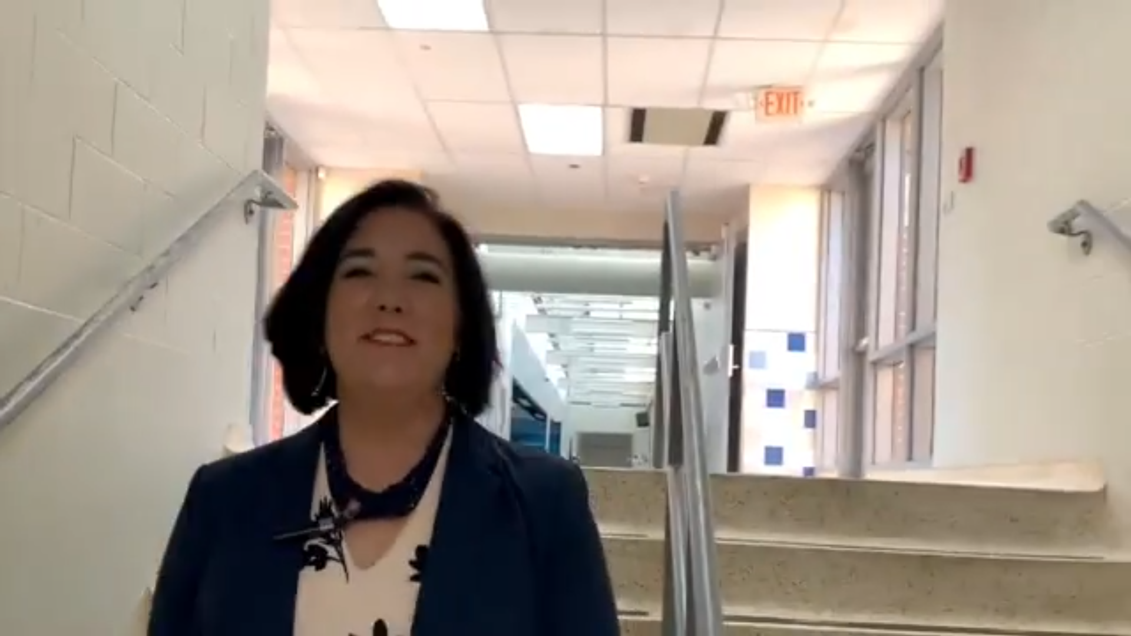
Identifying Gifted Students
Notes:
Brain break

