Slide 1

Inspiring Careers – Empowering Lives
The National Career Development Association (NCDA) provides professional development, publications, standards, and advocacy to practitioners and educators who inspire and empower individuals to achieve their career and life goals.
www.ncda.org

Slide 2

Premier Association for Career Counselors and Career Development Specialists
www.NCDA.org

Slide 3
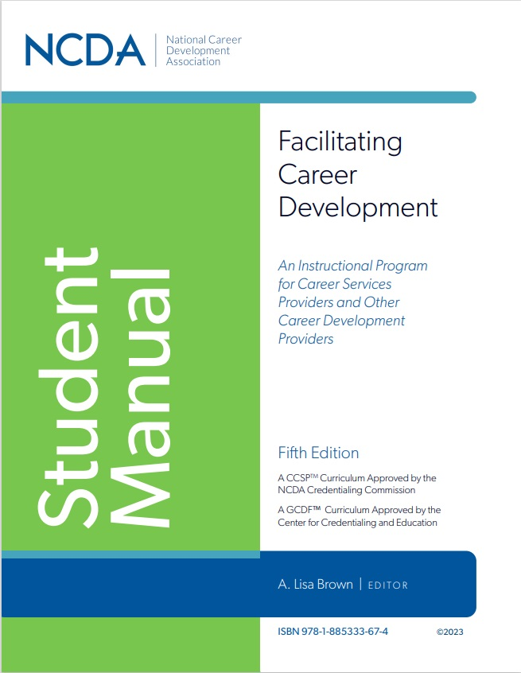
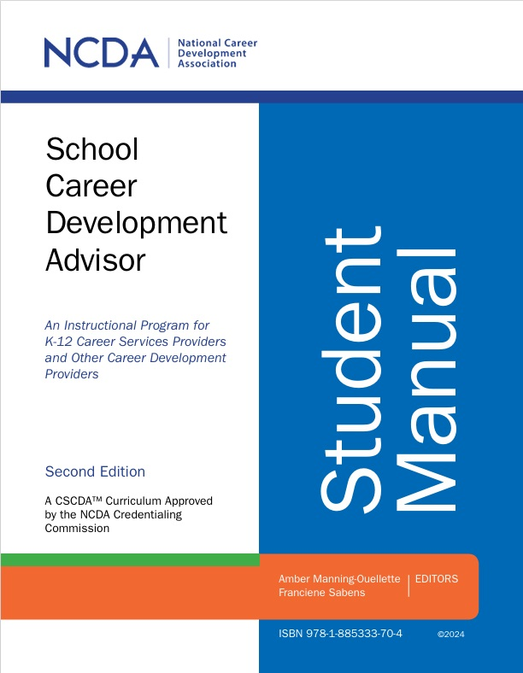
NCDA Training Programs

Slide 4
Facilitating Career Development (FCD)
Flagship training program for career development professionals
Foundational career competencies for effective career facilitation
Learner-centered training including experiential activities and group interaction

Slide 5
Facilitating Career Development (FCD)
Competencies include helping skills, career theory, assessment, labor market information, ethics, group facilitation, overcoming employment challenges, and more
Transferable across education, workforce, private practice, government, and nonprofit sectors
Courses starting weekly – 8 to 12 weeks in length
120-hours of synchronous and synchronous Instruction

Slide 6
School Career Development Advisor (SCDA)
Specialized career instruction for career development professionals working with youth
Integrating business/community partnerships
Career advising competencies
Student advising knowledge

Slide 7
School Career Development Advisor (SCDA)
48-hours of Synchronous and Asynchronous Instructions
Courses starting weekly – 5 to 6 weeks in length
Ethical considerations
Business & industry collaboration

Slide 8
SCDA Impact
Who Benefits
K-12 school counselors/teachers
Outcomes
Stronger school-to-work pathways
School-business partnership coordinators
Workforce development practitioners who collaborate with schools
Increased capacity for career readiness initiatives
Expanded collaboration among stakeholders

Slide 9

NCDA Credentialing Commission
FCD Completers eligible for the Certified Career Service Provider (CCSP) Credential
SCDA Completers eligible for the Certified School Career Development Advisor (CSCDA) Credential

Slide 10

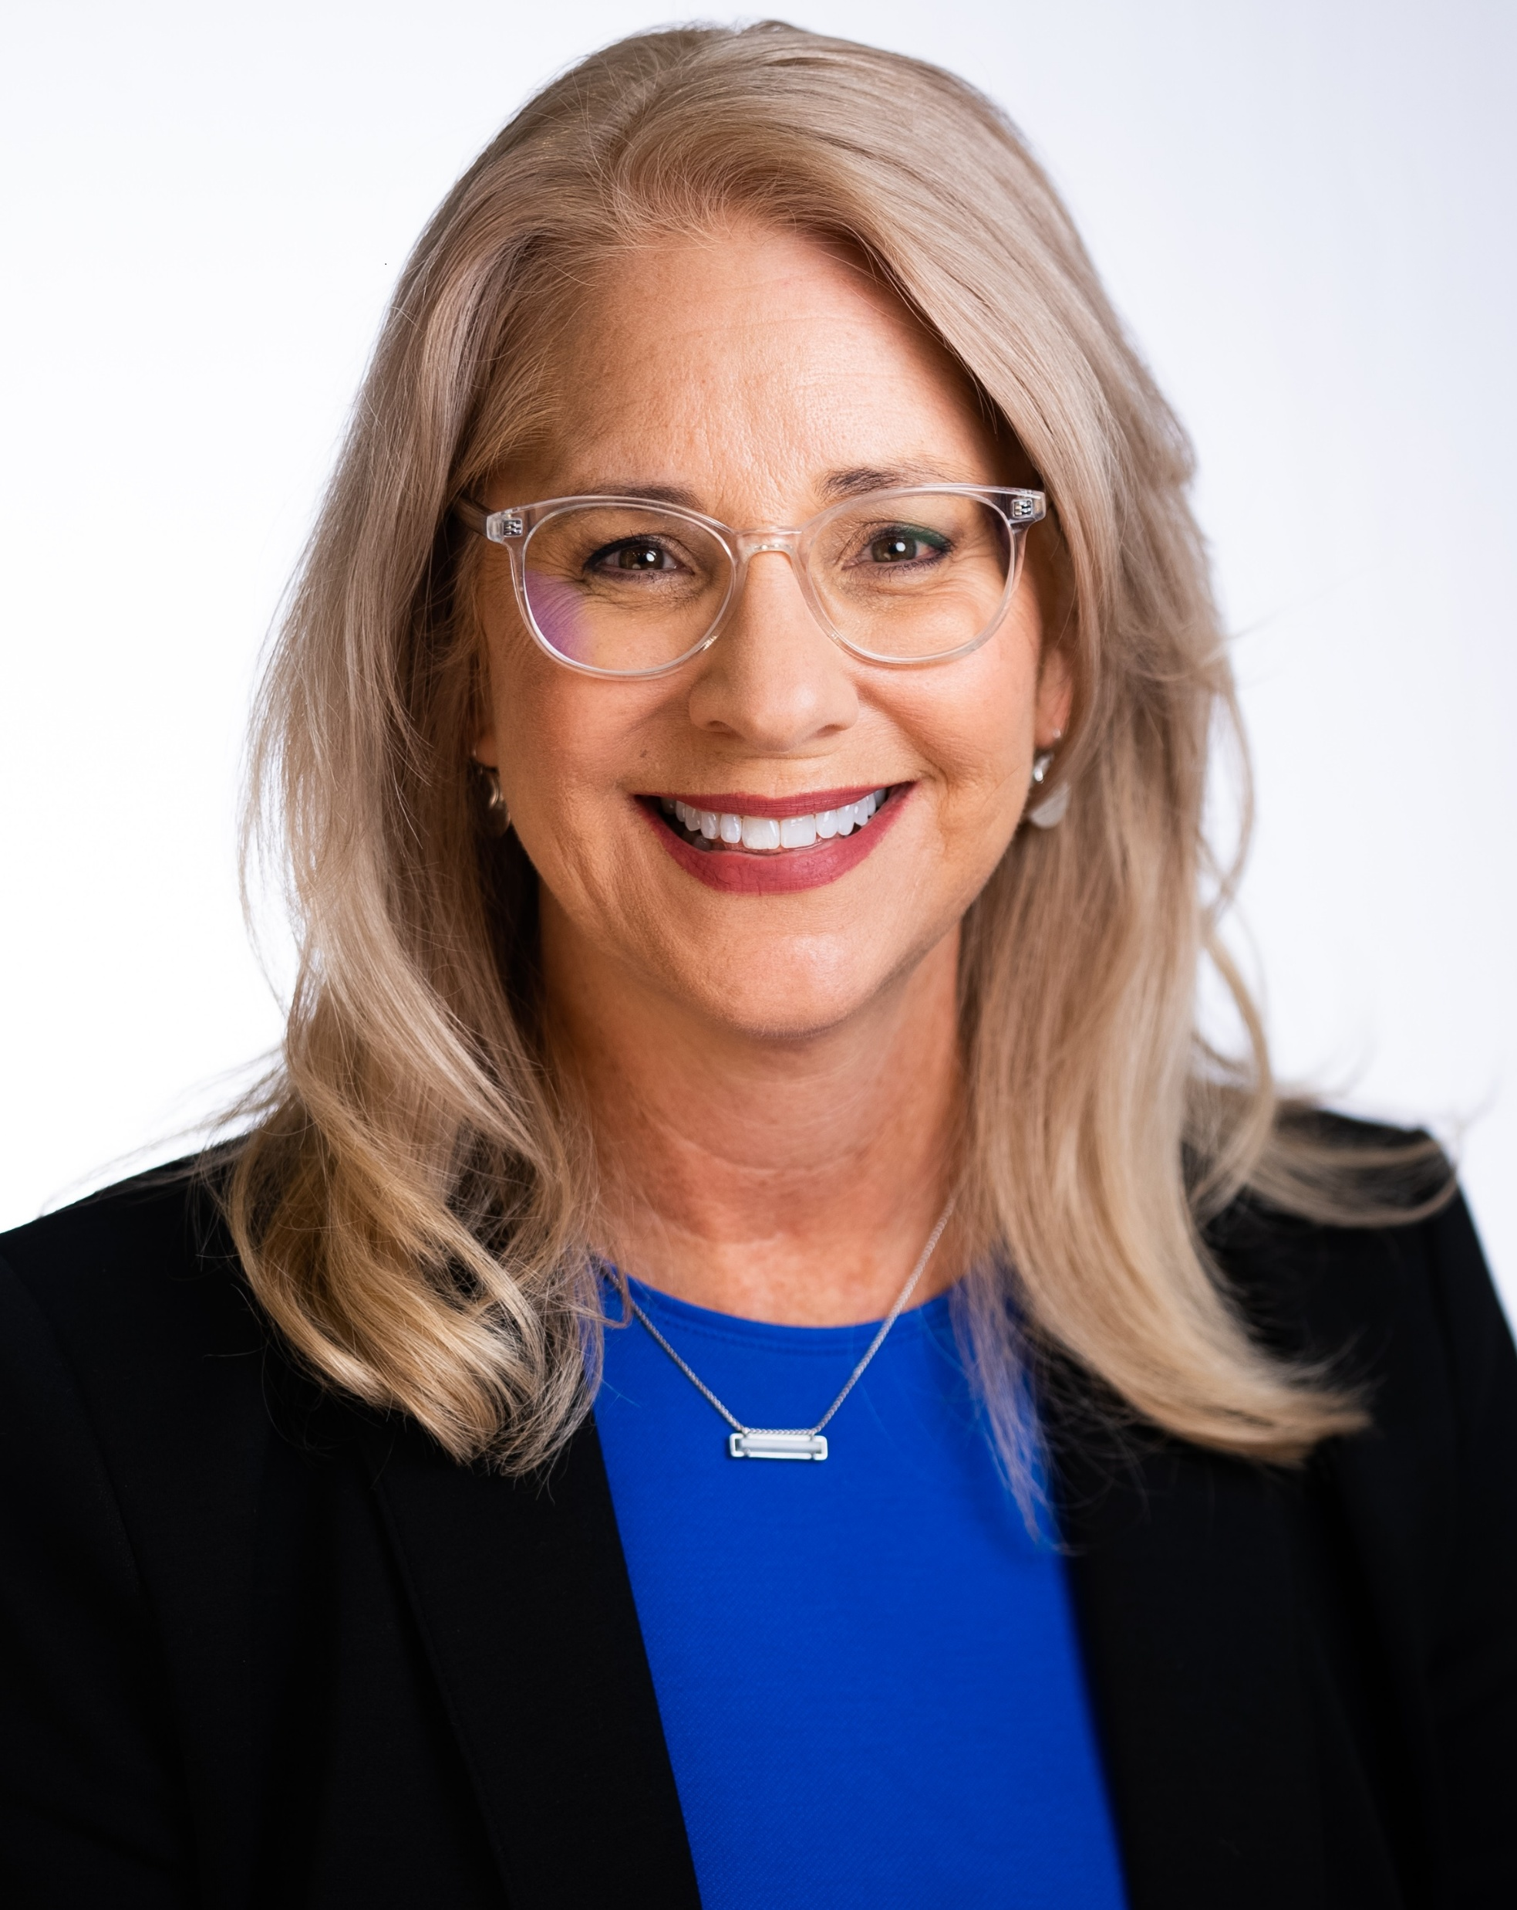
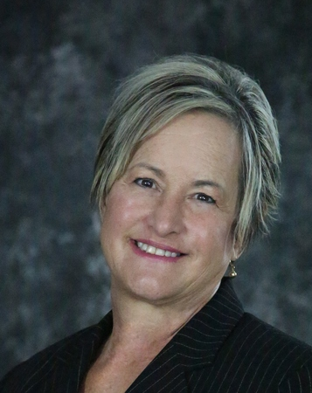
FCD Courses
and Costs:
SCDA Courses
and Costs:
For More Information:
 | Mary Ann Powell Director of Special Projects Email: mpowell@ncda.org www.ncda.org
 | Dr. Pamela Ehlers A&P Consulting, Director Emerita, OSU Career Services Email: pam.Ehlers@okstate.edu www.ncda.org

