Slide 1
ICAP Overview
Individual Career Academic Planning

Slide 2
Jennifer Peters
College and Career Readiness Specialist
Supporting Oklahoma school counselors, educators, and administrators
Assistance and coaching in areas of college and career readiness and ICAP implementation.
Experience
Career Specialist for Moore Public Schools, 10 years
Education
B.A. Human Development and Family Science
M.S. School Counseling
Jennifer Peters, M.S.
College and Career Readiness Specialist
Jennifer.Peters @sde.ok.gov
O: (405) 522-9998
C: (405)416-3656

Slide 3
Marissa Lightsey
Executive Director of College and Career Readiness
Supporting Oklahoma school counselors, educators, and administrators in CCR alignment
Technical assistance and coaching in areas of ICAP, academic advisement, college and career readiness, early workforce programming, and comprehensive college and career readiness models.
Experience
Higher Education 8 years
College and Career Advising (GEAR UP & Upward Bound) 5 years
Workforce development 9 years
Marissa Lightsey
Executive Director of College and Career Readiness
Marissa.Lightsey@sde.ok.gov

Slide 4
Agenda
Question cards
ICAP Overview / Progress
ICAP Activities / Documentation
ICAP Implementation
ICAP Resources / Best Practices

Slide 5
ICAP
Question Cards

Slide 6
Question Cards
Fill out a card if you have a question during the session
I’ll answer as many as possible at the end of today’s presentation
Any we don’t have time for will be addressed one-on-one within the next week or so

Slide 7
ICAP
ICAP Overview

Slide 8
College and Career Readiness Services
College and Career Counseling
Academic Counseling
Work - Based Learning Planning
Data Strategy

Slide 9
College and Career Ready (CCR) Graduates
possess the knowledge and skills needed to enroll and succeed in a post-secondary program without the need for remediation and
have the ability to apply core academic skills to real-world situations through collaboration with peers in problem-solving, and life-long career development.

Slide 10
CCR Success Indicators
< 10 percent absences
On - track to graduation indicators
No more than one failure of ninth-grade subjects
% of students completing FAFSA
% of Students completing Ok’s Promise
Rigorous course enrollment
High school graduation rates
Postsecondary outcomes (college, CTE, military, workforce training) enrollment immediately after high school
Performance on Pre- ACT, ACT, SAT, Workkeys, ASVAB
College and Career Readiness Success Center
Notes:
This is how we know ICAP is working

Slide 11
Individual Career Academic Planning
Individual Career Academic Planning is a multi-year process that intentionally guides students as they explore career, academic, and postsecondary opportunities.
Beginning with the family and student involvement in the ICAP process and support from educators, students develop the awareness, knowledge, and skills to create their own meaningful pathways to be career and college ready.

Slide 12
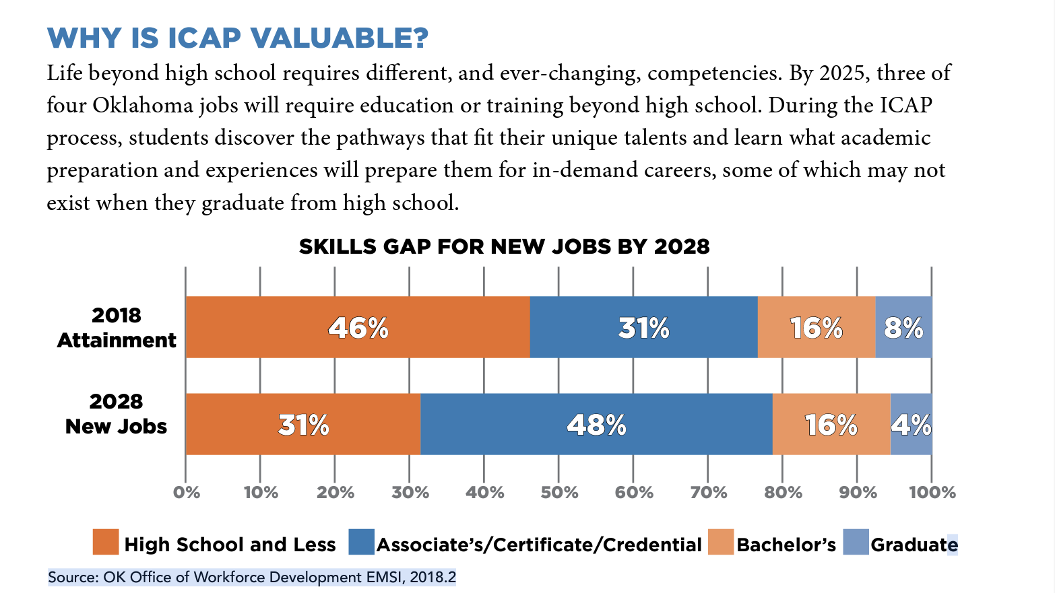
Why is ICAP Valuable?
Notes:
46% of the workforce had a HS diploma or less, but we see that by 2028, only 31% of jobs are attainable with HS or less. That leave 15% of the Workforce that aren’t qualified for the available jobs.
Ex: grocery shopping has changed. Jobs that required HS are now being automated
Jobs/Industries requiring Master’s degrees and higher are leaving OK

Slide 13
Minimum Requirements of ICAP
An ICAP identifies student interests, skills, postsecondary and workforce goals and experiences that lead to a meaningful plan that charts the progress needed to prepare students for college, career and life. It should include:
Career and college interest surveys
Written postsecondary and workforce goals and progress toward those goals
Scores on assessments (required state and federal assessments and a college and career ready assessment)
Experiences in service learning and/or work environments including apprenticeships, internships, mentorships, job shadowing and others
Intentional sequence of courses that reflects progress toward the postsecondary goal (this may include identified career pathways or career endorsements)
Academic progress
Self-Awareness
Exploration
Preparation
Action
Source: https://www.okedge.com/educators/implementing-the-icap/
Notes:
ICAP is career advisement

Slide 14
ICAP
ICAP Activities / Documentation

Slide 15
Career Interest Assessments
Students will complete at least 1 online career assessment every year to explore their career interests, learn career skills and begin connecting their interests to careers.

Slide 16
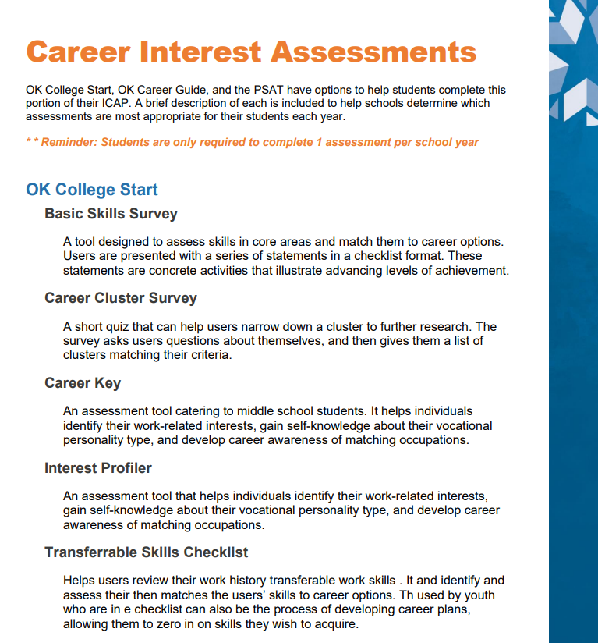
Documenting Interest Assessments
Each online tool provides career and interest assessments.
Students can access their results within their student accounts
Members of the ICAP Team can access this information through the Administrative / Professional Center of their online tool.

Slide 17
Postsecondary Goals
Students will update their career and postsecondary goals every year as they track their progress toward meeting their goals and add new goals as a result of learning about new opportunities.

Slide 18
Documenting Postsecondary Goals
Each online tool provides a space for students to record their written career goals.
Students can access their Goals within their student accounts.
Members of the ICAP Team can access this information through the Administrative / Professional Center of their online tool.
Notes:
Personal preference: Create a NEW Goal every year so it’s easy to see at a glance if the student has completed the annual requirement

Slide 19
College and Career Readiness Assessments
Students will update their required state and federal assessments (English language arts, mathematics and science) and college and career readiness assessment (ACT or SAT) results as they become available.
Notes:
Why students should care about these pieces
Benchmark for College Readiness
Admissions (or ASVAB: placement within the military)
Financial Aid (Kaytie. 3 points on the ACT)

Slide 20
Documenting CCR Assessments
College and Career Assessments refer to required assessments such as the ACT, SAT, and other required assessments by state law 70 O.S. § 1210.508 These are typically entered as students complete them and scores may not be available until a student’s final year.
These scores can be documented through the online tool, or through the school’s Student Information System.
Notes:
ICAP is built from HB 2155 AND HB 3218. That’s why ACT, SAT are part of this conversation.

Slide 21
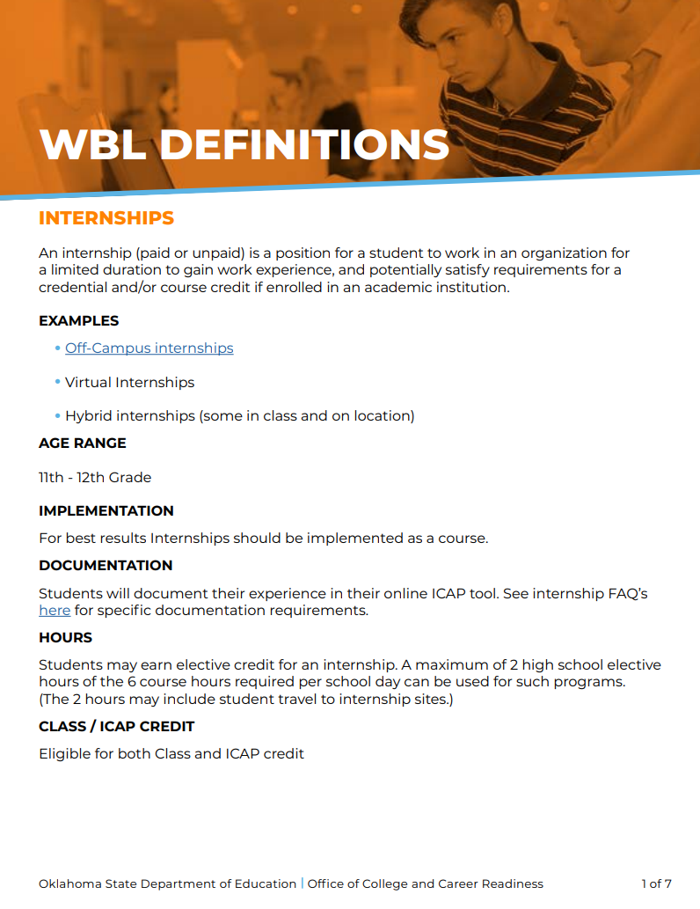
Work – Based / Service Learning (WBL / SL)
Students will complete at least one service learning or work environment activity, before high school graduation.
Notes:
Transition to next slide: One key factor to keep in mind for these experiences is that…. (they MUST be connected to the student’s career interest)

Slide 22
Documenting WBL / SL
This experience must be connected to their career interest.
Each online tool provides a space for students to indicate they have participated in a Service Learning or Work-Based Learning experience.
Reflection is built into OK College Start, while schools using OK Career Guide will need to document that reflection through another means.
Notes:
PT job at a Day Care: early childhood teacher
PT job at Arby’s would only work if the student wanted to go into management or culinary arts Even though they’re learning important skills, the work environment needs to be reflective of their future plans.

Slide 23
Academic Planning / Progress
Students will annually update their academic courses and progress in those courses.
Students will also list any career technology programs, AP or IB courses, concurrent enrollment courses or career endorsements that reflect progress toward their individual career pathways.

Slide 24
Documenting Academic Planning / Progress
Intentional Sequence of Courses
Each online tool provides a space for students to record the courses they intend to take during high school. These courses should align with graduation requirements and the student’s Career and Academic Plans for the future.
Students can access their planned courses within their student accounts.
Members of the ICAP Team can access this information through the Administrative / Professional Center of their online tool.
Most Student Information Systems (SIS) provide a means for tracking this information.
Academic Progress
If the Sequence of Courses is the Plan, Academic Progress is the ongoing process through which students work toward graduation and their future plans.
Most SIS provide a means for tracking this information. Documentation can include updating the Intentional Sequence of Courses, tracking completion of a College & Career Ready Assessment, and recording any earned certifications.
Notes:
Online tool and/or SIS

Slide 25
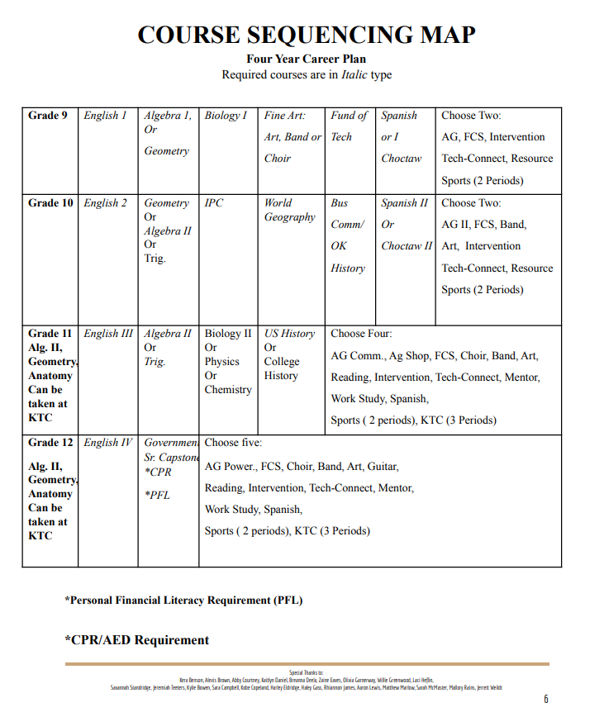
Academic Advisement and ICAP
Taken from Atoka Public Schools Academic Catalog
Notes:
The more integrated into your school climate ICAP becomes, the less students will realize they’re completing ICAP components

Slide 26
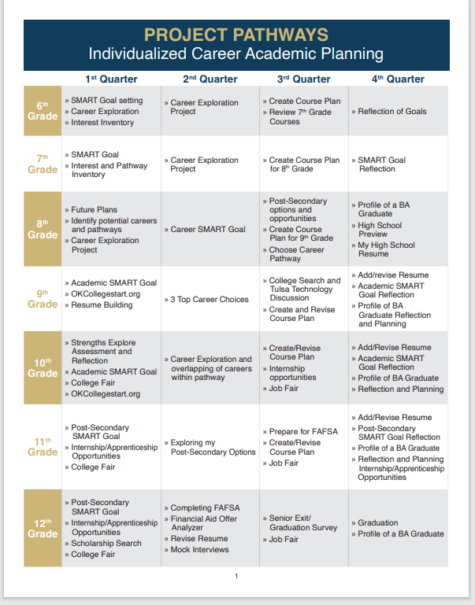
Academic Advisement and ICAP
Pathways and Supports must provide students with opportunities to master common skills while still allowing them to tailor individualized learning programs to pathway-specific goals based on their postsecondary aspirations.
Although student pathways will vary greatly based on postsecondary goals, all students must be provided with the supports necessary to meet similarly rigorous standards. Pathway options must be determined by student aspirations and capabilities rather than prior and existing performance.
Pathways and Supports must be flexible, allowing students to alter programs of study to align with changing postsecondary goals.
Student supports must be strategically targeted and delivered to maximize each learner’s college and career success. These supports should be designed to enable each learner to meet well-defined college and career readiness goals and expectations.
Taken from Broken Arrow Public Schools Academic Catalog
Notes:
Broken Arrow. Created a structured process so each student knows what is expected
Districts can require their own components above what is the minimum for ICAP as part of the graduation process.

Slide 27
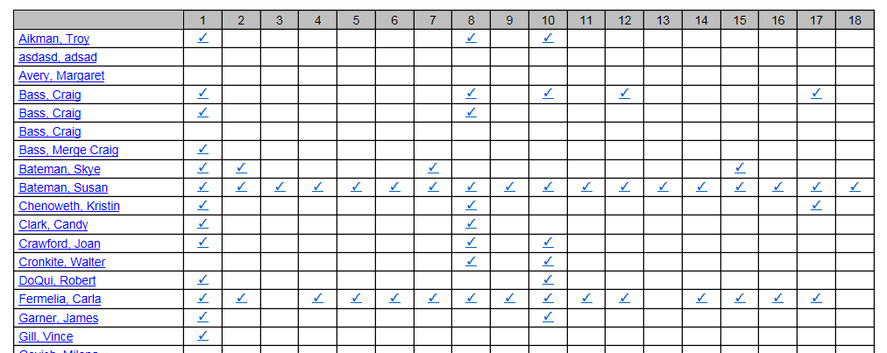
ICAP Progress Monitoring
Columns align with list of assigned activities
Rows show all students who meet report parameters
Checkmark indicates activity has been completed

Slide 28
ICAP Reporting and Documentation
ICAP completion may be monitored by an ICAP coordinator (i.e. a teacher, counselor, principal etc.) via the district online tool. Using their login, the ICAP coordinator should be able to show a Regional Accreditation Officer the progress of each student.
School districts have autonomy in choosing their ICAP online tool, however the most popular tools include OK College Start or OK Career Guide. ICAP reporting can be accomplished through various processes, as long as:
All ICAP activities are documented.
The documentation can be easily accessed by the student, parent, ICAP Team, etc.
Schools using more than one tool for reporting ICAP progress should be advised
that documentation for each student is required, failure to do so may result in an incomplete ICAP.
ICAP RAO Guide

Slide 29
ICAP Online Tools
OK College Start
OK College Start is a free online tool that provides career interest quizzes, career information, growing occupation trends, scholarship and financial aid resources, and information about programs of study in Oklahoma. This is a perfect tool to pair with career curriculum in the classroom, as well as financial aid presentations.
OK Career Guide
The OK Career Guide is a free online tool used to provide students free career interest assessments, information about career expectations, growing trends in occupations, and information on programs of study available in Oklahoma. This interactive tool can be used in the classroom during career lessons and also while at home with parents.

Slide 30
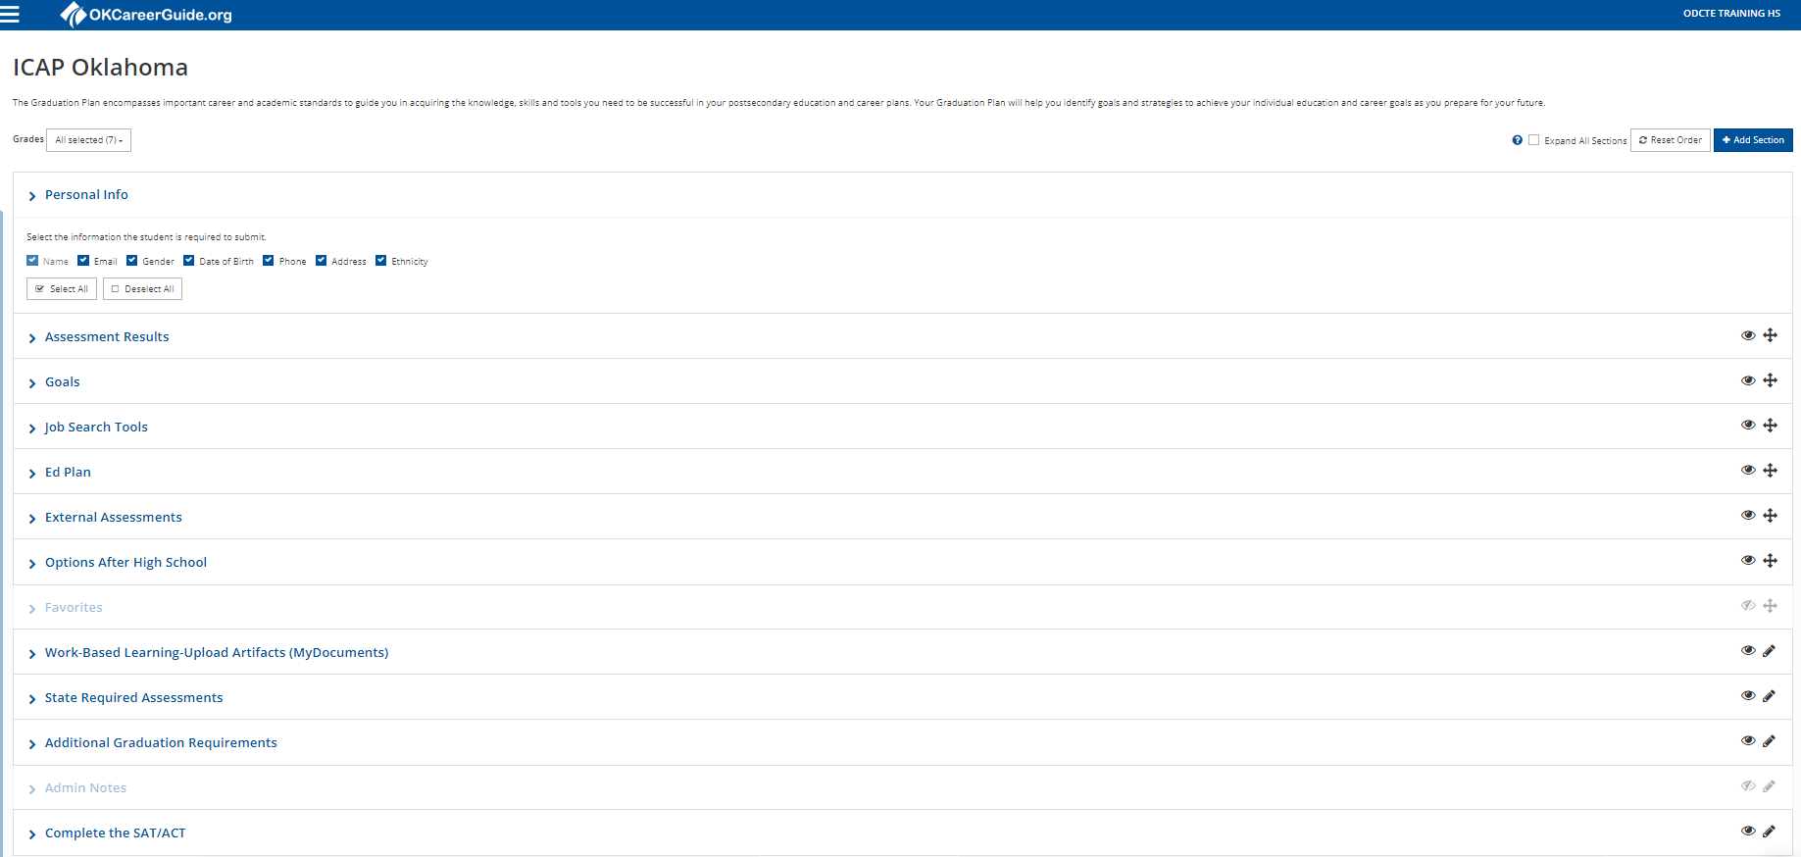
OK Career Guide Customizing ICAP
Notes:
Building your ICAP- you must customize it

Slide 31
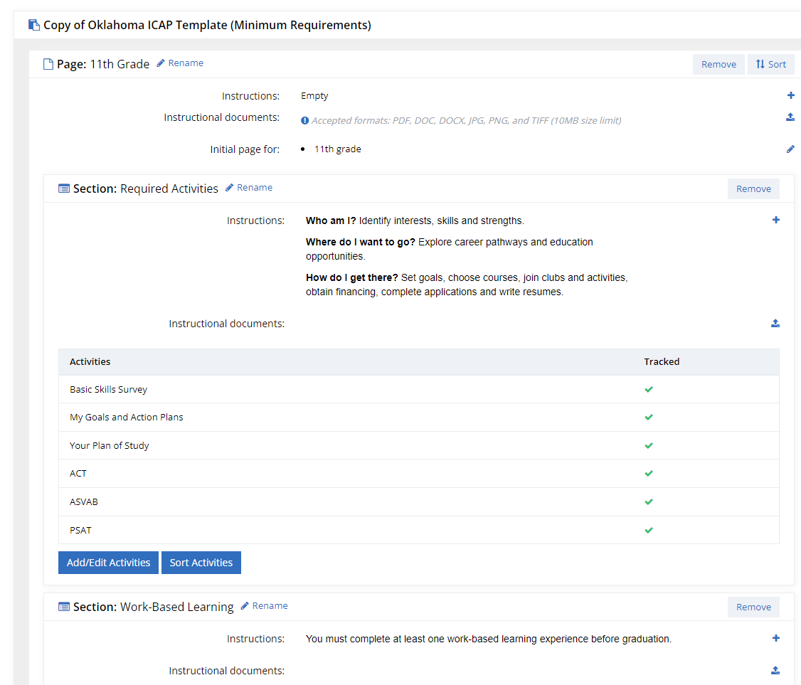
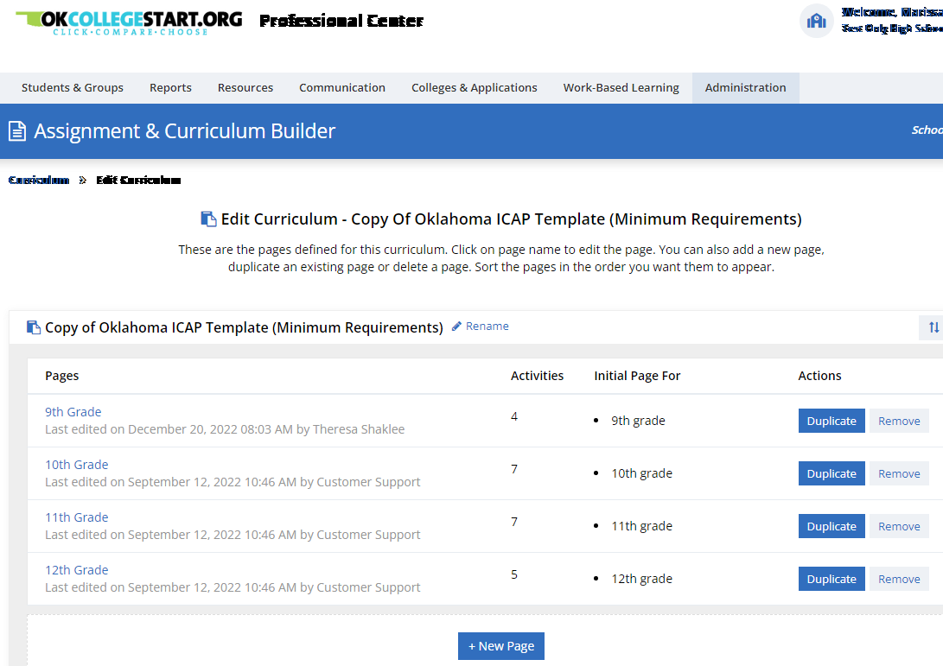
OK College Start Customizing ICAP

Slide 32
ICAP Transcript Statement
Verification that a district is following the required ICAP for its high school students will be an element of the annual accreditation compliance report. Districts should retain all relevant documentation to confirm compliance with the law via ICAP online tools or other methods of district choice.
State on transcript: “The student has satisfactorily met the graduation requirement of completing an Individual Career and Academic Plan (ICAP). (70 O.S. § 1210.508-4)”
Transcript Guidance Overview

Slide 33
ICAP
School – Wide ICAP Implementation
Notes:
I used the tagline “school-wide implementation” here because that’s how ICAP was designed to work.
You’ve almost made it through the first graduating class, likely carrying the weight of ICAP by yourself… so now we’re going to transition into what it could/should look like moving forward…

Slide 34
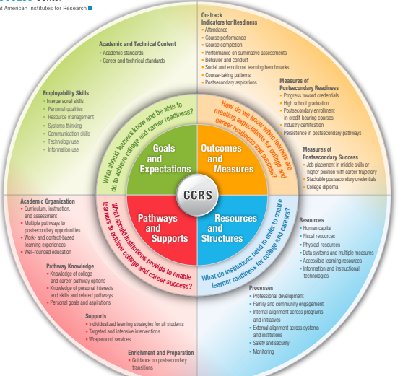
School – wide ICAP Approach
All educators have a stake in ensuring our kids have a successful future.
This work takes educators, family, business and community to come together to support Oklahoma students as they work toward achieving their individual goals and dreams.
Notes:
This can help your school personnel see where they fit in the process so everyone better understands their role
I know a lot of you are doing this work alone, but it was never intended to be that way. The language of House Bill 2155 specifically states that an ICAP means “an individualized plan developed by the student and the student’s parent or legal guardian, in collaboration with their school counselors, school administrators, teachers and other school personnel…”

Slide 35
ICAP Outcomes
When students complete a meaningful ICAP process, they:
Connect the relevance of education to their future goals
Create secondary and postsecondary course plans to pursue their career and life goals
Strategically select a postsecondary pathway to align with self-defined career, college and life goals
Establish better communication and engagement between school and home
Understand and demonstrate career exploration and career planning
Notes:
ICAP Surveys provide us a lot of information to analyze. Based on the responses, we see that a MEANINGFUL ICAP results in…

Slide 36
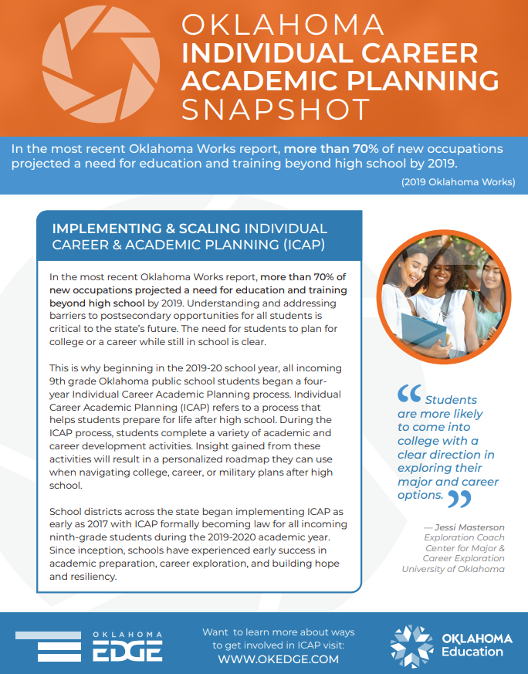
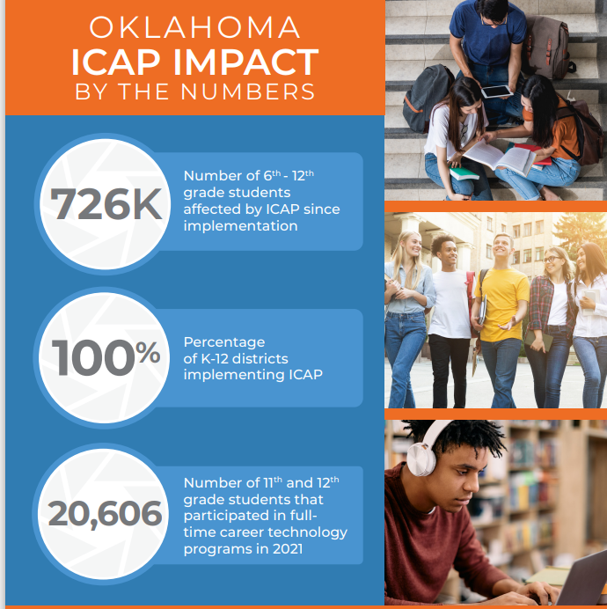
ICAP Outcomes
Notes:
We expect to see the impact and effects increase as our State continues to develop ICAP programs

Slide 37
ICAP
Resources

Slide 38
ICAP Implementation
ICAP Implementation Examples
This resource is perfect for districts who may already offer college and career readiness activities to their students, who desire a framework to expand their activities to meet ICAP requirements.

Slide 39
ICAP Implementation
Individual Career Academic Plan Toolkit
If you are ready to redefine what college and career readiness looks like in your district we recommend using this toolkit to start building your ICAP process from the ground up! View this resource guide designed to provide your team with best practices for creating a meaningful ICAP process for all students.

Slide 40
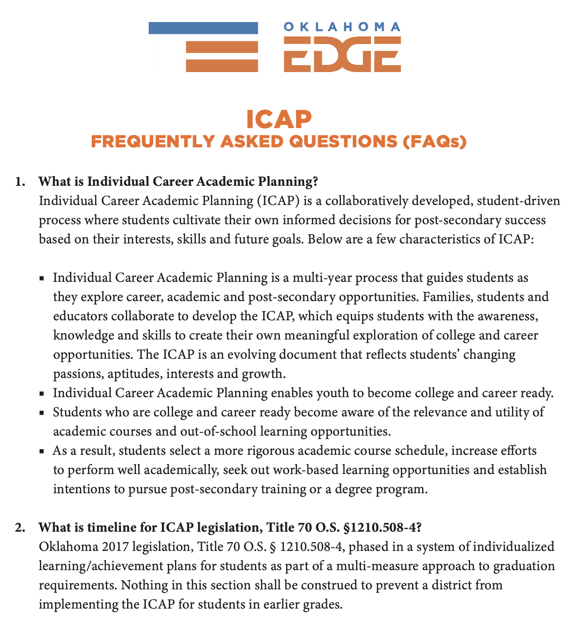
ICAP FAQs & Promo Video
Notes:
Great video to recruit team buy-in with school staff and community partners. Our resources are updated based on your survey responses.

Slide 41
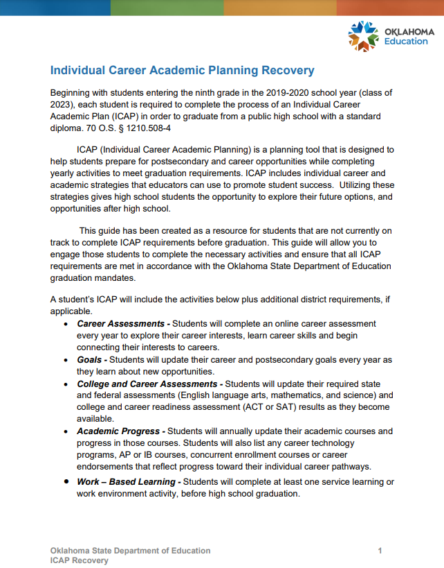
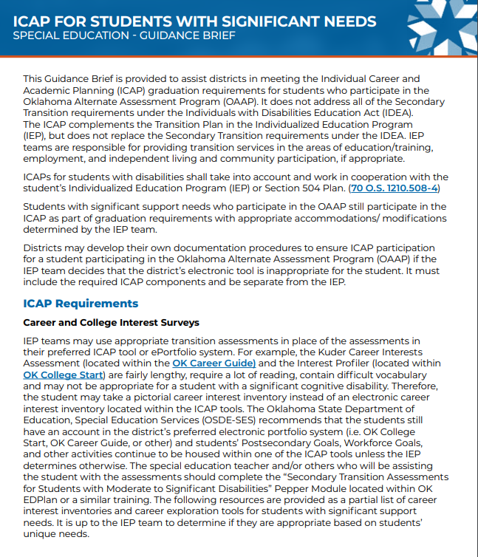
Specialty Guides
ICAP Recovery Guide
ICAP for Students with Significant Needs

Slide 42
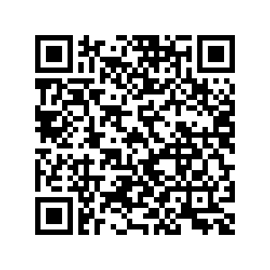
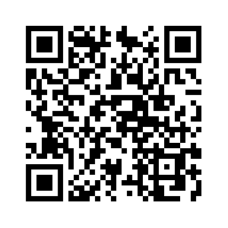
Upcoming webinars
ICAP & OK College Start Q&A with OSDE
Thurs, March 23rd
10 am
SIS ICAP Reporting
Wed, March 29th
9 am
Notes:
Executive Director of Data & Information Services at OSDE.
She is working with the SIS vendors in the state to assess capabilities for using your Student Information System to Track ICAP activities.

Slide 43
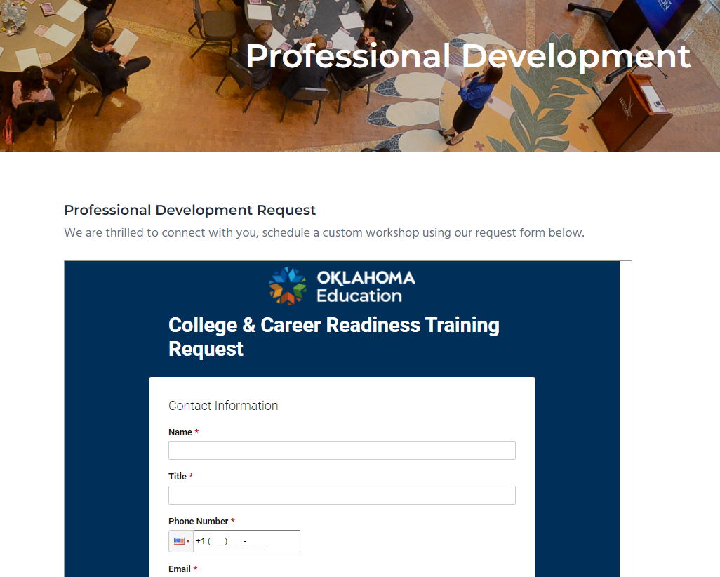
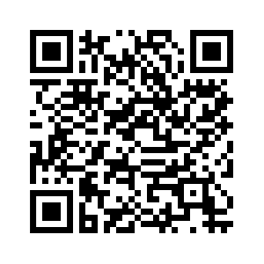
Request free CCR PD
Schedule a custom workshop using our request form, available by clicking on the image to the left, or scanning the QR Code below.
Recorded webinars
2021 Recorded webinars
2019 Recorded Webinars
2018 Recorded Webinars

Slide 44
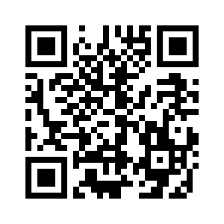
OSDE Connect
Join our new online learning community created specifically for ICAP!
https://osdeconnect.instructure.com/enroll/JNXJ8W

Slide 45
ICAP Resources
OK Edge website
Follow us on Facebook
Request College & Career Readiness Training
ICAP Toolkit
Sign up for the ICAP Newsletter
select “College & Career Readiness”
ICAP Assessment Guide
ICAP Documentation Guide
Enroll in the ICAP course on OSDE Connect

Slide 46
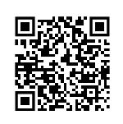
Question Cards
Jennifer Peters, M.S.
College and Career Readiness Specialist
jennifer.peters @sde.ok.gov
O: (405) 522-9998
C: (405)416-3656
Let’s Connect!

