Slide 1
Health Science Professions
Easy Ways to Involve Students in Exploration
March 10, 2026

Slide 2
Student Involvement Works
Partnership with OHA: Virtual Health Career Day
Governor’s Council on Healthcare Workforce: Health Science Program, College and Career Fair
Apprenticeships
HOSA-Future Health Professionals
Local Workforce Job-Shadowing
Tech Center Involvement: Teddy Bear Clinic, Mass Casualty Event,

Slide 3

Partnership with Oklahoma Hospital Assn: Virtual Health Career Day
Middle, High School or Post-Secondary Adults
10 Careers at 10 Partner Hospitals; Featured in 5-10 min. video
Followed by live Q & A sessions.
Last year’s Recordings: Explore Healthcare: Oklahoma Virtual Career Expo – YouTube
Features Curriculum for Each Career as Pre-or Post-Session Work: Explore Healthcare Oklahoma Virtual Career Expo - Classroom Resources.pdf

Slide 4
Health Occupations Featured
Radiologic Technologist—Fairfax
Respiratory Therapists—Ascension St. John, Tulsa
Occupational and Physical Therapist/Assistant and Speech Pathologist—St. Mary’s Enid
EMS Paramedic and EMT—Beaver County Memorial Hospital
Pharmacist and Pharm Tech- INTEGRIS Health, OKC

Slide 5
Health Occupations Featured
Pediatric Nursing and Direct Care Specialist—JD McCarty Center for Children, Norman OK
Surgical Technologist and OR Nurse—St. Francis Hospital, Tulsa
Cardiac Catheterization Lab—Nursing and Imaging—Hillcrest Medical, Tulsa
Nursing Scholarship Program—SSM Health/St. Anthony OKC
Also featured on YouTube Channel is the Entire Expo, lasting four hours and five minutes!
Classroom Activities: Explore Healthcare Oklahoma Virtual Career Expo - Classroom Resources.pdf

Slide 6
Governor’s Council on Healthcare Workforce Health Science Program, College and Career Fair
2025-2026 Featured OKC and Tulsa Area Fairs
Available to Middle School, High School and Post-Secondary/Adults
Career Tech Program Areas, College and University Programs/Majors, and Healthcare Employers including Hospitals, Staffing Companies and Tribal Entities
Featured State Organizations like Healthcare Workforce Training Commission, Office of Rural Health, Oklahoma Center for Nursing and HOSA-Future Health Professionals

Slide 7
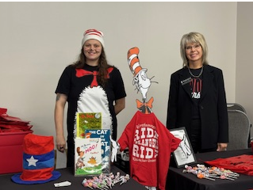
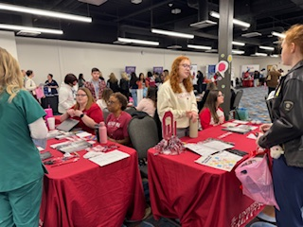
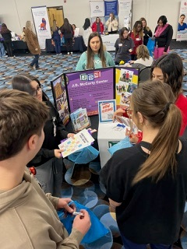
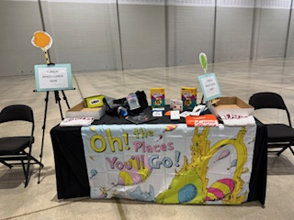
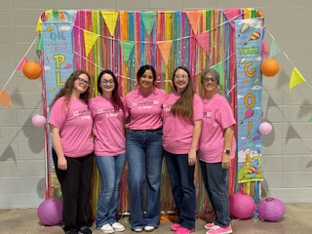
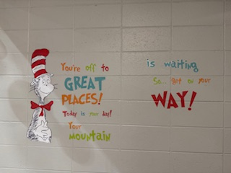
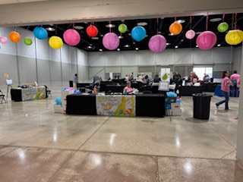
Health Science Career Fair

Slide 8
Youth Apprenticeships
Started with SSM Health (St. Anthony’s and Multiple other facilities in OKC area)
Sr. in high school—must have completed Long Term Care Nurse Aide in Junior year of CareerTech experience.
Apply and Interview for posted positions of Youth Apprenticeships after confirmed Sr. year enrollment in AUA, Phlebotomy or Medical Assisting.
Selected students are part time employees of SSM and have access to pick up additional shifts, qualify for scholarships like all employees.

Slide 9
HOSA: Future Health Professionals
50th year of HOSA Chartered Organization in Oklahoma
Available for middle school, high school, and post-secondary/collegiate students with different events for each level.
CareerTech Student Organization—Can have a chapter without having a funded program. Should take the place of any “medical” or “healthcare” club for students
Offers opportunities for Leadership, Professional Development, Social Activities, Community Service and Competitive Events
This is the “WHY” the classroom curriculum matters

Slide 10
HOSA: Future Health Professionals
Major Activities:
Fall Leadership Conference (MS and HS) and PEAK (PS)
Day with the Thunder
Health Science Day at the Capitol
State Leadership Conference
Camp IGNITE (High School Students)
International HOSA Conference

Slide 11
HOSA: Future Health Professionals
Requirements for a chapter:
  An Advisor and Five Paid HOSA Members
  Costs $25/affiliated member
Chapter Advisor Resource Guide Available
Can use Competitive Event Guidelines for Classroom projects
Over 300,000 International Members
Current OK Affiliation Count—9512!

Slide 12
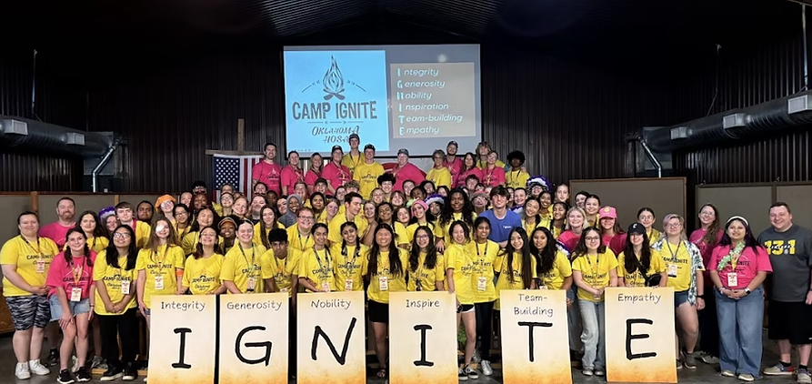
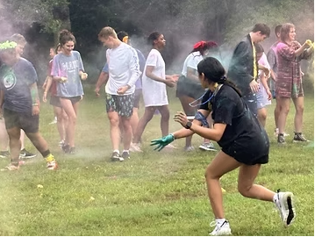

Camp Ignite Video
For Information, contact Amy Warner: amy.warner@careertech.ok.gov
What Is
HOSA?

Slide 13
Local Workforce Job-Shadowing
Identify healthcare resources within community or Tech Center district
Communicate with healthcare personnel; Could start with Chamber of Commerce meeting; Visiting with hospital CEO/marketing/workforce coordinator
Prepare students by having them take safety and HIPAA course and get suggested background knowledge
Use a resource like Work-based Learning Guide 4.0 from National Consortium for Health Science Education: Work Based Learning - National Consortium for Health Science Education

Slide 14
Local Workforce Job-Shadowing
National Consortium for Health Science Education
Forms—consent, emergency contact, health questionnaire, student confidentiality, requirements checklist, affiliation agreement, staff and student evaluations of rotation
Rotations include HR, ICU, LTC, Plant Operations, Outpatient Surgery, Nutrition, Pharmaceutical Services, Non-Invasive Cardiology, RT, Rehab, Post-Op, Bone Marrow Transplant, Central Supply, Clinical Lab, Dental, Veterinary, Volunteer, Diagnostic Imaging, ER, Electroneurodiagnostics, Environmental Services, and more.

Slide 15
Tech Center Program Outreach
Teddy Bear Clinic
Mass Casualty Event
Scratch and Patch Hospital
Summer Camps for Youth
Tours/Shadowing Program Areas
TAP

Slide 16
Virtual Resources
Print and review the Healthcare and Human Services Sub-Clusters Chart
Students can visit The Career Project site. The Career Project site offers a free personality test, explains some of the most famous options and offers a free career matching test.
Review the Hidden Careers in Healthcare Handbook for additional information and resources.
Review When I Grow Up: Career Lessons and Activities for 9-12 to find various career exploration activities.
Watch Igniting the Spark in Career Exploration, a webinar from the National Consortium for Health Science Education.

Slide 17
Questions?
Call or Email Lara Morris at
405.743.5106
Lara.morris@careertech.ok.gov

