Slide 1



CURRICULUM
Kindergarten
and
4th Grade
Notes:
Take participants to ctyou.org live
Will send instructions to get to ctyou
Talk about everything on page and let them know we will look at everything and discuss its possible use.

Slide 2


Pre Lesson-Materials. 11X17 Poster
Notes:
K What Do People Do at Work Poster.pdf
Pre lesson materials
Show What is work Poster 11x17

Slide 3







Pre Lesson-Materials. PowerPoint
Notes:
K What Do People Do at Work.pptx
Show What is work PowerPoint that goes with the poster

Slide 4

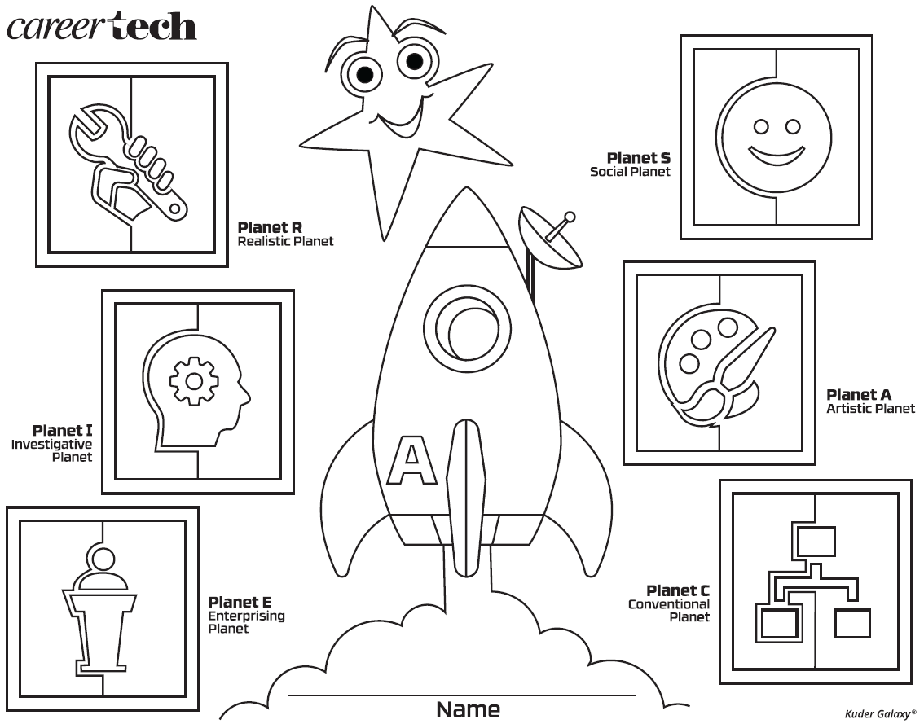
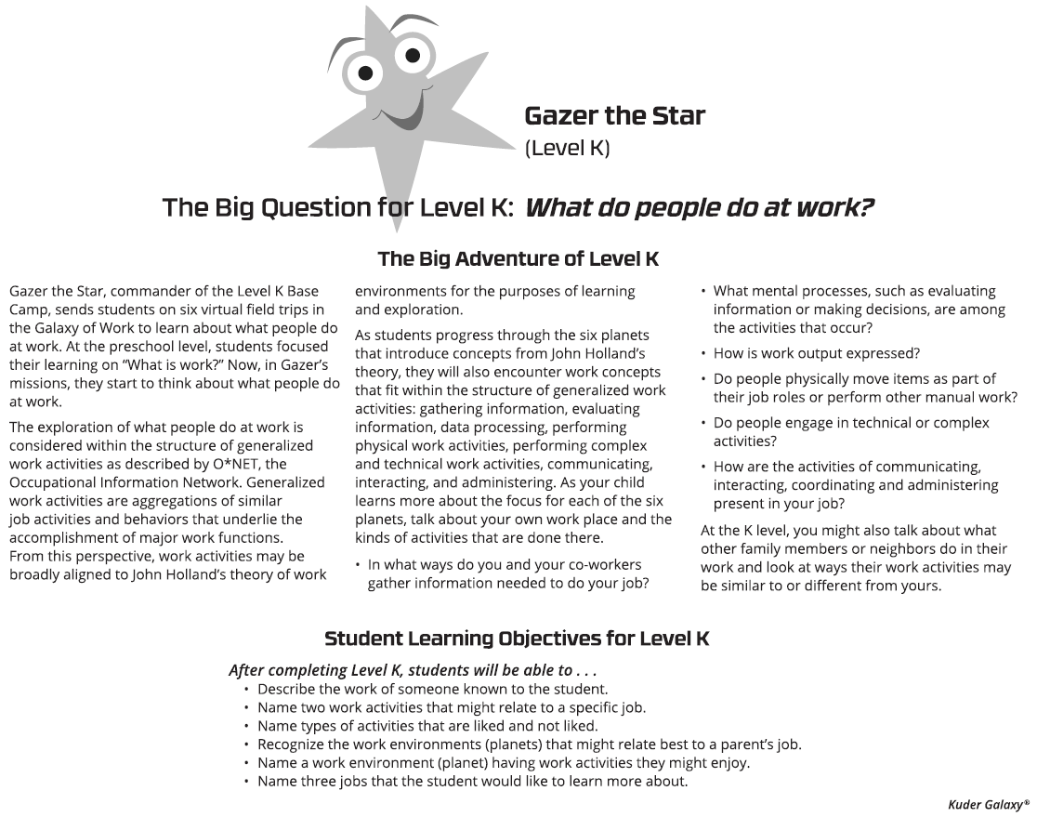
Pre Lesson-Materials. Optional worksheet
Notes:
Kindergarten Start or End Worksheet.pdf
Show the start or end worksheet talk about how it can be used at the beginning or at the end of all lessons or not at all. Talk about info on the back.

Slide 5

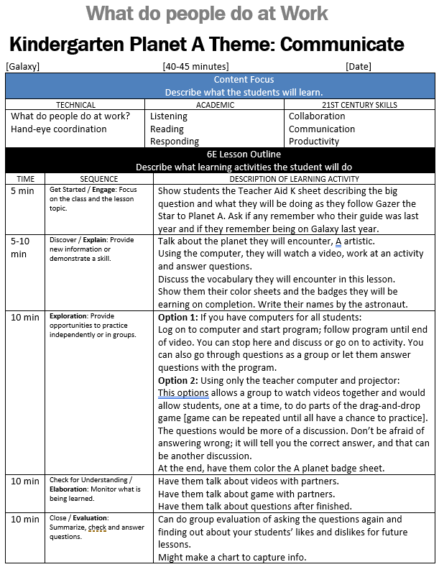
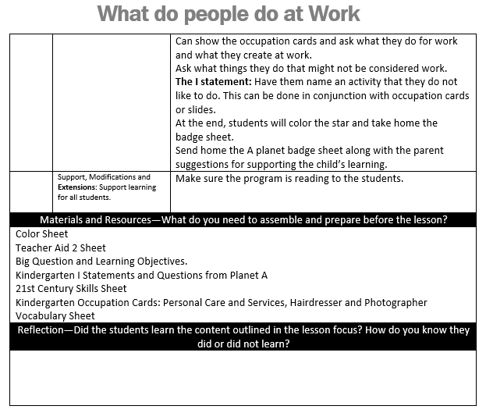
Lesson Plans
Notes:
Show 5 E lesson plans and format
It is in word format so they can be easily adjusted to meet personal teaching style.
There are 2 options to follow. One if all students have a computer, one if the teacher has the only computer with a projector or whiteboard.

Slide 6




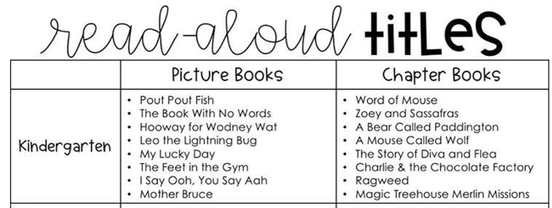
Reading List Found with Lessons Plans
Notes:
Show the K -5th grade reading list
Talk about how the picture books are also listed on back of the worksheets

Slide 7

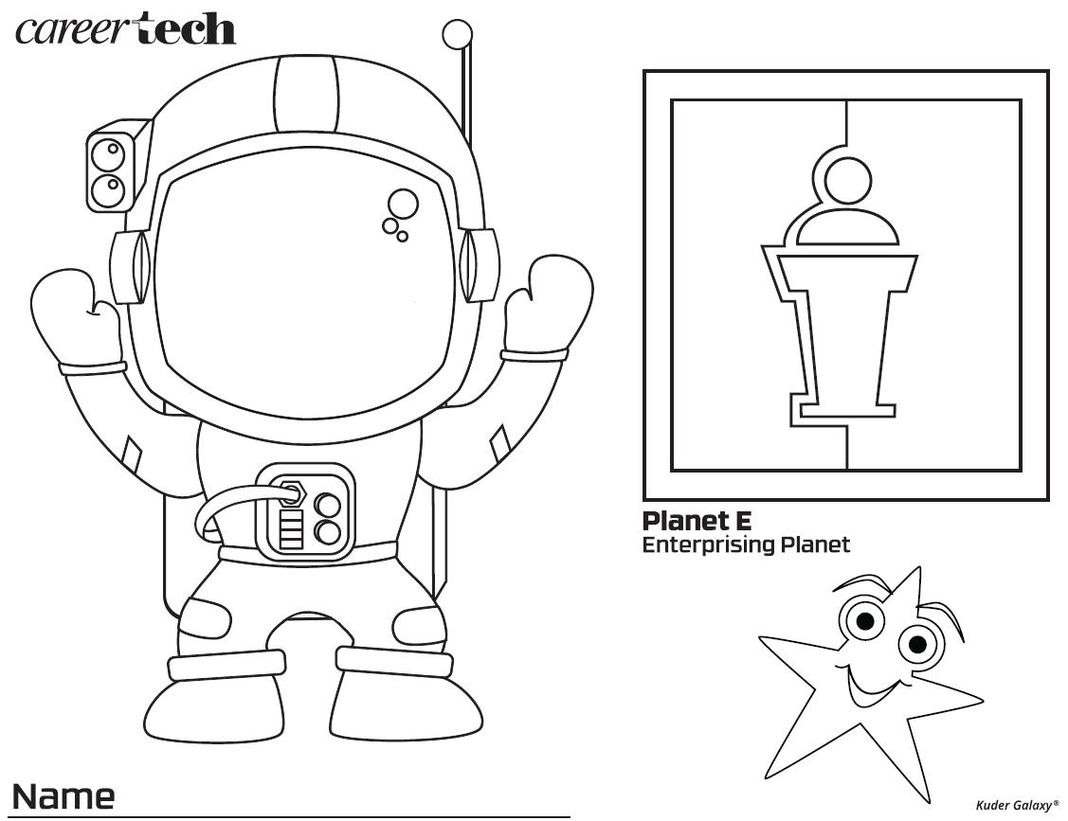
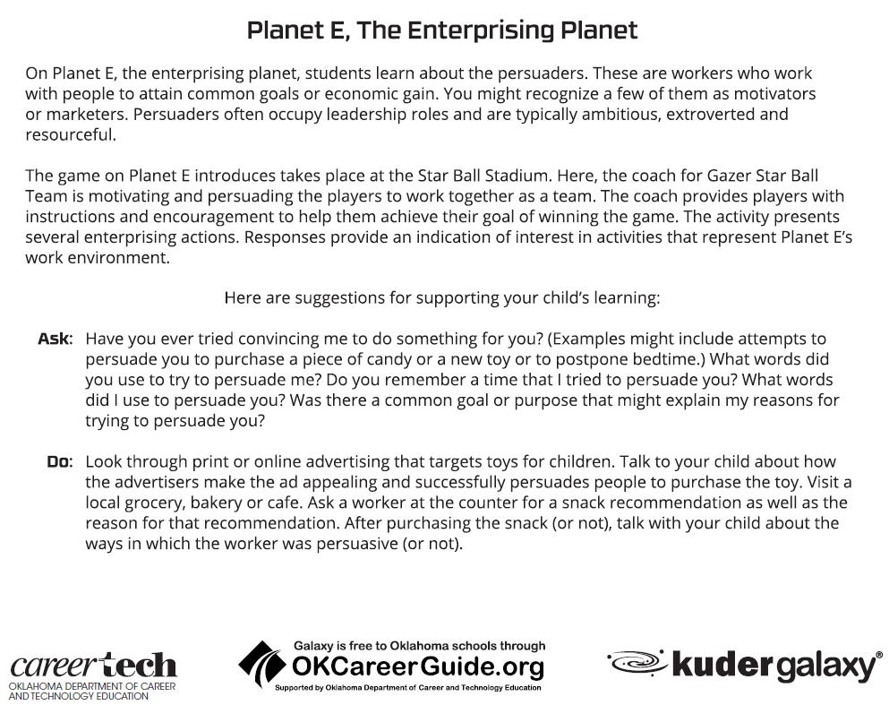
Kindergarten Planet Badge Worksheets
Notes:
Kindergarten Badge Worksheets.pdf
Show K Planet badge worksheets
Talk about the front and the back of worksheet

Slide 8

Occupations Cards
Notes:
Kindergarten occupation cards to print.pdf
PK Occupation cards
Can be used with a small group or small class.

Slide 9
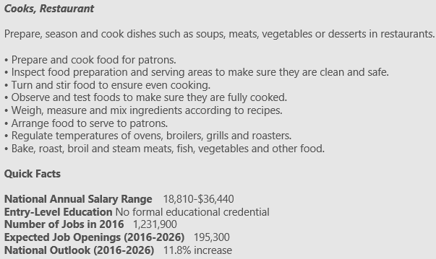

Occupations PowerPoint
Notes:
Kindergarten occupations.pptx
Show K Occupation card PowerPoint
Talk about how this can be used with the lesson as a group activity

Slide 10



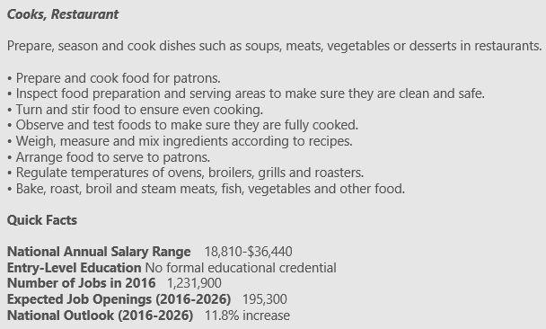
Combined PowerPoint option
Notes:
K lesson plan occupations and planet info.pptx
Show K Lesson Plan Occupation and planet info Power Point
This is a combination of both PowerPoints that allow you to use the pre-lesson material as part of the total group lesson.

Slide 11
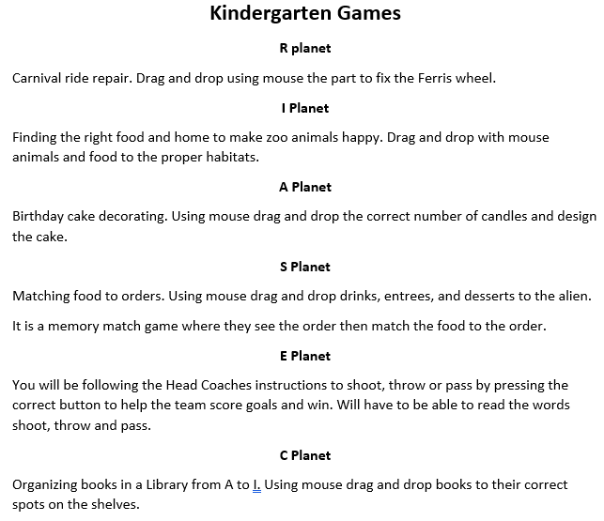
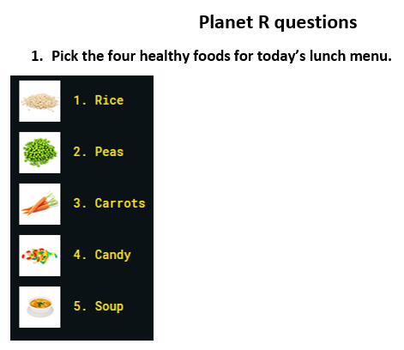
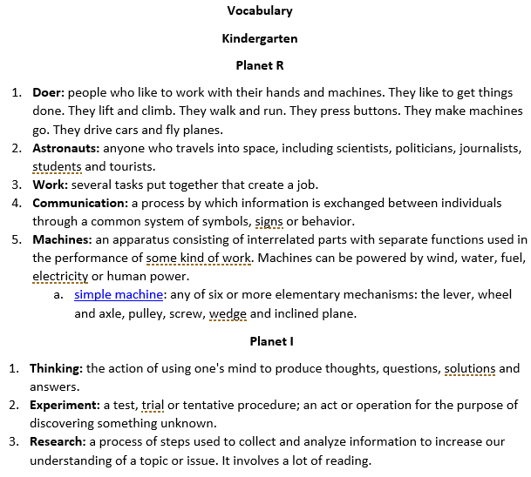
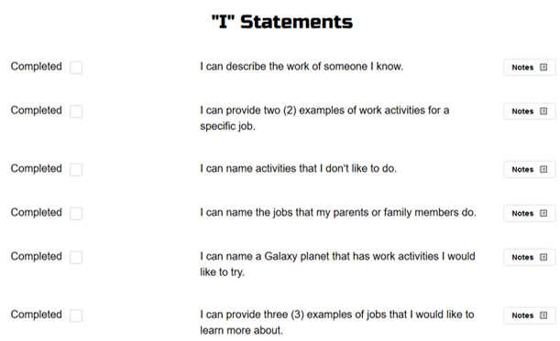
Additional support for Lesson Plan
Game info
Questions and
“I” Statements
Vocabulary
Notes:
K Vocabulary.docx
Kindergarten Games.docx
K Questions and I statements for K.docx
Show support info Vocabulary, Games, questions, and I statement.
Show how these are there to help support the lesson for the teacher and better facilitate the lesson.

Slide 12
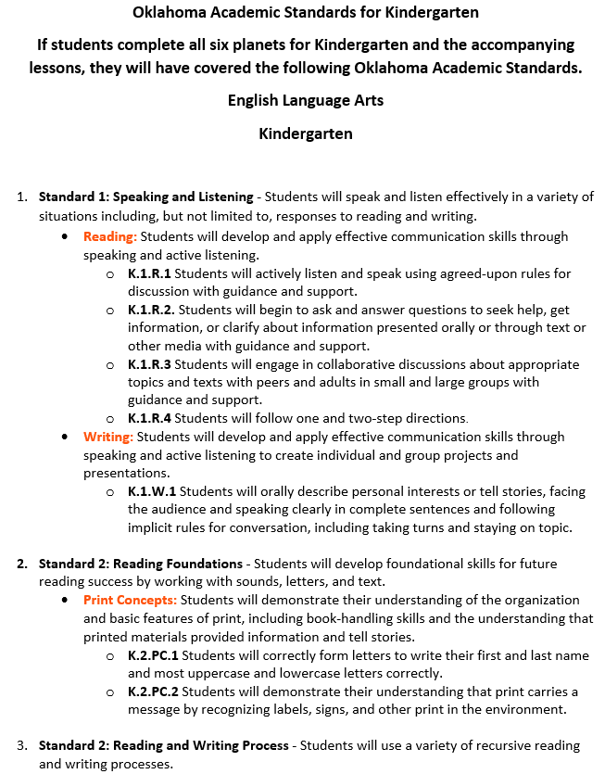
Additional support for Lesson Plan
Oklahoma Academic Standards for Kindergarten
Notes:
Oklahoma Academic Standards for Kindergarten.docx
Show Oklahoma Academic Standards for K
Talk about if students have done all 6 planets and the lesson material then they will have covered these standards for PK

Slide 13

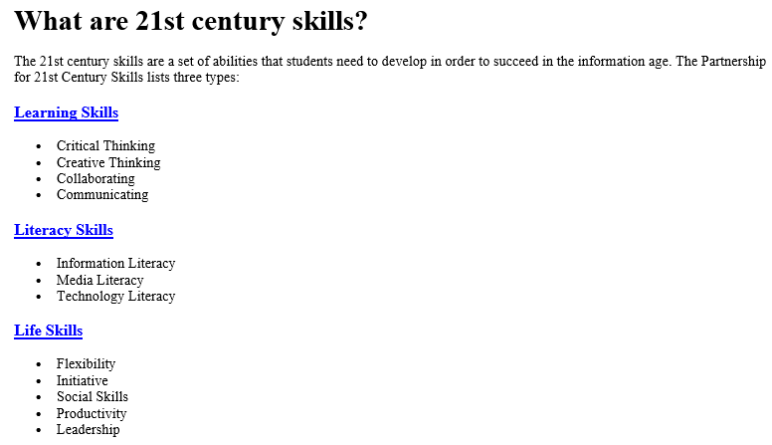
Additional support for Lesson Plan
Notes:
What are 21st century skills.docx
Kindergarten Mission Patches.pdf
Show 21st Century skills
Skills needed for an information world. Info that also goes along with standards. The hotlinks will take you to more information and short videos
Show K Mission Patches
Talk about printing on sticker paper and giving out after finishing all 6 planets also about using a button cutter to quick cut out in circles.

Slide 14
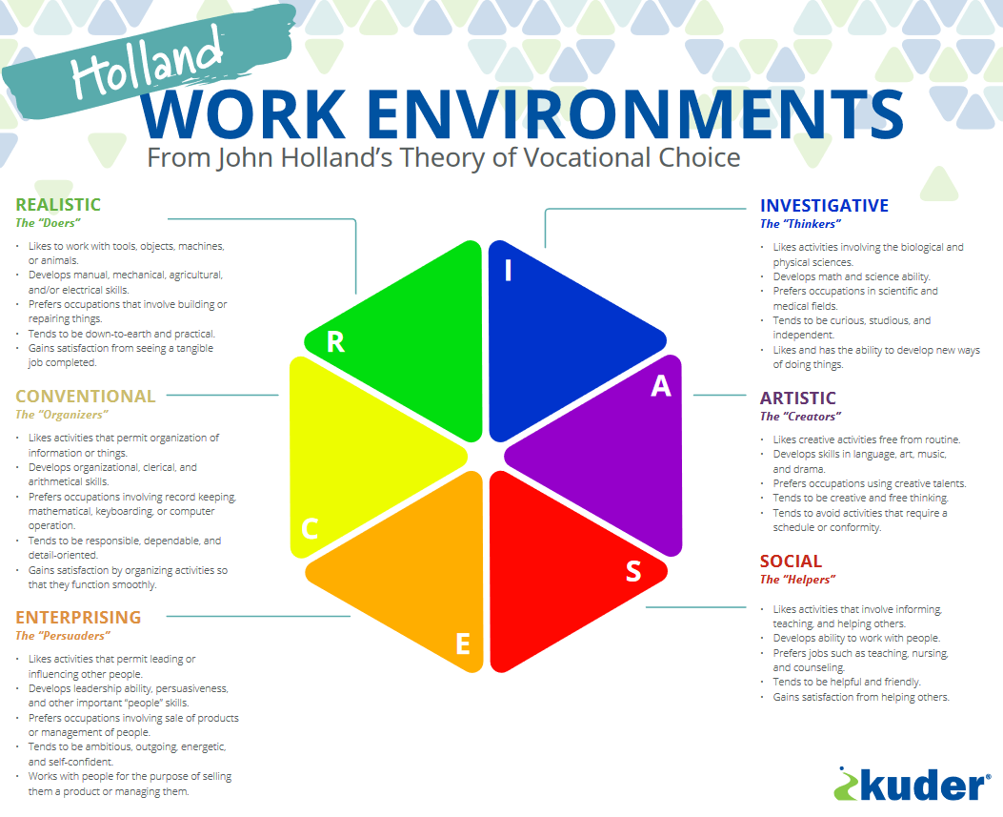
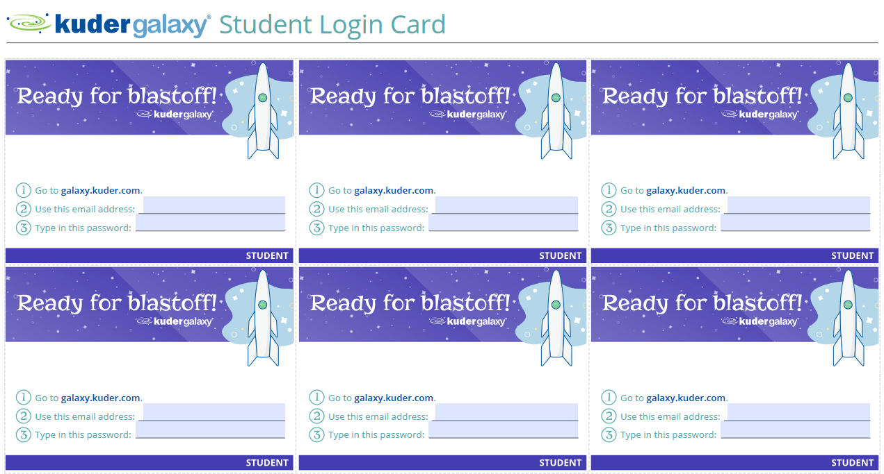
Additional support for Lesson Plan
Notes:
Galaxy Student Login Card.pdf
RIASEC (Holland) Poster.pdf
Show additional support with Student login Cards / option of using clever
Show additional support material the Holland poster
Can request an 18x24 poster mailed out
Not available to students at this level at the end of exploring planets

Slide 15
Questions thus far ????????????????????????????
Notes:
Go live and show
The button it is all yours to use or not.

Slide 16
4th Grade
Notes:
Go back to ctyou.org / Galaxy home page.
Show how to use the breadcrumb trail to move about the page.
Then go to the 5th grade folder
Make sure to open all the sub folders

Slide 17


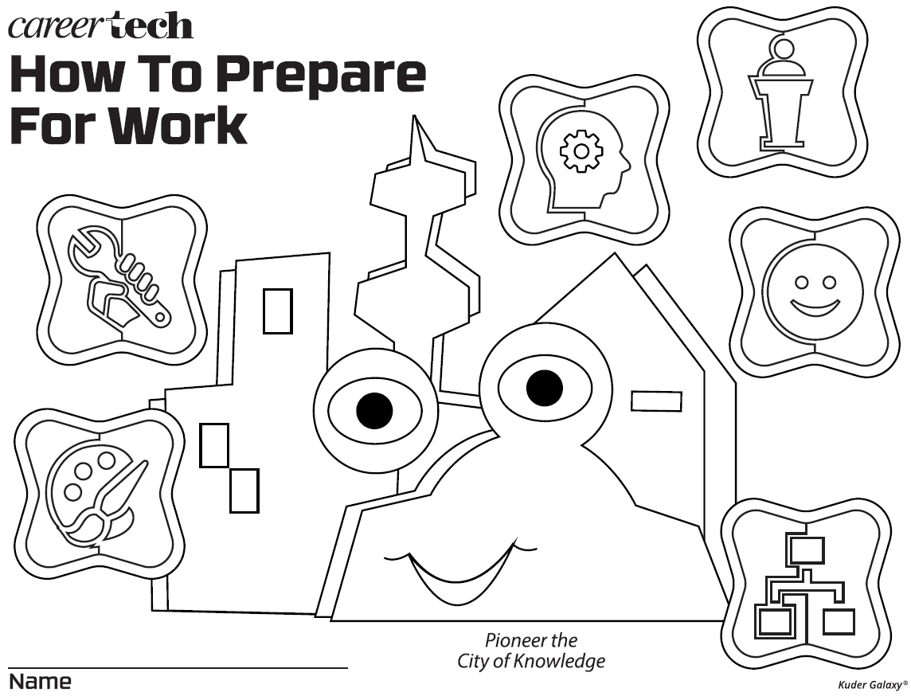

Pre Lesson-Materials. 11X17 Poster, PP, WS
Notes:
4th How to Prepare for Work Poster.pdf
How to Prepare for Work.pptx
4th Start or End Worksheet.pdf
Pre lesson materials
Show How To Learn About Occupations Poster 11x17
Show How To Learn About Occupations PowerPoint that goes with the poster
Show the start or end worksheet talk about how it can be used at the beginning or at the end of all lessons or not at all. Talk about info on the back. This can also be used at a parent info night to show used with students.

Slide 18
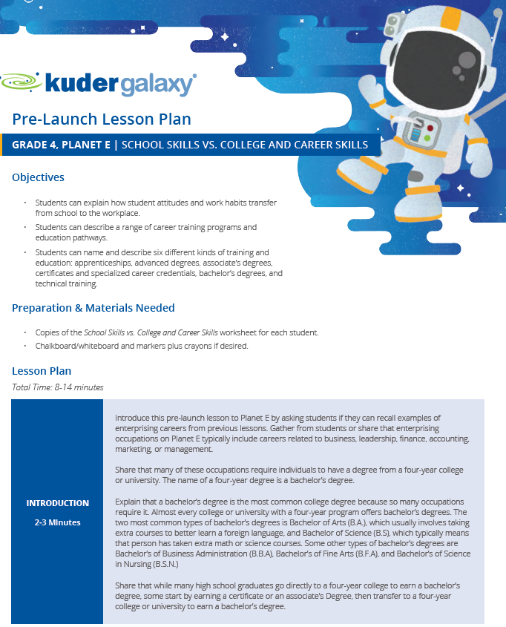
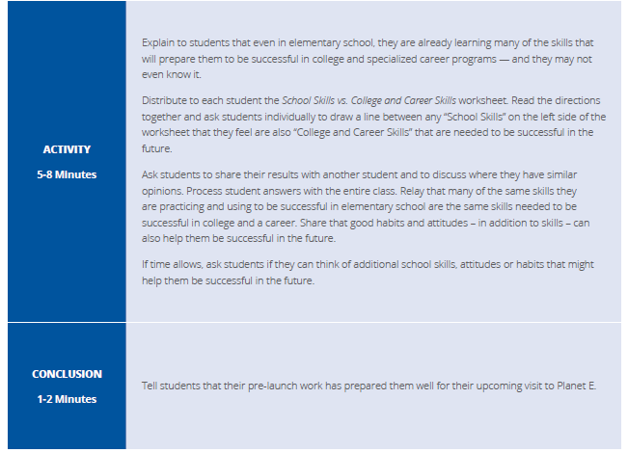
Pre-Launch Lesson Plans
Notes:
Grade 4_Planet E_Pre Launch.pdf
Pre-Launch Lesson Plans
At this level each planet has a Pre-Launch lesson. They are classroom lessons that get them ready to understand what they will encounter on each planet. These lessons are 12- 20 minutes in length depending on the size of the class and teacher.

Slide 19
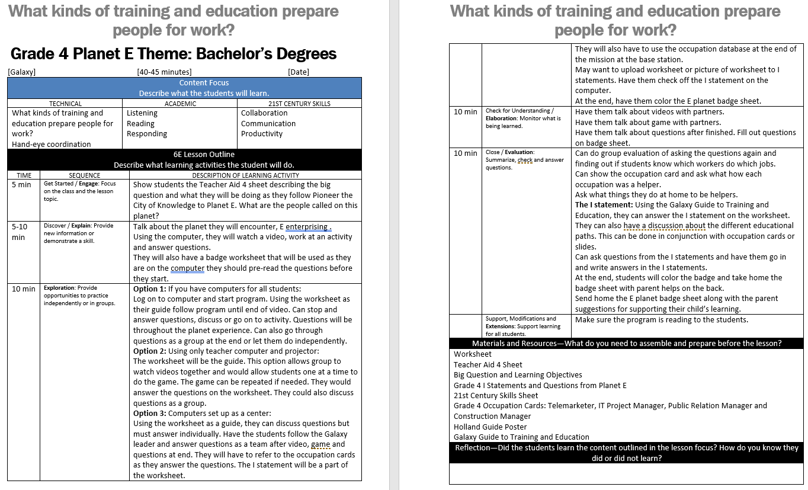
Planet Lesson Plans
Notes:
Grade 4 planet E Lesson Plan Template.docx
Planet lesson plans
Show 6E lesson plans and format
It is in word format so they can be easily adjusted to meet personal teaching style.
There are 3 options to follow. The additional option at this age it to use Galaxy as a center.

Slide 20


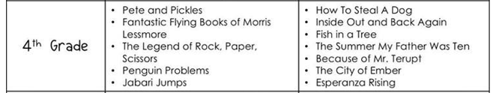
Reading List Found with Lessons Plans
Notes:
Pre-K-5 Books.docx
Reading list support materials
Same list as before but a larger section for 4th grade and beyond. There are several titles that could be added to a reading center in the room.

Slide 21
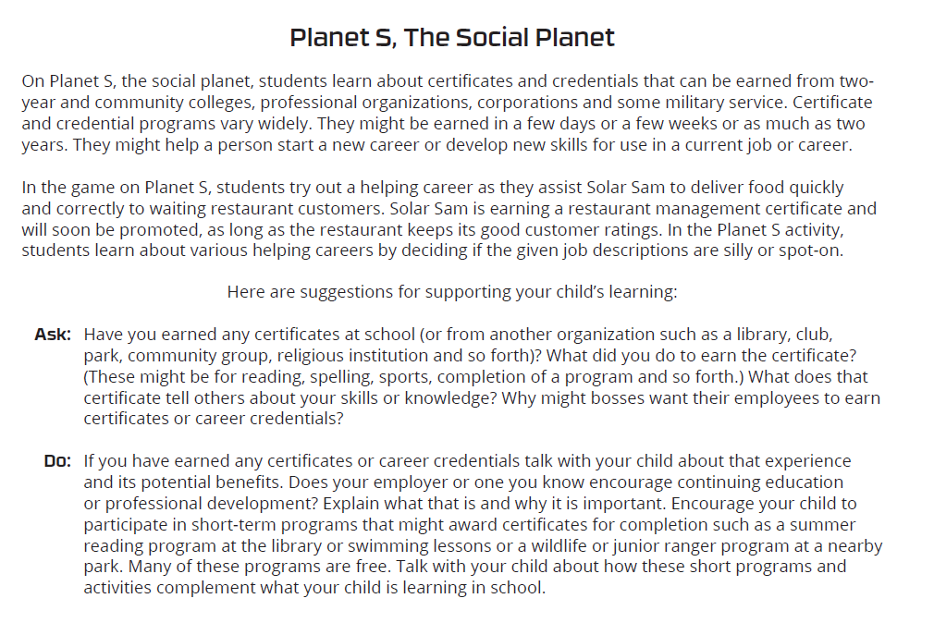
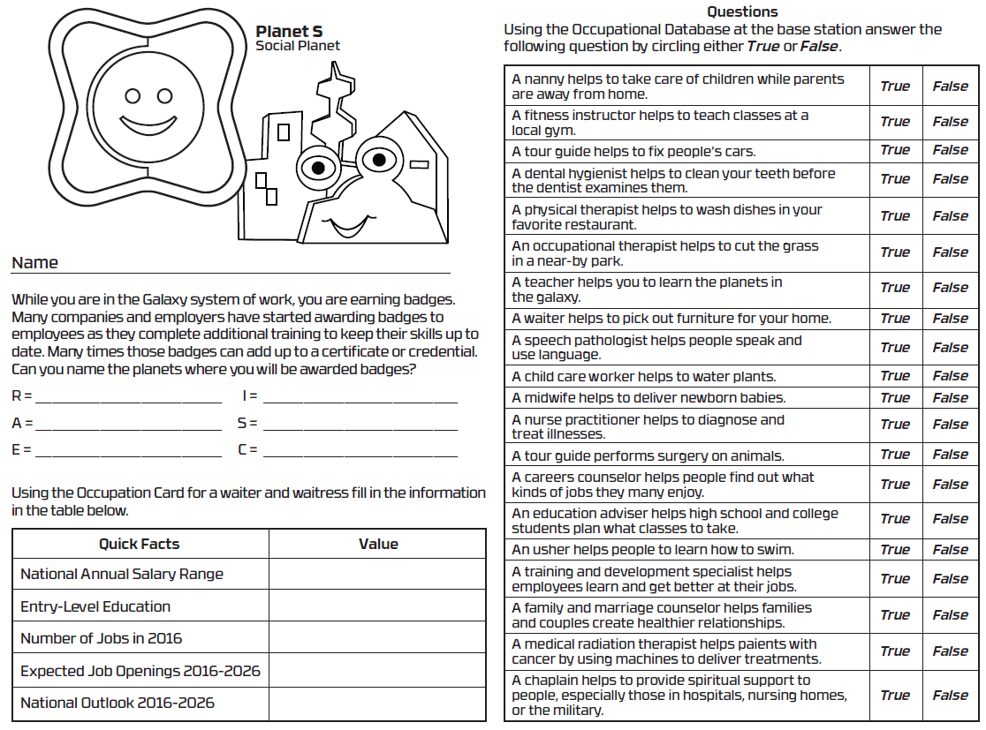
4th grade Planet badge worksheets
Notes:
4th Planet Badge Worksheet.pdf
Show 4th grade Planet badge worksheets
Talk about the front and the back of worksheet and that the worksheets go along with each planet online.

Slide 22

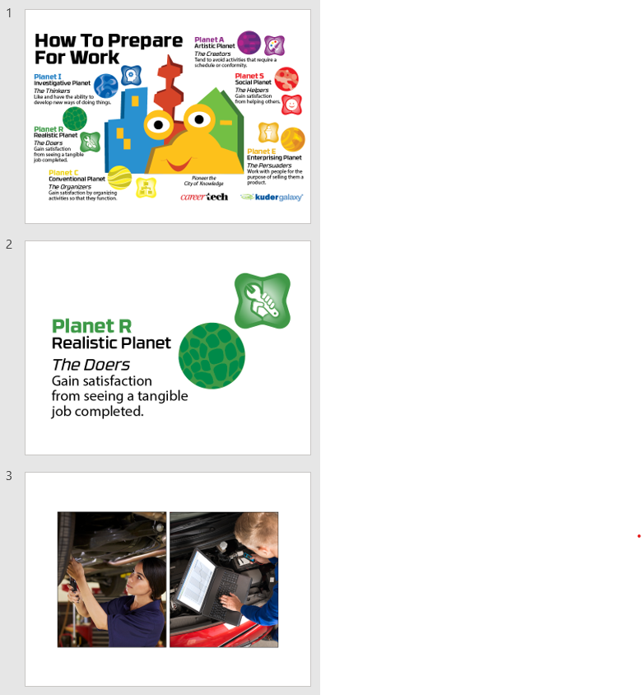
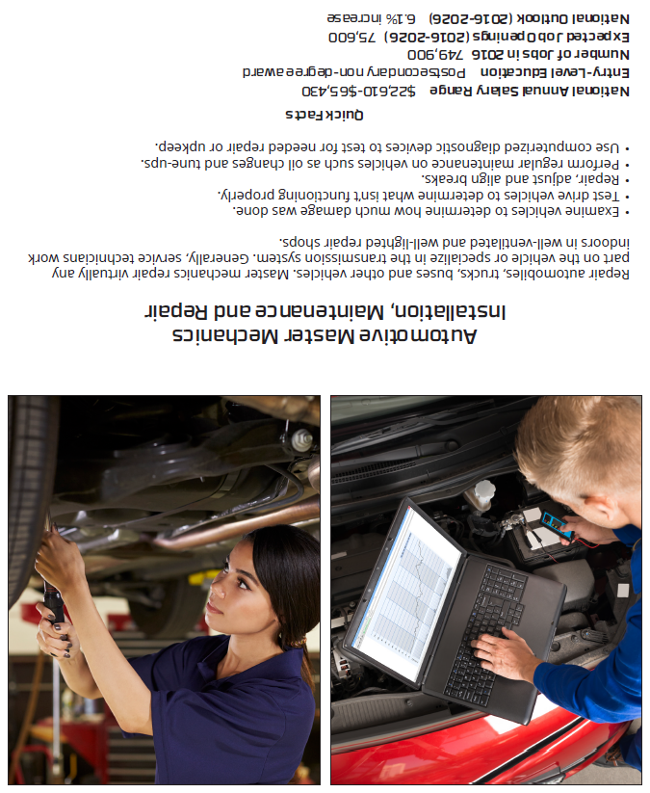
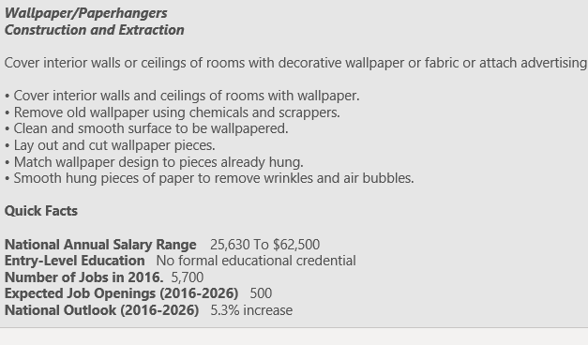
Support for Lesson Plan
Occupation Cards
Occupation
PowerPoint
Combined PowerPoint
Notes:
4th Grade occupation cards to print.pdf
4th Grade occupations.pptx
Grade 4 Lesson plan Occupations and planet info.pptx
4th grade Occupation cards to print
Can be used with a small group or small class. At this level they work best with centers and the worksheet.
4th grade Occupation card PowerPoint
Talk about how this can be used with the lesson as a group activity and can be used with the pre and post launch lessons.
4th Lesson Plan Occupation and planet info Power Point
This is a combination of both PowerPoints that allow you to use the pre-lesson material as part of the total group lesson or just an option before or after each planet.

Slide 23
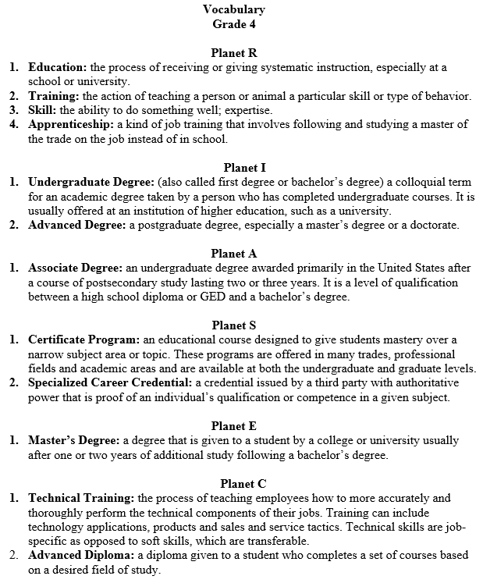
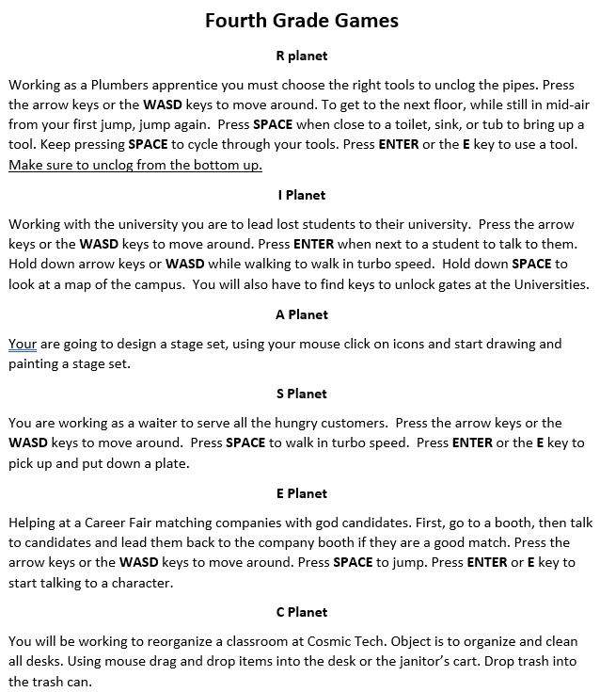
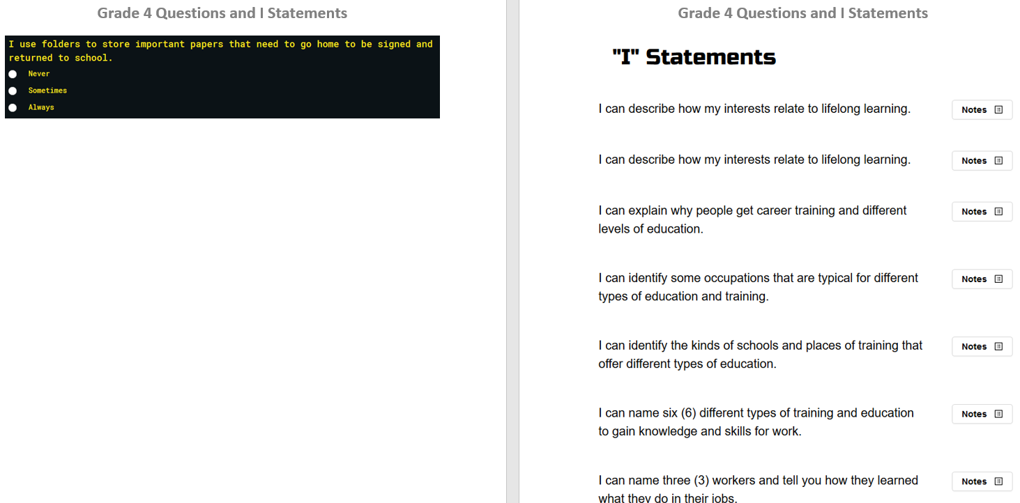
Additional support for Lesson Plan
Questions and “I” Statements
Vocabulary
Game
Information
Notes:
Grade 4 Vocabulary.docx
Grade 4 Vocabulary.docx
Grade 4 Questions and I statements.docx
Additional support info Vocabulary, Games, questions, and I statement.
Show how these are there to help support the lesson for the teacher and better facilitate the lesson.

Slide 24
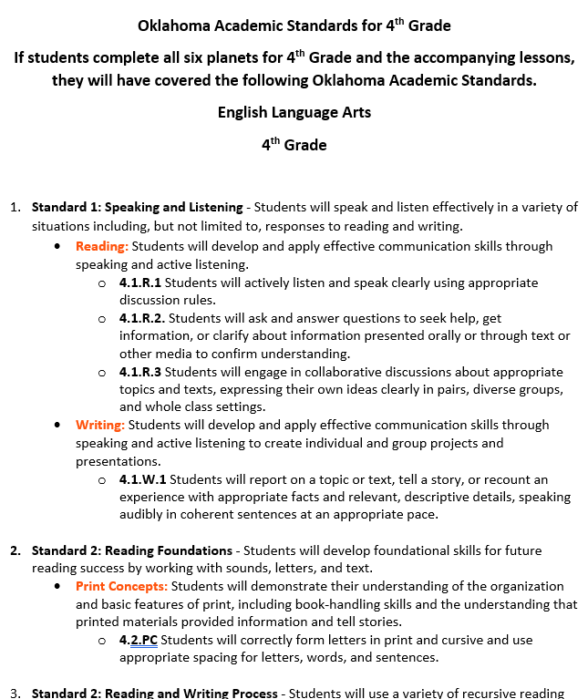

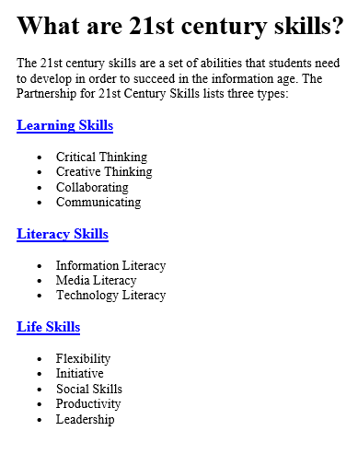
Additional support for Lesson Plan
Mission Patches
Oklahoma Academic Standards for 4th Grade
21st Century Skills
Notes:
Oklahoma Academic Standards for 5th Grade.docx
What are 21st century skills.docx
5th Grade Mission Patches.pdf
Oklahoma Academic Standards for 5th grade
Talk about if students have done all 6 planets and the lesson material then they will have covered these standards for 5th grade.
Show 21st Century skills
At all grade levels 21st Century skill are a set of skill students will need to develop to be successful in the information age. Each skill area is a hot link that takes teachers to more information and short videos.
5th grade Mission Patches
Talk about printing on sticker paper and giving out after finishing all 6 planets also about using a button cutter to quick cut out in circles.

Slide 25
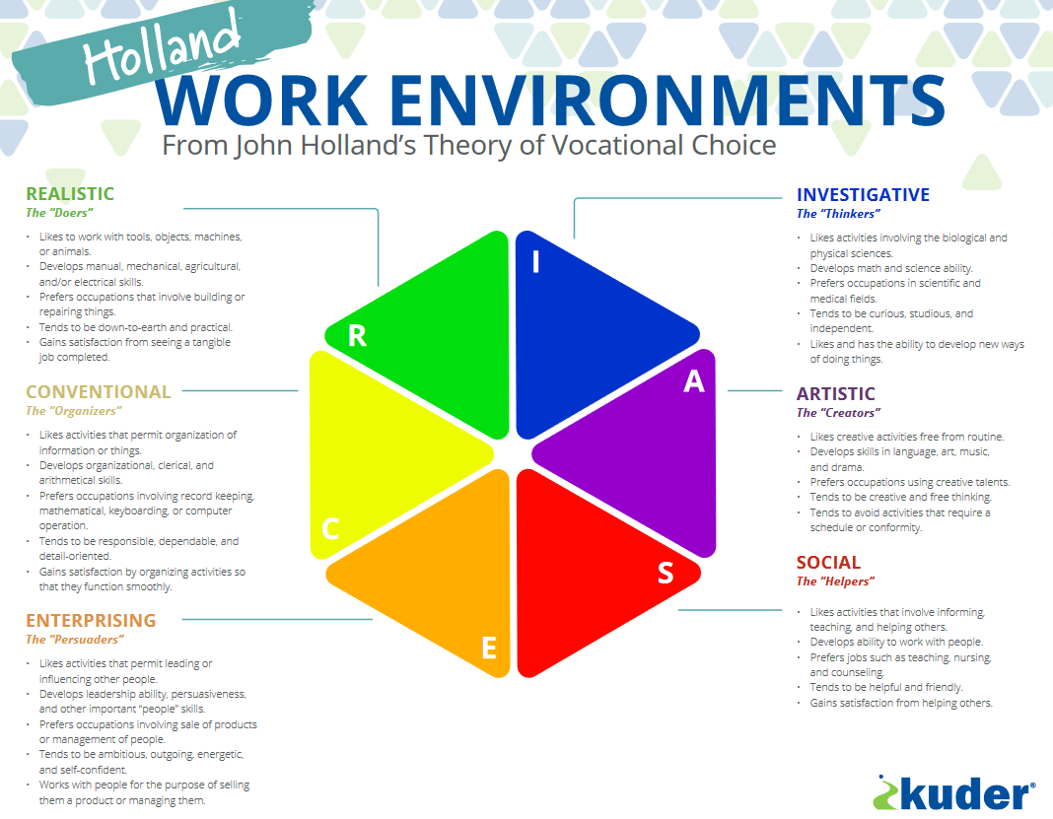
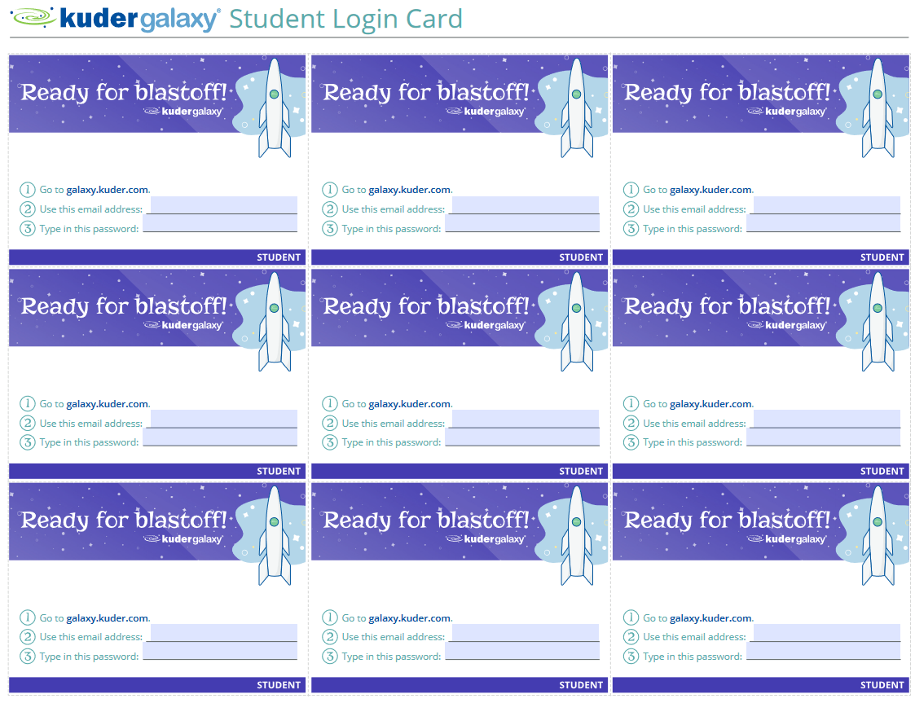

Additional support for Lesson Plan
Notes:
Galaxy Student Login Card.pdf
RIASEC Poster.pdf
Show additional support with Student login Cards, however, at this grade level they should not need the cards but might still be helpful.
Show additional support material the Holland poster
Can request an 18x24 poster mailed out
At this level the Holland information is available to students when they complete a planet mission.

Slide 26
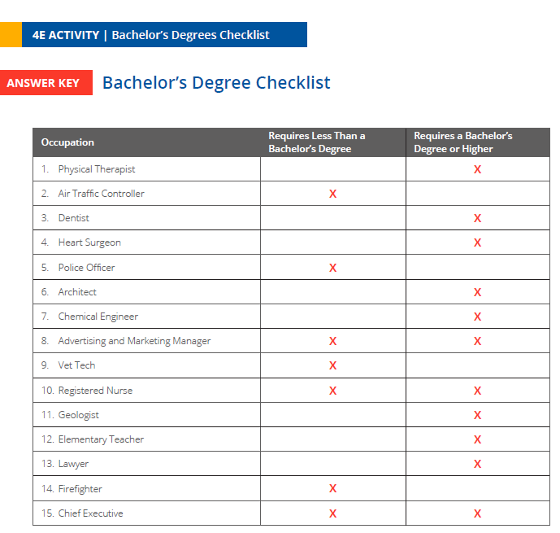
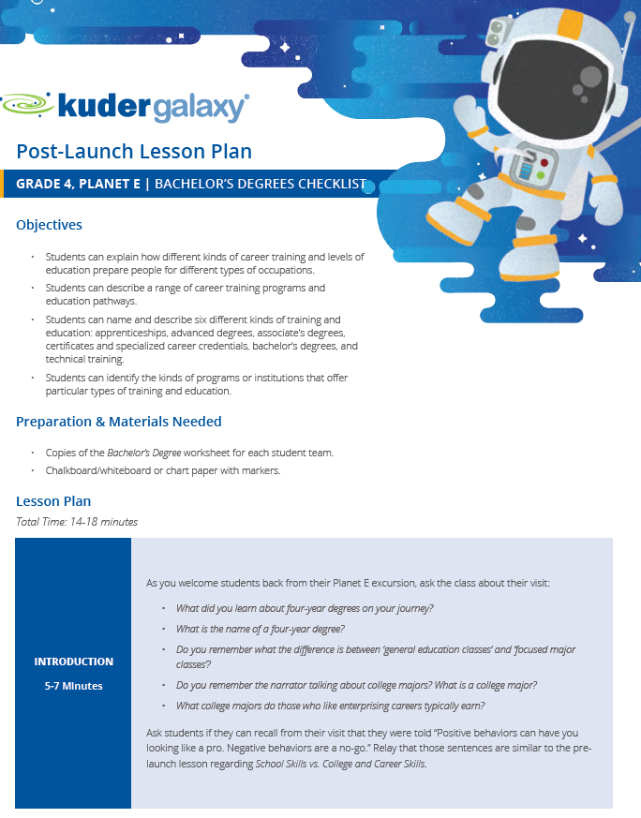
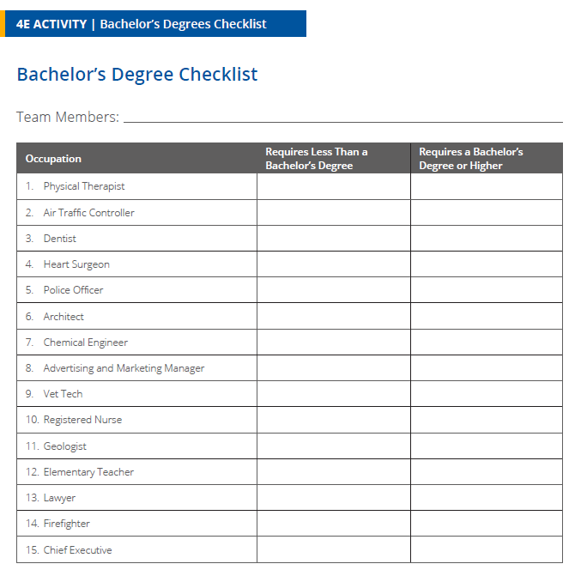
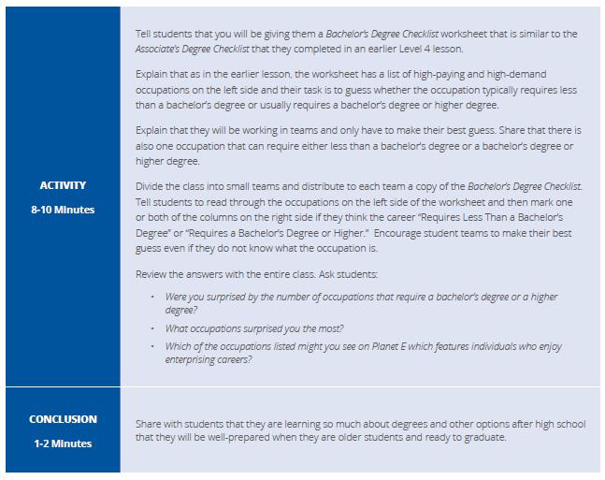
Post- Launch Lesson Plans
Notes:
Grade 4_Planet E_Post Launch.pdf
Post-Launch Lesson plans
The post launch lesson plans are 12–20-minute activities and discussion that is a good wrap up for each planet. Most have some sort of worksheet to reinforce what they just covered online.

Slide 27

The Download Folder and it is all yours to use or not live look at Ctyou.org download live look at OKCG assessment upload
Live look at OKCG Galaxy documents upload

Slide 28
Follow up documents
I will be sending you:
Instructions for navigation inside ctyou.org
Parent sample letter to be used before instruction begins.
Sample accounts for Kindergarten and 4th grade letting you choose which support material to use and how much time will be allotted to each planet.

Slide 29
CURRICULUM
Pre-Kindergarten
and
5th Grade
Notes:
Start by going to Ctyou

Slide 30

Pre Lesson-Materials. 11X17 Poster
Notes:
What is WorkPoster.pdf

Slide 31






Pre Lesson-Materials. PowerPoint
Notes:
What is Work PP.pptx

Slide 32
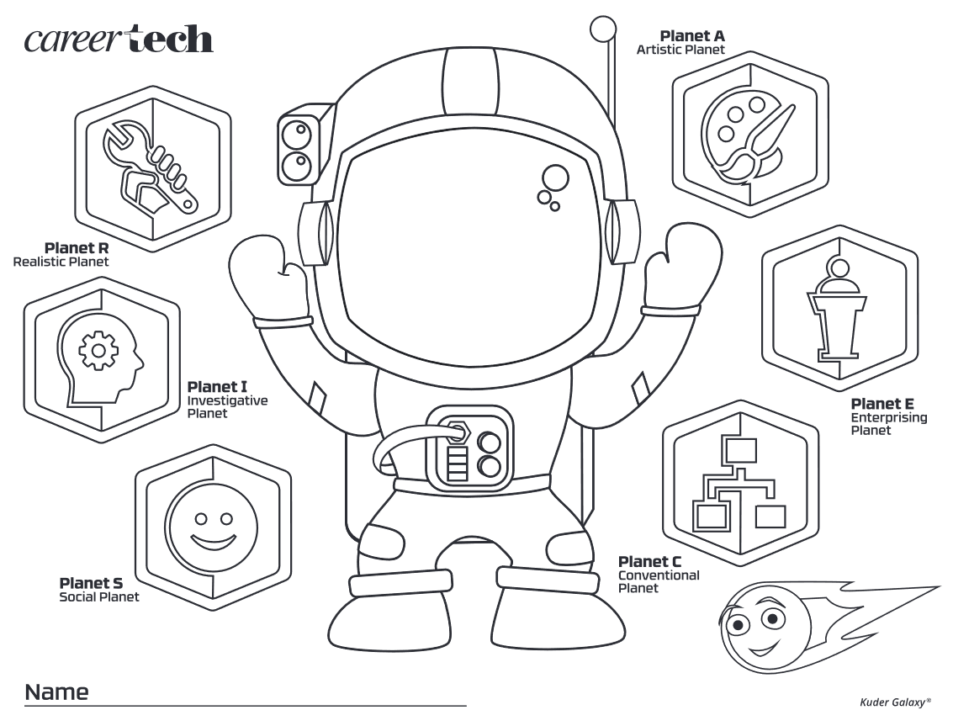
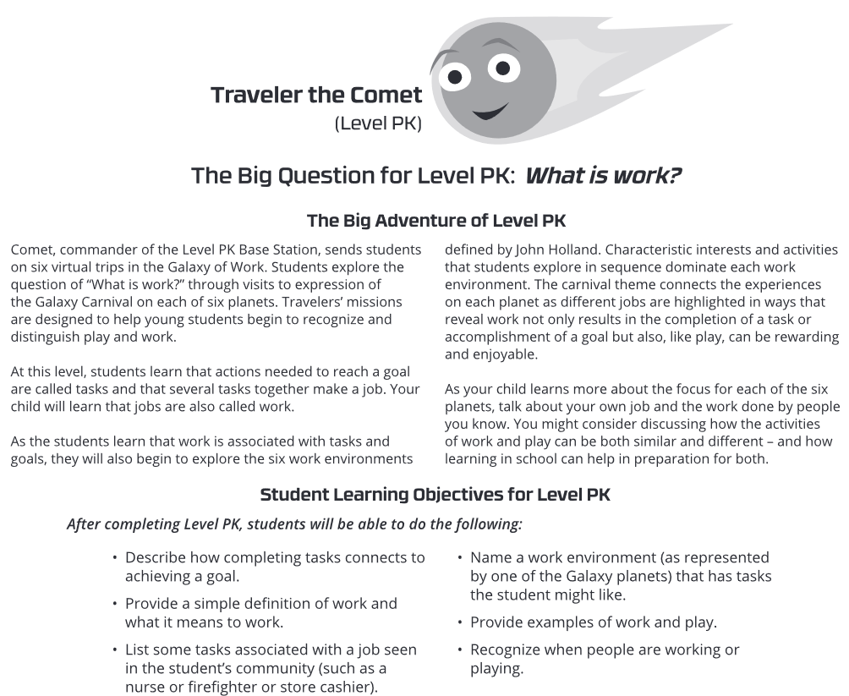
Pre Lesson-Materials. Optional worksheet
Notes:
Pre-K Start or End Worksheet.pdf

Slide 33
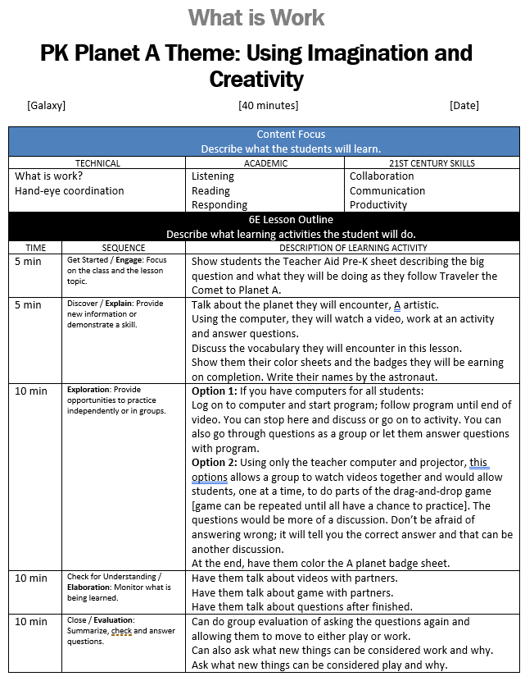
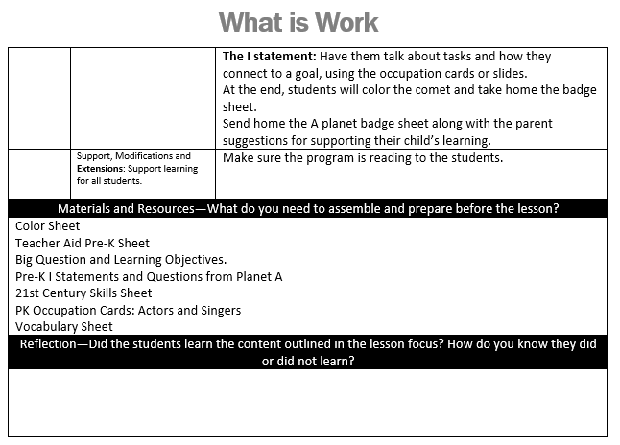
Lesson Plans
Notes:
Show lesson plans and format
It is in word format so they can be easily adjusted to meet personal teaching style.
There are 2 options to follow. One if all students have a computer, one if the teacher has the only computer with a projector or whiteboard.

Slide 34
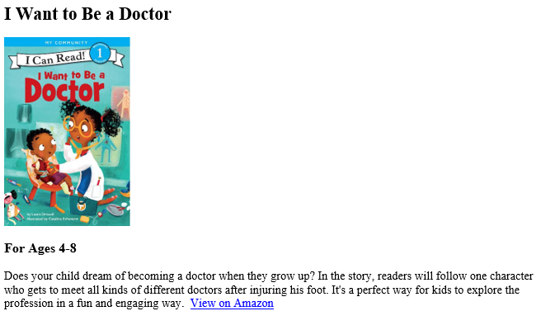
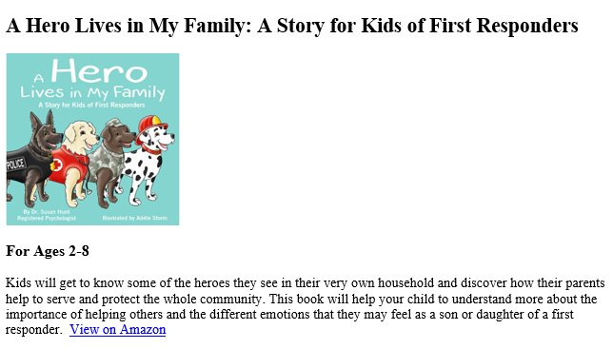
Reading List Found with Lessons Plans
Notes:
Show the PK -5th grade reading list
Talk about how the picture books are also listed on back of the worksheets

Slide 35
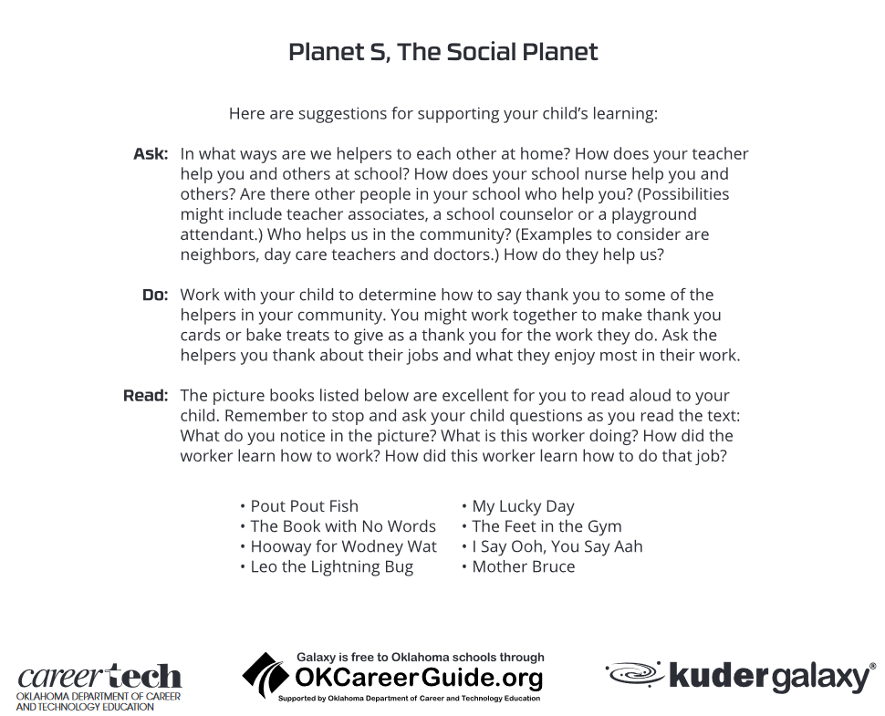
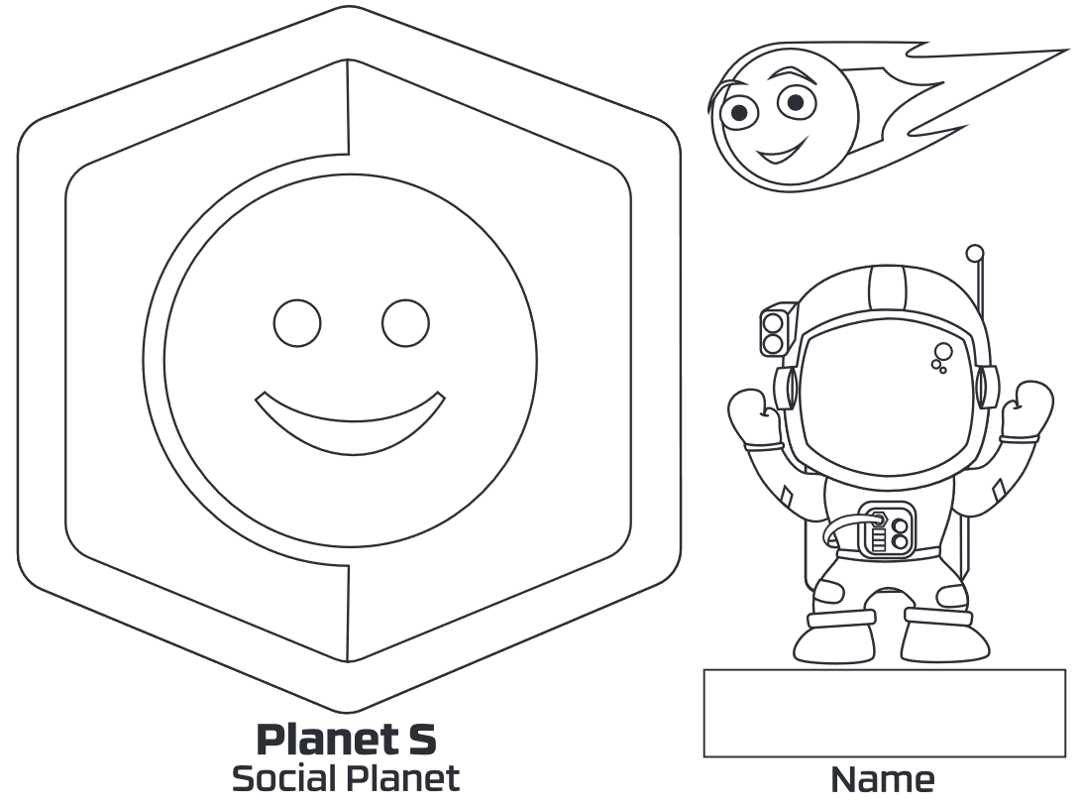
PreK Planet Badge Worksheets
Notes:
PreK Planet Badge Worksheets.pdf
Show PK Planet badge worksheets
Talk about the front and the back of worksheet

Slide 36

Occupations Cards
Notes:
PreK_occupation cards to print.pdf
PK Occupation cards
Can be used with a small group or small class.

Slide 37
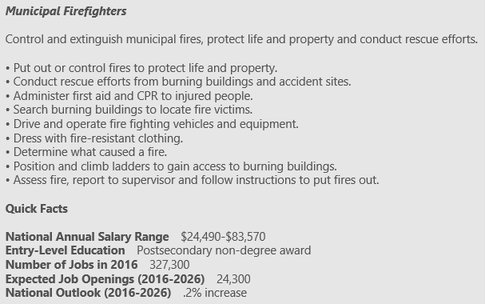

Occupations PowerPoint
Notes:
Pre-K occupations.pptx
Show PK Occupation card PowerPoint
Talk about how this can be used with the lesson as a group activity

Slide 38



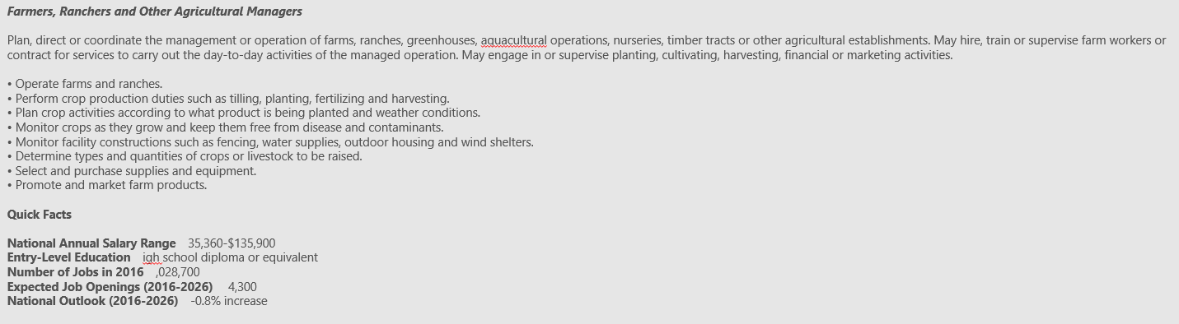
Combined PowerPoint option
Notes:
Pre-K lesson plan occupations and planet info.pptx
Show PK Lesson Plan Occupation and planet info Power Point
This is a combination of both PowerPoints that allow you to use the pre-lesson material as part of the total group lesson.

Slide 39
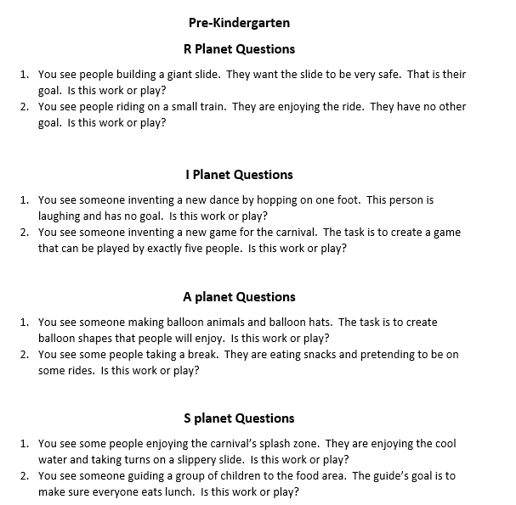
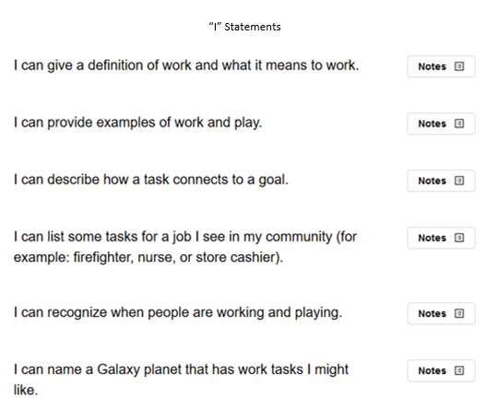


Additional support for Lesson Plan
Game info
Vocabulary
Questions and
“I” Statements
Notes:
Pre-K Vocabulary.docx
Pre Kindergarten Games.docx
Pre-K Questions and I statements for PK.docx
Show support info Vocabulary, Games, questions, and I statement.
Show how these are there to help support the lesson for the teacher and better facilitate the lesson.

Slide 40

Additional support for Lesson Plan
Oklahoma Academic Standards for Pre-Kindergarten
Notes:
Oklahoma Academic Standards for Pre Kindergarten.docx
Show Oklahoma Academic Standards for PK
Talk about if students have done all 6 planets and the lesson material then they will have covered these standards for PK

Slide 41

Additional support for Lesson Plan
Notes:
What are 21st century skills.docx
PreK Mission Patches.pdf
Show 21st Century skills
Skills needed for an information world. Info that also goes along with standards. The hotlinks will take you to more information and short videos
Show PK Mission Patches
Talk about printing on sticker paper and giving out after finishing all 6 planets also about using a button cutter to quick cut out in circles.

Slide 42
Additional support for Lesson Plan
Notes:
Galaxy Student Login Card.pdf
RIASEC (Holland) Poster.pdf
Show additional support with Student login Cards / option of using clever
Show additional support material the Holland poster
Can request an 18x24 poster mailed out
Not available to students at this level at the end of exploring planets

Slide 43
Questions thus far ????????????????????????????
Notes:
Go live and show
The button it is all yours to use or not.

