Slide 1

FAFSA Simplification act
What is it and what does it do?
Robbie Leftwich, OCAP
March 8, 2023
This presentation is for educational purposes only and is not intended to be construed as financial, investment, legal and/or tax advice.

Slide 2
What is the FAFSA Simplification Act?
The FAFSA Simplification Act represents a significant overhaul of federal student aid, including the Free Application for Federal Student Aid (FAFSA®) form, needs analysis, and many policies and procedures for schools that participate in federal student aid programs.
No current information about release date for the 2024-2025 FAFSA – supposed to be October 1, 2023 but could be as late as January 1, 2024.

Slide 3

What does that mean?
Streamlines the FAFSA Form
Expands access to some Federal Student Aid
Replaces the Expected Family Contribution (EFC) with the Student Aid Index (SAI)

Slide 4
Streamlining the fafsa form
Everyone will be required to allow financial information to be transferred to FAFSA from IRS, even non-filers and undocumented students and parents
Very limited paths for manually entering financial data
Number of financial questions greatly reduced

Slide 5
Expanded Access to Federal student aid
Certain questions will no longer be asked:
Veteran’s Education Benefits
Workman’s Comp
Child Support Payments
Payment to Tax-Deferred Pensions
Other Untaxed Income

Slide 6
Student aid index (sai) formula changes
Family size will be based on number of people claimed as exemptions
Will be an option to modify that number, if it has changed
Parent info to be provided will no longer be primary custodial parent; FAFSA will use the parent who provides the most financial support
SAI will no longer be divided by number in college
If required to report assets, families would have to report net value of any businesses or family farm – no more exceptions for this

Slide 7
Fsa id
All users (students and parents) must set up FSA ID prior to starting the FAFSA.
FAFSA will no longer have options for users to set up the FSA ID once they’ve started the application
FSA ID will require Multi-Factor Authentication (MFA) for students and parents
Even parents without SSN will be required to have FSA ID, so there will no longer be a printable signature page - they will have to sign the application with an FSA ID
If marital status for parents is Not Married, but Living Together or tax filing status is Married and Filing Separately, each person will be required to have FSA ID

Slide 8
Other misc. changes
Demographic survey questions are now a required part of the FAFSA, and are a requirement to submitting the application
Students can list up to 20 colleges; previous limit was 10
Parents/spouses will be asked to provide full demographic information

Slide 9
Other misc. changes
Students will no longer create a save key; instead everyone involved will need an FSA ID
No option for independent students to provide parent information

Slide 10
Process changes
FAFSA resource materials will be provided for multiple languages
If student is first to fill out FAFSA form, they must answer financial asset questions – remains to be seen if it is better for student or parent to go first
If tax return is required, but not yet found at IRS, FSA will continue to send the file for a match until a date in which the IRS indicates that the tax filing is complete

Slide 11
Process Changes
Form will ask if the parent or student’s spouse is the one they were married to for the tax year being reported
No more IRS Data Retrieval Tool, new process will be a direct transfer from the IRS and will be required to submit the application

Slide 12
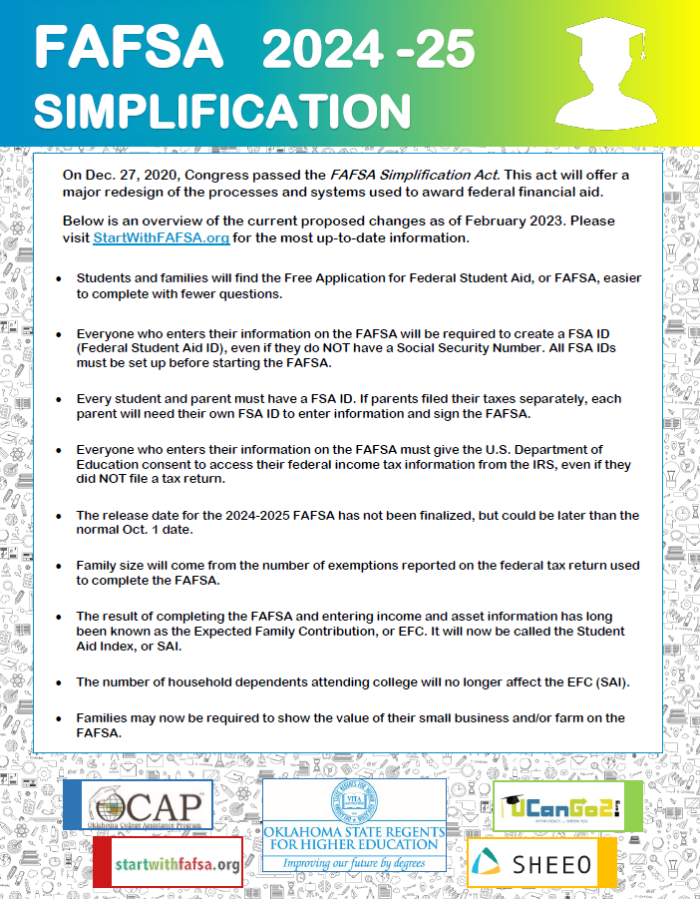
For more information
Please visit StartWithFAFSA.org
FAFSA Simplification Flyer
As new changes are announced we will keep you updated!

Slide 13

Questions
Please be gentle!

Slide 14
Counselor Only Conference
March 8, 2023
Letha Huddleston, Outreach Specialist

Slide 15



Introduction to ucanGo2

Slide 16
Our history
OGSLP (Oklahoma Guaranteed Student Loan Program)
Up until June 30, 2010, Federal student loans were issued by private or state lenders and guaranteed by another entity
We were the largest guarantor in Oklahoma
OCAP
After that date all loans became Direct Federal Loans; Federal Student Aid, a division of the US Department of Education, is lender and guarantor
We changed our business model and branched out to meet the various needs of those planning, preparing and paying for college

Slide 17

Ucango2.org
Created in 2010
Began with resources for middle school and high school students

Slide 18

Planning for college
Is college the right choice for me?

Slide 19
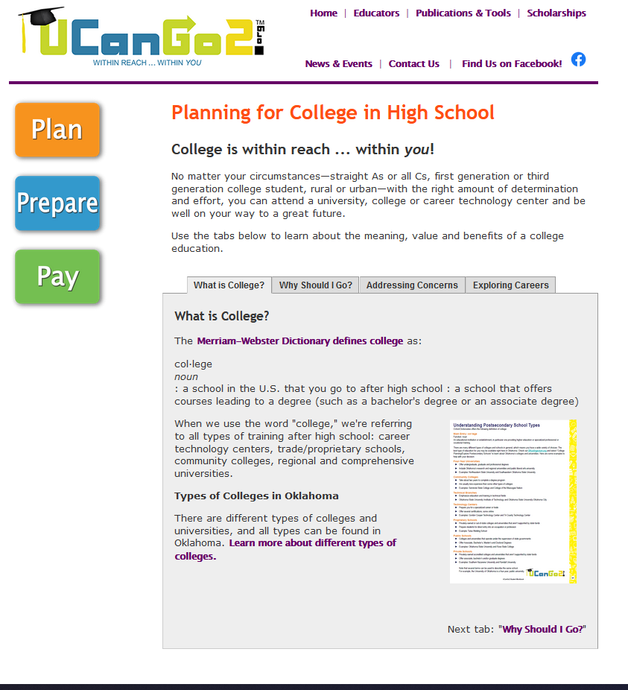
Exploring colleges & Careers
Benefits of college
Types of higher ed institutions
Begin career exploration
All pages contain clickable thumbnails and links

Slide 20
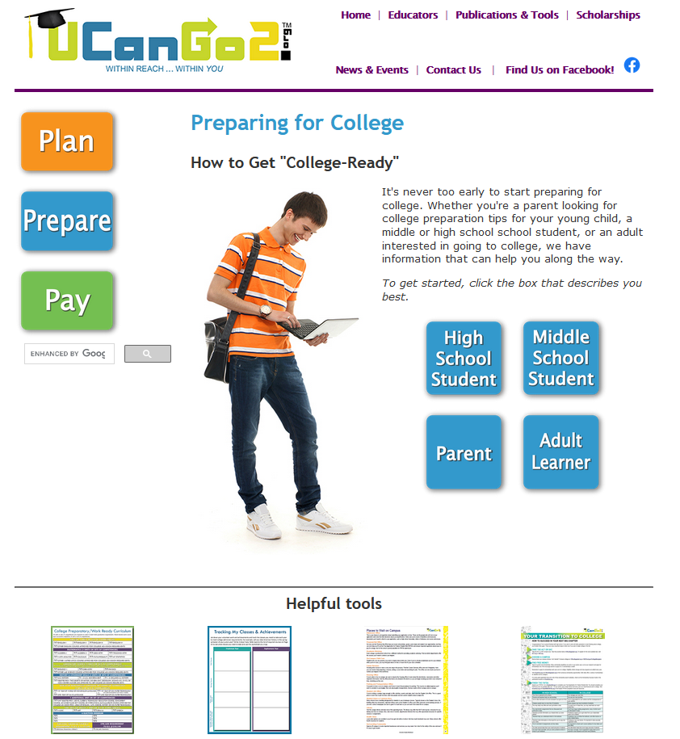
Preparing for college
What can I do to get ready for college?

Slide 21
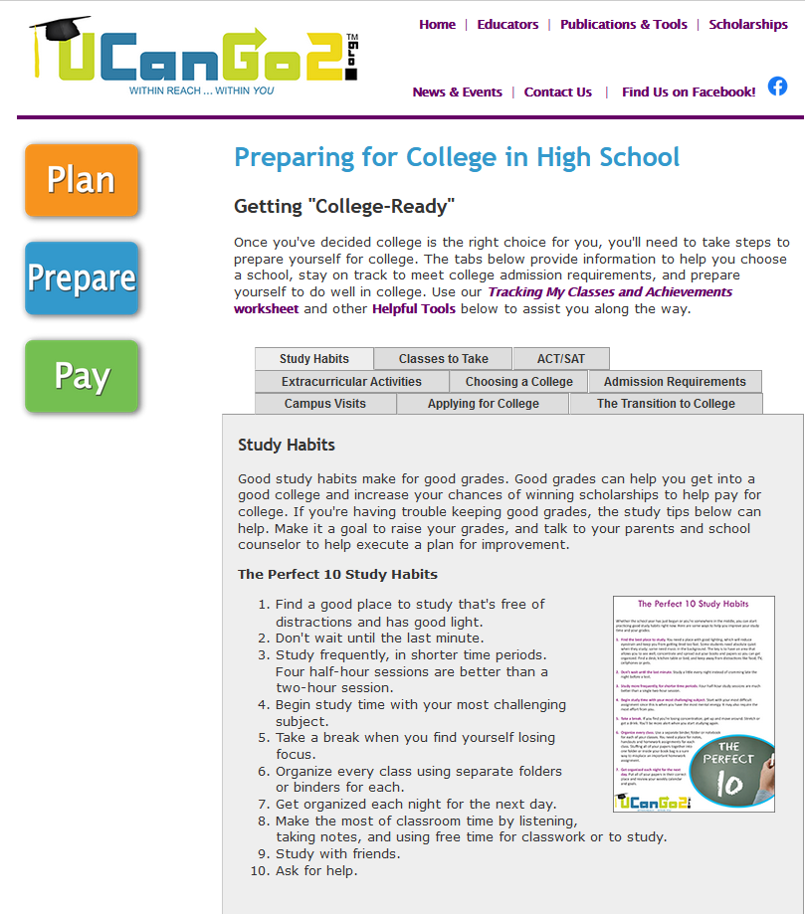
Getting “college Ready”
Nine short sections to assist with college prep
Everything from good study habits to showing the differences between high school and college

Slide 22
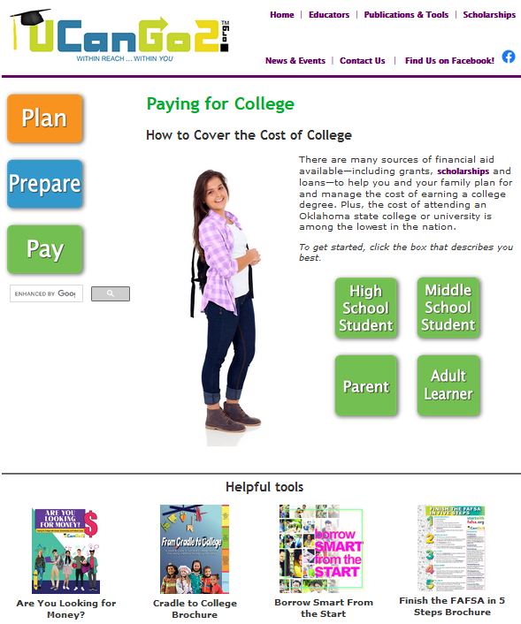
Paying for college
HOW will I page for college?

Slide 23
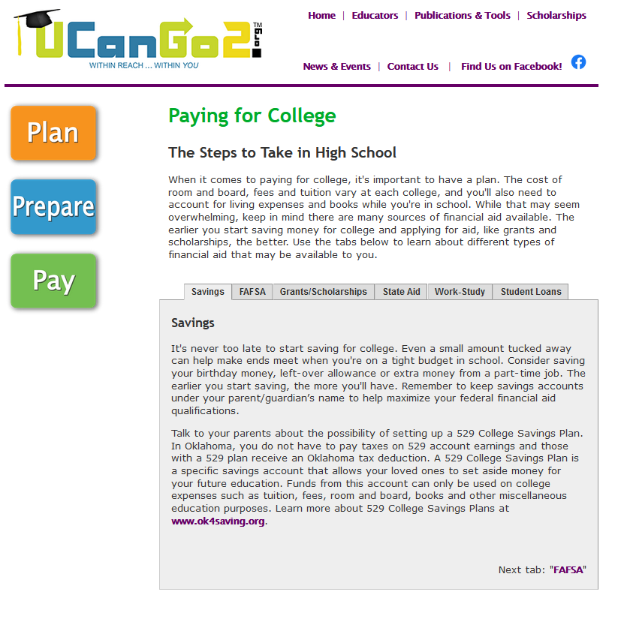
Different sources of aid
Topics
Savings
FAFSA
Scholarships
State Aid
Work Study
Student Loans

Slide 24
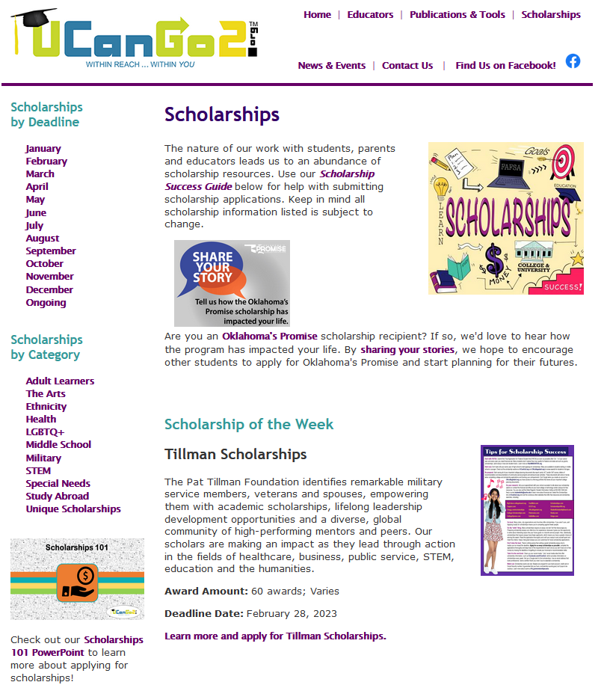
scholarships
Landing page
Search by deadline
Search by category
Scholarship of the week

Slide 25
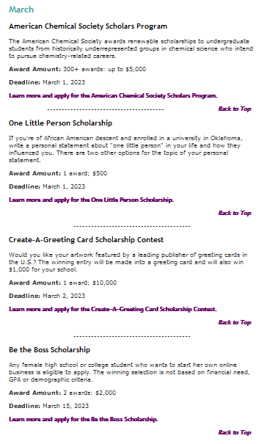
featured scholarships
10 scholarships with descriptions, often for specific interests and abilities
But wait! That’s not all!

Slide 26
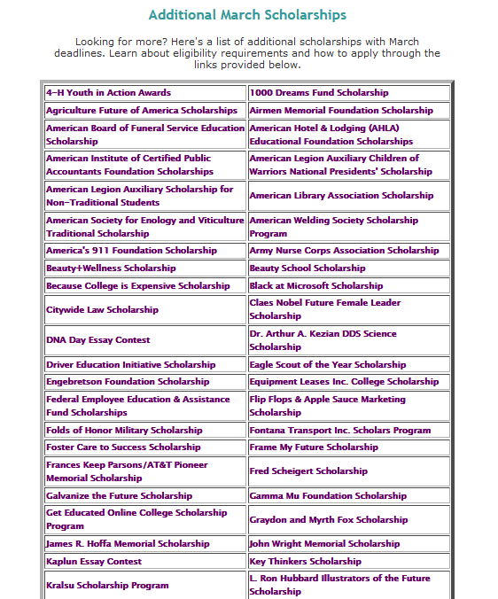
Additional scholarships
Scroll down past featured scholarships
Table lists even more scholarships
Each cell contains a link that takes students to the application

Slide 27
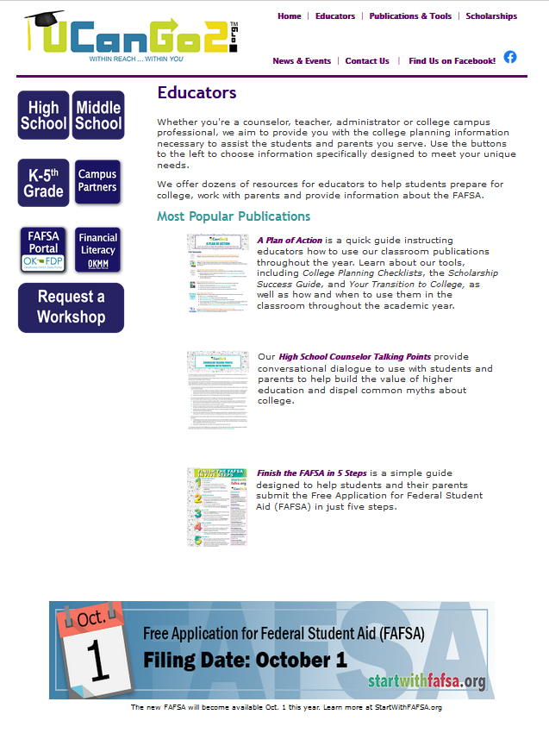
Educators & campus partners
Resources for
K-5th grades
Middle school
High school
Campus partners
Financial literacy – OKMM
Request a Workshop!
✓

Slide 28
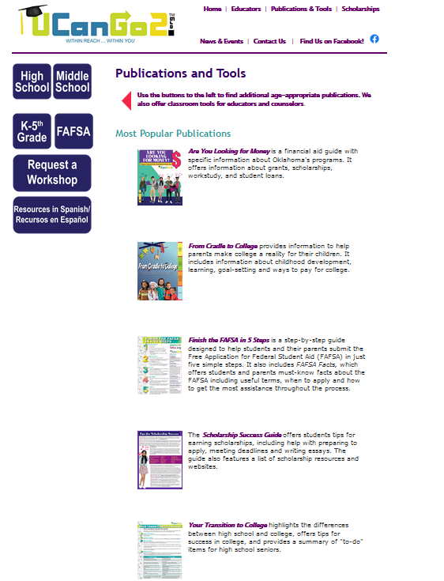
Publications & tools
Our publications & tools are now only available online
We’ve added a button for our resources in Spanish
More Spanish pubs/tools to come!
✓

Slide 29



Other ocap resources
OklahomaMoneyMatters.org

Slide 30


College application week
⇦
September 25-29, 2023

Slide 31
Last year – CAW 2022
132 schools, libraries and community partners
Over 5,000 seniors, over 5,000 applications
Colleges in 36 states, Canada and England

Slide 32



Oklahoma school of excellence award
2019 – Edmond Memorial High School
2020 – Miami High School
2021 – Indianola High School
???
2022 –
- Winner to be announced this spring

Slide 33
To become a school of excellence
Submit your Exit Survey – report your results
Make comments in the survey – brag on your school
Share innovative ideas – inspire other schools

Slide 34

Important details
You can host your CAW any week, September through November
The Event Coordinator packet at OKCollegeAppWeek.org supplies planning materials and resources
Plan for as many days as your schedule allows
Goal is to give every senior the opportunity to submit at least one online college application

Slide 35
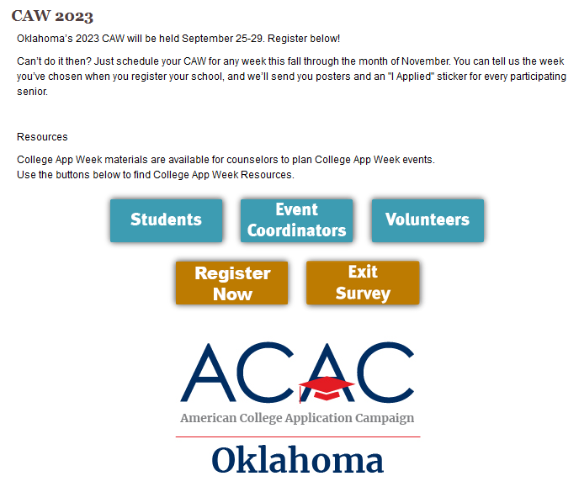
Register at OKCollegeappweek.org
https://www.surveymonkey.com/r/CAWReg2023

Slide 36

Contact us
Oklahoma College Assistance Program
UCanGo2 Outreach Team
UCanGo2@ocap.org
405.234.4239
866.443.7420

