Slide 1


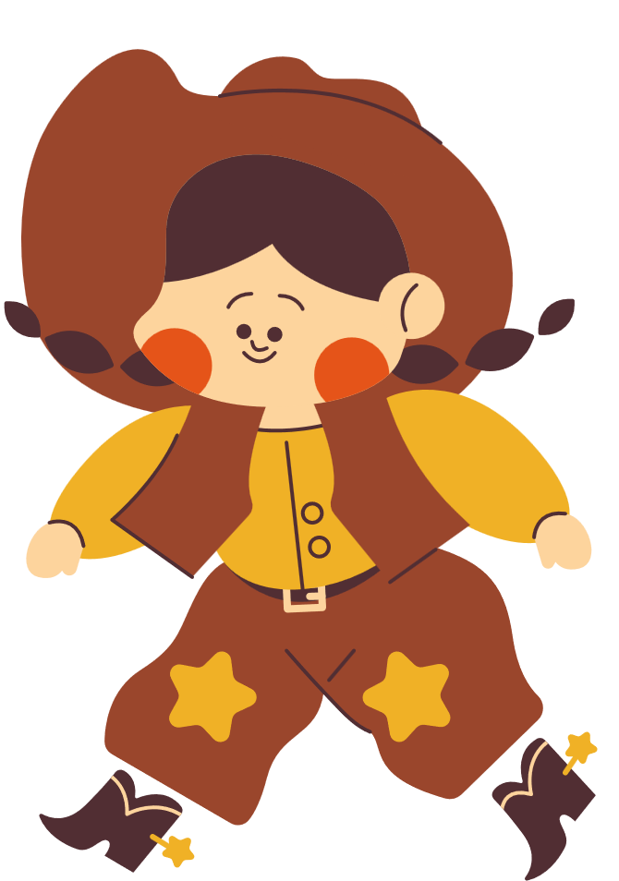



Don’t squat with your Spurs on!!!
Counselors only 2026
Notes:
WELCOME Pardners!! ;)

Slide 2


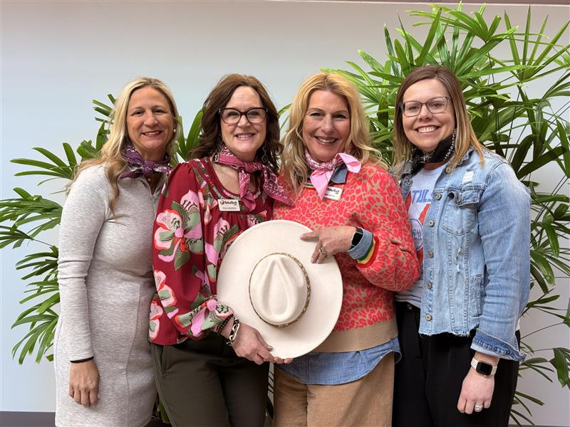



Should’ve been a Cowboy!
Notes:
Introductions
Housekeeping (Paula)
*Please share- we love interaction!
*Take care of yourself- come and go as you need.
The cards and place settings on the tables are yours for the takin'!
*We have a grand prize giveaway...Hint-Pay attention to the critters in our presentation.

Slide 3




What’s Y’alls’
“Sunrise Song”?
And your “Sunset Song”?
Let’s Go!
Windin’ Down!
Notes:
(Tammy)
Tammy plays our Sunrise Songs and .....
This is where we show the Kevin Bacon video of
"Lovely Day" by Bill Withers
(Jessica)- Place Setting and Sunset Song!!!
https://www.instagram.com/reel/DTJMOAsCYtP/?hl=en

Slide 4


Building a STRONG Ranch Culture...
School Culture- The personality of the school. It shapes how students feel, how teachers teach and how everyone interacts.
Why is culture important?
Culture is built intentionally not accidentally
Every individual in your school helps shape your brand
Gratitude is Worth its’ time in “GOLD”
Notes:
(Kim T.) -
Warm Hug Story
Diversity of Programs on campus and blending to feel like community.
(Paula) Introduce Video
Tammy and I starting sharing these to each other and then we asked our Administration to show at staff meetings.
(Tammy) Tell Heenen story!
Show Steve Hartman video:
https://youtu.be/Lx8xl21VMyU?si=mVUyPxZhHjyv0E9e

Slide 5
Campire Conversations...
Notes:
(Paula)- Use the sticky notes to share your idears!! Also put your email address on the Campfire Conversation sheet on your table. We will compile a master list and share.
What are some things y'all do to build your "School Brand"?

Slide 6

Standing Tall in your saddle...
“The Counselor’s Role”
*What is our role as leaders in promoting School Culture?
Leaders set the tone
Being Visible and consistent
Modeling the attitude you expect
(Positive or Negative attitudes~ BOTH are contagious)
You Got This!
Notes:
(Jessica)- What is our role as School Counselors in promoting school culture?
Counselors usually have a "Mountaintop View" over the lay of the land.
Often Counselors are called to lead...what are ways you lead at your schools?

Slide 7
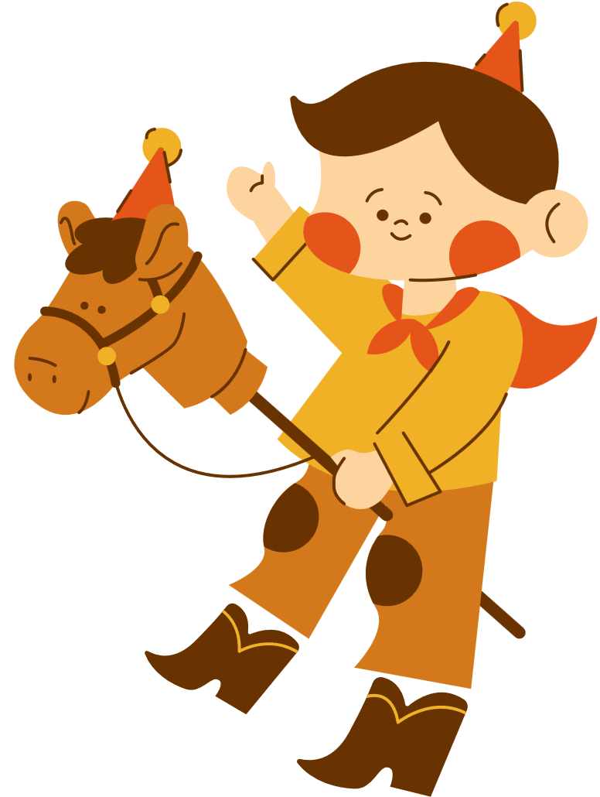
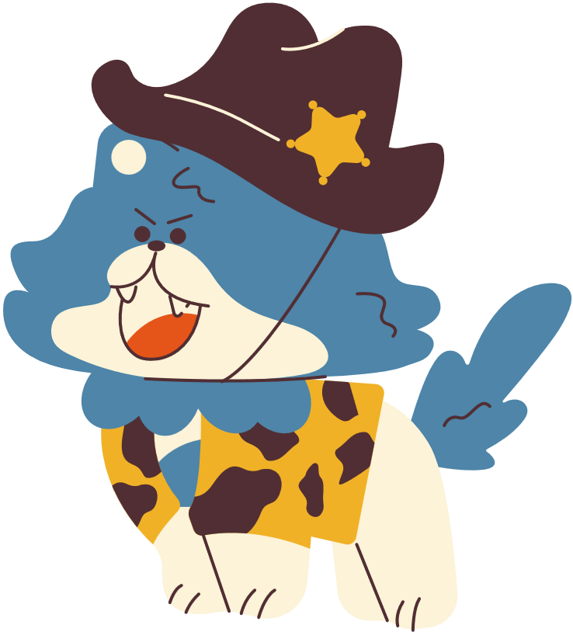
Ways to Circle the wagon...
Ideas to build school-Wide culture!
*Music *Matching T-shirts
*Games/Puzzles *Coloring stations
*Student Appreciation Days
*Student Spotlight/Awards
*Student Mixers- During break Times
*Mindful Mondays *Positive Messages around campus
*Comfortable Environment- Calm spaces
Campfire Conversation...
Notes:
(All) Popcorn!!
(Jessica and Tammy)
(Paula and Kim)
On our campuses this a big part of what our Counselors provide that promotes overall culture. During the Spring Months these can be the things that keep our horses wrangled and herds in step.

Slide 8
Campire Conversations...
Notes:
*Remember to use the sticky notes on your tables!
What are ways your school site creates a positive brand for your District......

Slide 9


Ride Together ~ No one Rides Alone...
Ways to build Realationships with your People!
*Galentines *Staff luncheons/Souper Bowl *Staff Treats
*Birthday Cards *Book Study *Work Dates
*Favorite Things *Tell me something good
*What I did last summer *Positive Stories
“Supporting Our Colleagues”
Campfire Conversation...
Notes:
(All)
(Kim and Paula)- Staff Challenges.
(Jessica and Tammy)
Talk about all the things we do to promote a positive environment for our staff so that they pass it along to our students. Happy Campers, Happy Counselors!

Slide 10
Campire Conversations...
Notes:
*Sticky Note Reminder!
What are ways y'all encourage your staff especially during high-stress times of the school year!

Slide 11
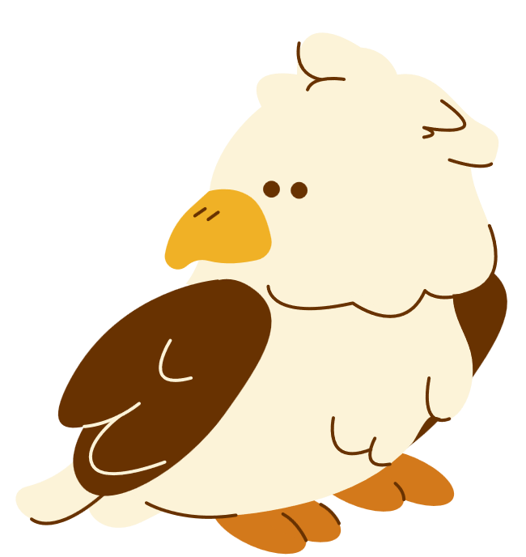
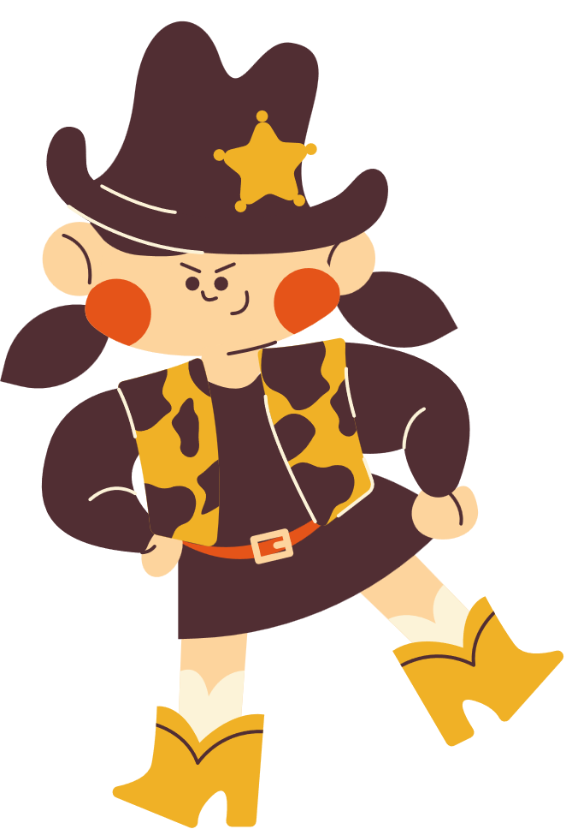
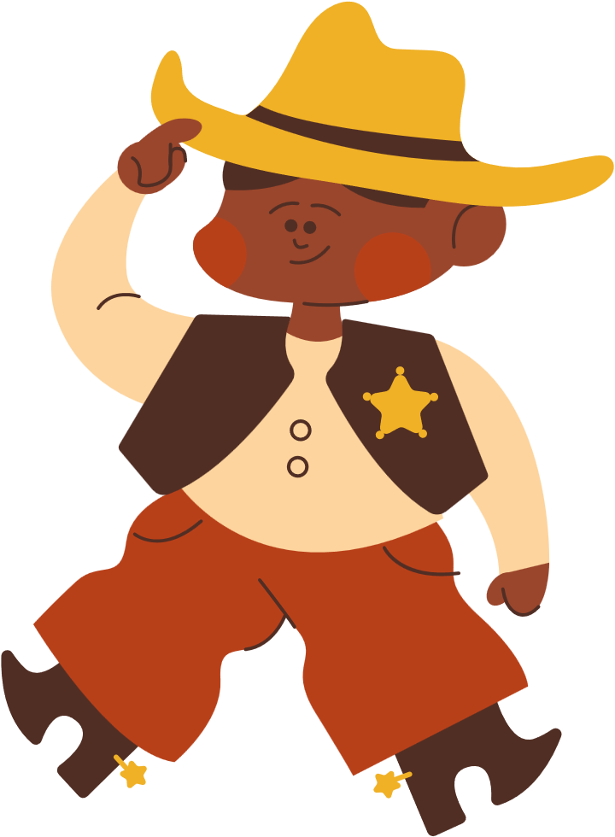

Put a Kick in Student Interactions...
1.) Greet Students Daily
2.) Bring the Energy
3.) Find a common Connection
*Inviting Space *Fidgets/take-aways
*REsources FP/PP *Out & About
CAMPFIRE CONVERSATION...
Notes:
(Kim T.) *Door Story!
Coming up with creative ways to stay up with the times and keep our students engaged can be challenging.
SEL Themes and activities support these 3 priorities and are consistent ways to show up for our student body.
Also having your Administration backing your counseling philosophy is KEY!!

Slide 12
Campire Conversations...
Notes:
*Sticky Note Reminder!
What are ways your counseling/administrative department show up for your student body?

Slide 13
Tending to Your Campfire...
“Never miss a chance to rest your horse”
> 10yrs or Less
>20yrs or Less
>30yrs or Less
>40yrs or Less
What makes YOU stay?
Notes:
(Tammy)
Stand-up and popcorn answers to why you stay!

Slide 14


The Code of the West
Write it in your Heart. Stand by the code and it will stand by you.
Ask no more and give no less than Honesty, Courage , Loyalty, Generosity, and Fairness.
Notes:
(Kim T)
Give away Framed Mantra/Code!

Slide 15
“Making it in Education is kinda like Bustin’ Broncs:
You’re Gonna get thrown A lot.....
The Simple Secret is
to Keep Gettin’ Back On!!!”
You Got This!
Notes:
(Jessica)

Slide 16
Thanks Ya’ll
For Ridin’ along with us and Remember~
Don’t squat with your spurs on!
Notes:
Give-Away time!!
4 Note-books
2 Framed Codes
1 DSWYSO Book
Texas Road House GC
Stickers on the place setting and ask which slide had the Cute Lil Eagle on it?

