Slide 1
Health Science Education
Apprenticeships and Work-Based Learning in Healthcare
March 10, 2026

Slide 2
Youth Apprenticeships
Current Partnership with SSM Health, a four-state healthcare entity.
Metro-area Technology Centers: Francis Tuttle, Moore-Norman Tech, Mid-Del Tech, EOC Tech, Metro Tech and Canadian Valley Tech
Youth Apprenticeships in three areas of employment: Phlebotomy, Medical Assisting and Advanced Unlicensed Assistant.

Slide 3
Youth Apprenticeships
Students must have completed Core, Med Term, CPR/FA, A & P and Long-Term Care and be certified as LTC Aide
Positions working at hospitals and medical clinics for $14/hour
Must complete their program they are enrolled in as a
senior and sit for the state/national certification
May transition to new part-time position after YA position complete.

Slide 4
Youth Apprenticeships
All students doing very well and SSM is pleased.
Mentors give excellent feedback to instructors to better prepare students.
Added five new positions this year and hope to add more in the future—pharmacy technician.
Student have front-loaded curriculum so the skills they need in the workplace completed first. May go to job as a work-release from class or work nights/weekends/vacations.

Slide 5
Statewide Roll Out
Working with large hospitals such as Mercy or INTEGRIS to implement with them.
Preparing for meeting with Oklahoma Hospital Association to share the opportunity for large and small hospitals across the state
Forms/paperwork include a step-by-step process and contract between hospital and student, facilitated by instructor.
Hospital will provide bi-monthly reporting on youth apprentices for grade reports.

Slide 6
Work-based Learning Guide
Identify healthcare resources within community or Tech Center district
Communicate with healthcare personnel; Could start with Chamber of Commerce meeting; Visiting with hospital CEO/marketing/workforce coordinator
Prepare students by having them take safety and HIPAA course and get suggested background knowledge
Use a resource like Work-based Learning Guide 4.0 from National Consortium for Health Science Education: Work Based Learning - National Consortium for Health Science Education

Slide 7
Local Workforce Job-Shadowing
National Consortium for Health Science Education
Forms—consent, emergency contact, health questionnaire, student confidentiality, requirements checklist, affiliation agreement, staff and student evaluations of rotation
Rotations include HR, ICU, LTC, Plant Operations, Outpatient Surgery, Nutrition, Pharmaceutical Services, Non-Invasive Cardiology, RT, Rehab, Post-Op, Bone Marrow Transplant, Central Supply, Clinical Lab, Dental, Veterinary, Volunteer, Diagnostic Imaging, ER, Electroneurodiagnostics, Environmental Services, and more.

Slide 8
Demonstrate Work-Based Learning Guide
This resource contains 240 files in Word/PDF/PTT for coordinating a high-quality work-based learning component for your health science education program.
Lesson Plans
Projects
Resources
Activities
Templates

Slide 9
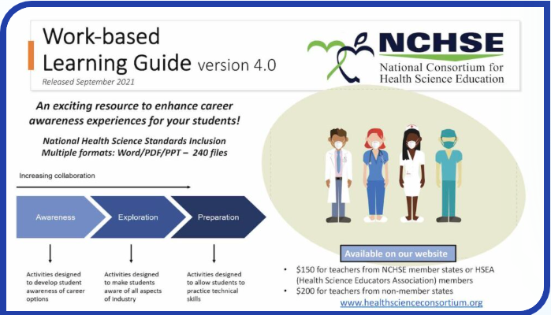
Demonstrate Work-Based Learning Guide
Work Based Learning - National Consortium for Health Science Education

Slide 10
Demonstrate Work-Based Learning Guide
Log in to “Member Portal” where your WBL Guide will be after purchase.
Cost is $150 for Member States (Oklahoma is one)
National Consortium for Health Science Education
(WBL--table of contents)
Portal Landing Page - National Consortium for Health Science Education

Slide 11
Questions?
Call or Email Lara Morris at
405.743.5106
Lara.morris@careertech.ok.gov

