Slide 1


Oklahoma Broadband Office
ARPA & CPF Funding Draw Request Procedure
June 04, 2025
Presented by:
Notes:
Please reference the instructions at the end of this slide deck for detailed information on how to complete this slide.

Slide 2
Examples of Documentation for Draw Requests
Complete Draw Request Package:
  Budget Template Draw Request excel Template
  OBO Cover Page(s) for either each invoice or estimate/quote.
  Supporting documentation for each OBO Cover Page.
Examples of Required Supporting Documentation:
  For advanced funding: Proof of quote, estimate, work order, etc.
  For reimbursements: Proof of payment (invoices, receipts, bills of lading)
  For milestones: Engineer certification for drops laid, invoices for services rendered during that performance milestone
  Proof of competitive bidding (or letter from the ISP stating they’re exempt)
Acceptable Documentation Examples:
  Purchase orders, unpaid invoices, estimates, quotes
  Executed contracts, subgrant agreements

Slide 3
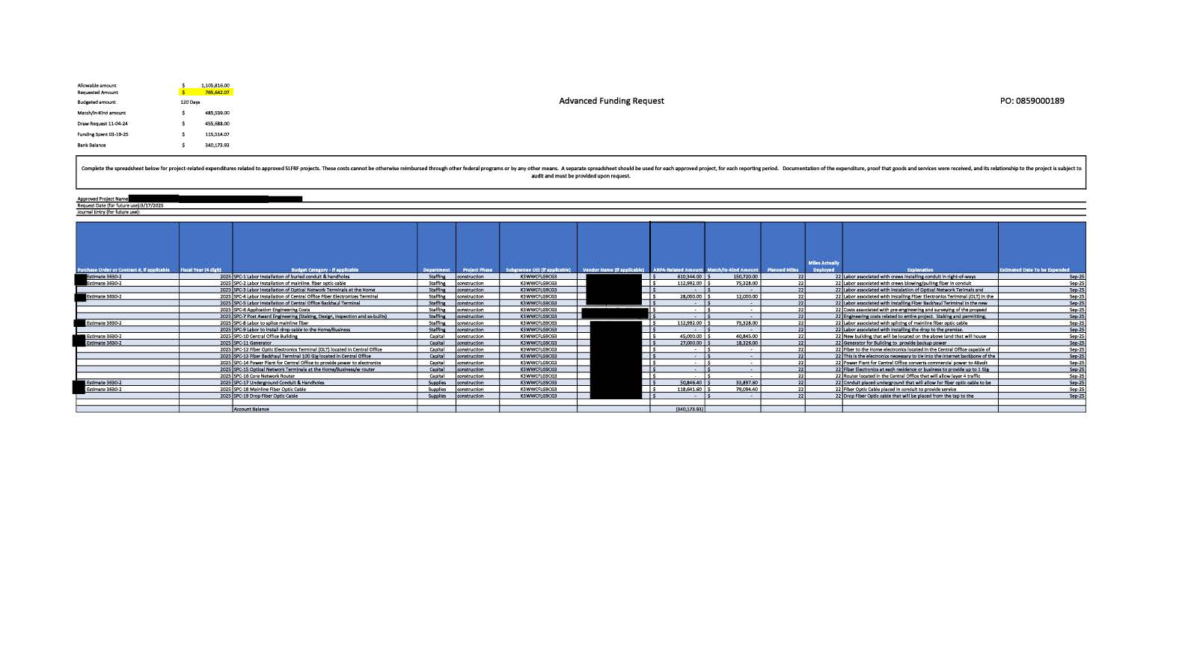
Example of an Advanced Funding Draw Request

Slide 4
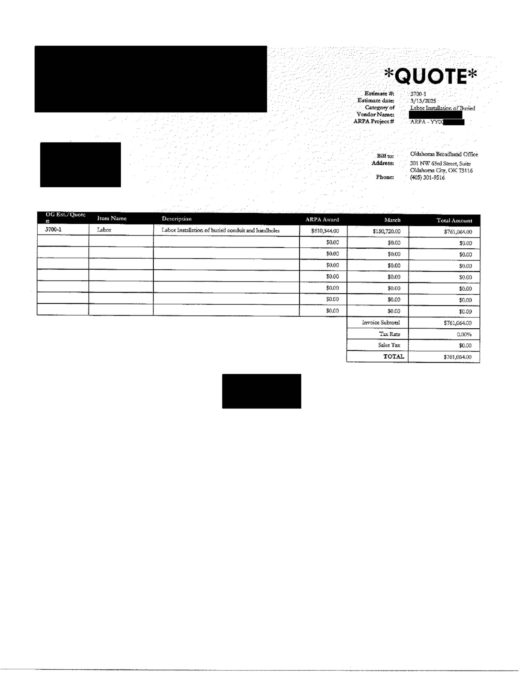
Example of an OBO Cover Page for Estimated Quote

Slide 5
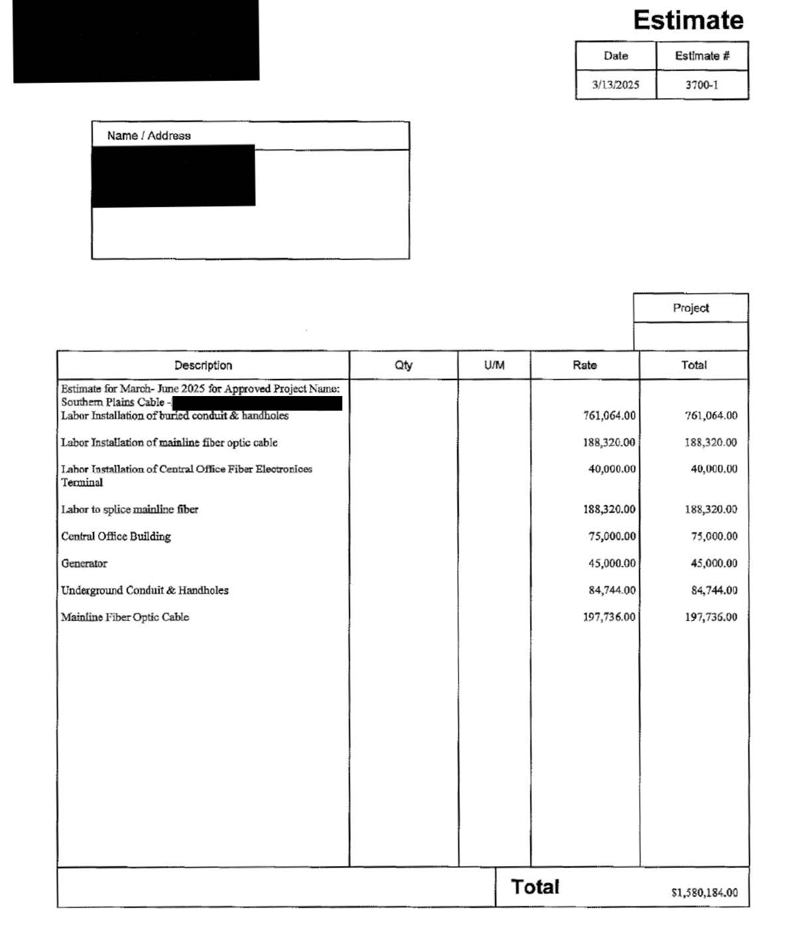
Original Estimate/Quote Aways Needs to be attached behind every OBO Quote Cover Page for reference.

Slide 6
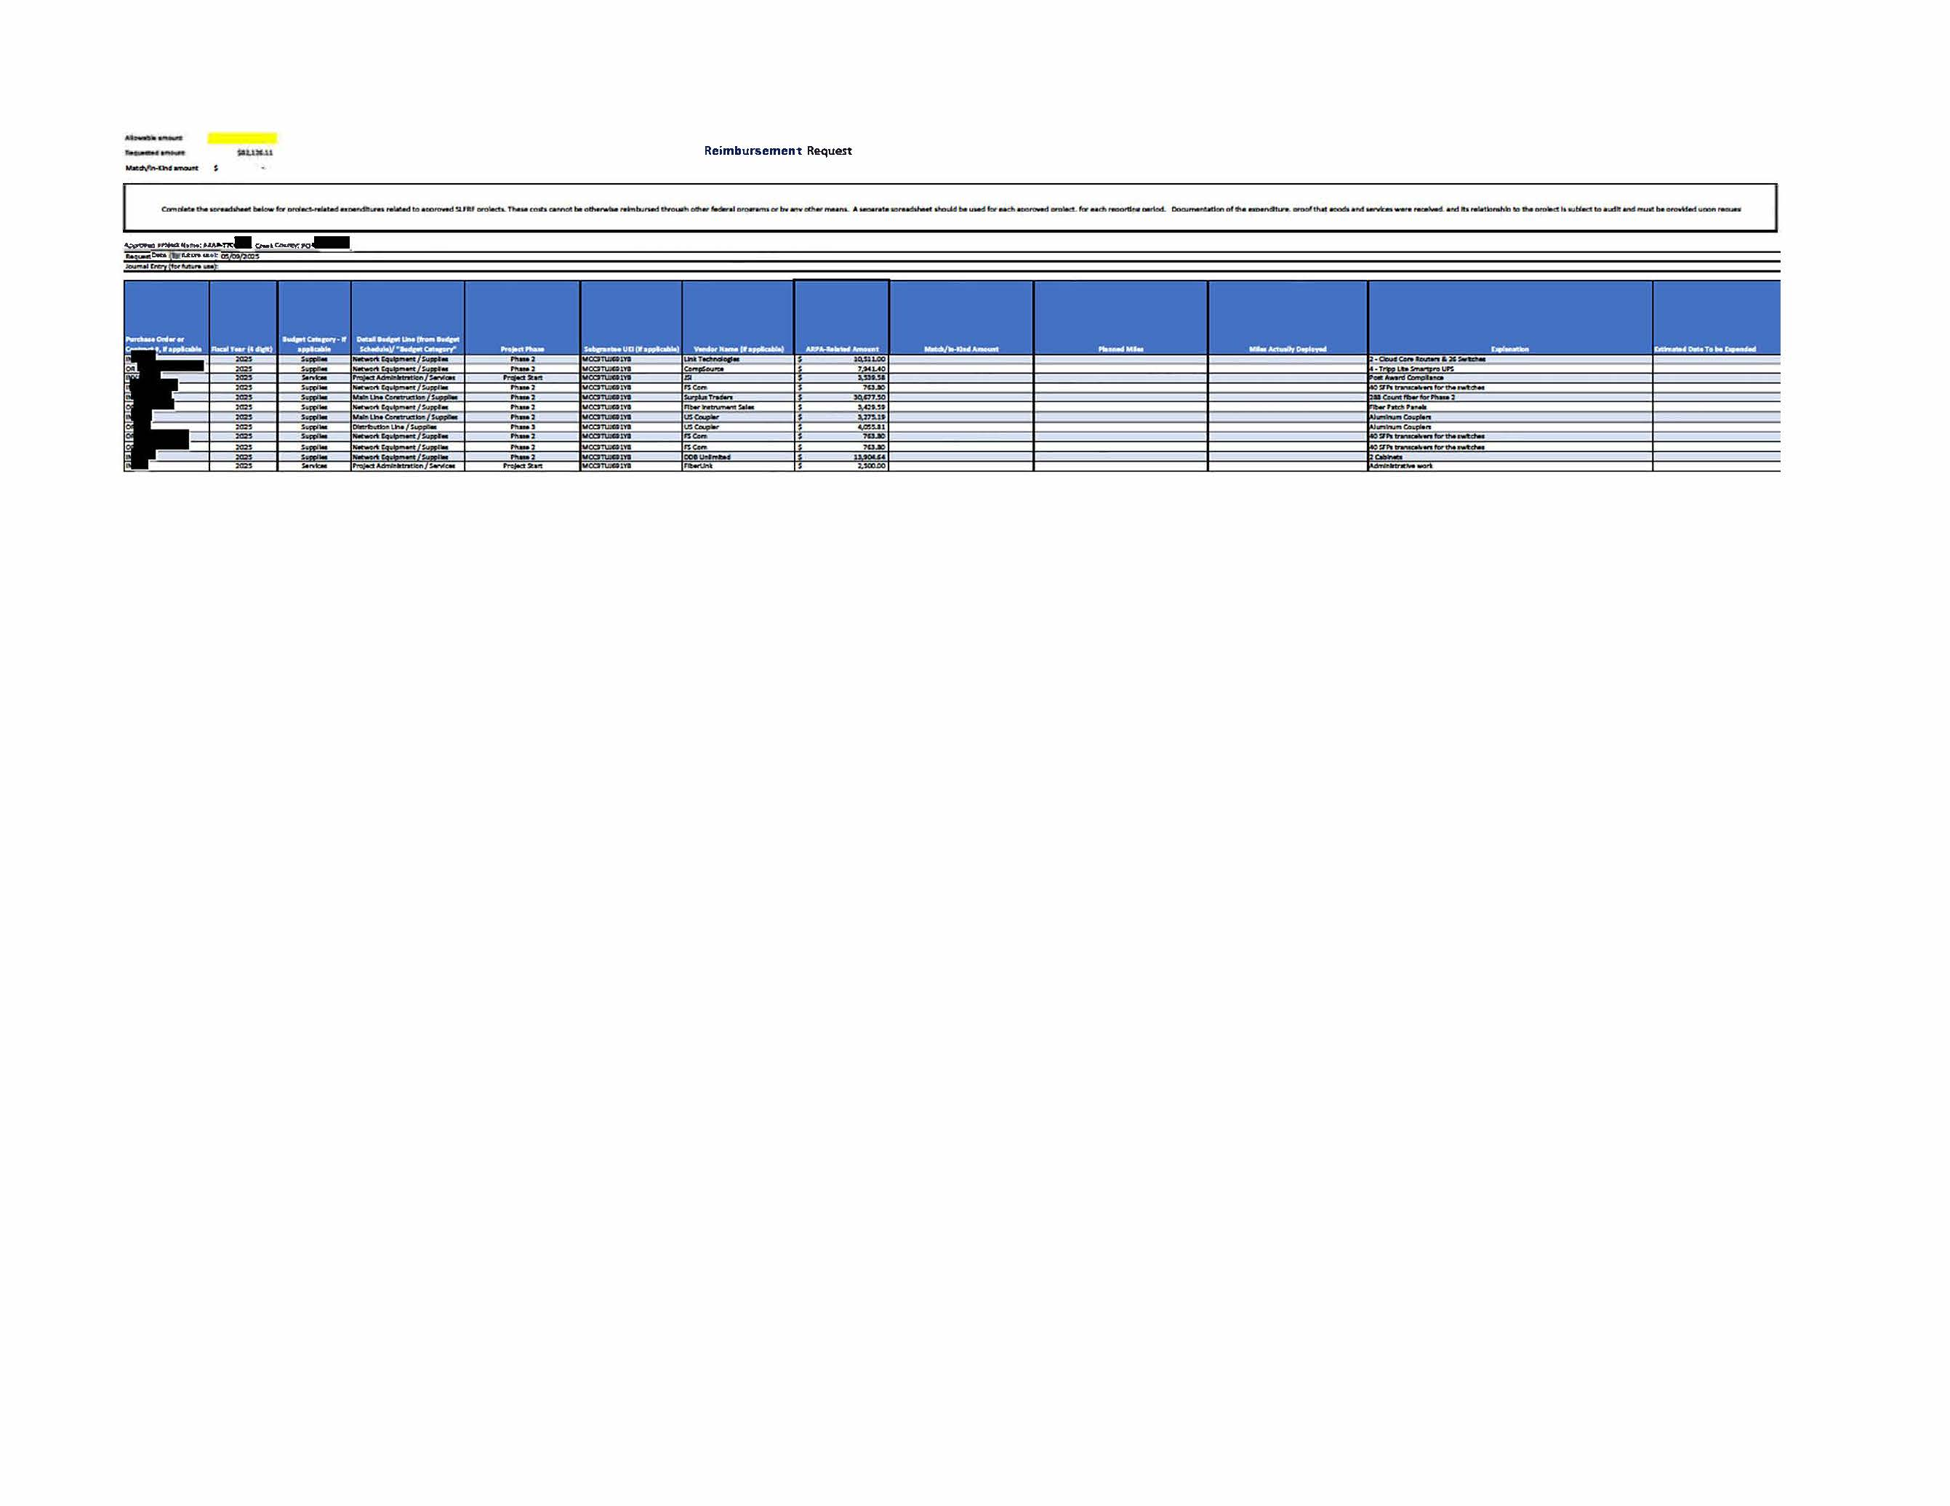
Example of the Reimbursement Draw Request

Slide 7
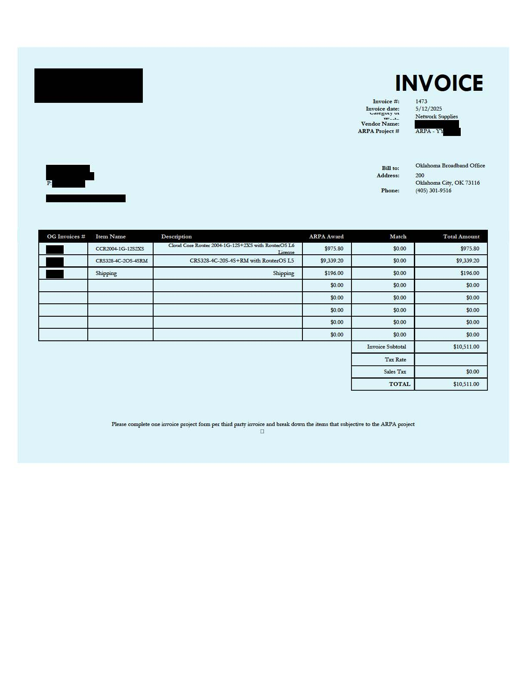
Example of an OBO Cover Page for Paid Invoice

Slide 8
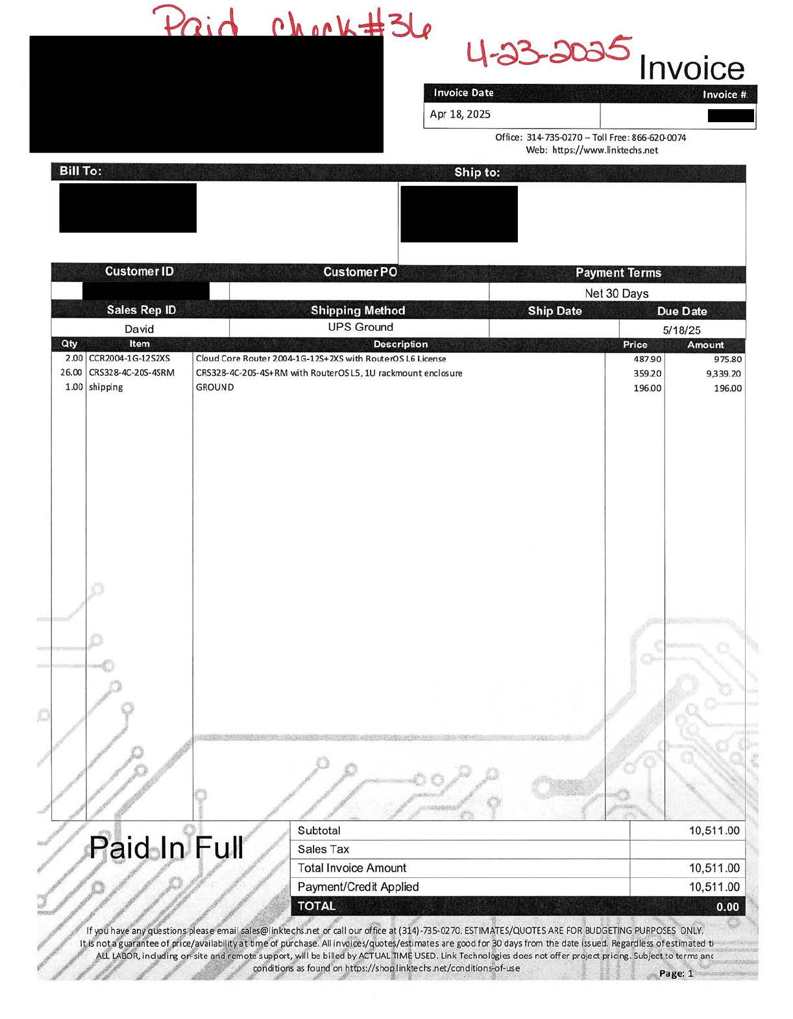
Paid Invoices Aways Need to be attached in the back of OBO Cover Page for reference.

Slide 9
Example of a Milestone Funding Request
Criteria:
  Eligibility: Low and low-moderate risk subrecipients only
  10% Mobilization Payment: Available when permits, equipment, and staff are in place to start work
  Additional Milestone Payments: At 35%, 50%, 85%, and 100% completion of fiber miles and drops laid
  Requirement: Must demonstrate completion of each performance milestone to receive payment
Complete Draw Request Package:
  Advance Funding/Milestone Report Draw Request excel Template
  Third Party Independent Engineer certification for either 25%, 50%, 85% and 100% Completion
  Invoices attached to OBO cover page.

Slide 10
Milestone Draw Request Template
Budget Milestone Schedule
Awarded Funds | Total | Dispensed |  | 10% | 25% | 50% | 85% | 100%
Miles of Fiber | 14.38 | 1.44
Number of New customers |  | 0
Staffing |  | $0.00
Capital (Real) |  | $0.00
Capital (other) |  | $0.00
Service | $589,176.02 | $58,917.60 |  | $ 58,917.60
Supplies | $202,546.98 | $20,254.70 |  | $ 20,254.70
Total Award Amount | $791,723.00 | $79,172.30 |  | $ 79,172.30
Grant Drawdown totals |  | $0.00
Matching Funds | Total | Dispensed |  | 10% | 25% | 50% | 85% | 100%
Staffing |  | $0.00
Capital (Real) |  | $0.00
Capital (other) |  | $0.00
Service | $190,235.19 | $19,023.52 |  | $ 19,023.52
Supplies | $80,321.19 | $8,032.12 |  | $ 8,032.12
Total Match Amount | $270,556.38 | $27,055.64 |  | $ 27,055.64
Percentage of Award Amount | 34.17%

Slide 11
Example of an OBO Cover Page for Paid Invoice

Slide 12
Paid Invoices Aways Need to be attached in the back of OBO Cover Page for reference.

Slide 13
Oklahoma Broadband Office
https://broadband.ok.gov
301 NW 63rd Street
Oklahoma City, OK 73116

