Slide 1
Oklahoma ABLE Commission PRO Brand Registration brandregistration@able.ok.gov 405-521-3484
https://www.productregistrationonline.com

Slide 2
Statues and Oklahoma Administrative Codes References
Title 37A § O.S. 5-132 Registration of Labels - Fees
OAC 45-30 3.2 Manufacturer’s Brand Name Label Registration
OAC 45-30 5.2 Brewer’s Brand Name Label Registration

Slide 3
What types of Licenses are required to register their products?
Non-Resident Sellers
Distillers
Small Farm Winery/Winemaker
Brewers/Small Brewers
Rectifiers

Slide 4
Which Product types to register?
Wine
Malt
Spirits
Combo/VP (Variety Pack)

Slide 5
Information you may need to include for each product registered.
Image of the Product Label
Vintage
Bottle Size
Container Type
ABV
Bottle per selling unit
Selling units per case
Letter of Appointment from Brand Owner
Trademark Document
Bottling Letter

Slide 6
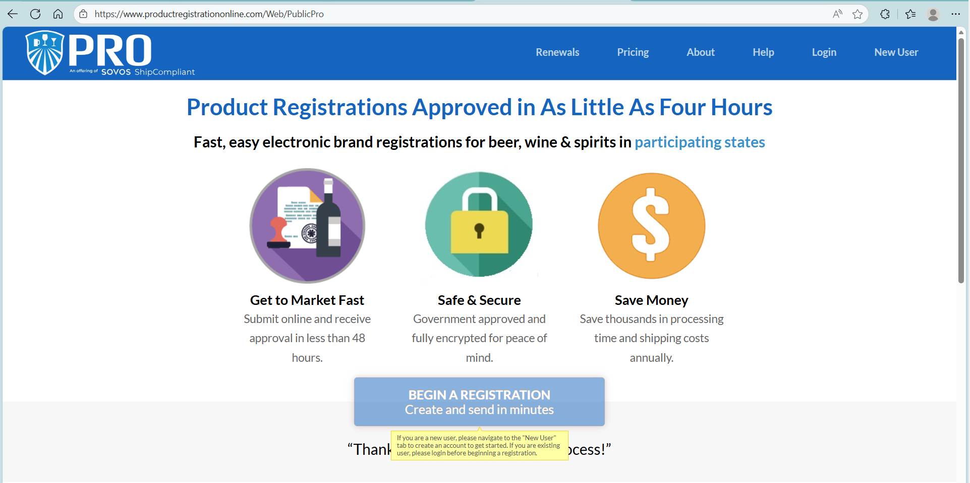
Product Registration Home Page
Step 1 – Click on blue BEGIN A REGISTRATION box. If you are a new user, Click on NEW USER you will need to create an account. If you are an existing user, click on LOGIN.

Slide 7
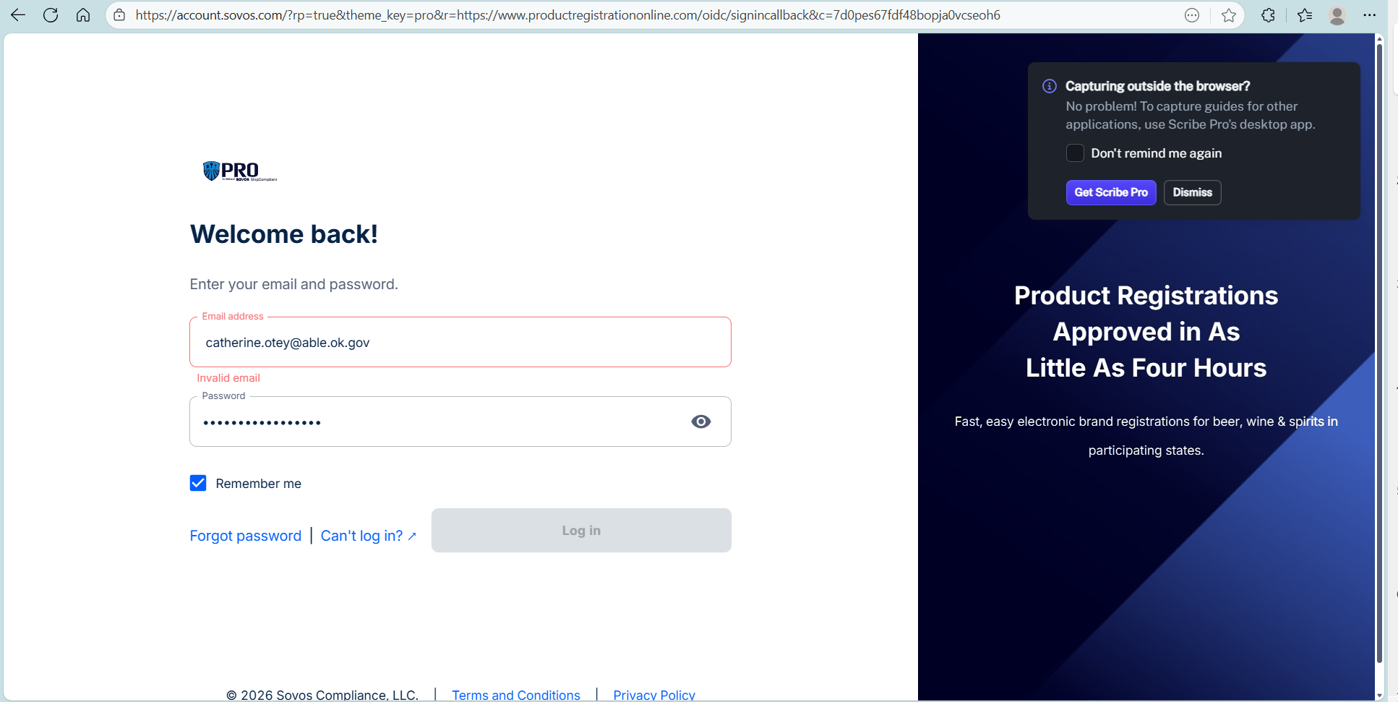
Create an Account or Login
Step 2
Enter your email and password.
If you have trouble logging into your account, please contact support.sovos.com to open a support case.
Please note, each member of your compliance team will need to set up an individual account.

Slide 8
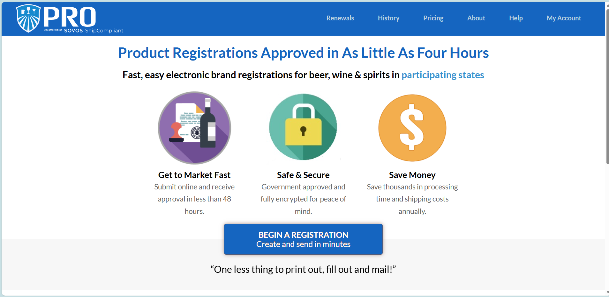
Begin A Registration Page
Step 3
Click on the “BEGIN A REGISTRATION” box.

Slide 9
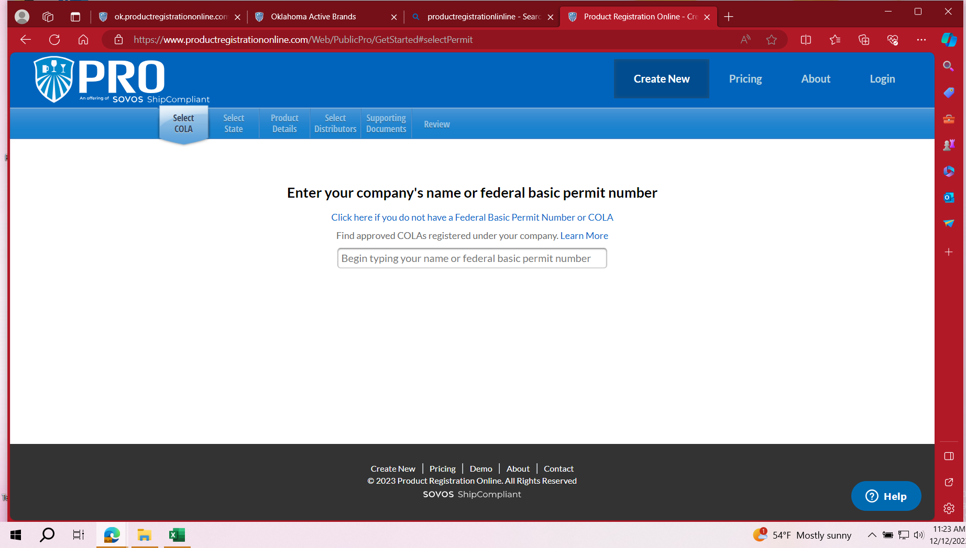
SELECT COLA PAGE
Step 4
If you are registering labels using a COLA (Certificate of Label Approval), you will enter your company’s name in the drop down and click on your Federal Basic Permit Number issued by the TTB.
If you are registering labels without a COLA, choose the Click here if you do not have a Federal Basic Permit Number or COLA. This includes COMBO/VP. Must register as NO COLA. All products within variety pack must be registered individually. (See Registering with no COLA slide.)

Slide 10
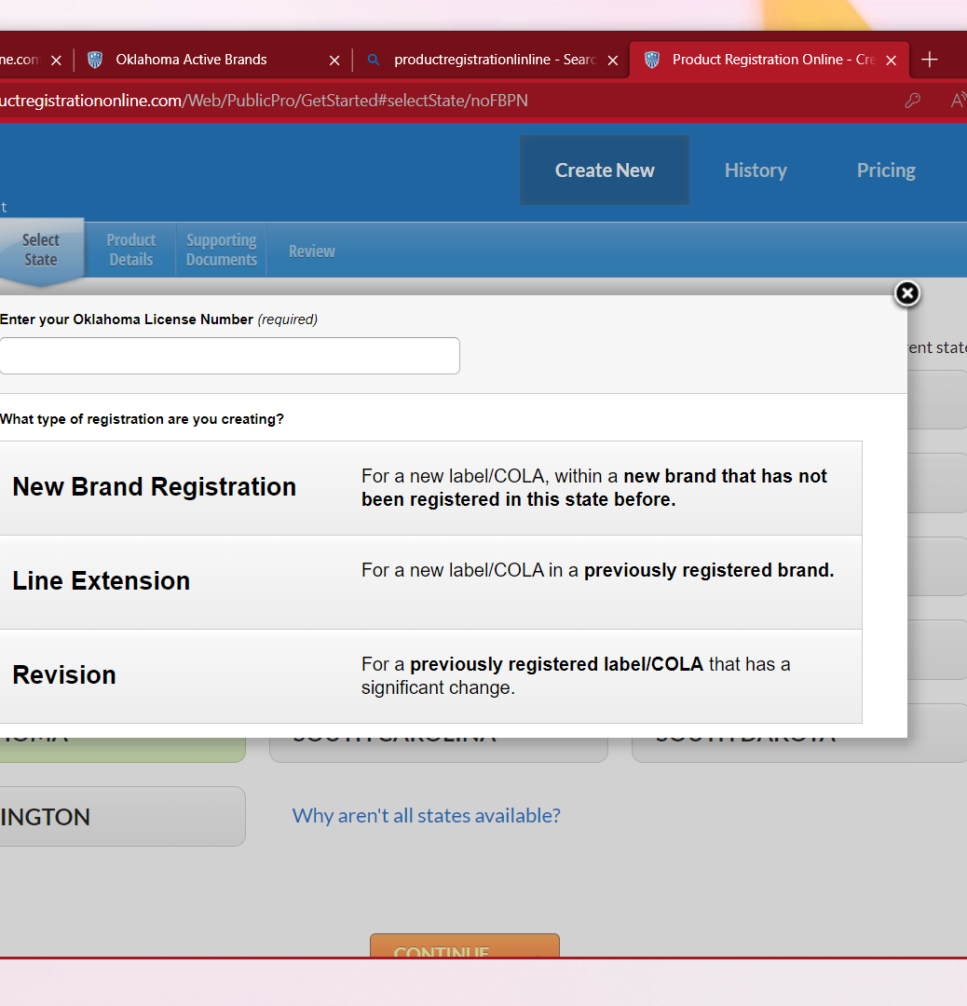
Enter Your Oklahoma License Number
Step 5
Enter your ABLE license number or your company name in the box.
Please be sure to choose your name/license number.
It is possible to register your labels under any license number. Make sure that your ABLE license number is being selected.
If you have an ABLE license number that includes an alpha, a year and 6 digits, please enter with no spaces or hyphens.

Slide 11
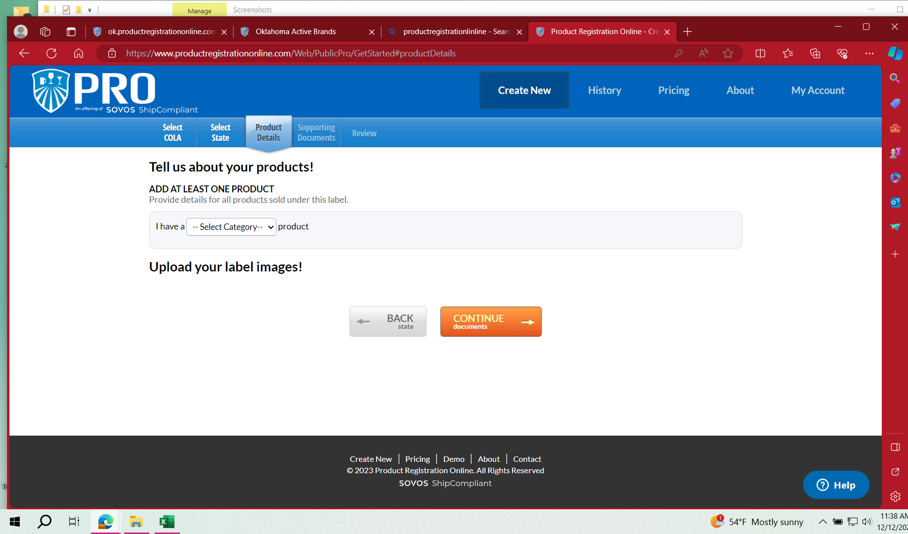
Registering with NO COLA
Step 5
Choose your product type
Enter Product details.
Click on Add another product if needed.
You will be prompted to upload images. Save Image before going to CONTINUE to Documents.
After clicking CONTIUE, you should be at Step 9 of the Registering with a COLA Instructions.

Slide 12
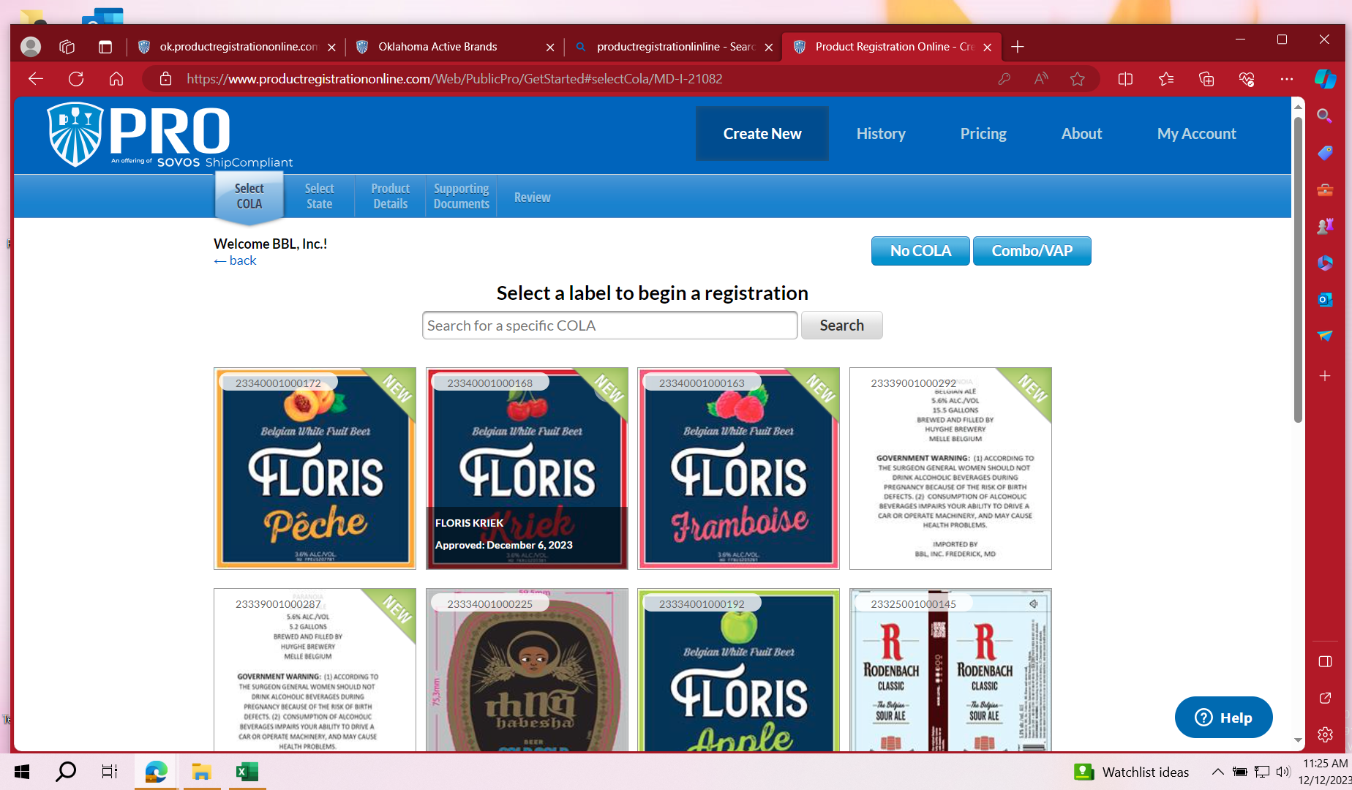
Registration with a COLA
Step 6
Enter Basic Federal ID to find your COLAs
Select the COLA for the label you are registering.
All COLAs download directly from the TTB.
If you are registering without a COLA or a COMBO/VP (Variety Pack), choose NO COLA button.

Slide 13
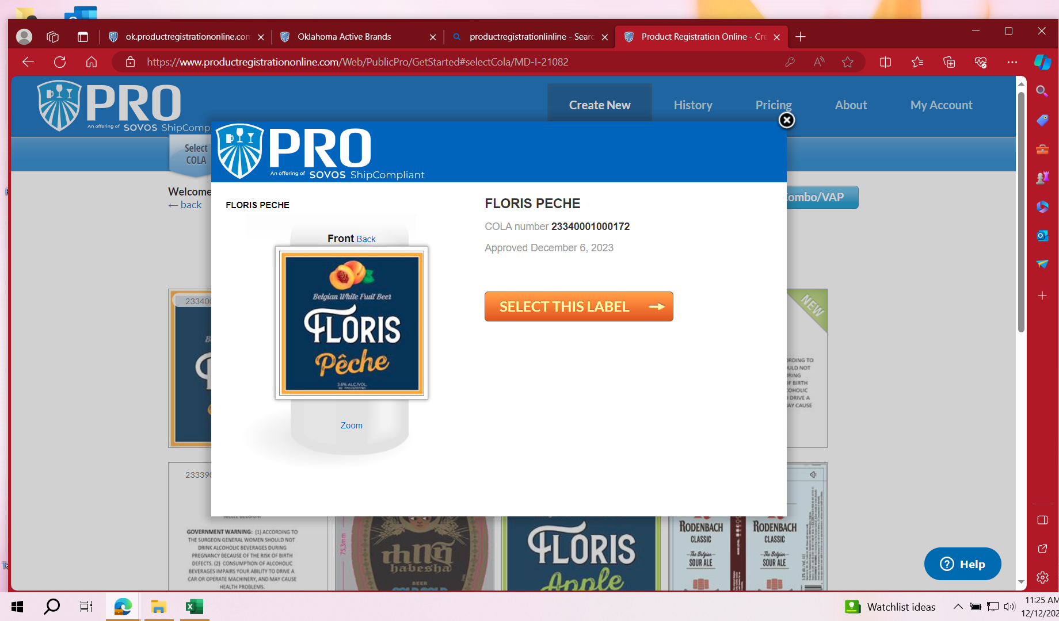
Step 7 – Select this label

Slide 14
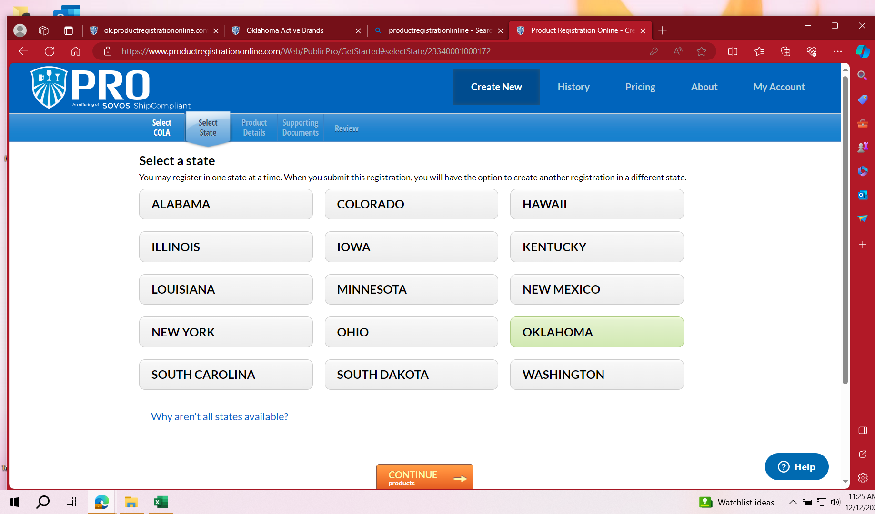
Step 8 – Select OKLAHOMA

Slide 15
Types of Registrations
Step 9
Next you will be shown the 3 types of registrations. Each type has the criteria to help you choose the type you need.

Slide 16
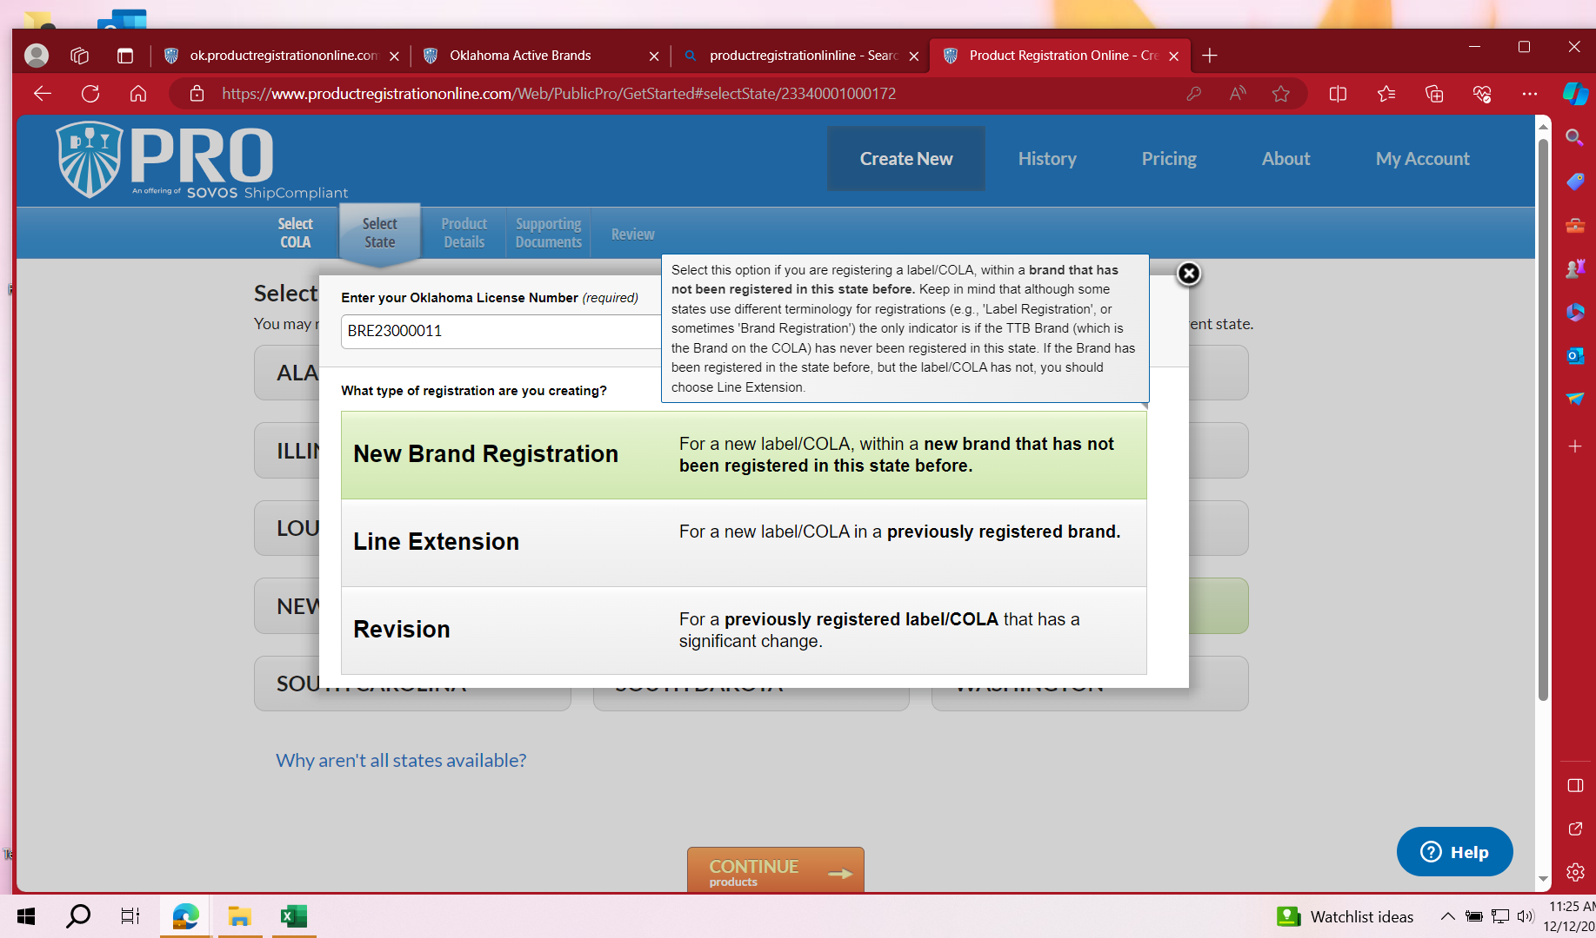
Types of Registrations – New Brand
Use this type if you are registering a label/COLA within a brand that has not been previously registered in the state during the current year.
Each brand registration is effective from 7/1 to 6/30 of each year.

Slide 17
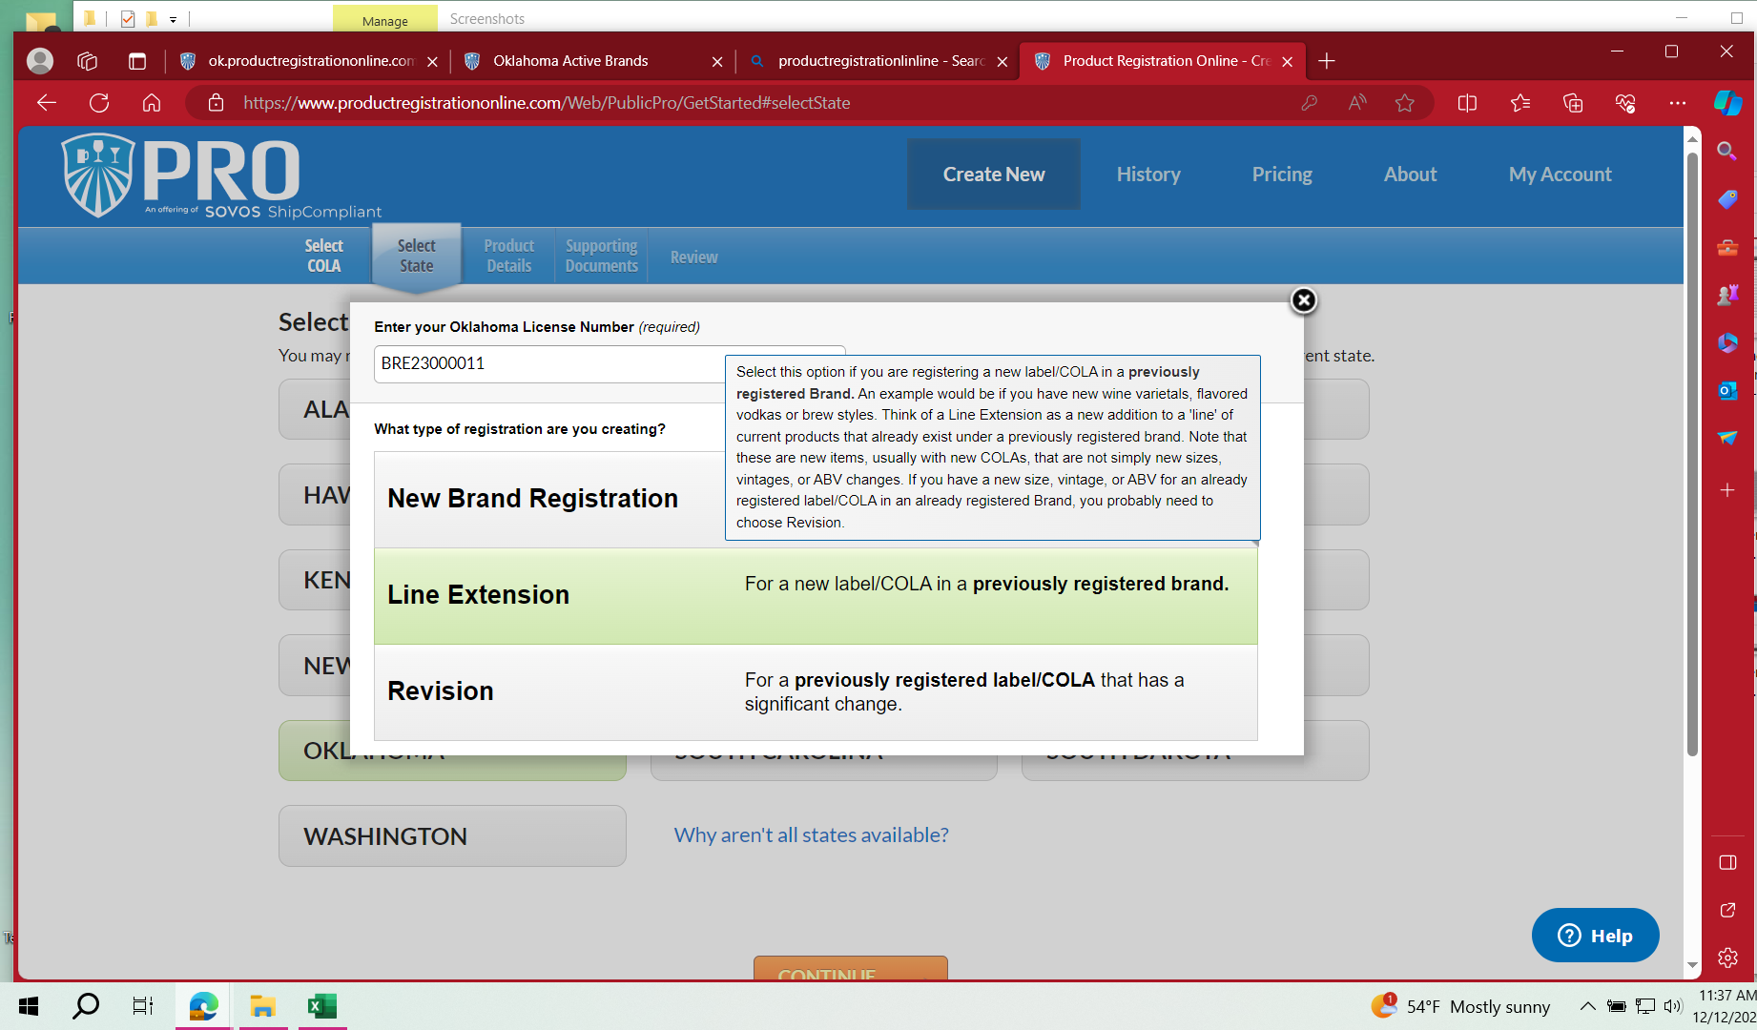
Types of Registrations – Line Extension
Use this type for a new label/COLA in a previously registered brand during the current year.
Do not add line extension if the brand is not currently registered. This could result in your registration being denied.

Slide 18
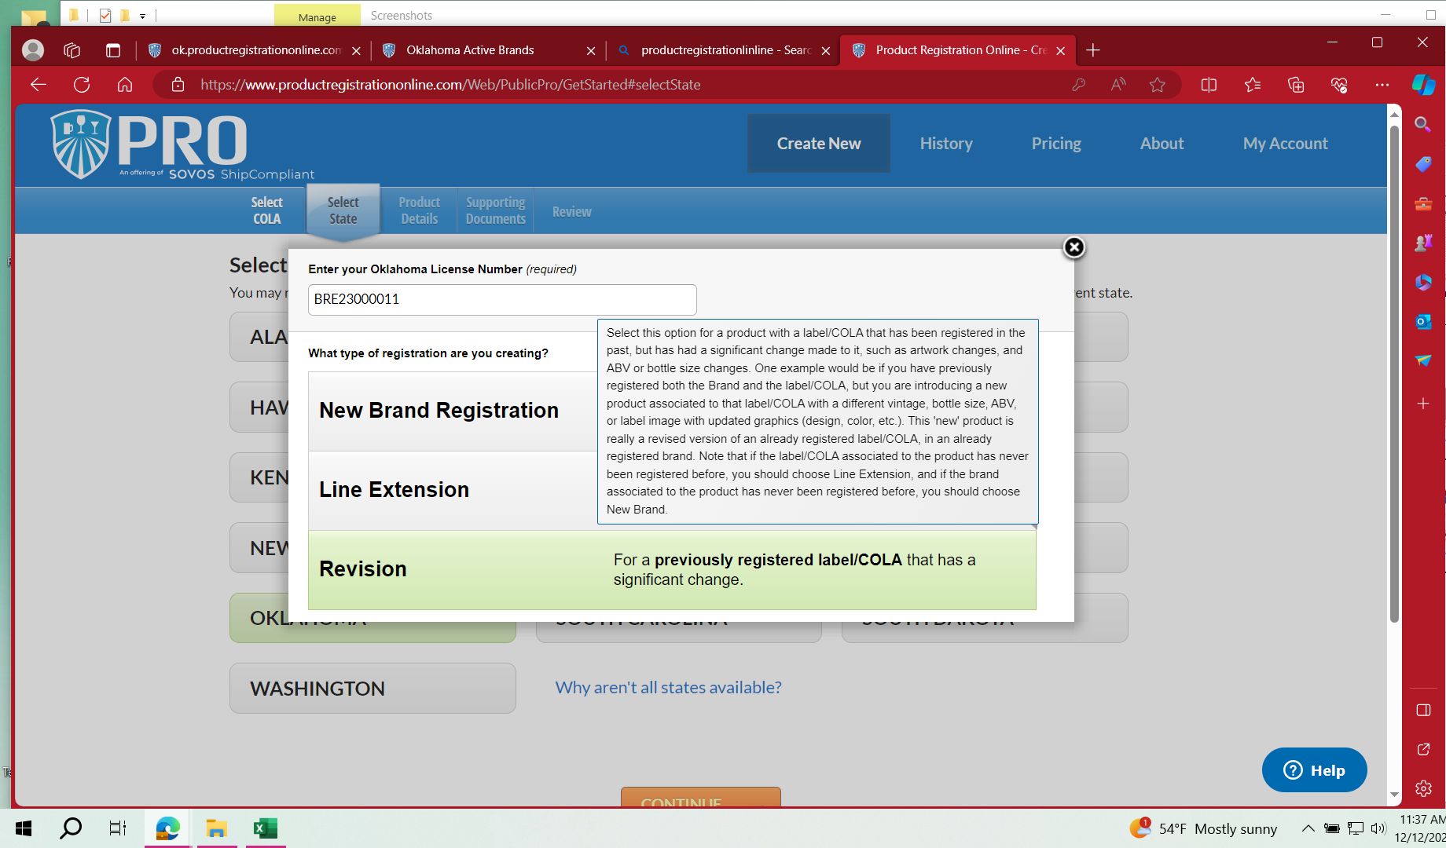
Types of Registrations - Revision
Use this type for a previously registered label/COLA that has significant change.
Examples of these changes are, new vintage or age, new ABV, content type, size or case configuration or graphics change on the label

Slide 19
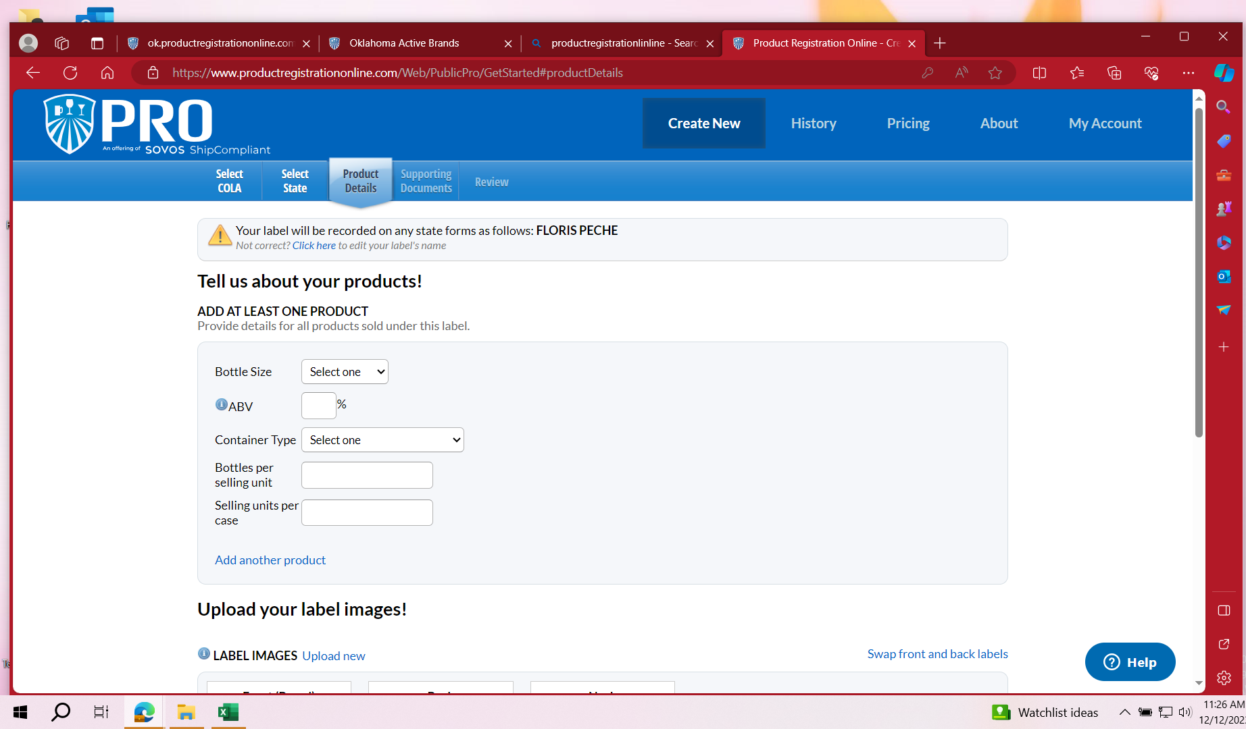
Product Details Tab
Step 10
You will see a yellow triangle at the top of the page.
Choose - Click here.
If registering with NO COLA, enter the Brand Name and the Fanciful Name. You can enter the Sub Brand and Style if you wish to do so. This is important because PRO charges the state fee according to each brand name that is registered.
If you are registering with a COLA, the brand name is auto-populated.
Add Product Details.

Slide 20
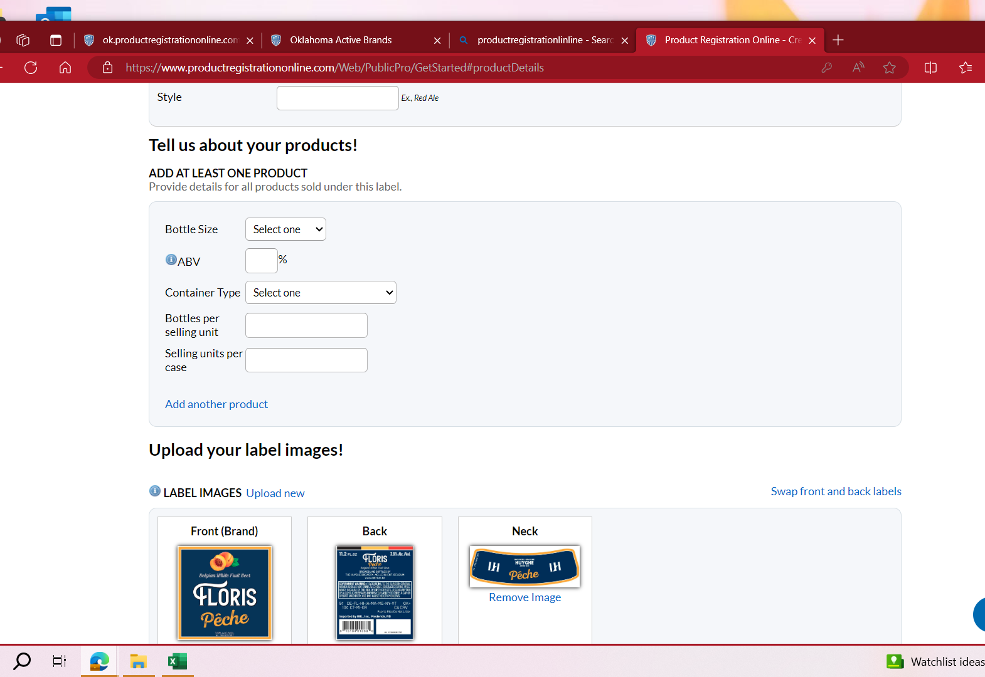
Adding Multiple Products to one registration
If you have more than one content size of the same product that has the same ABV, you can click on Add another Product.

Slide 21
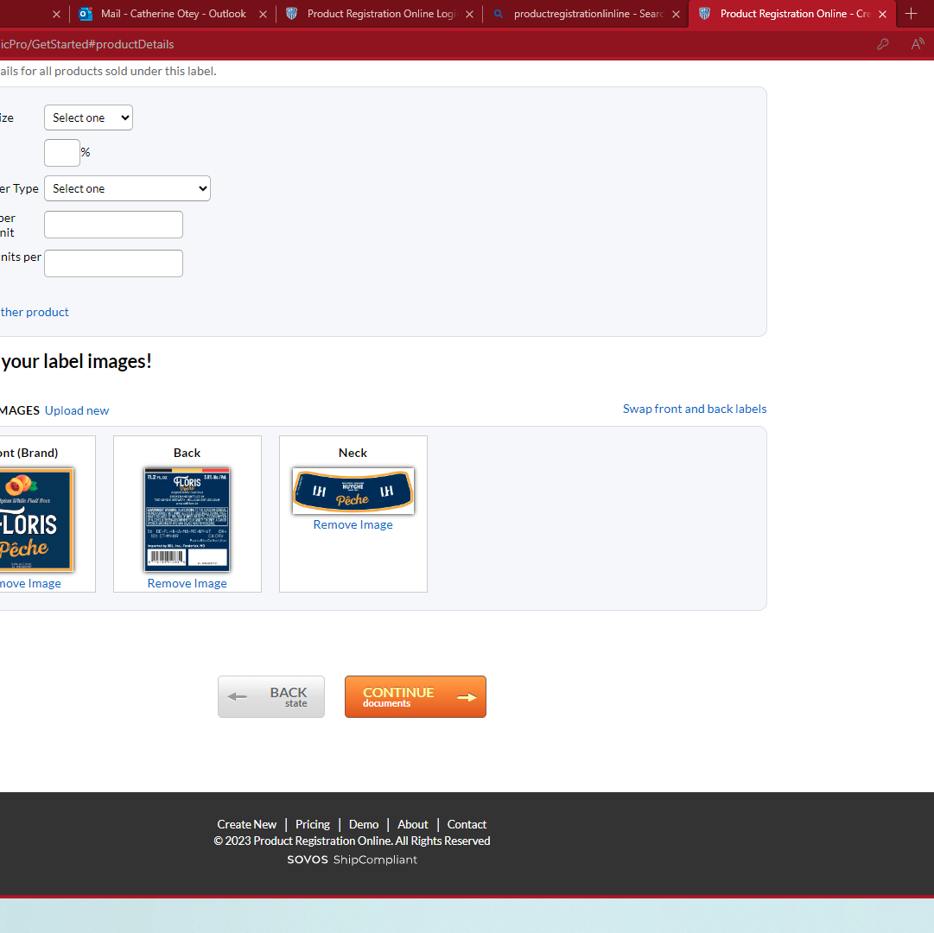
Upload your label images!
Step 11
After you have entered all your product details, click the CONTINUE to Documents box.
Your labels should already be uploaded if registering with a COLA.
If registering without a COLA, you will need to upload your label or keg collar manually.
If you have issues uploading your label, please contact support.sovos.com.

Slide 22
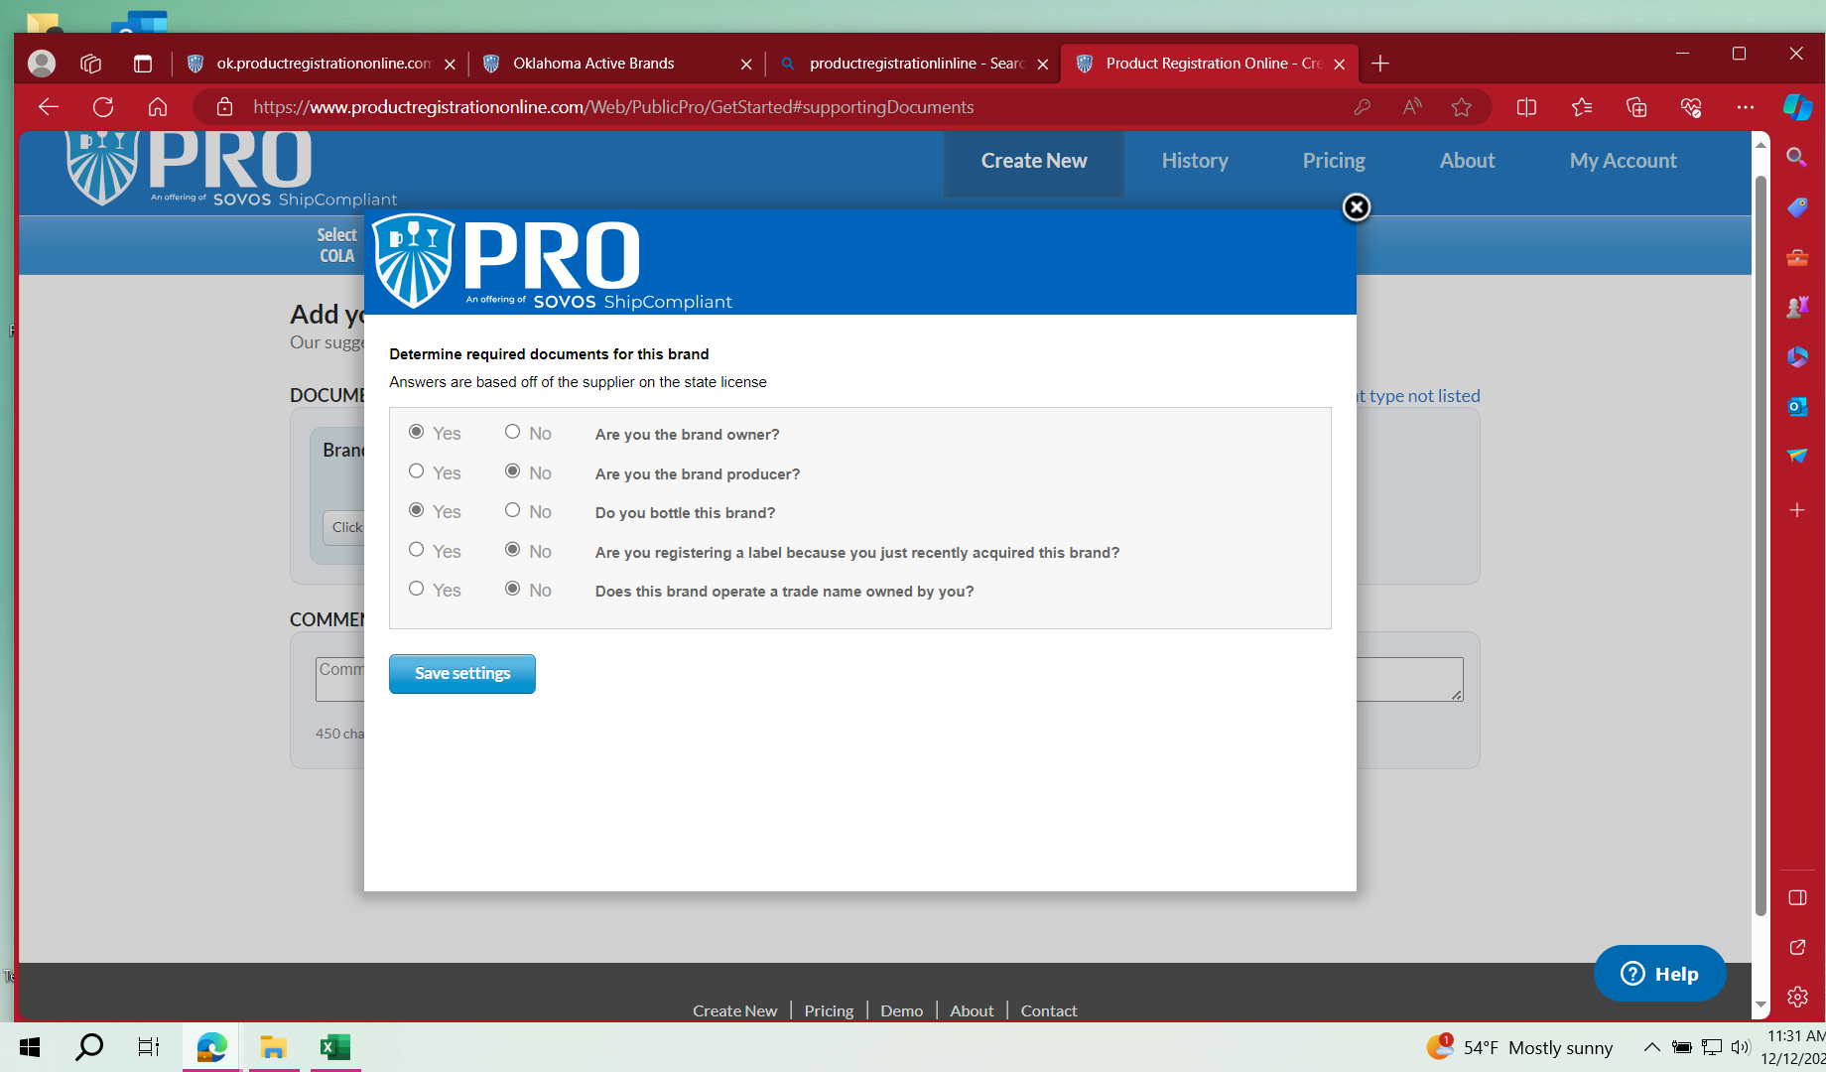
Determining Required Documents
Step 12
Answer each question
See the Required Document slide for information about each question.
Save settings
Click on continue

Slide 23
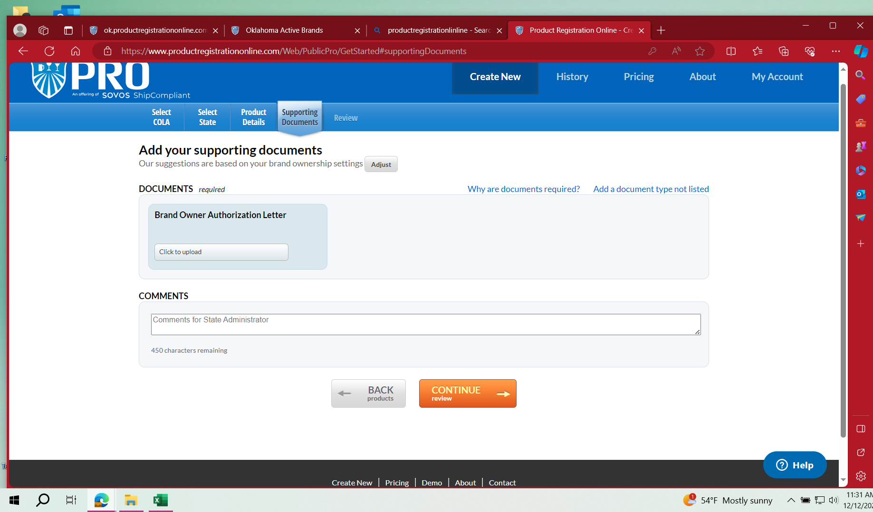
Add your supporting Documents Step 13

Slide 24
Required Documents
Brand Acquisition Letter (if you answered yes to, Are you registering a label because your just recently acquired this brand?)
Trade Name Document (if you answered yes to, Does this brand operate a trade name owned by you?)
Bottling Letter (if you answered no to, Do you bottle this brand?)
Brand Owner Authorization Letter (if you answered no to, Are you the brand producer?)
After you unload the required documents, Click on CONTINUE TO REVIEW

Slide 25
Payment
Step 14
After you review your registration and everything looks correct, you should be prompted to go to the payment page.
When you are adding a new registration, you must pay for each registration separately.
Depending on the type of registration you submitted, you may be charged a state fee.
In addition to any applicable state fees, there will be $5 technical fee that is charged by PRO for each registration. This is non-refundable by the ABLE Commission.
You can choose to start a new registration after your payment is submitted.
Registrations can take from 1 to 30 days to auto-approve.

