Slide 1
State of Oklahoma Boundary Facilitation Workshop
Annie Cahill, GISP | Technical Consultant

Slide 2

Introductions
Annie Cahill, GISP
Technical Consultant
DATAMARK
Annie.Cahill@mbakerintl.com

Slide 3
Agenda
Module 1: Introduction to Boundaries
Module 2: Assessing Boundaries
Module 3: Open Discussion/Local Questions

Slide 4
Introduction To Boundaries
MODULE 1

Slide 5
What Is A Boundary?
A division between adjacent political entities (such as counties, countries, or districts), tracts of private land, or geographic zones (such as ecosystems). Boundary lines may be imaginary lines, physical features that follow those lines (such as rivers, mountains, or walls), or the graphical representation of those lines on a map.
Examples:
  County, City, Town
  Parcels
  Emergency Service Numbers (ESNs), Public Safety Answering Point (PSAP)

Slide 6
Public Safety Boundaries
ESN: Emergency Service Number-a 3-5 digit number that represents one or more ESZs (Emergency Service Zones), stored as a 3-5 digit numeric string in MSAG/ALI/GIS databases.
ESZ: Geographic area that represents a unique combination of emergency service agencies (Law, Fire, Medical) within a specified 9-1-1 governing authority’s jurisdiction. An ESZ can be represented by an Emergency Service Number (ESN) to identify the ESZ.
Functions:
  Route call to assigned PSAP, either directly or as a transfer
  Provide proper emergency response service agency

Slide 7
Public Safety Boundaries
PSAP: Public Safety Answering Point - A physical or virtual entity where 9-1-1 calls are delivered by the 9-1-1 service provider
Discrepancy Agency Boundary (Provisioning) - Defines the area of responsibility for a GIS data provider for an NG9-1-1 system.
Emergency Service Boundaries (ESBs) - Used to identify the responding agencies, based on the Service URN, for a geographic area.
  Police (Law), Fire, EMS)-REQUIRED
  May also include other response agencies such as US Coast Guard, Animal Control

Slide 8
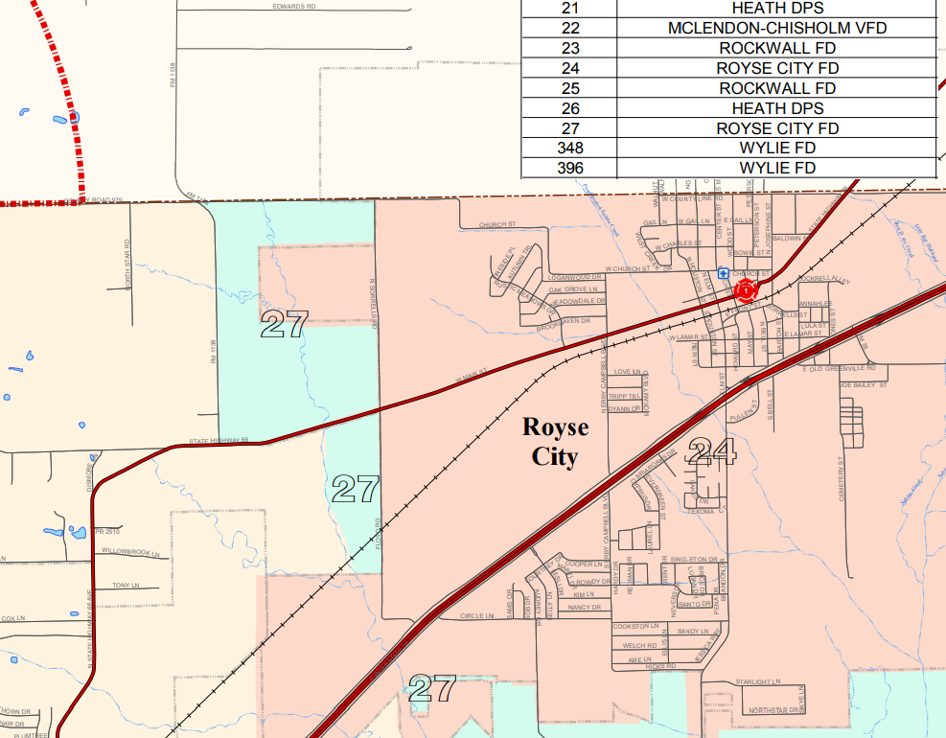
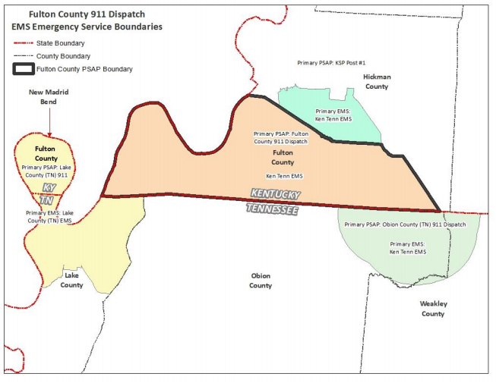
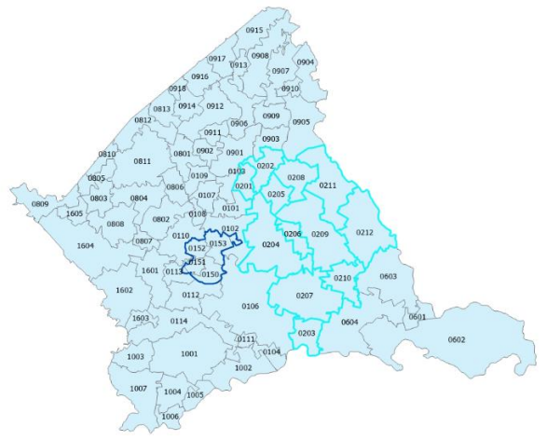
Boundaries In Legacy 9-1-1
Visual representation or reference of the tabular data
Tabular MSAG/ALI data routes the call, not the GIS boundaries

Slide 9
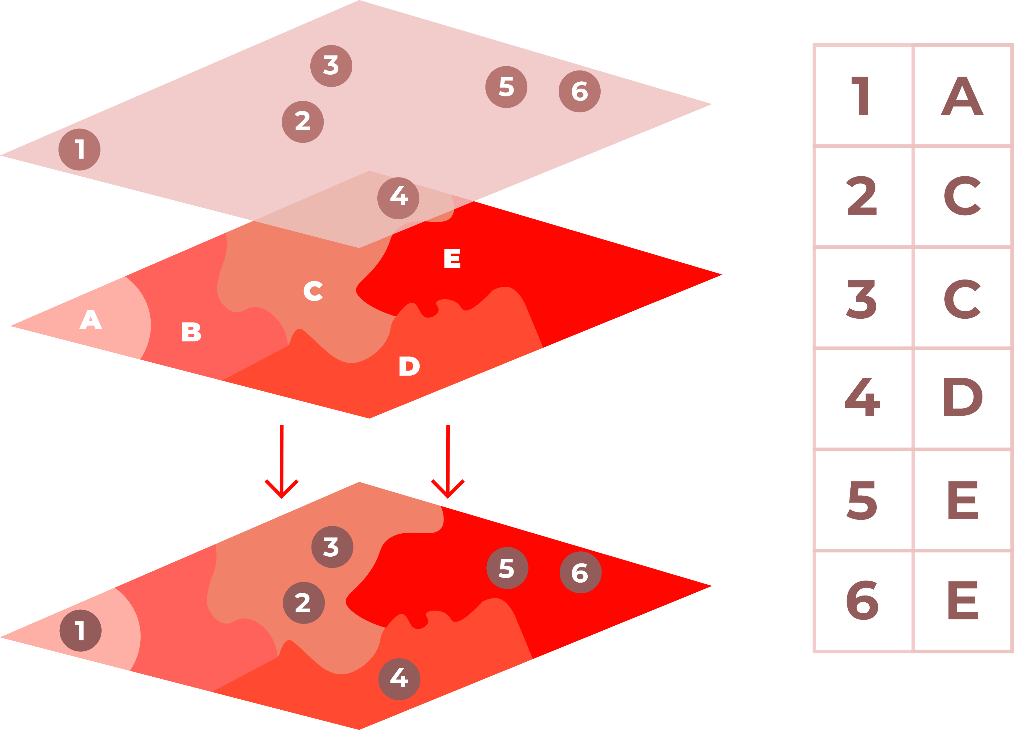
Boundaries In NG9-1-1
GIS boundaries route 9-1-1 call, not MSAG
  Discrepancy Agency Boundary
  PSAP
  ESBs
Notes:
NG9-1-1 is an IP based system that uses geospatial call routing to determine which PSAP receives the call. This is accomplished through a point-in-polygon analysis described here.

Slide 10
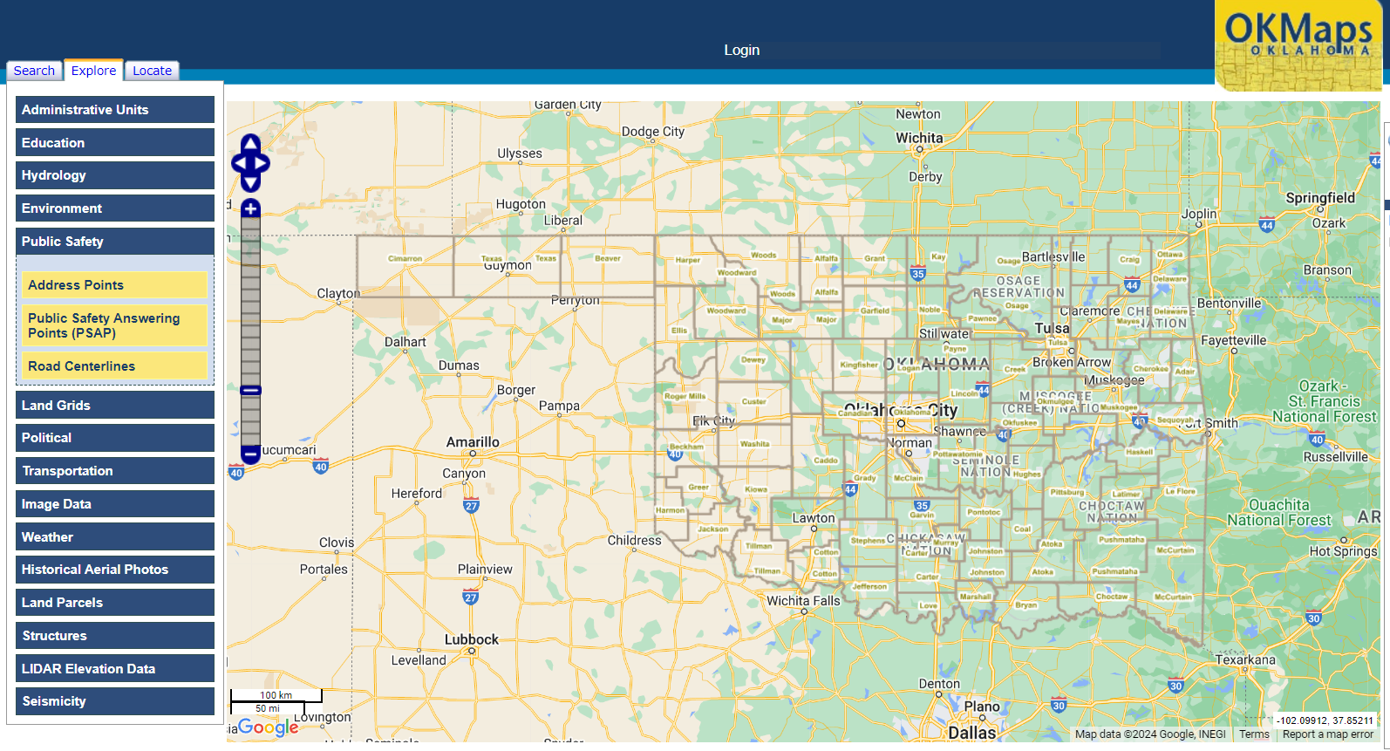
The State’s Role In Managing NG9-1-1 Boundary Data
OK 9-1-1 Management Authority
  Discrepancy Agency Boundary
  PSAP Boundary
https://www.ok.gov/911/Resources/NG9-1-1_Information_for_PSAPs/index.html

Slide 11
The Local’s Role In Managing NG9-1-1 And Legacy Boundary Data
Geospatial first responders!
Boundaries are PSAP decisions
All stakeholders must work together
  Public Safety
  GIS
  Addressing Authority
Data quality is important

Slide 12
Correcting Public Safety Boundaries
Discrepancy Agency Boundary
PSAP Boundary
ESNs/ESZs
ESBs
RCLs

Slide 13
Assessing Boundaries
MODULE 2

Slide 14
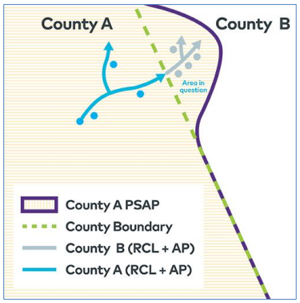
State’s Process For Boundary Amendment
https://www.ok.gov/911/documents/Municipal_PSAPMtcGuidelines.pdf
Review the document
  Annexations/De-annexation
  PSAP Boundary

Slide 15
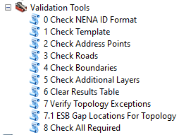
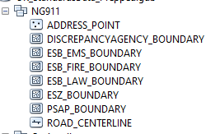
Using The NG9-1-1 Toolkit For Boundary Assessment
Toolkit will identify any gaps and overlaps in the boundary data
Gaps and overlaps violate topological relationships required for NG9-1-1
These must be resolved for submission to the Repository
Must have GIS (ArcMap) to assess topology and use Toolkit

Slide 16
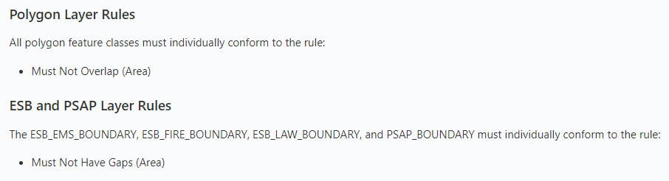
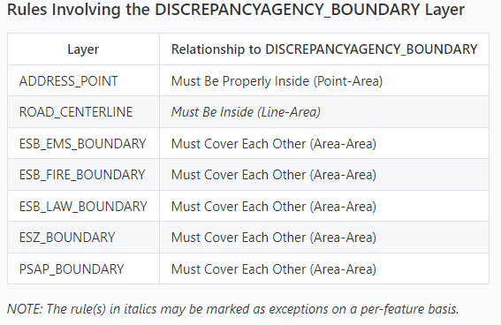
Boundary Topology Rules

Slide 17
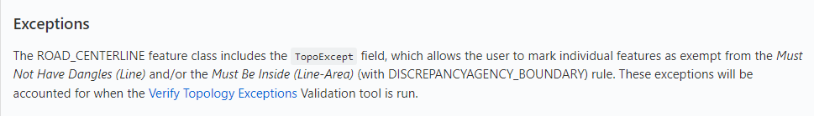
Usage Of Exceptions
Allowed only in the road centerlines
Are you working around a problem or making the data better?
Call routing boundaries=who gets the call first
Follow State process to amend PSAP if necessary
Don’t make exceptions on bad data just to validate

Slide 18
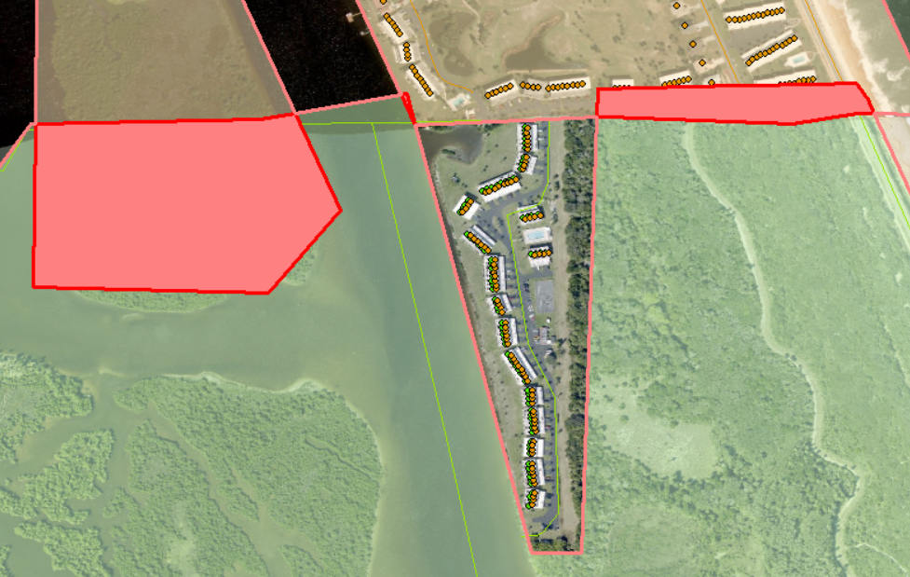
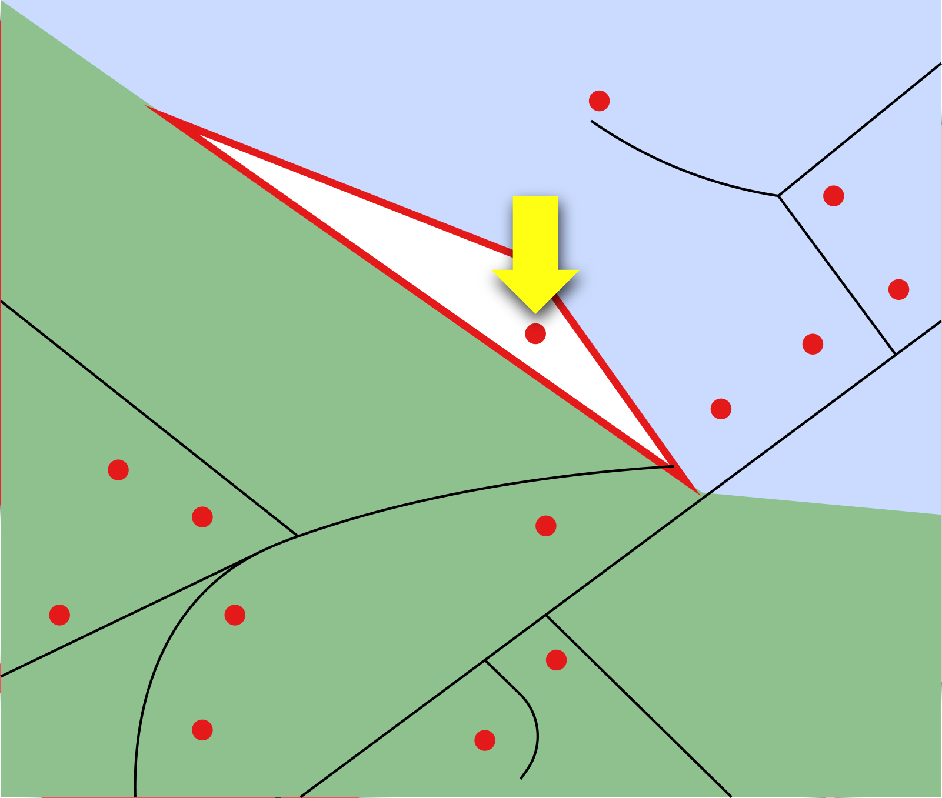
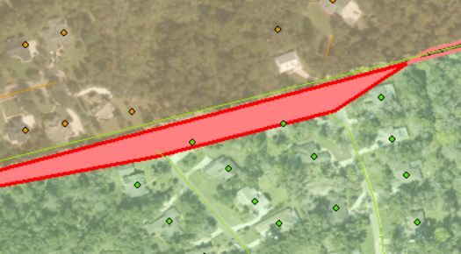

Slide 19
Neighboring PSAP Workshops
Download State-maintained PSAP boundaries
Examine and assess internal topology with Toolkit
GIS should run topology with PSAP and neighboring PSAPs
Build map package to review:
  Address points, road centerlines, municipal boundaries, PSAP boundaries, parcels, aerial photography
Meet with each neighbor
  PSAP Authority, GIS
  Bring Memorandums of Understanding (MOU), legal documentation, local knowledge, MSAG
  Review map anomalies and make decisions
  Document decisions and follow the State’s process to adjust

Slide 20
Best Practices For Sustainable NG9-1-1 Boundary Management
Purpose built boundaries!
Always review and assess data annually or whenever there are municipal changes
Be mindful of how annexations impact boundaries
Establish workflows for managing boundary data
Considerations for boundary adjustment:
  Annexations
  Future subdivisions/development
  NGCS provider may have requirements of the boundaries outside of the State/National standards
  Developing snap-to points can facilitate a better road centerline network

Slide 21
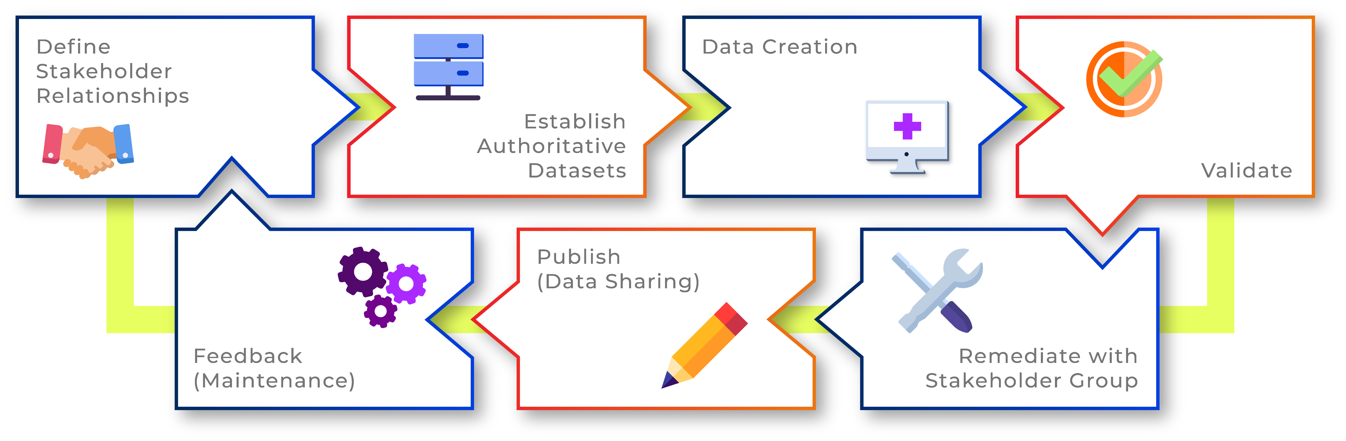
Ideal NG9-1-1 Data Management Workflow

Slide 22
Best Practices For Sustainable NG9-1-1 Boundary Management
Purpose built boundaries!
Always review and assess
Be mindful of how annexations impact boundaries
Establish workflows for managing boundary data
Considerations for boundary adjustment:
  Annexations
  Future subdivisions/development
  NGCS provider may have requirements of the boundaries outside of the State/National standards
  Developing snap-to points can facilitate a better road centerline network

Slide 23
Open Discussion and Local Questions
MODULE 3

Slide 24
QA1
Are ramps on interstate highways ever part of a city's jurisdiction?
Yes. We would need more information, is the question concerning maintenance of the road itself or 9-1-1 call routing?
QA2
The state does not have an authoritative and accurate county dataset. I come across various county naming, spatial extents, etc. I've stumped at least one federal agency with asking about their reference to local spatial extents. I know this has come up in the GI Council. Arriving at a solution appears to lack a concrete action plan with defined steps and target outcome.
What is meant by county dataset? Official county boundaries? County-wide data? Generally, county limits are determined locally.
QA3
I am not certain you classify this as a boundary issue, however, the Greer County 911 Central Dispatch Center historically has gotten calls within Blair Town limits that get routed to Greer County. We have submitted a request to AT&T to resolve the issue, however, AT&T has not notified us if the problem ever got resolved.
This sounds like it could be an AT&T wireless routing issue. Ex: with a cell tower with 4 sectors, the sector should be routed to the appropriate municipality. AT&T should have a form called a wireless call routing spreadsheet which can be modified and resubmitted for changes.
QA4
I fixed my issue but if this is for the next class being taught maybe go over how to fix the topology issue of must not have gaps. This was an area that I struggled a lot with because multiple polygon layers cause multiple gaps and then how do you find where the gap is and fix it. Topology was a real struggle for me and I still have some issues but not nearly as much as before.
We show this in the Toolkit Class. We also talk about topology in the Intro to ArcGIS Course.

Slide 25
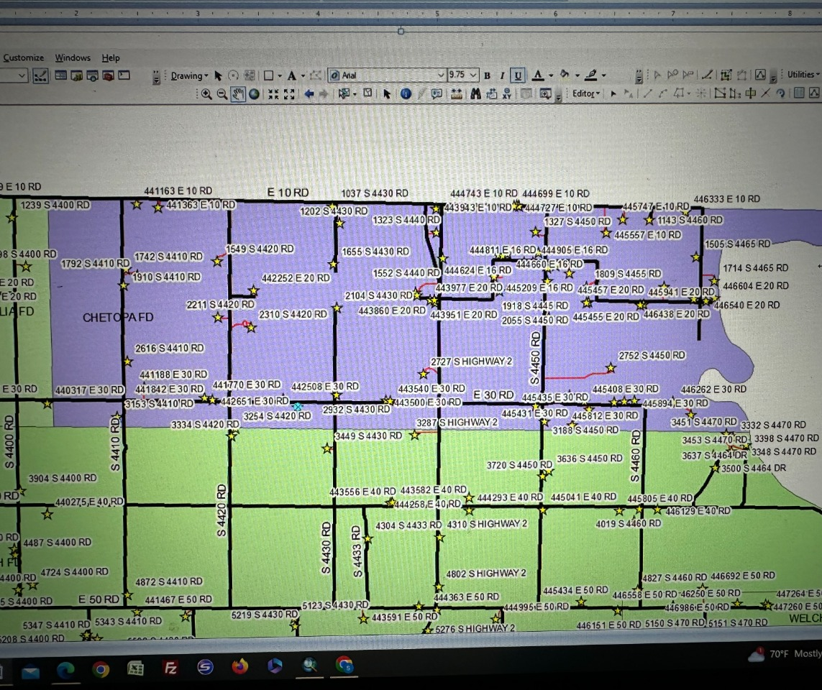
QA4
The area shaded in purple in the attached picture below is an area of my county that is serviced for fire by the town of Chetopa, KS. Apparently it was never entered into our MSAG due to it being serviced by an out of state entity. How might I go about addressing this so that everything in my county is accurately entered into the MSAG?
Since we are crossing state boundaries, and could possibly have two separate MSAG/ALI providers, it is recommended to communicate with the other town and inform them to remove that data from their MSAG and add to the other (OK) MSAG. They would need to remove the data from their GIS as well. The PSAP and ESB for Fire (and possibly Police and EMS) would need to be adjusted as well. Another option is an MOU and ensure it is documented that OK fire trucks are going into KS.

Slide 26
Questions?

