Slide 1
State of Oklahoma Addressing Workshop
Annie Cahill, GISP | Technical Consultant

Slide 2

Introductions
Annie Cahill, GISP
Technical Consultant
DATAMARK
Annie.Cahill@mbakerintl.com

Slide 3
Agenda
Module 1: Introduction to Addressing
Module 2: Addressing for Public Safety
Module 3: Best Practices for Addressing
LUNCH
Module 4: Creating Sustainable Addressing Workflows
Module 5: Open Discussion/Local Example Review

Slide 4
Introduction To Addressing
MODULE 1

Slide 5
Quiz Time
Addressing is a function of the US Postal Service.
An address can be assigned without a “structure” present.
Addressing is mission critical to all government functions.
Subaddressing isn’t that important to maintain.
False
✗
✓
True
✓
True
✗
False

Slide 6
History & Legacy

Slide 7
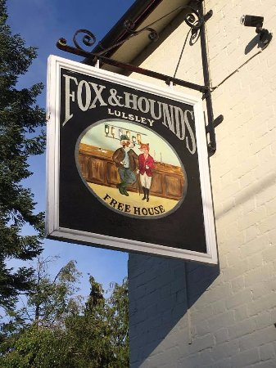

Origins
“I’ll meet you at the Fox and Hound”
Giving directions: “Turn left at the Windy Mermaid and then right at the Broken Wagon.”
Census
Conscription
Tax collection

Slide 8
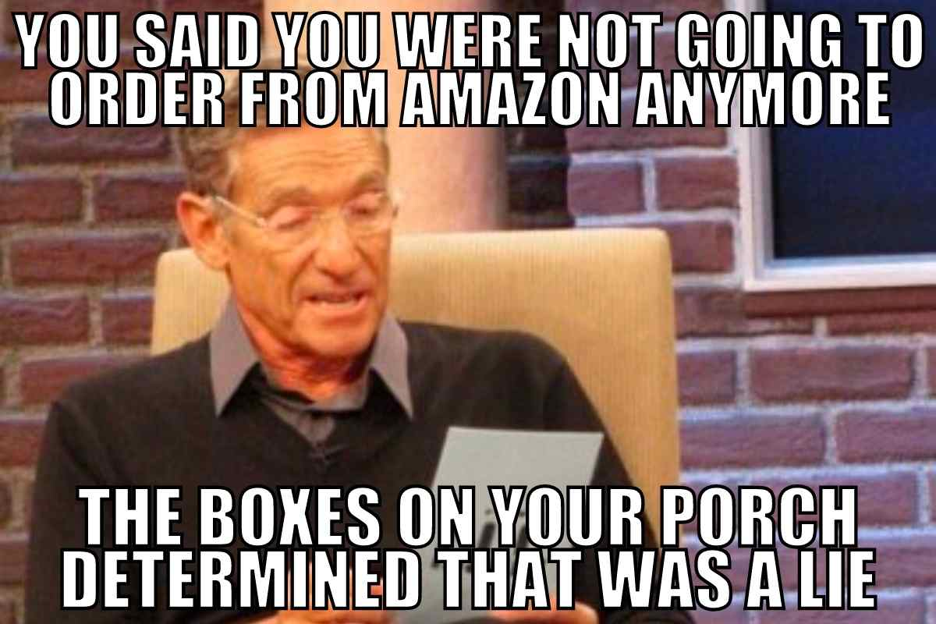
Point of Service Delivery
USPS
Pizza
Utilities
School bus
Uber/Lyft
Census
Public Safety

Slide 9
Evolution of Legacy Systems
Boundaries between jurisdictions
  Change in grids
  Change in street names, types, directional
Lack of information
  Driveway/access
  Number of lots
Lack of ordinances or SOPs

Slide 10
Addressing: Current State
Addressing is determined locally…for better or worse
Patchwork of addressing systems
Public perception: addressing is a function of USPS
No standard systems of record for addressing
Disparity in resources for managing addressing information

Slide 11










State and Local Governments Run on Addresses
Public Safety
Public Works
Utilities
Property Appraisal
Planning
NG9-1-1, Fire, Police, EMS
Asset & work order management
Electric, gas, water, solid waste, outage mgmt.
Subdivision affects house valuation, HOAs, school districts, etc.
Development review, zoning and permitting, code compliance
Emergency Management
GIS
Animal Care & Control
Citizen Engagement
Health & Human Services
Mass notification, evacuation
Address matching, geocoding city planning data
Dispatching animal specialists, trapping permissions
Disaster response, delivering home-based services
311, DMV, Polling

Slide 12
Addressing Authority
Local standards are a customization of the nationally recommended methods
Regionalization of approach and addressing standards should be sought where possible
Establish an address review committee with stakeholders such as Public Safety/9-1-1, Planning, Public Works, Utility Providers, etc.
Public safety addressing education
Establish ordinances and SOPs

Slide 13

Addressing Authority
Regionalization of approach and addressing standards should be sought where possible
Establish an address review committee with stakeholders such as Public Safety/9-1-1, Planning, Public Works, Utility Providers, etc.
Public safety addressing education
Establish ordinances and SOPs
Focus on accuracy and completeness in the GIS

Slide 14
Addressing For Public Safety
MODULE 2

Slide 15
Why is Addressing Important For Public Safety?
Create set of rules and guidelines to support public safety usability
Addressing system should be:
  Easy to understand and comprehend
  Logical
  Easy to update and maintain
Different addressing systems may be applied depending on the geography and municipal boundaries

Slide 16
What is an Addressing System?
Rules that define the order and placement of addresses within a geographic area
  Applied to partial, whole, or multiple jurisdictions
Have a visible logic (in assignment and posting)
  Consistent, sequential, and consecutive
  How are numbers organized in a system?
    Numbering origin point
    Parity (odd/even)
    Increments and blocks
  Street name elements

Slide 17
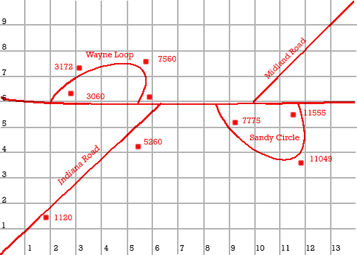
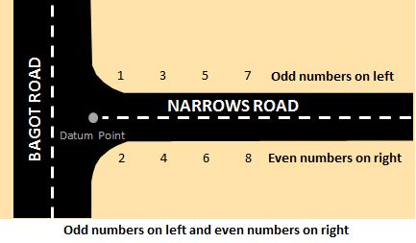
Common Addressing Systems
Block
  Increment by 100 each block
  Addresses increase by 2 or 4
  Small lots (.25 acres)
Grid
  Roads follow section lines
  Usually 1000 increments, large numbers
Distance-based (equal interval)
  Increment by distance along road
  Parity based on side of road
Combination
Systems are locally determined

Slide 18
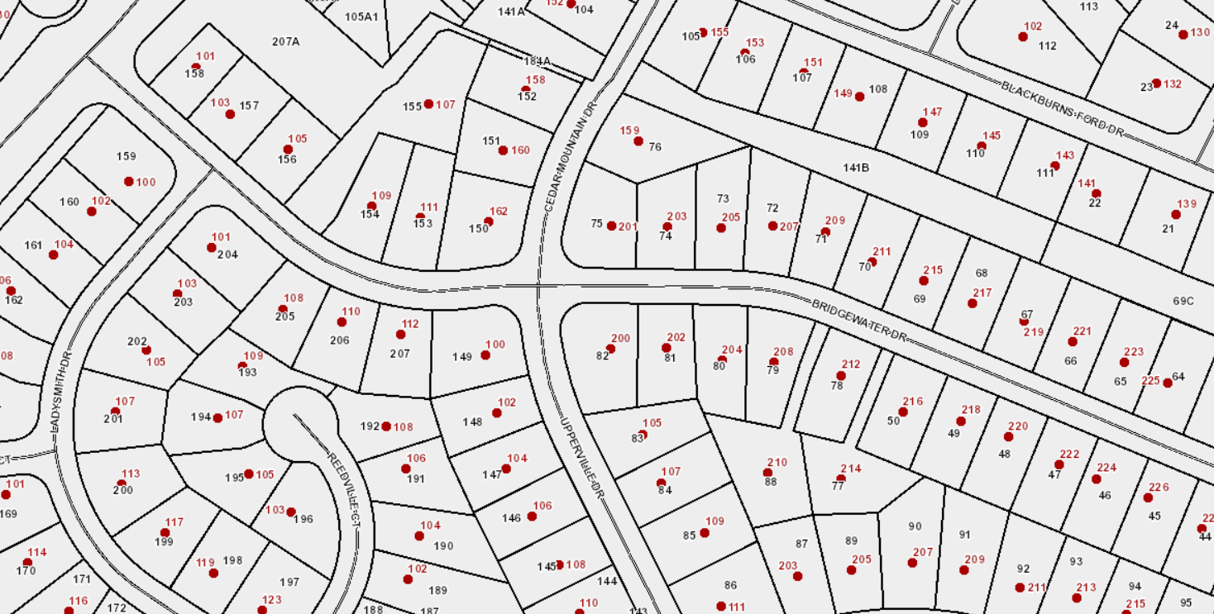
Block Addressing System
Blocks extend from one intersection to another
Intersection can create a change to the next 100 series

Slide 19
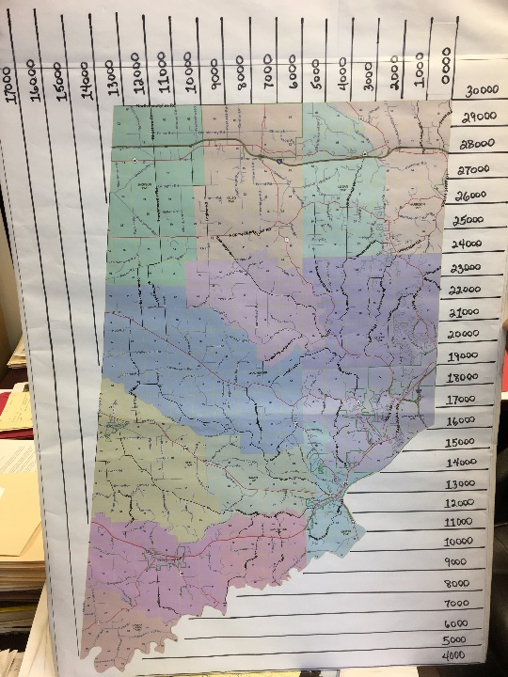
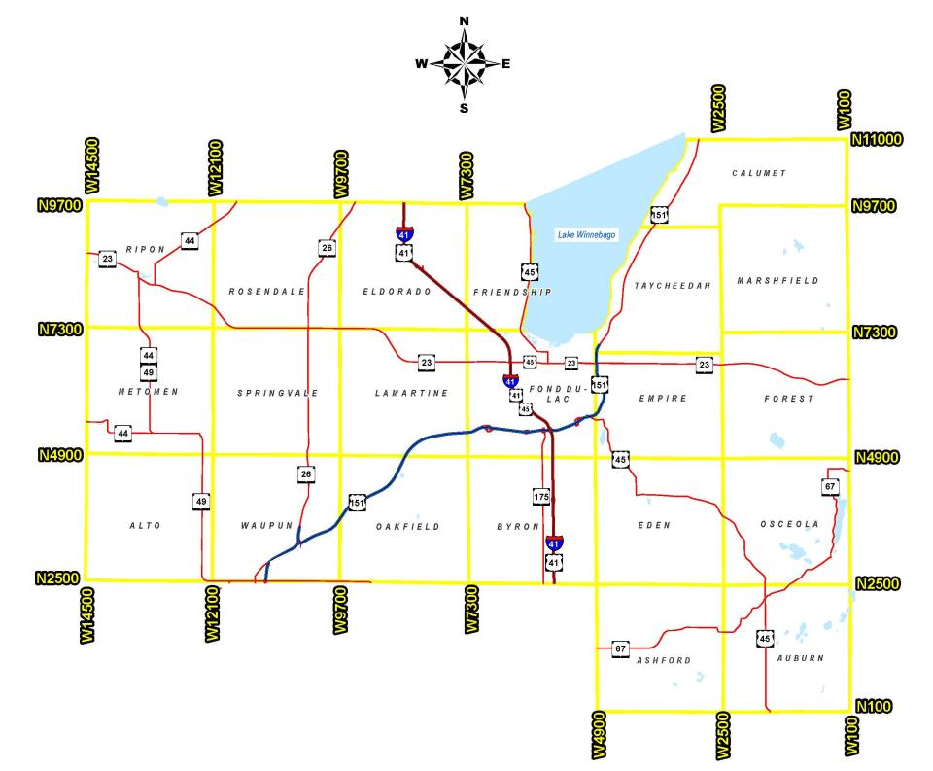
Grid Addressing System
N/S, E/W Roads
Lowest address on N/S road is N100
Lowest address on E/W road is W100
Addresses increase from N/W of starting points
400 numbers/mile (every 13.2 ft)
N/S, E/W Roads
Grid lines separated 1 mile intervals
Intervals of 1000
Starts in NE corner

Slide 20
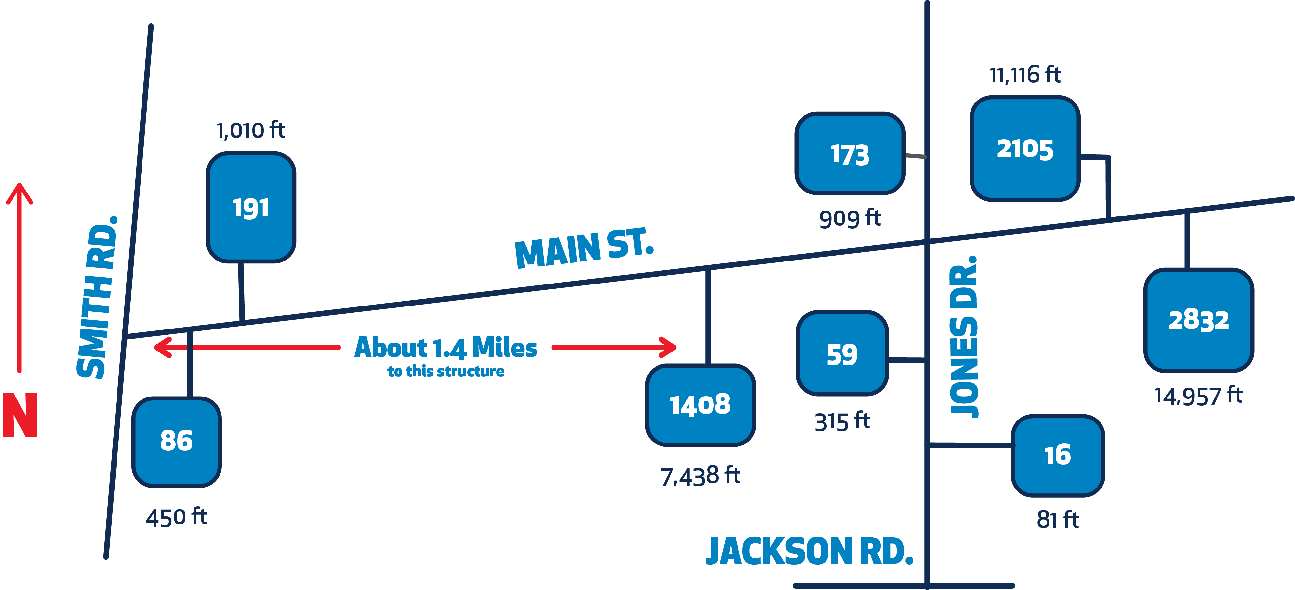
Distance-Based
The structure at 1408 Main Street is 7,438 feet - or 1.4 miles - from Smith Road (7438 ÷ 5.28 = 1408)

Slide 21
Streets in an Addressing System
Organized around the street network
  Urban areas
  Rural areas, based on topographic features
  Areas with no roads
How are names organized?
  Themes, numbers, directionals?
Where do name breaks occur?
Are there duplicates or names that sound phonetically similar?

Slide 22
Addressing Challenges: Open Discussion
Long driveways may upset addressing system intents
Range management: actual vs theoretical
Compact address ranges
Infill addressing gets complicated
Annexations
Sub-addressing
Lack of public safety engagement
Lack of GIS resources

Slide 23
What are Subaddresses?
Element of addresses that identify specific locations, within structures/sites or within a group of structures/sites to differentiate them from each other
Also used to reflect common names
Data model allows for sub-addressing down to the seat level

Slide 24
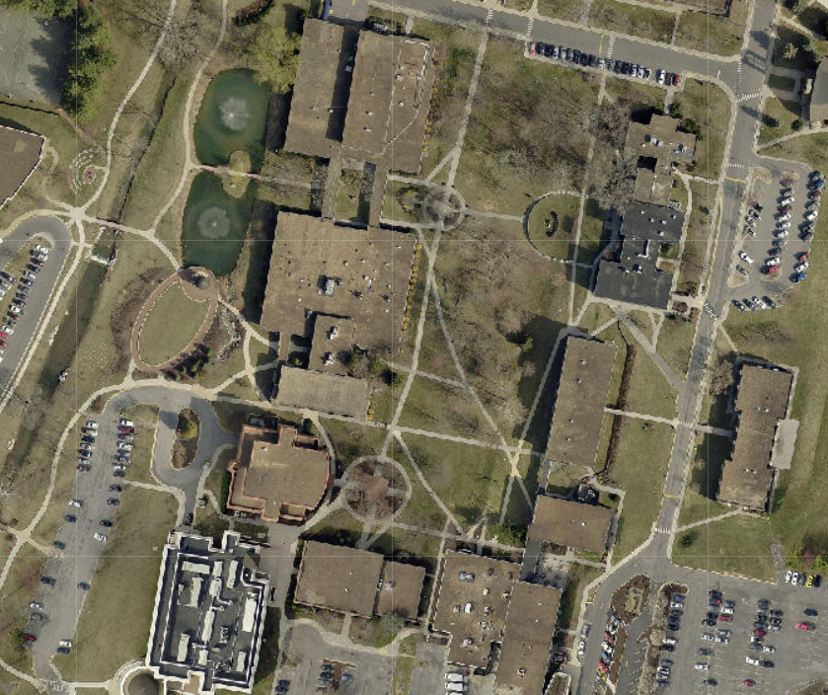
Examples
  Schools (elementary, middle, high, community college, university, vocational/technical, sensitive populations)
  Hospitals and health complexes
  Nursing homes/group residential
  Apartments/condos
  Mobile home parks
  Parks/sports fields/recreational areas
  Industrial/business complexes
  Shopping center complexes
  Farms
  Rehabilitation facilities
  Daycare centers
  Storage units

Slide 25
Subaddressing Challenges
For the addressing authority:
Inconsistent addressing
Addressing availability
Record maintenance
Ordinance support
Individual vs sub-addressing
Workflow/communication
For GIS
Placement method
Managing level of detail
Data quality issues
For public safety
  Proper resource routing
  Responder safety
  Delayed response time
  Signage issues
  Forcing addresses in CAD
  College campus example-next slide

Slide 26
Apartment Complex
Consider primary addresses for each building and subs for each apt

Slide 27
Business
Subaddresses for each structure or road name with primaries

Slide 28
Mobile Home Park
Best: road names in the mobile home park and primaries on each structure.

Slide 29
Business Park
Primaries for each structure, possibly road names if there are ROWs

Slide 30
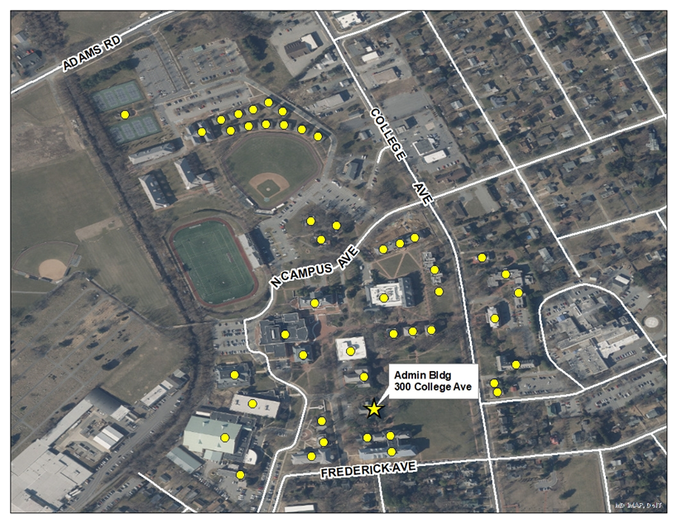
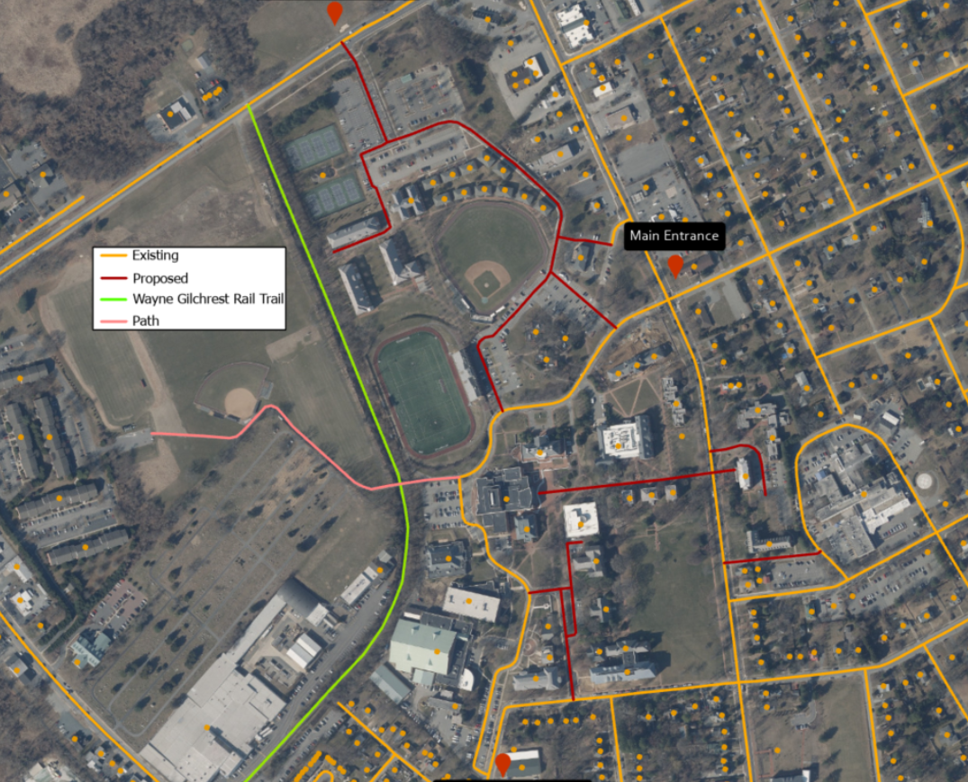
Case Study: College Campus

Slide 31
Best Practices For Address Assignment
MODULE 3

Slide 32
Resources Review
OK NG9-1-1 GIS and Addressing Standard
NENA Standard
SSAP Informational Document
GIS Data Stewardship

Slide 33
Naming Roads
Do:
Maintain a master road name list
Include public safety in naming/approval process
When 3 or more structures share a ROW or if ROW is ½ mi or longer, name the ROW
Naming roads prevents addressing shortage later
Avoid:
Duplicate names or ones that sound phonetically similar
Abbreviated names
Names with punctuation
Directionals
Numeric names
USPS Pub 28

Slide 34
Addressing
Do:
Assign numbers to all inhabited structures
Corner lots-assign address based on front door
Consider future development
5.28’-1000 addresses/mile
Avoid:
Street numbers longer than 6 characters
Fractionals
Alphanumerics
Hyphenated addresses
Manage subaddresses

Slide 35
Common Addressing Questions
I moved to a different location on my property or access my house from another road. Why can’t I just take my address with me & you give someone at my old house the new address?
What is the difference in my 9-1-1 address and my actual address for the post office?
What justifies a location getting an address? What is the criteria for assigning one?
The post office tells me I have the wrong address and to call the local addressing authority. Now what?

Slide 36
GIS Data Management

Slide 37
Drawing Roads
The use of the data determines how data is drawn in GIS
2 lane bidirectional road may be represented with a single line with ranges on both sides
Multilane roads with 2 or more lanes traveling in the same direction may be represented with two lines if a median or division is present
  The side with no addresses should have a 0-0 address range

Slide 38
Methods to Draw in Roads
GPS collection
Digitize from aerial photography
Georeference from paper maps
Digital submission from developers (provide CAD linework and bring into GIS)
Geometry has meaning for road centerlines
  Draw in the direction of increasing addresses
For a routable network, other fields must be populated (oneway, speed limit, cost, etc.)

Slide 39
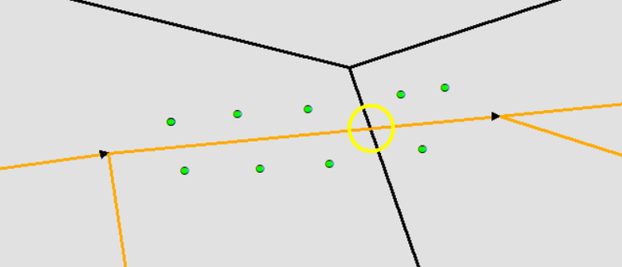
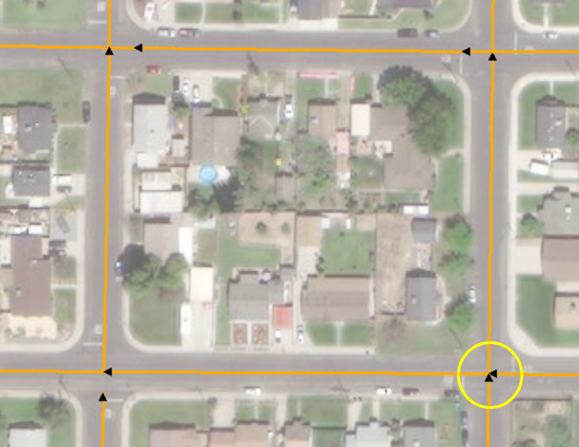
Managing Road Centerlines in GIS
Geometry and attributes should reflect real-world
Parse street elements into separate fields
Split and snap centerlines at intersections and boundaries (Country, State, County, Incorporated Municipality, Neighborhood Comm, Unincorporated Comm, ESN)
Digitize in the direction of increasing addresses
Avoid “paper streets” in the master road centerlines
Move driveways to separate file

Slide 40
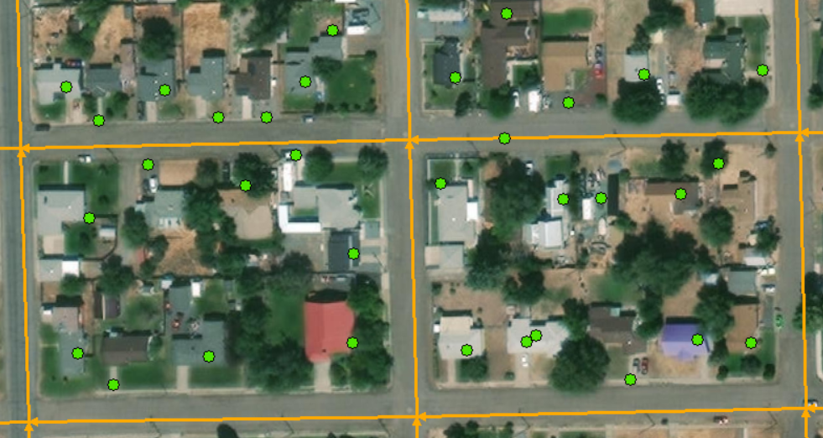
Managing Address Points In GIS
Geometry and attributes should reflect real-world
  Accuracy vs precision
Parse address elements into separate fields
Use consistent placement methodology
  NENA-INF-014.1-2015 Development of Site/Structure Address Point GIS Data
Manage subaddresses
Notes:
Placement methodology: remember that:
Address information must be sufficient to allow points to be accurately located
Should deliver first responders rapidly and efficiently to the correct location

Slide 41
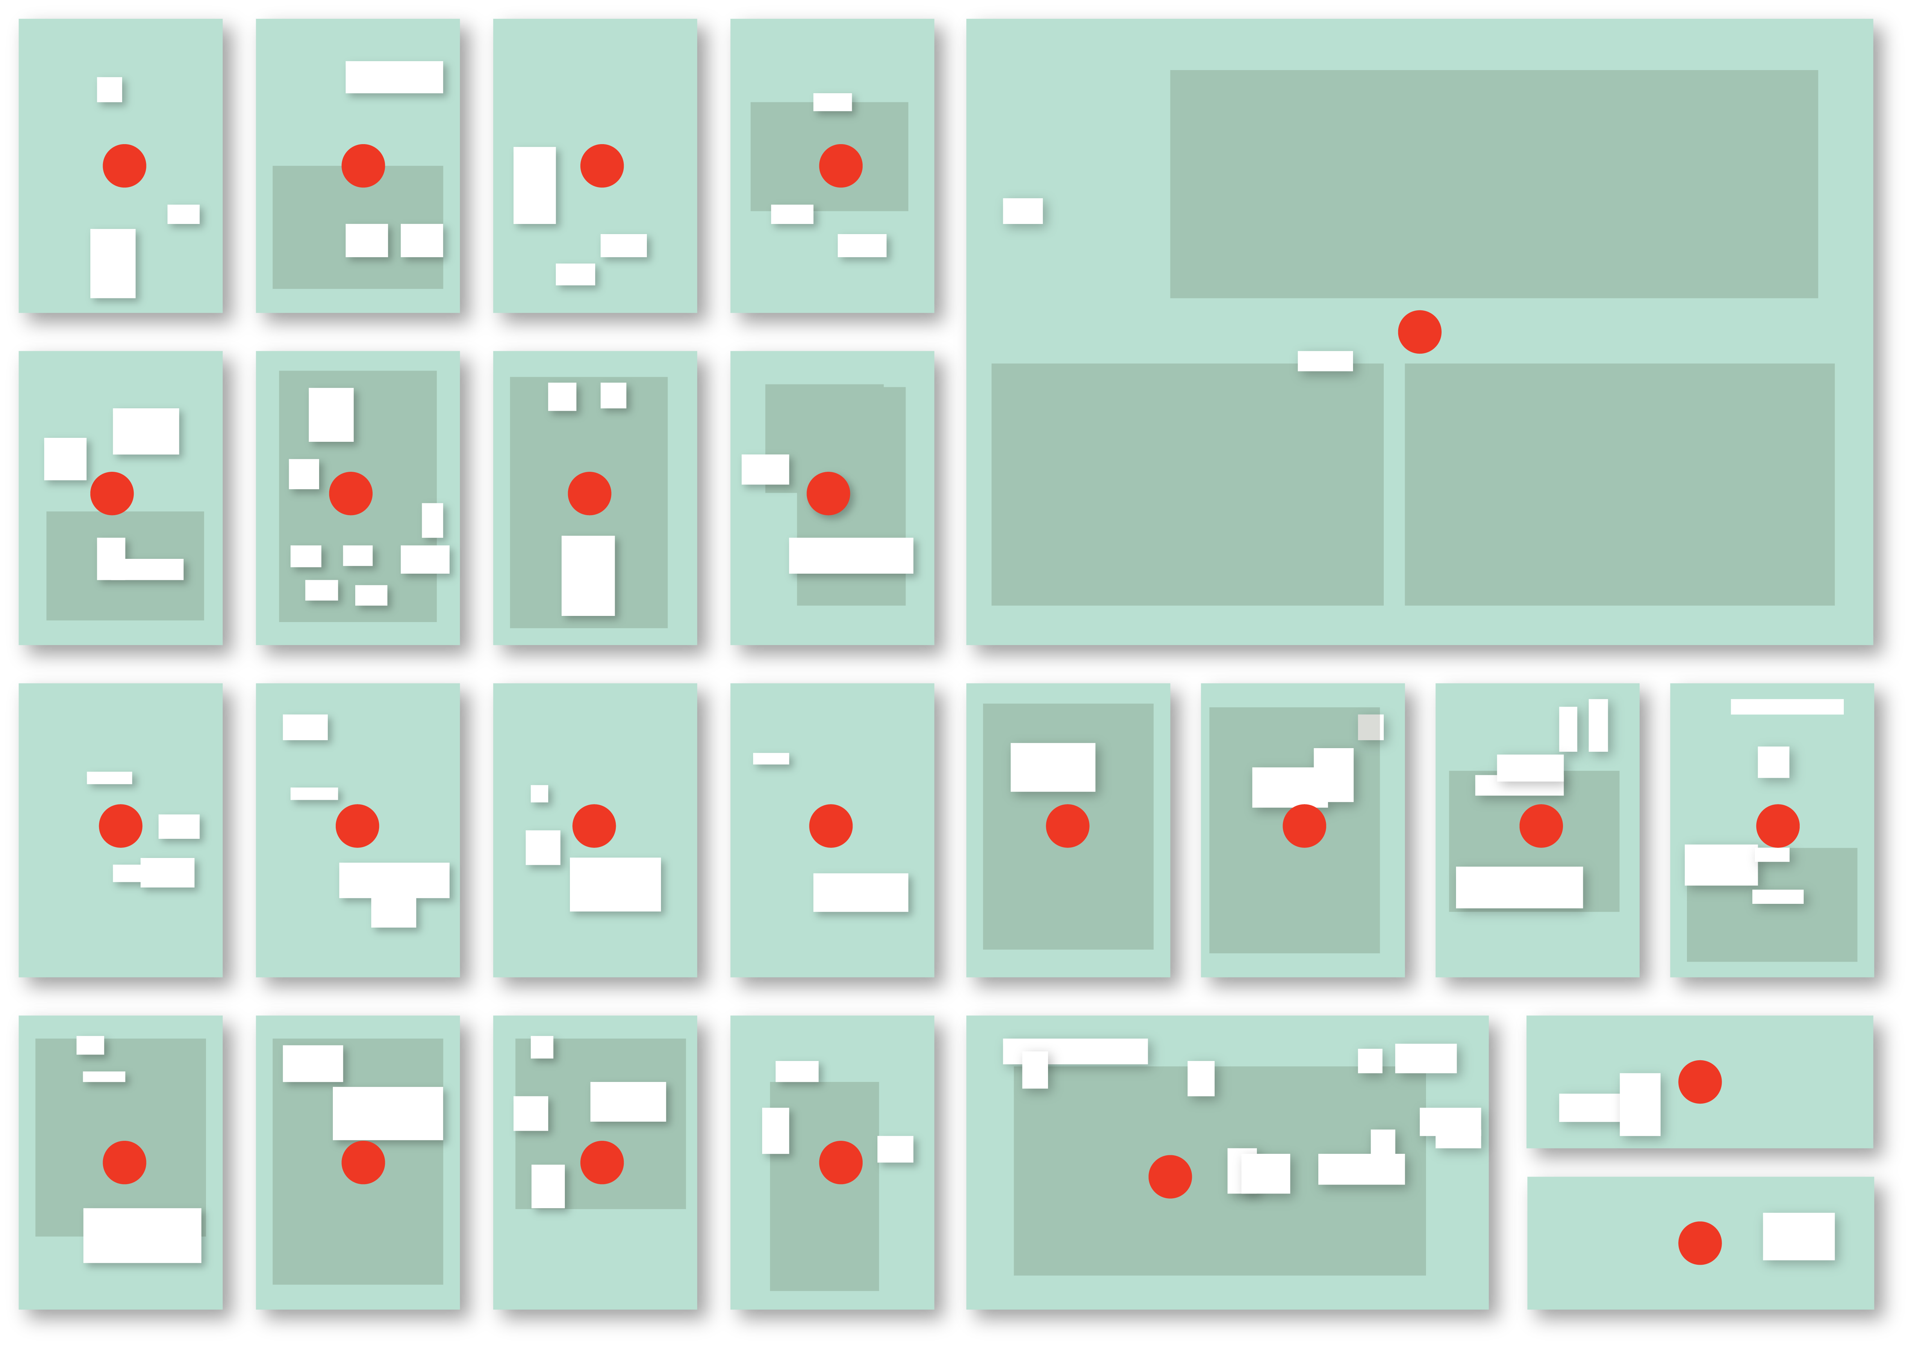
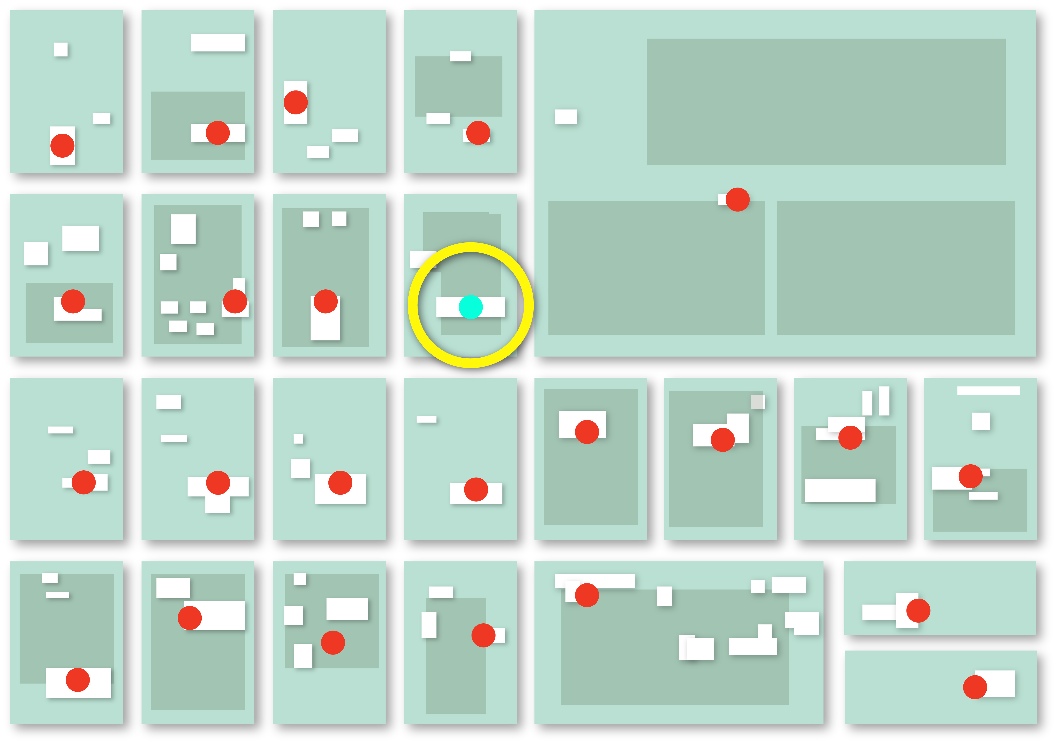
Address Point Placement Methodologies
Geocoding - range of road segment to approximate address
Parcel - centroid
Site - location with no defined boundary/structure
  Campsite, ball field, picnic area
Structure(s) - within the building footprint
Property access – at the access to the property

Slide 42
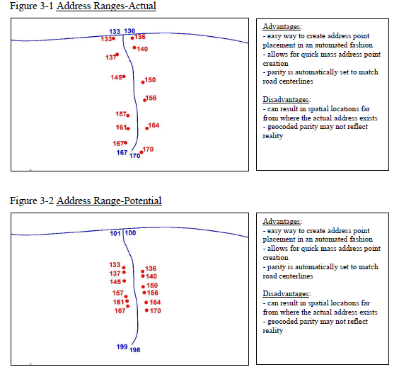
Geocoding / Calculated Placement

Slide 43
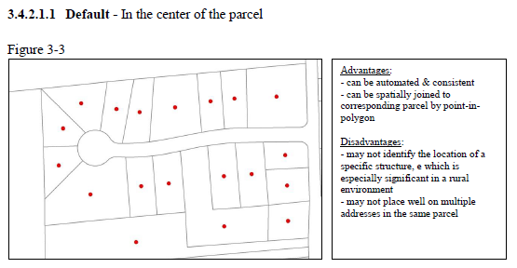
Parcel Centroid Placement

Slide 44
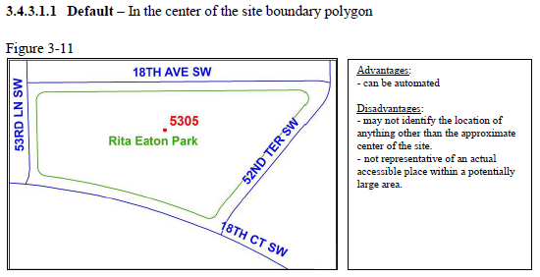
Site Placement

Slide 45
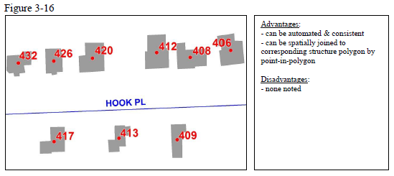
Structure Placement

Slide 46
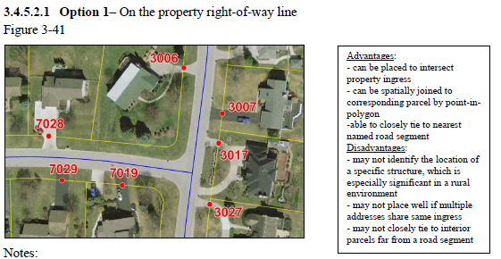
Property Access Placement

Slide 47
Placement Methodologies for Public Safety Applications
Method | NG9-1-1 Location Validation/Call Routing | 9-1-1 Map Display | Computer Aided Dispatch | Vehicle Routing | Emergency Notification
Geocoding | * | * | * | ** | *
Parcel | ** | ** | ** | * | **
Property Access | * | ** | ** | *** | **
Site | ** | ** | ** | * | **
Structure | *** | *** | *** | * | ***

Slide 48
Creating Sustainable Addressing Workflows
MODULE 4

Slide 49
Addressing Authority Responsibilities
Assign addresses for public safety (logical and consistent!)
Follow best practices for addressing and road naming
Data added to GIS within 3 business days (NENA)
Engage public safety!
  Plans/road name review
  Unique addressing scenarios
Resolve addressing discrepancies
  Real world
  GIS data

Slide 50
NG9-1-1 Workflow
Clearly defined roles and responsibilities
  Addressing authority
  Road centerline authority
  Public safety
  GIS
Communication and education
  Discrepancy feedback loop
Data editing and management
Updating public safety systems
Risk mitigation

Slide 51
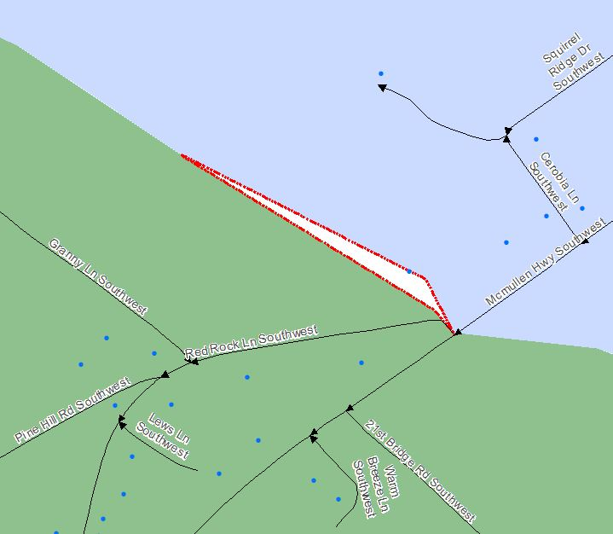
Public Safety Responsibilities
Engage in addressing/RCL process
  Identify discrepancies/problem areas
Assist with data creation
  ESBs
  ESZs
Boundary facilitation
MSAG/ALI
System vendors: NG9-1-1 compliance

Slide 52
GIS Responsibilities
Skilled staff
Work with public safety/addressing authority to create and manage required GIS layers
Understand the data model and Toolkit!
Data validation is an iterative process, not one and done

Slide 53
Communication and Education
9-1-1 Authority
Communications Director
MSAG Coordinator
CAD Administrator
GIS Authority
GIS Manager
Addressing Coordinator
Stakeholders such as Public Works, Tax Assessor, etc
Addressing Authority
Municipality Addressing
County Addressing
Addressing/RCL plan review process
Discrepancy feedback loop
  Dispatchers/first responders
  Citizens
  Ticketing system
Education for data managers
Education for non-public safety staff involved in the workflow
  Planning, Inspections, etc.

Slide 54
Mitigating Risks
Proactive, not reactive
Implement best practices for addressing and road centerline workflows
Best practices for data management
Create a QA culture
NG9-1-1 GIS Toolkit

Slide 55
Ordinances and SOPs
Ordinances
  Review and revise
  Establish:
    Authority and responsibility
    Addressing and road naming requirements
    Signage standards and requirements
    Enforcement process
SOPs
  Document full process
    Define roles and responsibilities
    Assignment process
    Communication process
      Requester
      Other departments
      Agencies

Slide 56
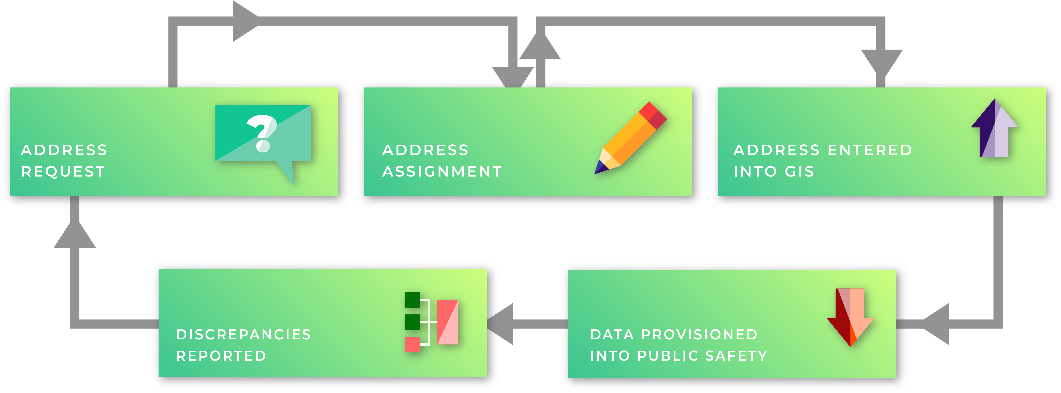
Addressing Lifecycle

Slide 57
Open Discussion / Local Questions
MODULE 5

Slide 58
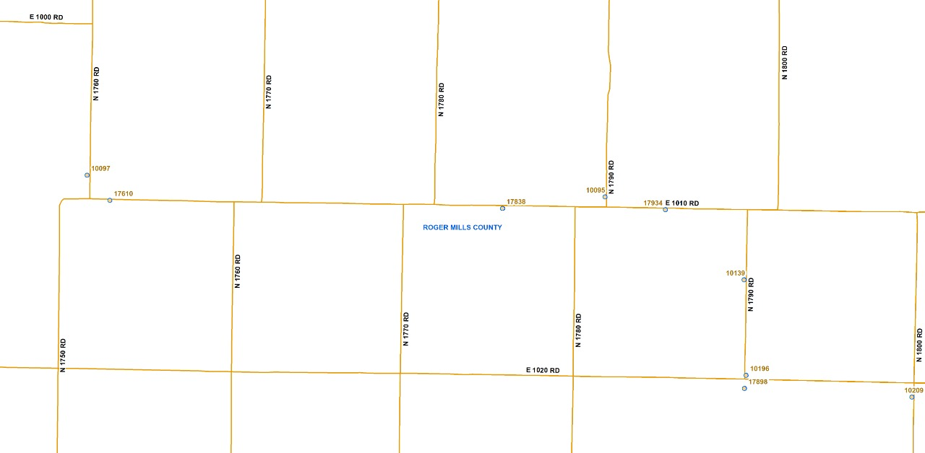
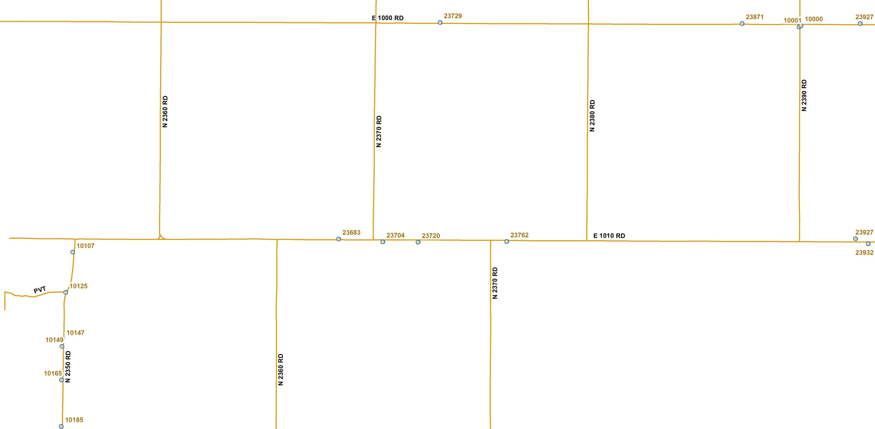
Example of state correction lines in Roger Mills County. the north/south roads are offset 8/10 of mile at E 1010 Rd in Roger Mills County. In Custer County (next county to the east) the north/south roads are offset by a little more than 1/2 mile at E 1010 Rd.
QA1
Are correction lines used as a grid?
Usually grids are separate from the road network. The most important thing is to ensure addressing is consistent within the system to the best of your ability.

Slide 59
QA2
We have duplicate (stacked) road segments they have the same address ranges, but the east side of the road is addressed off of 97th East Ave the west side is addressed off of Mingo Road. If I put in an alternate name, will it be able to go through toolkit?
No. Alternate/alias names are not used in NG9-1-1 call routing, only primary. Recommend two road centerlines for each road name. If they are official named roads and if there are addresses addressed off them, represent as two segments.
QA3
Not really an issue that is a location but a conflict. When a city usually creates their addressing standards, there is a POINT ZERO as to where all address starts from E, W, N, S and then Block numbers, and that is the easy part. In the meantime, outside of the city/town is County Addressing. Has there ever been a way to remedy this issue when the city comes in and annexes an area where some of the addressing is County addressing one direction and City Block style addressing the other direction. Is there a standard in place how to do this or is it a issue that the City has to deal with on its own? But since there is now a State Addressing standard, in place, has this issue been brought up anywhere?
This is a local decision, the State has not developed any standards or best practices for handling annexations and changing addresses.

Slide 60
QA4
When 911 addresses were originally issued in Greer County, Oklahoma, it appears that on north/south US and state Highway sections that change direction and instead of traveling north/south, travel due east/west at different points, the scheme changed on those sections that also changed direction, instead of maintaining the same addressing scheme.
This is common for highways to change directionality, keep addressing as consistent as possible.
QA5
The Town of Willow, seems to have been issued all ""South"" addresses, and addresses that fall above the north/south boundary, are not recognized and packages and sometimes mail, is delivered to vacant properties and those matching addresses that are in the south section. If has even been reported that on east/west streets, addresses were assigned with a south address.
This circumstance should be considered for an addressing change.
QA6
Another problem in Willow, for example is, on one address we needed to issue that would have been correctly calculated, the citizen was refused power from PSO because in their system they already had a customer at that address, however, there was no structure on that property. When demanding to speak to the supervisor for PSO, the supervisor stated that in their computer, they show that same address that was just assigned, as listed for another customer, BUT, there is also a statement in their computer to go to the same NORTH address to find the customer. So in other words, in PSO's computer system they acknowledge that their customer isn't really at the south address, but really at the north address, but yet, continue to prevent a proper numbering sequence to take place because of their poor recording keeping system that they don't seem to wish to correct.
Sure, because of not having that many structures on that block we could have changed the number slightly {so long as PSO didn't have THAT address assigned to anyone} and ended up having to, just because it was so difficult to get PSO to change their system. Consequently, PSO is dictating what addresses are assigned if any, because instead of correcting their computer, they are forcing the poor Willow addressing system to continue by making an address system conform to their incorrect record keeping system.“
9-1-1 addresses should always be assigned and distributed by the local addressing authority on official government letterhead. If there is a way to address the situation with a higher up staff member, we recommend that.

Slide 61
QA7
What we would like a little guidance on is more or less a procedure issue than anything else. When we do send out address changes on residences or commercial property what is the best way to ensure that a business or resident begins using the legally correct address? We'll send out letters (sometimes multiple) and some property owners aren't a problem while other property owners ignore and continue using the old address even if it was changed due to a 911 routing concern. I can give specific examples if needed but really this is an issue that we've had in multiple places. It results in messier situations since they aren't using the new address.
Ordinances that outline the legal action are key. Work with the County attorney to develop an ordinance that describes the violation process. Court, fines, etc. Another option is have the fire marshal identify the insurance company, and the County can reach out to them directly and notify of an unresolved addressing issue.
QA8
Road segment is outside of the PSAP boundary that the buildings on the north side of the road are addressed off. Also have an issue with the ranges are out of order. My solution was to mark the road as an exception (outside the boundary)
We need more context, but marking as an exception outside the Discrepancy Agency boundary is acceptable. For out of order ranges, a From greater than To is acceptable in the NENA data model. Most range issues are a notice within the Toolkit, not an error, thus will not prevent submission.

Slide 62
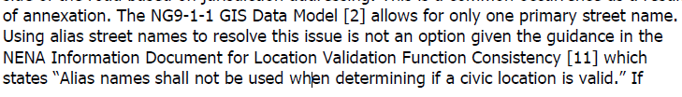
QA9
One side of the street is addressed off S Glenn Street the other side if E 147th Street South. My solution was to draw to segments that don't touch except for at the intersections. the ranges on the inside are 0's address right on 147th has the correct range for that street and address right on Glenn Street has a different range for that street.
This is an appropriate solution, refer to GIS Data Stewardship Document for more examples of how to represent this in GIS.
QA10
Address points are using 146th Street South the street in this area is W Main Street. Solution is to change the addresses to W Main Street the ranges is correct. The street name is West Main Street with the alternate name as West 146th Street South (used to be in the county now it is in Glenpool city limits)
Addresses should be officially changed to reflect the correct road name. A true change, not just in GIS.
QA11
Honorary Street Names Best Management Practices
Use the official road name in the road centerline layer. Aliases may be related to main centerline and joined with the NGUID. A field can also be added in the centerline file for alternates. If the CAD system uses aliases, verify it is in the CAD system so it converts to the correct street name and validates in the CAD system so it maps properly for dispatchers and first responders. There is no clear direction or guidance from NENA concerning honorary street names but treat them as an alias.

Slide 63
QA12
This maybe isn't an issue per se, but I am curious as to your recommendation. On county borders where there is a road running along the county line and each county has the road named differently with different road ranges, what should we do? Leave it as is, or should one county adopt the other name and addressing range?
What do the roads reflect? What are the addresses? If everything is reflecting the correct info (0,0 on one side, correct info on the other for the appropriate county) then maybe consider offsetting the RCL slightly to avoid geometry overlap. This could be an ongoing conversation when the NGCS provider is selected.
QA13
Highways and Naming? How do I parse the name across fields? Best recommendations?
See CLDXF pages 120-122 for examples of parsing. The current OK Toolkit can’t sustain this parsing due to the domain values applied. If the correct value isn’t in the field, it is going to flag as an error. For example, US Highway isn’t in the domain currently. Currently the pretype field has the posttype domain applied, this should hopefully be corrected in the next release.
QA14
When do I assign a new road name? When is it legally required & when is it a best management practice?
Generally, when 3 or more structures share a right of way, name the road.

Slide 64
QA15
What do I do when a road has multiple road names & road ranges that overlap & are not the same? When do you modify the data vs re-address/rename.
It depends on the circumstances. If it’s a boundary road between municipalities there are solutions. If addresses are out of order and causing a problem for public safety, consider a readdressing.
QA16
What is your addressing schema within your PSAP? A potential address every 5.28’ - Block ranges -Actual/Theoretical/Both Actual & Theoretical. Can you combine them?
Yes, you can combine them.

Slide 65
Questions?

